Slide 1

The iPlant Collaborative
Community Cyberinfrastructure for Life Science
Nirav Merchant
iPlant / University of Arizona
nirav@email.arizona.edu

Slide 2
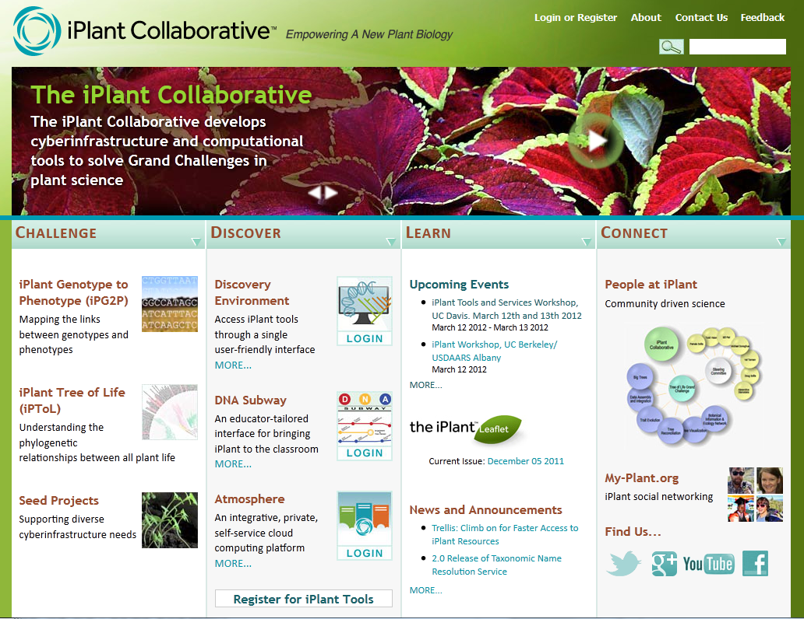
The iPlant Collaborative
Vision
Enable life science researchers and educators to use and extend cyberinfrastructure to understand and ultimately predict the complexity of biological systems
www.iPlantCollaborative.org

Slide 3
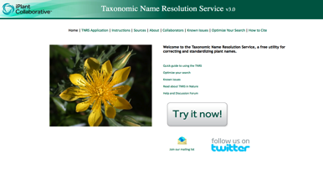
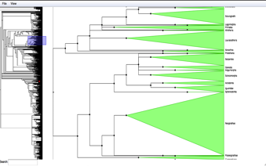
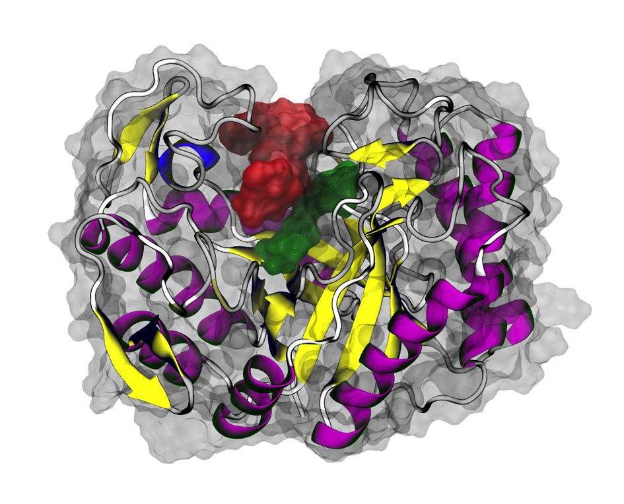
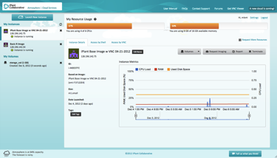
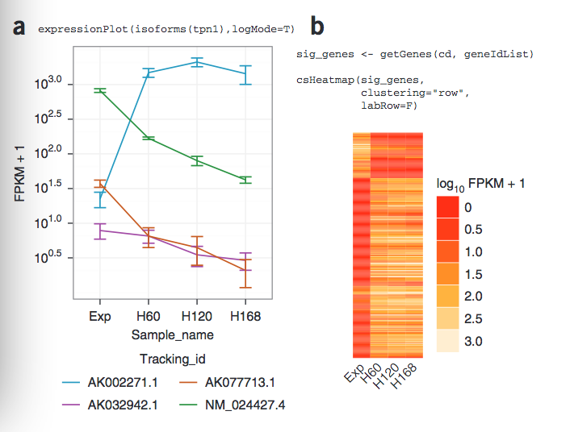
The iPlant Collaborative
Vision
The iPlant Collaborative is a community-driven organization building cyberinfrastructure for the plant (and animal) sciences.

Slide 4
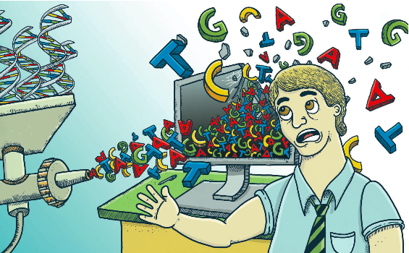
Reality today
Will Computers Crash Genomics ? Science Vol. 331 Feb 2011

Slide 5

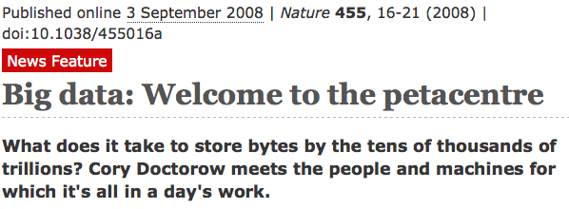
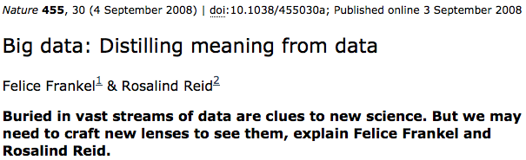
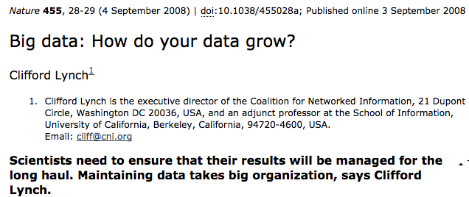
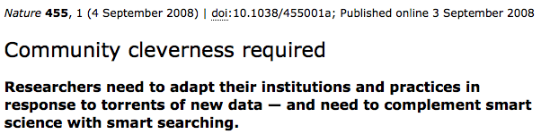
Biological Cyberinfrastructure
The Problem of Big Data in Biology

Slide 6
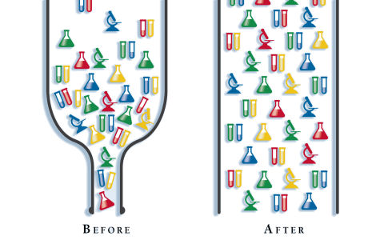
The iPlant Collaborative
Where iPlant is today and where we are going
Initial funding in 2008
Almost 2 years of community input gathering – software development starts in 2009
Major CI components appear late 2010
Finished 5th year
> 13500 users
> 20K (analyses) jobs in 2012
> 10K HPC jobs)
600 terabytes of user data
(+800TB of Galaxy usegalaxy.org data)

Slide 7

The iPlant Collaborative
Where iPlant is today and where we are going
iPlant Renewed by NSF
#DBI-1265383
September begins next 5 year period
Scientific Advisory Board
Focus on Genotype-Phenotype science
NSF Recommended expansion of scope beyond plants

Slide 8
The iPlant Collaborative
What we have to offer you
Data Management & Storage Resources
Access to High Performance Computing Resources
Tool Integration System
Application Programming Interfaces (APIs)
Cloud Computing Resources
Genotype To Phenotype Science Enablement Portfolio
Tree of Life Science Enablement Portfolio
Image Analysis Platform
Support for Molecular Breeding Platform (IBP)
Support for AgMIP

Slide 9
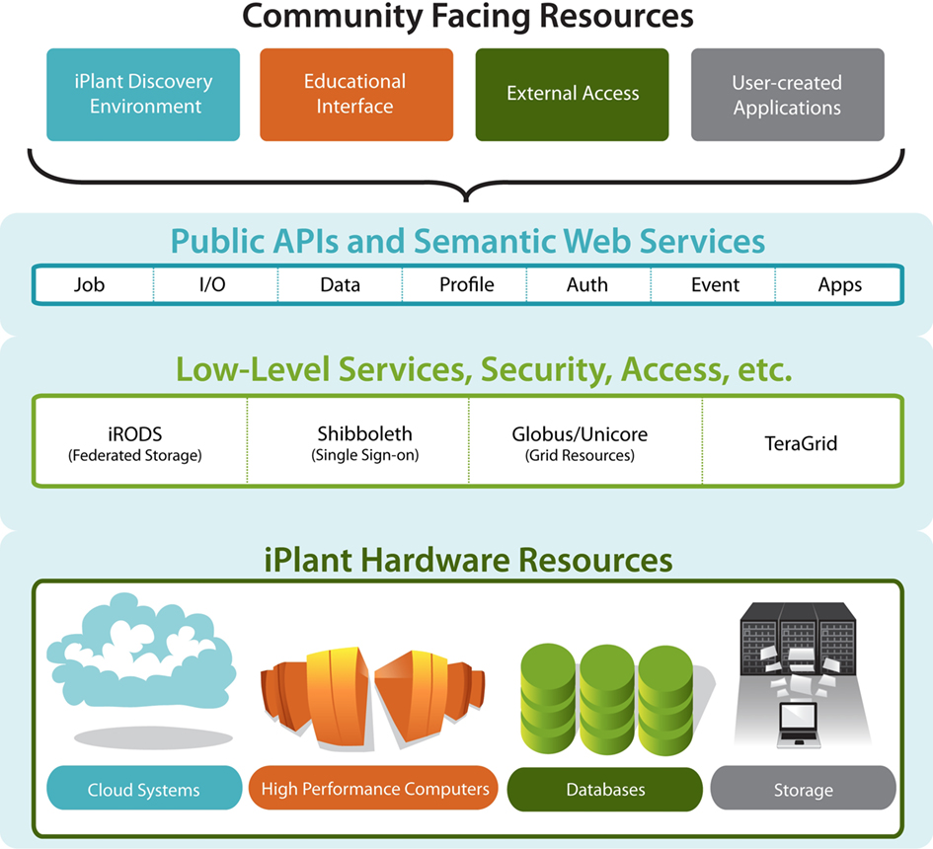
How iPlant CI Enables Discovery
Overview of resources
    Storage
    Computation
    Hosting
    Web Services
    Scalability
    Building a platform that can support diverse and constantly evolving needs.
End Users
XSEDE
Computational Users

Slide 10
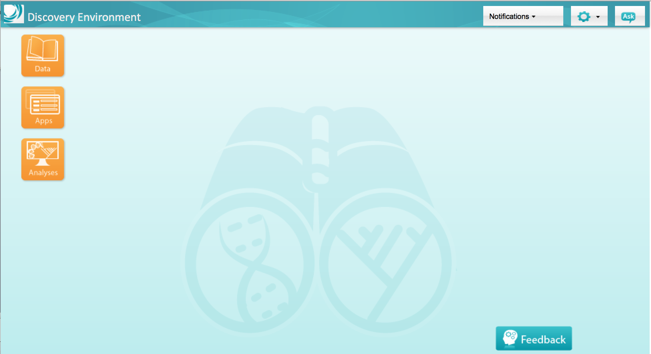
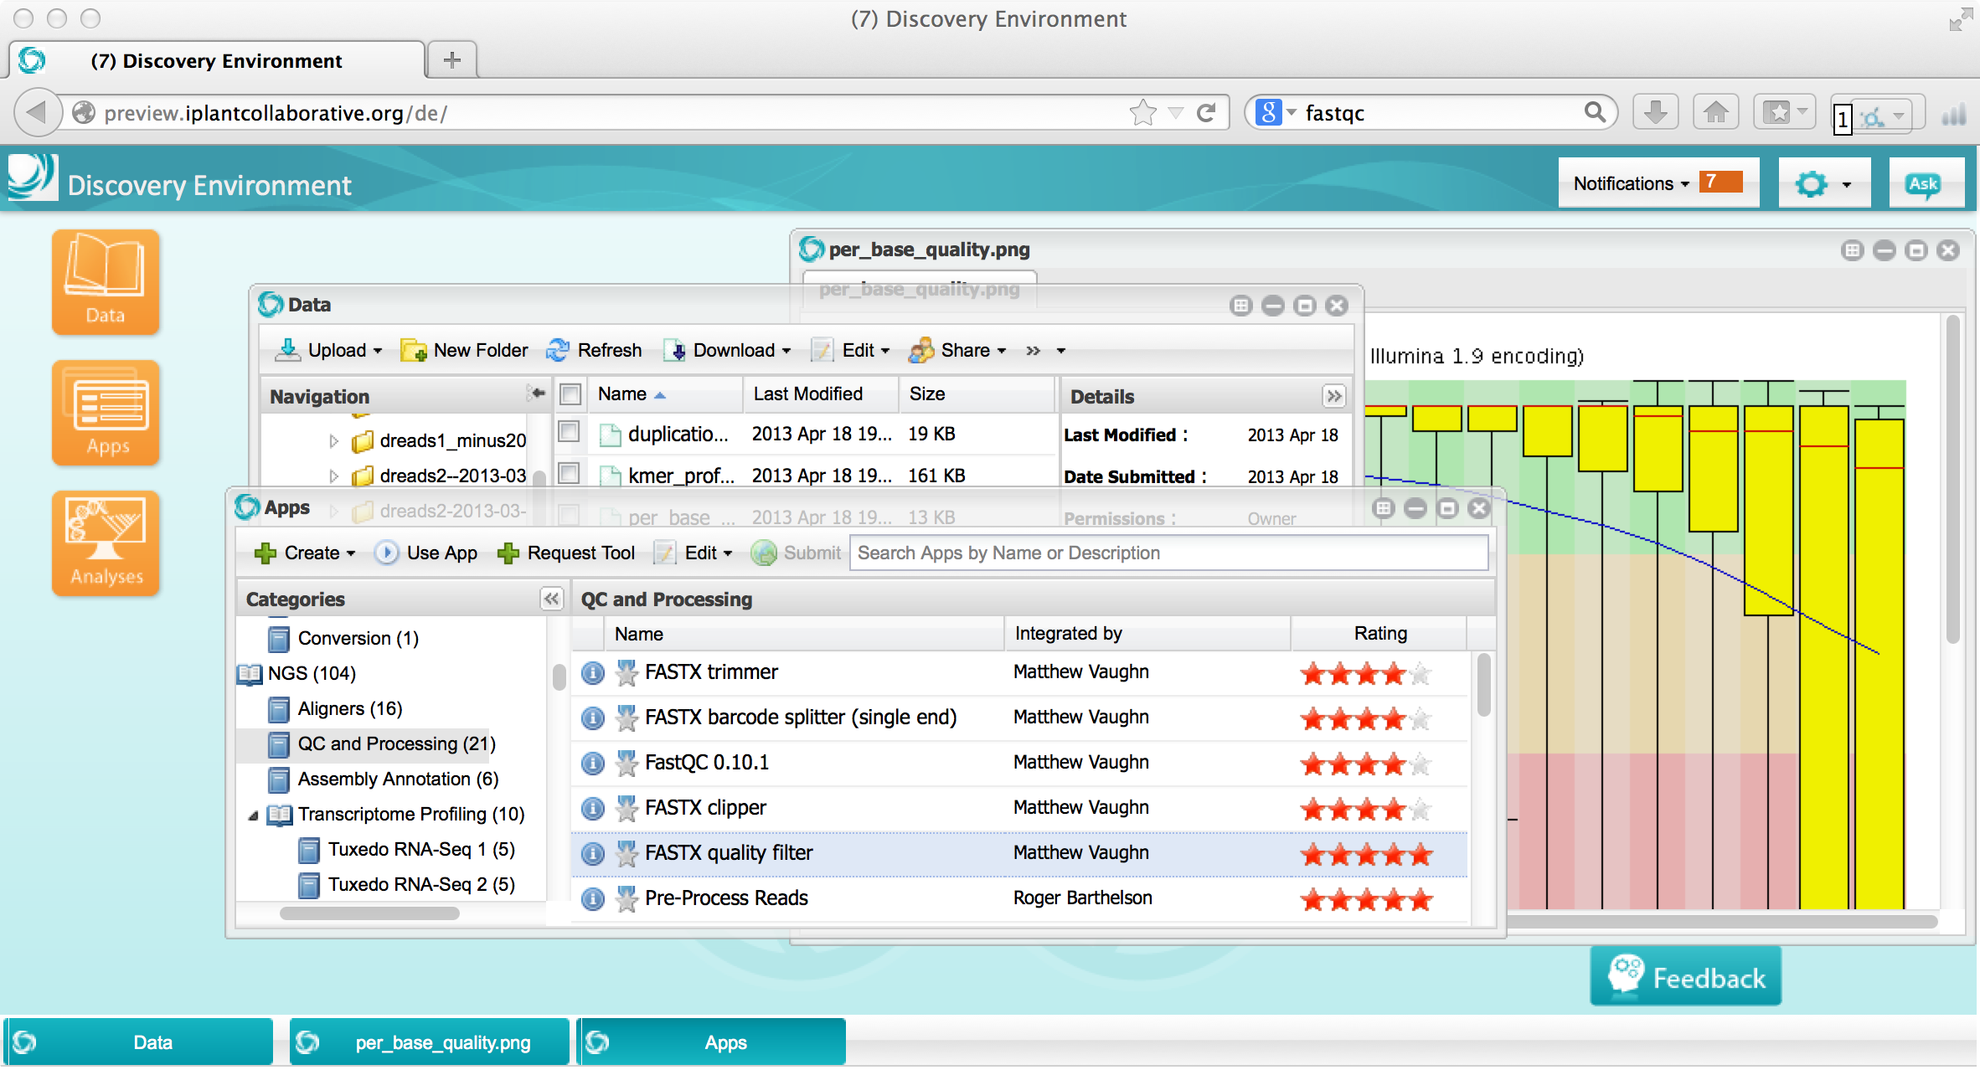
How iPlant CI Enables Discovery
Solution: Discovery Environment
An extensible platform for science
High-powered computing
Data sharing/collaboration
Easy to use interface
Virtually limitless apps
Analysis history (provenance)

Slide 11
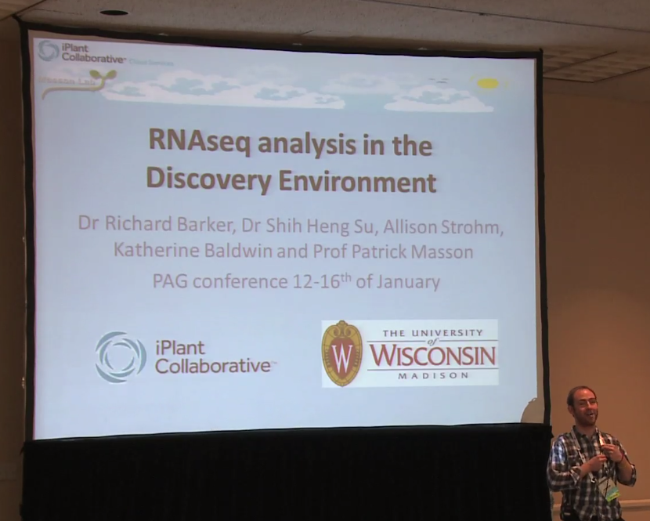
How iPlant CI Enables Discovery
What the Discovery Environment means to bench biologists
“In one week I was able to align my RNAseq samples using a method that had previously took me a month on the bioinformatics laboratory computers…
Being able to access my data any time and any place is invaluable...
The DE interface is intuitive and easy to use...[and] will allow greater continuity and comparability between different experiments from different laboratories.”
Richard Barker – Univ. Wisconsin, Madison

Slide 12
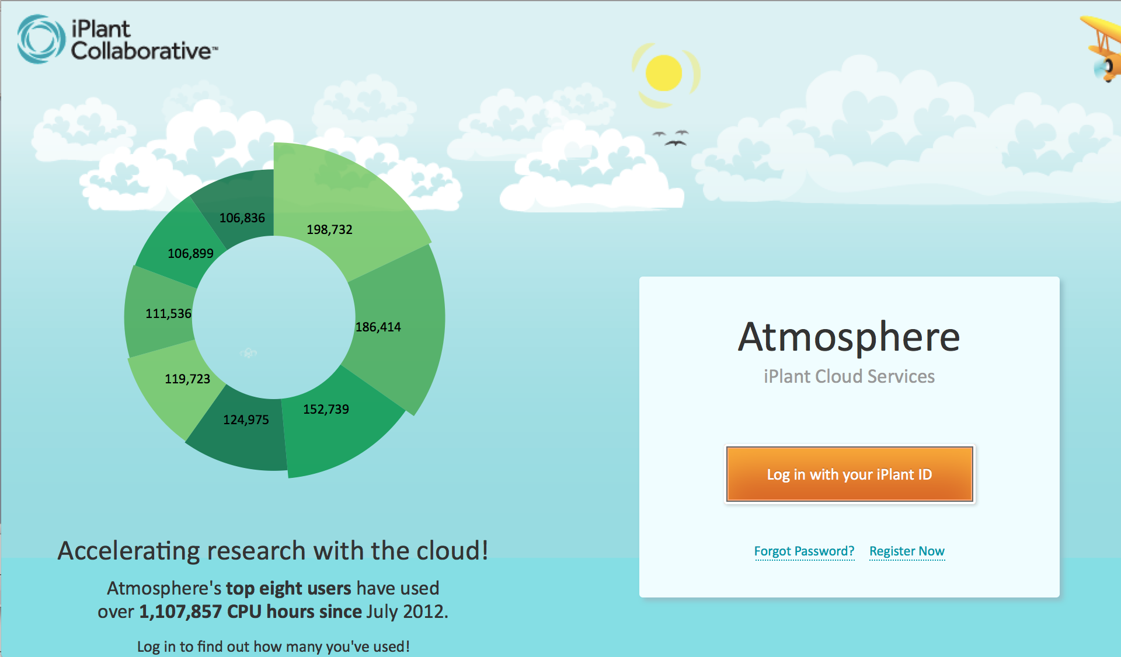
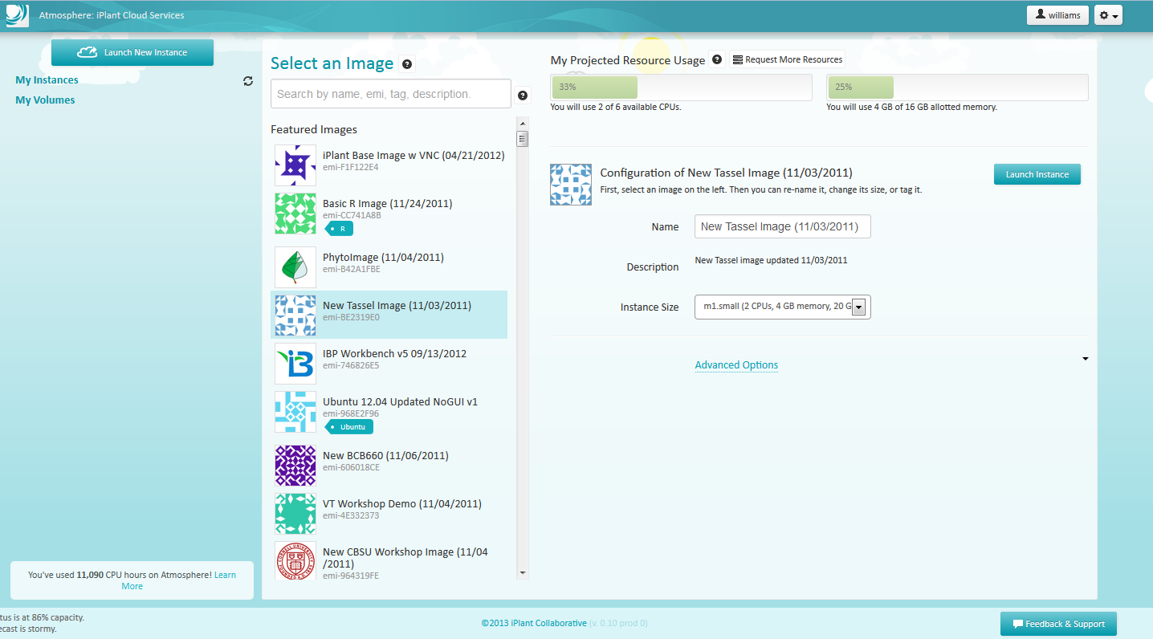
How iPlant CI Enables Discovery
Solution: Atmosphere
On-demand computing resource built on a cloud infrastructure
Virtual Machine pre-configured with:
  Software
  Memory requirements
  Processing power
  Plant authentication and storage and HPC capabilities
  Build custom images/appliances and share with community
  Cross-platform desktop access to GUI applications in the cloud (using VNC)

Slide 13
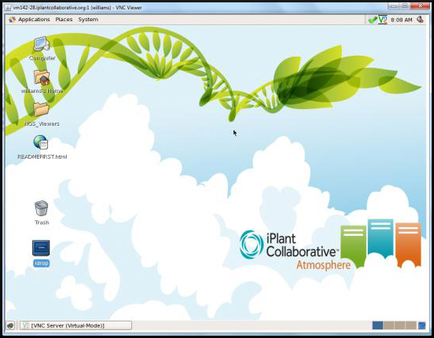
How iPlant CI Enables Discovery
What Atmosphere means to bioinformaticians
“What my users used to call me for, they now do on their own through Atmosphere. Now I can scale up my user community”
Nathan Miller, Univ. Wisconsin, Madison
BLAST 400k transcripts against NCBI nr in 36 h vs. 2 months
Use iPlant Data Store to move 1500 high-res images per day for analysis
“iPlant is a great equalizer.”
Mike Covington, UC Davis

Slide 14

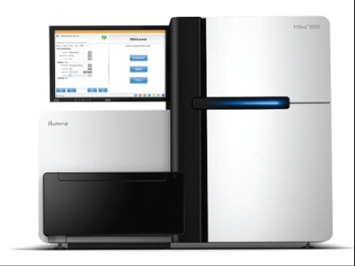
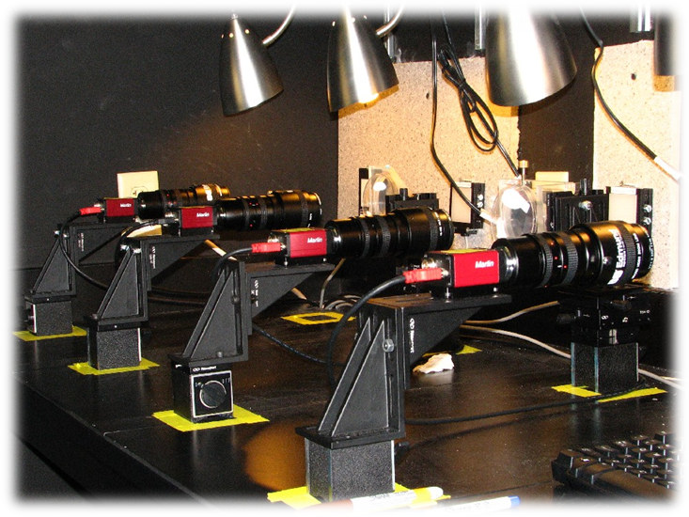
How iPlant CI Enables Discovery
Challenge: Navigate biology’s “Data deluge”
HT sequence data – TB’s per run
HT Image data – GB’s per day

Slide 15
How iPlant CI Enables Discovery
Solution: iPlant Data Store
All data in within the same platform
speed and accessibility
Access your data from multiple iPlant services
Automatic data backup redundant between University of Arizona and University of Texas (NSF Data management plan)
Multiple ways to share data with collaborators
Multi-threaded high speed transfers
Default 100GB allocation. >1TB allocations available with justification
Source | Time (s)
CD | 320
Berkeley Server | 150
External Drive | 36*
USB2.0 Flash | 30
iPlant Data Store | 18*
My Computer | 15

Slide 16
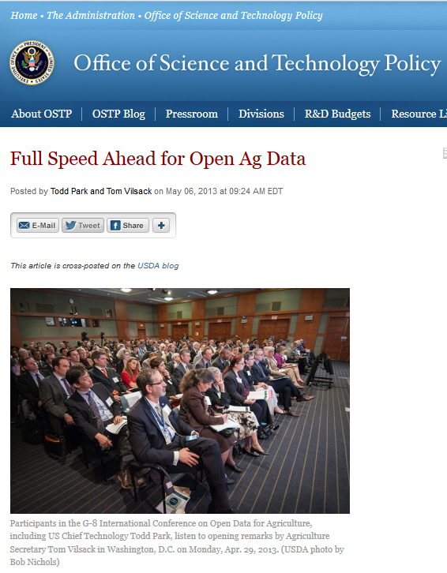
How iPlant CI Enables Discovery
What iPlant data solutions mean for a bovine breeder
“It's kind of like being in that COPD commercial where the weight is lifted off your chest, only in our case, we have access to more computational power, so we can get to projects much faster and we can do big projects that our machines may not have allowed us to do previously!
The ability to transport 2TB of data overnight using the iRODS system was particularly helpful because previously, we had been mailing hard drives which is not an optimal solution to sharing big data.”
James Koltes ,Iowa State

Slide 17
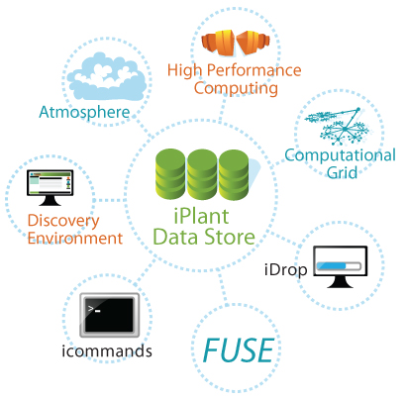


iPlant Data Store
Free Your Data
Different Users,
Different Access Needs:
One Data Store
Notes:
It is the central source for data. You can connect to anything.
Different users, different needs. Once Store to rule them all!

Slide 18
Data Management
Supporting the full lifecycle of data
From inception, analysis, collaboration and publication for multiple data types
Emphasis on scalability, reliability, federation
Integrate with external systems (provenance)
Ensure metadata is first class citizen of the infrastructure across all systems
Provide multiple modes of access to data
Promote and support the use standards compliant metadata (but offer flexibility)

Slide 19
Embedded Metadata

Slide 20
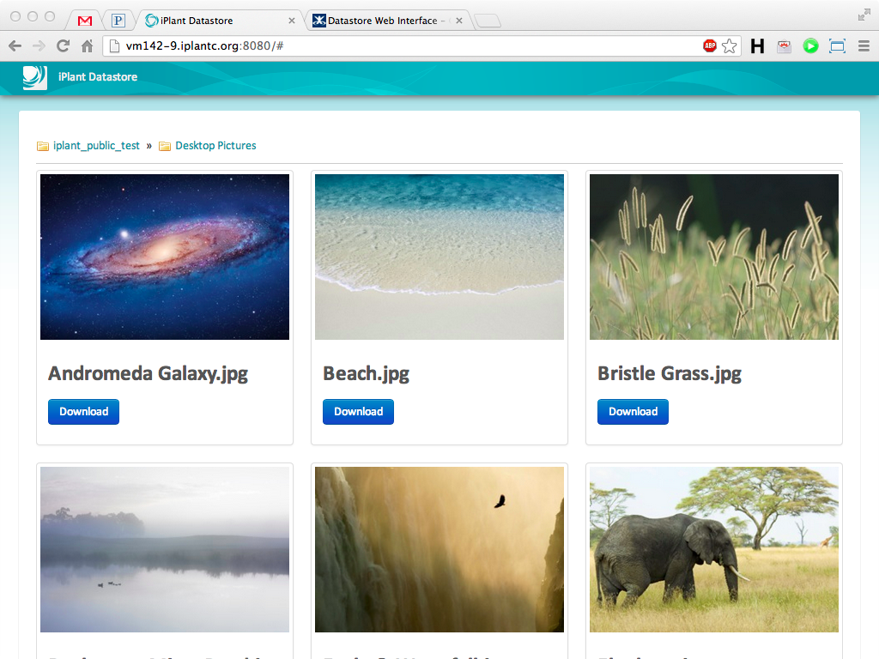
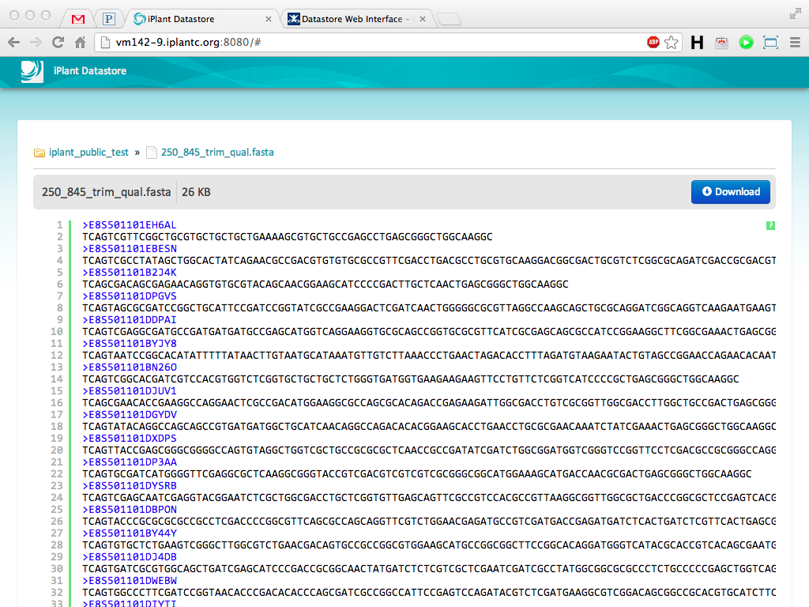
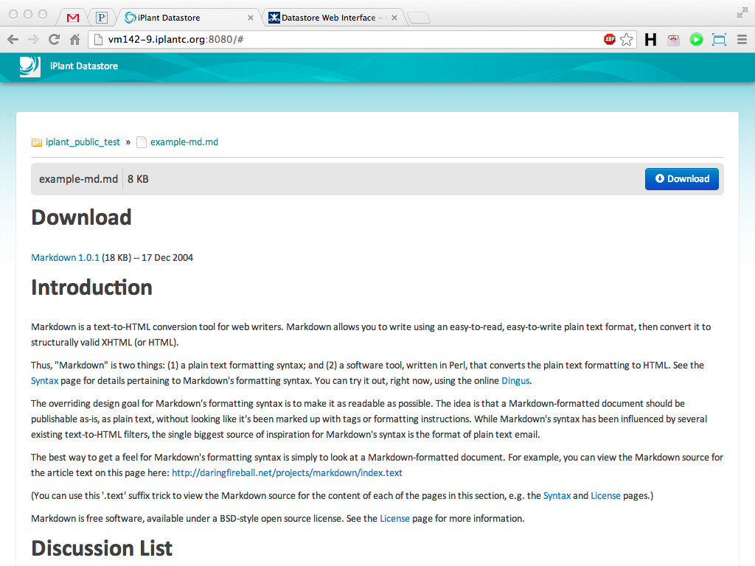
Display data the way you want
(no programming involved !)

Slide 21





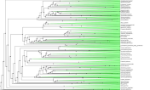
iPlant Data Store Lab
iPlant Supports the Life Cycle of Data
Markup
Search
Store
Transfer
Pre- Publication
Post- Publication
Share
Collaborate
Visualize
Analyze
Data Results A Results B
Algo1 Algo2
Notes:
You’ve seen an overview of how iPlant manages the life cycle of data.

Slide 22
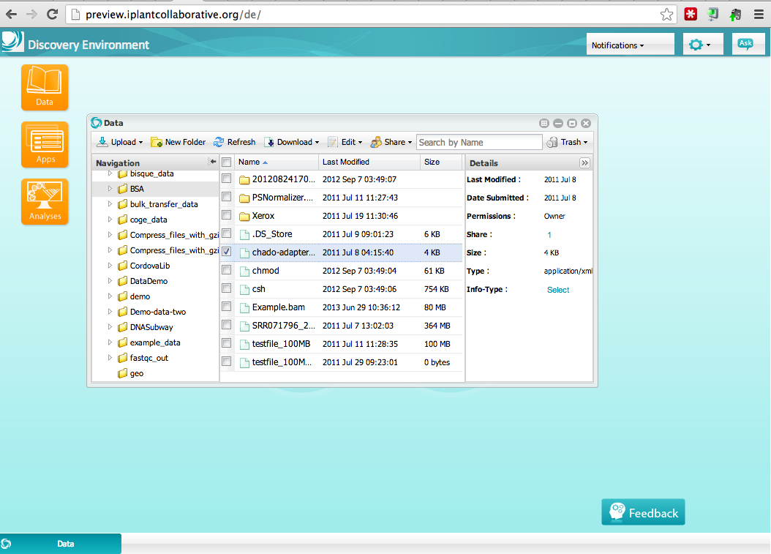
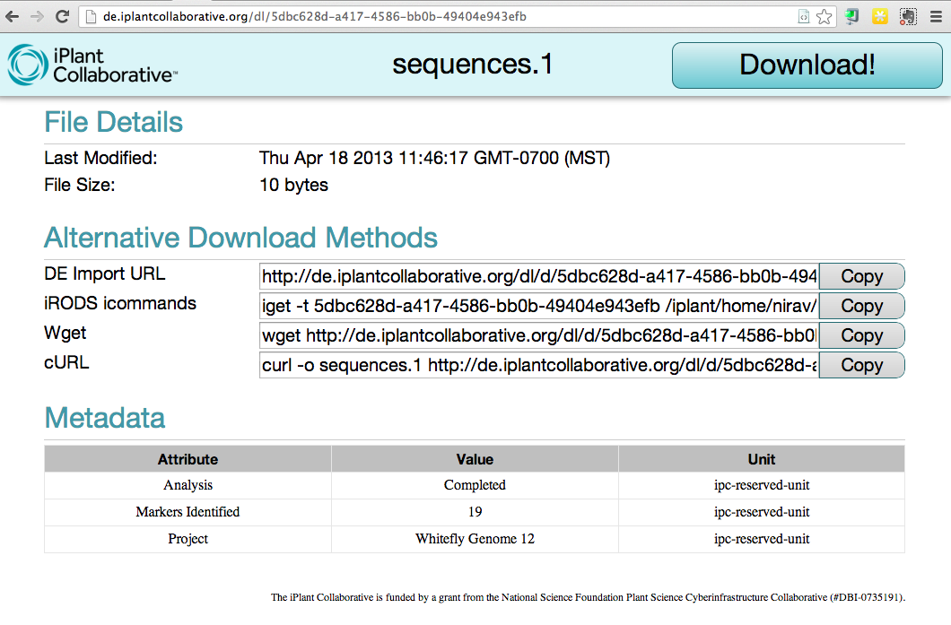
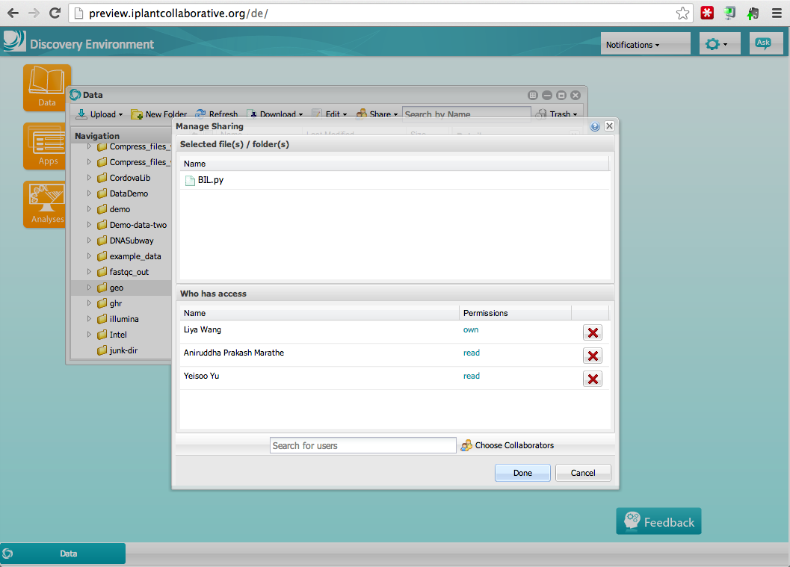
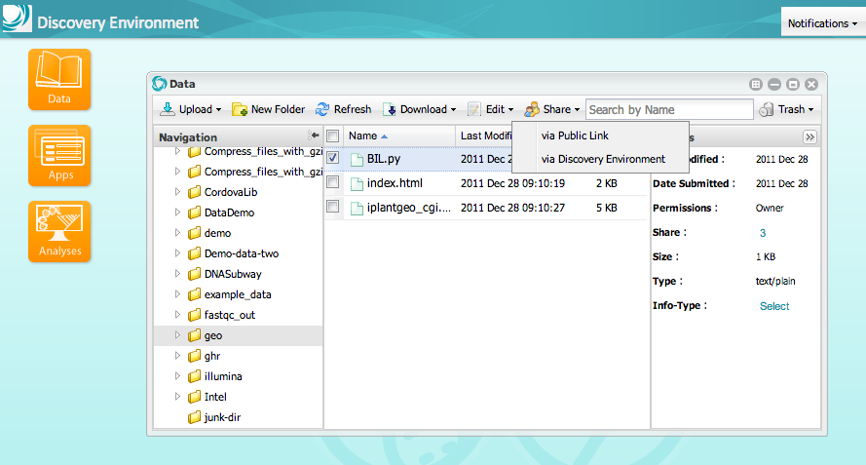
Sharing

Slide 23
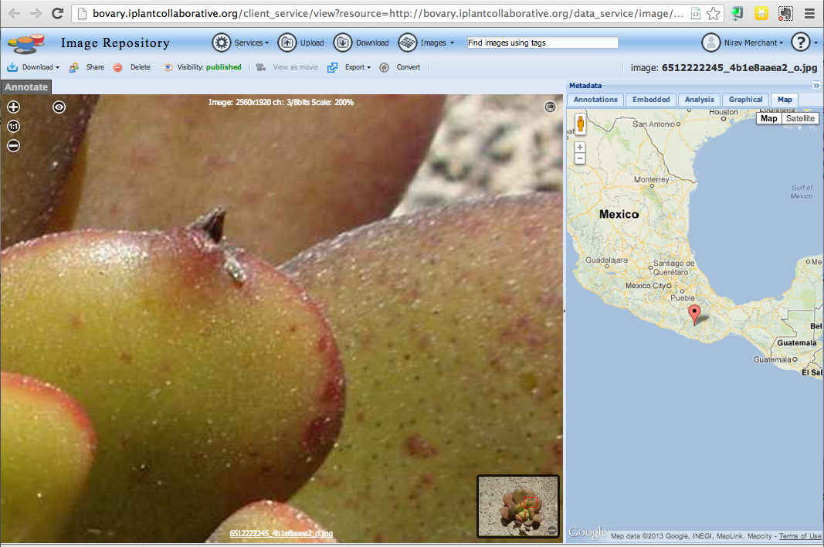

Slide 24
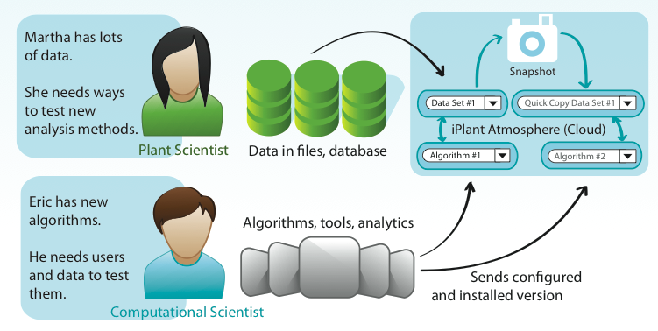
Atmosphere: Collaboration
iPlant Data Store
Parrot is used for connecting to data store, makeflow is used for task distribution to VM appliances

Slide 25
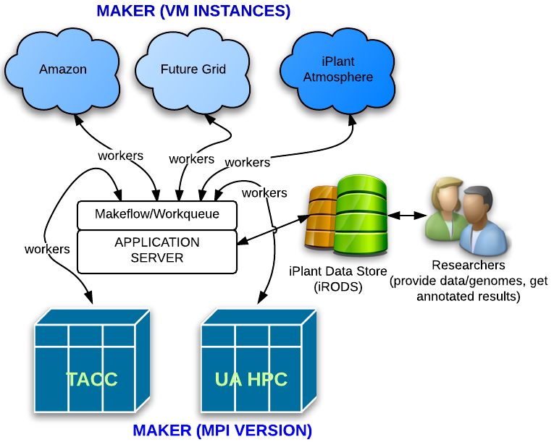

Slide 26
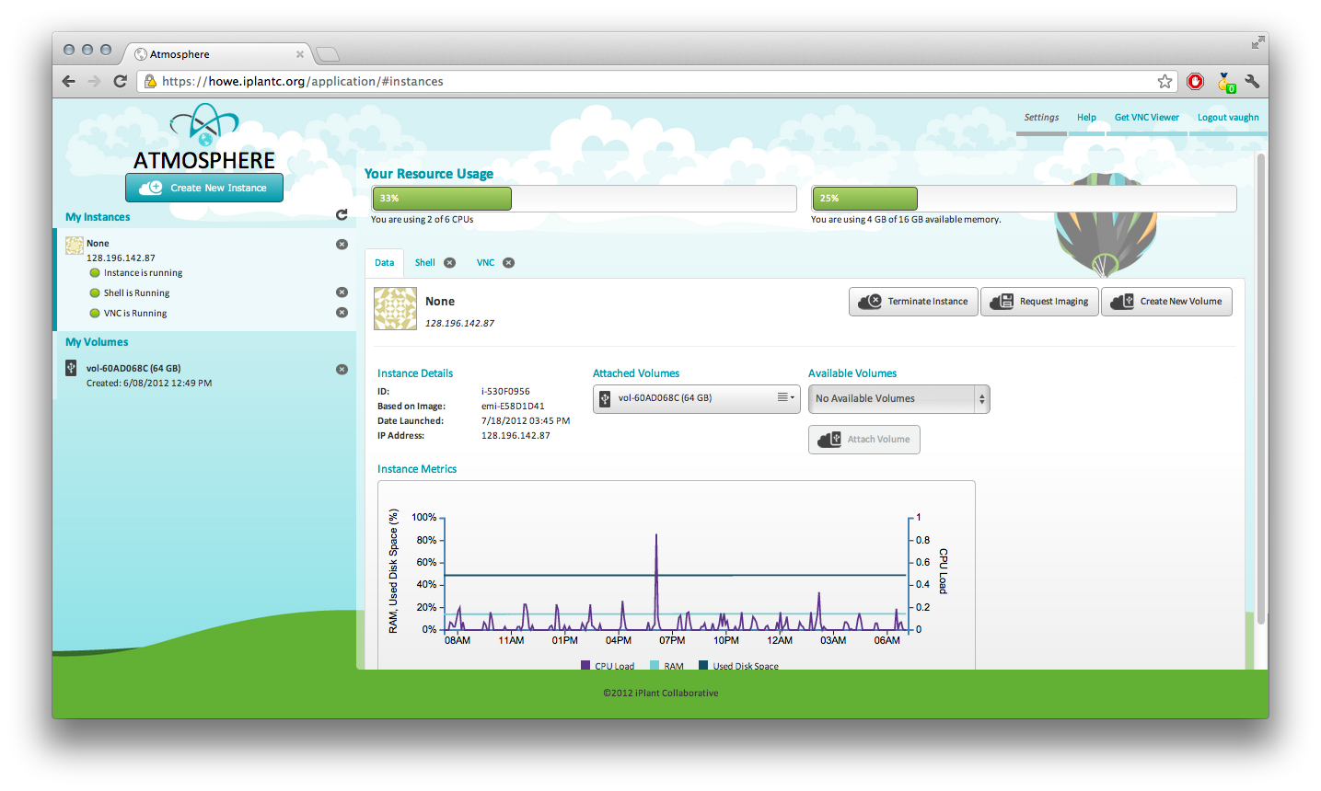
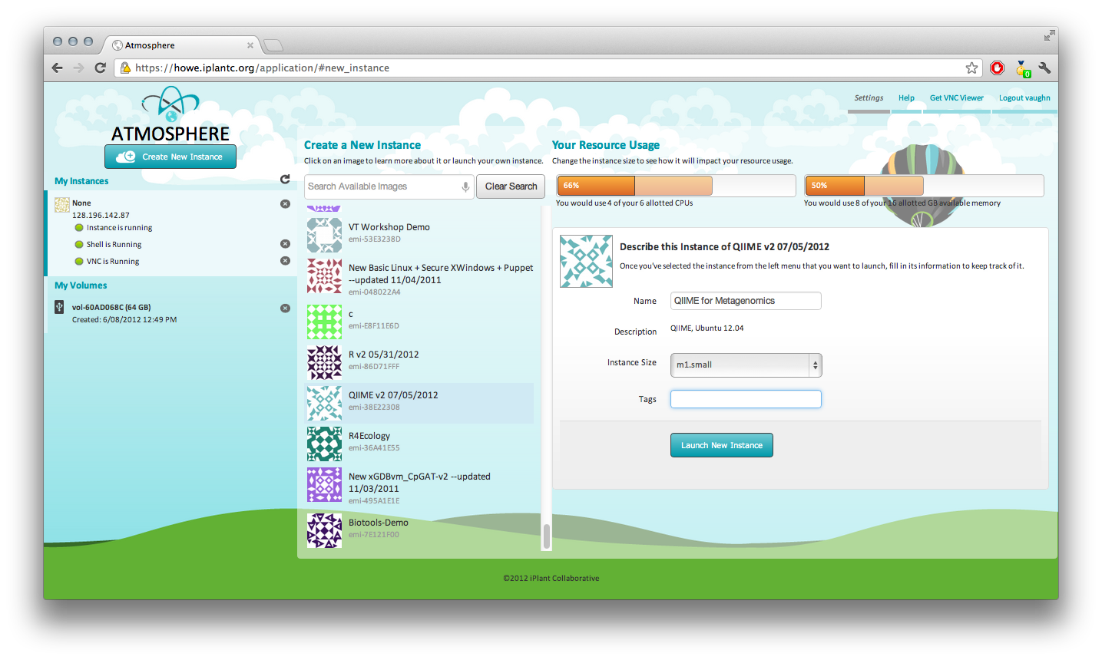
Atmosphere: Launch a new VM

Slide 27
Where are we going with data strategy
Elastic Search integration with iRODS
Data Federation (via DFC http://datafed.org/ and direct )
Extended metadata beyond simple AVU
Support specialized file types and formats (large sparse matrix, large VCF, HDF5)
Data commons (Atmosphere images with DOI etc, and more)
Relevance of parrot and makeflow, workqueue
Collaboration with large genome projects (10,000 Rice etc)

Slide 28
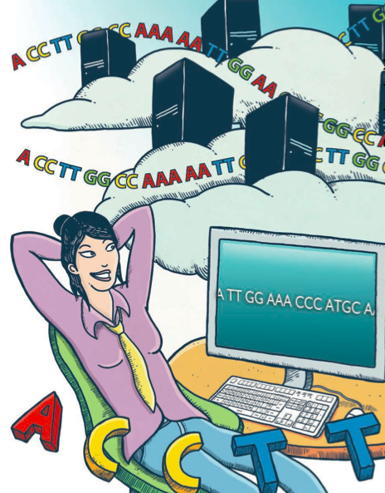
Will Computers Crash Genomics ? Science Vol. 331 Feb 2011

Slide 29
The iPlant Collaborative
Your colleagues
Leadership Team
Steve Goff - UA
Dan Stanzione – TACC
Matthew Vaughn - TACC
Nirav Merchant - UA
Doreen Ware – CSHL
Michael Schatz – CSHL
David Micklos – CSHL
Ann Stapleton – UNC Wilmington
Ron Vetter – UNC Wilmington
Postdocs:
Barbara Banbury
Christos Noutsos
Solon Pissis
Brad Ruhfel
Students:
Peter Bailey
Jeremy Beaulieu
Devi Bhattacharya
Storme Briscoe
YaDi Chen
David Choi
Barbara Dobrin
John Donoghue
Yekatarina Khartianova
Chris La Rose
Amgad Madkour
Aniruddha Marathe
Andre Mercer
Kurt Michaels
Zack Pierce
Andrew Predoehl
Sathee Ravindranath
Kyle Simek
Gregory Striemer
Jason Vandeventer
Nicholas Woodward
Kuan Yang
Faculty Advisors & Collaborators:
Ali Akoglu
Kobus Barnard
Timothy Clausner
Brian Enquist
Damian Gessler
Ruth Grene
John Hartman
Matthew Hudson
David Lowenthal
B.S. Manjunath
Staff:
Greg Abram
Sonali Aditya
Ritu Arora
Roger Barthelson
Rob Bovill
Brad Boyle
Gordon Burleigh
John Cazes
Mike Conway
Victor Cordero
Rion Dooley
Aaron Dubrow
Andy Edmonds
Dmitry Fedorov
Melyssa Fratkin
Michael Gatto
Utkarsh Gaur
Cornel Ghiban
Steve Gregory
Matthew Hanlon
Natalie Henriques
Uwe Hilgert
Nicole Hopkins
EunSook Jeong
Logan Johnson
Chris Jordan
Kathleen Kennedy
Mohammed Khalfan
David Knapp
Lars Koersterk
Sangeeta Kuchimanchi
Kristian Kvilekval
Sue Lauter
Tina Lee
Andrew Lenards
Monica Lent
Zhenyuan Lu
Eric Lyons
Aaron MarcuseKubitz
Naim Matasci
Sheldon McKay
Robert McLay
Nathan Miller
Steve Mock
Martha Narro
Shannon Oliver
Benoit Parmentier
Jmatt Peterson
Dennis Roberts
Paul Sarando
Jerry Schneider
Bruce Schumaker
Edwin Skidmore
Brandon Smith
Mary Margaret Sprinkle
Sriram Srinivasan
Josh Stein
Lisa Stillwell
Jonathan Strootman
Peter Van Buren
Hans VasquezGross
Rebeka Villarreal
Ramona Wallls
Liya Wang
Anton Westveld
Jason Williams
John Wregglesworth
Weijia Xu
David Neale
Brian O’Meara
Sudha Ram
David Salt
Mark Schildhauer
Doug Soltis
Pam Soltis
Edgar Spalding
Alexis Stamatakis
Steve Welch

