Slide 1
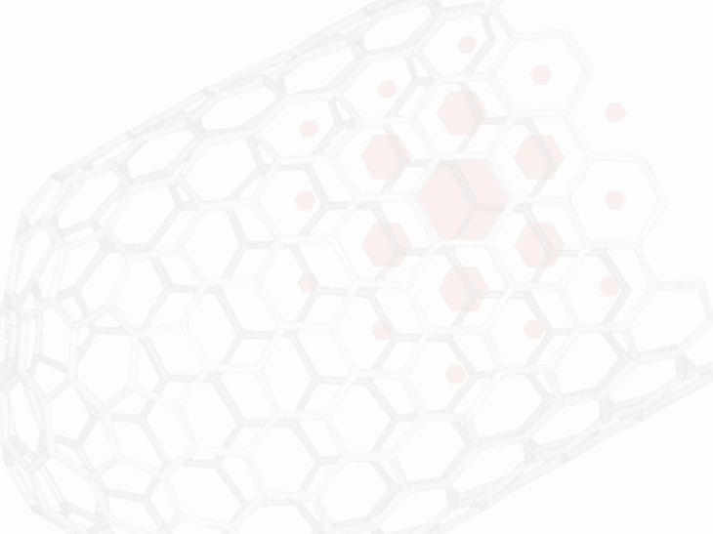
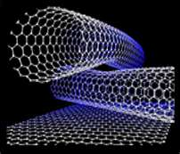
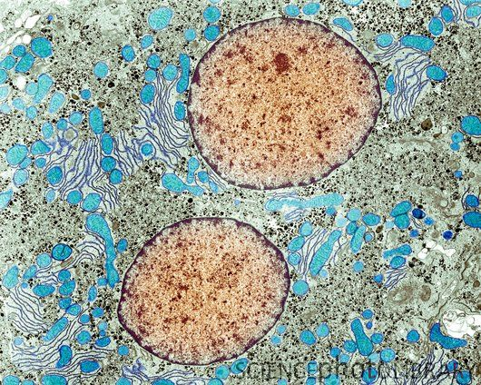
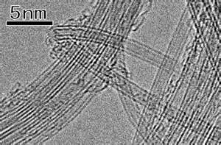
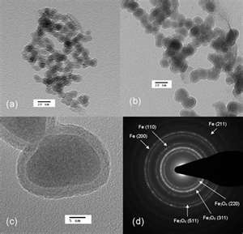
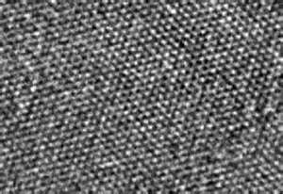
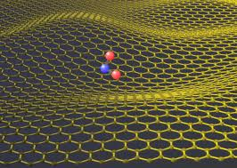
Scanning Electron Microscopy (SEM)
CBE 30361
Science of Engineering Materials

Slide 2
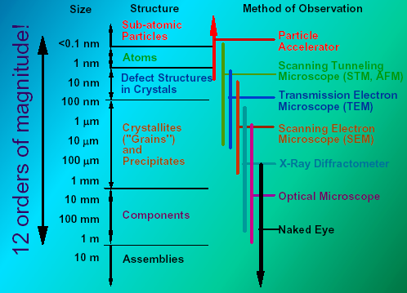
Scale of Structure Organization
Units:
micrometer = 10⁻⁶m = 1µm
nanometer= 10⁻⁹ m = 1nm
Angstrom = 10⁻¹⁰ m = 1Å
A hair is ~ 100 µm
A diameter of single wall carbon nanotube ~ 2 nm
A size of H₂ molecule ~ 2.5 Å
Notes:
Please pay attention to different methods of structure observation and investigation
The nano-level is studied by Scanning Tunneling and Transmission Electron Microscopy
While crystalline structure by X-ray diffraction technique
Finally microstructure can be investigated by Scanning electron Microscopy.
All these apparatus we do have at our University and if as a senior you decided to pursue additional
Material Science degree you will use these advanced techniques.
The electron cloud associated with metal atoms at a surface extends a very small distance above the surface. When a very sharp tip--in practice, a needle which has been treated so that a single atom projects from its end--is brought sufficiently close to such a surface, there is a strong interaction between the electron cloud on the surface and that of the tip atom, and an electric tunneling current flows when a small voltage is applied. At a separation of a few atomic diameters, the tunneling current rapidly increases as the distance between the tip and the surface decreases. This rapid change of tunneling current with distance results in atomic resolution if the tip is scanned over the surface to produce an image.

Slide 3
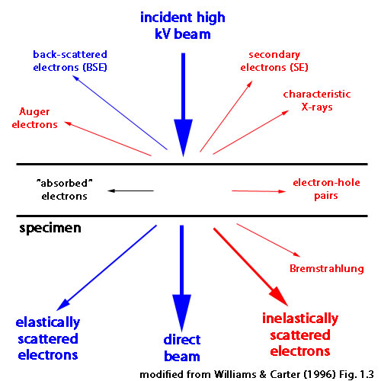
Electron Microscopy:
what can be done?
1. SEM gives images of the microstructure of a specimen with the resolution ~ 1nm; the range of the acceleration voltage 50eV - 30 kV.
Two characteristic electrons imaging modes:
(a) secondary electron image: contrast is
primarily due to topographical effects;
(b) backscattering electron image: contrast is
primarily due to average Z-effect effect;
Chemical analysis is also possible with available analytical attachments (EDS) for x-ray.
The space resolution is a function of the
acceleration voltage and is in the range of 1 to 5
microns

Slide 4
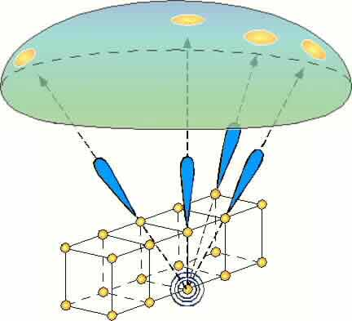
Electron Beam - Solid Surface
Interaction
The incident electrons are backscattered by the atoms at and below the surface, which act as point sources for secondary electrons.
Secondary electrons with moderate energy losses are channeled along the directions of neighbors of their point source. This is shown in the figure as blue lobular shapes. The secondary
electrons which emanate from the surface thus
produce bright spots on the collector screen.

Slide 5

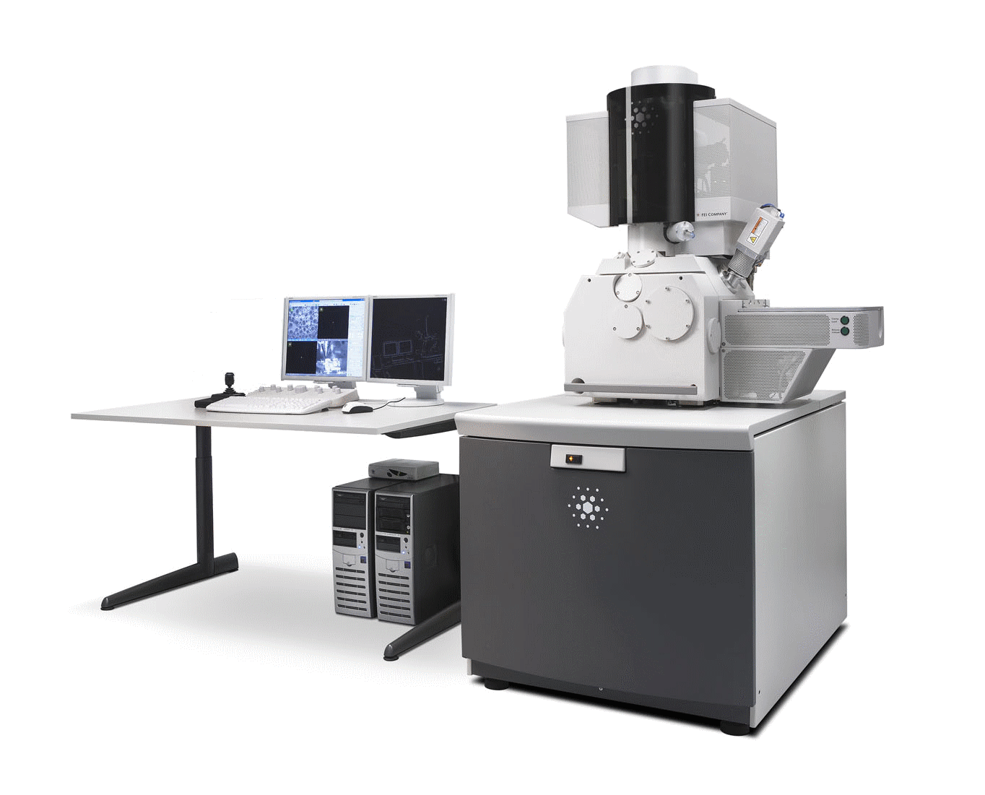
The Magellan 400
See what no one has ever seen:
XHR SEM and S/TEM complementarity
1Å
TEM
5Å
Best image resolution
XHR SEM
30kV STEM
10Å
UHR SEM
SEM
Minutes
Hours
From bulk sample to image in

Slide 6
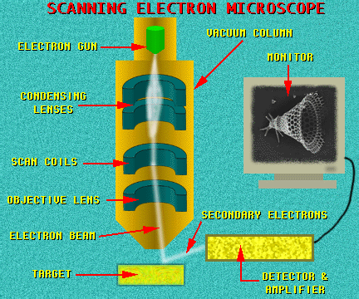
SEM: General Scheme

Slide 7
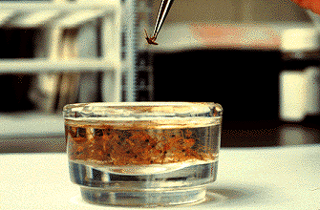
Sample Preparation
Samples have to be prepared carefully to withstand the vacuum inside the microscope.

Slide 8
Secondary Electron Imaging
The high energy incident electrons can also interact with the loosely-bound conduction band electrons in the sample. The amount of energy given to these secondary electrons as a result of the interactions is small, and so they have a very limited range in the sample (a few nm). Because of this, only those secondary electrons that are produced within a very short distance of the surface are able to escape from the sample.
This means that this detection mode boasts high resolution topographical images, making this the most widely used of the
SEM modes.

Slide 9
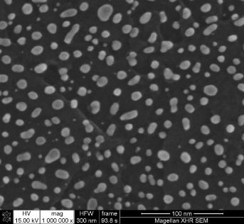
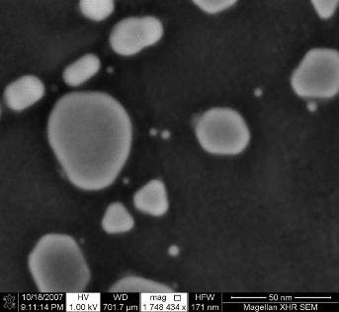
The extreme high resolution (XHR) SEM
The XHR SEM delivers sub nanometer resolution from 30kV down to 1kV
on small (e.g. thin) and large (e.g. bulk or wafer) samples
Gold particles on carbon test sample, imaged at 15kV (left, HFW of 300nm)
Gold particles on carbon test sample, imaged at 15kV (left, HFW of 300nm) and 1kV (ri9ht, HFW of 171nm).
0.8nm @ 15kV
0.9nm @ 1kV
50V
30kV
10kV
1kV
Get lower kV
with Magellan
100V
Notes:
The Magellan 400 family is not only about introducing a new family of SEMs, it is about creating a new category of SEMs, called XHR SEM (eXtreme High Resolution).
The XHR space expresses the need from the microscopy community to get higher resolution images from scanning electron microscopes on large samples at lower accelerating voltages. The XHR SEM defines as:
“ sub-nanometer resolution from 1 to 30kV in an analytical chamber”
In the XHR SEM space, the Magellan 400 family:
positions as the world’s first and only XHR SEM
establishes FEI as the leader, and really the only player in the XHR SEM market
The two ‘traditional’ gold on carbon images here illustrate how the Magellan 400 family comply to the XHR SEM criteria. It is also, in the lower energy bar, blinking in the very low kV space to indicate that there is something new to be said about very low kV and the Magellan 400 family. This is of high importance, because very low kV are essential for true surface imaging, because of reduced beam penetration. This will be explained in the coming slides.

Slide 10
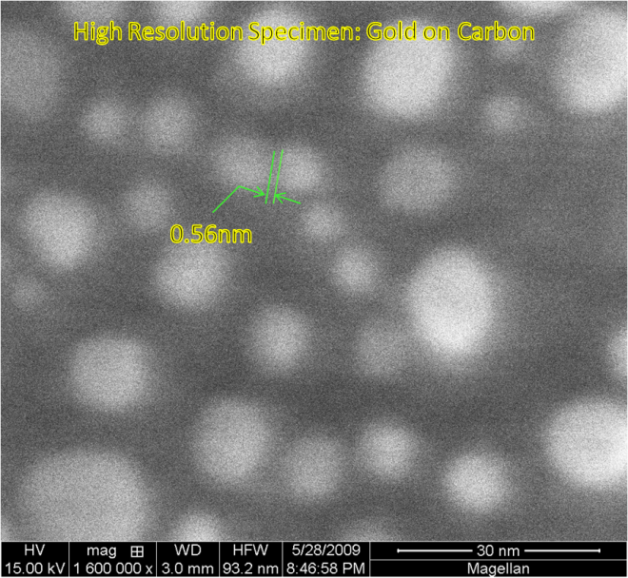
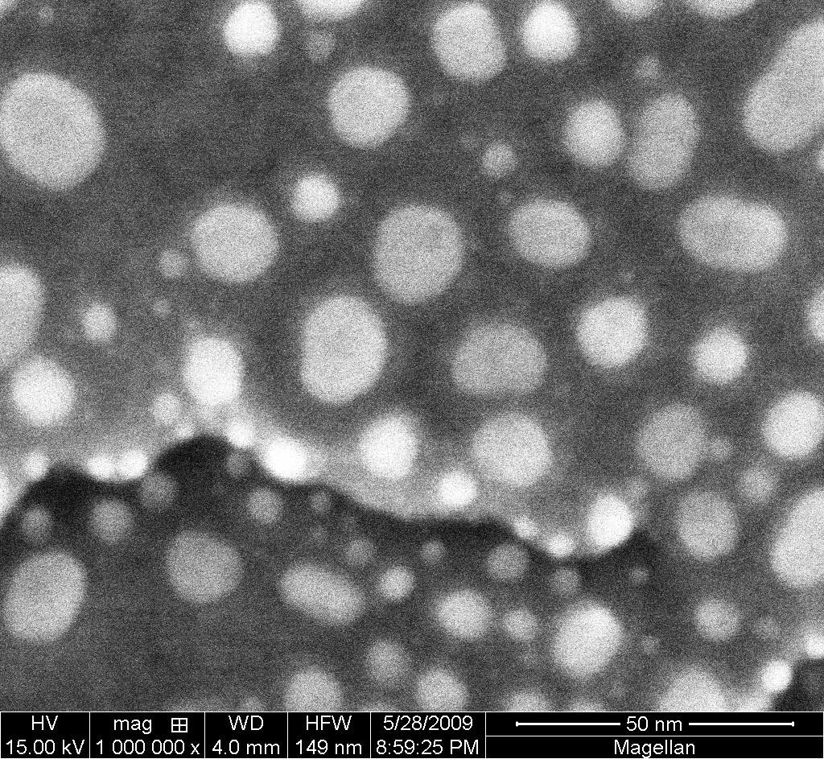
Gold on Carbon: World Record Resolution
FESEM
Magellan 400
Magnification x1,600,000
Resolution 0.58 nm

Slide 11
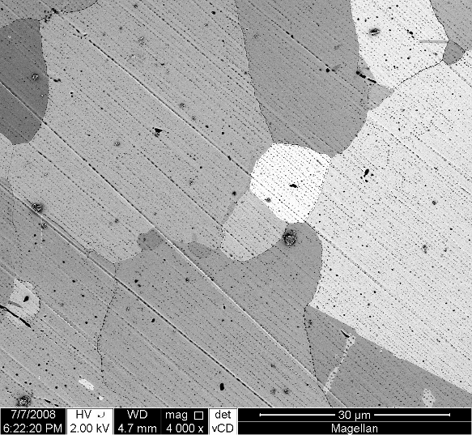
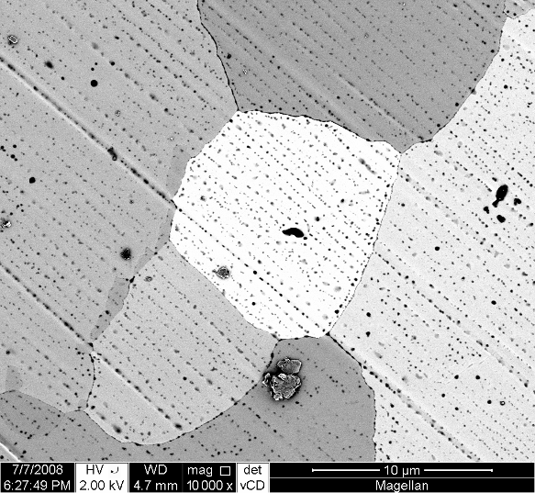
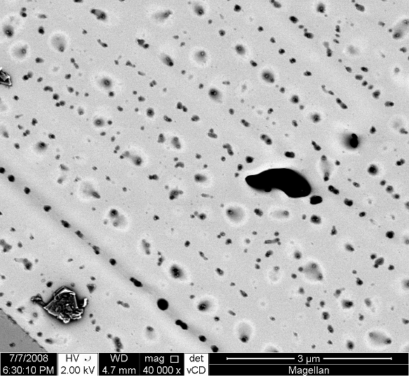
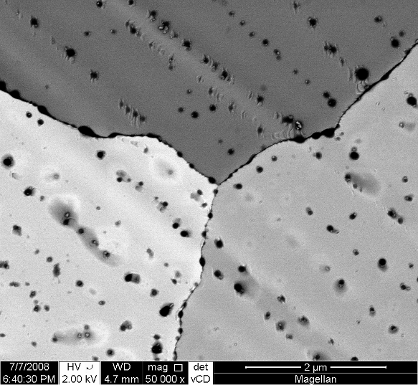
Refined contrasts
Refined contrasts using the Magellan 400 family detection suite
Superb channeling contrast (backscattered electrons using the vCD) from a platinum surface imaged at 2kV
Notes:
In this series of images, the main focus is not on ultimate resolution but on the superb channeling contrast obtained at low kV using the Beam Deceleration, the Immersion mode and the vCD. The beam deceleration allows for keeping a tiny contribution of topographic information in the image, as it provides emitted SE sufficient energy for them to be detected by the vCD.

Slide 12
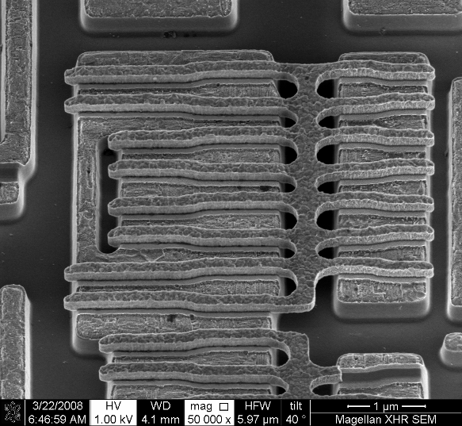
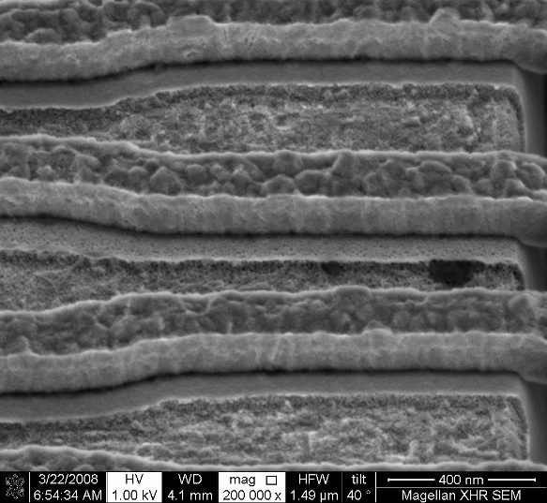
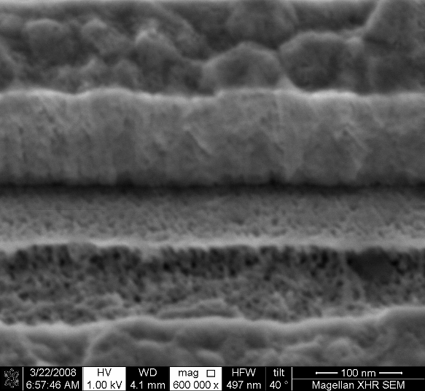
Very detailed information from complex 3D surfaces
Optimal imaging on bulk samples in tilted position
Very detailed information captured from the surface of a deprocessed integrated circuit in tilted position (smallest HFW 500nm), despite working at eucentric working distance - a must for tilting large samples. Courtesy of ST Microelectronics Grenoble and Malta.
Notes:
This series of images shows an XHR SEM application, where a deprocessed sample has been stripped back to the poly-silicon level. This series was taken in tilted position, using the TLD and UC mode, but no beam deceleration.
Here the benefits of using XHR SEM to inspect the complex 3D surfaces created are apparent – the sample can be navigated around at lower magnification (first image) and then areas of interest can be zoomed into to observe the intersection of various layers.
The porosities are likely to result from the deprocessing chemical.
The flexibility of the XHR SEM to tilt and rotate enables multiple viewpoints to be used. With the advent of FIN-FET and similar 3D gate structures in future nodes, these kinds of needs will only increase.

Slide 13
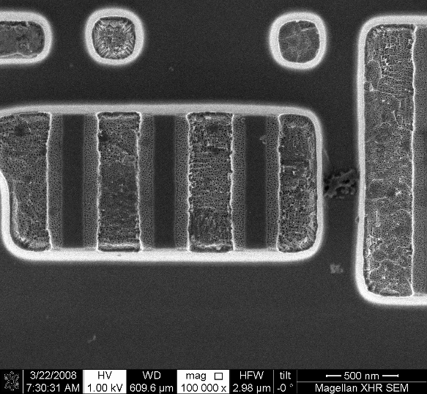
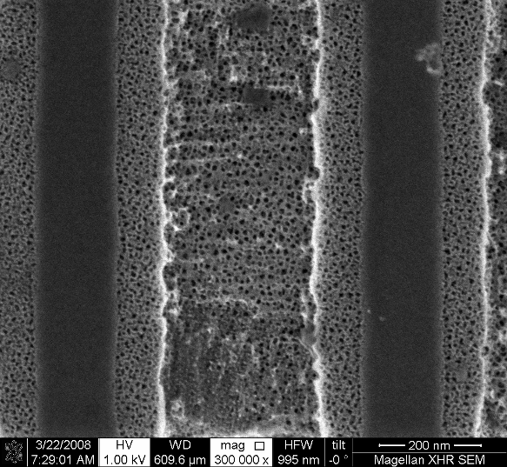
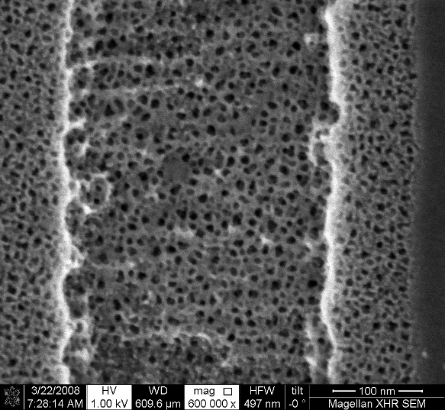
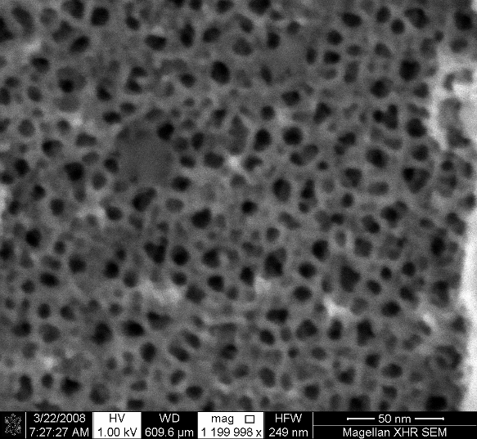
Very detailed information from complex 3D surfaces
Best top-down resolution on small and large bulk samples using low electron beam energies
Very detailed information captured from the surface of a deprocessed integrated circuit, imaged top-down at optimal working distance (smallest HFW 250nm), demonstrates Magellan’s excellent resolution. Courtesy of ST Microelectronics Grenoble and Malta.
Notes:
This series of images shows an XHR SEM application, where the same deprocessed sample has been stripped back to the poly-silicon level. This series was taken in top-down position, using the TLD and UC mode, but no Beam Deceleration
Here the benefits of using XHR SEM to inspect the complex 3D surfaces created are apparent – the sample can be navigated around at lower magnification (first image) and then areas of interest can be zoomed into to observe the intersection of various layers.
The porosities are likely to result from the deprocessing chemical.
The flexibility of the XHR SEM to tilt and rotate enables multiple viewpoints to be used. With the advent of FIN-FET and similar 3D gate structures in future nodes, these kinds of needs will only increase.

Slide 14
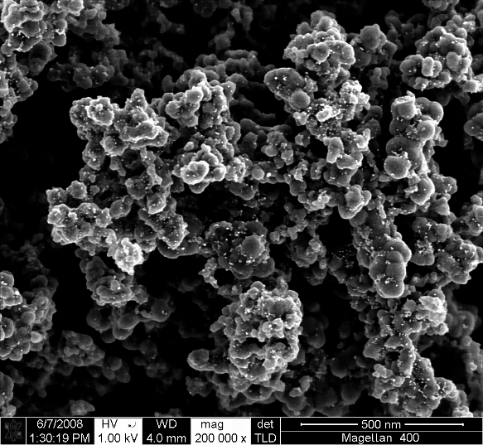
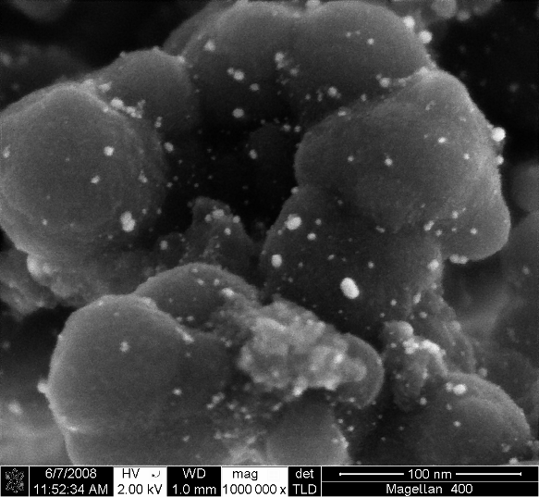
Investigating nanoparticles
Optimal topographic and materials contrast with extreme high resolution
Platinum catalyst nanoparticles, imaged at low energy using beam deceleration for enhanced surface details and a HFW of 300nm.
Notes:
With the XHR capability and an optimal balance between topographic and materials contrast, nanometer-scale particles are perfectly resolved and visible against the substrate, without sample preparation. At this unprecedented magnification, smaller nano-particles become visible for the first time. Also the nano-particle distribution, size, shape, orientation (and more) can be ideally studied.
The first image is ‘regular’ high-magnification shot (although of excellent image quality and contrast) while the second shows how the Magellan can push the magnification to get additional information.
To best resolve the individual catalyst particles, the images were shot using low kV, beam deceleration and the TLD. This allows to obtain the topographic information while preserving the materials contrast (bright Pt catalyst particles against a darker background).

Slide 15
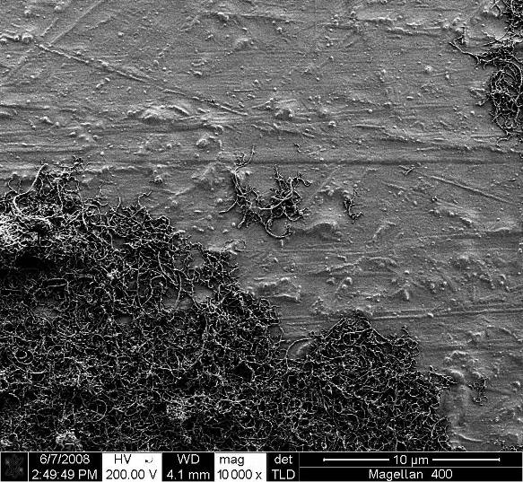
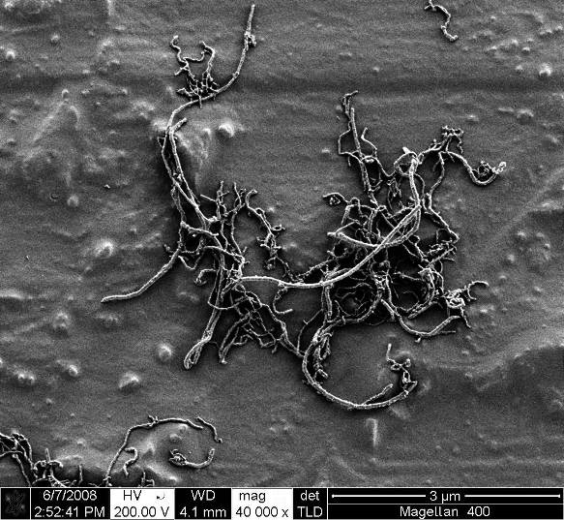
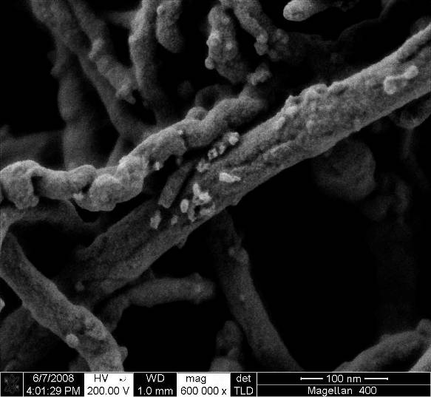
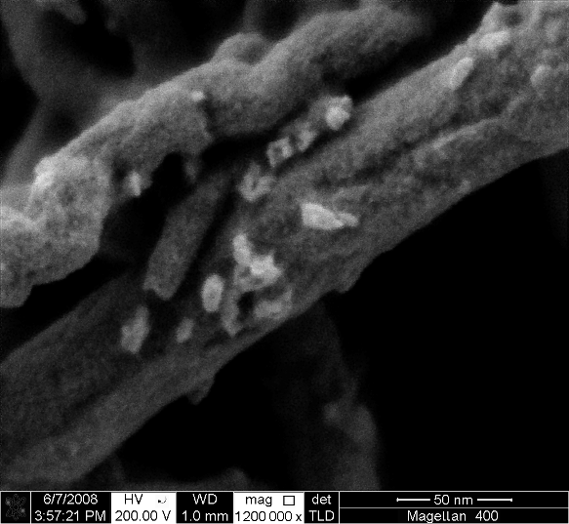
Investigating nanotubes
Unique surface sensitivity and details at very low voltages
Carbon nanotubes with catalyst particles on their surface, imaged at very low energy for best surface details and a HFW of 250nm. Courtesy of Prof. Raynald Gauvin and Camille Probst, Ph.D. Student, McGill University
Notes:
The highly resolved projection information available from S/TEM has been critical to the understanding and development of nanotubes (NT) and nanowires (NW). The Magellan makes it now possible to look at the other side of NT & NW, that is, their true surface at very high magnification, to keep scientists in the lead of the breathtaking race for NT & NW processes and applications development.
As it is surface information that is of importance in this case, very low kV and Beam Deceleration were chosen for this series of images. While the lower magnifications give a nice overview of the nanotubes stack, the 500,000x and above magnifications reveal the true surface of the nanotubes, with a SEM-related contamination that is barely visible. Even particles at the surface of the tubes become visible.

Slide 16
Back scattered electrons
When an electron from the beam encounters a nucleus in the sample,
the resultant Coulomb attraction results in the deflection of the electron's path, known as Rutherford elastic scattering. A few of these electrons will be completely backscattered, re-emerging from the incident surface of the sample.
Since the scattering angle is strongly dependent on the atomic number of the nucleus involved, the primary electrons arriving at a given detector position can be used to yield images containing both topological and compositional information.

Slide 17
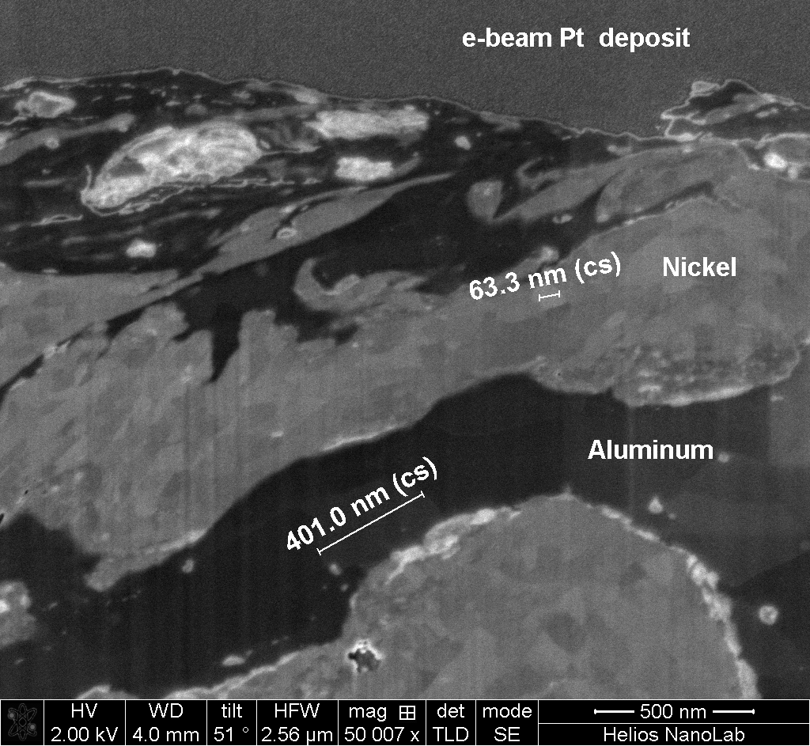
Mechanically Activated Composite Nano Particle

Slide 18
Energy-Dispersive analysis of X-rays
  Another possible way in which a beam electron can interact with an atom is by the ionization of an inner shell electron. The resultant vacancy is filled by an outer electron, which can release it's energy by emitting an X-ray.
  This produces characteristic lines in the X-ray spectrum corresponding to the electronic transitions involved. Since these lines are specific to a given element, the composition of the material can be deduced. This can be used to provide quantitative information about the elements present at a given point on the sample, or alternatively it is possible to map the abundance of a particular element as a function of position.

Slide 19
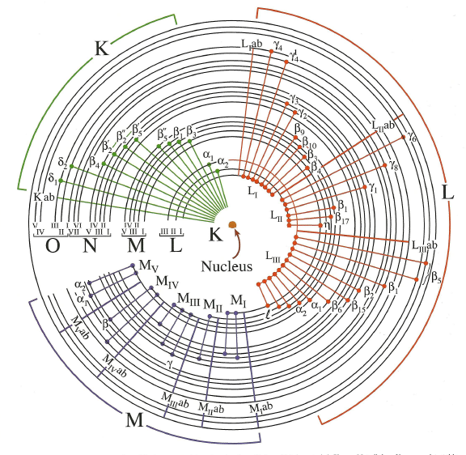
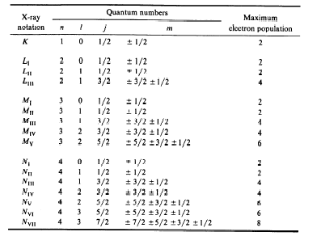
Characteristic X-Ray Emission
The XEDS detectors can fill and resolve
only K,L, and M and α and β lines.
Relative Weights of X-ray Lines
K_{α} (1) L_{α} (1) M_{α} (1) | K_{β} (1) L_{β1} (0.7) M_{β} (0.6) | L_{β2} (0.2) M_{ξ} (0.06) | L_{γ1} (0.08) M_{γ} (0.05)
E=hω= hc/λ
λ = 1.24/Ε(keV)

Slide 20
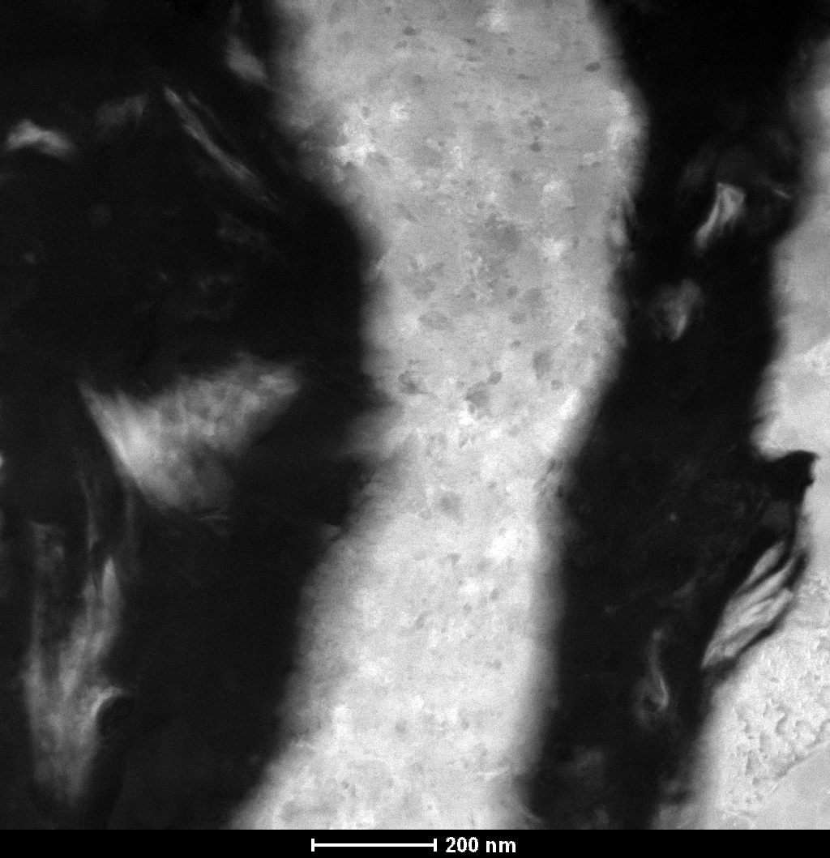
EDX Line Scanning
Marker
EDX Ni-Al-O Mass Percentage Profile

Slide 21
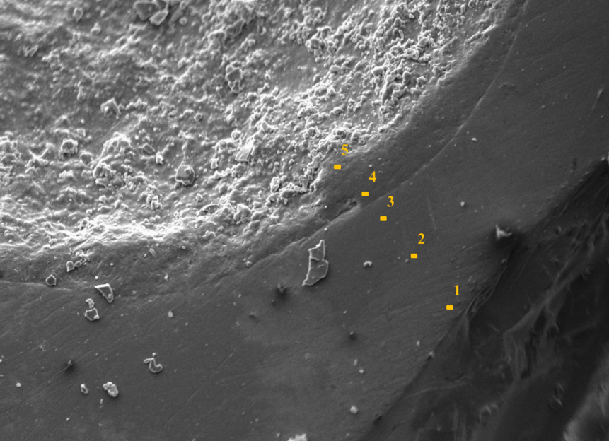
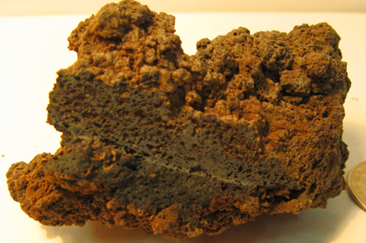
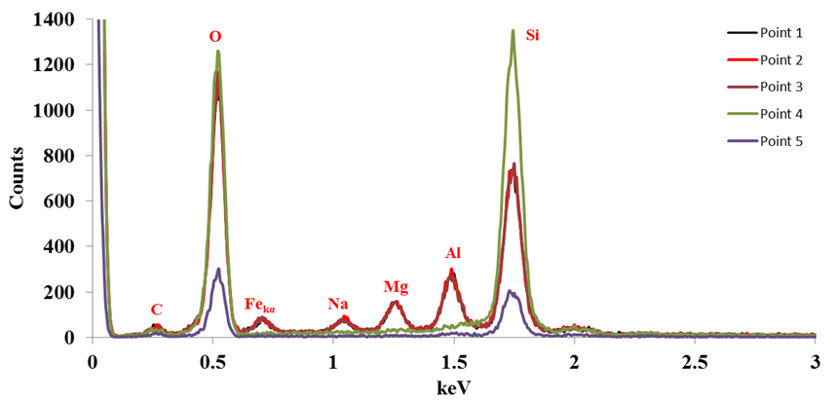
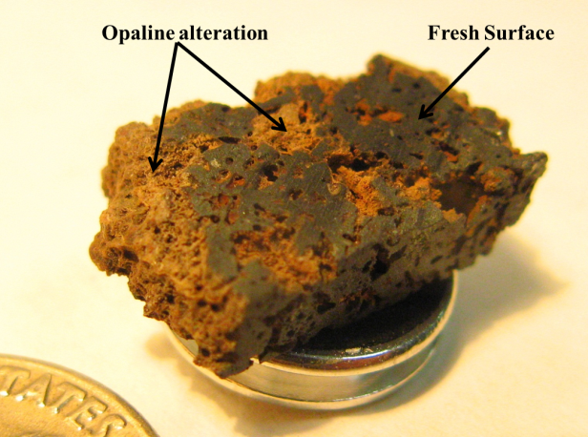
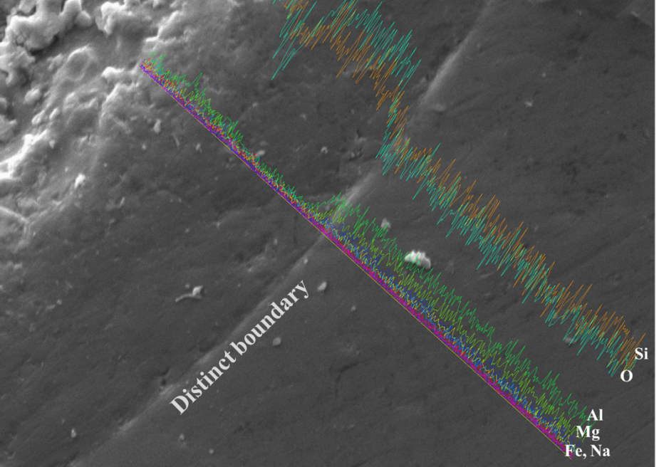
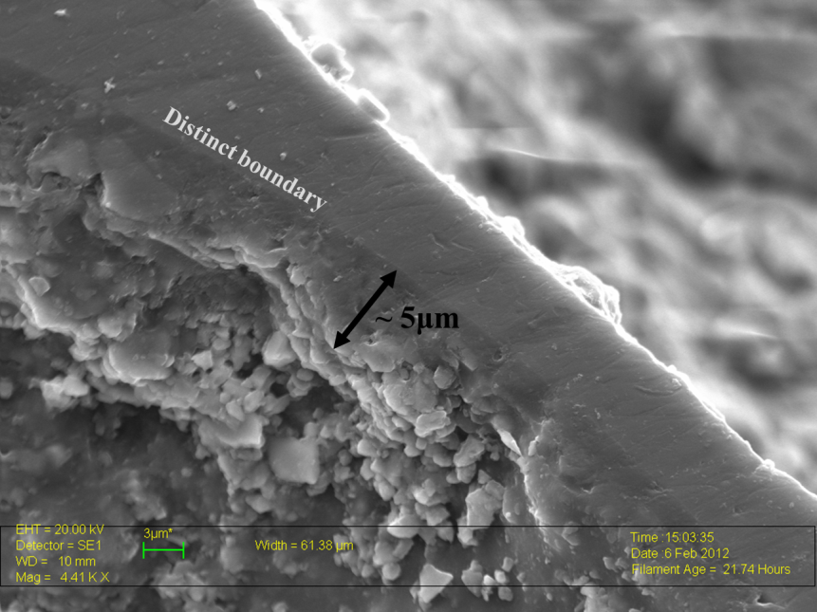
SEM Leo Helps to Understand Martian History
  Basalts collected from Hawaii: used as Martian analog for acid leaching study
  Exploring the mechanism for opaline formation from an acid leaching perspective will help to understand its presence on the Martian surface

Slide 22
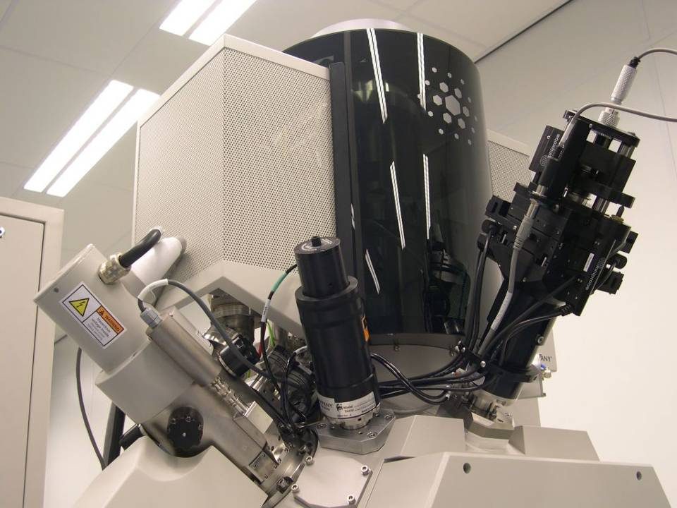
Helios Nano-Lab 600 Dual-Beam
Electron Column
Ion Column
Omni Probe

Slide 23
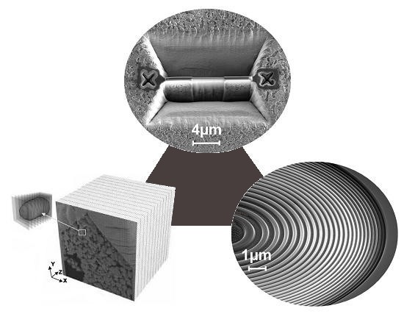
Pushing the Limits for Nano-Work
Ultimate
Sample
Preparation
Finer and more automated
2D and 3D Nano-Analysis
The best tools
for prototyping
at the nano-scale

Slide 24
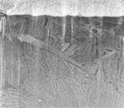
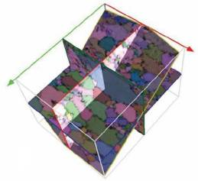
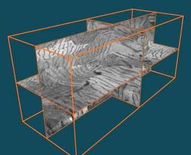
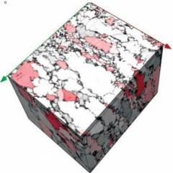

… Extends to Nano-Analysis in 3D !
Collect your data unattended
3D packages handle samples movements and protection to optimize the milling conditions as well as the data acquisition
Very large datasets supported
Reconstruct and explore in 3D a set of EBSD maps
EBS3TM
Auto Slice and ViewTM
Reconstruct and explore in 3D a tomographic set of cross-sectional images
http://www.youtube.com/watch?v=isH0-xCpla8

Slide 25

Automated Slice and View
Ti-based superalloy
Ti – super Alloy

Slide 26


3D Reconstruction
Alpha/beta Ti Alloy

Slide 27




Advanced Nano Prototyping with FIB
HELIOS NANOLAB
Combine the most accurate
milling of smallest features,
e.g. these sub-20nm lines
used in Nano Fluidics…
… with the new best FIB milling
strategies for fast, redeposition
free and smooth sidewalls…
… and write your most
advanced functional devices

Slide 28


Direct 3D patterning via bmp FIB milling

Slide 29

Nano Prototyping: Photonic Array

Slide 30

Nano Machining: Micro-indenter (Diamond)

Slide 31


FIB Preparation of Atom Probe Tips
10 nm tip diameter

Slide 32


Changing Digital e-Beam Parameters

Slide 33
Conclusions
There is arguably no other instrument with the breadth of applications in the study of solid materials that compares with the SEM. The SEM is critical in all fields that require characterization of solid materials. Most SEM's are comparatively easy to operate, with user-friendly "intuitive" interfaces. Many applications require minimal sample preparation. For many applications, data acquisition is rapid (less than 5 minutes/image for SEI, BSE, spot EDS analyses.) Modern SEMs generate data in digital formats, which are highly portable.
Samples must be solid and they must fit into the microscope chamber. Maximum size in horizontal dimensions is usually on the order of 10 cm, vertical dimensions are generally much more limited and rarely exceed 40 mm. For most instruments samples must be stable in a vacuum on the order of 10⁻⁵ - 10⁻⁶ torr. Samples likely to outgas at low pressures are unsuitable for examination in conventional SEM's. However, "low vacuum" and "environmental" SEMs also exist, and many of these types of samples can be successfully examined in these specialized instruments.
EDS detectors on SEM's cannot detect very light elements (H, He, and Li). Most SEMs use a solid state x-ray detector (EDS), and while these detectors are very fast and easy to utilize, they have relatively poor energy resolution and sensitivity to elements present in low abundances when compared to wavelength dispersive x-ray detectors (WDS) on most electron probe microanalyzers (EPMA). An electrically conductive coating must be applied to electrically insulating samples for study in conventional SEM's, unless the instrument is capable of operation in a low vacuum mode.

