Slide 1
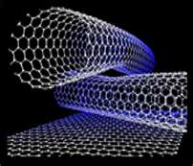
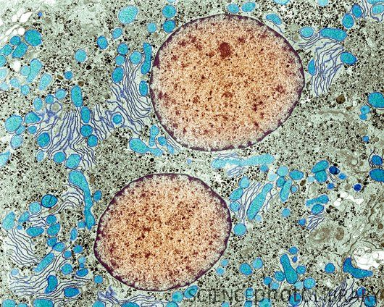
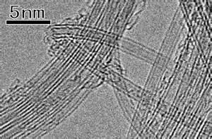
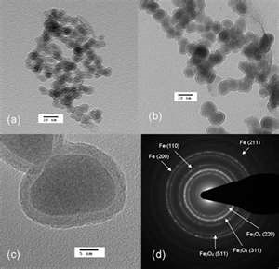
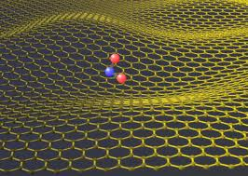
Transmission Electron Microscopy (TEM)
CBE 30361 Science of Engineering Materials

Slide 2
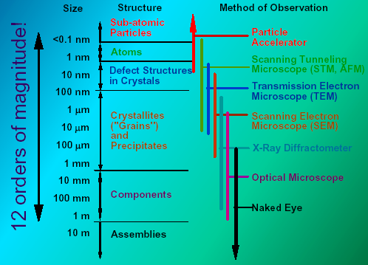
Scale of Structure Organization
Notes:
Please pay attention to different methods of structure observation and investigation
The nano-level is studied by Scanning Tunneling and Transmission Electron Microscopy
While crystalline structure by X-ray diffraction technique
Finally microstructure can be investigated by Scanning electron Microscopy.
All these apparatus we do have at our University and if as a senior you decided to pursue additional
Material Science degree you will use these advanced techniques.
The electron cloud associated with metal atoms at a surface extends a very small distance above the surface. When a very sharp tip--in practice, a needle which has been treated so that a single atom projects from its end--is brought sufficiently close to such a surface, there is a strong interaction between the electron cloud on the surface and that of the tip atom, and an electric tunneling current flows when a small voltage is applied. At a separation of a few atomic diameters, the tunneling current rapidly increases as the distance between the tip and the surface decreases. This rapid change of tunneling current with distance results in atomic resolution if the tip is scanned over the surface to produce an image.

Slide 3
Concept of Resolution
Rayleigh criterion for visible-light
Microscope states that the smallest
distance that can be resolved, δ, is
given approximately by:
is the wavelength of the radiation, μ the refractive
index of the viewing medium, and β the semi-angle
of collection of the magnifying lens. For the
sake of simplicity we can approximate μ sin β to unity
so the resolution is equal to about half
the wavelength of light.
Visible light λ=400 nm R= 200nm
Electrons λ=4 pm R= 2 pm << atom diameter
Notes:
Two point sources are regarded as just resolved when the principal diffraction maximum of one image coincides with the first minimum of the other.^{[1]} If the distance is greater, the two points are well resolved and if it is smaller, they are regarded as not resolved. If one considers diffraction through a circular aperture, this translates into:
where
θ is the angular resolution,
λ is the wavelength of light,and
D is the diameter of the lens' aperture.
The factor 1.220 is derived from a calculation of the position of the first dark circular ring surrounding the central Airy disc of the diffraction pattern. The calculation involves a Bessel function—1.220 is approximately the first zero of the Bessel function of the first kind, of order one divided by π
The resolution R (here measured as a distance, not to be confused with the angular resolution of a previous subsection) depends on the angular aperture :
Here NA is the numerical aperture, is half the included angle of the lens, which depends on the diameter of the lens and its focal length, is the refractive index of the medium between the lens and the specimen, and is the wavelength of light illuminating or emanating from (in the case of fluorescence microscopy) the sample.
It follows that the NAs of both the objective and the condenser should be as high as possible for maximum resolution. In the case that both NAs are the same, the equation may be reduced to:
The practical limit for is about 70°. In an air objective or condenser, this gives a maximum NA of 0.95. In a high-resolution oil immersion lens, the maximum NA is typically 1.45, when using immersion oil with a refractive index of 1.52. Due to these limitations, the resolution limit of a light microscope using visible light is about 200 nm. Given that the shortest wavelength of visible light is violet ( ≈ 400 nm),
which is near 200 nm.

Slide 4
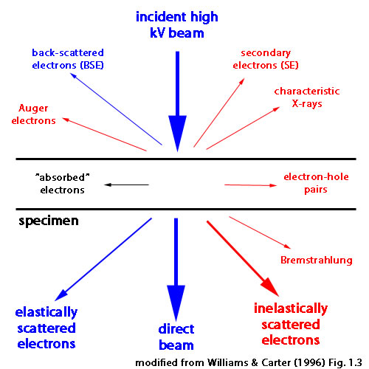
Transmission Electron Microscopy:
what can be done?
1. TEM gives images of internal structure of a specimen sufficiently thin (~1000 Å) to allow transmission of electrons, typically 100-300 kV.
2. Electrons diffract. Electron diffraction patterns give detailed crystallographic information:
Crystal orientation
Lattice parameters
Specimen thickness
3. Chemical analysis is also possible with available analytical attachments for x-ray or electron spectroscopy.

Slide 5
TEM Imagining
STANDARD TEM IMAGE MODES
BRIGHT FIELD (BF) IMAGE:
Only the transmitted beam is allowed to pass through the objective aperture. Image is ∴ bright where diffraction in specimen is weak.
DARK FIELD (DF) IMAGE:
Only one diffracted beam passes through objective aperture.
Image is dark where diffraction is weak, bright where diffraction is strong.
LATTICE IMAGE (High Resolution TEM: HRTEM image):
Interference of transmitted beam (TB) and diffracted beams (DBs) produces an image of the crystal lattice.
DIFFRACTION PATTERN:
Intermediate lens adjusted to image the diffraction pattern formed in back focal plane (BFP) of objective lens.

Slide 6
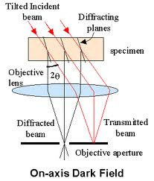
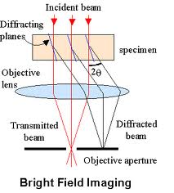
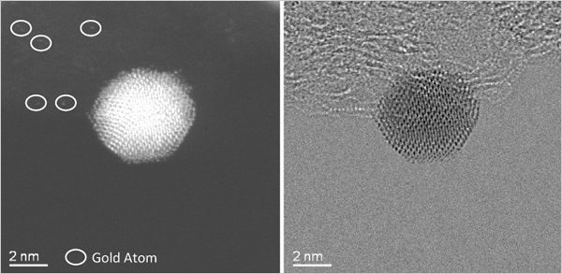
BF & DF Imaging
Isolated individual Gold Atoms
around Gold Nanoparticles:
(left) dark field image,
(right) bright field image.

Slide 7
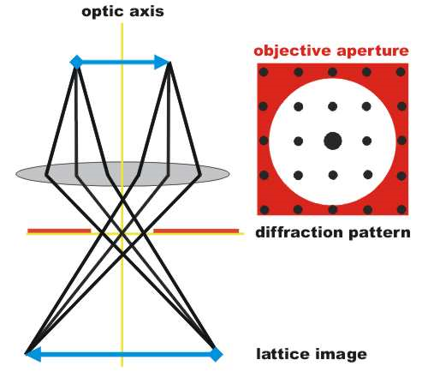
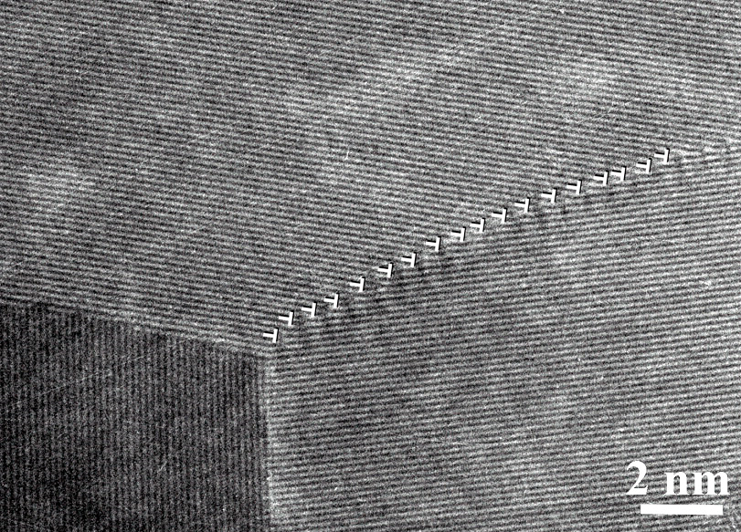
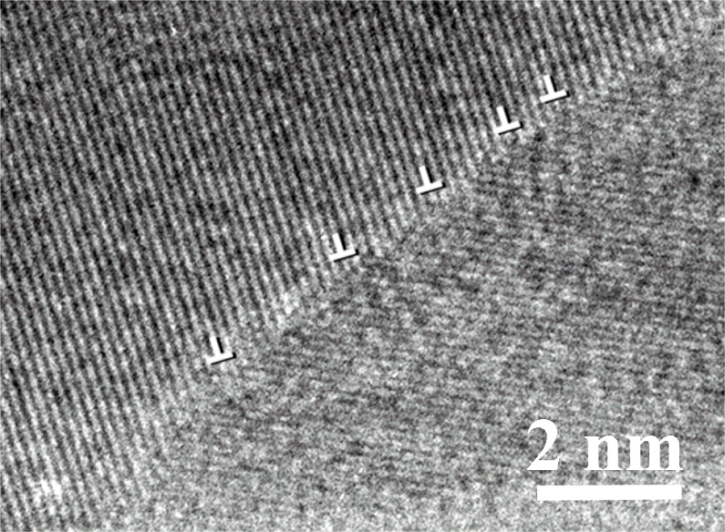
HRTEM: Lattice Imaging
Lattice-resolution imaging of Ni₃Al
The image shows three grains at a resolution
where the lines are closely related to planes of
atoms in the crystalline lattice. One grain
boundary is being depicted as a series of edge
dislocations.
HR-TEM image of Ni₃Al
High-resolution transmission electron microscopy
is capable of resolving individual planes of atoms
in the crystalline lattice. The lines in this image are
closely related to planes of atoms in the crystalline lattice.

Slide 8
MAJOR IMAGE CONTRAST MECHANISMS
Mass-thickness contrast: scattering out of transmitted beam creates contrast due to difference of atomic number (Z) and/or thickness t; scattering is proportional to Z²t. Higher-Z or thicker areas are darker in BF. Applicable to crystalline or amorphous materials.
Diffraction contrast: scattering out of transmitted beam creates contrast due to differences in diffracted intensity produces contrast for dislocations, grain boundaries, stacking faults, second phase particles etc. Strongly diffracting objects are darker in BF. Applicable only to crystalline materials.
Phase contrast: interference between transmitted and diffracted beam produces lattice fringes or atomic structure images (typically referred to as HRTEM (high-resolution TEM).

Slide 9
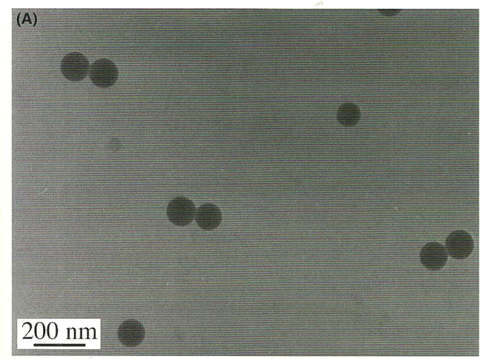
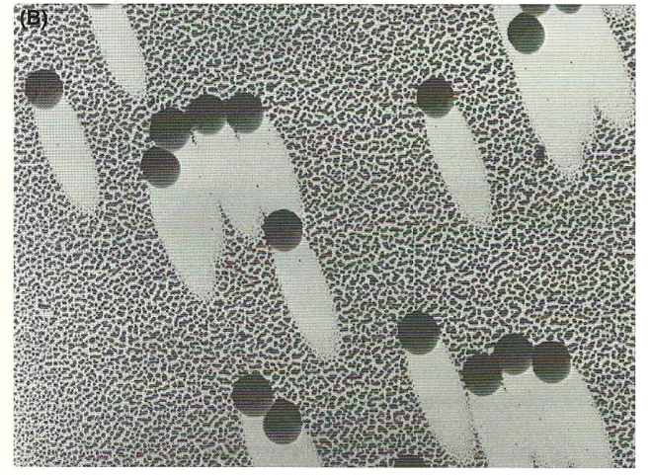
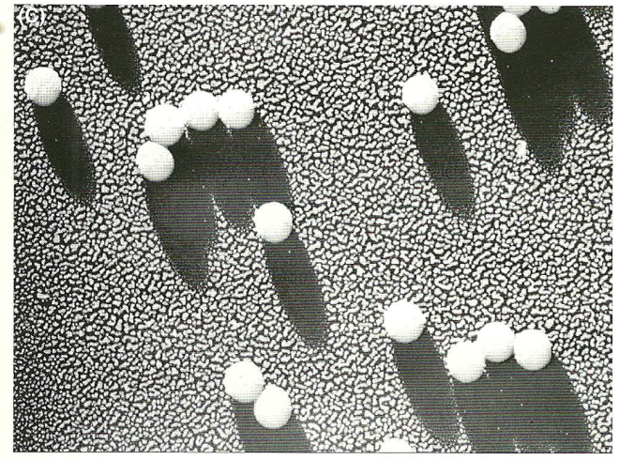
Mass-Thickness Contrast

Slide 10
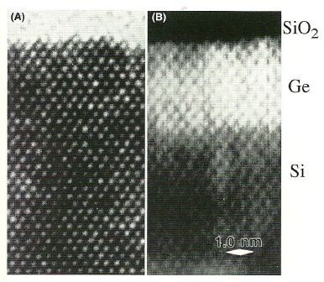
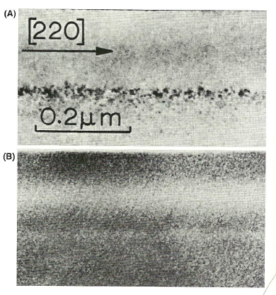
Z-Contrast
What do the Z-contrast of crystals look like?
HRTEM of epitaxial Ge on Si with amorphous SiO2 :
Si and Ge are undistinguishable;
(B) HR Z- contrast STEM image also show the atom rows
bur with strong contrast of at the Si-Ge interface.
We can think re (B) as a direct map of f(θ) variation in
the foil!!
TEM BF image of Bi implanted into Si
formed from the direct beam: defects with
the Bi implant are shown but there is no
contrast associated with Bi;
Z-contrast image: the Bi implanted area
is bright, but the defects contrast is not
preserved

Slide 11
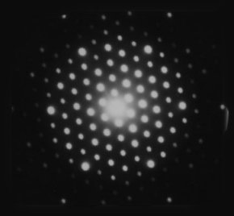
Diffraction in TEM
What is it?
What can we learn from it?
Why do we see it?
What determines the scale?
Comparison X-ray /Electrons:
- Electrons have a much shorter wavelength than X-ray
- Electrons are scattered more strongly
Electron beams are easily directed
However, much of electron D follows directly from X-ray D
An experimentally observed DP showing
the central intense, direct beam and array
of diffraction spots from different atomic
planes.
Is the specimen crystalline or amorphous?
If it is crystalline: what are crystallographic characteristics of the specimen?
Is the specimen mono-crystalline?
If not what is the grain morphology and grain size distribution?
Is more than one phase presented, how are they oriented to each other?

Slide 12
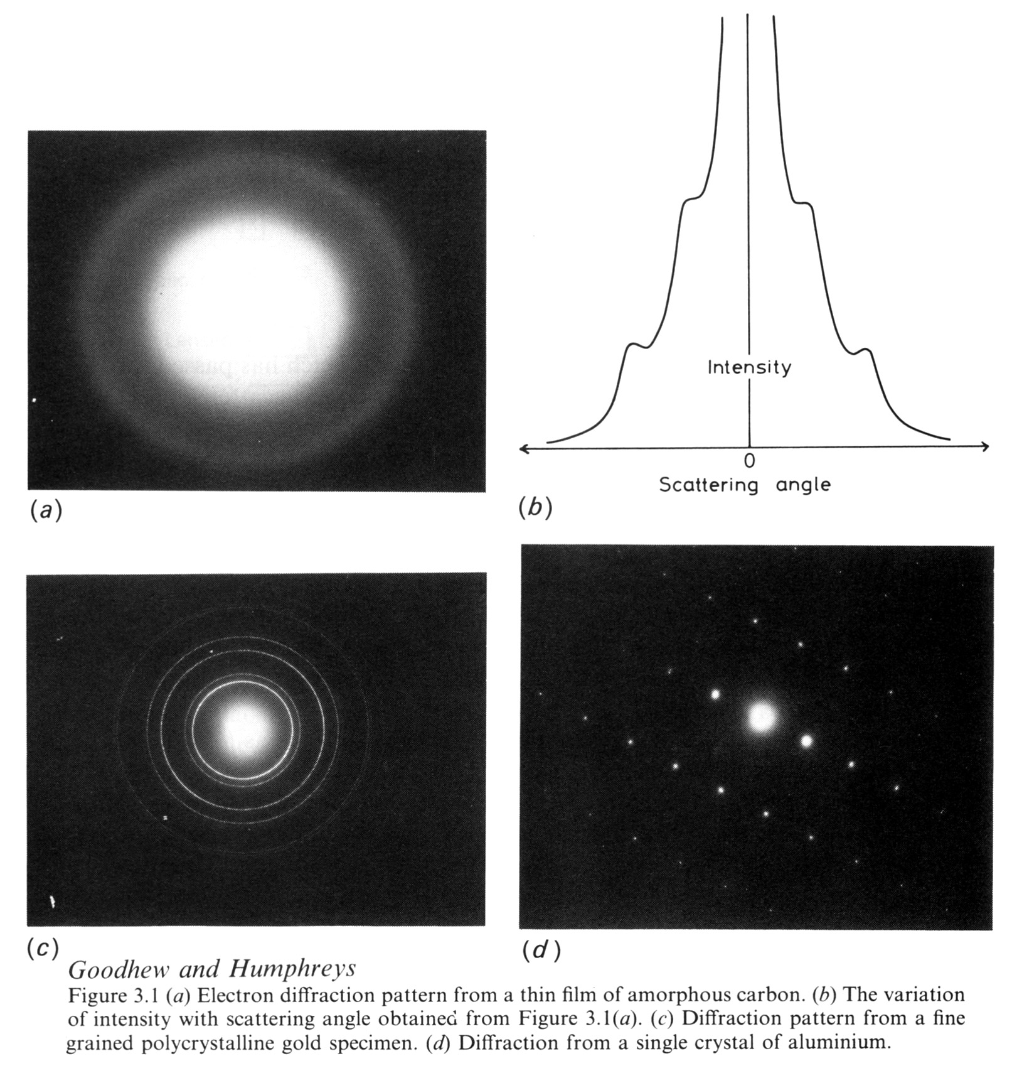
Ring Patterns
Amorphous (non-crystalline) materials give diffuse rings, as in (a) above, which is from a thin amorphous carbon support film. TEM grids with carbon support films are available from several microscopy suppliers. Crystalline materials give sharp rings, as in (c).

Slide 13
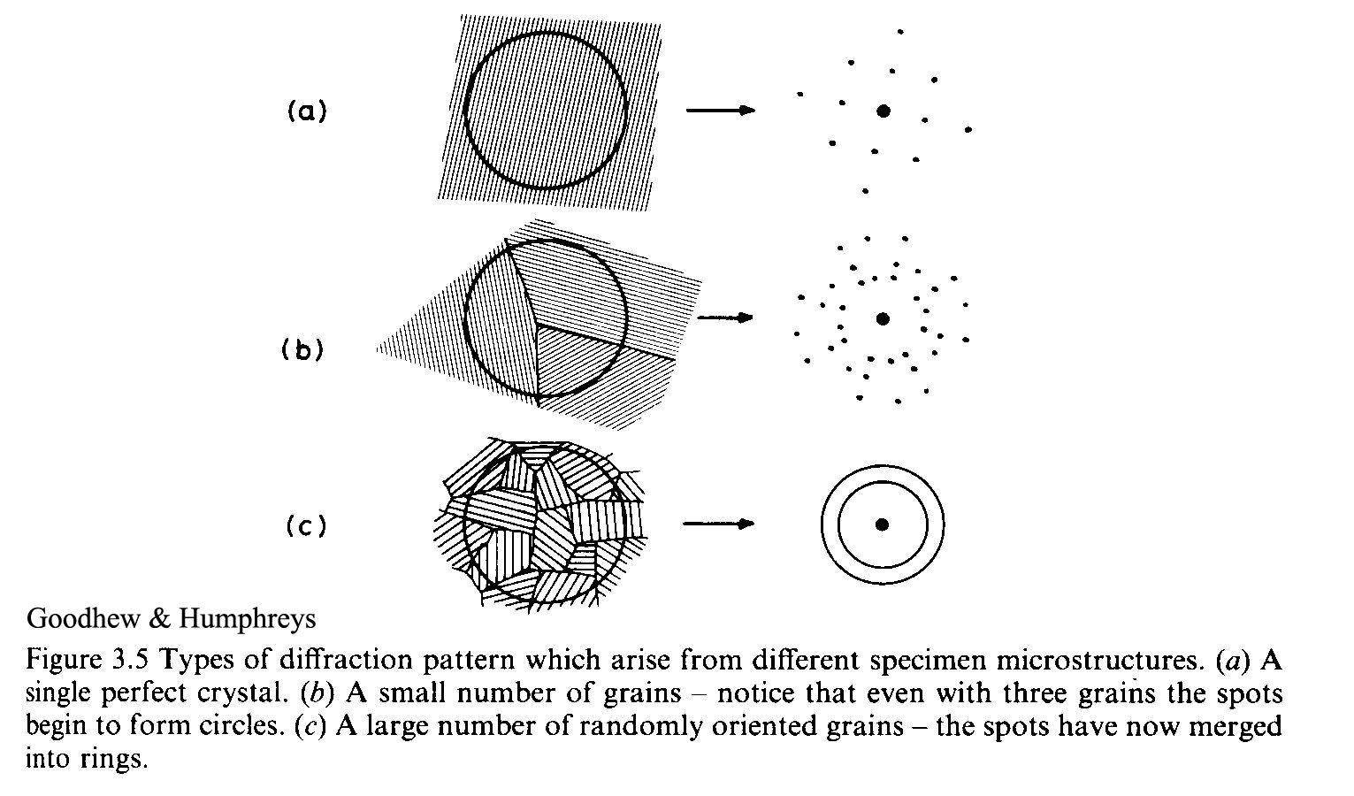
Ring Patterns
The diffraction pattern from a polycrystalline specimen area contains overlapping spot patterns from all grains illuminated by the incident beam. If the number of grains is small, we see “spotty” rings. If the number is large (small grain size) we will see smooth continuous rings.
The ring radii are given by the camera formula:
Where d is a crystal d-spacing; λ – wave length of the electron; L – constant of the TEM.

Slide 14
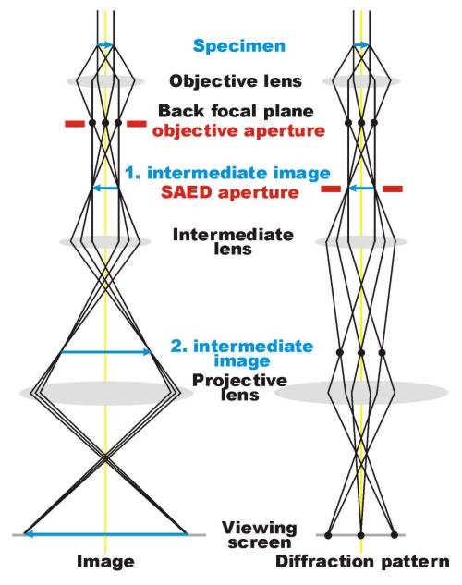
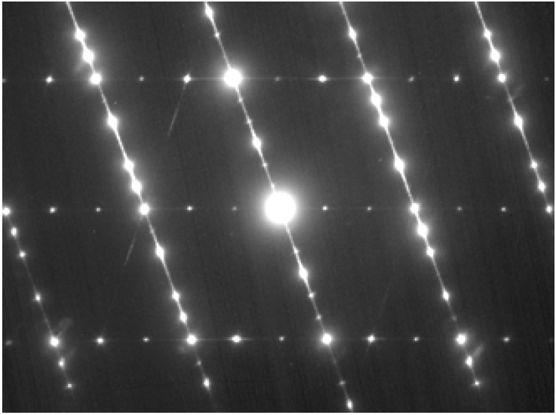
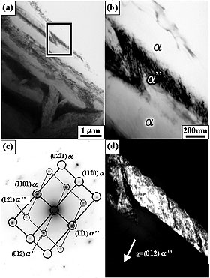
Selected Area Diffraction (SAD)
- Crystallographic structure from particular areas of a sample.
- Used to distinguish and identify crystalline (and amorphous) phases in a material.
SAD pattern:10-10 zone axis pattern
of a hexagonal GaN/cubic GaN
heterostructure
The objective lens forms a diffraction pattern in the back focal plane with electrons scattered by the sample and combines them to generate an image in the image plane (1. intermediate image). Thus, diffraction pattern and image are simultaneously present in the TEM. It depends on the intermediate lens which of them appears in the plane of the second intermediate image and magnified by the projective lens on the viewing screen. Switching from real space (image) to reciprocal space (diffraction pattern) is easily achieved by changing the strength of the intermediate lens.
TEM micrographs taken from
Ti-15Zr-4Nb-4Ta Alloy specimen :
(a) the bright field image,
(b) the magnified image of area,
(c) the selected area diffraction pattern
(d) the DF image taken with (012)_{α} reflection

Slide 15
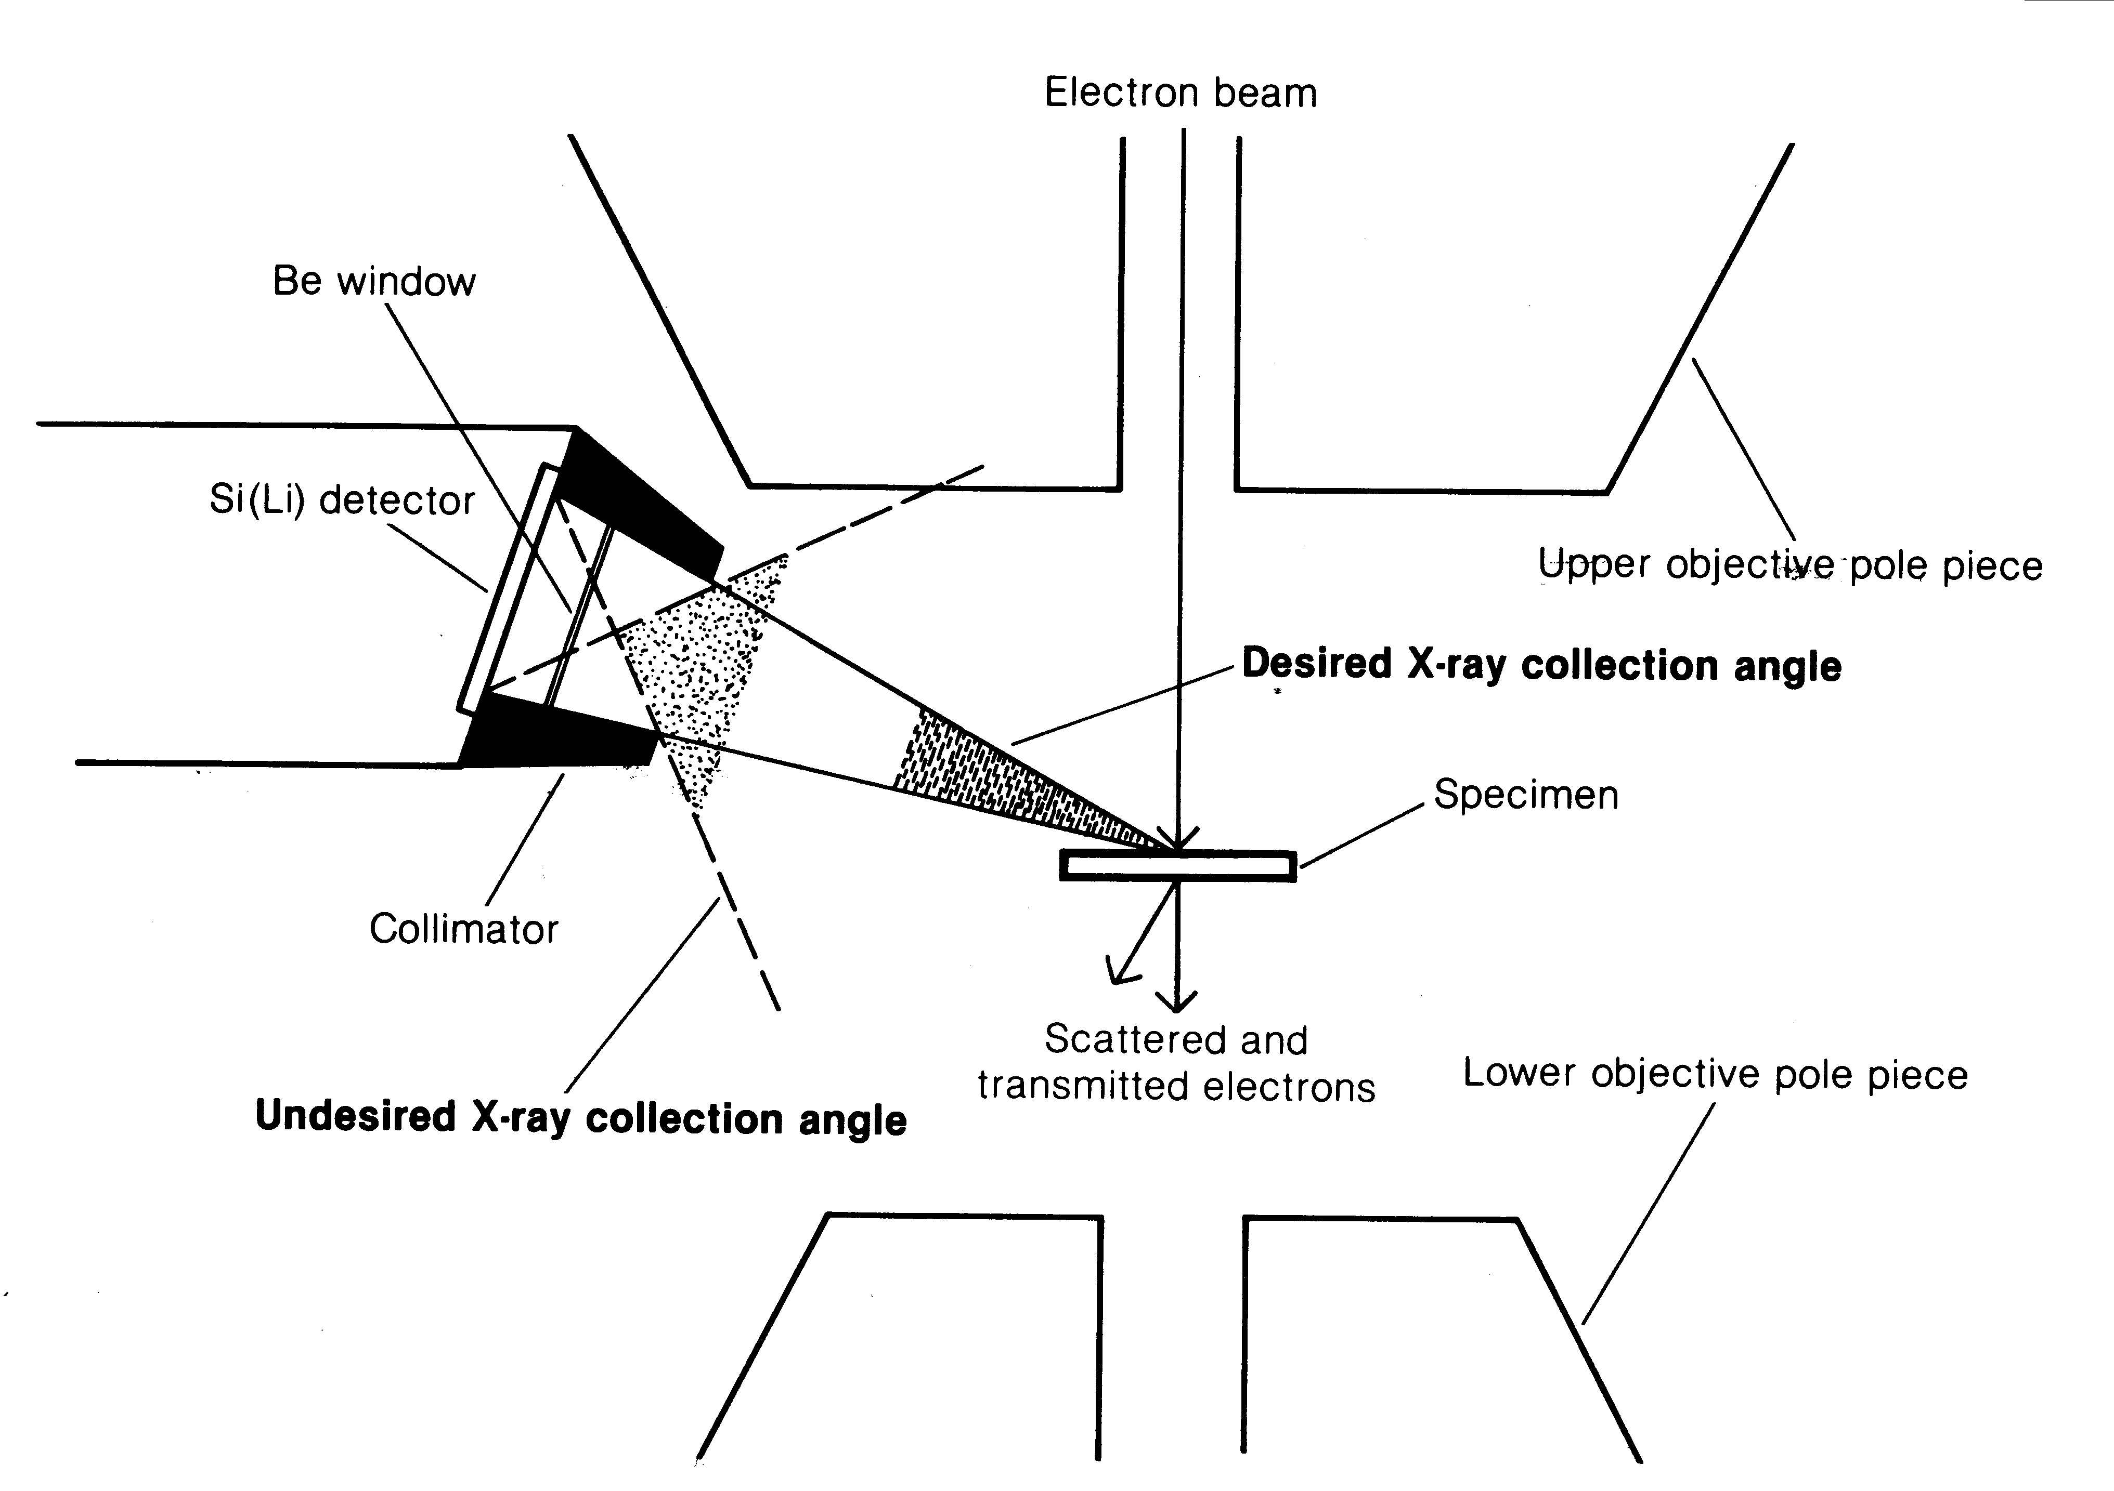
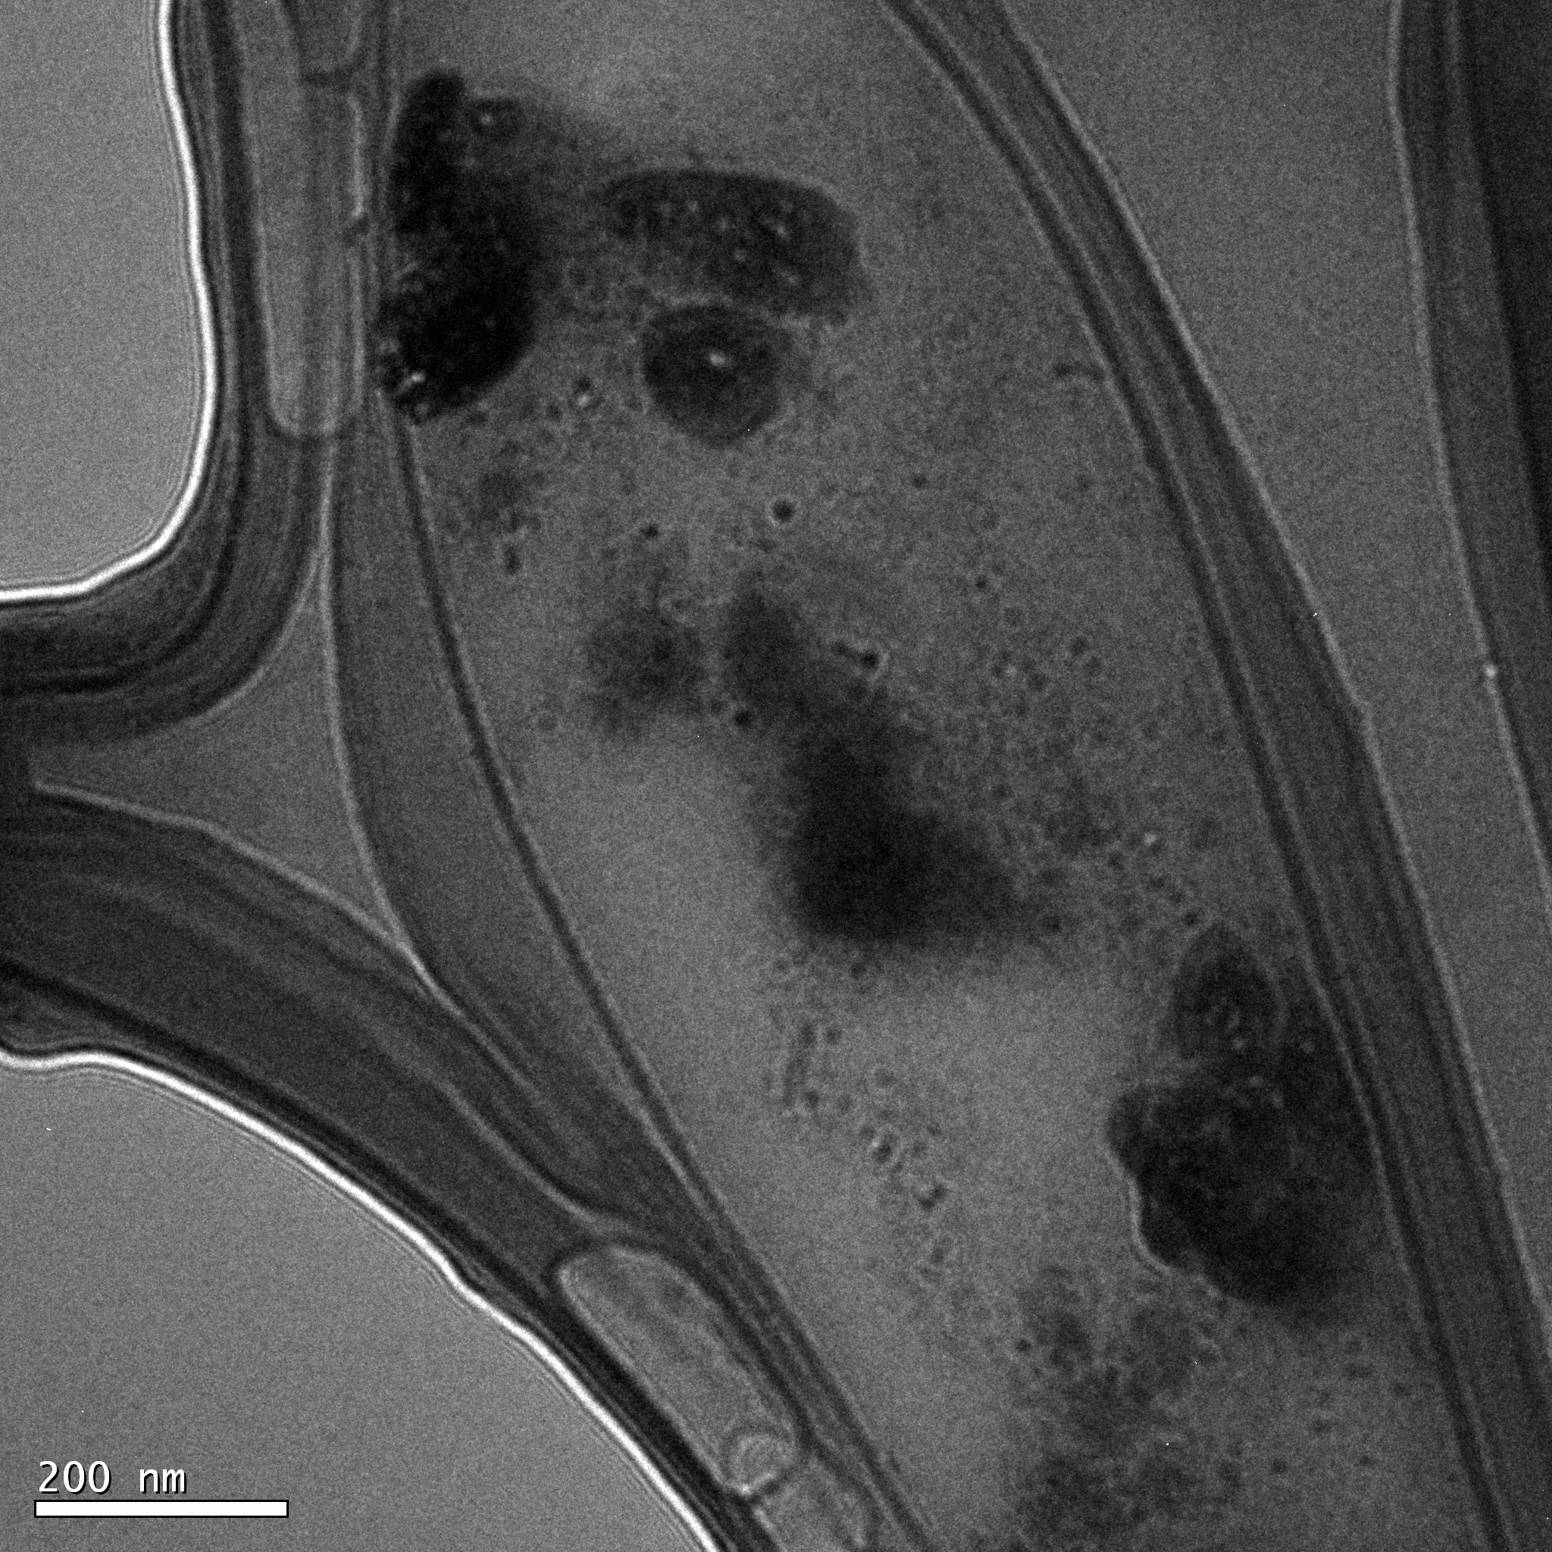
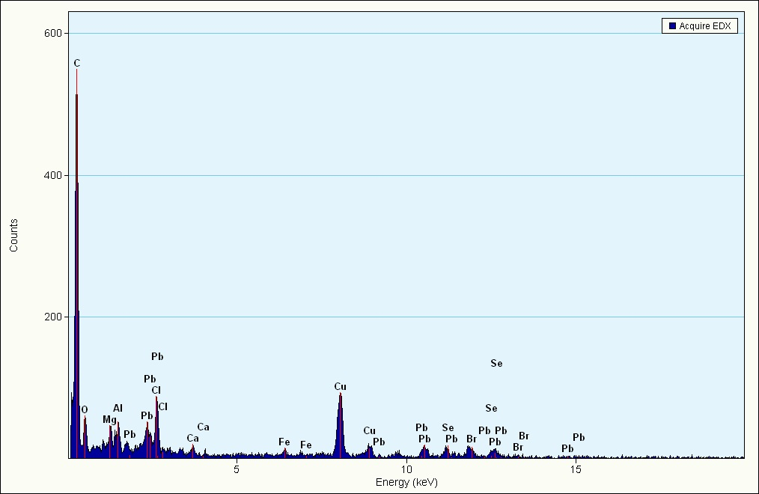
Chemical analysis: EDS
Energy Dispersive X-ray Spectroscopy (EDS)
– EDS makes use of the X-ray spectrum emitted by a solid sample bombarded
with a focused beam of electrons to obtain a localized chemical analysis..
– Spatial resolution on the order of probe size (can be as low as 2-3 Å)
Representative example of ED spectrum obtained
on a ~20 micron grain of titano maghemite from
submarine basalt. EDAX Phoenix EDS system;15 kV.

Slide 16
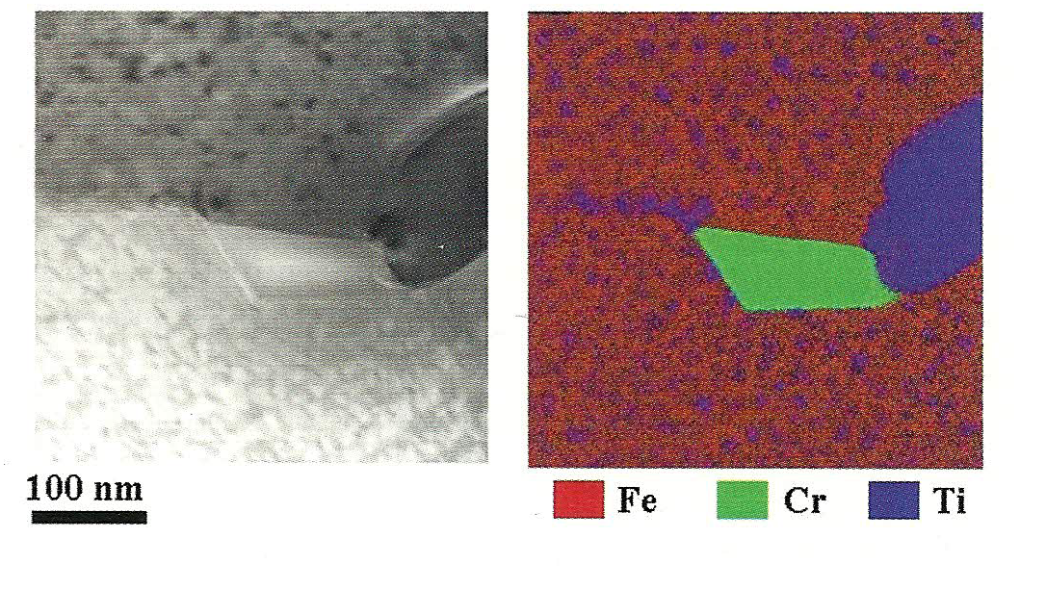
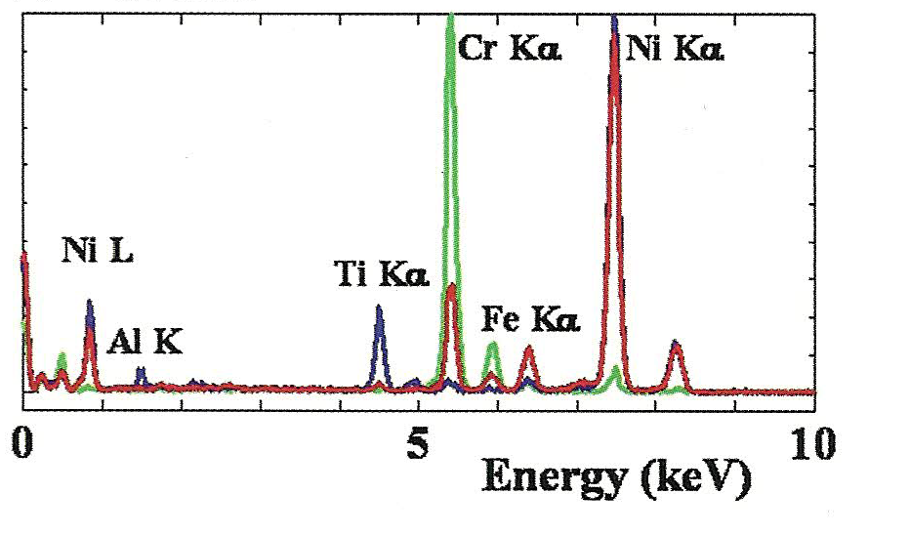
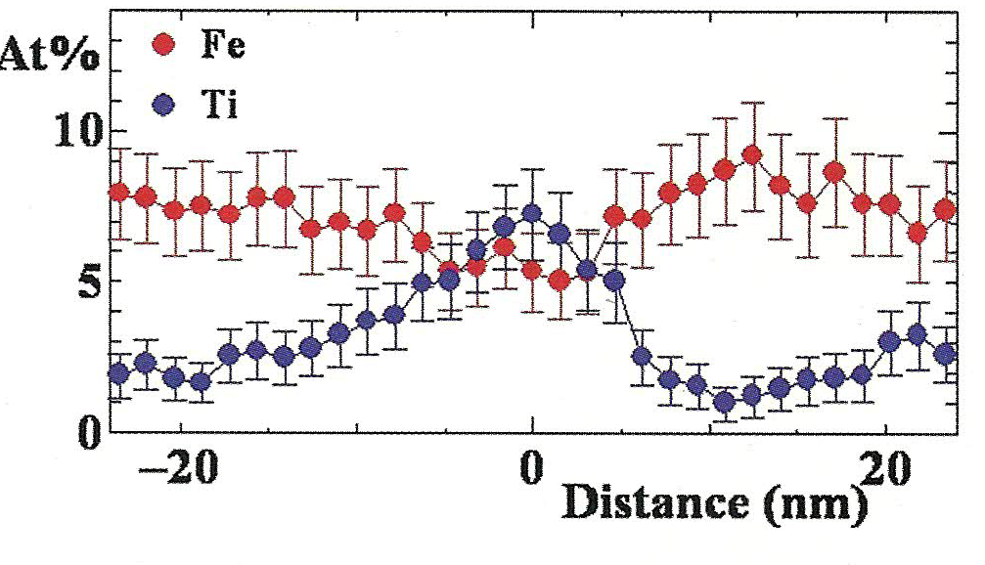
Chemical analysis: EDS
Nickel-based Supper Alloy

Slide 17
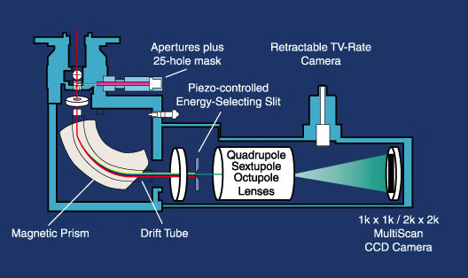
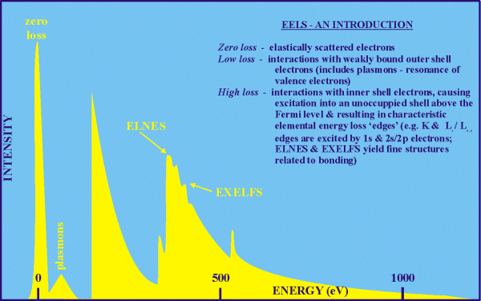
Chemical analysis: EELS
Electron energy loss spectroscopy (EELS)
Transmitted electrons lose energy due to plasmon excitation or excitation of atoms by ejecting inner-shell electrons. A bending magnet disperses electrons of different energies to different positions; a slit selects electrons of desired energy loss.
Allows for the determination of valence, bond length,
nearest neighbor co-ordination and quantification
of atomic species in minerals

Slide 18
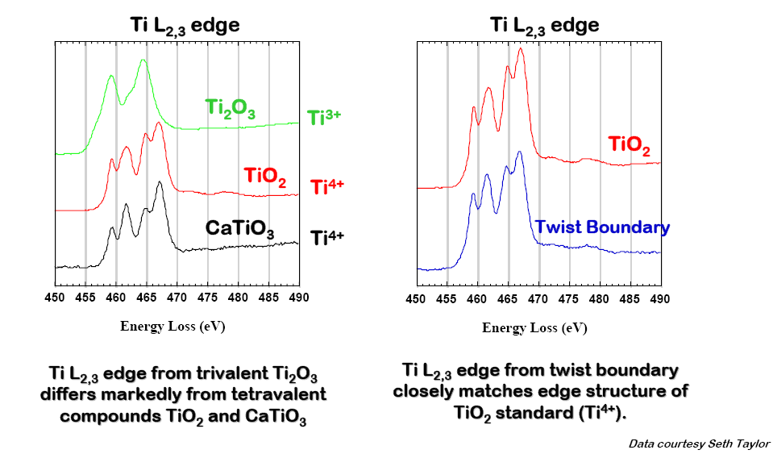
Chemical analysis: EELS
Electron energy loss spectroscopy - Valence determination

Slide 19
TYPICAL STRUCTURAL FEATURES STUDIED by TEM
CRYSTAL STRUCTURE
Single crystal, polycrystalline or amorphous?
Determine exact orientation of crystal(s).
Identify crystal structure (diffraction).
Evaluate crystal quality (lattice imaging).
CRYSTAL DEFECTS
Presence or absence of dislocations, stacking faults,
grain boundaries, twins
Dislocation Burgers vectors; nature of stacking faults
SECOND-PHASE PARTICLES
Size, shape, and distribution; crystallographic orientation
relative to surrounding “matrix”, chemical analysis via
analytical attachments (EDXS, EELS)
NANOPARTICLES, NANOWIRES, NANORODS etc.
Size distribution, crystal structure and orientation, crystal perfection

Slide 20
Conclusions
TEMs comprise a range of different instruments that make use of the properties of electrons, both as particles and as waves.
The TEM generates a tremendous range of signals so we can obtain images, DPs, and several different kinds of spectra from the same small region of the specimen.
If you count up the different imaging, diffraction, and spectroscopic operations that are available in a TEM there are almost 40 different modes of forming an image, DP, or spectrum, each of which produces different information about your specimen.
No other characterization technique comes close to the combination of versatility and quantification that is produced by this remarkable instrument, particularly when you consider the enormous range of magnifications over which the information is obtainable.

