Slide 1
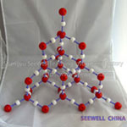


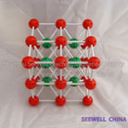
CHAPTER 3: CRYSTAL STRUCTURES
X-Ray Diffraction (XRD)
ISSUES TO ADDRESS...
• Historical retrospective
Henry Bragg Equation
XRD-analysis
How to read XRD patterns?
Exclusions
What questions can be answered by XRD method?

Slide 2
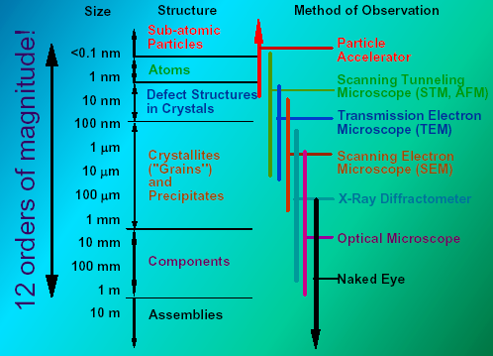
Scale of Structure Organization
Notes:
Please pay attention to different methods of structure observation and investigation
The nano-level is studied by Scanning Tunneling and Transmission Electron Microscopy
While crystalline structure by X-ray diffraction technique
Finally microstructure can be investigated by Scanning electron Microscopy.
All these apparatus we do have at our University and if as a senior you decided to pursue additional
Material Science degree you will use these advanced techniques.
The electron cloud associated with metal atoms at a surface extends a very small distance above the surface. When a very sharp tip--in practice, a needle which has been treated so that a single atom projects from its end--is brought sufficiently close to such a surface, there is a strong interaction between the electron cloud on the surface and that of the tip atom, and an electric tunneling current flows when a small voltage is applied. At a separation of a few atomic diameters, the tunneling current rapidly increases as the distance between the tip and the surface decreases. This rapid change of tunneling current with distance results in atomic resolution if the tip is scanned over the surface to produce an image.

Slide 3
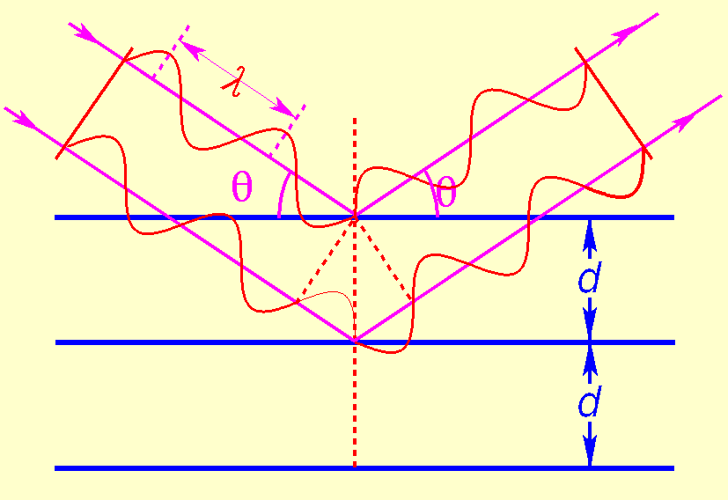
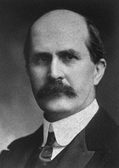
Sir William Henry Bragg:
William Henry and William Lawrence Bragg
(father and son) found a simple interpretation
of von Laue’s experiment.
They assume that each crystal plane reflects radiation as a mirror and analyze this situation for cases of constructive and destructive interference.
Bragg’s law
Noble prize 1915!
Conditions for reflection:
The most important thing in science is not so much to obtain new facts as to discover new ways of thinking about them.

Slide 4
Derivation of Bragg’s law
θ
θ
d_{hkl}
θ
x
Path difference Δ= 2x => phase shift
Constructive interference if Δ=nλ
This gives the criterion for constructive interference:
Bragg’s law tells you at which angle θ_{B} to expect maximum diffracted intensity for a particular family of crystal planes.
For large crystals, all other angles give zero intensity.

Slide 5
The powder diffractometers typically use the Bragg-Brentano geometry
Detector
X-ray tube
ω
θ
2θ
The incident angle, ω, is defined between the X-ray source and the sample.
The diffracted angle, 2θ, is defined between the incident beam and the detector angle.
The incident angle ω is always ½ of the detector angle 2θ .
In a θ:2θ instrument (e.g. Rigaku RU300), the tube is fixed, the sample rotates at θ °/min and the detector rotates at 2θ °/min.
In a θ:θ instrument (e.g. PANalytical X’Pert Pro), the sample is fixed and the tube rotates at a rate -θ °/min and the detector rotates at a rate of θ °/min.

Slide 6
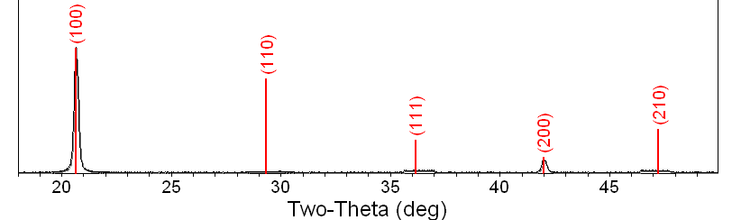
A single crystal specimen in a Bragg-Brentano diffractometer would produce only one family of peaks in the diffraction pattern.
2θ
At 20.6 °2θ, Bragg’s law fulfilled for the (100) planes, producing a diffraction peak.
The (110) planes would diffract at 29.3 °2θ; however, they are not properly aligned to produce a diffraction peak (the perpendicular to those planes does not bisect the incident and diffracted beams). Only background is observed.
The (200) planes are parallel to the (100) planes. Therefore, they also diffract for this crystal. Since d₂₀₀ is ½ d₁₀₀, they appear at 42 °2θ.

Slide 7
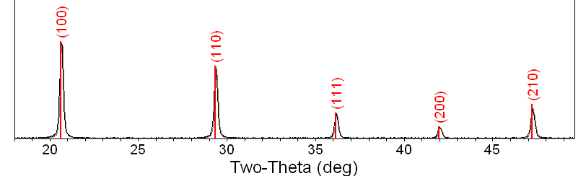
A polycrystalline sample should contain thousands of crystallites. Therefore, all possible diffraction peaks should be observed.
2θ
2θ
2θ
For every set of planes, there will be a small percentage of crystallites that are properly oriented to diffract (the plane perpendicular bisects the incident and diffracted beams).
Basic assumptions of powder diffraction are that for every set of planes there is an equal number of crystallites that will diffract and that there is a statistically relevant number of crystallites, not just one or two.

Slide 8
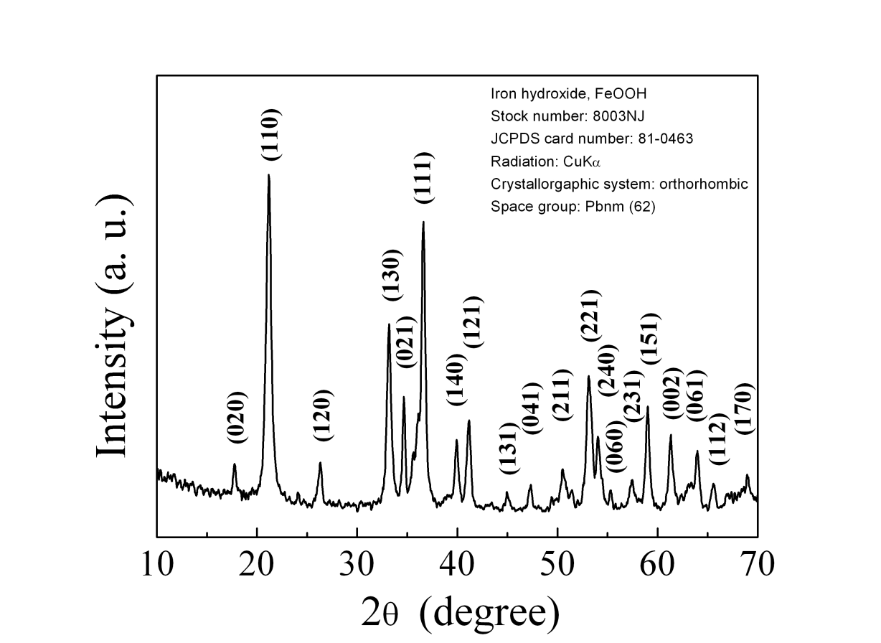
Example: Diffraction Patterns
Each peak represents the solution to Bragg’s law for known radiation wavelength (λ = 0.154nm)
The unique relationship between such patterns and crystal structures provide a powerful tool for identification of the phase composition of powders and polycrystalline materials.

Slide 9
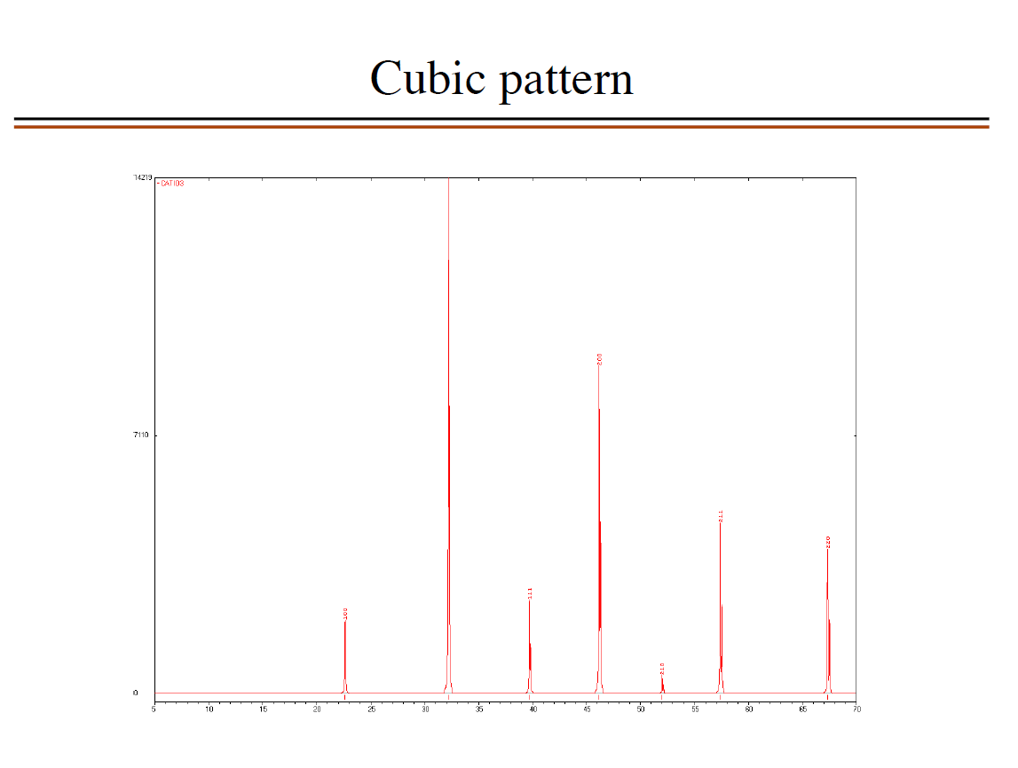

Slide 10
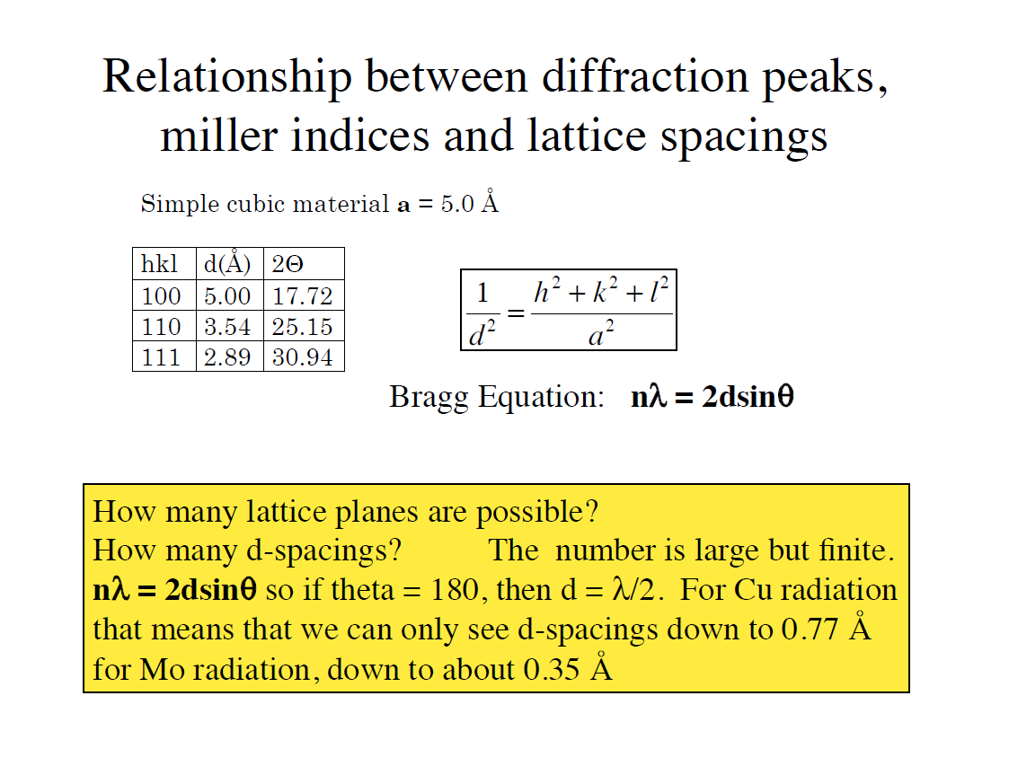

Slide 11
Basis and Bravais Structure Factor Terms
The following simple table giving the integer values of F_{BR} for the different types of centering translations. Keep in mind that these are valid for any crystal system.

Slide 12
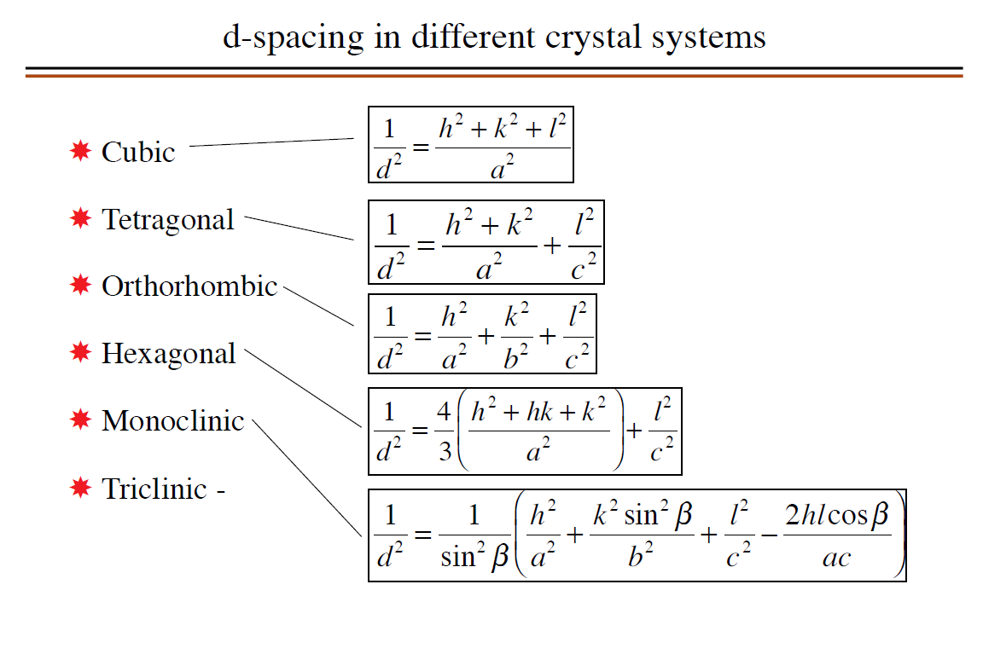

Slide 13
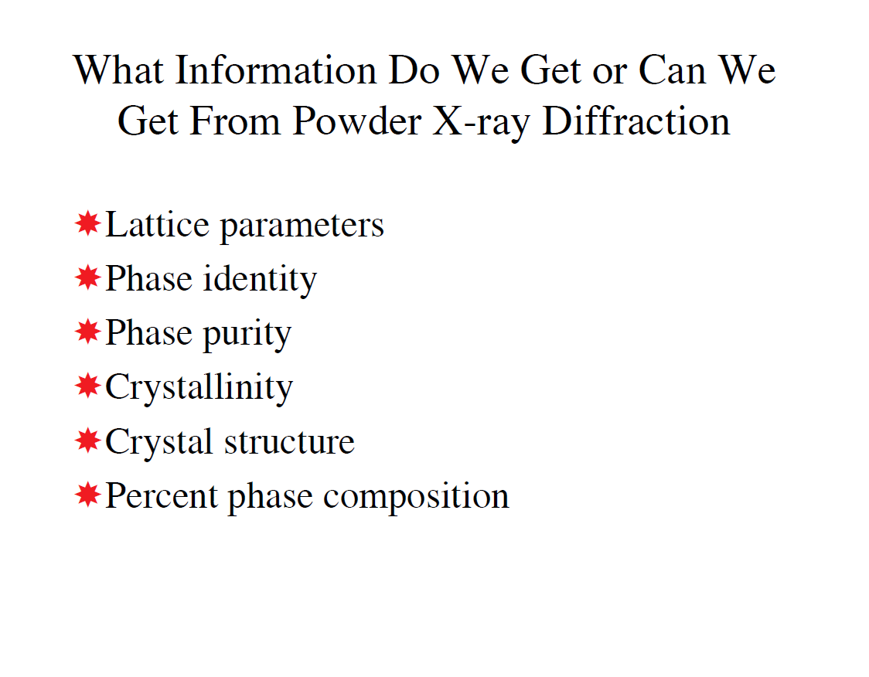

Slide 14
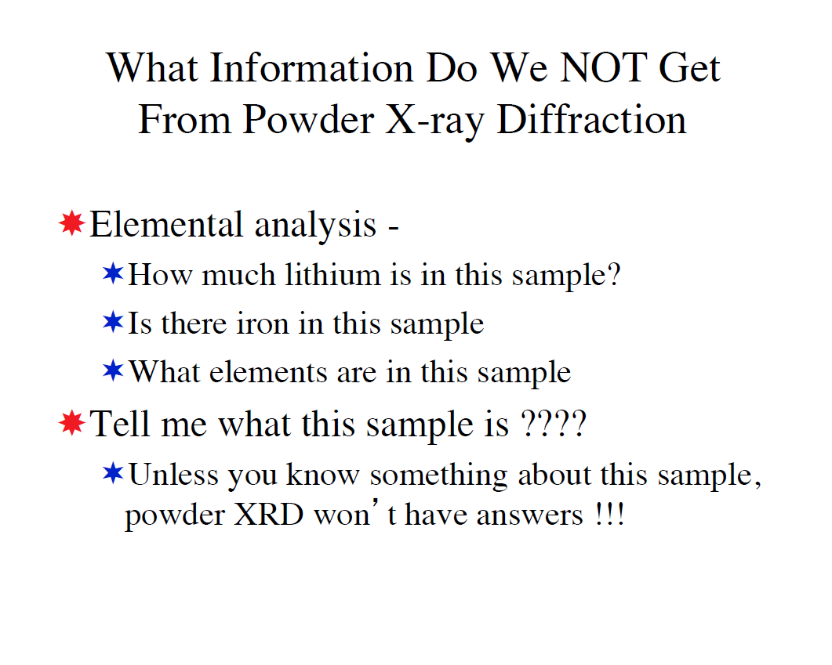

Slide 15
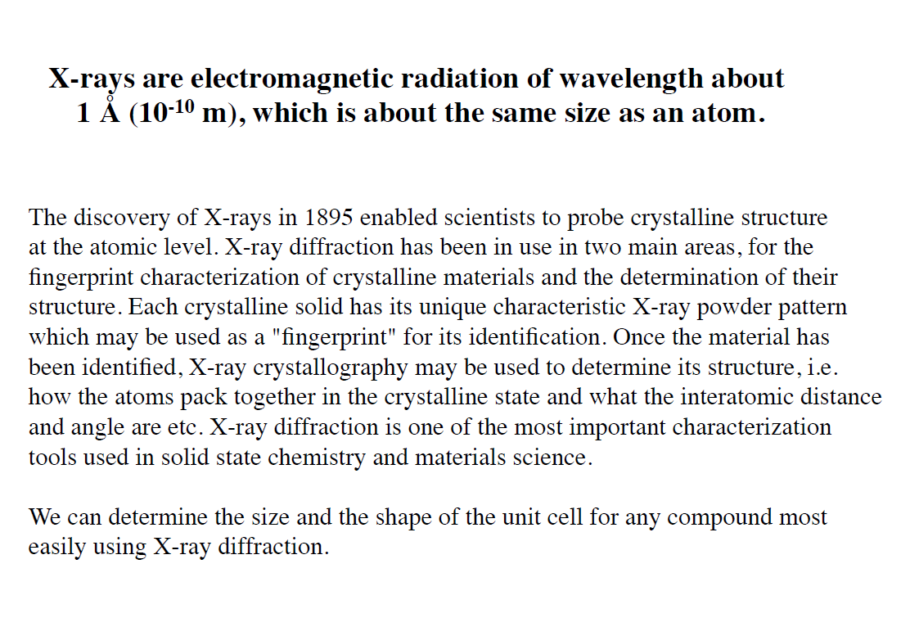
Summary

