Slide 1
Introduction to Scalable Programming using Makeflow
Ben Tovar and Dinesh Rajan
University of Notre Dame
October 9, 2013

Slide 2
The Cooperative Computing Lab
We collaborate with people who have large scale computing problems in science, engineering, and other fields.
We operate computer systems on the O(10,000) cores: clusters, clouds, grids.
We conduct computer science research in the context of real people and problems.
We develop open source software for large scale distributed computing.
http://www.nd.edu/~ccl

Slide 3
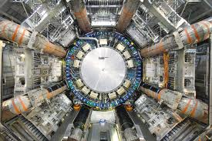
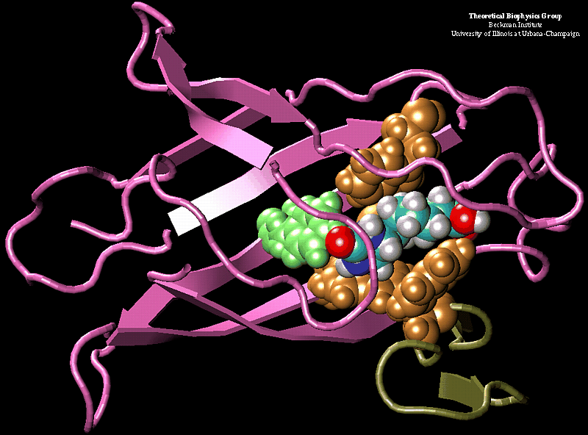
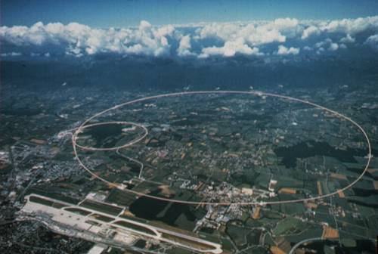
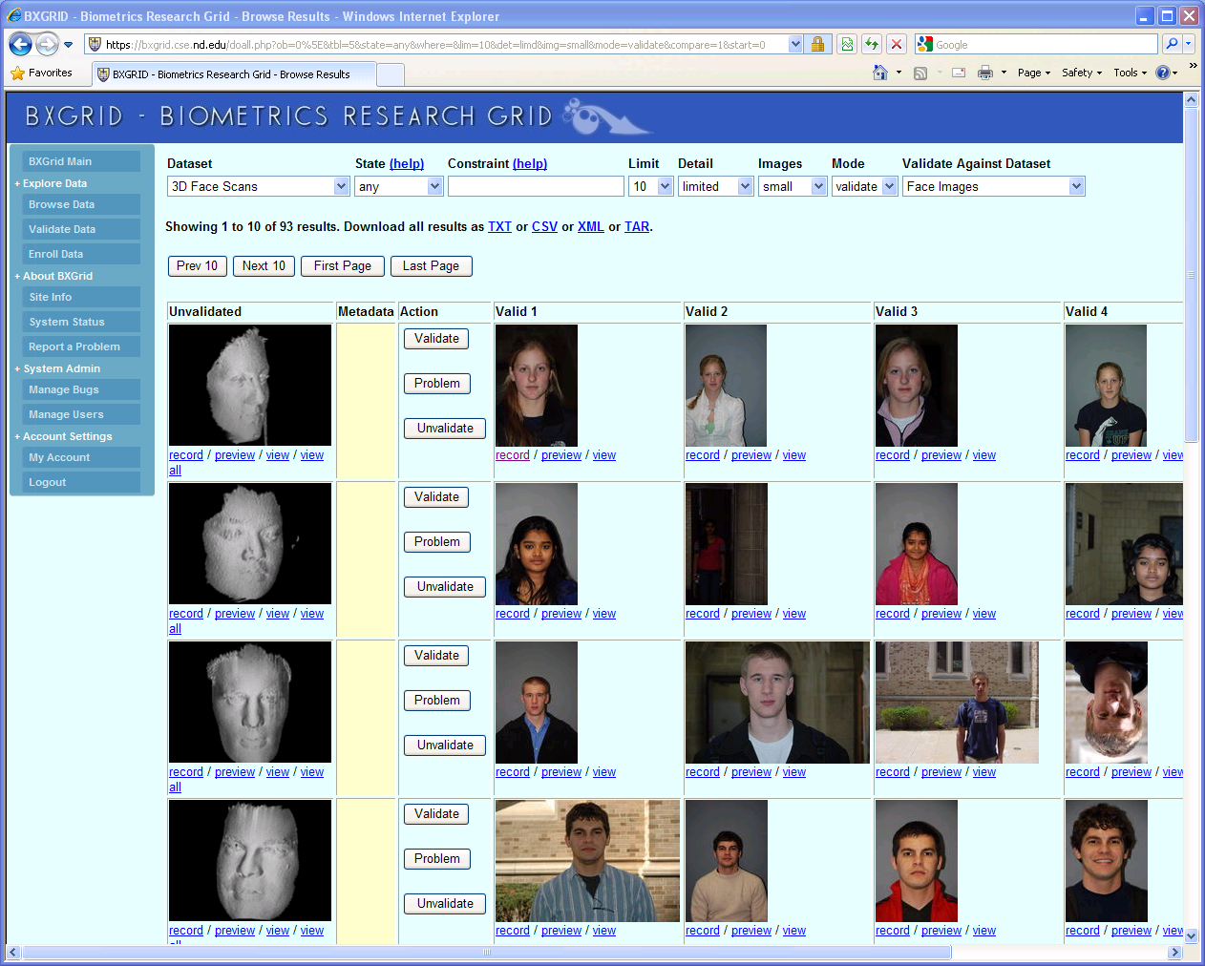
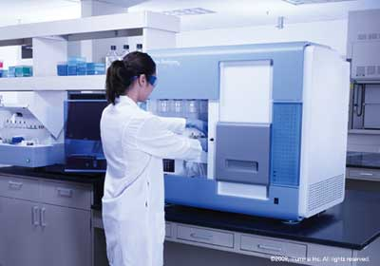

Science Depends on Computing!
AGTCCGTACGATGCTATTAGCGAGCGTGA…

Slide 4
The Good News:
Computing is Plentiful!

Slide 5




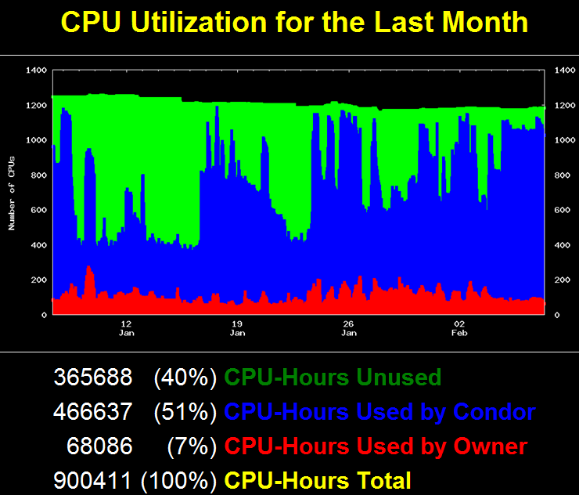





Slide 6


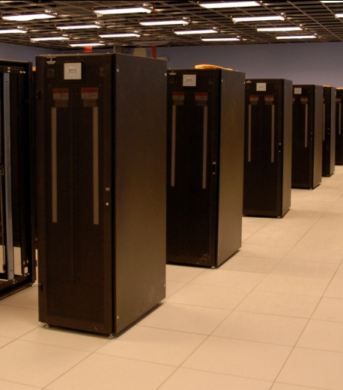
I have a standard, debugged, trusted application that runs on my laptop.
A toy problem completes in one hour.
A real problem will take a month (I think.)
Can I get a single result faster?
Can I get more results in the same time?
Last year,
I heard about
this grid thing.
This year,
I heard about
this cloud thing.
What do I do next?

Slide 7

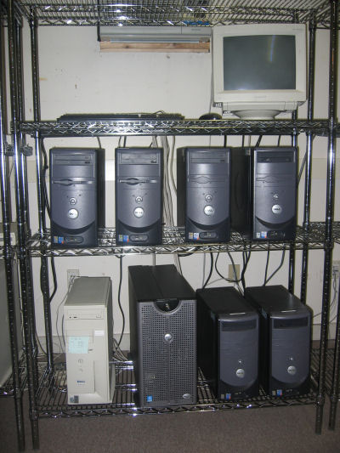

What people want.
What people get.

Slide 8
Should I port my program to MPI or Hadoop?
Learn C / Java
Learn MPI / Hadoop
Re-architect
Re-write
Re-test
Re-debug
Re-certify

Slide 9
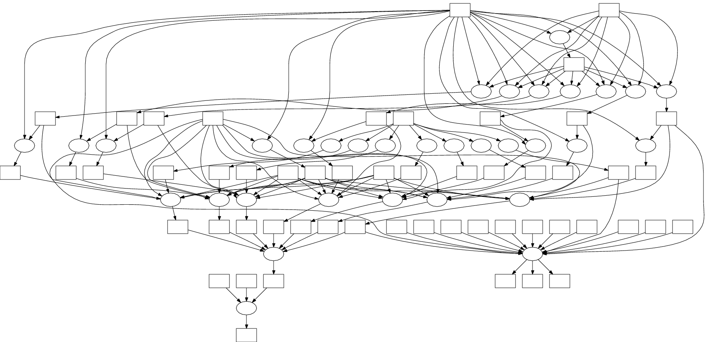
What if my application looks like this?

Slide 10
I can get as many machines on the cloud as I want!
How do I organize my application to run on those machines?

Slide 11
Our Philosophy:
Harness all the resources that are available: desktops, clusters, clouds, and grids.
Make it easy to scale up from one desktop to national scale infrastructure.
Provide familiar interfaces that make it easy to connect existing apps together.
Allow portability across operating systems, storage systems, middleware…
Make simple things easy, and complex things possible.
No special privileges required.

Slide 12
A Quick Tour of the CCTools
Open source, GNU General Public License.
Compiles in 1-2 minutes, installs in $HOME.
Runs on Linux, Solaris, MacOS, Cygwin, FreeBSD, …
Interoperates with many distributed computing systems.
  Condor, SGE, Torque, Globus, iRODS, Hadoop…
Components:
  Makeflow – A portable workflow manager.
  Work Queue – A lightweight distributed execution system.
  All-Pairs / Wavefront / SAND – Specialized execution engines.
  Parrot – A personal user-level virtual file system.
  Chirp – A user-level distributed filesystem.
http://www.nd.edu/~ccl/software

Slide 13
Makeflow:
A Portable Workflow System

Slide 14
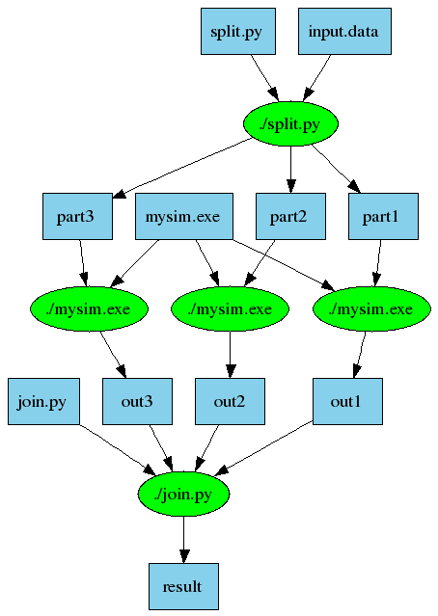
An Old Idea: Makefiles
part1 part2 part3: input.data split.py
./split.py input.data
out1: part1 mysim.exe
./mysim.exe part1 >out1
out2: part2 mysim.exe
./mysim.exe part2 >out2
out3: part3 mysim.exe
./mysim.exe part3 >out3
result: out1 out2 out3 join.py
./join.py out1 out2 out3 > result

Slide 15
Makeflow = Make + Workflow
Provides portability across batch systems.
Enable parallelism (but not too much!)
Fault tolerance at multiple scales.
Data and resource management.
Makeflow
Local
Condor
SGE
Work
Queue
http://www.nd.edu/~ccl/software/makeflow

Slide 16
Makeflow Syntax
[output files] : [input files]
[command to run]
One Rule
calib.dat
sim.exe
out.txt
in.dat
sim.exe in.dat –p 50 > out.txt
out.txt : in.dat
sim.exe –p 50 in.data > out.txt
out.txt : in.dat calib.dat sim.exe
sim.exe –p 50 in.data > out.txt
Not Quite Right!

Slide 17
You must state all the files needed by the command.

Slide 18
sims.mf
out.10 : in.dat calib.dat sim.exe
sim.exe –p 10 in.data > out.10
out.20 : in.dat calib.dat sim.exe
sim.exe –p 20 in.data > out.20
out.30 : in.dat calib.dat sim.exe
sim.exe –p 30 in.data > out.30

Slide 19
Makeflow + Batch System
CRC
SGE
Cluster
Private
Cluster
Makefile
makeflow –T sge
makeflow –T wq
Makeflow
makeflow –T wq
Campus
Condor
Pool
Public
Cloud
Provider
makeflow –T condor
Local Files and Programs

Slide 20
Drivers
Local
Condor
SGE
Batch
Hadoop
WorkQueue
Torque
MPI-Queue
XGrid
Moab

Slide 21
How to run a Makeflow
Run a workflow locally (multicore?)
  makeflow -T local sims.mf
Clean up the workflow outputs:
  makeflow –c sims.mf
Run the workflow on SGE:
  makeflow –T sge sims.mf

Slide 22
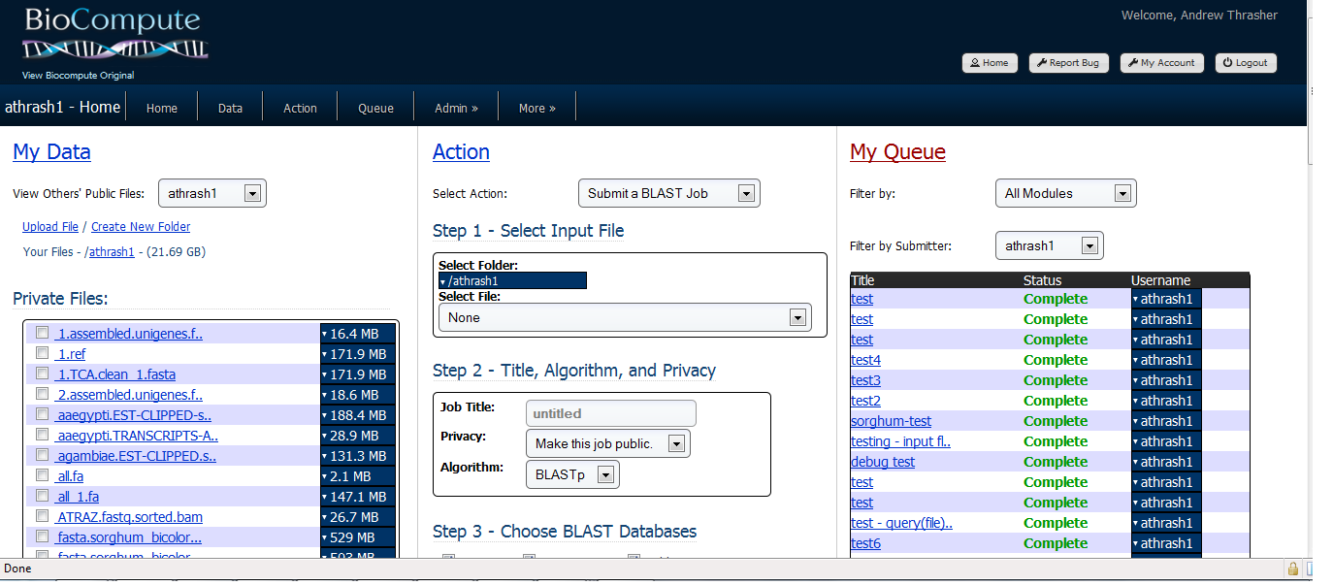

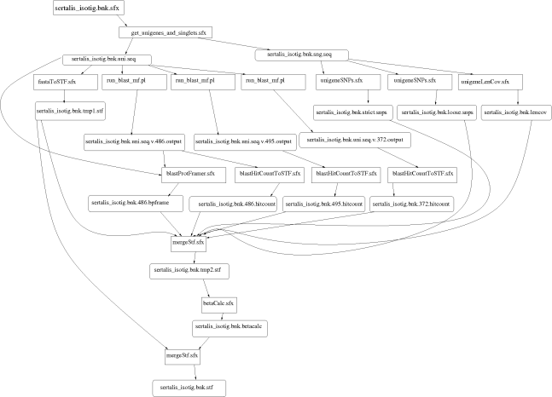
Example: Biocompute Portal
BLAST
SSAHA
SHRIMP
EST
MAKER
…
Progress
Bar
Generate Makefile
Transaction Log
Condor
Pool
Update
Status
Run
Workflow
Make
flow
Submit
Tasks

Slide 23
Makeflow + Work Queue

Slide 24
Makeflow + Batch System
FutureGrid
Torque
Cluster
Private
Cluster
Makefile
makeflow –T torque
???
Makeflow
???
Campus
Condor
Pool
Public
Cloud
Provider
makeflow –T condor
Local Files and Programs

Slide 25
Makeflow + Work Queue
torque_submit_workers
FutureGrid
Torque
Cluster
Private
Cluster
Makefile
W
W
Thousands of Workers in a
Personal Cloud
W
submit
tasks
W
W
W
Makeflow
Campus
Condor
Pool
Public
Cloud
Provider
W
W
W
W
W
W
W
Local Files and Programs
condor_submit_workers
ssh

Slide 26
Advantages of Work Queue
Harness multiple resources simultaneously.
Hold on to cluster nodes to execute multiple tasks rapidly. (ms/task instead of min/task)
Scale resources up and down as needed.
Better management of data, with local caching for data intensive tasks.
Matching of tasks to nodes with data.

Slide 27
Makeflow and Work Queue
To start the Makeflow
% makeflow –T wq sims.mf
Could not create work_queue on port 9123.
% makeflow –T wq –p 0 sims.mf
Listening for workers on port 8374…
To start one worker:
% work_queue_worker newcell.crc.nd.edu 8374

Slide 28
Start Workers Everywhere!
Submit workers to SGE:
sge_submit_workers newcell.crc.nd.edu 8374 25
Submit workers to Condor:
condor_submit_workers newcell.crc.nd.edu 8374 25

Slide 29
Keeping track of port numbers gets old fast…

Slide 30
Project Names
makeflow …
–a –N myproject
work_queue_worker
–M myproject
Makeflow
(port 4057)
connect to
newcell:4057
Worker
advertise
query
Catalog
work_queue_status
query
“myproject”
is at newcell:4057

Slide 31
Project Names
Start Makeflow with a project name:
% makeflow –T wq –p 0 –a –N nd-class sims.mf
Listening for workers on port XYZ…
Start one worker:
% work_queue_worker -a -M nd-class
Start many workers:
% sge_submit_workers –a –M nd-class 5

Slide 32
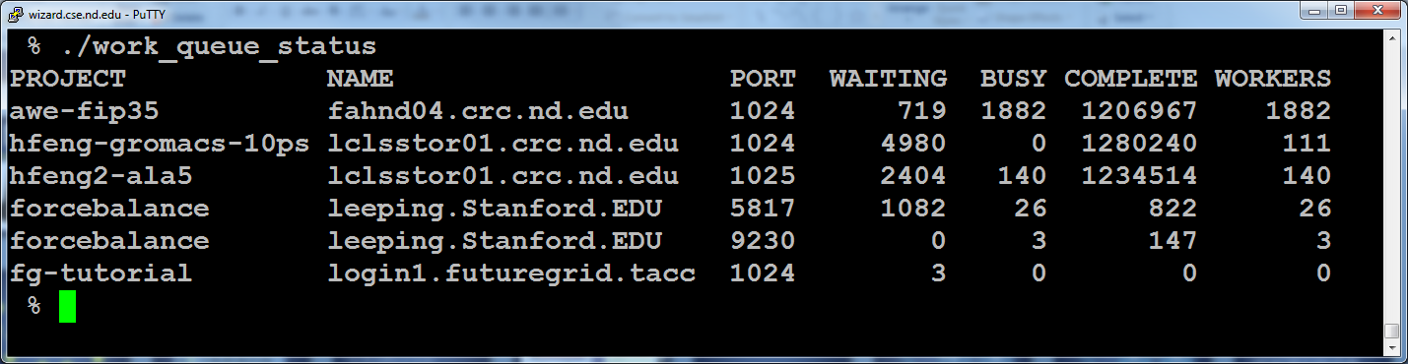
work_queue_status

Slide 33
Resilience and Fault Tolerance
MF +WQ is fault tolerant in many different ways:
  If Makeflow crashes (or is killed) at any point, it will recover by reading the transaction log and continue where it left off.
  Makeflow keeps statistics on both network and task performance, so that excessively bad workers are avoided.
  If a worker crashes, the master will detect the failure and restart the task elsewhere.
  Workers can be added and removed at any time during the execution of the workflow.
  Multiple masters with the same project name can be added and removed while the workers remain.
  If the worker sits idle for too long (default 15m) it will exit, so as not to hold resources idle.

Slide 34
Other parts of the CCTools…

Slide 35
Parrot Virtual File System
Ordinary
Appl
Filesystem Interface: open/read/write/close
Parrot Virtual File System
Local
HTTP
CVMFS
Chirp
iRODS
Web Servers
iRODS
Server
CVMFS
Network
Chirp
Server

Slide 36
Example of Using Parrot
% parrot_run bash
[short pause]
% cat /http/www.google.com/index.html
% ls –la /anonftp/ftp.gnu.org
% cd /irods/data.iplantcollaborative.org
% cd iplant/home
% ls –la
collections nirav nirav_test1 rogerab shared

Slide 37
All-Pairs and Wavefront
Specialized tools for very specific workflow patterns.
allpairs A.list B.list F.exe
wavefront M.data F.exe
A1
A2
A3
M[0,4]
M[2,4]
M[3,4]
M[4,4]
x
F
d
y
M[0,3]
M[3,2]
M[4,3]
B1
F
F
F
x
F
x
F
d
y
d
y
M[0,2]
x
M[4,2]
x
F
x
F
F
B2
F
F
F
d
y
d
y
d
y
M[0,1]
x
F
x
F
x
F
x
F
B3
F
F
F
d
y
d
y
d
y
d
y
M[0,0]
M[1,0]
M[2,0]
M[3,0]
M[4,0]

Slide 38
Example of Using All-Pairs
% compare.exe A1 B1
similarity 25.3% at position 65
% allpairs_master A.list B.list compare.exe
A1 B1 similarity 25.3% at position 65
A2 B1 similarity 85.6% at position 10
A3 B1 similarity 98.4% at position 48
A1 B2 similarity 31.3% at position 91
…

Slide 39
Elastic Application Stack
All-Pairs
Wavefront
Makeflow
Custom
Apps
Work Queue Library
Thousands of Workers in a
Personal Cloud
Public
Cloud
Provider
Shared
SGE
Cluster
Campus
Condor
Pool
Private
Cluster
W
W
Wv
W
W
W
W
W
W

Slide 40
Hands-on
Tutorial: Basic examples of how to use Makeflow.

Slide 41
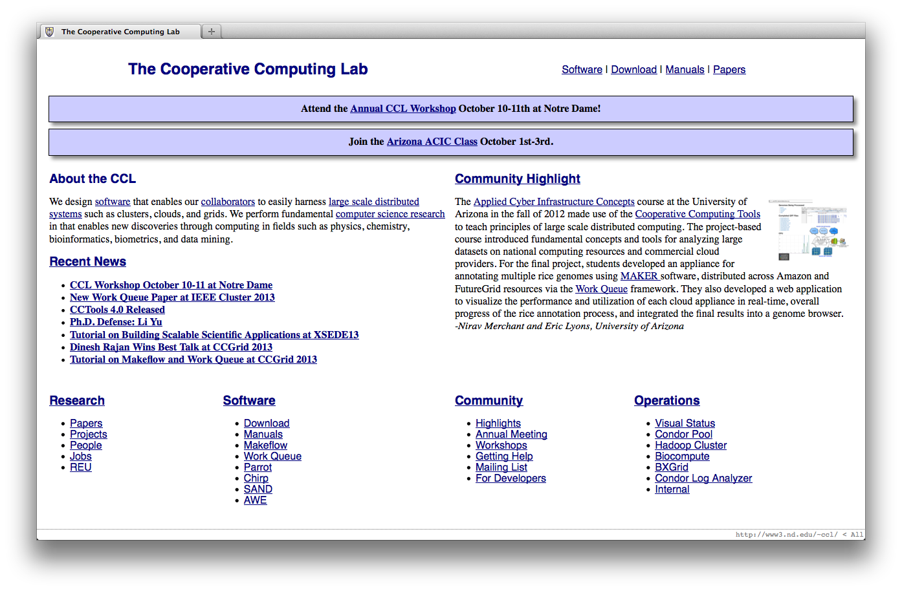
Go to: http://nd.edu/~ccl
Click “Annual CCL Workshop”

Slide 42
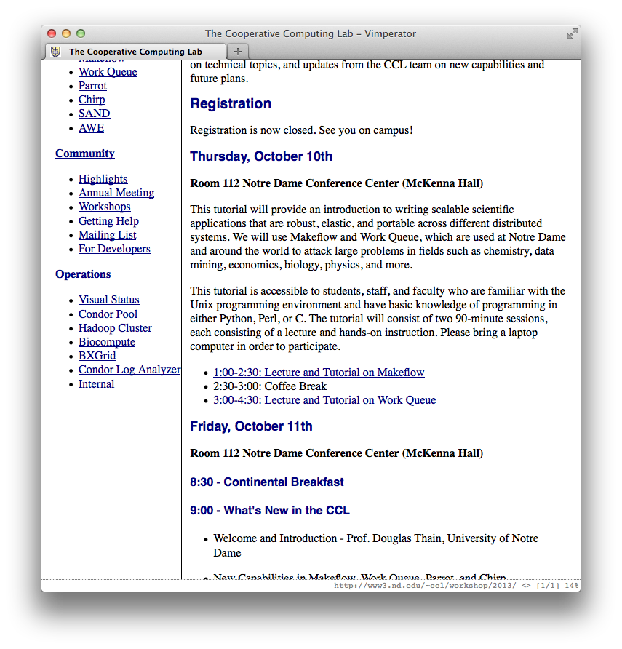
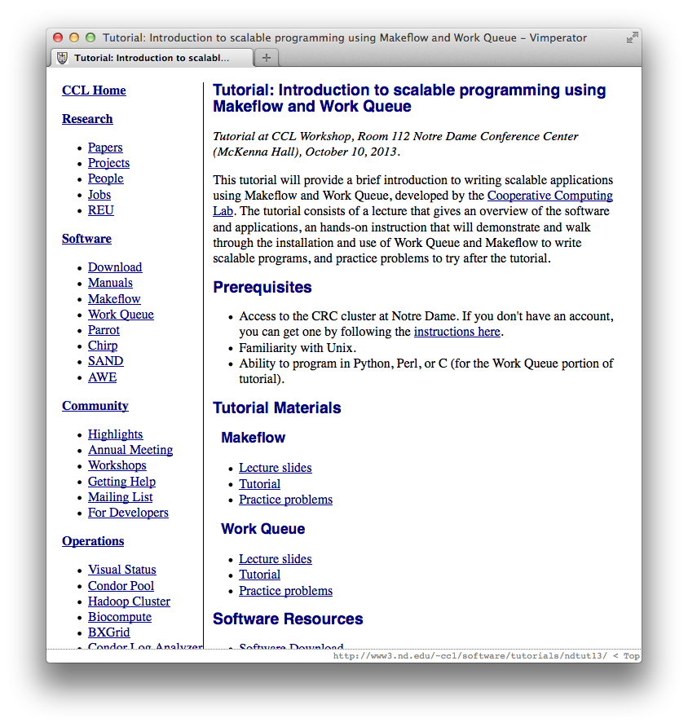
Click “Lecture and Tutorial on Makeflow”
Click “Tutorial” on Makeflow Section

Slide 43
Practice Problems
http://nd.edu/~ccl/software/tutorials/ndtut13/mf-hw.php
Write a Makeflow to check if "Shakespeare speak" still exists
Launch the makeflow on both your laptop and SGE
Consider ways you might use Makeflow for your research

