Slide 1
Introduction to Scalable Programming using Work Queue
Dinesh Rajan and Ben Tovar
University of Notre Dame
October 10, 2013

Slide 2
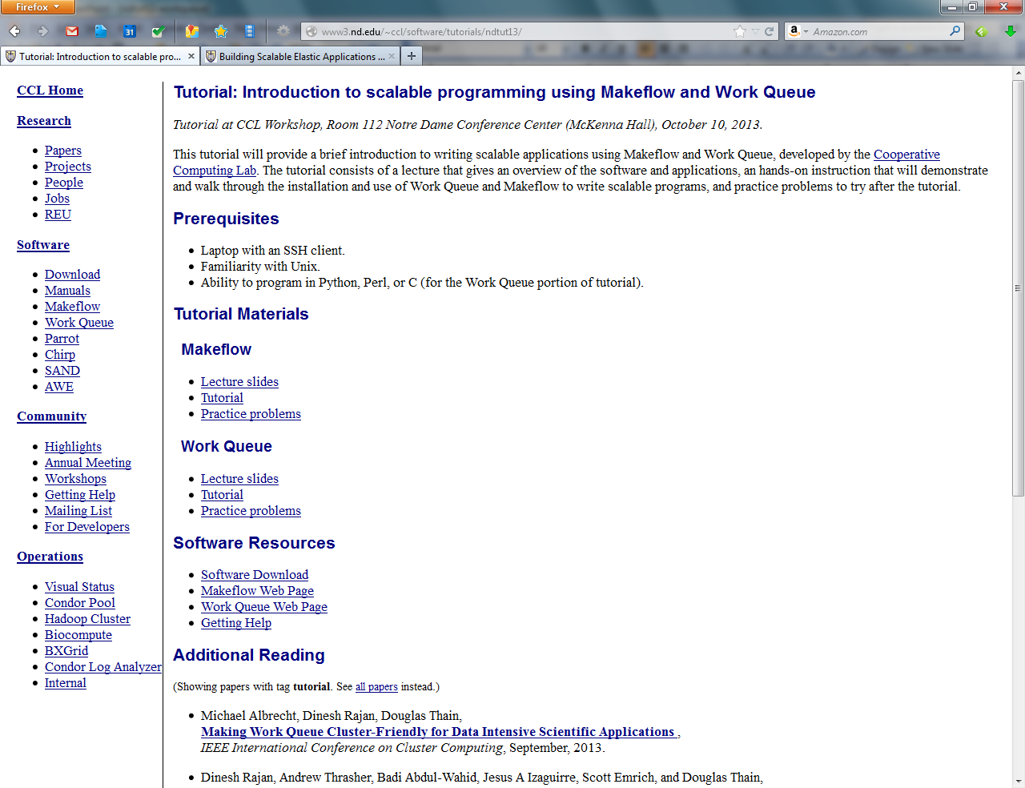
http://nd.edu/~ccl/software/tutorials/ndtut13

Slide 3
Recap: Makeflow

Slide 4
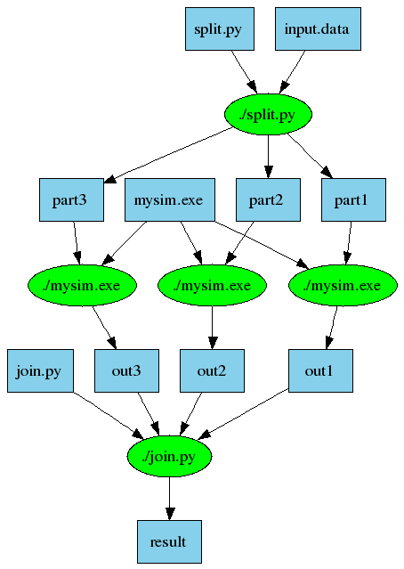
An Old Idea: Makefiles
part1 part2 part3: input.data split.py
./split.py input.data
out1: part1 mysim.exe
./mysim.exe part1 > out1
out2: part2 mysim.exe
./mysim.exe part2 > out2
out3: part3 mysim.exe
./mysim.exe part3 > out3
result: out1 out2 out3 join.py
./join.py out1 out2 out3 > result
4

Slide 5
Makeflow = Make + Workflow
Provides portability across batch systems.
Enable parallelism (but not too much!)
Fault tolerance at multiple scales.
Data and resource management.
Makeflow
Local
Condor
Torque
Work
Queue
http://www.nd.edu/~ccl/software/makeflow
5

Slide 6
Makeflow + Work Queue
torque_submit_workers
FutureGrid
Torque
Cluster
Private
Cluster
Makefile
W
W
Thousands of Workers in a
Personal Cloud
W
submit
tasks
W
W
W
Makeflow
Campus
Condor
Pool
Public
Cloud
Provider
W
W
W
W
W
W
W
Local Files and Programs
condor_submit_workers
ssh

Slide 7
Makeflow
Great for static workflows!
- Tasks/dependencies are known beforehand
- Directed Acyclic Graphs
Great for file-based workflows!
Input: files, Output: files
What if my workflow isn’t any of the above?

Slide 8
Use Work Queue!
API in:
  Python
  C
  Perl

Slide 9
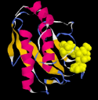
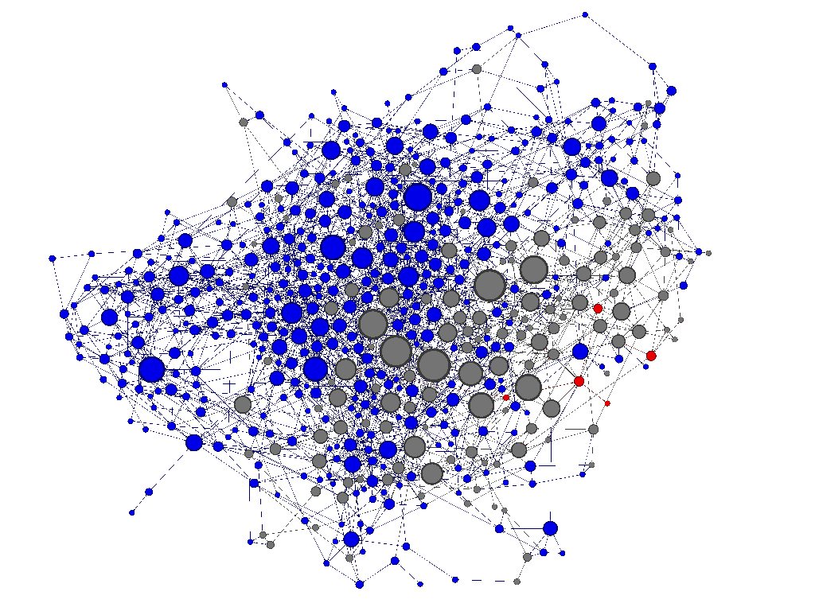
Protein Folding
Proteins fold into a number of distinctive states, each of which affects its function in the organism.
How common is each state?
How does the protein transition between states?
How common are those transitions?
9

Slide 10
Accelerated Weighted Ensemble (AWE)
Create N simulations
Run Simulations
Aggregate output of
simulations
if too many in
one state
Compute distribution of
state transitions
Redistribute states
Enough data collected?
No
Yes
Stop
YES
10

Slide 11
Challenges
~ 1 million simulations
Large scale of resources needed
  Continuously run simulations
  Lots of failures happen at large scales
  Manage resources
    Add and remove resources as needed
    Avoid wastage of resources
11

Slide 12
How did we do it?
Used Work Queue
  Aggregate resources from
  ND CRC, Condor, Amazon EC2, Microsoft Azure
  Use resources as they become available
  Handle failures and errors
  Efficiently use allocated resources
Used ~2500 CPU/GPUs over several weeks!
12

Slide 13
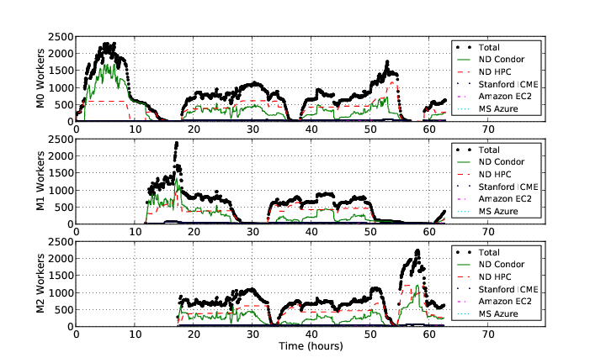
AWE on Clusters, Clouds, and Grids
13

Slide 14
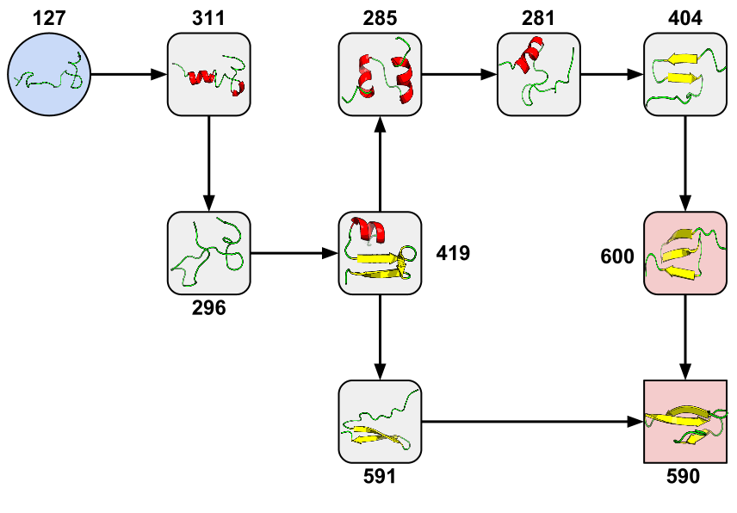
New Pathway Found!
Joint work with computational biologists:
Folding Proteins at 500 ns/hour with Work Queue, eScience 2012
14

Slide 15
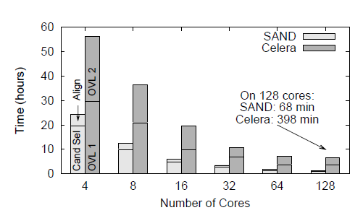
Genome Assembly
Sequence
Data
Modified Celera Assembler
SAND
filter
master
SAND
align
master
Celera
Consensus
W
W
Using Work Queue, we assembled a human genome in 2.5 hours on a collection of clusters, clouds, and grids with a speedup of 952x.
W
W
W
W
W
A Framework for Scalable Genome Assembly on Clusters, Clouds, and Grids,
IEEE Transactions on Parallel and Distributed Systems, 2012

Slide 16
Work Queue System
1000s of workers
dispatched to clusters, clouds, & grids
worker
worker
worker
worker
worker
worker
Work Queue Master Program
(C / Python / Perl)
Work Queue Library
put word-compare.py
put in.txt
exec word-compare in.txt > out.txt
get out.txt
worker
in.txt
word-
compare
out.txt
cache recently used files
16

Slide 17
Work Queue API Outline
use work_queue;
queue = work_queue_create();
while( work to be done ) {
task = work_queue_task_create();
// specify details for the task
work_queue_submit(queue, task);
}
while ( tasks in queue ) {
task = work_queue_wait(queue);
// process the completed task
}
for ( all tasks ) {
T = create_task();
specify_task(T);
submit_task(T);
}
while ( not finished ) {
T = wait_for_task();
//process T’s output
}
17

Slide 18
Run One Task in Python
from work_queue import *
queue = WorkQueue( port = 0 )
task = Task(“sim.exe –p 50 in.dat >out.txt”)
### Missing: Specify files needed by the task.
queue.submit( task )
While not queue.empty():
task = queue.wait(60)

Slide 19
Run One Task in Perl
use work_queue;
$queue = work_queue_create( 0 );
$task = work_queue_task_create(“sim.exe –p 50 in.dat >out.txt”);
### Missing: Specify files needed by the task.
work_queue_submit( $queue, $task );
while(!work_queue_empty($queue)) {
$task = work_queue_wait( $queue, 60 );
if($task) work_queue_task_delete( $task );
}

Slide 20
Run One Task in C
#include “work_queue.h”
struct work_queue *queue;
struct work_queue_task *task;
queue = work_queue_create( 0 );
task = work_queue_task_create(“sim.exe –p 50 in.dat >out.txt”);
/// Missing: Specify files needed by the task.
work_queue_submit( queue, task );
while(!work_queue_empty(queue)) {
task = work_queue_wait( queue, 60 );
if(task) work_queue_task_delete( task );
}

Slide 21
Python: Specify Files for a Task
calib.dat
sim.exe
out.txt
in.dat
sim.exe in.dat –p 50 > out.txt
task.specify_file( “in.dat”, ”in.dat”,
WORK_QUEUE_INPUT, cache = False )
task.specify_file( “calib.dat”, ”calib.dat”,
WORK_QUEUE_INPUT, cache = False )
task.specify_file( “out.txt”, ”out.txt”,
WORK_QUEUE_OUTPUT, cache = False )
task.specify_file( “sim.exe”, ”sim.exe”,
WORK_QUEUE_INPUT, cache = True )

Slide 22
Perl: Specify Files for a Task
calib.dat
sim.exe
out.txt
in.dat
sim.exe in.dat –p 50 > out.txt
work_queue_task_specify_file( $task,“in.dat”,”in.dat”,
$WORK_QUEUE_INPUT, $WORK_QUEUE_NOCACHE );
work_queue_task_specify_file( $task,“calib.dat”,”calib.dat”,
$WORK_QUEUE_INPUT, $WORK_QUEUE_NOCACHE );
work_queue_task_specify_file( $task,“out.txt”,”out.txt”,
$WORK_QUEUE_OUTPUT, $WORK_QUEUE_NOCACHE );
work_queue_task_specify_file( $task,“sim.exe”,”sim.exe”,
$WORK_QUEUE_INPUT, $WORK_QUEUE_CACHE );

Slide 23
C: Specify Files for a Task
calib.dat
sim.exe
out.txt
in.dat
sim.exe in.dat –p 50 > out.txt
work_queue_task_specify_file( task,“in.dat”,”in.dat”,
WORK_QUEUE_INPUT, WORK_QUEUE_NOCACHE );
work_queue_task_specify_file( task,“calib.dat”,”calib.dat”,
WORK_QUEUE_INPUT, WORK_QUEUE_CACHE );
work_queue_task_specify_file( task,“out.txt”,”out.txt”,
WORK_QUEUE_OUTPUT, WORK_QUEUE_NOCACHE );
work_queue_task_specify_file( task,“sim.exe”,”sim.exe”,
WORK_QUEUE_INPUT, WORK_QUEUE_CACHE );

Slide 24
You must state all the files needed by the command.

Slide 25
Running the Work Queue program
Python:
$ python work_queue_example.py
Perl:
  $ perl work_queue_example.pl
C:
$ gcc work_queue_example.c -o work_queue_example
-I~/cctools/include/cctools -L~/cctools/lib -ldttools -lm
$ ./work_queue_example

Slide 26
Start workers for your
Work Queue program
Start one local worker:
work_queue_worker $MASTERHOST $MASTERPORT
Submit (10) workers to SGE:
sge_submit_workers $MASTERHOST $MASTERPORT 10
Submit (10) workers to Condor:
condor_submit_workers $MASTERHOST $MASTERPORT 10
$MASTERHOST = Name of machine where Work Queue program runs. (e.g., opteron.crc.nd.edu)
$MASTERPORT = Port on which Work Queue program is listening. (e.g., 1024)

Slide 27
Harness resources from multiple platforms
torque_submit_workers
FutureGrid
Torque
Cluster
Private
Cluster
W
W
Thousands of Workers in a
Personal Cloud
W
submit
tasks
W
W
W
Work Queue Master
Campus
Condor
Pool
Public
Cloud
Provider
W
W
W
W
W
W
W
Local Files and Programs
condor_submit_workers
ssh

Slide 28
Advantages of Using Work Queue
Harness multiple resources simultaneously.
Hold on to cluster nodes to execute multiple tasks rapidly. (ms/task instead of min/task)
Scale resources up and down as needed.
Better management of data, with local caching for data intensive tasks.
Matching of tasks to nodes with data.

Slide 29
Keeping track of port numbers gets old really fast

Slide 30
Use Project Names
work_queue_worker
-a –N myproject
“myproject”
Work Queue
(port 9037)
connect to
opteron:9037
Worker
advertise
query
Catalog
work_queue_status
query
“myproject”
is at opteron:9037

Slide 31
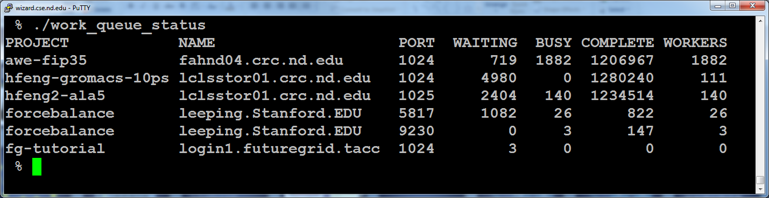
work_queue_status

Slide 32
Specify Project Names in Work Queue
Specify Project Name for Work Queue master:
Python:
q.specify_name (“ccl-tutorial”)
Perl:
work_queue_specify_name ($q, “ccl-tutorial”);
C:
work_queue_specify_name (q, “ccl-tutorial”);

Slide 33
Start Workers with Project Names
Start one worker:
$ work_queue_worker -N ccl-tutorial
Start many workers:
$ sge_submit_workers -N ccl-tutorial 5
$ condor_submit_workers -N ccl-tutorial 5

Slide 34
Advanced Features

Slide 35
Tag a Work Queue task
You can specify a tag for a task
  Batch together related tasks with a tag
  Add a unique identifier as tag to quickly identify on completed.
Python:
t.specify_tag(“iteration_1”)
Perl:
work_queue_task_specify_tag($t, “iteration_1”);
C:
work_queue_task_specify_tag(t, “iteration_1”);

Slide 36
Cancel Work Queue task
You can cancel any task anytime after it has been submitted to Work Queue as follows:
Python:
q.cancel_by_taskid(q, cancel_taskid)
q.cancel_by_tasktag(q, “redudant_task”)
Perl:
work_queue_cancel_by_taskid($q, $cancel_taskid);
work_queue_cancel_by_tasktag($q, “redudant_task”);
C:
work_queue_cancel_by_taskid(q, cancel_taskid);
work_queue_cancel_by_tasktag(q, “redudant_task”);

Slide 37
Retry “slow” Work Queue tasks
Running on large number of resources
  High probability of stragglers
  These stragglers slow down completion of your computation
Work Queue has a “fast abort” feature to detect stragglers and migrate tasks to other available resources.
  It keeps running average of the task execution times.
  Activate fast abort by specifying a multiple of the average task execution time
  Work Queue will abort any task executing beyond the specified multiple of the task execution time.
  The aborted task will then be retried for execution on another available machine.

Slide 38
Activating fast abort in Work Queue
Python:
#abort if task exceeds 2.5 * avg execution time
q.activate_fast_abort (2.5)
Perl:
work_queue_activate_fast_abort ($q, 2.5);
C:
work_queue_activate_fast_abort (q, 2.5);

Slide 39
Send intermediate buffer data as input file for Work Queue Task
You may have data stored in a buffer (e.g., output of a computation) that will serve as input for a work queue task.
To send buffer data as input to a task:
Python:
buffer = “This is intermediate data”
t.specify_buffer(buffer, input.txt, WORK_QUEUE_INPUT, cache=True)

Slide 40
Send intermediate buffer data as input file for Work Queue Task
Perl:
my $buffer = “This is intermediate buffer data”
my $buff_len = length($buffer);
work_queue_task_specify_buffer($t,$buffer,$buf_len, “input.txt”, $WORK_QUEUE_CACHE);
C:
const char * buffer = “This is intermediate buffer data”;
int buff_len = strlen(buffer);
work_queue_task_specify_buffer(t, buffer, buff_len, “input.txt”, WORK_QUEUE_CACHE);

Slide 41
Work Queue Task Structure
The Work Queue task structure contains information about the task and its execution.
The following information is available in the task structure:
  Task command (command line arguments)
  Task output (stdout)
  Task return status (exit code of command)
  Task host (hostname and port on which it ran)
  Task submit time, Task completion time
  Task execution time (command)
  And more..

Slide 42
Accessing Work Queue Task structure
Python:
# After ‘t’ has been retrieved through q.wait()
print % t.output
print % t.host
Perl:
# After ‘t’ has been retrieved through work_queue_wait()
print “$t->{output}\n”;
print “$t->{host})\n”:
C:
// After ‘t’ has been retrieved through work_queue_wait()
printf (“%s\n”, t->output);
printf (“%s\n”, t->host):

Slide 43
Work Queue Statistics
Collects statistics on tasks & workers during run time
The statistics can be retrieved anytime during run time
Global statistics
  Total bytes sent, Total send time
  Total bytes received, Total receive time
  Total tasks dispatched, Total tasks complete
  Total workers joined, Total workers removed
Statistics on Tasks
  Tasks running, Tasks complete, Tasks waiting
Statistics on Workers
  Workers ready, workers busy, workers cancelling
And more…

Slide 44
Accessing Work Queue Statistics
You can access the Work Queue statistics anytime during run time as follows:
Python:
print q.stats
print q.stats.tasks_running
Perl:
my $work_queue_stats = work_queue_stats->new();
work_queue_get_stats ($q, $work_queue_stats);
print “$work_queue_stats->{tasks_running}”;

Slide 45
Accessing Work Queue Statistics
You can access the Work Queue statistics anytime during run time as follows:
C:
struct work_queue_stats *wq_stats;
work_queue_get_stats (q, wq_stats);
printf (“%d”, work_queue_stats->tasks_running);

Slide 46
Password Authentication
Authentication between Work Queue master (Makeflow) and Work Queue workers
Set password to use at master
Only workers started with the same password will be accepted by master
Challenge-response authentication
  Password not sent out in the open

Slide 47
Hierarchical Work Queue
Hierarchy in Work Queue: Master, Foremen, Workers
Master
Foreman
Foreman
Foreman
Foreman
Thousands of Workers in XSEDE
Thousands of Workers in FutureGrid
Thousands of Workers in Condor
Thousands of Workers in SGE

Slide 48
Managing Your Workforce
Master
A
work_queue_pool –T condor
Condor
Pool
W
WQ
Pool
200
500
W
W
Master
B
Submits new workers.
Restarts failed workers.
Removes unneeded workers.
SGE
Cluster
W
W
WQ
Pool
200
0
Master
C
W
work_queue_pool –T sge

Slide 49
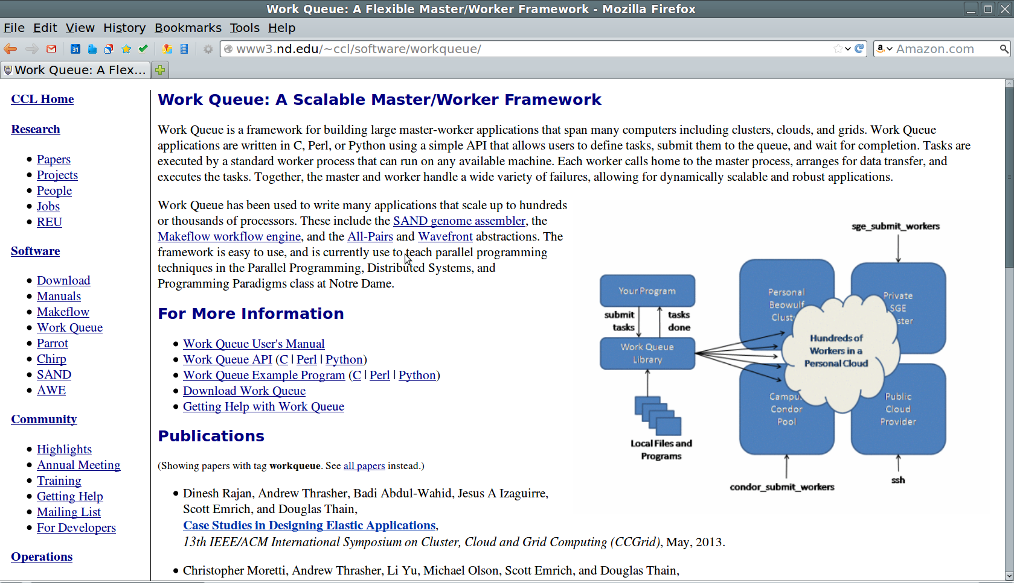
Work Queue Documentation
www.nd.edu/~ccl/software/workqueue/

Slide 50
http://nd.edu/~ccl/software/tutorials/ndtut13

Slide 51
Next Steps
Tutorial: Basic examples of how to write and use Work Queue.
Practice problems to try on completion of tutorial.

