Slide 1
Demonstration of Scalable Scientific Applications
Peter Sempolinski and Dinesh Rajan University of Notre Dame

Slide 2
Makeflow
Great for static workflows!
Tasks/dependencies are known beforehand
Directed Acyclic Graphs
Great for file-based workflows!
Input: files, Output: files

Slide 3
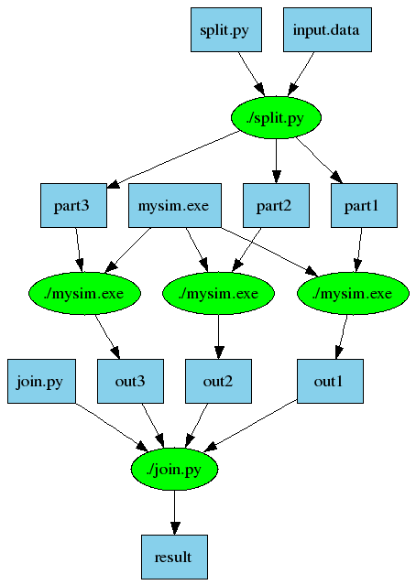
An Old Idea: Makefiles
part1 part2 part3: input.data split.py
./split.py input.data
out1: part1 mysim.exe
./mysim.exe part1 >out1
out2: part2 mysim.exe
./mysim.exe part2 >out2
out3: part3 mysim.exe
./mysim.exe part3 >out3
result: out1 out2 out3 join.py
./join.py out1 out2 out3 > result

Slide 4
Work Queue
Iterative, dynamic applications
use work_queue;
queue = work_queue_create();
while( work to be done ) {
task = work_queue_task_create();
// specify details for the task
work_queue_submit(queue, task);
}
while ( tasks in queue ) {
task = work_queue_wait(queue);
// process the completed task
}
for ( all tasks ) {
T = create_task();
specify_task(T);
submit_task(T);
}
while ( not finished ) {
T = wait_for_task();
//process T’s output
}

Slide 5
Harness resources from multiple platforms to achieve scale
SGE_submit_workers
XSEDE
Cluster
Private
Cluster
W
Work Queue Application
W
Thousands of Workers in a
Personal Cloud
W
submit
tasks
W
W
W
Work Queue Library
Campus
Condor
Pool
Public
Cloud
Provider
W
W
W
W
W
W
W
Local Files and Programs
condor_submit_workers
ssh

Slide 6
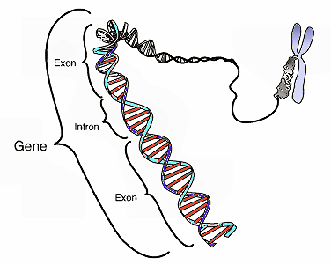
Gene Alignment
Sequence 1:
TCTGGCTGGAT
Sequence 2:
GATGGGGCGATTCAGGC
Aligned Sequence:
TCTGGCTGGATGATGGGGCGATTCAGGC

Slide 7
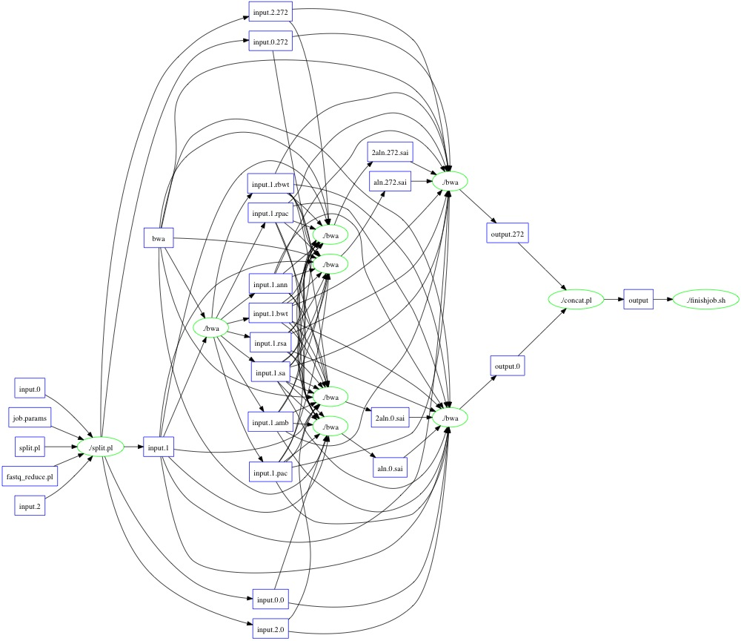
BWA (Makeflow)

Slide 8
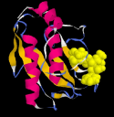
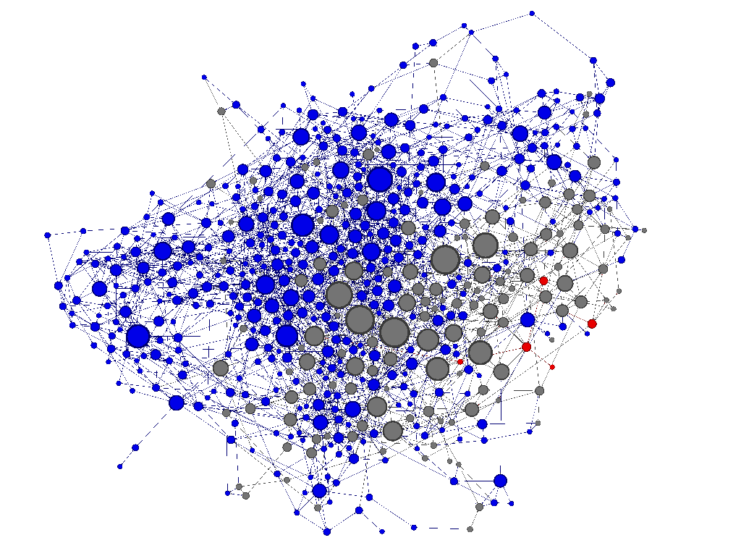
Protein Folding
Proteins fold into a number of distinctive states, each of which affects its function in the organism.
How common is each state?
How does the protein transition between states?
How common are those transitions?

Slide 9
Elastic Replica Exchange
Protein Molecule
Inputs
Work Queue Master
Attempt exchange
between 2 replicas
Create replicas of protein
Create configurations
for each replica
Assign temperature to each replica
Transfer inputs for replicas
After each step
Simulate replicas for given Monte Carlo step
Workers running simulations
Replica 1
Replica N
Transfer output to master

Slide 10
Project Names in Work Queue
work_queue_worker –a –N myproject
Work Queue
(port 9037)
connect to
ccl.cse.nd.edu:9037
Worker
advertise
query
Catalog
work_queue_status
query
“myproject”
is at ccl.cse.nd.edu:9037

Slide 11
Hierarchical Work Queue
Hierarchy in Work Queue: Master, Foremen, Workers
Master
Foreman
Foreman
Foreman
Foreman
Thousands of Workers in XSEDE
Thousands of Workers in FutureGrid
Thousands of Workers in Condor
Thousands of Workers in SGE

Slide 12
work_queue_status

Slide 13
http://www.nd.edu/~ccl

Slide 14
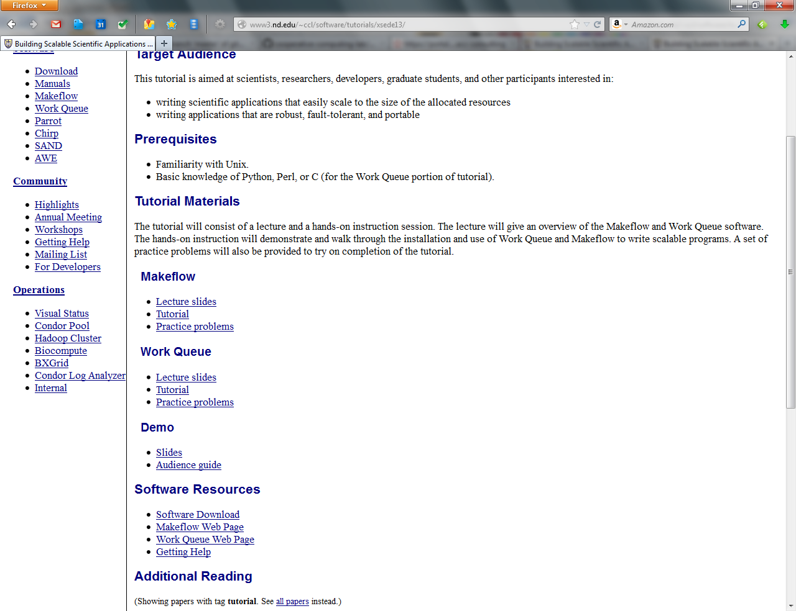

Slide 15
http://www.nd.edu/~ccl

