Slide 1
Massively Parallel Ensemble Methods Using Work Queue
Badi’ Abdul-Wahid
Department of Computer Science
University of Notre Dame
CCL Workshop 2012

Slide 2
Overview
Background
Challenges and approaches
Our Work Queue software
Folding@Work (F@W)
Accelerated Weighted Ensemble (AWE)
Discussion and usage of F@W and AWE

Slide 3
Background: Molecular Dynamics
Proteins can be thought of as strings of molecules that adopt 3D conformations through folding.
Many diseases are believed to be caused by protein misfolding
Alzheimer’s: amyloid beta aggregation
BSE (Mad Cow): prion misfolding
Understanding protein folding allows us to better understand disease and develop and test treatments.
Notes:
Bovine spongiform encephalopathy

Slide 4
Challenges for MD
Courtesy of Greg Bowman
Bowman, G. R., Voelz, V. A., & Pande, V. S. (2010). Current Opinion in Structural Biology, 21(1), 4–11

Slide 5
One Approach: Specialized Hardware
Anton
Developed by D.E. Shaw Research
1000x speedup
Expensive and limited access
GPUs
Requires a programming paradigm shift
OpenMM allows MD to run on GPUs
More accessible, but still limited capabilities
Eg: certain features present on CPU MD software are not yet provided for GPU

Slide 6
Another Approach: Massive Sampling
Folding@Home (Vijay Pande at Stanford)
Crowd sources the computation
Donors allow simulations to be run on their computers
300,000+ active users
CPUs & GPUs
6800 TFLOPs (x86)

Slide 7
Goal: Sample Rare Events
Pathways through transition regions
Difficult to capture experimentally
High computational complexity
High potential for parallelism

Slide 8
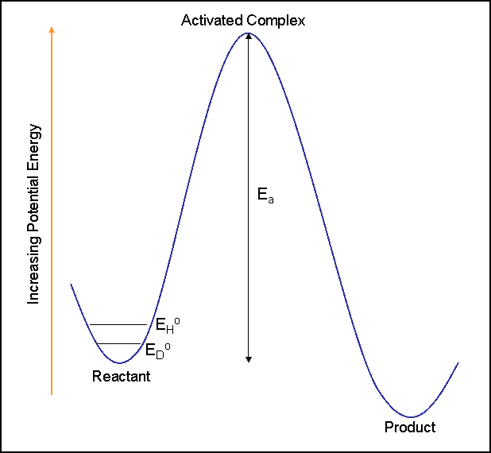
Adaptive Sampling
Traditional methods: Poor sampling of unstable regions
Adapt sampling procedure to enrich these areas
UC Davis Chemwiki

Slide 9
Products
Folding@Work
Accelerated Weighted Ensemble
Written with Haoyun Feng
Both are built on top of Work Queue
Use the Python bindings to Work Queue

Slide 10
Folding@Work
Data dependencies/organization
Simulation lifetime

Slide 11
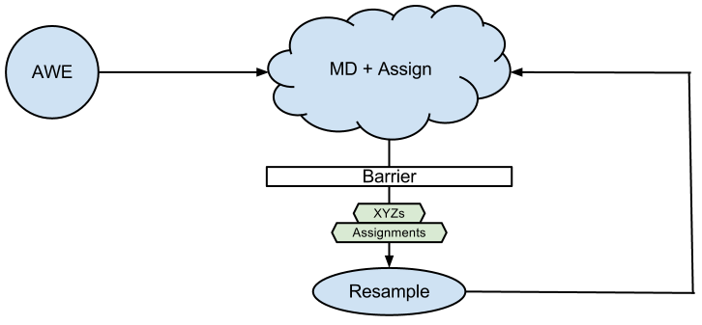
Accelerated Weighted Ensemble

Slide 12
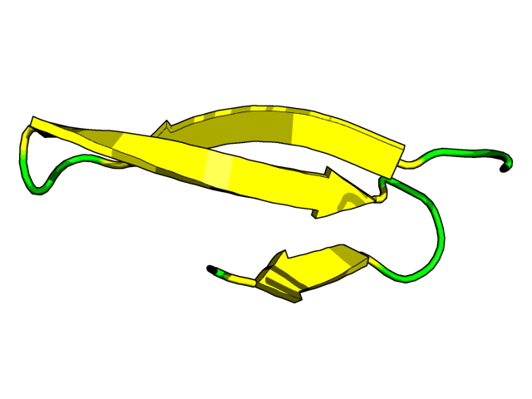
WW Fip35
Prep. Simulation
200+ us
Amber96
Generalized Born
Timestep of 2fs
Gamma of 1/ps
Nvidia GeForce GTX 480
OpenMM
MSMBuilder

Slide 13
AWE Resources
Multiple masters
…sharing several pools
…from different sources:
ND GRID: CPUs
Condor: ND + Purdue + U. Wisc. Madison. CPUs
Stanford ICME: GPUs
Amazon EC2: High CPU XL instances
Windows Azure: Large CPU instances

Slide 14
Pool allocation for WQ masters

Slide 15
Execution Times

Slide 16
Bottlenecks: communication
All data is sent through Work Queue
Initialization cost: 34MB
Payloads (to/from): 100KB
Architecture-depend files specified via WQ-exposed $OS and $ARCH variables
2% of tasks required initialization
< 1s average communication time
< 1% of master execution time
wq.specify_input_file("binaries/$OS-$ARCH/mdrun")
wq.specify_input_file("binaries/$OS-$ARCH/assign")
wq.specify_input_file("binaries/$OS-$ARCH/g_rms")

Slide 17
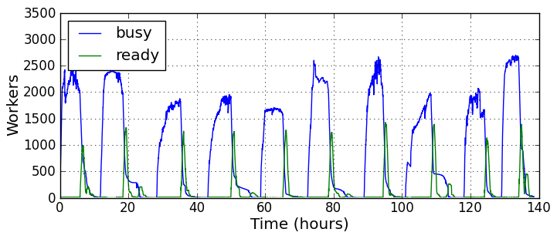
Bottlenecks: straggling workers
50% of the time to complete an iteration was due to certain workers taking overlong.
WORK_QUEUE_SCHEDULE_TIME
Fast abort multiplier = 3
Recently implemented WQ Cancel Task allows task replication to overcome this

Slide 18
Preliminary results
Transition network from AWE
Sample folding pathways

Slide 19
Conclusions
Work Queue allows Folding@Home style applications to easily be run using Folding@Work
Work Queue allowed the first application of the AWE algorithm to a large biomolecular system
An important aspect was usage of different resources: CPU + GPU on Cloud + Grid + Dedicated
The synchronization barrier in AWE allows straggling workers to have a large impact
Currently testing solution using new WQ features
These preliminary results (AWE) are promising, but further validations needed

Slide 20
Acknowledgements
Prof. Jesús A. Izaguirre (Notre Dame)
Prof. Douglas Thain (Notre Dame)
Prof. Eric Darve (Stanford)
Prof. Vijay S. Pande (Stanford)
Li Yu, Dinesh Rajan, Peter Bui
Haoyun Feng, RJ Nowling, James Sweet
CCL
Izaguirre Group
Pande Group
NSF
NIH

Slide 21
Questions?

