Slide 1
Why I finally BLASTed five hundred million sequences
(and the many ways it failed)
Scott Emrich
Computer Science and Engineering
Scientific manager, NIH/NIAID VectorBase
Co-director, Notre Dame Genomics and Bioinformatics
University of Notre Dame

Slide 2
Talk overview
Genomics “data deluge”
“Real” cost of genome sequencing, analysis
Case study:
  97 soil genomes
  ~500 genomes from three environments
Lessons learned

Slide 3
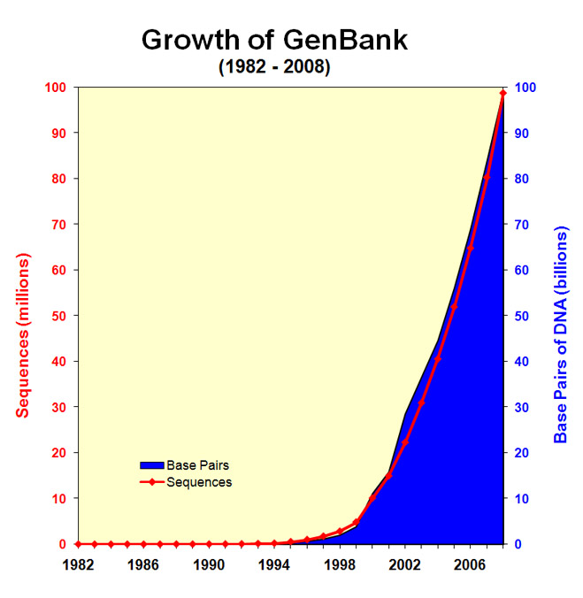

Slide 4
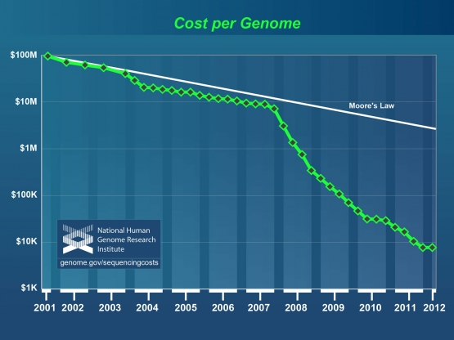

Slide 5
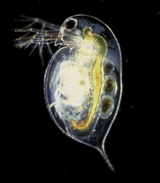
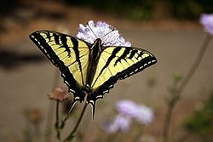

What's Going in my Lab (fav critters)
Ecological Research
Daphnia
  Early warning for pollution in bodies of water
Swallowtail and Duskywing Butterflies
  Climate change study system
Anopheles gambiae
  Major vector of malaria

Slide 6
BLASTing 500 million seqs?
BLAST is a common sequence search tool that is ubiquitous in bioinformatics and has been used in many different ways.
At a conference about a year ago, a colleague showed hypothetical Amazon EC2 results of BLASTing roughly ~500 million reads.
  Goal was to show cost of informatics

Slide 7
Made up slide with similar conclusion
$1000 human genome, w/ $4000 in analysis!

Slide 8
What is the computing cost, though?
NSF/NIH can pay
  iPlant
  XCEDE (Galaxy link planned @Pitt)
  National Center for Genome Analysis Support @IU
  Bioinformatics Resource Centers (VB@ND)
Your university can pay
  Condor/SGE
  Web portals to the above
Your credit card can pay
  Amazon EC2

Slide 9
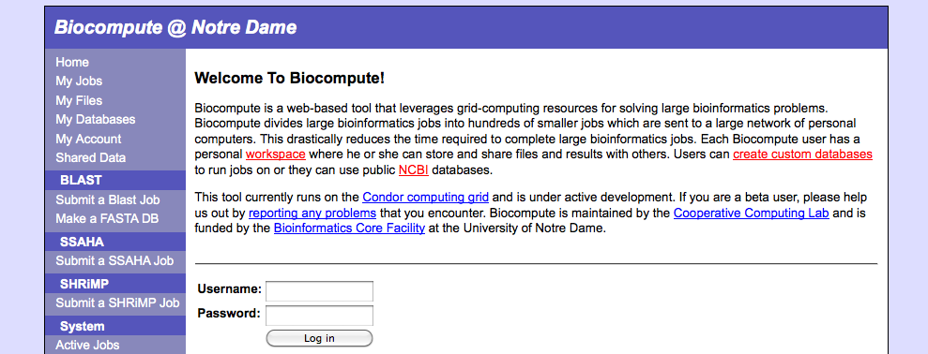
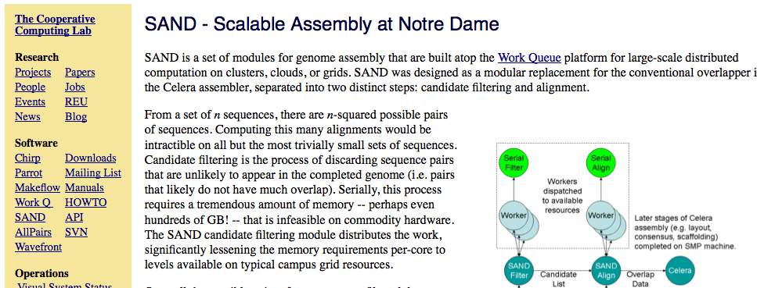
Makeflow-based
Work queue-based

Slide 10
What is the **REAL** cost? (software challenges part 1)
“Thinking doesn’t scale”
  Not every tool works “out of the box”
  Sequencing doesn’t solve everything
Sometimes, even scaling does not scale
  “conveniently” parallel doesn’t mean convenient to program
  Just like on HPC systems, there are limits

Slide 11
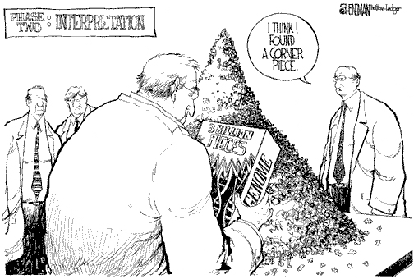
Sequence Assembly Required!
11
ISMB 2007
Notes:
11

Slide 12
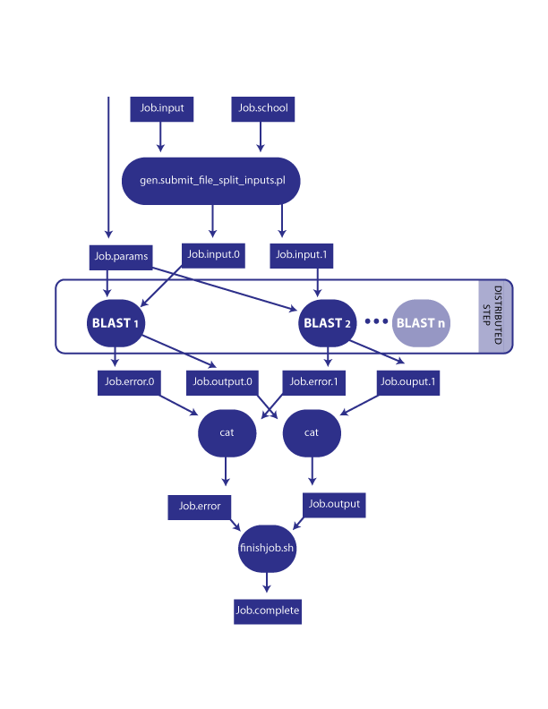
Makeflow for a BLAST workflow
  Makeflow uses make syntax to describe job dependencies
  Interfaces with many batch computing systems such as SGE, Condor, XGrid, and Work Queue (we have tools running on all 4 systems)
  Increases fault tolerance

Slide 13
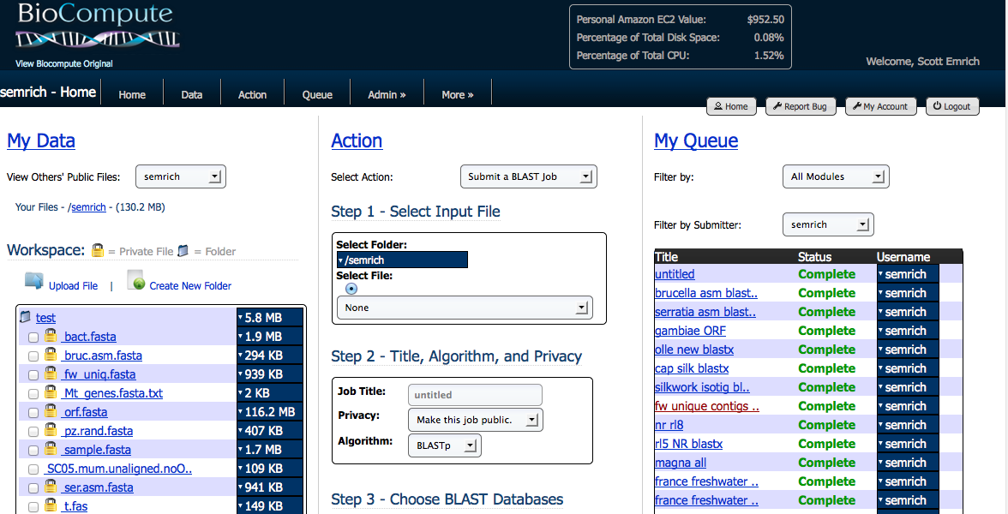
Biocompute

Slide 14
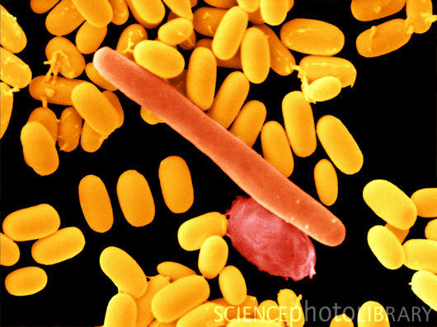
Meta-analysis of genomes
We are involved in a USDA grant to look at genomic underpinnings of dormancy.
One common approach is generating spores.

Slide 15
Initial study: soil genomes
Most endospore-forming bacteria live in soil
We obtained 97 genomes from the NCBI
  Based on literature, 45 of these form spores
There were ~500K genes total that were processed into 43,975 “related gene ” clusters

Slide 16
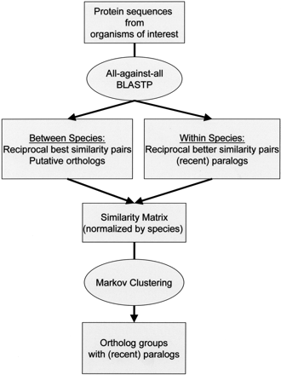
OrthoMCL clustering overview
Can be run on grids/clouds
“Conveniently” parallel
Serial step; uses mySQL to help scaling
Li et al (2001) Genome Research

Slide 17
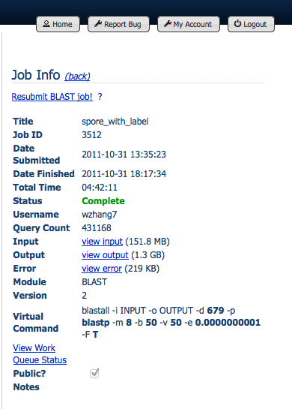
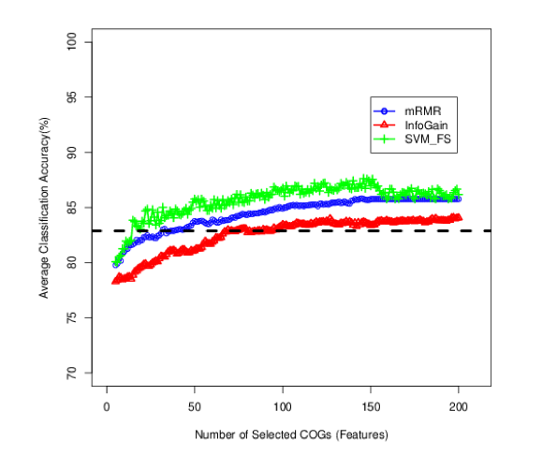
Success! (for now…)

Slide 18

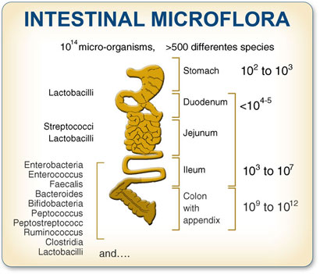

Three environments

Slide 19
Environmental data
2,275,997 proteins from 580 genomes
Finally took ~2 days on 500 cores with 7000 jobs submitted
Issues:
  50 jobs never finished on Condor pool
  Disk ran out of space, required cleanup
  mySQL did not scale; required reworking

Slide 20
Software challenges 2 (aka other lessons learned)
AFS file-in-folder maximum:
  64,000 files (directory entries) in an AFS directory if the filenames are all less than 16 characters long
Open files per user:
  1024 default on linux, can check it (and many other built in limits) with the `limit` command
Bytes in path and command line (combined):
  131072 on beagle, check-able with getconf
Scalibility of native OS tools:
  Basic tools have failed with long command lines (see above) or other issues

Slide 21
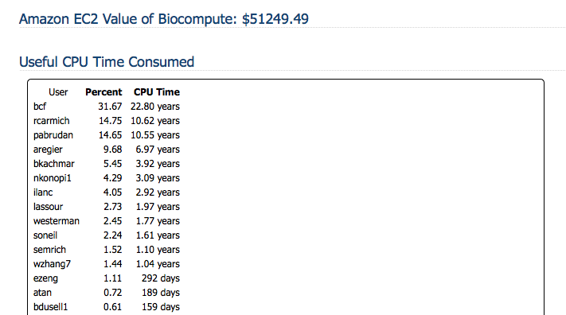

No free lunches

Slide 22
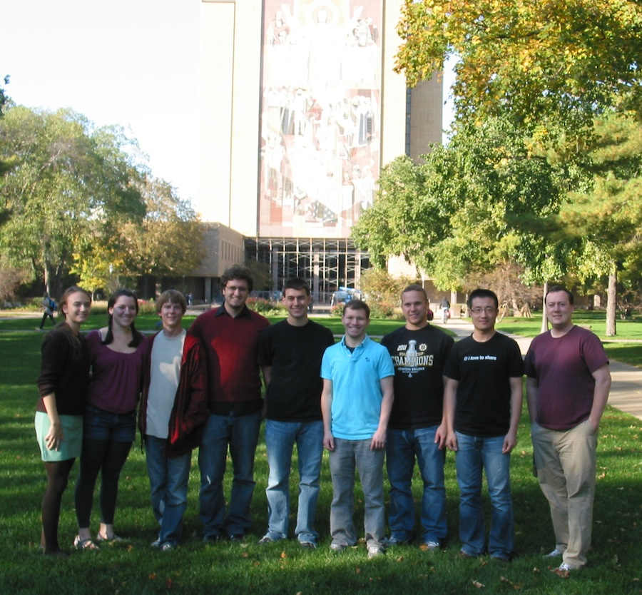
Acknowledgements
Notre Dame
NDBL (below)
Frank Collins (VectorBase)
Nora Besansky (Anopheles)
Jeff Feder (Rhagaletis)
Mike Pfrender (Daphnia)
CCL
Doug Thain
Chris Moretti
Mike Olson
Li Yu, Andrew Thrasher
REUs
Soil dormancy
Stuart Jones
Dan Yu
Wei Zhang
Josh Livermore
Erliang Zhang

