Slide 1
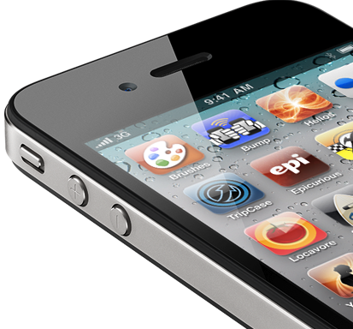

Is there an app for that ?
Challenges in scalable analysis for Life sciences
Nirav Merchant
UA BioComputing + iPlant
Arizona Research Laboratories
University of Arizona
http://bcf.arl.arizona.edu/
1

Slide 2
Topic Coverage
Formula for success (and failure)
Flavors of Bio-information
What is iPlant ?
Typical Non-NGS workflow
Data life cycle issues (some)
Application life cycle issues (some)
Why “app” ?

Slide 3



Simple Formula
+
=

Slide 4



The Reality
PERL Python
Java Ruby
Fortran C C# C++
R Matlab
etc.
Amazon
Azure
Rackspace
Campus HPC
XSEDE
Etc.
+
+
and lots of glue…..

Slide 5


Simple Formula
+
=

Slide 6
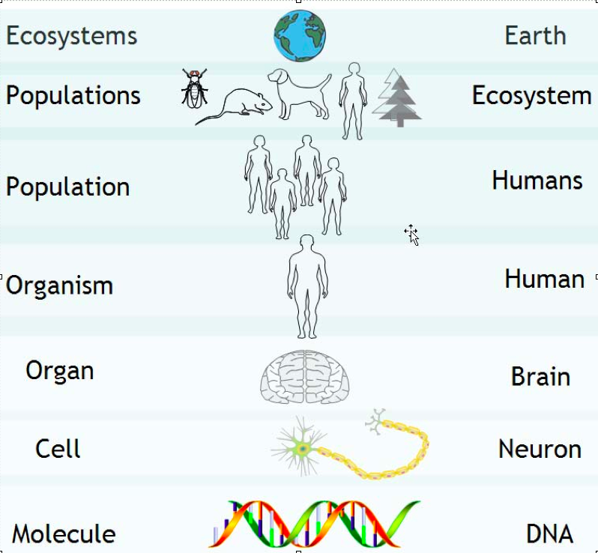
Life science: Going across scales

Slide 7
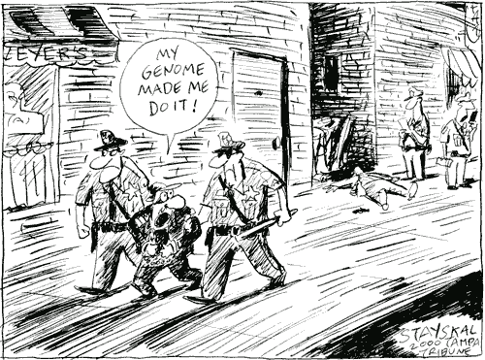
Putting it all to work
Wayne Stayskal, The Tampa Tribune

Slide 8

The iPlant Collaborative
Cyberinfrastructure for the Plant Sciences
The iPlant CI is designed as infrastructure.
This means it is a platform upon which other projects can build.
Use of the iPlant infrastructure can take one of several forms:
    Storage
    Computation
    Hosting
    Web Services
    Scalability
Notes:
So what is iPlant’s contribution to the problems of Big Data?
iPlant is not “Take it or leave it” there are many component that you can customize for your own research.

Slide 9
The iPlant Collaborative
Cyberinfrastructure for the Plant Sciences
For a challenge as broad as “plant science,” focus on specific applications/tools is a moving target, and never enough.
Most important to build a platform that can support diverse and constantly evolving needs. “Cyberinfrastructure” is, in fact, infrastructure. The platform can lift all the apps, not select winners and losers.
“The useful lifetime of our analysis toolchains is now 6 months”
-Matthew Trunnel, Broad Institute
Notes:
This is why having this workshop is important. Learning how to use iPlant as a platform is knowledge that will exceed the lifetime of its component pieces.
Trunnel is IT director at Broad

Slide 10
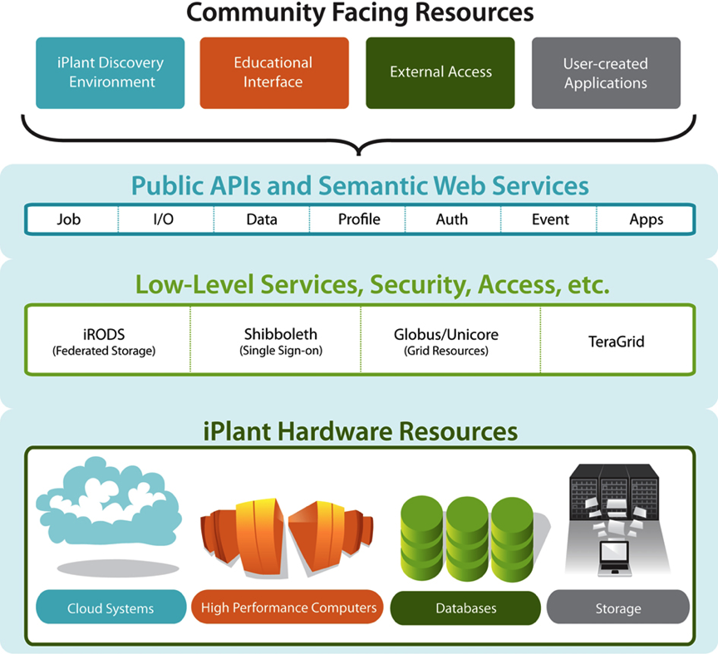
The iPlant Collaborative
Cyberinfrastructure for the Plant Sciences
End
Users
Teragrid
XSEDE
Computational
Users
Notes:
iPlant layer cake of resources and services.
Bottom->Up: Hardware->low-services/middleware->APIs

Slide 11
BioInformation :: Data Flavors
Sequences
Structures
Images
Video
Audio
Pathways (graphs)
Text (Publications)
Traces
Combination (eg Video & Traces)
And much more …

Slide 12
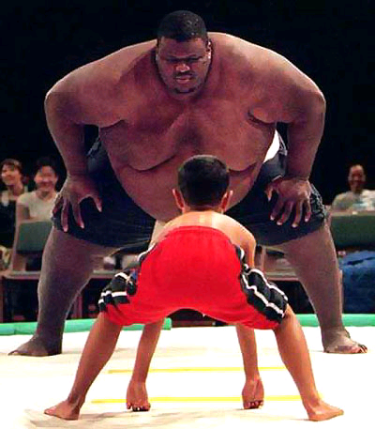
Life scientist :: Data Wrestler
Volume of data is increasing
Resolution of data is increasing
Number of data repositories is increasing
Ever increasing analysis options
Demands to share, collaborate data (team science)
Do you know where your data is ?
(and your collaborators data !)

Slide 13
Genomics
Proteomics
Pathways
Modeling
Systems
Biology
Pharmaco-
genomics
Clinical
Functional
Genomics
Metabolomics

Slide 14

X prize for sequencing
2012 guidelines are different, this is graphics dated

Slide 15
X prize for analyzing it ?
?

Slide 16
The Lifecycle
Data Acquisition and Modeling
Collaboration and Visualization
Analysis and Data Mining
Dissemination and Sharing
Archive and Presentation
The Fourth Paradigm: Data-Intensive Scientific Discovery

Slide 17
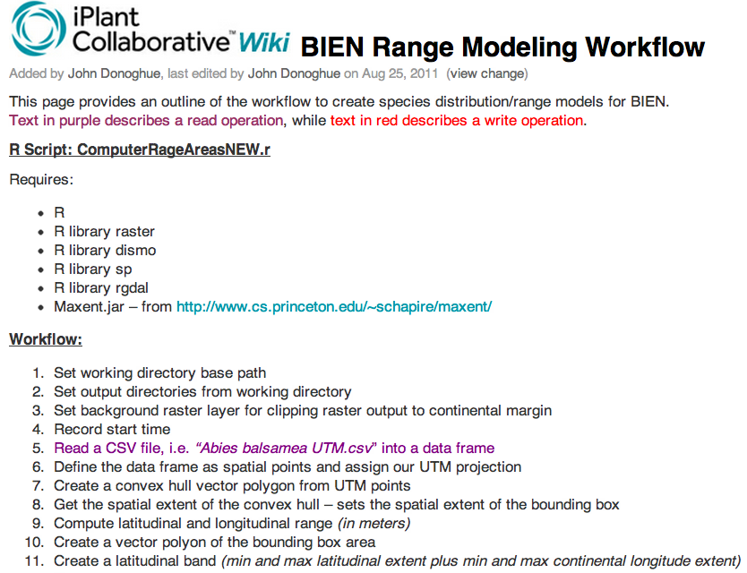

Slide 18
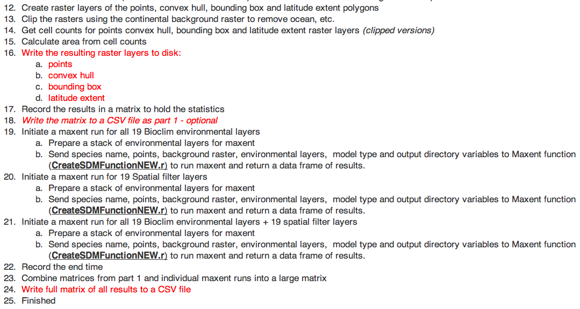

Slide 19
Why is this hard when we have …
Pegasus
Taverna
Kepler
Condor (DAGman)
Gearman
Makeflow
myExperiment
Science pipes
We have X (take your pick)

Slide 20
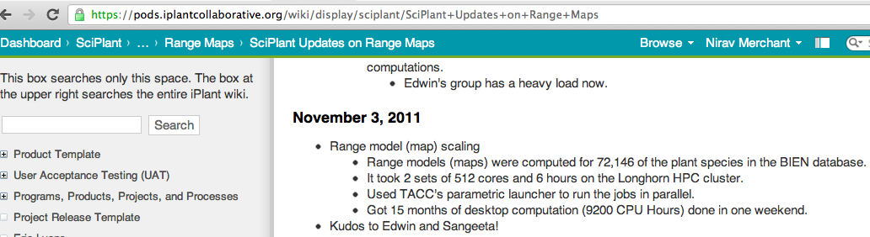
What did the scientists do ?
Used the “parametric launcher”
Essentially its a very functional “submit” script !
Why use it ?
  Dir of full of files and one executable
  Simple linear flow (no branching)
  Needed results “yesterday” for conference/working group
  Need to be run ONCE every year
Not sexy but functional
Serial runs are important

Slide 21
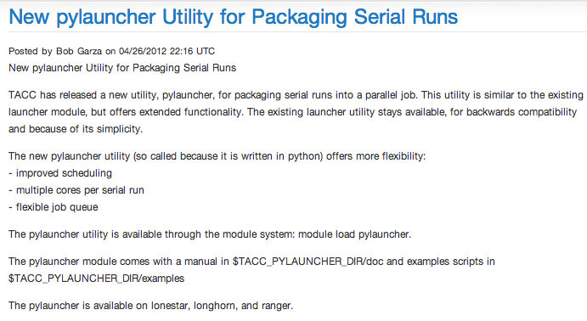
Python in HPC : OMG

Slide 22
Data issues

Slide 23
DLM: Issues
Most “pipelines/analysis” are Data intensive
Sadly data originates from slow desktops, external hard drives, file servers using ftp, http etc (and ends up there)
Hard to stage data to begin computation !
No place to bring things together (quickly)
Data needs substantial pre and post processing
Meta data is usually not adequate
RDBMS are part of workflows
Do you need better indexing of flat files ?
It does not have to be this way !

Slide 24
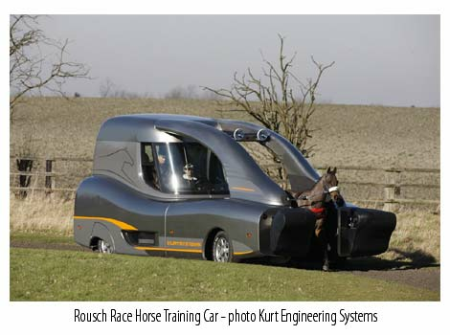

Slide 25
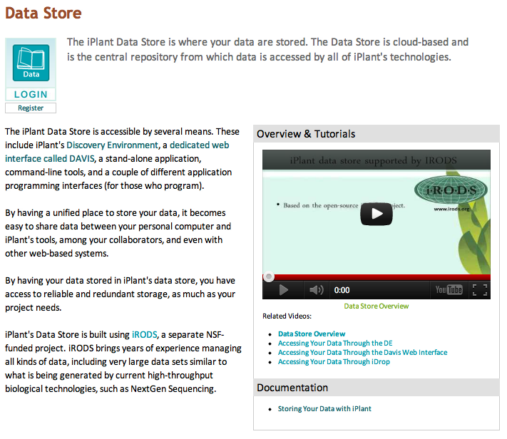
Data Lifecycle: Our effort

Slide 26
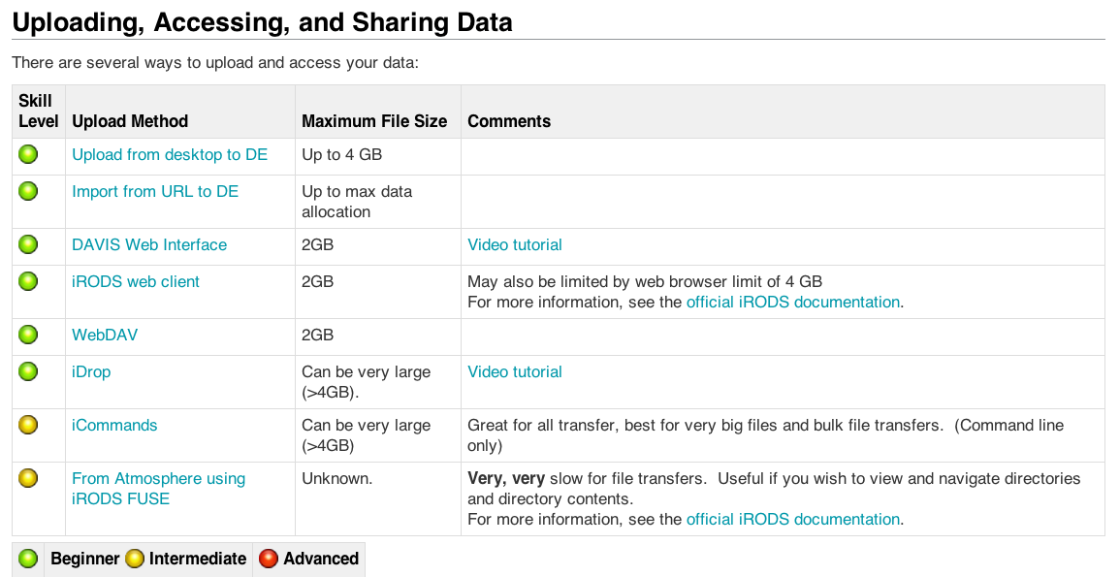
What can users do ?

Slide 27
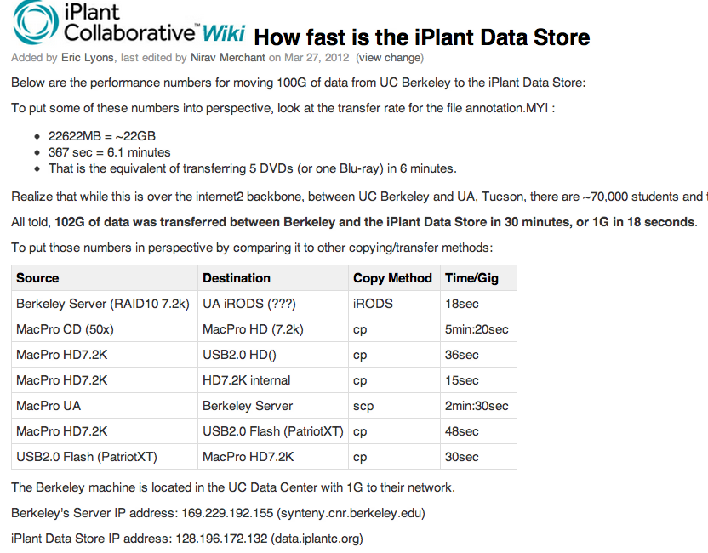

Slide 28
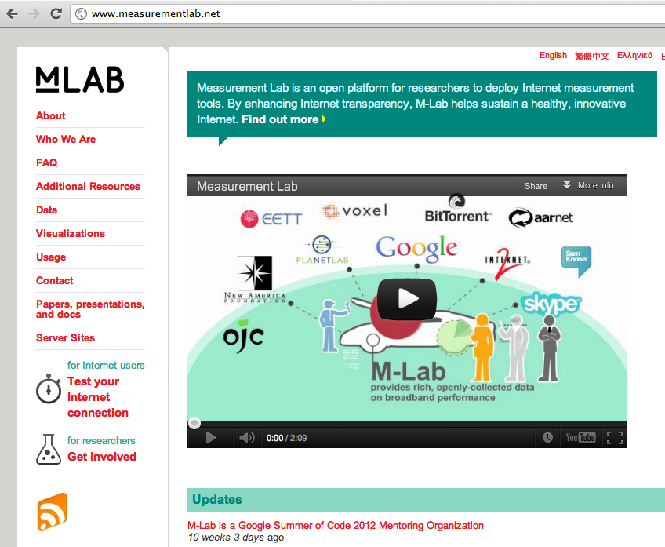
But I don’t get throughput
Networking is huge BLACK BOX and too much finger pointing

Slide 29
Compute Issues: Cloud

Slide 30
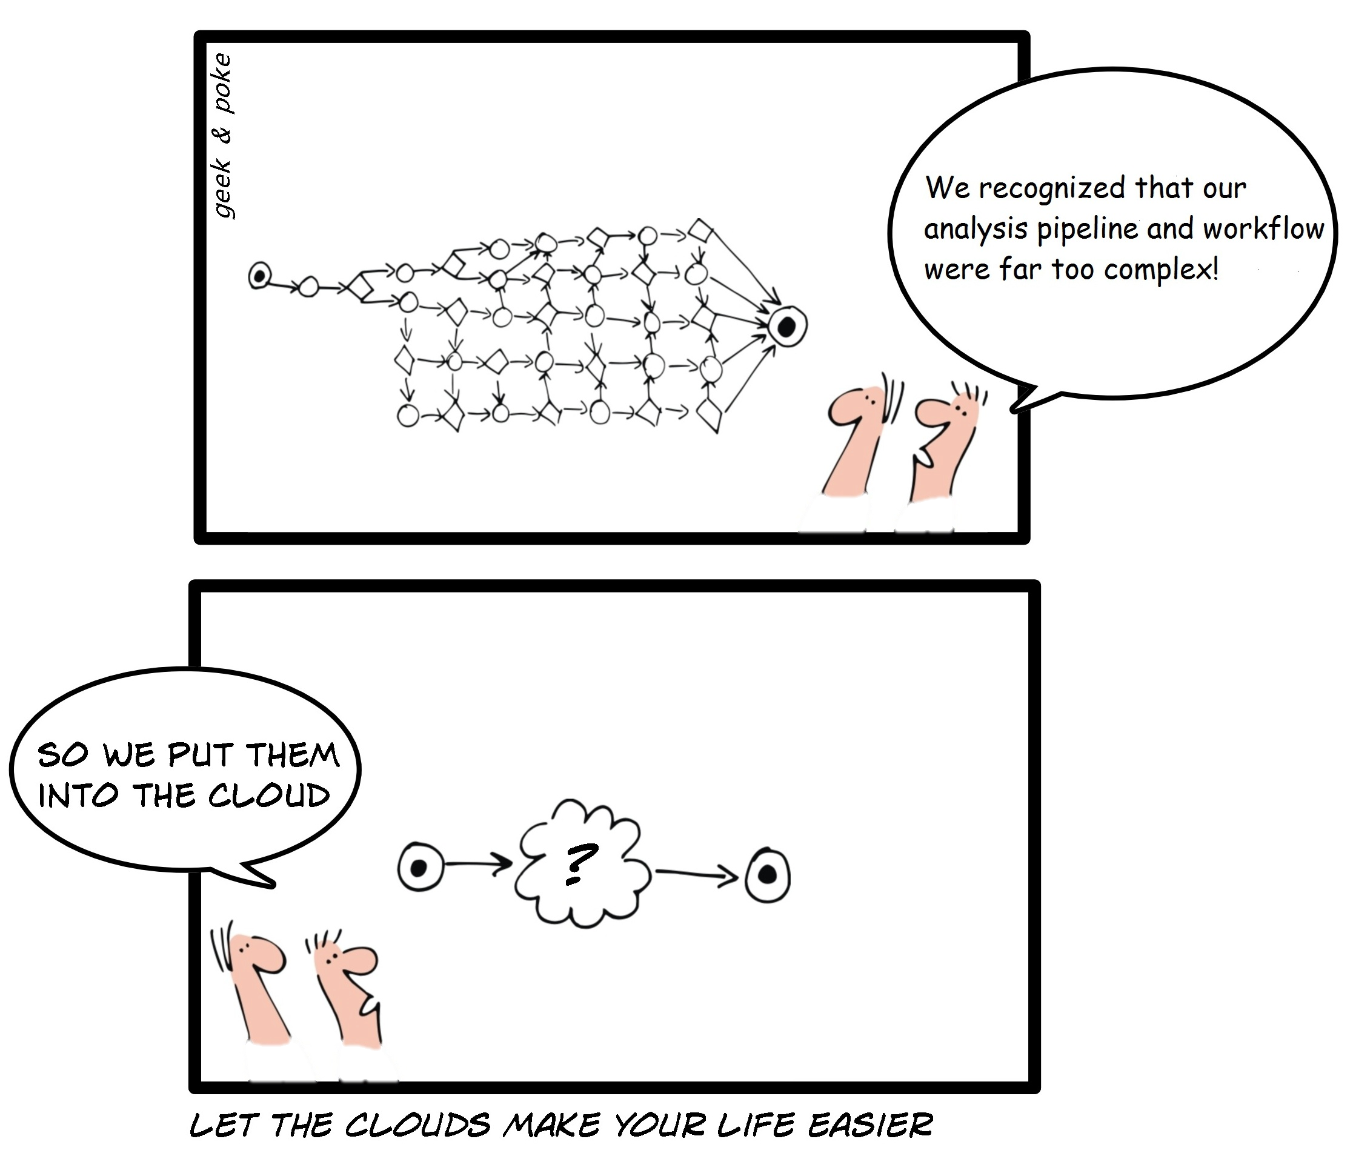
What is cloud computing ?
http://geekandpoke.typepad.com/geekandpoke/2009/03/let-the-clouds-make-your-life-easier.html

Slide 31
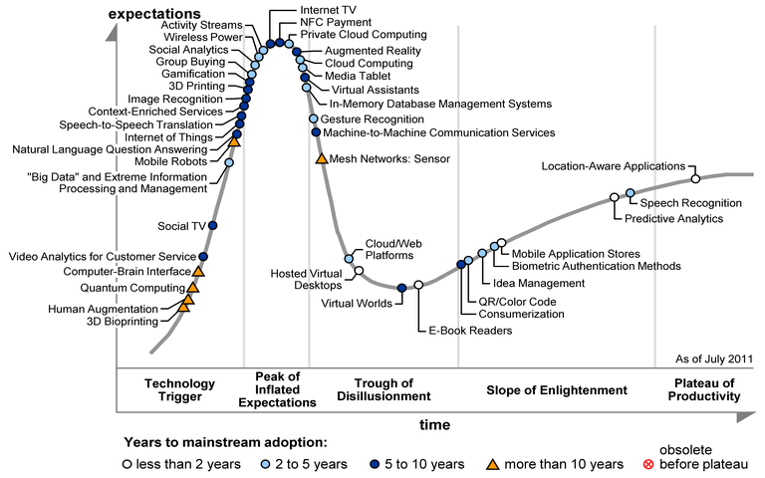
The application lifecycle

Slide 32
The iPlant Collaborative
iPlant Discovery Environment
A rich web client
  Provides a consistent interface to a range of bioinformatics tools
  Provides a portal to users not wishing to interact with lower level infrastructure
An integrated, extensible system of applications and services
  Provides additional intelligence above low level APIs – Provenance, Collaboration, etc.

Slide 33

The iPlant Collaborative
Project Atmosphere™: Custom Cloud Computing
API-compatible implementation of Amazon EC2/S3 interfaces
Virtualize the execution environment for applications and services
Get Up to 12 core / 48 GB instances
Access to Cloud Storage + EBS
1008 users
167 users launched 657 instances (May 2012)
227 were terminated outside the of Atmosphere due to idleness (per user's request)
430 instances average time was 1 day, 16 hours, and 13 minutes. Longest running was 30 days
Run servers, CloudBurst desktop use cases. Big data and the desktop are co-local again!
>60 hosted applications in Atmosphere today, including users from USDA, Forest Service, data providers, etc.
30+ private images for postdocs and grad students for training classes

Slide 34
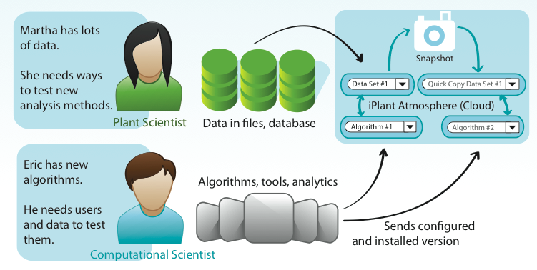
Atmosphere: Collaboration
iPlant Data Store

Slide 35
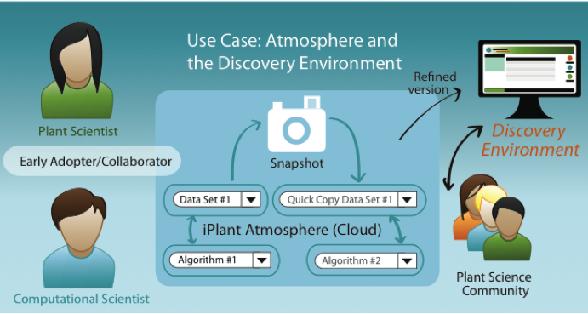
Lifecycle

Slide 36
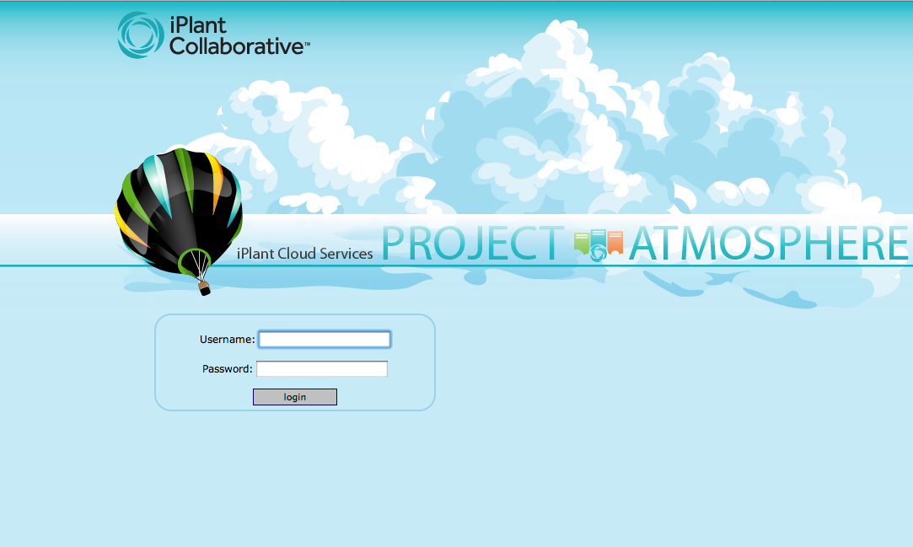
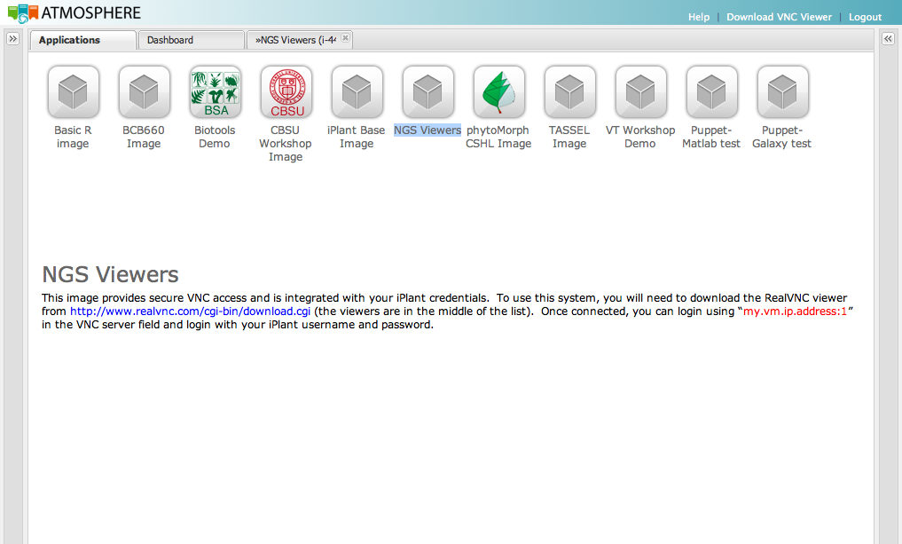
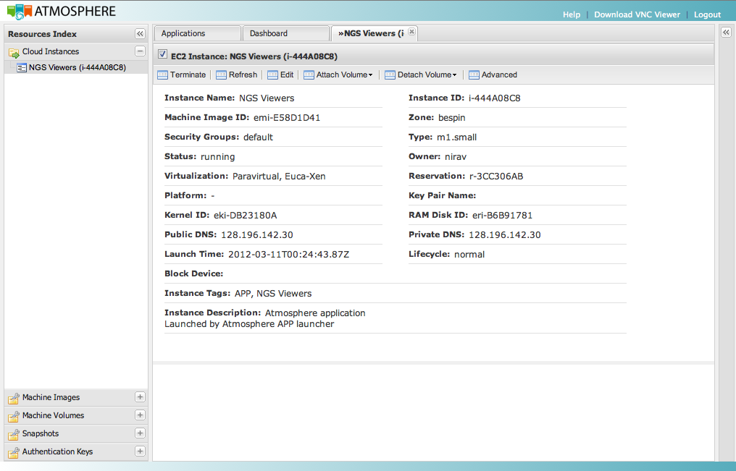
How to Connect

Slide 37
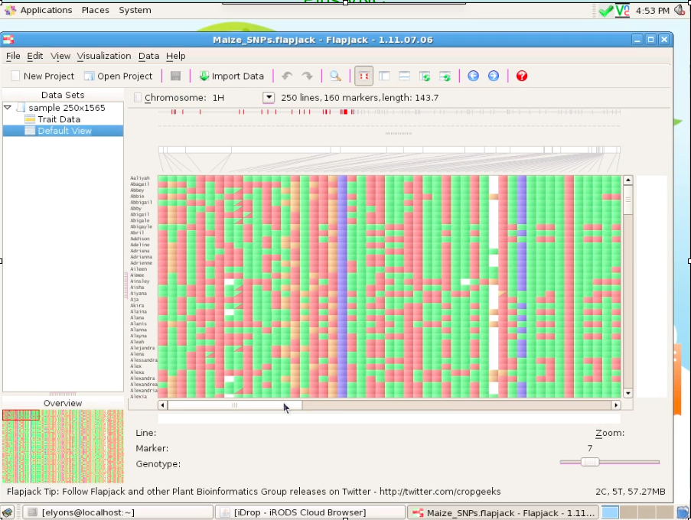
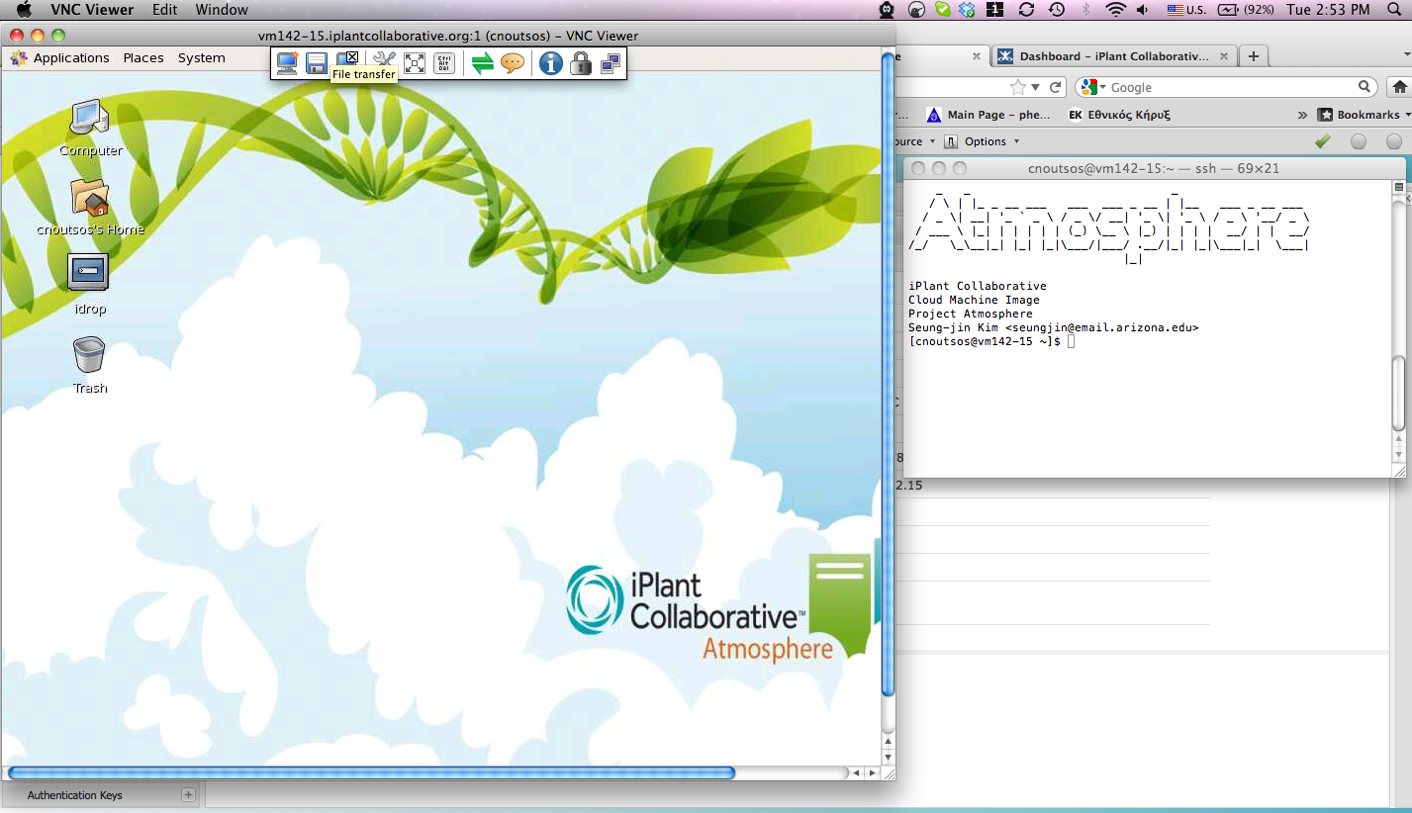
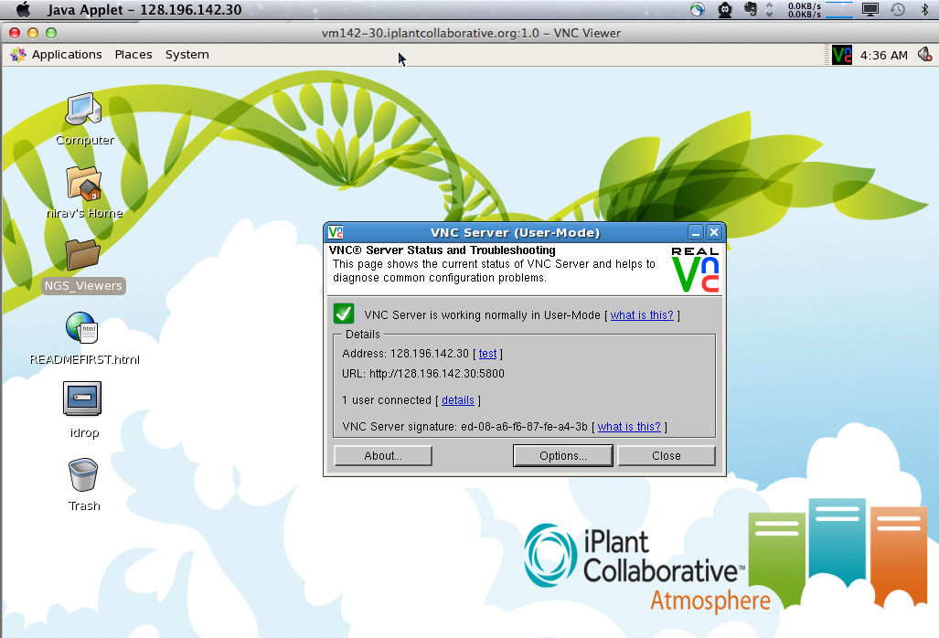
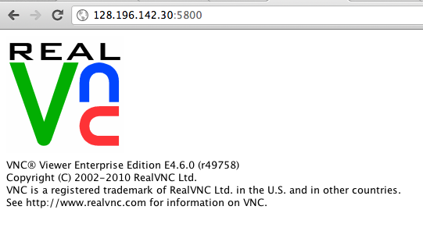
Different Ways to Log in to VMs

Slide 38
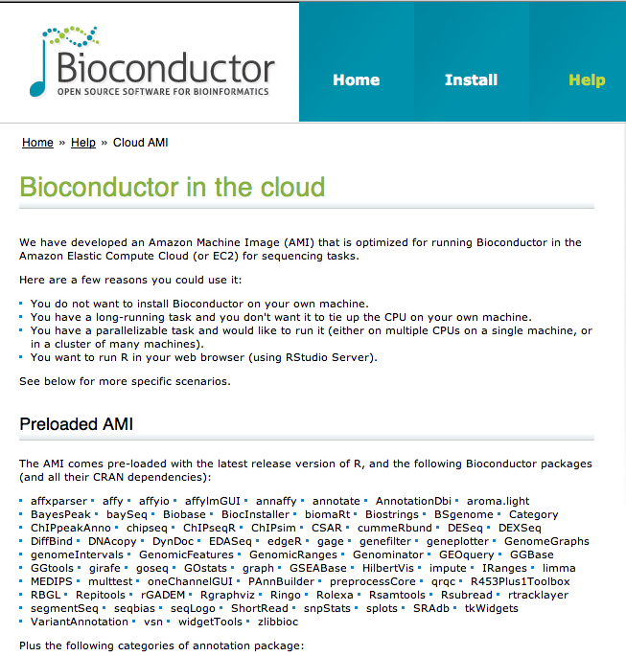
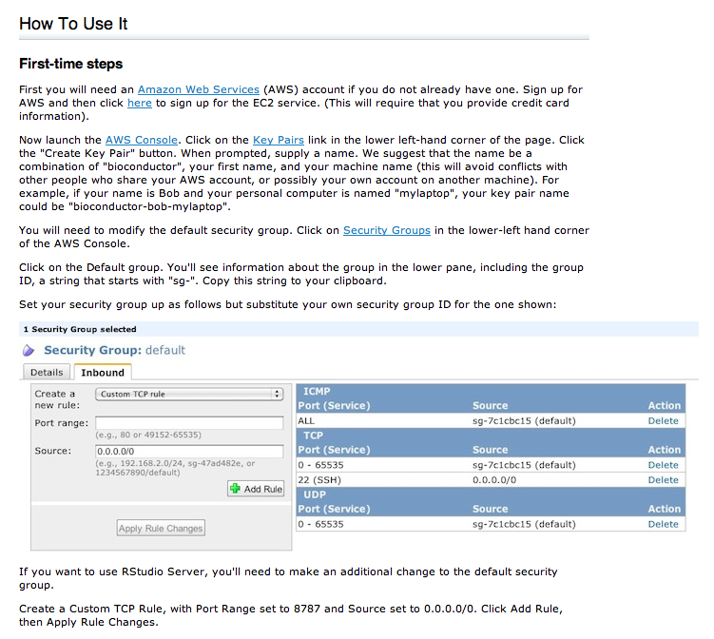
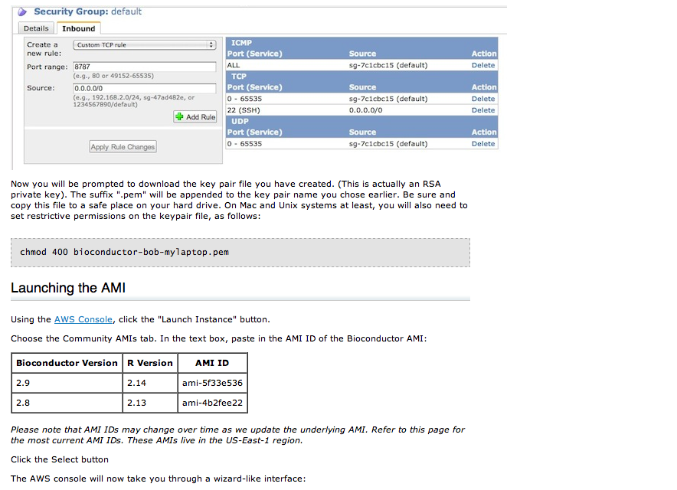
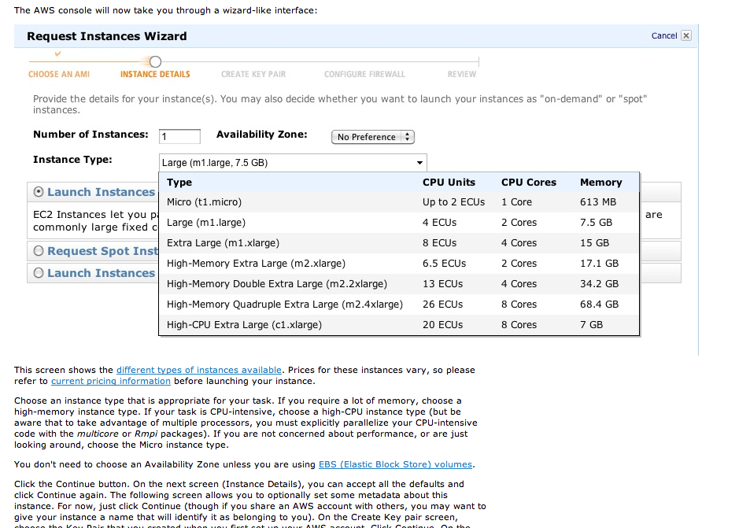
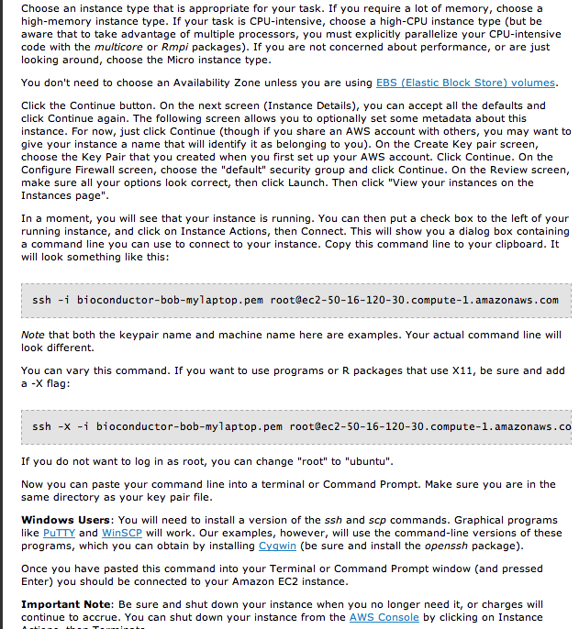
Steps to get started !

Slide 39
My wish list for CCL (parrot)
Improved performance for iRODS transfers
(parallel transfers ?)
File permission calls (iRODS ACL)*
Ability to provide throughput/transfer stats
Thanks for updating iRODS support to 3.1

Slide 40
My wish list for CCL (makeflow)
*Bundle dependencies along with script and binaries e.g.
CDE: Automatically create portable Linux applications
http://www.pgbovine.net/cde.html
Progress reporting, profiling of performance e.g equivalent progress bar
*Not a makeflow issue but a good feature

Slide 41

The iPlant Collaborative
Postdocs:
Barbara Banbury
Jamie Estill
Bindu Joseph
Christos Noutsos
Brad Ruhfel
Stephen A. Smith
Chunlao Tang
Lin Wang
Liya Wang
Norman Wickett
Students:
Peter Bailey
Jeremy Beaulieu
Devi Bhattacharya
Storme Briscoe
Ya-Di Chen
John Donoghue
Steven Gregory
Yekatarina Khartianova
Monica Lent
Amgad Madkour
Aniruddha Marathe
Kurt Michaels
Dhanesh Prasad
Andrew Predoehl
Jose Salcedo
Shalini Sasidharan
Gregory Striemer
Jason Vandeventer
Kuan Yang
Executive Team:
Steve Goff
Dan Stanzione
Metadata
Data
Tools
Workflows
Viz
Faculty Advisors & Collaborators:
Ali Akoglu
Greg Andrews
Kobus Barnard
Sue Brown
Thomas Brutnell
Michael Donoghue
Casey Dunn
Brian Enquist
Damian Gessler
Ruth Grene
John Hartman
Matthew Hudson
Dan Kliebenstein
Jim Leebens-Mack
David Lowenthal
Robert Martienssen
Staff:
Greg Abram
Sonali Aditya
Roger Barthelson
Brad Boyle
Todd Bryan
Gordon Burleigh
John Cazes
Mike Conway
Karen Cranston
Rion Doodey
Andy Edmonds
Dmitry Fedorov
Michael Gatto
Utkarsh Gaur
Cornel Ghiban
Michael Gonzales
Hariolf Häfele
Matthew Hanlon
Anthony Heath
Barbara Heath
Matthew Helmke
Natalie Henriques
Uwe Hilgert
Nicole Hopkins
Eun-Sook Jeong
Logan Johnson
Chris Jordan
B.D. Kim
Kathleen Kennedy
Mohammed Khalfan
Seung-jin Kim
Lars Koersterk
Sangeeta Kuchimanchi
Kristian Kvilekval
Aruna Lakshmanan
Sue Lauter
Tina Lee
Andrew Lenards
Zhenyuan Lu
Eric Lyons
Naim Matasci
Sheldon McKay
Robert McLay
Angel Mercer
Dave Micklos
Nathan Miller
Steve Mock
Martha Narro
Praveen Nuthulapati
Shannon Oliver
Shiran Pasternak
William Peil
Titus Purdin
J.A. Raygoza Garay
Dennis Roberts
Jerry Schneider
Bruce Schumaker
Sriramu Singaram
Edwin Skidmore
Brandon Smith
Mary Margaret Sprinkle
Sriram Srinivasan
Josh Stein
Lisa Stillwell
Kris Urie
Peter Van Buren
Hans Vasquez-Gross
Matthew Vaughn
Fusheng Wei
Jason Williams
John Wregglesworth
Weijia Xu
Jill Yarmchuk
B.S. Manjunath
Nirav Merchant
David Neale
Brian O’Meara
Sudha Ram
David Salt
Mark Schildhauer
Doug Soltis
Pam Soltis
Edgar Spalding
Alexis Stamatakis
Ann Stapleton
Lincoln Stein
Val Tannen
Todd Vision
Doreen Ware
Steve Welch
Mark Westneat
74

