Slide 1
Elastic Applications in the Cloud
Dinesh Rajan
University of Notre Dame
CCL Workshop, June 2012
Notes:
1

Slide 2
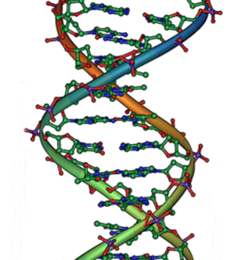
Application
Notes:
2

Slide 3
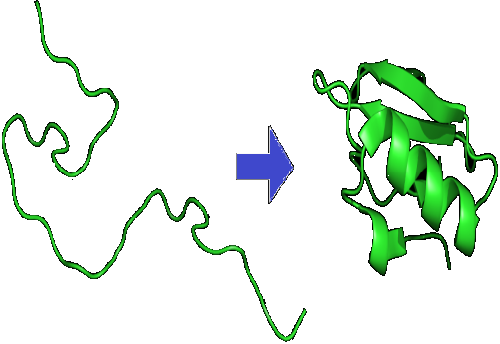
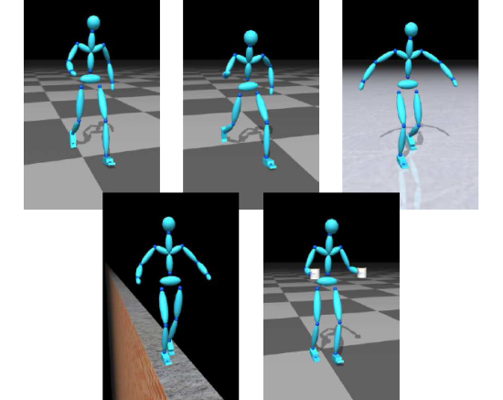
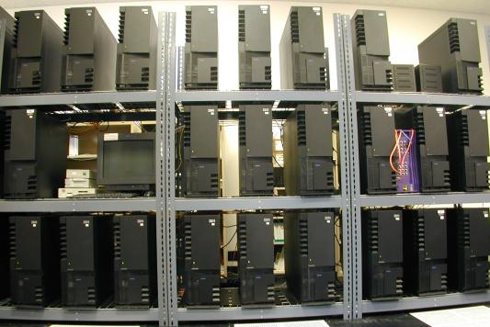
Scenarios of Interest
High performance computing
On-demand
Inexpensive
Dedicated
3
Notes:
3

Slide 4
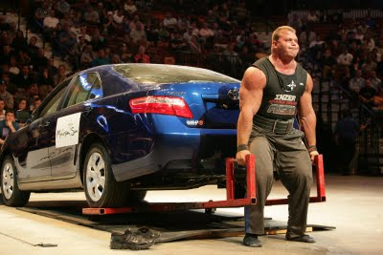
Elastic Application Candidates
High-performance applications
Protein folding
Genome sequencing
Genetic algorithms (search)
Employ parallel computing frameworks
MPI
+
4
Notes:
4

Slide 5
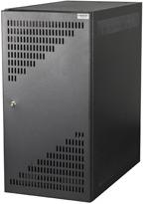
Elastic Applications Characteristics
Agile: + + +
Elastic:
Robust: handle & recover failures
Elastic Applications
High Scalability + Reliability
App Run
5
Notes:
5

Slide 6
Talk Overview: Elastic Applications
Guidelines for Software Framework
Choose Framework: Work Queue
Build Elastic Applications
Features in Work Queue
6
Notes:
6

Slide 7
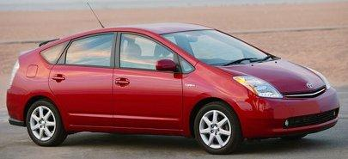
Building Elastic Applications
Use Software Frameworks
Library to write applications
Abstract away low level details
Lower effort to build & run on distributed systems
Software Framework
Application
+
7
Notes:
7

Slide 8
Guidelines for Software Framework
Elasticity: Harness, adapt to run-time resource availability
Fault-tolerance: Continue execution through failures
Portability: Enable application on different cloud platforms
Scalability: Allow application to scale in size, complexity
Platform Independence: Independent of different platforms
Application Independence: Not tied to any application domain
Ease of effort: Minimal effort in deploying, running in cloud
8
Notes:
8

Slide 9
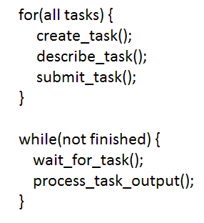
Work Queue Application Model
Build
Application
Work Queue API
Deploy
Work Queue
Execute
Worker
Worker
Worker
Worker
Cloud infrastructure
Notes:
9

Slide 10
Example Elastic Application
Replica Exchange
Molecular dynamics application
Used in study of Protein Folding
Convert to Elastic Replica Exchange
Using Work Queue
10
Notes:
10

Slide 11
Elastic Replica Exchange
Protein Molecule
Inputs
Work Queue Master
Attempt exchange
between 2 replicas
Create replicas of protein
Create configurations
for each replica
Assign temperature to each replica
Transfer inputs for replicas
After each step
Simulate replicas for given Monte Carlo step
Workers running simulations
Replica 0
Replica 1
Replica 2
Replica 3
Replica 4
Replica 5
Replica 6
Transfer output to master
11

Slide 12
Elastic Replica Exchange
./condor_submit_workers
./ec2_submit_workers
./sge_submit_workers
Notes:
12

Slide 13
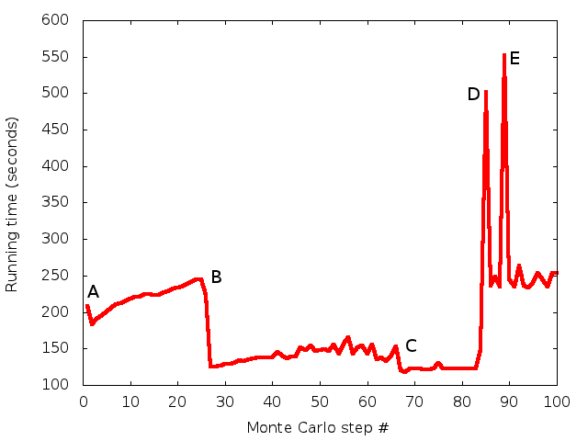
Elasticity
400 Replicas
Remove 125 in Plat D + 25 in Plat. A
Remove 100 in Plat. B
Start with 100 workers in Plat. B
Add 150 workers in Plat. D
Add 110 in Plat. D + 40 in Plat. A
13
Notes:
13

Slide 14
Elasticity + Portability gives Scalability
100 Workers
250 Workers
400 Workers
150 Workers
14
Notes:
14

Slide 15
Elastic Applications in CCTools
Elastic Replica Exchange
replica_exchange.py
using ProtoMol
Molecular Dynamics Simulation Framework
protomol_functions.py
In CCTools
bin/ in install
apps/ in src
http://cse.nd.edu/~ccl/software/download.shtml

Slide 16
Elastic Applications in CCTools
Asynchronous Replica Exchange
Synchronize only exchanging replicas
Lower synchronization overheads
Default mode in Elastic Replica Exchange
-b flag to use synchronous replica exchange
Barrier
Barrier
Barrier
Barrier
R1
R2
R3
R4
R5
R6
R1
R2
R3
R4
R5
R6

Slide 17
New Work Queue Features for Elastic Applications
String Interpolation in Input Files
Dispatch dependencies based on worker environment
Cygwin vs. Linux vs. Solaris ($OS)
X86_64 vs. i686 vs. GPU ($ARCH)
Transfers a.Linux.x86_64 to workers running on Linux x86_64
Transfers a.Cygwin.i686 to workers running on Cygwin i686
API: task_specify_file(t, "a.$OS.$ARCH", "a", WORK_QUEUE_INPUT, WORK_QUEUE_CACHE)

Slide 18
New Work Queue Features for Elastic Applications
Cancel Task
Cancel any submitted task
Immediately retrieves task & removes from Work Queue
Tasks to cancel identified by either taskid or tag
This cancels a task with tag named ‘task3’
Useful where there are redundant or obsolete tasks
Replicate tasks when there are more resources than tasks
API: cancel_by_tasktag (q, “task3”)

Slide 19
Upcoming Elastic Applications
Elastic Replica Exchange
GROMACS
Multi-dimensional Exchange – OpenMM
Adaptive Weighted Ensemble Method
Improve sampling of kinetics of MD systems
Large scale ~3000 workers
Genetic Algorithms for Assistive Robotics
Search for optimal biped walking controller
19
Notes:
19

Slide 20
Ongoing and Future Work
For given cost & performance requirements:
What should be the size of resource allocation?
For given resource allocation & its characteristics:
How to decompose application workflow into tasks?

Slide 21
Conclusions
High Performance Applications
costly, constrained with parallel computing frameworks
Build Elastic Applications
robust, flexible, scalable
Software framework for Elastic Applications
Work Queue
Example Elastic Applications
Replica Exchange
Genetic Algorithms in Robotics
Adaptive Weighted Ensemble Method
21
Notes:
21

Slide 22
http://nd.edu/~ccl

Slide 23
Cloud Platforms
Name | Platform | Processor | I/O | Cost
Platform A | Amazon EC2 | 2*2 x 1.0-1.2 GHZ | 7.5 GB Memory | $0.34/hr
Platform B | Notre Dame SGE | 2*2 x 2.6 GHZ | 8-12 GB Memory | $0.0/hr
Platform C | Microsoft Azure | 2 x 1.6 GHZ | 3.5 GB Memory | $0.24/hr
Platform D | Condor | 2 x 2.4 GHZ | 4 GB Memory | $0.0/hr
23
Notes:
23

