Slide 1
Welcome to Notre Dame! CCL Workshop 2012 Scalable Scientific Computing www.nd.edu/~ccl/workshop/2012

Slide 2
The Cooperative Computing Lab
We collaborate with people who have large scale computing problems in science, engineering, and other fields.
We operate computer systems on the O(10K) cores: clusters, clouds, grids.
We conduct computer science research in the context of real people and problems.
We develop open source software for large scale distributed computing.
http://www.nd.edu/~ccl

Slide 3
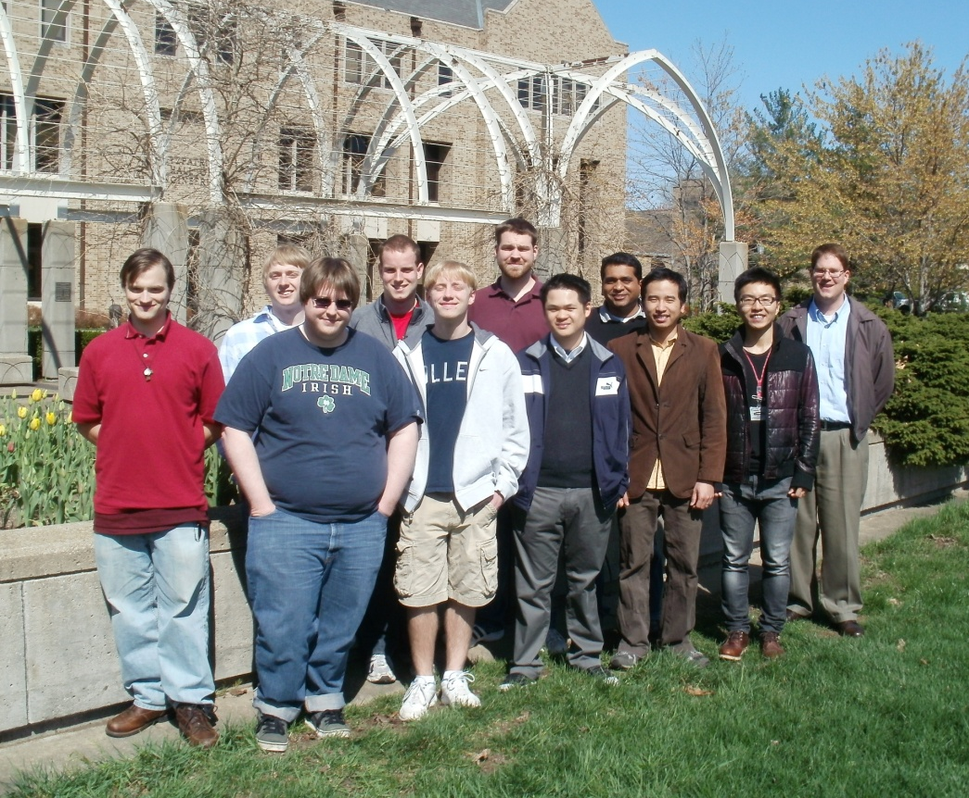
Meet the CCL Team
Newly minted Ph.D.s:
Dr. Hoang Bui: Rutgers University
Dr. Peter Bui: University of Wisconsin – Eau Claire
Current Grad Students:
Li Yu (Bloomberg)
Dinesh Rajan
Michael Albrecht
Patrick Donnelly
Peter Sempolinksi
Undergraduate Students:
Iheanyi Ekechuku
Chris Bauschka
Joseph Fetsch

Slide 4
Our philosophy:
Make it easy to scale up from one desktop to national scale infrastructure.
Provide familiar interfaces that make it easy to connect existing apps together.
Allow portability across operating systems, storage systems, middleware…
Make simple things easy, and complex things possible.
No special privileges required.

Slide 5
We are not there yet!

Slide 6
A quick tour: Makeflow Work Queue Parrot Chirp

Slide 7
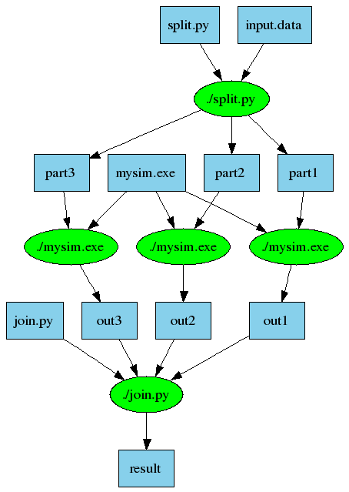
An Old Idea: Makefiles
part1 part2 part3: input.data split.py
./split.py input.data
out1: part1 mysim.exe
./mysim.exe part1 >out1
out2: part2 mysim.exe
./mysim.exe part2 >out2
out3: part3 mysim.exe
./mysim.exe part3 >out3
result: out1 out2 out3 join.py
./join.py out1 out2 out3 > result

Slide 8
Makeflow = Make + Workflow
Provides portability across batch systems.
Enable parallelism (but not too much!)
Fault tolerance at multiple scales.
Data and resource management.
Makeflow
Local
Condor
SGE
Work
Queue
http://www.nd.edu/~ccl/software/makeflow

Slide 9
Work Queue Library
#include “work_queue.h”
while( not done ) {
while (more work ready) { task = work_queue_task_create();
// add some details to the task
work_queue_submit(queue, task);
}
task = work_queue_wait(queue);
// process the completed task
}
http://www.nd.edu/~ccl/software/workqueue

Slide 10
Work Queue System
1000s of workers
dispatched to clusters, clouds, and grids
worker
worker
worker
worker
worker
worker
Work Queue Program
C / Python / Perl
Work Queue Library
put P.exe
put in.txt
exec P.exe <in.txt >out.txt
get out.txt
worker
In.txt
P
out.txt
http://www.nd.edu/~ccl/software/workqueue

Slide 11
Makeflow + Work Queue
sge_submit_workers
Private
Cluster
Shared
SGE
Cluster
Makefile
Wv
W
Hundreds of Workers in a
Personal Cloud
W
submit
tasks
W
W
W
Makeflow
Campus
Condor
Pool
Public
Cloud
Provider
W
W
W
W
W
W
W
Local Files and Programs
condor_submit_workers
ssh

Slide 12
Parrot and Chirp
Ordinary
Appl
Filesystem Interface: open/read/write/close
Parrot Virtual File System
Local
HTTP
CVMFS
Chirp
iRODS
Web Servers
iRODS
Server
CVMFS
Network
Chirp
Server

Slide 13
CS Research Questions
How do we allocate the appropriate resources from clusters/clouds/grids to run a given workload?
How do we avoid overloading shared resources that we do not control?
How do we safely compose multiple applications that have elastic parallelism?
How do we manage an ocean of results generated by scalable codes?

Slide 14
Software Challenges
How can we maintain/develop our software on an explosion of platforms at a reasonable level of effort?
How should we engage with other software projects, particularly NSF SI2?
Should we focus on broad capabilities or targeted solutions?
How do we balance software engineering against fundamental research?

Slide 15
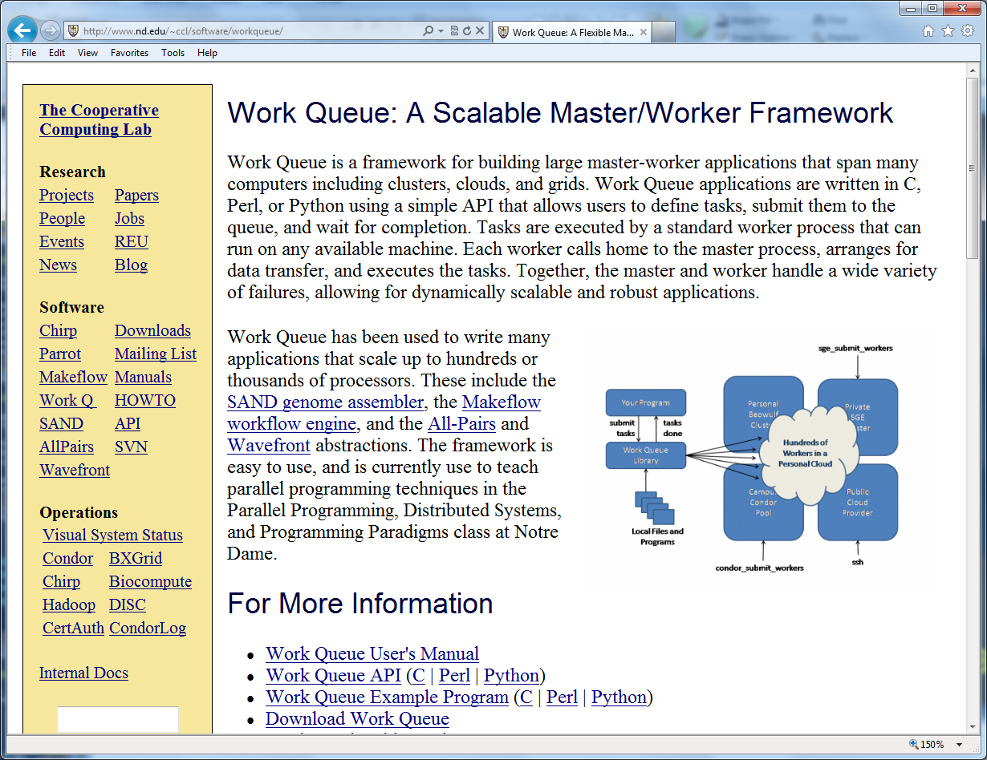
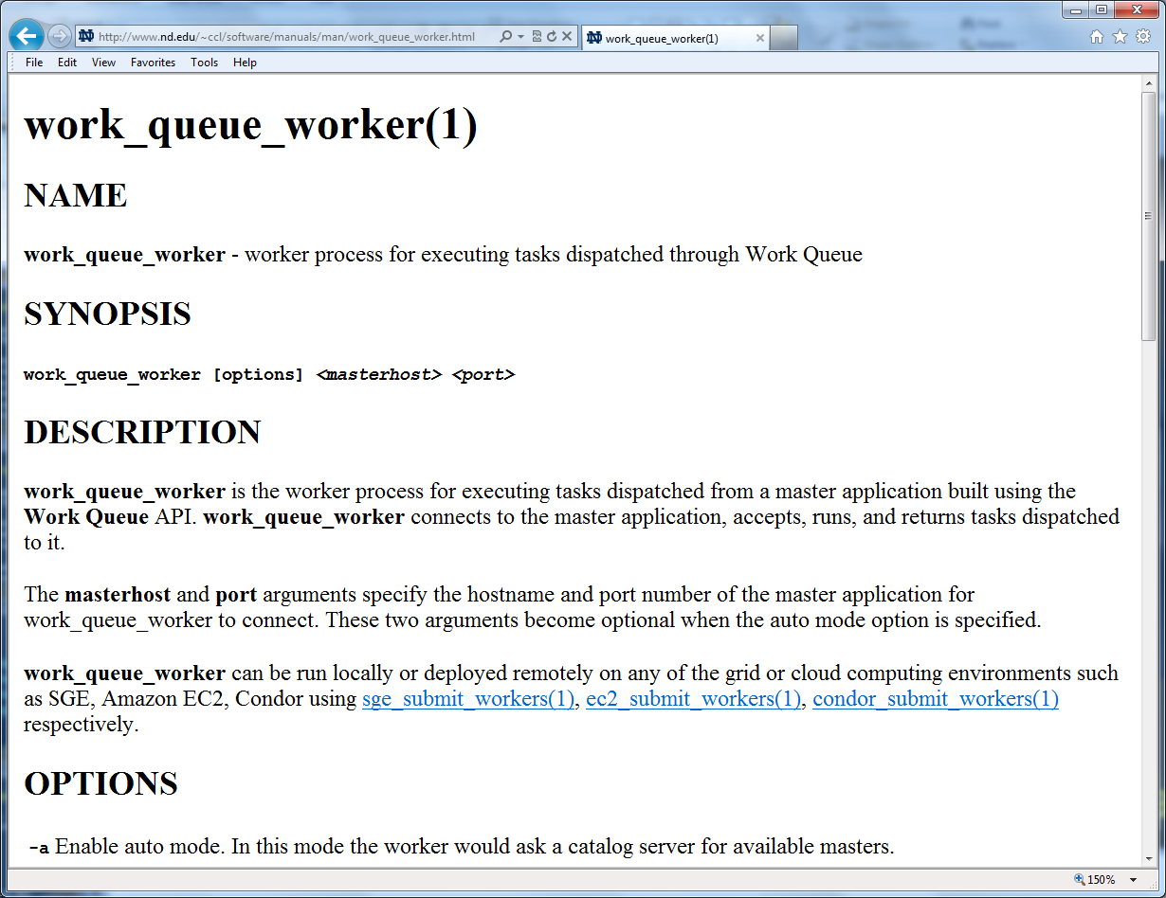
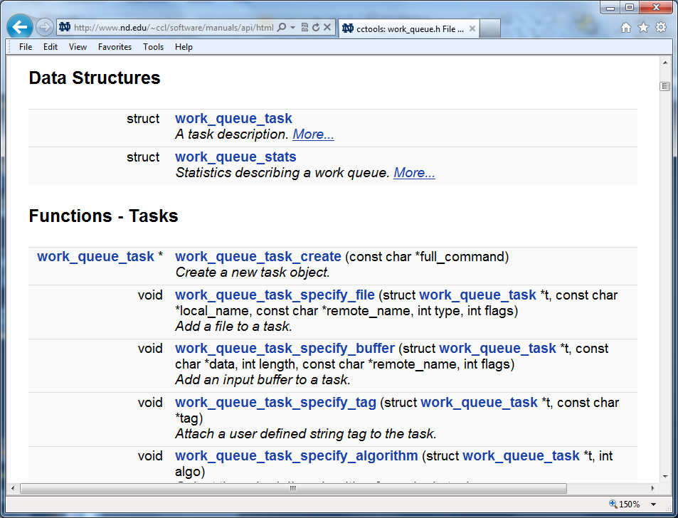
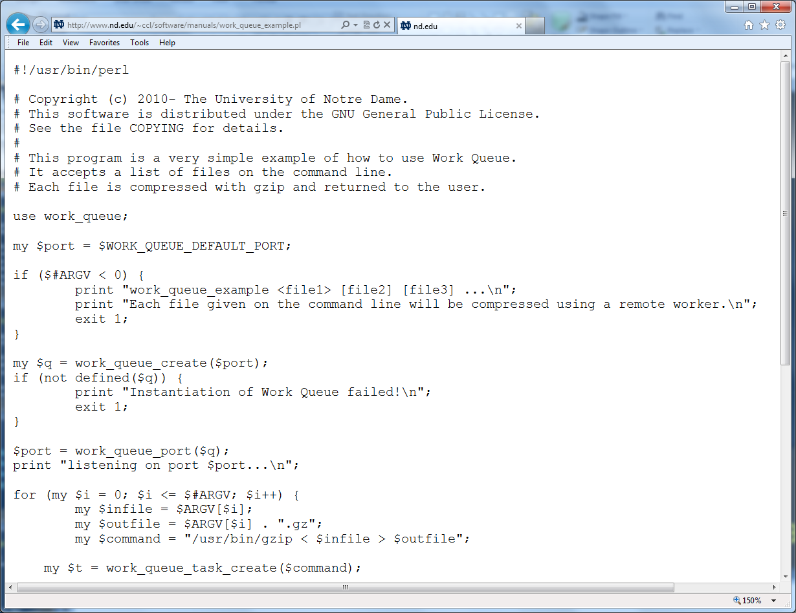
http://www.nd.edu/~ccl/software/manuals

Slide 16
What are the software challenges in your research? (and how can we help?)

Slide 17
Workshop Agenda
Monday Morning
Bioinformatics and Workflows
Molecular Dynamics Applications
Lunch
Monday Afternoon
High Energy Physics
Floods and Earthquakes
Dinner on Your Own
Tuesday Morning
New Developments from the CCL Team
Breakout Sessions
www.nd.edu/~ccl/workshop/2012

