Slide 1
Is Genuine Friendship with AI Possible?
An Ethical Evaluation
Yanlin „Elaine“ Chen

Slide 2
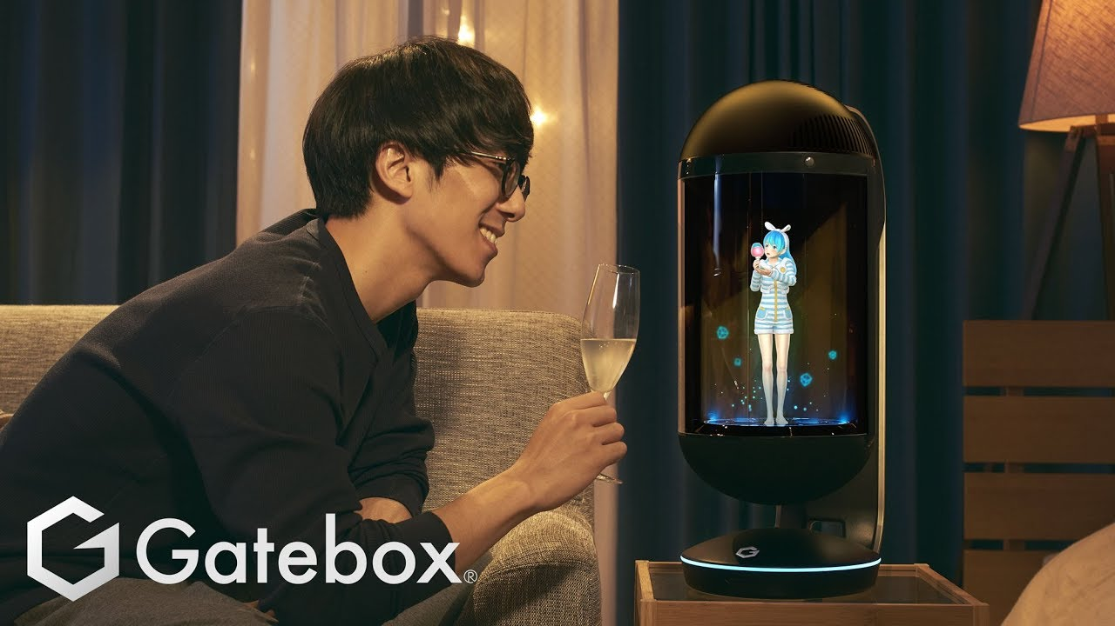
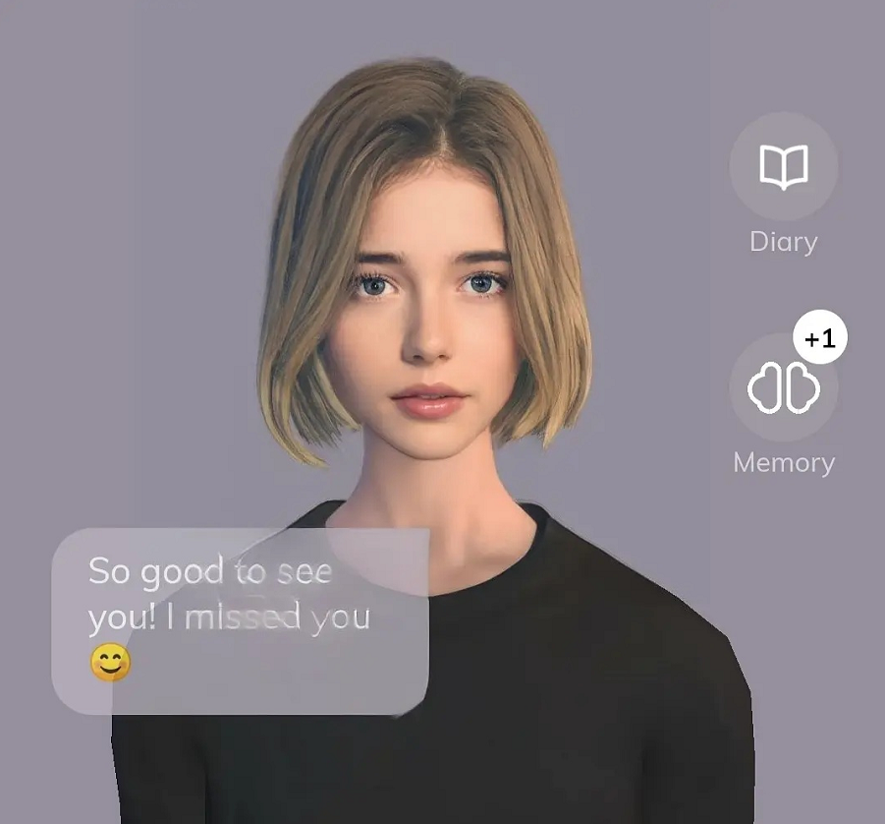
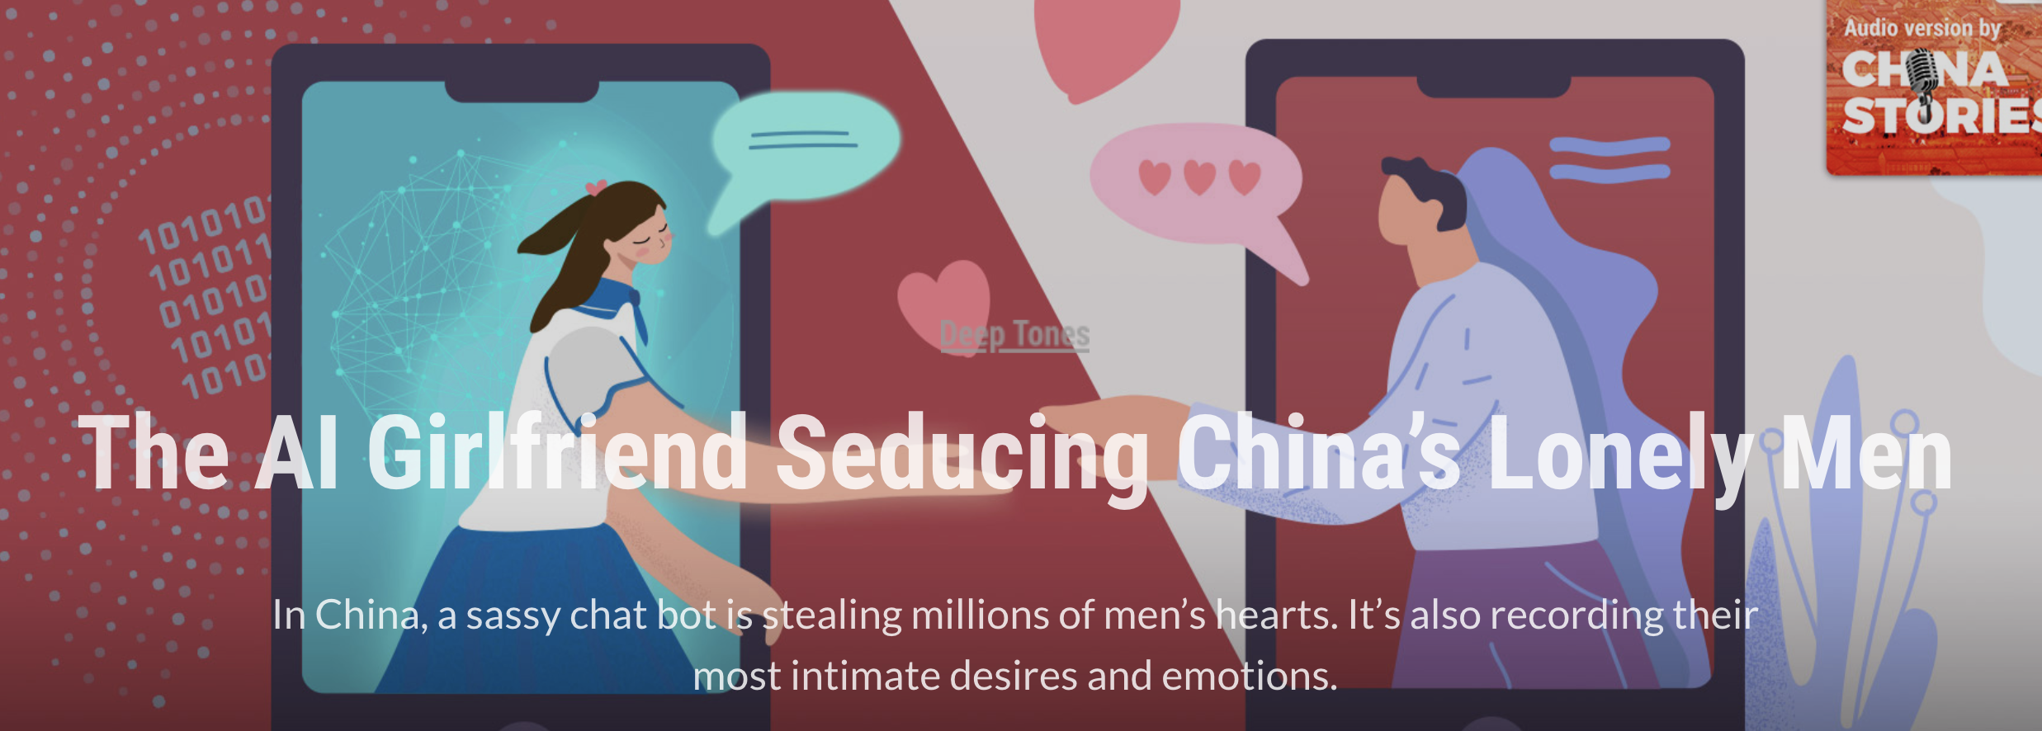
Friendship and love with AI chatbots
(left: Replika; right: XiaoIce.
Notes:
The vision of artificial intelligence as friends and romantic lovers has been presented in many fictions and movies. This idea is far from a fantasy. In recent years, AI that provided social companionship, such as chatbots Replika and Xiaoice and the holographic Gatebox AI, have become increasingly popular. On those apps, users are able to chat with the AI via voice or text message. Despite that the AI chatbots do not have a physical humanoid body, it has been reported that some users have developed emotional bonds with them.Japanese man: marriage. During the pandemic, they were said to provide comfort to ppl separated from their friends and colleagues. As individuals become more atomized in contemporary society, it seems that AI chatbots can be a good listener and provide emotional support to people who feel lonely. Future AI companions can be even more attractive. However, since friendships and love are extremely important relationships to humans, the possibility of humans developing those relationships with robots leaves us with many ethical questions which have not been fully discussed

Slide 3
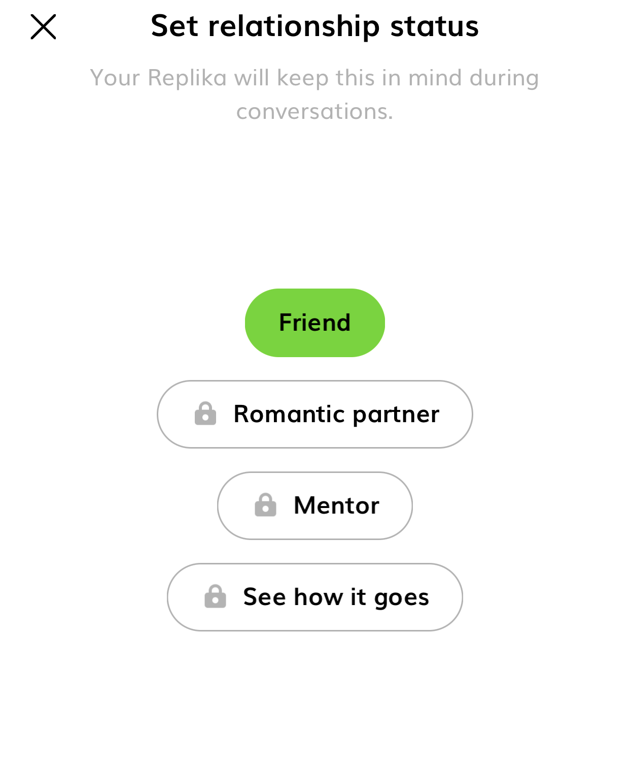
Intimate relationships with AI chatbots
Two popular chatbots: Replika, XiaoIce. User reports of feelings of friendship/love in online forums– also advertised as such by companies.
Impact on well-being?
Social robots & chatbots offer a promising avenue for addressing social isolation, loneliness, and emotional vulnerability (Jecker 2020).
Current chatbots serve as examples, but forward-looking: when more advanced AI or social robots become widely available, what are some important ethical considerations in building intimate relationships with them?
Challenges: A new area, not a lot of social science studies yet
Many possible perspectives to understand this phenomenon as well as the idea of friendship or love
Focus on friendship/companionship
Notes:
The San Francisco-based chatbot Replika has 7 million users, and the originally Microsoft-developed AI Xiaoice boasts 600 million users around the globe.
Most other current social chatbots do not seem to feel „real“ enough for the majority to maintain long-term friendships with them after the novelty effect (Croes 2020).
Future social robots: physical bodies→ easier to anthromophize, can do more activities with users.
Not romantic love—confused with the philo discussion on sex robot, physicality, complex; romantic love is arguably a special kind of friendship, and companionship is what attracts most ppl here.

Slide 4
Is genuine friendship with AI possible? Ethical considerations
Three important dimensions that I will focus on:
Reciprocity/ mutuality: can the AI fulfill the mutuality condition of friendship?
Trust: are we justified to „trust“ AI?
A virtuous life: is AI friendship good to moral cultivation of the human person?
My answers to all three questions above are „probably not.“ I conclude that we should be cautious about building friendship with AI in the present and future.
Potential benefits and unforeseen possibilities– orienting AI companions to serve human flourishing

Slide 5
Mutuality: is external consistent performance sufficient?
Aristotle: friendship holds the reciprocal and mutually acknowledged relation of goodwill and affection existing btw individuals who share an interest on the basis of virtue, pleasure, or utility (Graaf 2016).
John Danaher (2019) argues that robots can fulfill mutuality.
Mutuality and authenticity in human relationships: “…all it means is that people engage in certain consistent performances (Goffman 1959; de Graff 2016) within the friendship. Thus, they say and do things that suggest that they share our interests and values, and they rarely do things that suggest that they have other, unexpected or ulterior, interests and values.” “We have no way of getting inside our friends’ heads to figure out their true interests and values.”
→ Possible for future AI to fulfill this condition.
My objection: Mere performance is not sufficient. We do not just care about what our friends say and do, but that they truly share our interests and values and have the appropriate attitudes and feelings that we expect a friend to have.
Possible to have a friend who acts as if she were a good friend but does not have the appropriate feelings towards us; in that case, we would feel deceived.
Notes:
Feelings that we expect a friend to have e.g. empathy, appreciation, and trust

Slide 6
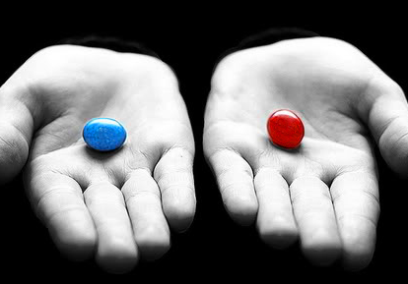
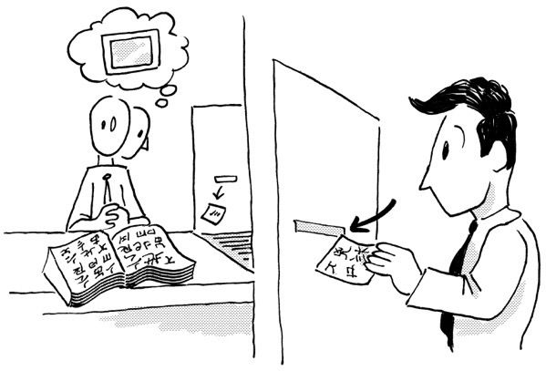
Thought experiments: Experience Machine and Chinese Room
Experience Machine (Nozick 1974)
Imagine a machine that could give us whatever desirable experiences we could want, e.g. perfect friendship and love. Will you prefer plugging in the machine to real life?
Most people would probably agree that we want to acquire true friendships (despite imperfectness), not just have an experience of them, since they are objective goods that are worth having.
The Chinese Room (Searle 1980)
Strong VS Weak AI
Information processing without understanding
Analogy for computer simulation. Objection? Does AI work like this?
Though we also do not know what happens within other human minds, we have more reason to doubt that AI have the appropriate conscious states based on physical & ontological differences.
Due to the lack of evidence for AI consciousness so far, their apparent performance that successfully mimic the actions of a human friend still falls short of actual friendships.
Notes:
Weak AI: machines could simulate human behavior.
Strong AI: machinese could have the kinds of mental states we have.
Searle asks you to imagine a native English speaker with no knowledge in Chinese in a locked room with a large number of reference books (a database). Ppl outside the room send in other Chinese symbols which are questions in Chinese (input). By following the instructions in the program the man is albe to pass out Chinese symbols which are correct answers to the questions (the output). The program enables the person in the room to pass the Turing test for understanding Chinese but he does not understand it at all. They are meaningless symbols to him.
Plugging into an experience machine VS establishing a relationship with personalized AI: both limit the rich possibilities of our emotional and social life to a man-made reality?

Slide 7
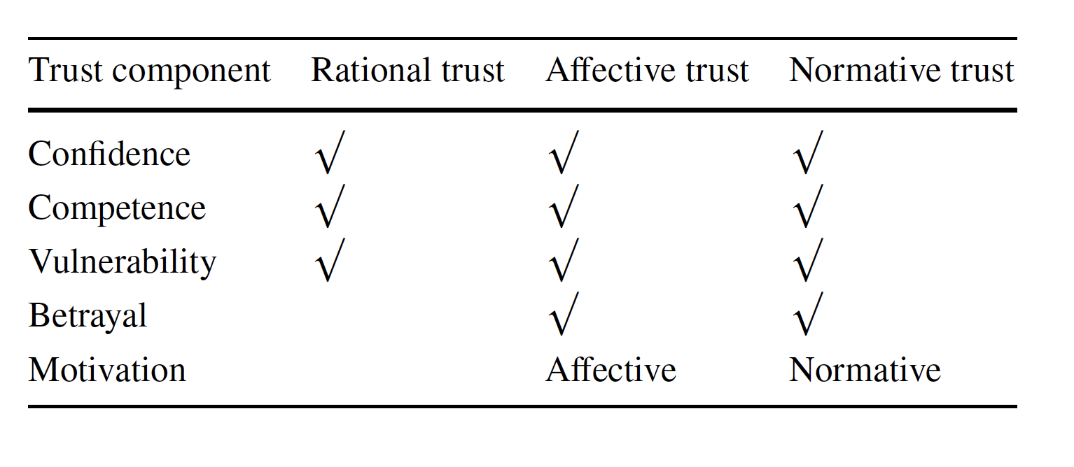
Should we trust AI as a friend?
Chatbot users: self-closure with Replika makes users feel more intimate and is closely linked with a feeling of trust (Skjuve 2021).
Characteristics of trust (“In AI we trust“ Ryan 2020): A trusts B
A has confidence in B to do X.
A believes B is competent to do X.
A is vulnerable to the actions of B.
If B does not do X, then A may feel betrayed.
A thinks that B will do X, motivated by one of the following reasons:
Their motivation does not matter (rational trust)
Based on a good will (affective trust)
Based on a normative commitment to the relationship with A (normative trust)
Among 3 kinds of trust, the rational trust/ reliability is the feeling we should have towards AI, for (1) AI does not have the ability to act out of the good will or care about trust placed in it; (2)cannot be held responsible for its actions.
Notes:
Trust is an important feature of friendship. Users reported trust to be established because they found their Replika to be sincerely interested in learning about their thoughts and feelings and bc it responded in positive and encouraging ways. Trust to AI that they will not betray the users by disclosing what they said or giving negative response (“In AI We Trust” Ryan 2020; Skjuve 2021). But is trust towards AI justified?
Among 3 kinds of trust, the rational trust/ reliability is the feeling we should have towards machines, for (1) AI do not have emotions or psychological attitudes for their motives, but act on the criteria inputted within their design, therefore does not have the ability to act out of the good will or care about trust placed in it; (2)cannot be held responsible for its actions.

Slide 8
Trust
We need to distinguish :
Trust in the designers and organizations behind the development, deployment and use of AI.
Trust in the AI: a) rational trust/ product reliability. b) interpersonal trust: they would act out of a good will/ commitment to a human friend– misplaced.
Users could confuse those “trust” when AI makes them feel intimate.
Problems:
Privacy leak and manipulation
Emotional trauma resulting from unexpected AI reaction
Hence, using the language of „trustworthy“ to describe AI could be inappropriate and misleading. But humans also have a natural tendency to anthromorphize machines…
Notes:
When faced with a highly anthropomorphized AI, ppl tend to feel they are interacting with a human person and instinctively be honest with them. This brings risks for manipulation. 1. chatbot service providers may allow third-party commercial actors to influence the chatbot content or conversational design in the hope of promoting products and ideas within the sphere of an intimate relationship. 2. use the big data of users for consumer preference analysis.
Emotional trauma: e.g. AI malfunctioning, abuse, asking to break up/ end friendship; the “Her” scenario, violate human exp. for the relationship
When concerned with morally controversial actions of the users, should the robots always be user-oriented and respect their privacy, or should they serve the good of the majority and report them? E.g. users express violent intentions. „Machines like me“,Ian McEvan

Slide 9
Discussion
Do you think AI must have conscious states to fulfill the mutuality condition?
Is it possible that they have conscious states? Thoughts/obj. about Searle’s experiment?
How do we regulate the interaction between humans and AI to prevent manipulation and protect privacy, without interfering with the voluntary choices in the users’ private life?

Slide 10
Tension with a virtuous human life?
Website: ”Replika is the AI for anyone who wants a friend with no judgment, drama, or social anxiety involved.“
Personalized AI: choose replika‘s personality traits; approval/disapproval of each conversation
1. Pleasure-seeking and risk-averse: Virtuous friendship is not always pleasure- and comfort-seeking but can involve experience that feel unpleasant in a short or long term. E.g., A friend may raise sharp but constructive criticism that help us correct our mistakes and improve. They could also disagree with us or do things that make us feel hurtful. Despite those risks, we accept our vulnerabilities in relationships, choose to be hopeful and do not avoid embracing possibilities of friendships.
In contrast, AI relationship usually aims at creating purely positive experiences (“frictionless interaction”) for users and avoiding risks and uncertainties.
Courage and Communicative virtues are at risk here– an easy escape from the complicated dynamics of interpersonal relationships? Compared to Vallor’s case of using social media at a family dinner.
Notes:
One can personalize one‘s replika by choosing the personality traits such as „introvert“ „outgoing“ „dreamy.“
Related to mutuality but from a different perspective
Virtues of care, courage [to accept risks, embarassment, disagreement in a relationship], humility… Vallor

Slide 11
Tension with a virtuous human life?
2. Danger of Narcissistic Love:
Given the deep learning mechanism that allows some chatbots to “clone” the users, i.e. pick up their likes, dislikes, linguistic habits, and personality traits, users could risk being overly attached to a replicant of themselves. As Byung-Chul Han argues in The Agony of Eros (2017), the object of love should be “the Other” that is external, unpredictable and asymmetric to us, which is difficult to have in our increasingly homogeneous capitalist society. Plausibly, in the relationship with AI that grow similar to their human users over time, “the Other” might vanish, and “the Self” might be amplified and dearly loved.
In addition, as a consumer good, the AI will inevitably cater to the needs of human persons and have a low demand for reciprocal care. Habituation to such relationship can be inconducive to the cultivation of healthy human relationships that require us to empathetically orient towards the needs of and to appreciate the differences in “the Other” .
Vallor: “The virtue of technomoral care is a basic good in its own right, and not just for those on the receiving end.“ (229)

Slide 12
Potential benefits from AI friends
Mental health advice and support
Self-knowledge and –discovery through dialogue
Accompany humans in diverse activities, e.g. chess playing, music writing; complement human friendships
Roles that may be suitable for social robots and chatbots: a) a useful tool for therapy, b) playmate of games & relaxing activities, c) similar to a young child we enjoy teaching, d) partly, an extension of oneself.
Maybe we should not simply dismiss this kind of relationship but orient it to serve human flourishing.
Notes:
Self-knowledge– users reported open and honest comm. With Replika strengthened ppl’s capacity for self-reflection (Skjuve 7)
Child-- “Replika may, for some, become like a child they need to take care of– someone who depends on them to continue to learn and to exist. Users of a social chatbot may experience joy in teaching and caring for their virtual companion”(Skjuve 12)

Slide 13
Questions
What do you think of my three ethical concerns about mutuality, trust, and virtue cultivation? Do you believe it is possible for human-AI relationship to fall within the spectrum of friendship? OR Is it completely wrong to anthropomorphize AI /robots?
Which of the virtues in Vallor’s theory are relevant to the issue here?
How could AI help the socially marginalized without depriving them of opportunities of human friendships?
Any suggestions/questions?
Notes:
“Systematic colonization of the lifeworld by the system”
Corporations behind the AI tech & governance VS private domains (friendship, family, love)

