Slide 1
Concepts on motion: A prelude to the foundations of modern mechanics
Terry Hines
Amy Porter
Tom VanSlochem
Notes:
There existed a long and gradual change of concepts on motion during the Middle Ages

Slide 2
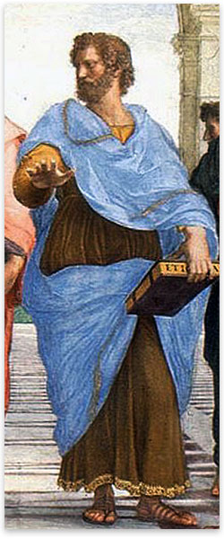
Aristotle
“Unnatural” motion requires the action of an external agent
Many who studied Aristotle were critical of this point

Slide 3
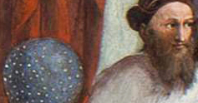
Hipparchus
190 – 120 B.C.
Expressed vaguely the concept of an impressed force that was transmitted to a moving body

Slide 4
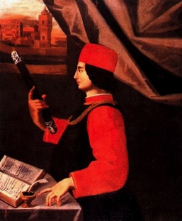
John Philoponus
490 - 570
Greek Christian philosopher
Argues that a heavier body will not fall faster than a lighter one
Saw no problem with motion through a void
Argued that forced motion is produced

Slide 5
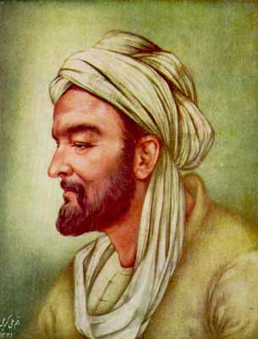
Avicenna & Avempace
980 – 1037
Muslim, Aristotelian philosopher & scientist
1095 – 1138/9
Supported view of an impressed force

Slide 6
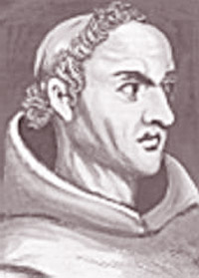
William of Ockham
1287 – 1347
English Franciscan
Held that motion, once it existed, did not require continuous cause to maintain it
Disagreed with all previous beliefs that required a force for sustained motion

Slide 7
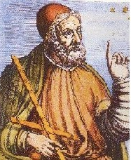
John buridan
1295 – 1358
French Aristotelian philosopher
Studied under William of Ockham
Formulated Impetus Theory

Slide 8
Impetus theory
“The mover of an object transmits to the object a power proportional to the product of the amount of matter (or mass) in the object times the speed of the object.” - Cushing
In modern terms: mv

Slide 9
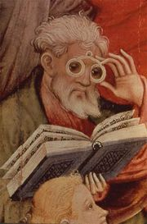
Nicholas oresme
1320 - 1382
Student of Buridan
Proved Merton Theorem
Notes:
This is essentially the same law Galileo would establish 300 years later.

Slide 10
question
What do you think Aristotle would have said in response to Impetus Theory?

Slide 11
Galileo galilei
1564-1642

Slide 12
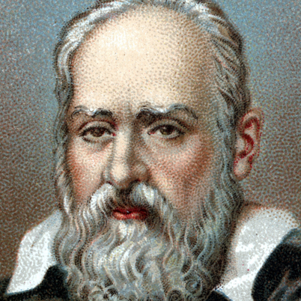
Galileo
Born in Pisa in 1564
Father, Vincenzo Galilei, was famous composer
Had 3 children with his mistress, Marina Gamba
Virginia (1600 - 1634) became Sister Maria Celeste
Livia (1601 – 1659) became Sister Arcangela
Vincenzio (1606 - 1649)
Correspondence from 1623 – 1634 between Galileo & Maria Celeste

Slide 13
Excerpt from Letter to Galileo from daughter dated May 14 1633:
Most Beloved Lord Father,
…This current year was to bring Suor Arcangela's turn as Cellarer, an office that gave me much to ponder. Indeed I secured the Mother Abbess's pardon that it not be given to her by pleading various excuses; and instead she was made Draper, obliging her to bleach and keep count of the tablecloths and towels in the convent.
I feel particularly delighted to hear that your health is in good condition, Sire, as I was very worried about your well-being on account of the travails you have endured; but the Lord God wanted to grant you the combined graces of freeing you not only from the torments of the spirit but also those of the body. May He be ever praised!”…
Your most affectionate daughter, S. M. Celeste

Slide 14
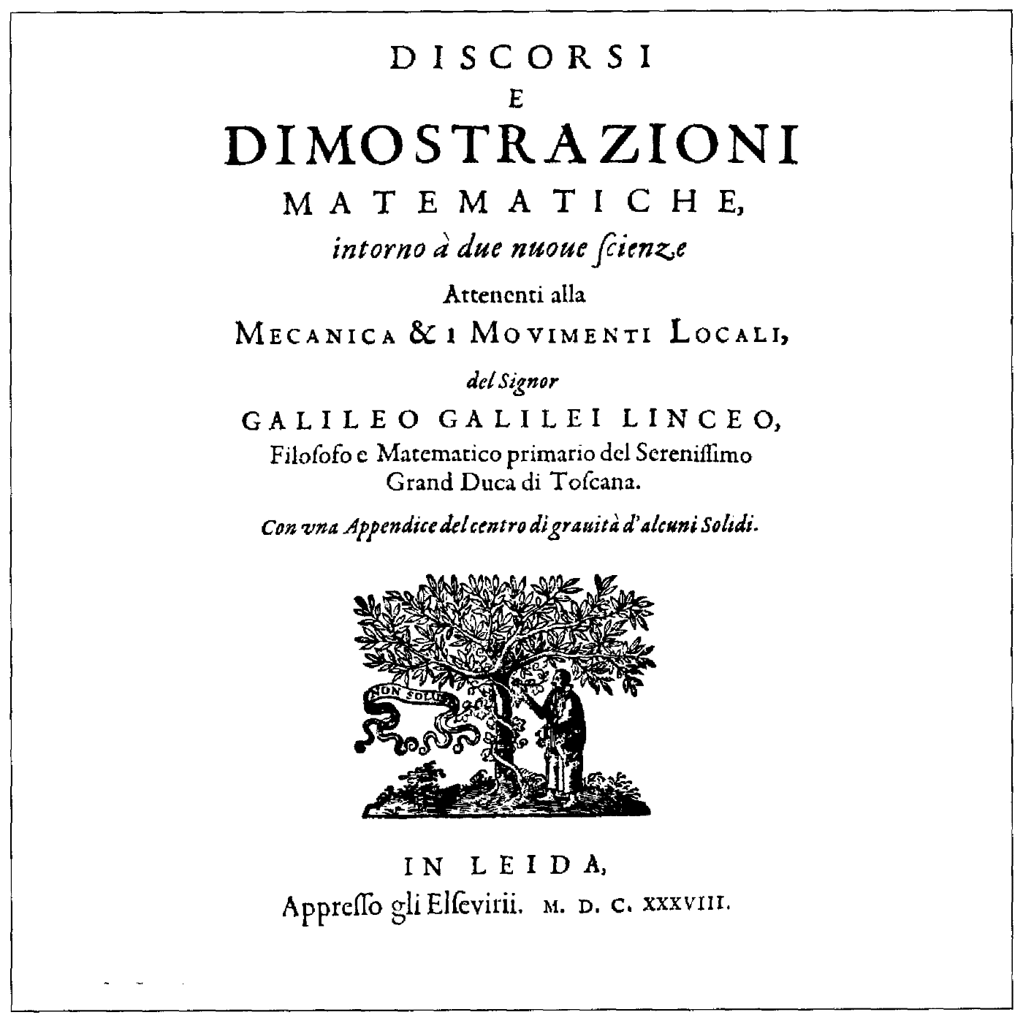
Galileo’s Dialogues
Published in 1638 in Italian
Two new sciences: Strength of Materials & Motion
Notes:
During the time he taught the mathematical subjects at the university of Pisa (1589-1592), Galileo began a book, De motu ("On motion"), which was never published. In it, we can trace the early development of his ideas concerning motion.

Slide 15
Galileo on Aristotle
Refutes the Aristotelian dogma that rate of fall of a body is proportional to its weight
M > m, V > v
http://www.youtube.com/watch?v=SyfgsqBM1Ng
m
M
M
m
v
V
v’
Notes:
If m and M represent light and heavy stones, then according to Aristotle, M should fall more rapidly than m (v < V)
Together (m+M), m should retard M while M should make m fall more rapidly (v < v’ < V)
However, since (m+M) is heavier than M, it should fall more rapidly than M alone
Galileo claims that this results in an inconsistency (v’ < V and v’ > V simultaneously) in Aristotle’s hypothesis
This can be avoided if v’ = v = V: the statement that all bodies fall at the same rate
This argument was largely a polemical device to undercut the Aristotelian position and, by inference, to support Galileo’s.

Slide 16
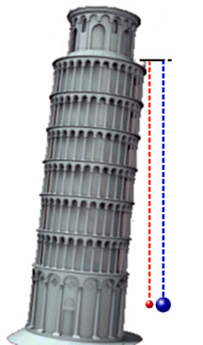
Leaning Tower of Pisa Experiment
Often cited as proof that all bodies fall at the same rate
Galileo could never actually have gotten his alleged results
Notes:
Galileo could have never actually gotten the alleged result that a heavy body and a light one had the same time of fall from the top of the tower
To prove this, we use the hindsight of modern theoretical mechanics, as well as direct observation

Slide 17
Naturally accelerated motion
“A motion is said to be equally or uniformly accelerated when, starting from rest, its [speed] receives equal increments in equal times.”
Key insight: time as an independent variable so that position and velocity become functions of time
Notes:
One of Galileo’s greatest discoveries was that, in natural free-fall, a body is accelerated toward the Earth at a constant rate
He termed motion with constant accelerated “Naturally accelerated motion”
He stated that N.A.M. should be defined in a way that not only agrees with the facts, but is also such that the velocity increases in a simple a manner as possible

Slide 18
Question
How could Galileo slow down the fall of objects in order to measure them?

Slide 19
Incline experiments
Naturally accelerated motion includes vertical free-fall and motion of object down a smooth incline
Notes:
According to Galileo, N.A.M. included vertical free-fall and motion of an object down a smooth incline
He argued that an object starting at rest would cover a distance proportional to the square of the elapsed time
Ran experiments on inclined planes to prove this

Slide 20
Question
How else do you think Galileo measured time in his experiments?

Slide 21
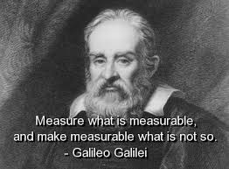
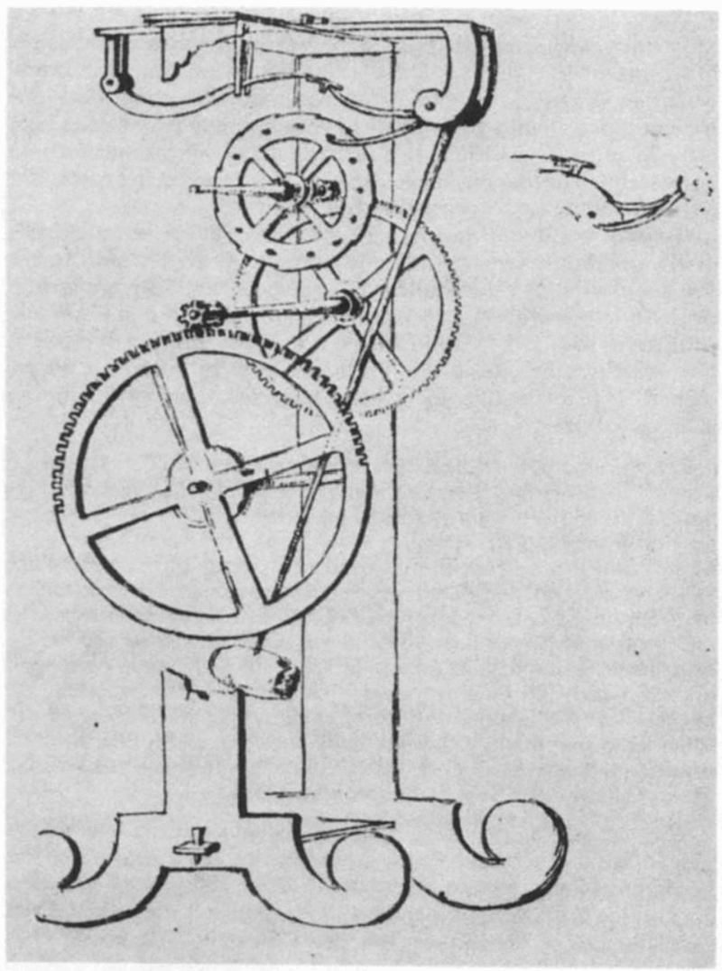
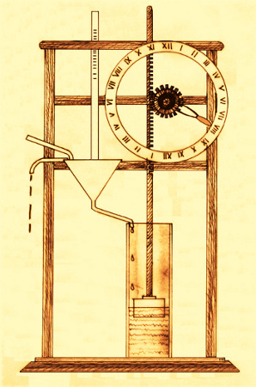
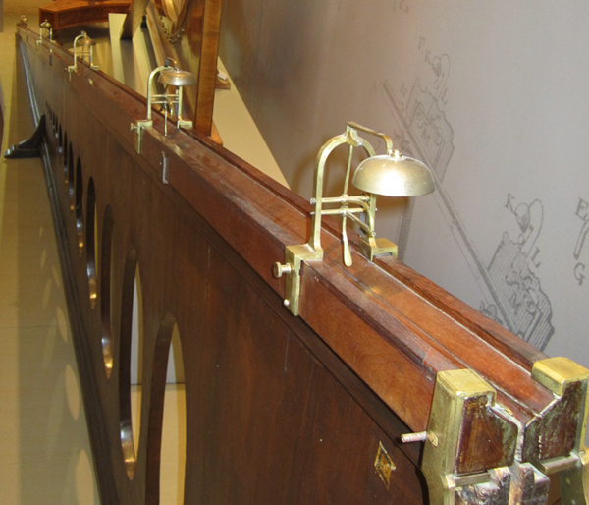
Galileo’s instrumentation
Pendulum
Water Clock

Slide 22
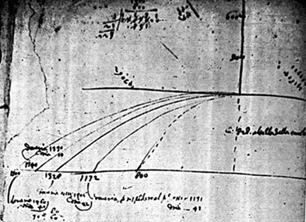
Projectile motion
A page from his notebook demonstrating projectile motion:

Slide 23
inertia
Galileo
Formulated concept, but did not include dependence on mass
Inertia: a property by which a body tended to persist in its state of motion
Descartes
Principle of Inertia: every body tends to continue its motion in a straight line (or to remain at rest) unless it is under some constraint
Huygens
“Any body already in motion will continue to move perpetually with the same speed and in a straight line unless it is impeded”

Slide 24
Question
What about Galileo made it possible for him to break from Aristotelian thought?
Notes:
Does it make any difference that Galileo grew up in a household with a father who was a very famous musician?
What about his personal life, training, education, family, etc would have impacted this?
Had an early work that was very Aristotelian → eventually broke free of this

