Slide 1
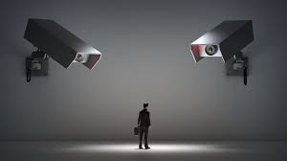
Dataveillance and Covid-19
THE CONFLICT BETWEEN FUNDAMENTAL RIGHTS AND HEALTHCARE
SOLINA KIM

Slide 2
Table of Contents
01
Background
02
Case studies of Covid-19 dataveillance
China
South Korea
Singapore
United States
03
Public’s response to Covid-19 dataveillance
Pushback on dataveillance
Pushback on abuse of dataveillance
Submission or Trust?
04
Discussion

Slide 3
01
Background
HISTORY OF HEALTH SURVEILLANCE
Record-keeping for disease control
1348 bubonic plague epidemic: first instance of mass quarantine
2003 SARS (US)
2015 MERS (S. Korea)
2020 COVID-19

Slide 4
02
Case studies of Covid-19 dataveillance
- Common use of mobile apps
CHINA
S KOREA
SINGAPORE
US
Health Code App (QR)
Close Contact Detector App (GPS data)
Quarantine app (GPS data)
QR codes
Initial self-reporting system
QR codes
TraceTogether
(proximity data)
Exposure Notifications

Slide 5
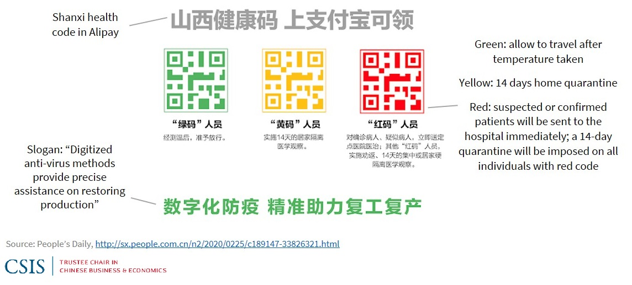
02
Case studies of Covid-19 dataveillance
Health Code App (QR)
Close Contact Detector App (GPS data)
CHINA
Name, ID, facial information, body temperature, symptoms, GPS data
RED status: restricted travelling, enforced quarantine
National health, aviation, transport data

Slide 6
02
Case studies of Covid-19 dataveillance
Quarantine app (GPS data)
QR codes
Initial self-reporting system
S KOREA
Contagious Disease Prevention and Control Act (CDPCA)
Established after 2015 MERS outbreak
But contact tracing was initially based on a self-reporting system
Data accessed only in critical situations of non-compliance
Mandatory disclosure of tracked information on MOHW website

Slide 7
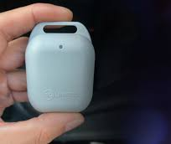
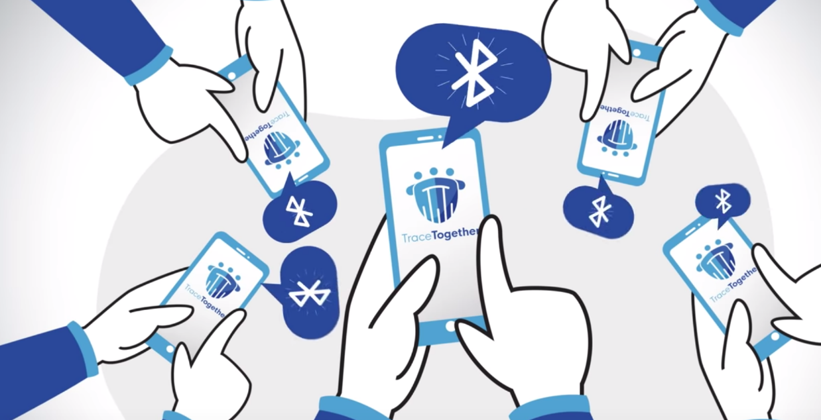
02
Case studies of Covid-19 dataveillance
QR codes
TraceTogether (proximity data)
SINGAPORE
Developed by the Government Technology Agency of Singapore
Does NOT track geolocation data
Uses Bluetooth to track proximity between users
The government maintained that the app does not track users’ location data, and that the collected proximity data will not be used for other purposes
But the government used the app to identify interactions between individuals relevant to a murder case
25% low adoption rate
TraceTogether tokens
TraceTogether

Slide 8
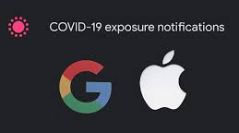
02
Case studies of Covid-19 dataveillance
US
Exposure Notifications API
Lack of funding for contact-tracing in many states
No legal authority like Korea’s Contagious Disease Prevention and Control Act
Practically impossible to enforce mass quarantine without dataveillance
Similar to Singapore’s TraceTogether
Joint developed by Google and Apple

Slide 9
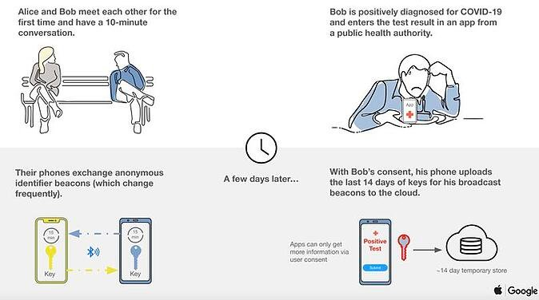
02
Case studies of Covid-19 dataveillance
US
Exposure Notifications API

Slide 10
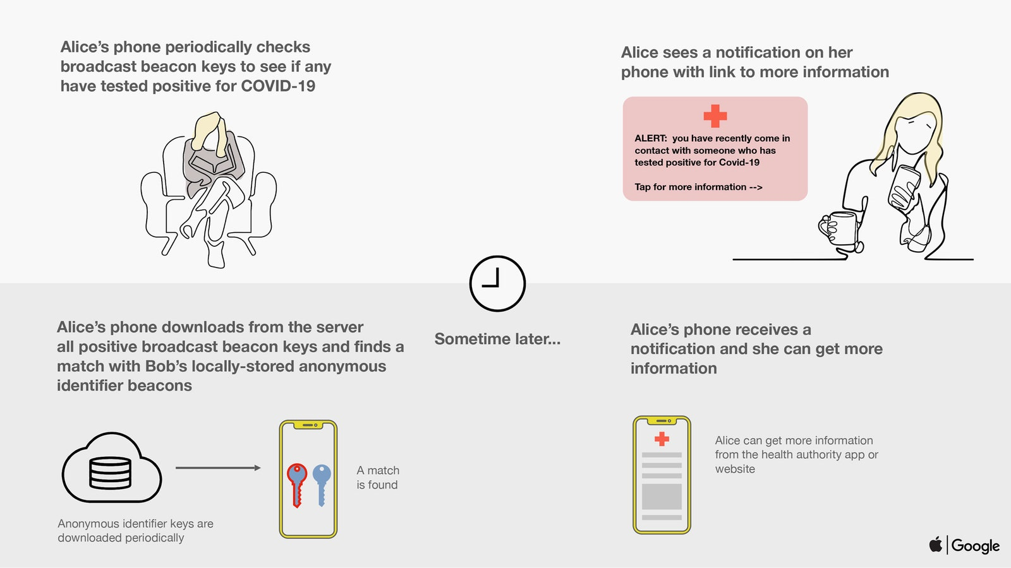
02
Case studies of Covid-19 dataveillance
US
Exposure Notifications API

Slide 11
02
Case studies of Covid-19 dataveillance
US
Exposure Notifications API

Slide 12
02
Case studies of Covid-19 dataveillance
US
Exposure Notifications API
Countries with apps that are based on Google and Apple’s Exposure Notifications API:
Austria, Belgium, Brazil, Canada, Croatia, Cyprus, Czech Republic, Denmark, Ecuador, Estonia, Finland, Germany, Gibraltar, Greece, Ireland, Italy, Japan, Kazakhstan, Latvia, Lithuania, Malta, Netherlands, New Zealand, Northern Ireland, Norway, Panama, Poland, Portugal, Russia, Saudi Arabia, Scotland, Slovenia, South Africa, Spain, Switzerland, United Kingdom, Uruguay,
USA (Alabama, Arizona, California, Colorado, Connecticut, Delaware, District of Columbia, Guam, Hawaii, Louisiana, Maryland, Michigan, Minnesota, Nevada, New Jersey, New York, North Carolina, Oregon, Pennsylvania, Puerto Rico, South Carolina, North Dakota, Wyoming, Utah, Virginia, Washington, Wisconsin)

Slide 13
02
Discussion
Is it more effective to outsource to private companies in countries like the US where there is significant distrust in the government?
GOV-DEVELOPED APPS
vs
PRIVATE COMPANIES
Singapore’s TraceTogether
Only collects proximity data
Motivation to access data for investigations and government surveillance
Apple/Google’s Exposure Notifications
Only collects proximity data
Not a government; less motivation to abuse data
Even if they do access the data, it will not be to punish crimes.
Concentration of technology and global data. More difficult to shut down system if problems arise.

Slide 14
02
Discussion
LOCATION DATAVEILLANCE
vs
PROXIMITY DATAVEILLANCE
S. Korea & China’s app
GPS-based
Invasion of private life
Certain restaurants/businesses can lose customers
Singapore’s TraceTogether & Apple/Google’s Exposure Notifications
Bluetooth-based
Danger of previously confidential interactions being disclosed
(lawyer-client, doctor-patient, journalist-source)

Slide 15
03
Public’s response to Covid-19 dataveillance
3 CATEOGRIES:
Pushback on dataveillance
Pushback on abuse
of dataveillance
And...well China
US
S KOREA
CHINA
SINGAPORE

Slide 16
03
Public’s response to Covid-19 dataveillance
42% support the government encouraging everyone to download/use contact tracing apps
49% support carrying out centralized quarantine
44% support electronic device monitoring
Difference between Republican opposition (54%) and Democratic opposition (53%) is indistinguishable
General distrust in the government
Emergence of extreme libertarianism & data protectionism in the US
Pushback on dataveillance
US

Slide 17
03
Public’s response to Covid-19 dataveillance
Prioritizing healthcare over data privacy
But pushback on abuse of data in situations irrelevant to pandemic regulation
89.1% support the government’s dataveillance methods for Covid-19 regulation
On Mar 9, 2020, Korea’s National Human Rights Commission issued a suggestion that exceedingly detailed information on contact tracing reports were an unnecessary infringement on data privacy
Pushback on abuse
of dataveillance
S KOREA

Slide 18
03
Public’s response to Covid-19 dataveillance
Jan 2020
July 2020

Slide 19
03
Public’s response to Covid-19 dataveillance
Submission?
Trust?
“In China, no one has privacy. At least now they can use the information for something good.”
Overall compliance to expanding surveillance based on trust in the Chinese government
Frustration of the West’s blame on Chinese for the pandemic and their focus on abstract ethics when people were dying
CHINA

Slide 20
04
Discussion
How can we use dataveillance to improve pandemic control without sacrificing too much privacy?
NATURE’S PROPOSED GUIDELINES FOR CONTACT-TRACING APPS:
Does it need to be developed to save lives?
Does the gravity of the situation justify the potential negative impact?
Is it sufficiently effective, timely, popular and accurate?
Is there an explicit and reasonable date on which it will cease?
Is it optional to download and install?
Does it require consent?
Are the data kept private and users’ anonymity preserved?
Can users erase the data?
Is the purpose of the data collection explicitly defined?
Is its use limited to tracing and tracking of Covid-19 only?
Is the code publicly available for inspection, sharing and collaborative improvement?
Is there a decommissioning process?

Slide 21
04
Discussion
How can we use dataveillance to improve pandemic control without sacrificing too much privacy?
CONCERNS:
Difficult for ordinary citizens to check if the government is abusing data from health surveillance
Requires highly advanced scientific literacy. True transparency means making sure the public understands.
But too much transparency can also be problematic
Korea: too transparent, data was abused by the public
Singapore: not transparent, data was abused by government
government developed apps vs privately developed apps
location dataveillance vs interaction dataveillance
Extreme distrust in the government
Snowden Revelations 2013
Routine mass surveillance by Obama administration (exposed in 2017) even after vowing not to do so (in 2011)

Slide 22
04
Discussion
How can we use dataveillance to improve pandemic control without sacrificing too much privacy?
CONCERNS:
Multi-purpose data
There is no guidelines that address government/tech companies’ use of data for expanding purposes.
Is it okay for Google to use Chrome users’ data to develop self-driving cars?
Is this example different from the Singaporean government’s use of Covid-19 surveillance data for judicial purposes?

