Slide 1
Alex Nisbet | Annotated bibliography presentation | Prepared for April 22nd
AI x Healthcare: Facilitative of the good life or an erosion of patient trust and physician expertise?

Slide 2
Plan for today:
Introduction
Three use cases
Ethical Considerations
Legal considerations
What does it mean to be a doctor?
Being Mortal
Possible implications
Summary of literature search

Slide 3
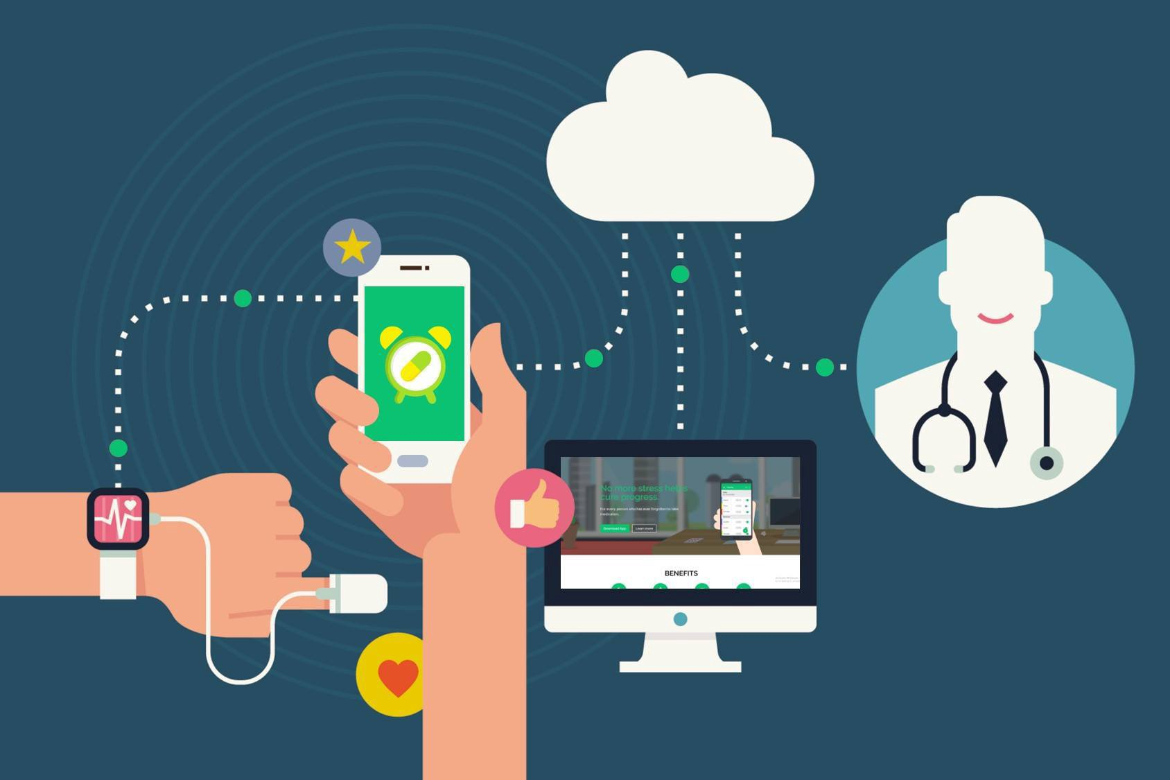
Introduction
The core tenet of my concern: to what extent will the use of AI/ML/Big Data within the healthcare sphere exacerbate pre-existing bias or potentially introduce new ones.
Technology has a profound possibility of aiding current healthcare practices, but with these new interventions come concerns about risk to privacy, equity, and fairness.
Widely growing in prevalence:
As of 2020 there were 64 FDA-approved devices, with more seeking approval each year

Slide 4
Learning Data sets
Algorithms, specifically AI/ML programs learn from pre-disposed data sets, termed ”learning” or “training” sets, in order to observe patterns that can henceforth be used to generate predictions for future relations.
Problem: our status quo systemic entrenchment of inequity (can be broke down by race/ethnicity, SES, geography, etc.) may dictate that ‘learning’ data sets contain misplaced inequities that inform biases
Worry: That an algorithm may produce unfair results (e.g., the disadvantaging of people of color), even if developers intentionally consider only non-demographic factors
Notes:
Worry: informed by (Lin et al 2020). Within the medical sphere this might look like an algorithm arbitrarily offering less care (measured by the perceived return on investment) to people of color who happen to live in a neighborhood with lessoned access to care and wellness supplements (i.e., grocery stores and parks).
The lack of food and wellness access could result in a decreased ability to follow medical advice, scoring them worse on medical adherence simply due to circumstantial limitations
This could result in a bias against POC being perpetuated due to the pre-existing environmental conditions that these families themselves do not fully control but are nonetheless punished for.

Slide 5
Three use cases
(1) Community Vital signs:
A proposed primary care algorithm that automatically links a patient’s zip code to calculated demographic risk factors and presents this data to the clinician
(2) Diabetes Retinopathy
Algorithmic scanning of risk factors and optometric imaging to assess risk.
Assistive diagnostics
(3) Prescriptive Diagnostics
Further researching – but what happens when computers themselves make diagnostics?
Issues with privacy? Who is held accountable?
Notes:
(1)
Could draw from economic conditions, supermarket availability, social deprivation indices, etc.
Allow a professional to know if their patient lives in poverty and what resources might be available
Diffuse difficult conversations about living in poverty such that these data are already available to the clinician.
(2)
Diabetes Retinopathy is the leading cause of non-congenital vision in the US.
Early action is imperitive
Amongst the first uses of AI within the healthcare setting. Good accuracy. Have been validated to a host of multi-ethnic datasets.
Strong arguments throughout the literature that image diagnostics are uniquely able to capture all of the positives of AI without many of the broader worries
(3)
Privacy issues pervade the field and have heretofore limited the trust of interventions and their ability to be implemented within the field.
Accountability is likewise a significant consideration that has not fully been considered to this point.
For example, the Watson machine is predicted as being able to read 500,000 papers within 15s → theoretically the knowledge base of the algorithmic decision making systems will be far superior.

Slide 6
Discussion Questions
Are these potential use cases an invasion of privacy?
The authors of Voigt 2019 bring up that if these algorithms are as beneficial as they claim to be, might we have a moral imperative TO implement them?
Do the ethical qualms differ significantly by the usage of the algorithms in each case? Can one set of guidelines aid the full scope of AI/ML within healthcare?
Notes:
Class comments:
-

Slide 7
Ethical Considerations
Black Box – eroding the trust of a healthcare diagnosis?
Patient & Physician Autonomy
Inherently in contradiction with patient-based medicine (?)
Virtue based system of technology management
Notes:
(BB) A recurring theme in my research has been the difficulties that physicians themselves have with trusting AI/ML algorithms and their impact on the healthcare sphere. There is outstanding hesitancy over the ability to understand the inner workings of these systems.
Without an understanding of the inner workings, and a direct knowledge of the weights assigned to various different points, many physicians and patients are unsure of how to navigate this space.
(Autonomy) Both physicians themselves and patients are worried about the ability to trust and make their own medical decisions, rather than just be told the diagnoses without room for rebuttal.
Current legal landscape on physician decision making preserves room for purposeful variance, will this be eroded?
(Patient-based medicine) if the inherent goal of patient-based medicine is for the physician and patient to enter into a shared state of medical decision making, then relying upon an un-interpretable AI/ML diagnostic and prescriptive machine may impair the opening of this relationship.
(virtue) Ferryman offers the possibility that we encourage companies and systems themselves to redefine and set up equity in order to ensure that we offer good healthcare AI/ML
(1) demonstrated knowledge of health disparities in clinical domain
(2) data bias review
(3) group impacts/performance decisions
(4) health equity review – iterative management of group differences or key impacts to be aware of.

Slide 8
Legal Considerations
Accountability – similar to those issues raised with autonomous weaponry
FDA Guidelines: Constantly updating their regulations, working to respond to adaptive machines
But adaptive response is difficult
Possibilities of data cooperatives
Regulatory frameworks for AI reporting are actively being suggested (Norgeot 2020)
Notes:
(Account.) who will take the blame? Will all responsibility remain within the culpability of the physician? Will their requirement of responsibility be delegated to the autonomous equipment manufacturers?
Different types of accountability for specific types of AI/ML?
(FDA) FDA is actively working to classify and prepare for the increase in medical device saturation of the markets. Potential emphasis on clearing specific companies.
(data cooperatives) possibility of letting individuals have some governance over their own data and how it impacts the possibility of data safety. Lets persons have a seat at the table.

Slide 9
Selected Technosocial Virtues
Justice: Upholding rightness
“A reliable disposition to seek a fair and equitable distribution of the benefits and risks of emerging technologies” (128).
Empathy: Compassionate Concern for others
“Cultivated openness to being morally moved to caring action by the emotions of other members of our technosocial world” (133).
Care: Loving service to others
“Consider how systems of social and economic privilege have long allowed individuals to divest themselves of the responsibility for caring practices by delegating these responsibilities to hired substitutes or, increasingly, by using technology to meet needs that previously could only be met by the active labor of human caregivers” (139)
Other suggestions?
Notes:
In each of these virtues, I selected a piece of text where Vallor writes on the ways that these virtues are implemented within our world.
Justice: motivates healthcare to prioritize equity
Empathy: encourages to look towards and dig into those difficulties or inequities in the system, rather than looking away to avoid.
Care: we should seek to love and serve others, and prioritize technological systems that do just that. But, we have to have a purposeful disposition of care that informs our desire to serve those within our grasp.

Slide 10
What does it mean to be a doctor?
Discussions of Care in Vallor:
Do we desire frictionless interactions?
There is a richness in the human experience that must be appreciated through our desire to care for others
Possible that assistants ‘lighten the burden’ on human caretakers?
Discussions of Care in Pasquale:
Hierarchies of care --- will people pay to be treated by robots? Or to avoid them altogether?
Core AI competency: avoiding human errors
Worries about data set biases

Slide 11
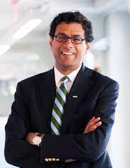
Being Mortal by Atul Gawande
“We’ve been wrong about what our job is in medicine. We think our job is to ensure health and survival. But really it is larger than that. It is to enable well-being. And well-being is about the reasons one wishes to be alive. Those reasons matter not just at the end of life, or when debility comes, but all along the way. Whenever serious sickness or injury strikes and your body or mind breaks down, the vital questions are the same: What is your understanding of the situation and its potential outcomes? What are your fears and what are your hopes? What are the trade-offs you are willing to make and not willing to make? And what is the course of action that best serves this understanding?” pg. 259.
What if preventing death is not the only goal?
A radically different perspective on the ways that we think of healthcare. Emphasis on personable care and prioritizing wellness through personable care.
Physicians as more than just conduits of information - a personable guide and advocate through the medical process
Notes:
Atul Gawande: Practicing endocrine surgeon, professor at Harvard Medical School and widely read physician author whose works have set the standard for medical narratives. Other contributions include writing for The New Yorker,
Could robots ever provide this type of care that in the ways that medicine is heading? How might they serve in this human-first interaction that is more than just a provision of information.

Slide 12
In Closing
If, as Vallor writes, “technologies are extensions of the human value contexts in which they operate,” how are we to interpret the intrusion of AI, machine learning, and big data on the most private sphere of our lives? What might this say about our values?
Notes:
Pg. 177

Slide 13
Possible implications
Currently unsure of the direction that I will head in terms of implications. Possible themes include:
Regulatory suggestions
Ethical considerations and/or directives
Educational paradigms
Class suggestions?

Slide 14
Summary of Literature Search
Philosophical Articles: 7/11 read
Legal Articles: 1/7 read
Medical Articles: 6/13 read
Public Journalism: NYT & Atlantic Articles
Class Books: Vallor & Pasquale
Outside Literature: Being Mortal by Atul Gawande

