Slide 1
Galileo’s Letter to the Grand Duchess
Cushing, Chp. 10
10/02/2017

Slide 2
In Case You Forgot!!
GALILEO
Court Scientist to the Medici Family
Tried to build his own telescope (but did not know about Snell’s Law)
Still observed:
Jupiter’s moons
Sun spots
Mountains on the moon

Slide 3
Timeline
1609 – Galileo makes telescope observations than convince him of Copernican truth
March 1610 – Galileo published The Starry Messenger
December 1613 – Galileo’s letter to Benedetto Castelli, regarding relation between science and religion
December 1614 – Galileo is publically attacked by Father Thomas Caccini for his views on Copernican system.
February 1615 – a copy of Galileo’s letter to Castelli was sent to the Holy Office in Rome. The same year, he wrote his Letter to the Grand Duchess.
December 1615 – Galileo went to Rome to defend his views on Copernican system
February 1616 – Galileo officially forbidden to hold Copernican theory by Jesuit Robert Cardinal Bellarmine
Notes:
Starry Messenger discusses telescopic observations and discoveries. Many more stars in heavens than initially thought. Rough surface of moon. Moons orbit Jupiter. Popular appeal and wide impact.
Galileo’s letter to grand duchess was not published when written

Slide 4
Timeline, cont.
March 1616 – The Congregation of the Index prohibited publication of Copernicus’ De Revolutionibus, pending corrections
October 1623 – Galileo published The Assayer, about his views on the origin of comets
February 1632 – Dialogue Concerning the Two Chief World Systems was published, presenting Ptolemaic and Copernican models
August 1632 – The Holy Office ordered sales of the Dialogue to be suspended
October 1632 – Galileo summoned to Rome to stand trial
June 1633 – Galileo convicted
Notes:
Galileo’s hypothesis on comets is later proven incorrect, but presents some of Galileo’s most important ideas on philosophy of science
The Dialogue does not explicitly support Copernican system but argument is such that any intelligent reader could see which Galileo took to be correct
Galileo sentenced to indefinite imprisonment in his villa. Not a bad life, tbh,

Slide 5
Important Names
Father Thomas Caccini: Dominican friar that publically attacked Galileo’s views as “heretical”
Benedetto Castelli: Cleric and “brilliant student” of Galileo who discussed his stance on the correctness of the Copernican model in front of the Duchess
Cardinal Bellarmine: Jesuit cardinal who views Copernican system as purely instrumental and theoretical
Dowager Grand Duchess: troubled by the Copernican theory’s supposed clash with the Scripture
Maffeo Barberini: Partial to Galileo’s work, friendly for many years. Becomes Pope Urban VIII in August 1623.
Notes:
- Barberini : Ultimately chooses to preserve authority of Scripture over advancing scientific knowledge.

Slide 6
Major Causes of Tension?
Notes:
Intellectual freedom versus institutional authority
Personalities of Galileo, Bellarmine, and Pope Urban
Social structure
Ultimately : Instrumentalism verses realism

Slide 7
Freedom of Inquiry vs. Institutional Authority

Slide 8
THE LETTER
Notes:
Literal vs logical interpretation !! Bc Point of Bible is salvation, not science. Bible was written for common man, not a philosopher of Physics

Slide 9
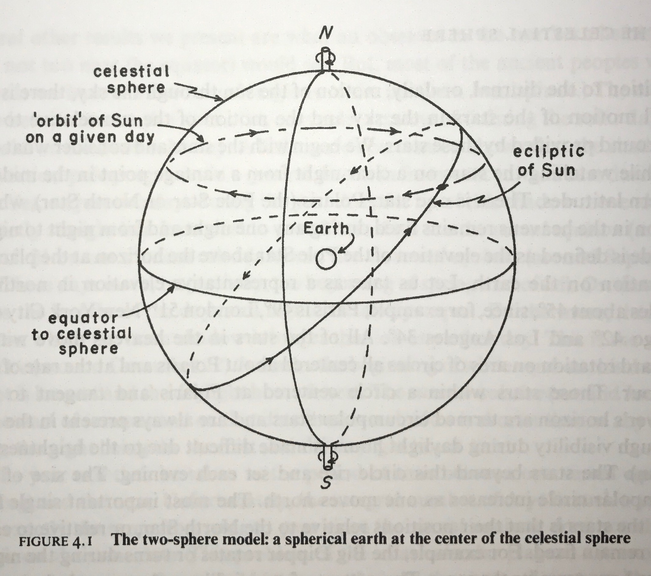
One of the Main Issues, Addressed
Passage in the Book of Joshua
Ptolemaic model wouldn’t work to explain this
Copernican model actually kind of would
Notes:
There are times in the Bible when something disagrees w science. Not that either is wrong, but remember the bible was written for common people so it might mention something they’d understand over truth since the point is not to teach science but rather salvation:
Example, in Job 26:7 the heavens are referred to as “void” or “nothing.” which of course we know isn’t true because at the very minimum there is air amongst other things.
Large cause for debate was a passage in Joshua, in which Joshua commanded the sun to stand still so the Israelites could slay the Ammorites

Slide 10
Major Points in the Letter
Opinion > Truth
Science makes no claims on religion
Experience and reason for interpretation > blindly accepting authority
The Bible was not meant to teach science
Dangerous for dogma to silence intellectual inquiry
Better idea: seek sense of the Bible with the aid of science !
Notes:
1. Science was against scripture rather than demonstrably wrong. Brings up St. Augustine’s view that you can’t believe anything based on a suspect point, otherwise you gain prejudice against something that truth may later show to not be contrary in any way to Scripture and also St. Augustine talks about what is in the bible vs. what man imagines to be in there: bible is beyond comprehension but not interpretation
In The Assayer, Galileo makes a case for reason over blind acceptance:
Someone says “Babylonians cook their eggs by whirling them in slings.”
You have eggs, slings, and sturdy men to whirl them, but the eggs do not cook.
All you’re missing is being Babylonian, so that must be the cause of the eggs hardening, not the friction of air.
Points out flaw in logic that is you do not achieve the same results as someone else previously found, the issue is that your method lacked something theirs had, so the thing lacking is the cause for failure and the true reason as to why the experiment initially worked.
4. “The intention of the Holy Ghost is to tech us how one goes to heavn, not how heaven goes/”

Slide 11
Personalities

Slide 12
Social Structure
Notes:
Competition for funding and sponsoorship in this world
Not smart enough to have brilliant findindings? Defame someone who does

Slide 13
Is this debate still alive?
Notes:
Yes but in a different form. Wasn’t until 1987 that supreme court ruled creationism to be religion, not science
“intelligent design” theory from Newton is still alive
Use Bible to prove science or science to prove religion – always looking for proof – there’s an issue there

