Slide 1
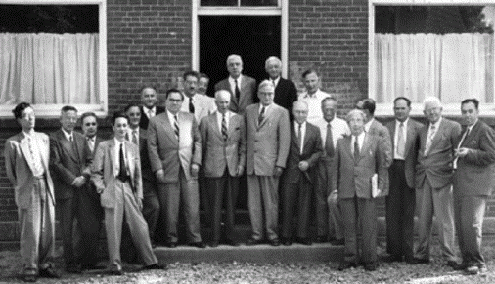
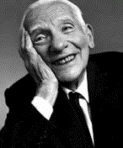
First Pugwash Conference, Pugwash,
Nova Scotia, July 8-11, 1957.
The 1995 Nobel Peace Prize was
awarded jointly to the Pugwash
Conferences and to their leading
figure, the physicist Joseph
Rotblat.
Left to right: Iwao Ogawa, Chou Pei-Yuan, Vladimir P. Pavlichenko, Shinichiro Tomonaga, Cecil. F. Powell, Antoine M. B. Lacassagne, Alexander V. Topchiev, Alexander M. Kuzin, Eugene Rabinowitch, George Brock Chisholm, Dmitri V. Skobeltzyn, John S. Foster, Cyrus S. Eaton, Hermann J. Muller, Joseph Rotblat, Hans Thirring, Leo Szilard, Walter Selove, Eric H. S. Burhop, Mark L. E. Oliphant, and Marian Danysz. David F. Cavers, Paul Doty, Victor F. Weisskopf, and Hideki Yukawa were absent when this photograph was taken.

Slide 2
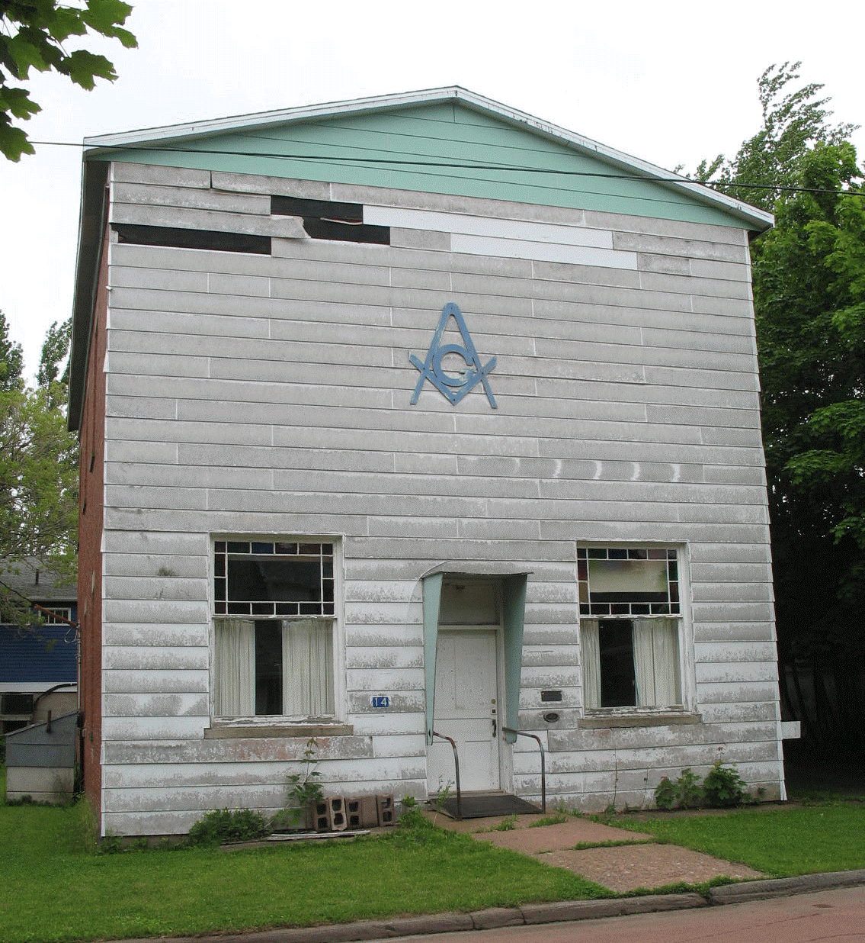
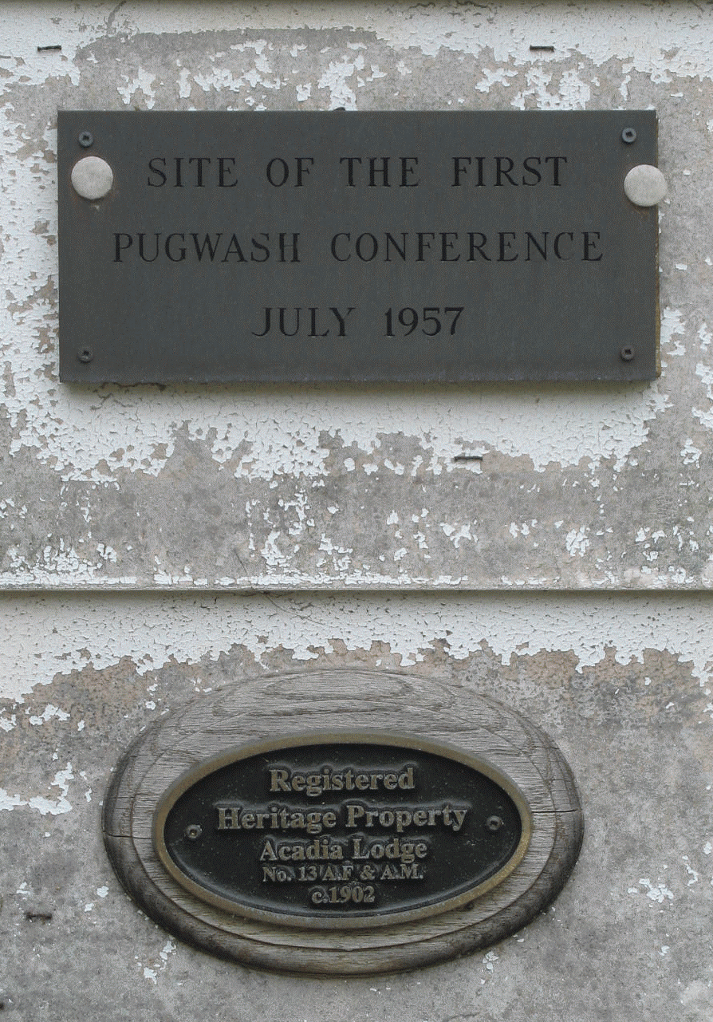
First Pugwash Conference, Pugwash,
Nova Scotia, July 8-11, 1957.
The meeting location as it appears
today.

