Slide 1
Wallach Chapters 14-15

Slide 2
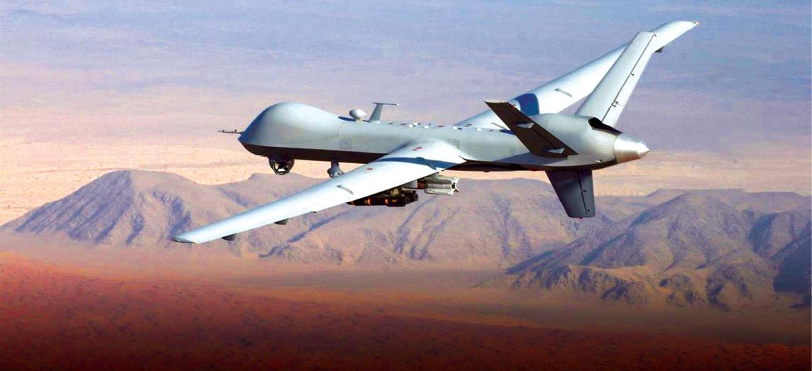
How early do we need to act?
“Any technology of enough significance to be interesting will inevitably destabilize existing institutions, power relationships, social structures, reigning economic and technological systems, and cultural assumptions.” - Braden Allenby
Regulation for clones
...but not for domestic drones, yet
"Because the risks of something going wrong are so high"
Until there is "evidence that they pose challenges which existing privacy law fails to manage in a satisfactory manner”

Slide 3
Absence of Evidence vs Evidence of Absence

Slide 4
Current Regulatory Conditions
Many different government agencies and regulatory authorities hold overlapping jurisdictional responsibilities
Pacing problem: as technology development accelerates, regulatory agencies slow down and become rigid, burdened by red tape and unfunded mandates
Anachronistic laws for current technology (Toxic Substances Control Act)
Unwillingness for regulatory agencies to make difficult moral decisions (FDA with meat and milk from cloned animals)

Slide 5
Wallach’s Proposal: Government Coordinating Committees
Work together with all interested stakeholders
Does not overlap with existing institutions
Search for gaps, overlaps, conflicts, inconsistencies, and synergistic opportunities among the various public and private entities involved in shaping the course of the field
Primary task: forge a robust set of mechanisms that comprehensively address challenges arising from new innovations, while remaining flexible enough to adapt those mechanisms as an industry develops and changes
Avoid hard regulation but be able to recommend it in case warnings are not heeded
Ears for advocates and scholars
Authoritative information curators

Slide 6
Open Questions for GCC’s
When will a GCC acquire influence (power), authority, or legitimacy?
Who will select or appoint the staff?
What steps must be taken in order to establish a committee’s credibility? To whom will a committee be accountable?
How will it get its funding?

Slide 7
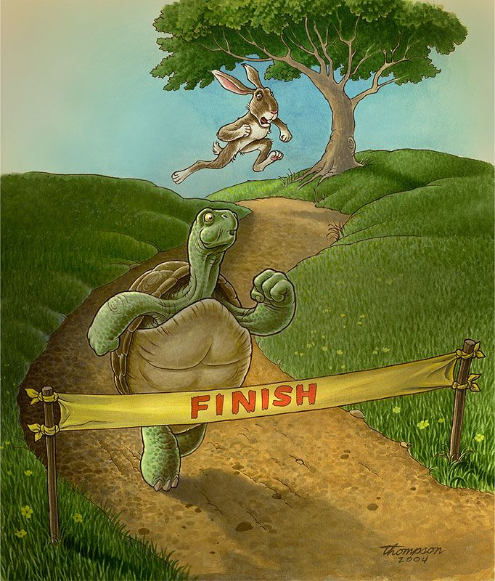
“Humanly Manageable Pace”
A moderate pace allows us to effectively monitor risks and recognize inflection points before they disappear
Too much speed undermines democratic systems
We cannot afford to be in a permanent state of emergency
“Legitimization crisis”

Slide 8
The Fate of the Guild Navigators
“Our humanity could be lost. Not because our bodies might be altered, but because we fail to actively affirm the more admirable qualities and values that have distinguished our species … Navigating the future will require our full, conscious engagement.”
-Wallach, Ch. 15

