Slide 1
Real-World Barriers to Scaling Up Scientific Applications
Douglas Thain
University of Notre Dame
Trends in HPDC Workshop
Vrije University, March 2012

Slide 2
The Cooperative Computing Lab
We collaborate with people who have large scale computing problems in science, engineering, and other fields.
We operate computer systems on the O(1000) cores: clusters, clouds, grids.
We conduct computer science research in the context of real people and problems.
We release open source software for large scale distributed computing.
http://www.nd.edu/~ccl

Slide 3
Our Application Communities
Bioinformatics
I just ran a tissue sample through a sequencing device. I need to assemble 1M DNA strings into a genome, then compare it against a library of known human genomes to find the difference.
Biometrics
I invented a new way of matching iris images from surveillance video. I need to test it on 1M hi-resolution images to see if it actually works.
Molecular Dynamics
I have a new method of energy sampling for ensemble techniques. I want to try it out on 100 different molecules at 1000 different temperatures for 10,000 random trials

Slide 4
The Good News: Computing is Plentiful!

Slide 5
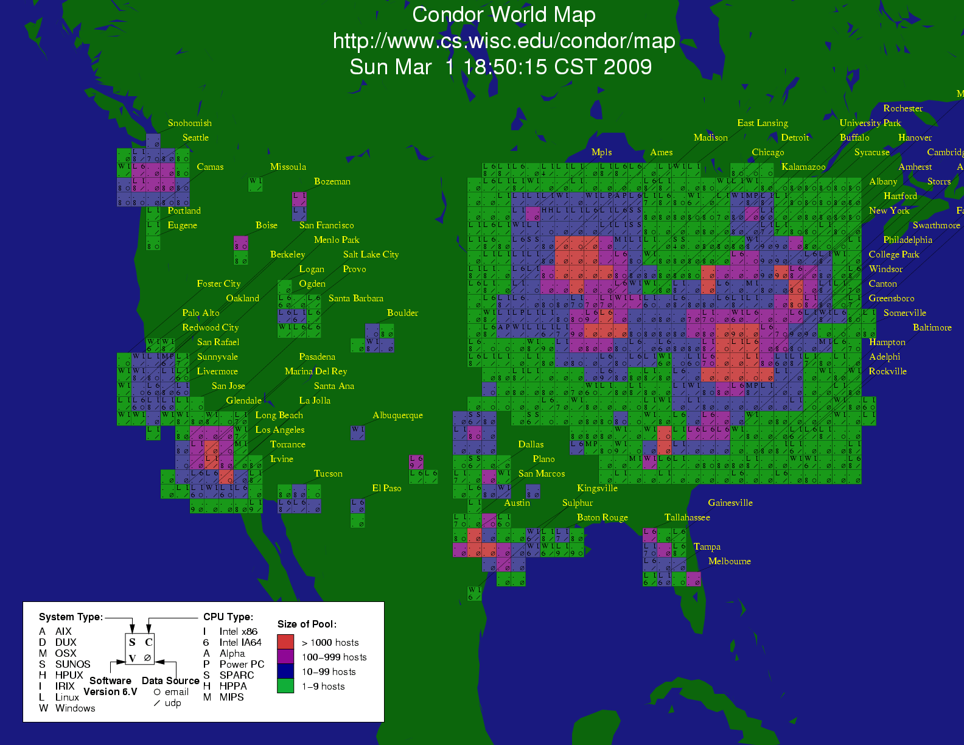

Slide 6
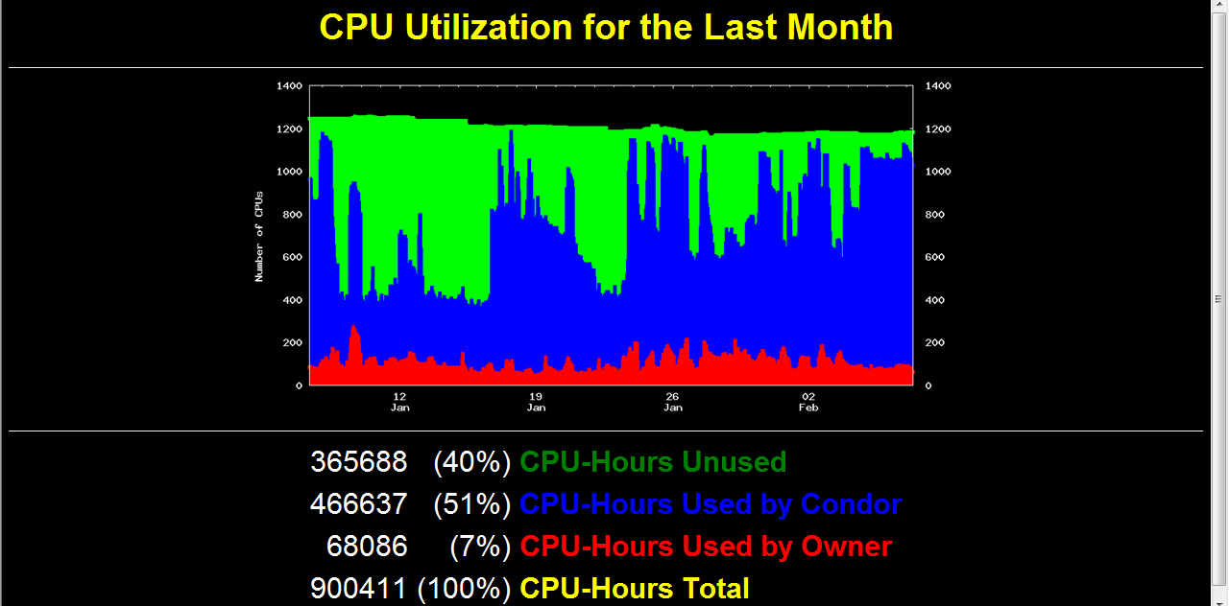

Slide 7
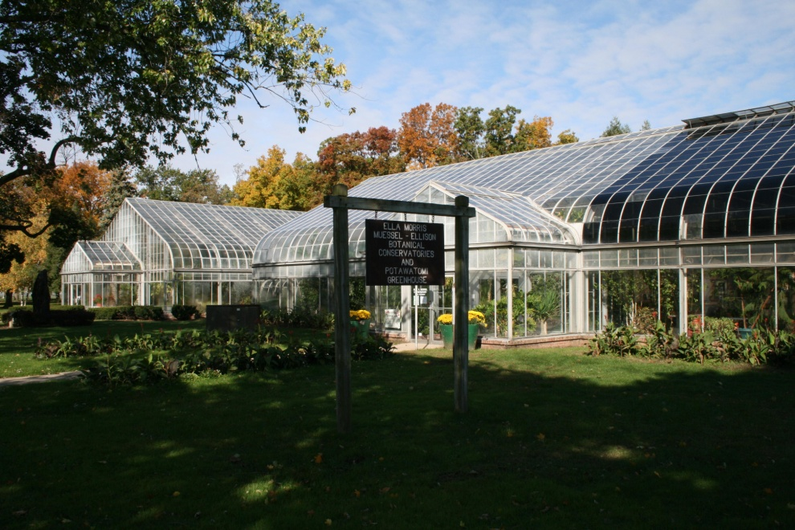
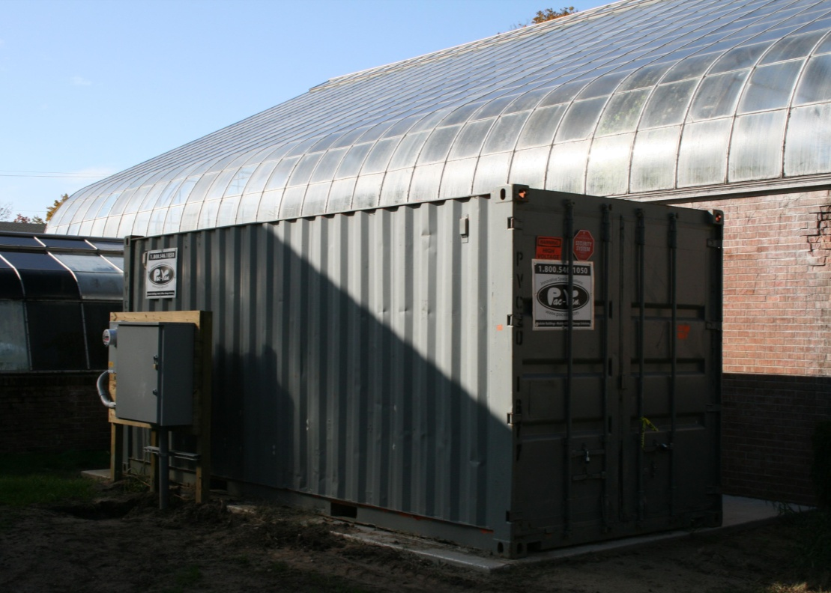
greencloud.crc.nd.edu

Slide 8
Superclusters by the Hour
http://arstechnica.com/business/news/2011/09/30000-core-cluster-built-on-amazon-ec2-cloud.ars

Slide 9
The Bad News: It is inconvenient.

Slide 10
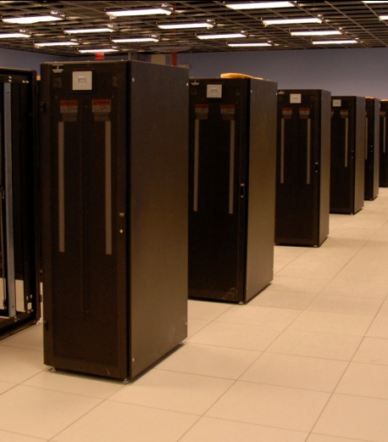
I have a standard, debugged, trusted application that runs on my laptop.
A toy problem completes in one hour.
A real problem will take a month (I think.)
Can I get a single result faster?
Can I get more results in the same time?
Last year,
I heard about
this grid thing.
This year,
I heard about
this cloud thing.
What do I do next?

Slide 11
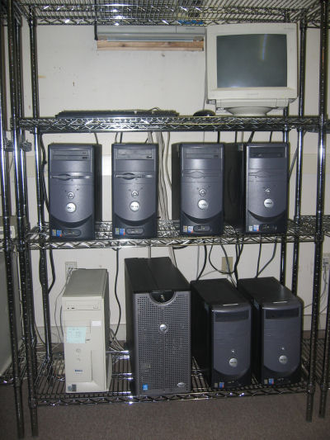
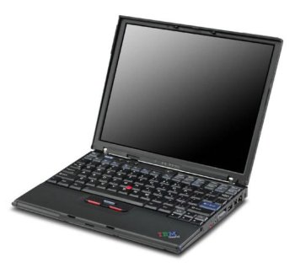
What users want.
What they get.

Slide 12
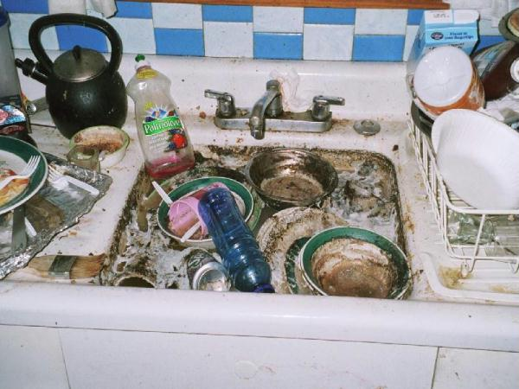
The Traditional Application Model?
Every program attempts to grow until it can read mail. - Jamie Zawinski

Slide 13
What goes wrong? Everything!
Scaling up from 10 to 10,000 tasks violates ten different hard coded limits in the kernel, the filesystem, the network, and the application.
Failures are everywhere! Exposing error messages is confusing, but hiding errors causes unbounded delays.
User didn’t know that program relies on 1TB of configuration files, all scattered around the home filesystem.
User discovers that the program only runs correctly on Blue Sock Linux 3.2.4.7.8.2.3.5.1!
User discovers that program generates different results when run on different machines.

Slide 14
Abstractions for Scalable Apps

Slide 15
Work Queue API
wq_task_create( files and program );
wq_task_submit( queue, task);
wq_task_wait( queue ) -> task
C implementation + Python and Perl

Slide 16
Work Queue Apps
Raw Sequence Data
ACTGAGC
TAATAAG
Fully Assembled Genome
SAND
AGTCACACTGTACGTAGAAGTCACACTGTACGTAA…
Work Queue
Align
Align
Align
Ensemble MD
x100s
Work Queue
T=10K
T=20K
T=30K
T=40K

Slide 17
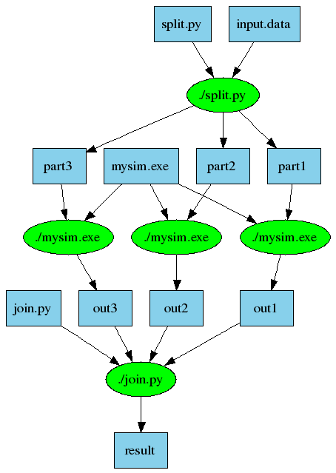
An Old Idea: Make
part1 part2 part3: input.data split.py
./split.py input.data
out1: part1 mysim.exe
./mysim.exe part1 >out1
out2: part2 mysim.exe
./mysim.exe part2 >out2
out3: part3 mysim.exe
./mysim.exe part3 >out3
result: out1 out2 out3 join.py
./join.py out1 out2 out3 > result

Slide 18
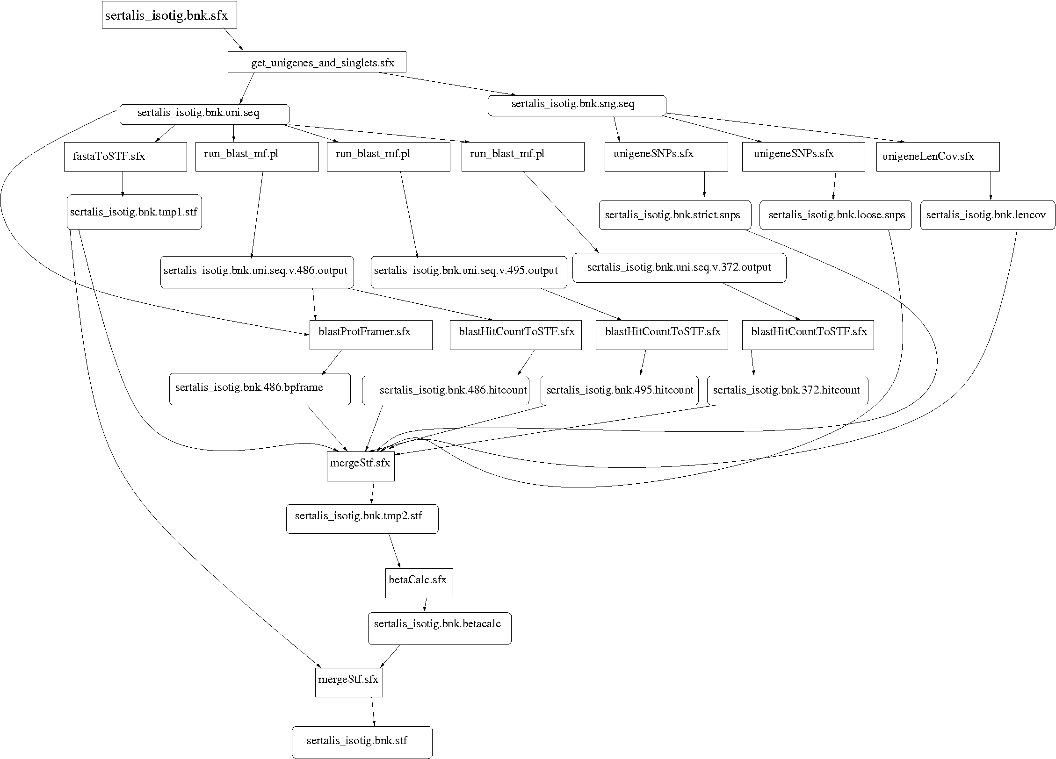
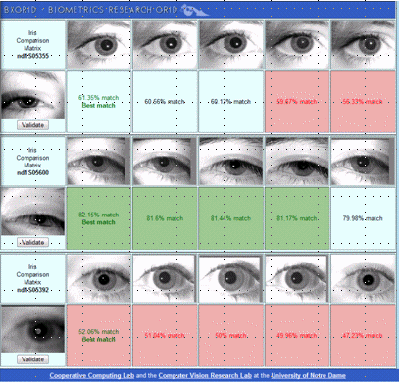
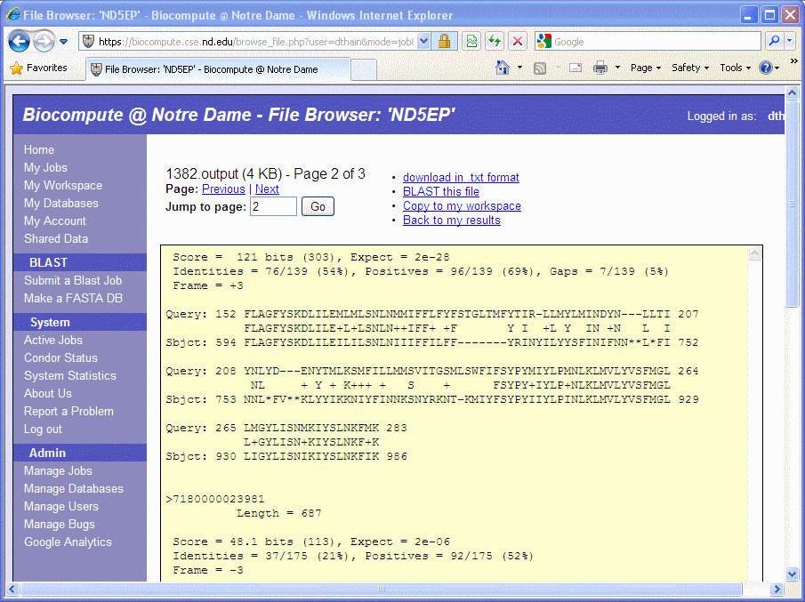
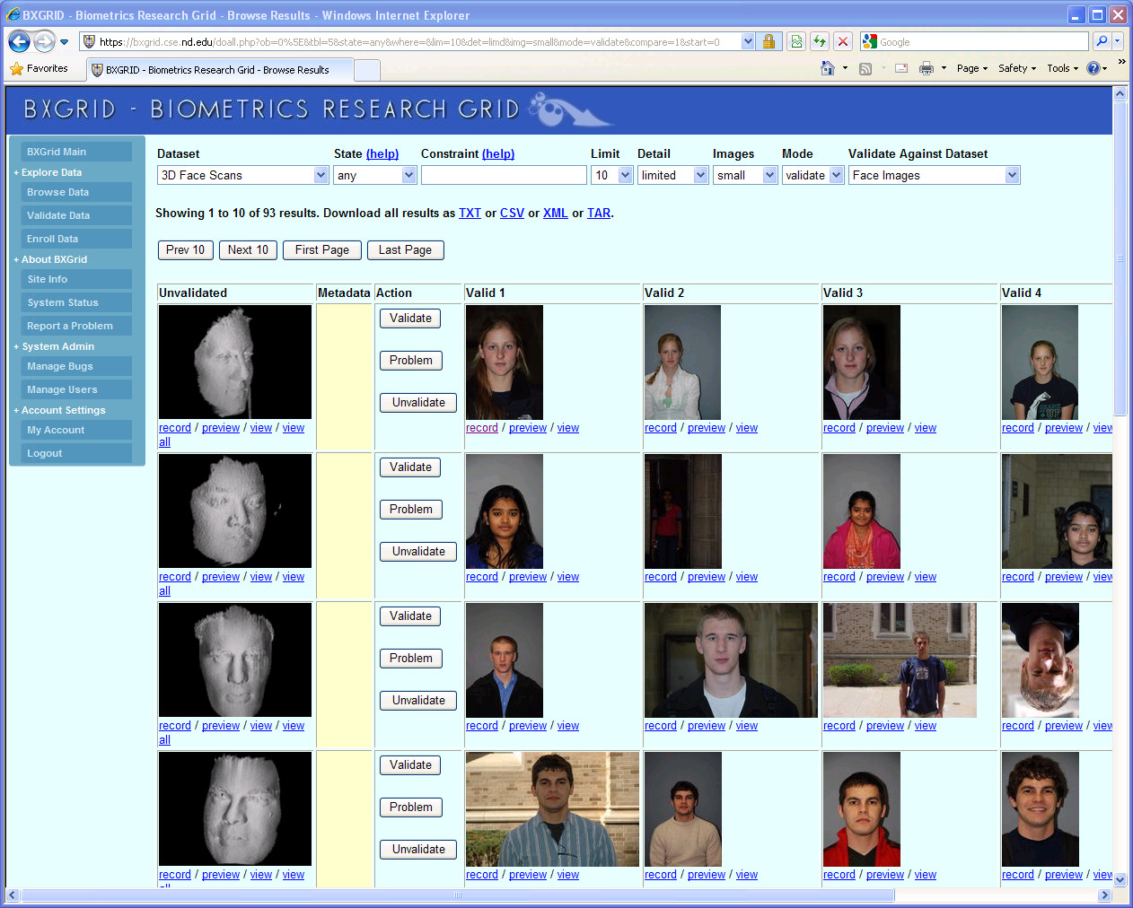
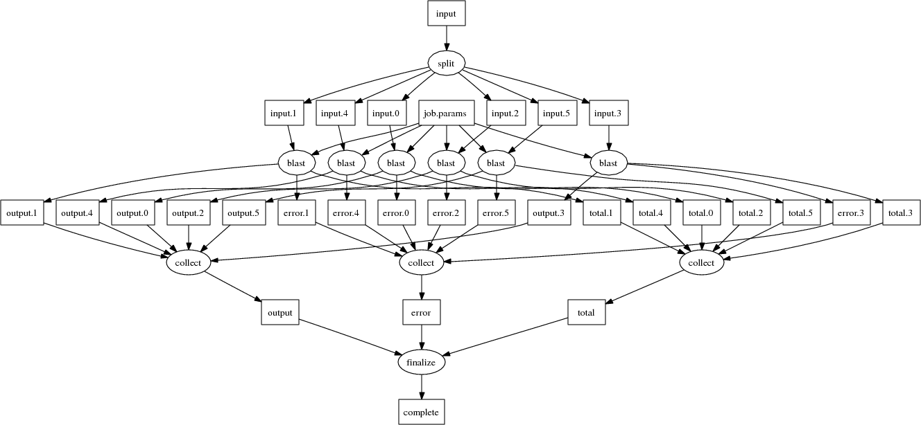
Makeflow Applications

Slide 19
Why Users Like Makeflow
Use existing applications without change.
Use an existing language everyone knows. (Some apps are already in Make.)
Via Workers, harness all available resources: desktop to cluster to cloud.
Transparent fault tolerance means you can harness unreliable resources.
Transparent data movement means no shared filesystem is required.

Slide 20
Work Queue Overlay
sge_submit_workers
Private
Cluster
Shared
SGE
Cluster
Application
Wv
W
Hundreds of Workers in a
Personal Cloud
W
submit
tasks
W
W
W
Work Queue API
Campus
Condor
Pool
Public
Cloud
Provider
W
W
W
W
W
W
W
Local Files and Programs
condor_submit_workers
ssh

Slide 21
Elastic Application Stack
All-Pairs
Wavefront
Makeflow
Custom
Apps
Work Queue Library
Hundreds of Workers in a
Personal Cloud
Public
Cloud
Provider
Shared
SGE
Cluster
Campus
Condor
Pool
Private
Cluster
W
W
Wv
W
W
W
W
W
W

Slide 22
The Elastic Application Curse
Just because you can run on a thousand cores… doesn’t mean you should!
The user must make an informed decision about scale, cost, performance efficiency.
(Obligatory halting problem reference.)
Can the computing framework help the user to make an informed decision?

Slide 23
Input Files
Elastic App
Runtime
Cost
Scale of System
Service Provider

Slide 24
Abstractions for Scalable Apps

Slide 25
Different Techniques
For regular graphs (All-Pairs), almost everything is known and accurate predications can be made.
For irregular graphs (Makeflow) input data and cardinality are known, but time and intermediate data are not.
For dynamic programs (Work Queue) prediction is not possible in the general case. (Runtime controls still possible.)

Slide 26
Is there a Chomsky Hierarchy for Distributed Computing?
Language Construct | Required Machine
Regular Expressions | Finite State Machine
Context Free Grammar | Pushdown Automaton
Context Sensitive Grammar | Linear Bounded Automaton
Unrestricted Grammar | Turing Machine

Slide 27
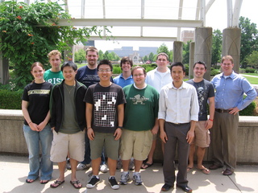
Papers, Software, Manuals, …
http://www.nd.edu/~ccl
This work was supported by NSF Grants CCF-0621434, CNS-0643229, and CNS 08554087.

