Slide 1
Scaling Up Data Intensive Science with Application Frameworks
Douglas Thain
University of Notre Dame
Michigan State University
September 2011

Slide 2
The Cooperative Computing Lab
We collaborate with people who have large scale computing problems in science, engineering, and other fields.
We operate computer systems on the O(1000) cores: clusters, clouds, grids.
We conduct computer science research in the context of real people and problems.
We release open source software for large scale distributed computing.
http://www.nd.edu/~ccl

Slide 3
The Good News: Computing is Plentiful
My personal workstations / servers.
A shared cluster at my school / company.
A distributed batch system like Condor.
An infrastructure cloud like Amazon EC2.
A platform cloud like Azure or App Engine.

Slide 4
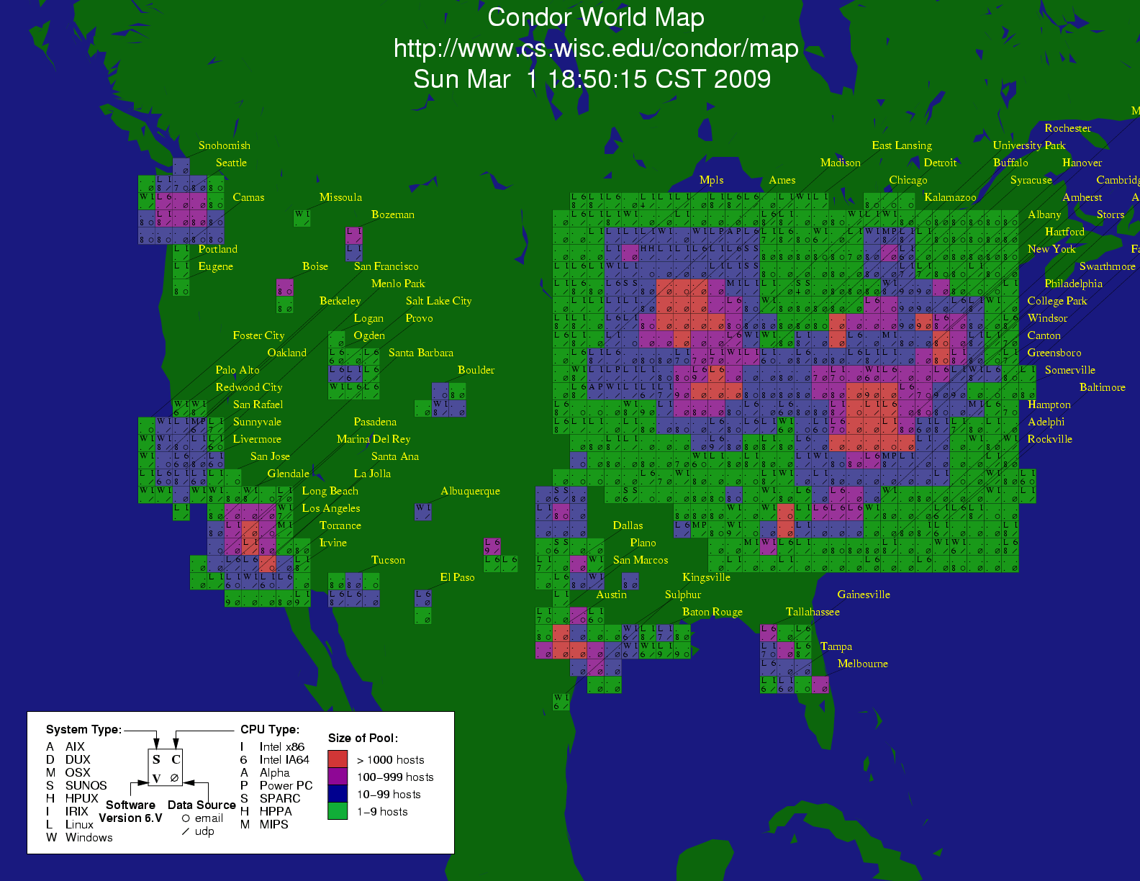

Slide 5
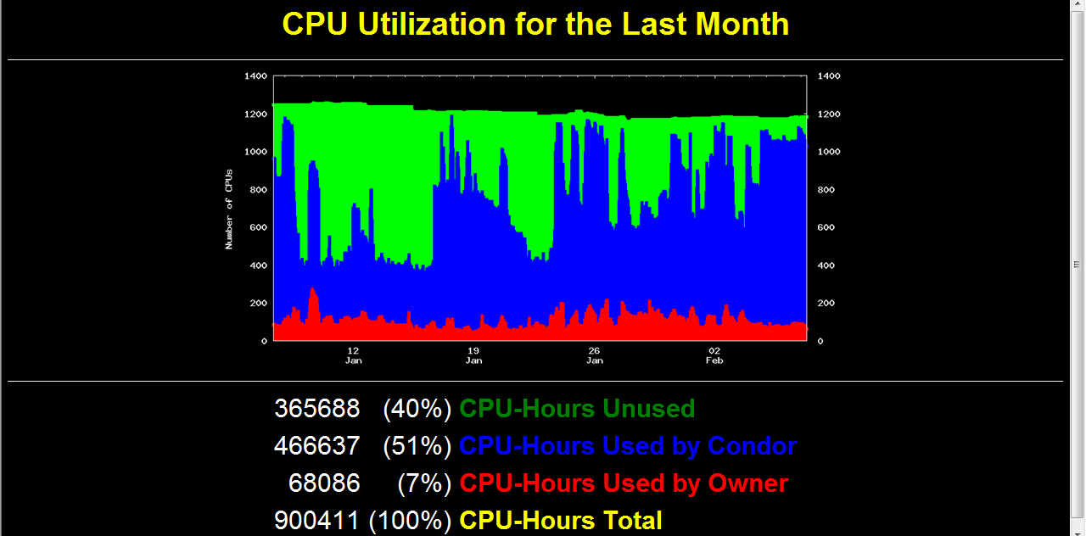

Slide 6
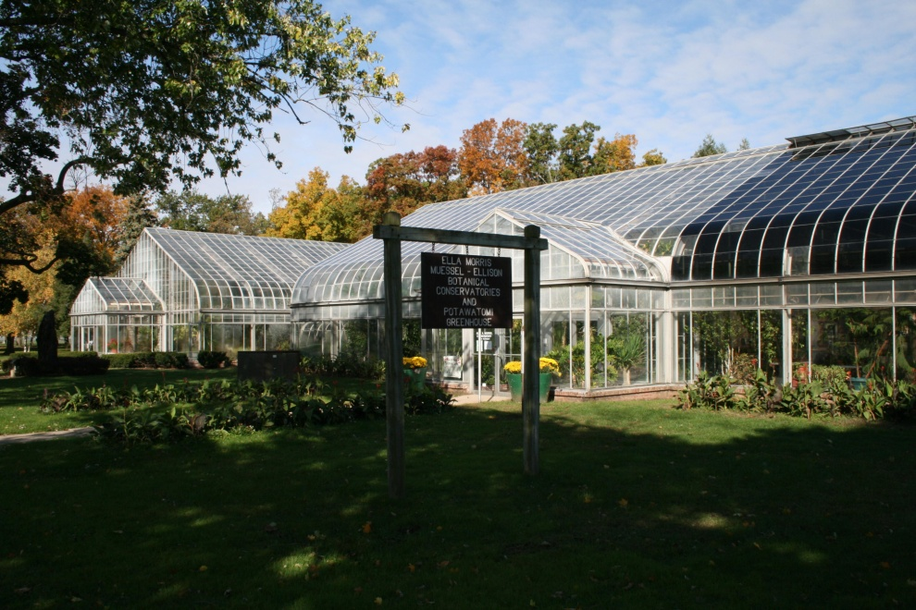
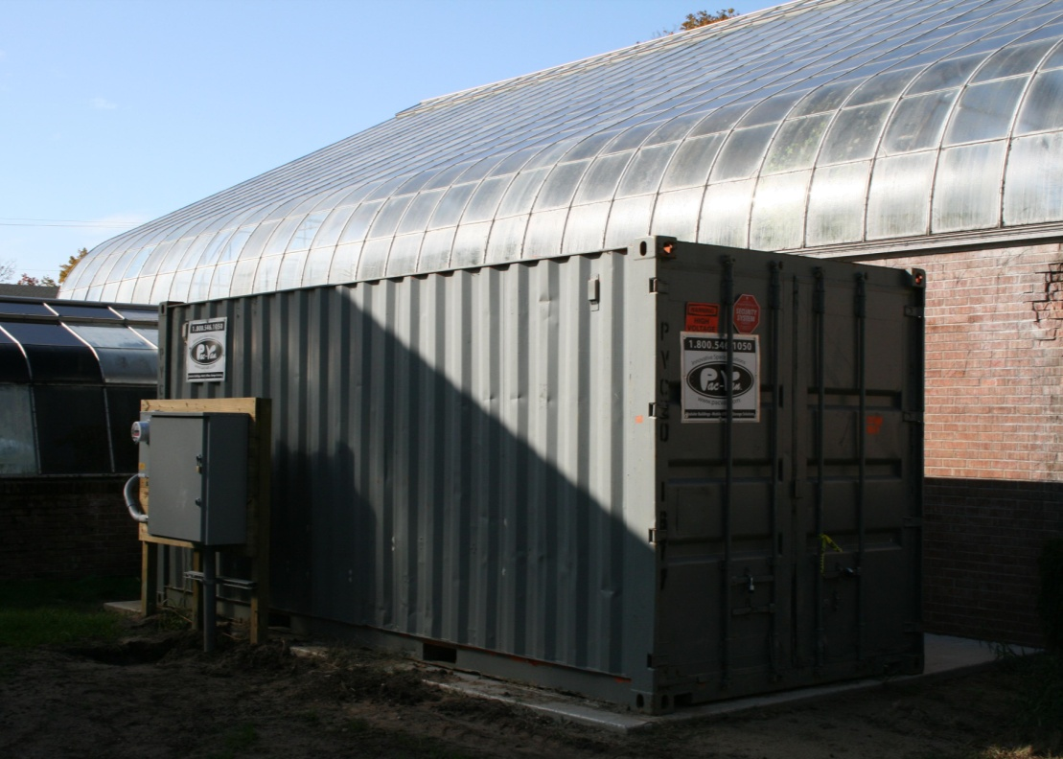
greencloud.crc.nd.edu

Slide 7
Just Yesterday… Cycle Cloud Using Condor
http://arstechnica.com/business/news/2011/09/30000-core-cluster-built-on-amazon-ec2-cloud.ars

Slide 8
The Bad News:
These systems are not dedicated to me.
Many systems = many interfaces.
Application may not be designed for distributed / parallel computing.
Relationship between scale and performance is not obvious.
Real cost of running app is not obvious.

Slide 9
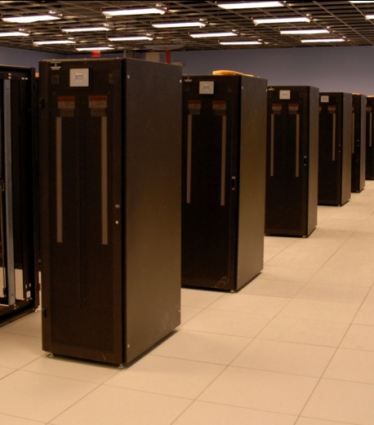
I have a standard, debugged, trusted application that runs on my laptop.
A toy problem completes in one hour.
A real problem will take a month (I think.)
Can I get a single result faster?
Can I get more results in the same time?
Last year,
I heard about
this grid thing.
This year,
I heard about
this cloud thing.
What do I do next?

Slide 10
Our Application Communities
Bioinformatics
I just ran a tissue sample through a sequencing device. I need to assemble 1M DNA strings into a genome, then compare it against a library of known human genomes to find the difference.
Biometrics
I invented a new way of matching iris images from surveillance video. I need to test it on 1M hi-resolution images to see if it actually works.
Data Mining
I have a terabyte of log data from a medical service. I want to run 10 different clustering algorithms at 10 levels of sensitivity on 100 different slices of the data.

Slide 11
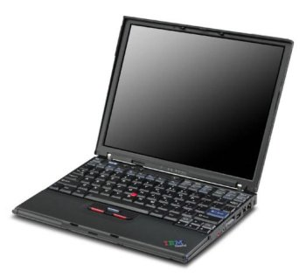
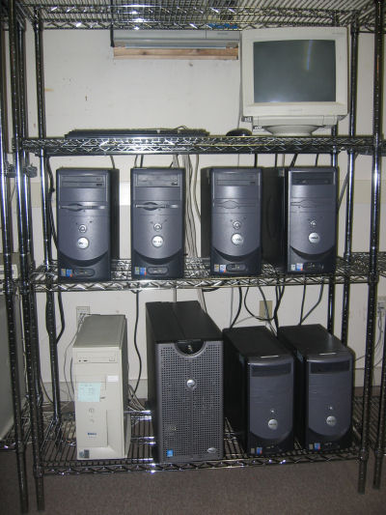
What they want.
What they get.

Slide 12
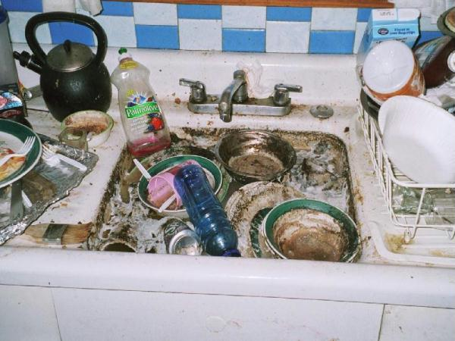
The Traditional Application Model?
Every program attempts to grow until it can read mail. - Jamie Zawinski

Slide 13
An Old Idea: The Unix Model
input < grep | sort | uniq > output

Slide 14
Advantages of Little Processes
Easy to distribute across machines.
Easy to develop and test independently.
Easy to checkpoint halfway.
Easy to troubleshoot and continue.
Easy to observe the dependencies between components.
Easy to control resource assignments from an outside process.

Slide 15
Our approach: Encourage users to decompose their applications into simple programs. Give them frameworks that can assemble them into programs of massive scale with high reliability.

Slide 16
Working with Frameworks
A1
A1
A2
A2
F
An
Bn
AllPairs( A, B, F )
Custom
Workflow
Engine
Cloud or Grid
Compact Data Structure

Slide 17
Examples of Frameworks
AllPairs( A, B, F ) -> M
Wavefront( X, Y, F ) -> M
A1
A2
A3
R[0,4]
F
R[2,4]
R[3,4]
R[4,4]
x
B1
F
F
F
R[0,3]
d
y
R[3,2]
R[4,3]
x
F
x
F
R[0,2]
d
y
d
y
R[4,2]
x
F
x
F
x
F
B2
F
F
F
d
y
d
y
d
y
R[0,1]
F
F
F
F
x
x
x
x
R[0,0]
d
y
d
y
d
y
d
y
B3
F
F
F
R[1,0]
R[2,0]
R[3,0]
R[4,0]
Classify( T, P, F, R ) -> V
Makeflow
T1
F
V1
1
A
4
C
T
P
T2
F
V2
C
V
2
T3
F
V3
B
D
5
R
3

Slide 18
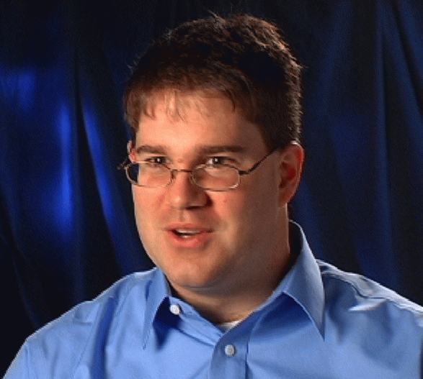
Example: Biometrics Research
Goal: Design robust face comparison function.
F
F
0.97
0.05

Slide 19
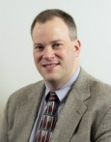
Similarity Matrix Construction
 | 1.0 | 0.8 | 0.1 | 0.0 | 0.0 | 0.1
 |  | 1.0 | 0.0 | 0.1 | 0.1 | 0.0
 |  |  | 1.0 | 0.0 | 0.1 | 0.3
 |  |  |  | 1.0 | 0.0 | 0.0
 |  |  |  |  | 1.0 | 0.1
 |  |  |  |  |  | 1.0
Challenge Workload:
60,000 images
1MB each
.02s per F
833 CPU-days
600 TB of I/O

Slide 20
All-Pairs Abstraction
AllPairs( set A, set B, function F )
returns matrix M where
M[i][j] = F( A[i], B[j] ) for all i,j
A1
A1
A2
A3
A1
allpairs A B F.exe
An
AllPairs(A,B,F)
B1
F
F
F
B1
B1
Bn
B2
F
F
F
F
B3
F
F
F
Moretti et al, All-Pairs: An Abstraction for Data Intensive Cloud Computing, IPDPS 2008.

Slide 21
User Interface
% allpairs compare.exe set1.data set2.data
Output:
img1.jpg img1.jpg 1.0
img1.jpg img2.jpg 0.35
img1.jpg img3.jpg 0.46
…

Slide 22
How Does the Abstraction Help?
The custom workflow engine:
Chooses right data transfer strategy.
Chooses blocking of functions into jobs.
Recovers from a larger number of failures.
Predicts overall runtime accurately.
Chooses the right number of resources.
All of these tasks are nearly impossible for arbitrary workloads, but are tractable (not trivial) to solve for a specific abstraction.

Slide 23
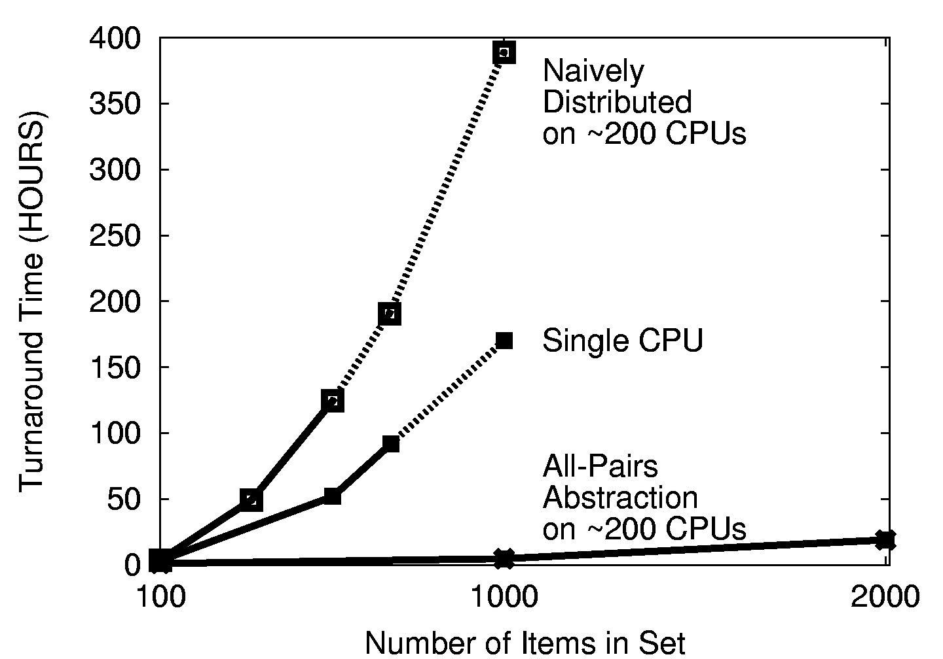

Slide 24
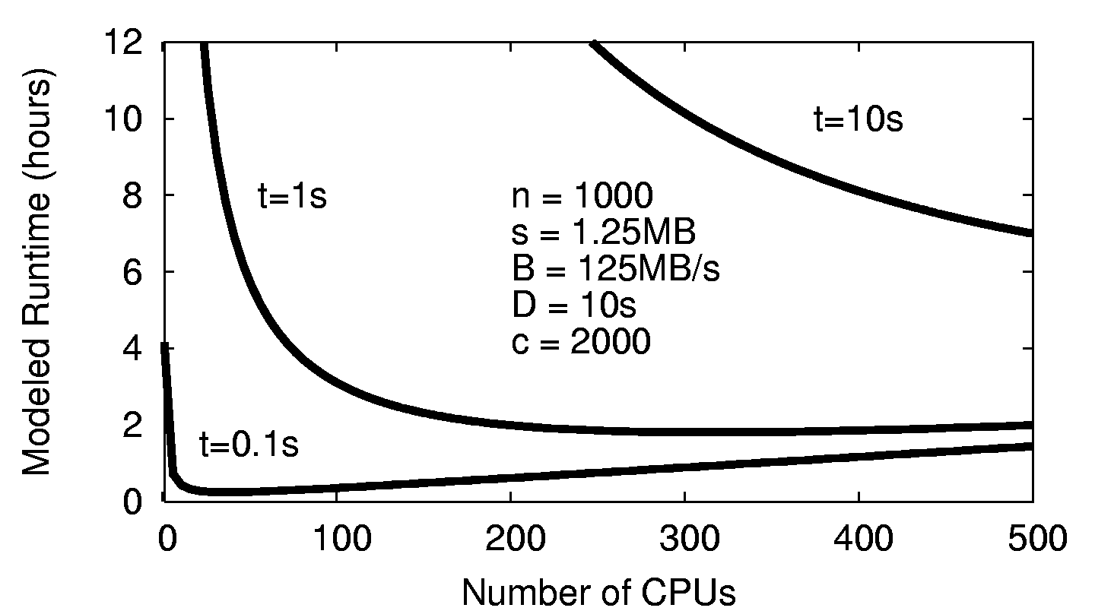
Choose the Right # of CPUs

Slide 25
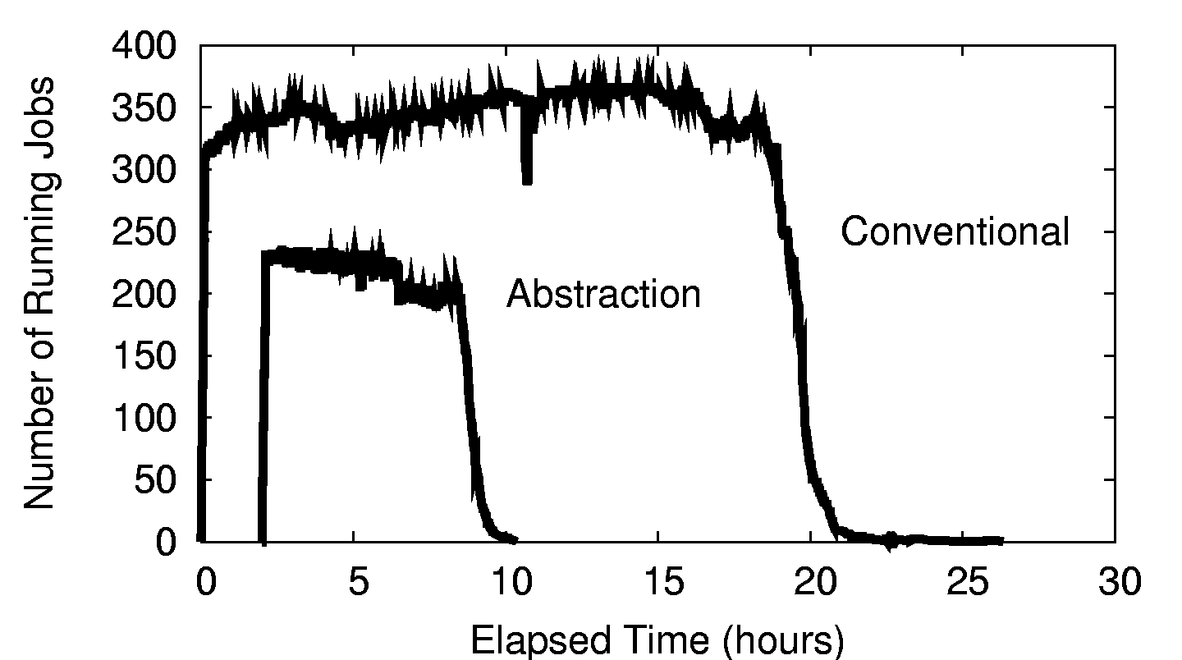
Resources Consumed

Slide 26
All-Pairs in Production
Our All-Pairs implementation has provided over 57 CPU-years of computation to the ND biometrics research group in the first year.
Largest run so far: 58,396 irises from the Face Recognition Grand Challenge. The largest experiment ever run on publically available data.
Competing biometric research relies on samples of 100-1000 images, which can miss important population effects.
Reduced computation time from 833 days to 10 days, making it feasible to repeat multiple times for a graduate thesis. (We can go faster yet.)

Slide 27
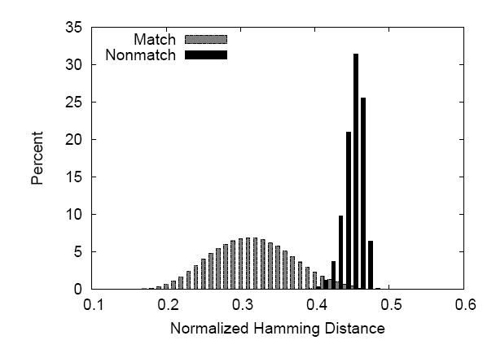

Slide 28
All-Pairs Abstraction
AllPairs( set A, set B, function F )
returns matrix M where
M[i][j] = F( A[i], B[j] ) for all i,j
A1
A1
A2
A3
A1
allpairs A B F.exe
An
AllPairs(A,B,F)
B1
F
F
F
B1
B1
Bn
B2
F
F
F
F
B3
F
F
F
Moretti et al, All-Pairs: An Abstraction for Data Intensive Cloud Computing, IPDPS 2008.

Slide 29
Are there other abstractions?

Slide 30
Classify Abstraction
Classify( T, R, N, P, F )
T = testing set R = training set
N = # of partitions F = classifier
T1
F
V1
T
P
T2
F
V2
C
V
T3
F
V3
R
Chris Moretti et al, Scaling up Classifiers to Cloud Computers, ICDM 2008.

Slide 31
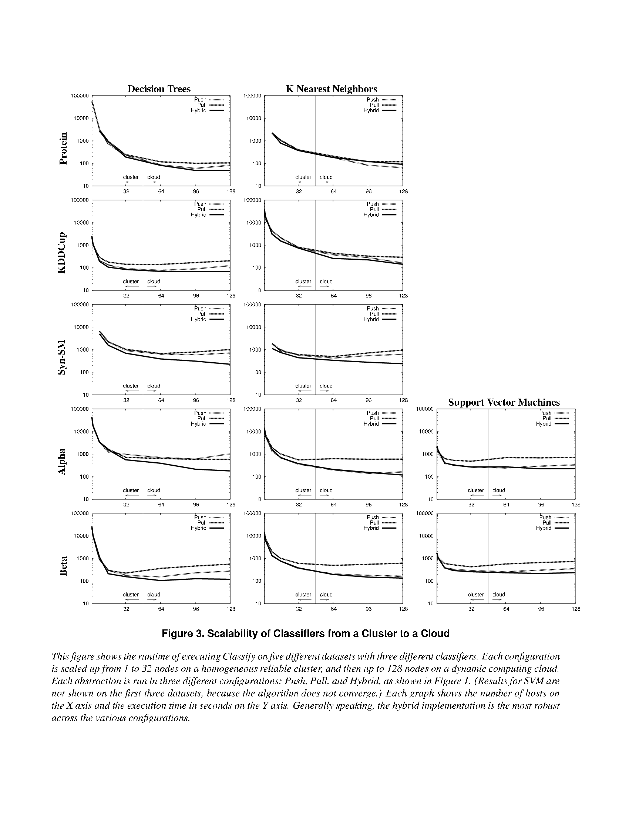
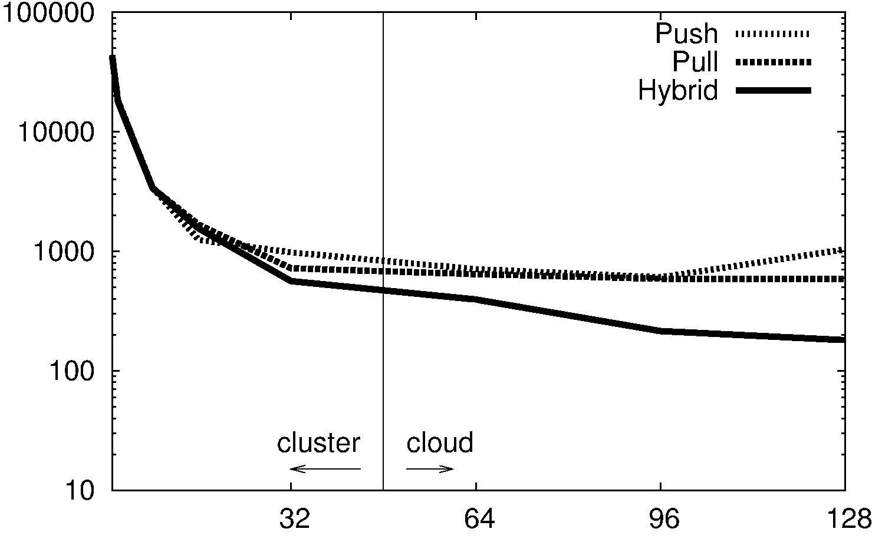

Slide 32
Wavefront( matrix M, function F(x,y,d) )
returns matrix M such that
M[i,j] = F( M[i-1,j], M[I,j-1], M[i-1,j-1] )
M[0,4]
M[2,4]
M[3,4]
M[4,4]
x
F
d
y
M[0,3]
M[3,2]
M[4,3]
Wavefront(M,F)
x
F
x
F
M
d
y
d
y
M[0,2]
x
M[4,2]
x
F
x
F
F
d
y
d
y
d
y
F
M[0,1]
x
F
x
F
x
F
x
F
d
y
d
y
d
y
d
y
M[0,0]
M[1,0]
M[2,0]
M[3,0]
M[4,0]
Li Yu et al, Harnessing Parallelism in Multicore Clusters with the
All-Pairs, Wavefront, and Makeflow Abstractions, Journal of Cluster Computing, 2010.

Slide 33
Applications of Wavefront
Bioinformatics:
Compute the alignment of two large DNA strings in order to find similarities between species. Existing tools do not scale up to complete DNA strings.
Economics:
Simulate the interaction between two competing firms, each of which has an effect on resource consumption and market price. E.g. When will we run out of oil?
Applies to any kind of optimization problem solvable with dynamic programming.

Slide 34
Problem: Dispatch Latency
Even with an infinite number of CPUs, dispatch latency controls the total execution time: O(n) in the best case.
However, job dispatch latency in an unloaded grid is about 30 seconds, which may outweigh the runtime of F.
Things get worse when queues are long!
Solution: Build a lightweight task dispatch system. (Idea from Falkon@UC)

Slide 35
Solution:
Work Queue
1000s of workers
Dispatched
to the cloud
worker
worker
worker
worker
worker
worker
queue
tasks
wavefront
engine
work
queue
put F.exe
put in.txt
exec F.exe <in.txt >out.txt
get out.txt
worker
tasks
done
In.txt
F
out.txt

Slide 36
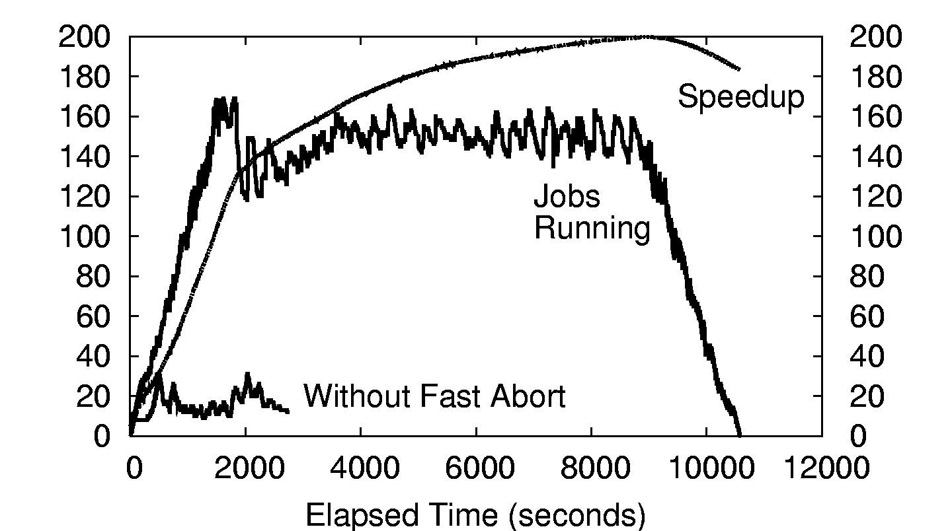
500x500 Wavefront on ~200 CPUs

Slide 37
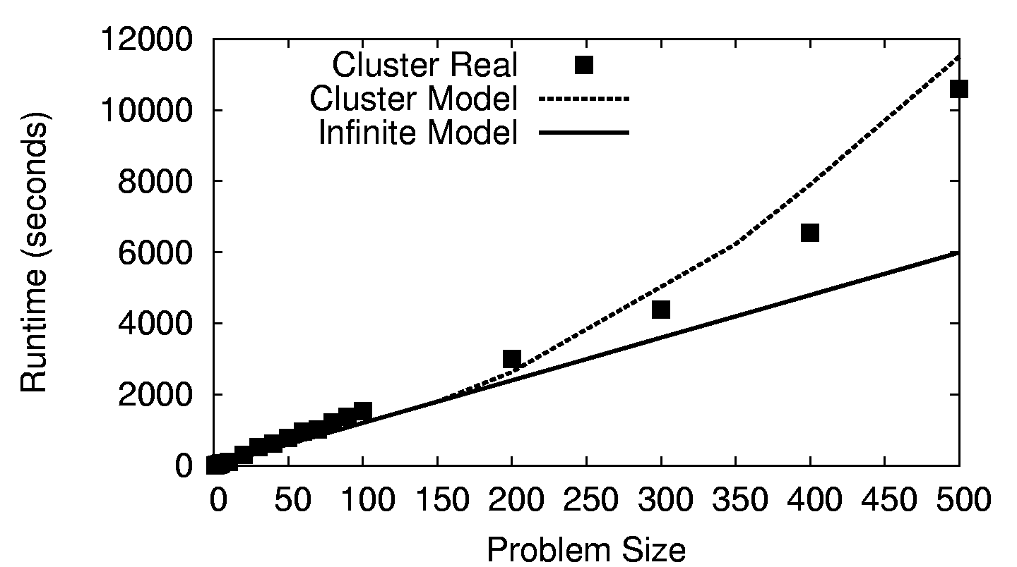
Wavefront on a 200-CPU Cluster

Slide 38
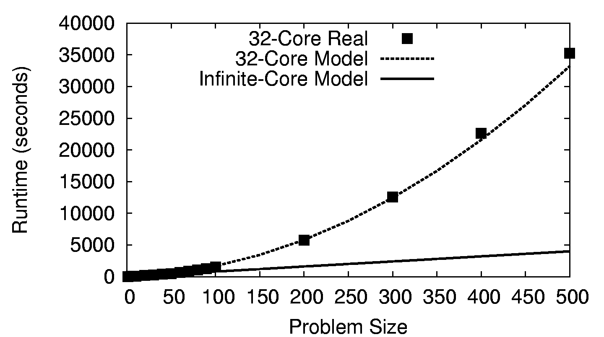
Wavefront on a 32-Core CPU

Slide 39
The Genome Assembly Problem
AGTCGATCGATCGATAATCGATCCTAGCTAGCTACGA
Chemical Sequencing
AGTCGATCGATCGAT
Millions of “reads”
100s bytes long.
TCGATAATCGATCCTAGCTA
AGCTAGCTACGA
Computational Assembly
AGTCGATCGATCGAT
TCGATAATCGATCCTAGCTA
AGCTAGCTACGA

Slide 40
Some-Pairs Abstraction
SomePairs( set A, list (i,j), function F(x,y) )
returns
list of F( A[i], A[j] )
A1
A1
A2
A3
A1
An
SomePairs(A,L,F)
A1
F
(1,2)
(2,1)
(2,3)
(3,3)
A2
F
F
F
A3
F

Slide 41
SAND Genome Assembler
Using Work Queue
100s of workers
dispatched to
Notre Dame,
Purdue, and
Wisconsin
(1,2)
(2,1)
(2,3)
(3,3)
worker
A1
worker
A1
F
worker
An
worker
worker
worker
queue
tasks
detail of a single worker:
somepairs
master
work
queue
put align.exe
put in.txt
exec F.exe <in.txt >out.txt
get out.txt
worker
tasks
done
in.txt
F
out.txt

Slide 42
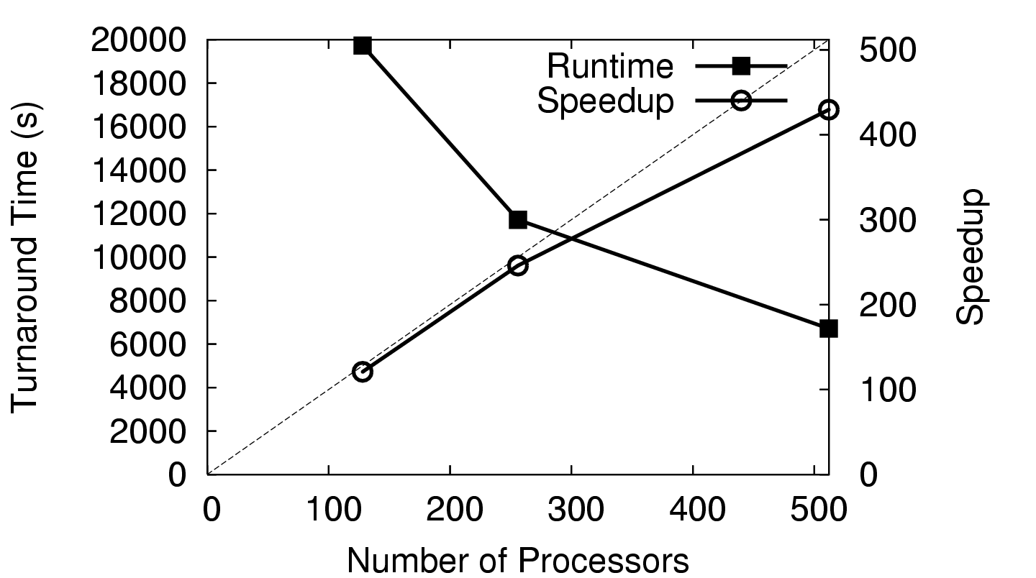
Large Genome (7.9M)

Slide 43
What’s the Upshot?
We can do full-scale assemblies as a routine matter on existing conventional machines.
Our solution is faster (wall-clock time) than the next faster assembler run on 1024x BG/L.
You could almost certainly do better with a dedicated cluster and a fast interconnect, but such systems are not universally available.
Our solution opens up assembly to labs with “NASCAR” instead of “Formula-One” hardware.
SAND Genome Assembler (Celera Compatible)
http://nd.edu/~ccl/software/sand

Slide 44
What if your application doesn’t fit a regular pattern?

Slide 45
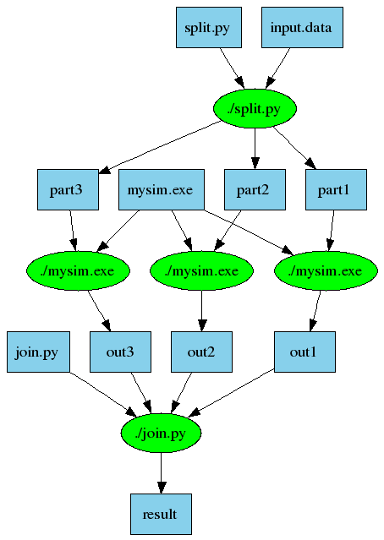
Another Old Idea: Make
part1 part2 part3: input.data split.py
./split.py input.data
out1: part1 mysim.exe
./mysim.exe part1 >out1
out2: part2 mysim.exe
./mysim.exe part2 >out2
out3: part3 mysim.exe
./mysim.exe part3 >out3
result: out1 out2 out3 join.py
./join.py out1 out2 out3 > result

Slide 46
Makeflow: Direct Submission
Private
Cluster
Shared
SGE
Cluster
Makefile
Makeflow
submit
jobs
Campus
Condor
Pool
Public
Cloud
Provider
Local Files and Programs

Slide 47
Problems with Direct Submission
Software Engineering: too many batch systems with too many slight differences.
Performance: Starting a new job or a VM takes 30-60 seconds. (Universal?)
Stability: An accident could result in you purchasing thousands of cores!
Solution: Overlay our own work management system into multiple clouds.
Technique used widely in the grid world.

Slide 48
Makeflow: Overlay Workerrs
sge_submit_workers
Private
Cluster
Shared
SGE
Cluster
Makefile
Wv
W
Hundreds of Workers in a
Personal Cloud
W
submit
tasks
W
W
W
Makeflow
Campus
Condor
Pool
Public
Cloud
Provider
W
W
W
W
W
W
W
Local Files and Programs
condor_submit_workers
ssh

Slide 49
Makeflow: Overlay Workers
worker
100s of workers
dispatched to
the cloud
worker
bfile: afile prog
prog afile >bfile
worker
worker
worker
worker
queue
tasks
detail of a single worker:
makeflow
master
work
queue
put prog
put afile
exec prog afile > bfile
get bfile
worker
tasks
done
Two optimizations:
Cache inputs and output.
Dispatch tasks to nodes with data.
afile
prog
bfile

Slide 50
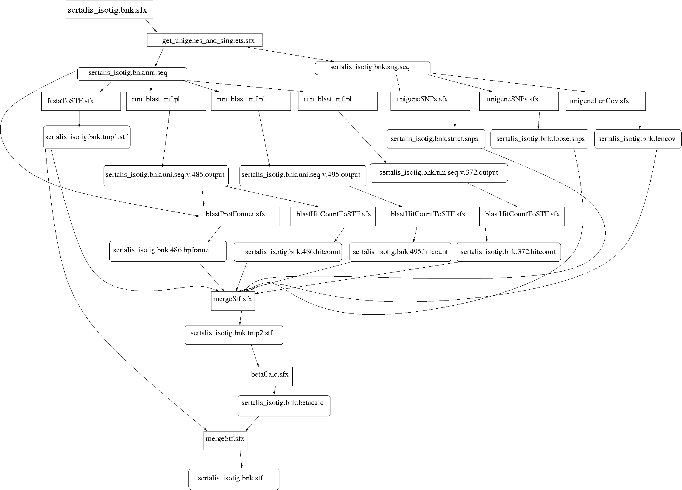
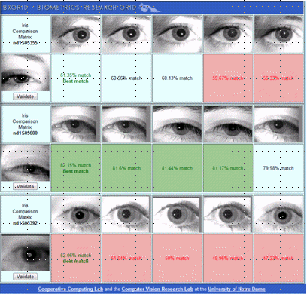
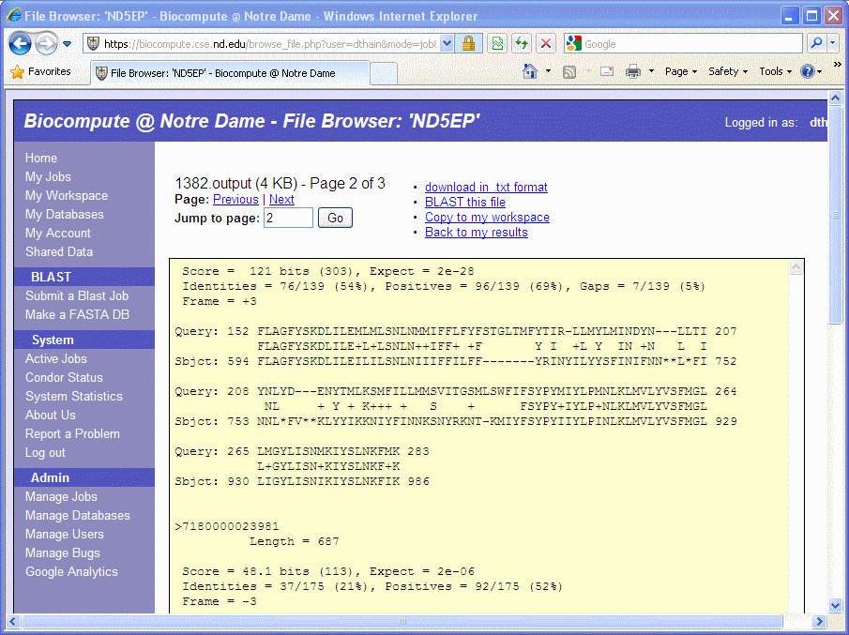
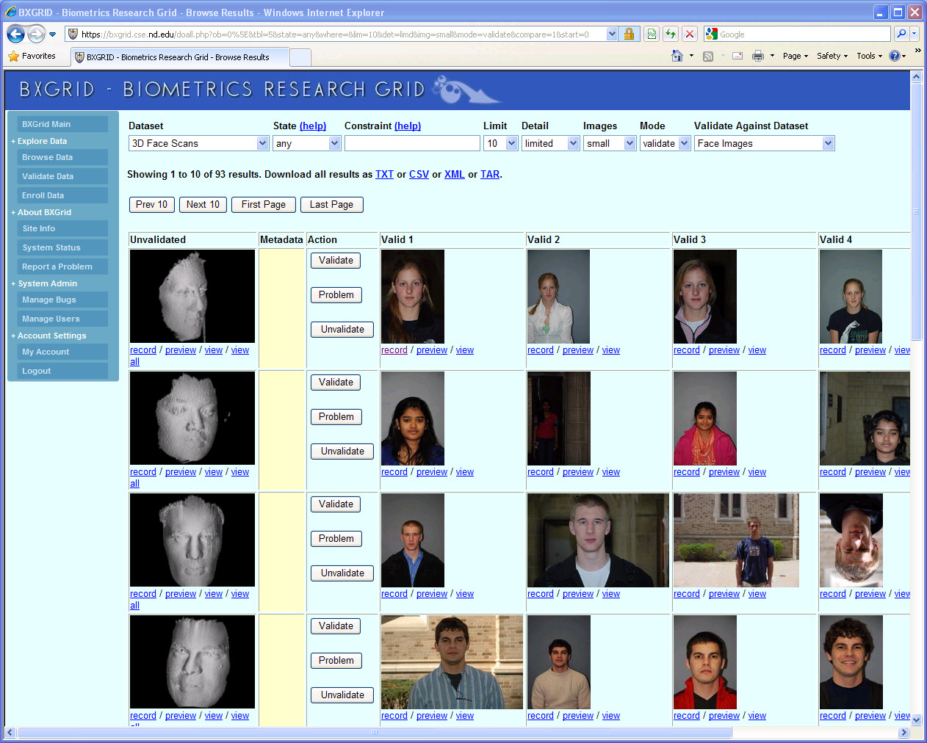
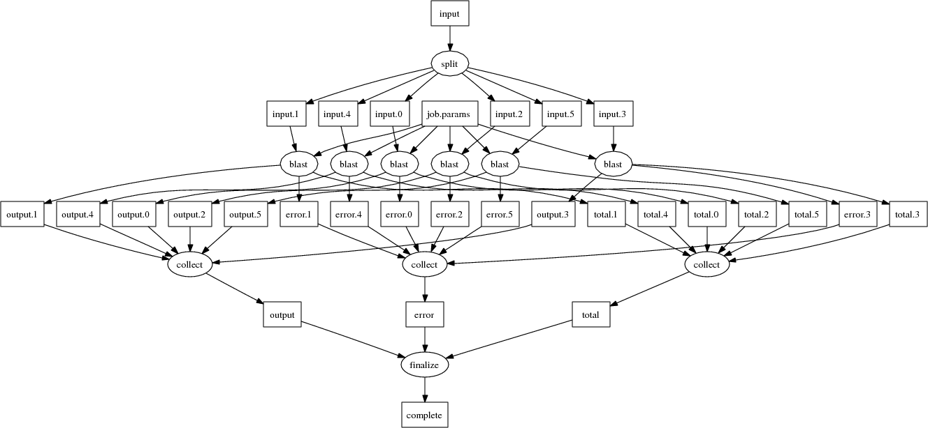
Makeflow Applications

Slide 51
Makeflow for Bioinformatics
BLAST
SHRIMP
SSAHA BWA
Maker..
http://biocompute.cse.nd.edu

Slide 52
Why Users Like Makeflow
Use existing applications without change.
Use an existing language everyone knows. (Some apps are already in Make.)
Via Workers, harness all available resources: desktop to cluster to cloud.
Transparent fault tolerance means you can harness unreliable resources.
Transparent data movement means no shared filesystem is required.

Slide 53
Common Application Stack
All-Pairs
Wavefront
Makeflow
Custom
Apps
Work Queue Library
Hundreds of Workers in a
Personal Cloud
Public
Cloud
Provider
Shared
SGE
Cluster
Campus
Condor
Pool
Private
Cluster
W
W
Wv
W
W
W
W
W
W

Slide 54
Work Queue Apps
AGTC
ACTCAT
ACTGAGC
TAATAAG
Raw Sequence Data
Fully Assembled Genome
Scalable
Assembler
AGTCACACTGTACGTAGAAGTCACACTGTACGTAA…
Work Queue
Align
Align
Align
Replica Exchange
x100s
Work Queue
T=10K
T=20K
T=30K
T=40K

Slide 55
I would like to posit that computing’s central challenge how not to make a mess of it has not yet been met. - Edsger Djikstra

Slide 56
The 0, 1 … N attitude.
Code designed for a single machine doesn’t worry about resources, because there isn’t any alternative. (Virtual Memory)
But in a distributed system, you usually scale until some resource is exhausted!
App devels are rarely trained to deal with this problem. (Can malloc or close fail?)
Opinion: All software needs to do a better job of advertising and limiting resources. (Frameworks could exploit this.)

Slide 57
Too much concurrency!
Vendors of multi-core projects are pushing everyone to make everything concurrent.
Hence, many applications now attempt to use all available cores at their disposal, without regards to RAM, I/O, disk…
Two apps running on the same machine almost always conflict in bad ways.
Opinion: Keep the apps simple and sequential, and let the framework handle concurrency.

Slide 58
To succeed, get used to failure.
Any system of 1000s of parts has failures, and many of them are pernicious:
Black holes, white holes, deadlock…
To discover failures, you need to have a reasonably detailed model of success:
Output format, run time, resources consumed.
Need to train coders in classic engineering:
Damping, hysteresis, control systems.
Keep failures at a sufficient trickle, so that everyone must confront them.

Slide 59
Federating resources.
10 years ago, we had (still have) multiple independent computing grids, each centered on a particular institution.
Grid federation was widely desired, but never widely achieved, for many technical and social reasons.
But, users ended up developing frameworks to harness multiple grids simultaneously, which was nearly as good.
Let users make overlays across systems.

Slide 60
Examples of Frameworks
AllPairs( A, B, F ) -> M
Wavefront( X, Y, F ) -> M
A1
A2
A3
R[0,4]
F
R[2,4]
R[3,4]
R[4,4]
x
B1
F
F
F
R[0,3]
d
y
R[3,2]
R[4,3]
x
F
x
F
R[0,2]
d
y
d
y
R[4,2]
x
F
x
F
x
F
B2
F
F
F
d
y
d
y
d
y
R[0,1]
F
F
F
F
x
x
x
x
R[0,0]
d
y
d
y
d
y
d
y
B3
F
F
F
R[1,0]
R[2,0]
R[3,0]
R[4,0]
Classify( T, P, F, R ) -> V
Makeflow
T1
F
V1
1
A
4
C
T
P
T2
F
V2
C
V
2
T3
F
V3
B
D
5
R
3

Slide 61
Common Application Stack
All-Pairs
Wavefront
Makeflow
Custom
Apps
Work Queue Library
Hundreds of Workers in a
Personal Cloud
Public
Cloud
Provider
Shared
SGE
Cluster
Campus
Condor
Pool
Private
Cluster
W
W
Wv
W
W
W
W
W
W

Slide 62
A Team Effort
Faculty:
Patrick Flynn
Scott Emrich
Jesus Izaguirre
Nitesh Chawla
Kenneth Judd
Grad Students
Hoang Bui
Li Yu
Peter Bui
Michael Albrecht
Peter Sempolinski
Dinesh Rajan
Undergrads
Rachel Witty
Thomas Potthast
Brenden Kokosza
Zach Musgrave
Anthony Canino
NSF Grants CCF-0621434, CNS-0643229, and CNS 08-554087.

Slide 63
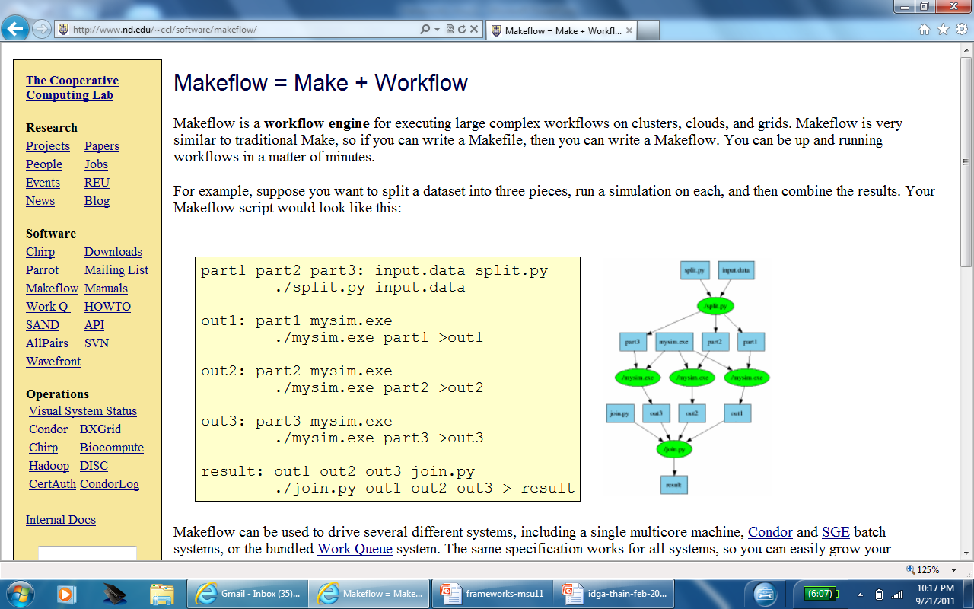
Open Source Software
http://www.nd.edu/~ccl

Slide 64
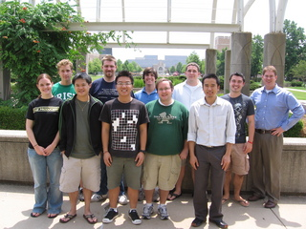
The Cooperative Computing Lab
http://www.nd.edu/~ccl

