Slide 1

Improved Rates of Convergence In Extreme Value Statistics
Ashivni Shekhawat
Miller Research Fellow
Department of Materials Science and Engineering, UC Berkeley
Materials Science Division, Lawrence Berkeley National Lab
Workshop on Aging and Failure in Biological,
Physical and Engineered Systems
Notes:
Today I will be talking about extreme value statistics or statistics of rare events. In particular I will describe a method that solves a long standing problem in the field, and provides more reliable estimates of probabilities of rare events based on limited amount of data. However, before I go into the details, let me begin by motivating why we care about rare events, and showcasing the extraordinarily wide variety of fields where extreme value statistics finds applications.

Slide 2

Thousands of moving parts, the failure of any one of which can be catastrophic
Notes:
Consider a modern engineering marvel that is a jet engine. This machine has literally thousands of moving parts, the failure of any one of which will lead to catastrophy and loss of life and limb. So each time you step into an airplane, remember that your safety is predicated on the occurrence, or the lack thereof, of an extremely rare event.

Slide 3
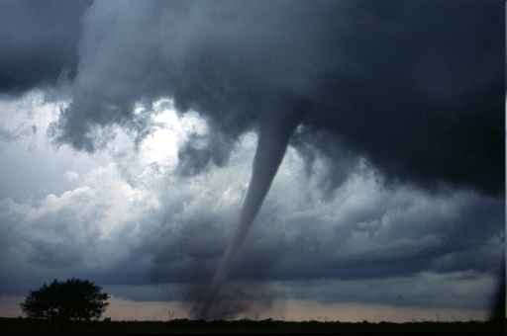
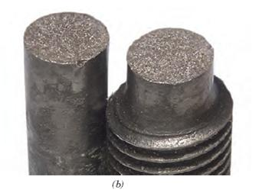
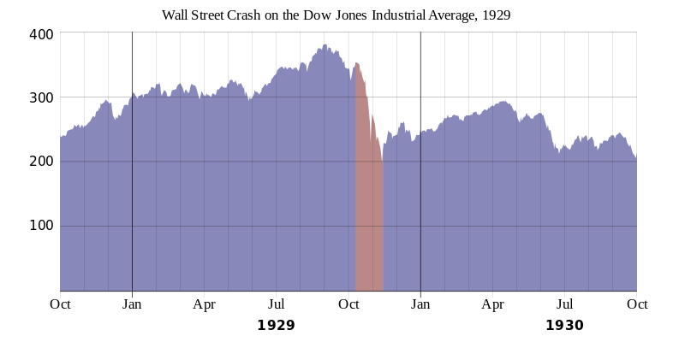

The Fate of Many Disparate Phenomena is Dictated by Rare Events
Insurance
Brittle Fracture
Financial Markets
Notes:
Indeed, our ability to model and understand a vast variety of disparate phenomena depends on our ability to predict rare events. For example, an insurer needs to estimate the probability of a rare extreme weather events. Similarly, in brittle fracture we want to estimate the probability that a material sample contains a rare large flaw. A stock trader on the other hand wants to predict the probability of a large movement in the stock prices. And the goal of extreme value statistics is to provide a principled framework to estimate such probabilities.

Slide 4


F.A.R. Section 33.75: … hazardous engine effects are predicted to occur at a rate not in excess of that defined as extremely remote (probability range of 10⁻⁷ to 10⁻⁹ per engine flight hour).... In dealing with probabilities of this low order of magnitude, absolute proof is not possible, and compliance may be shown by reliance on engineering judgment…
Notes:
Just to give you an idea of the numbers involved, the federal aviation regulation demands that for a airplane to be deemed safe, it should have a failure probability of less 1 in 10 million per hour of operation. How on earth is an engineer supposed to make this determination? One cannot flight test a plane for 10 million hours, nor can one test 10 million planes for 1 hour each! This predicament is symptomatic of a deeper problem. Pretty much by definition, we will only ever have a small amount of empirical data about rare events! Thus we need some extraordinarily good theory to make predictions from typically a very small dataset. Traditionally the theory used to make such predictions is called the extreme value theory.

Slide 5
Predicting rare events is
important!
Message of
this talk
We can often do better than standard Extreme Value Theory
Notes:
So then, the message of this talk is two fold. One of course, that predicting rare events is essential in many applications. And two, often we can do better than the standard extreme value theory. The method that I will talk about applies to any place where extreme value statistics is traditionally used. The methodology that I will present in a sense complements the sorts of physics based techniques that one of the speakers yesterday described. My technique is physics agnostic, and build on very general principles for characterizing extreme events.

Slide 6
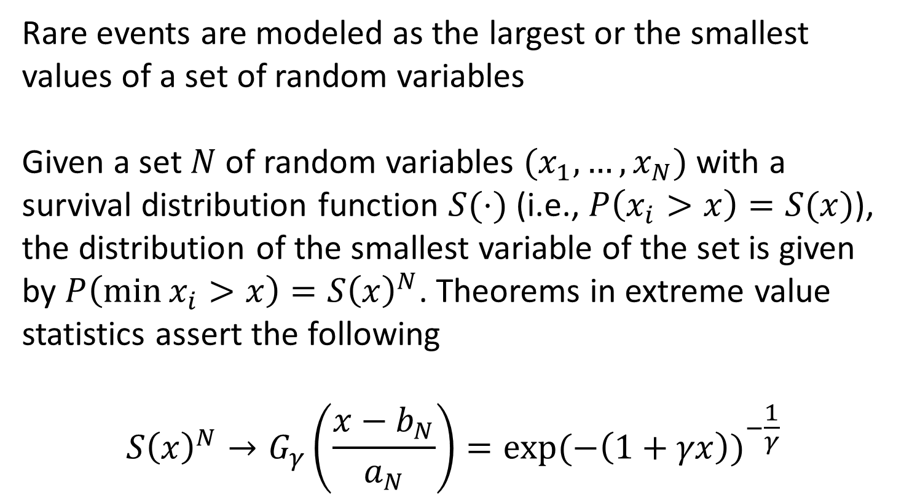
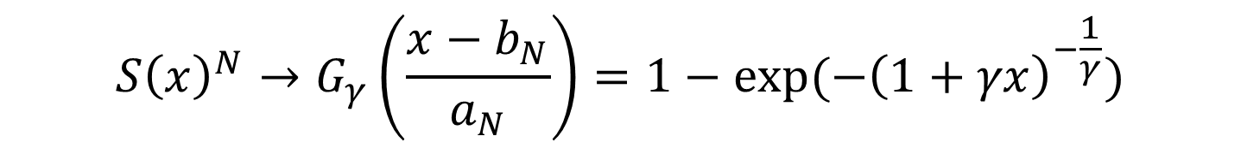
Extreme Value Statistics
$$S{\left(x\right)}^{N}→G_{γ}\left(\frac{x−b_{N}}{a_{N}}\right)=1−\exp{(−{\left(1+γx\right)}^{−\frac{1}{γ}})}$$
Notes:
Before I present the improvement to extreme value statistics, let me present the traditional method, and demonstrate some of the potential problems. So lets begin with extreme value statistics 101. In the framework of extreme value statistics, rare events are modeled as a the largest or the smallest value of a bunch of random variables. For instance, size of a large flood is by definition the largest of many floods, each of which is a random variable. Similarly the fracture strength of a brittle material can be thought of as the smallest of several random variables, where each random variable corresponds to the strength of a weak spot in the material.
More formally, given a set of N random variables, with a survival distribution S, the survival distribution for the smallest of these random variables is given by simply S^N. This is just saying that the minimum of N random variables is larger than x if each one of these random variables is larger than x, and assuming independence of random variables, this probability is given by S^N. The central theorem of extreme value statistics claims that for large N, this survival probability can be approximated by G, which is called the generalized extreme value function.

Slide 7
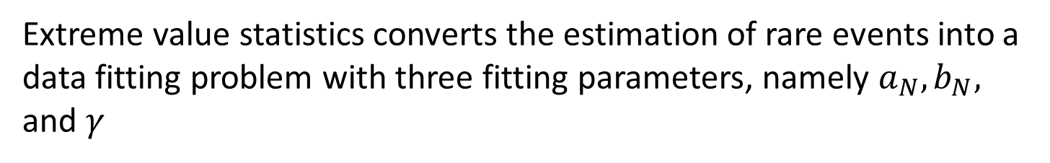
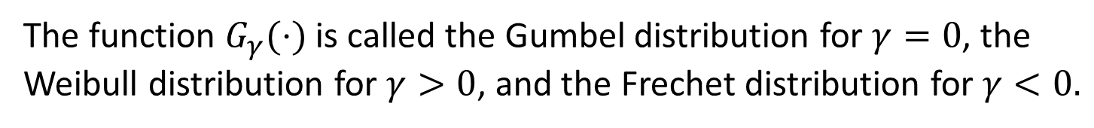
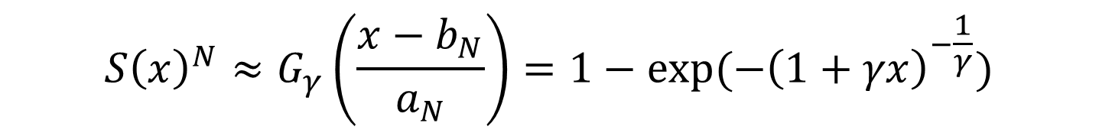
Extreme value statistics converts the estimation of rare events into a data fitting problem with three fitting parameters, namely $a_{N}, b_{N},$ and $γ$
$$S{\left(x\right)}^{N}≈G_{γ}\left(\frac{x−b_{N}}{a_{N}}\right)=1−\exp{(−{\left(1+γx\right)}^{−\frac{1}{γ}})}$$
The function $G_{γ}(⋅)$ is called the Gumbel distribution for $γ=0$, the Weibull distribution for $γ>0$, and the Frechet distribution for $γ<0.$
Notes:
So, extreme value statistics coverts the problem of estimation of rare events into a simple data fitting problem. The power of this result is its generality. Notice that we have placed almost no restriction on the underlying distribution function S. So this result says that no matter what the microscopic details of your system are, so long as the object that you are interested in is given by the smallest or the largest of a large set of random variables, its distribution will be given by G, or the generalized extreme value function. This function is also called by a few different names depending on the sign of the parameter gamma. In particular, it is called the Gumbel distribution when gamma = 0, and the Weibull distribution for gamma > 0. This is an extremely powerful result, which says that the fracture strength of brittle materials, large insurance claims, size of large floods, and the probability of a rare mutation, all follow the same universal distribution! This is all good news, so whats the problem?

Slide 8
Rate of Convergence in Extreme Value Statistics is Dependent on Details
Notes:
The problem is that the rate of convergence in extreme value statistics is dependent of details and can vary wildly. First lets look at how we characterize rate of convergence.

Slide 9
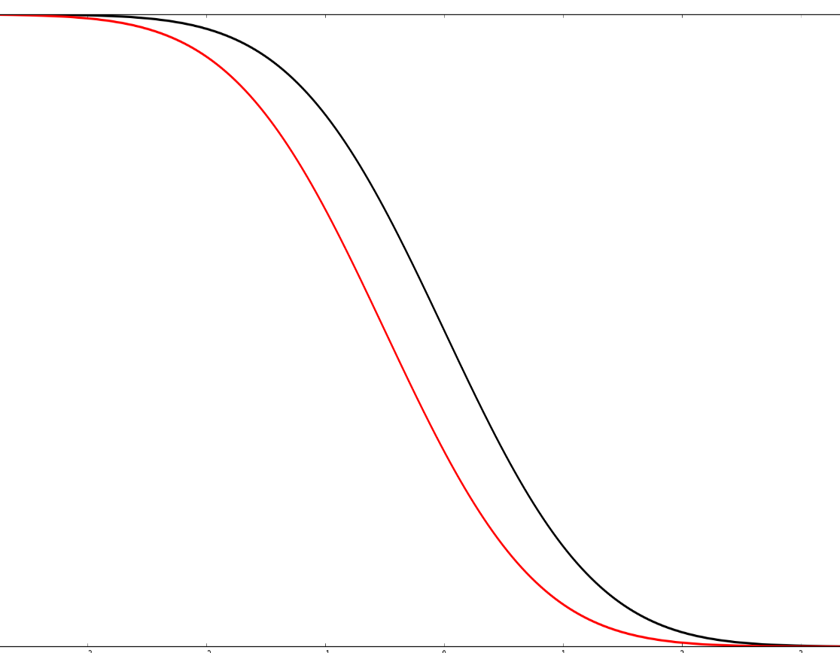


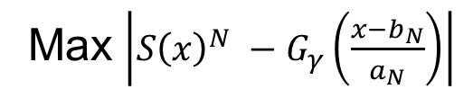
Rate of Convergence in Extreme Value Statistics is Dependent on Details
Max $\left|S{\left(x\right)}^{N} −G_{γ}\left(\frac{x−b_{N}}{a_{N}}\right)\right|$
$$S{\left(x\right)}^{N}$$
Approx
Exact
$$x$$
Notes:
There are two notions of the rate of convergence here. The basic idea is that we are trying to approximate S(x)^N, which is our observed data, with G, which is our fitting function. And we would like to know how good a job of fitting the data does G do? The most natural way to measure the convergence then is to look at the largest difference between the data and the fit. So if the black line here is data, and the red line is the fit, then the largest difference happens sort of in the middle of the data, and is shown by the black arrow here. Extreme value theory guarantees that as N becomes large, this difference goes to zero. That’s good to know. However, there is no guarantee on the rate at which it goes to zero. I will come back to that in a second, but before that we need to introduce another measure of convergence.

Slide 10

Rate of Convergence in Extreme Value Statistics is Dependent on Details
$$\frac{1−G_{γ}\left(\frac{x −b_{N}}{a_{N}}\right)}{1 −S{\left(x\right)}^{N}}$$
Max $\left|S{\left(x\right)}^{N} −G_{γ}\left(\frac{x−b_{N}}{a_{N}}\right)\right|$
$$S{\left(x\right)}^{N}$$
Approx
Exact
$$x$$
Notes:
And we need this second measure because most of the time, we are not so interested in what happens in the middle of the data, rather, we want to extrapolate deep in the high reliability tail. For instance if we do hundred experiments and find the level of stress at which the survival probability is 99%. Now, we want to use this data to extrapolate to the stress level where the survival probability is 99.999%, because that’s where we want our design to be, thus we want to extrapolate deep in the high reliability tail. And since both the data, and the approximation are rather close to 1 there, the difference between them is not a very useful quantity. Instead, we have to look at the relative error, given by this ratio here. Ideally, we would like this ratio to go to 1. However, the extreme value theory gives no guarantee at all about the behavior of this quantity. Lets see, how bad can these convergence properties be in practice.

Slide 11

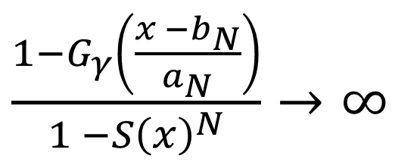
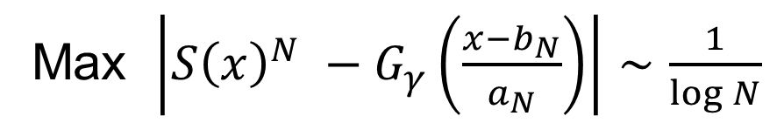
If $S(x)$ is Gaussian
The maximum error decays logarithmically
Max $\left|S{\left(x\right)}^{N} −G_{γ}\left(\frac{x−b_{N}}{a_{N}}\right)\right|∼\frac{1}{\log{N}}$
The relative error in the tail diverges
$\frac{1−G_{γ}\left(\frac{x −b_{N}}{a_{N}}\right)}{1 −S{\left(x\right)}^{N}}→∞$
Notes:
Lets assume that the underlying distribution that we are looking at is Gaussian. That is to say that lets say we can looking that the statistics of highest water levels in the Charles river, and that the typical water levels are given by a guassian distribution. Then, the largest error of approximation will go down as 1/log N. So, if you want to reduce this error by a factor of 2, you need hundred times more data! Further, the relative error in the tail, instead of being 1, diverges to infinity! And I would say, that for typical values of 1 and infinity, that’s a pretty bad approximation! And the mathematicians have known about this problem for a long time. Infact there is a very interesting paper about 30 years ago, that show how by doing several pages worth of math, you can improve that 1/log N and make it 1/ 2 log N, and that paper also shows that in the standard theory you cannot do any better than ½ log N. So it seems that we have our back to the wall here! What can we do to improve these abysmal results?

Slide 12
If you cannot win the game,
then change the rules!
Notes:
Well, as they say, if you cannot win the game, then change the rules! So that’s what I did.

Slide 13
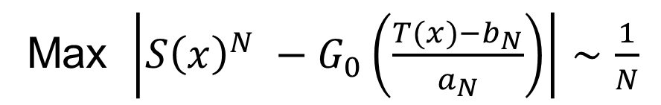
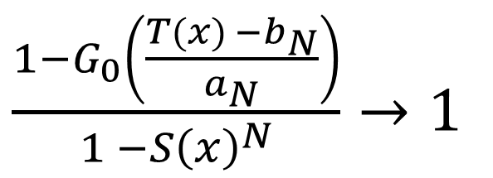
The T-Method
There always exists a transformation, such that
Max $\left|S{\left(x\right)}^{N} −G_{0}\left(\frac{T(x)−b_{N}}{a_{N}}\right)\right|∼\frac{1}{N}$
And
$\frac{1−G_{0}\left(\frac{T(x) −b_{N}}{a_{N}}\right)}{1 −S{\left(x\right)}^{N}}→1$
Notes:
So, I changed the rules a little and amended the standard method. What I can show formally is that there always exists a transformation, T(x), such that we get rather strong convergence guarantees when we work with data transformed by T(x). A rather intuitive way to think about this is the following. I showed you that for Gaussian data, the convergence is rather bad. However, I did not tell you that for exponential data, the convergence is rather rapid. Now since there is a unitary transformation that transforms Gaussian data to exponential data, in this case, T is that unitary transformation. So that’s a simple idea. However, there is a slight problem with this scheme. It turns out that to know the transformation T, we need to know S, and if we knew S in the first place, then there is no need to approximate it by anything! So, again we have our back to the wall!

Slide 14
If you still cannot win the game,
then change the rules again!!
Notes:
Well, as they say, if you cannot win the game, then change the rules! So that’s what I did.

Slide 15
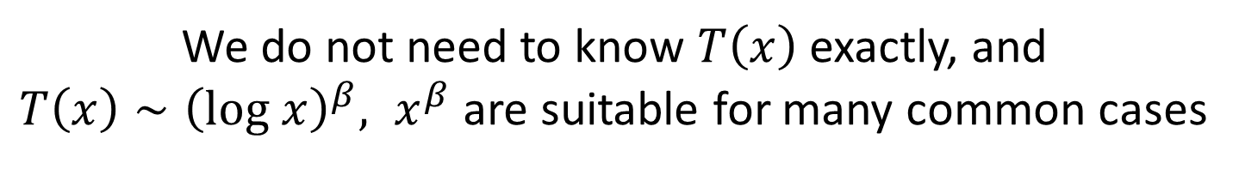
The T-Method
There always exists a transformation, such that
Max $\left|S{\left(x\right)}^{N} −G_{0}\left(\frac{T(x)−b_{N}}{a_{N}}\right)\right|∼\frac{1}{N}$
And
$\frac{1−G_{0}\left(\frac{T(x) −b_{N}}{a_{N}}\right)}{1 −S{\left(x\right)}^{N}}→1$
We do not need to know $T\left(x\right)$ exactly, and
$T\left(x\right)∼{\left(log x\right)}^{β}, x^{β}$ are suitable for many common cases
Notes:
The crucial step is that I can show formally that for several common cases, we can use rather simple approximations for T, and get rather good results. So now, instead of estimating gamma, a_n, and b_n, we estimate beta, a_n, and b_n. Thus, the data fitting is no more complicated, but the results are much better, as I will show you next.

Slide 16




Exact
Extreme Value
T-Method
$$S{\left(x\right)}^{10}$$
$$−x$$
The T-Method for the Gaussian Case

Slide 17
Gaussian
Log-Normal
Heights of Brownian
Excursions
Fiber Bundle
Strength

Slide 18
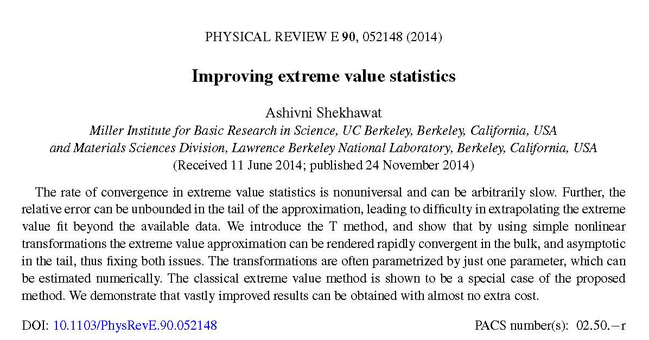
Notes:
I will be describing the salient features my work here – some of the details can be found in this publication.

Slide 19
Thank you!!
Notes:
Well, as they say, if you cannot win the game, then change the rules! So that’s what I did.

