Slide 1
THE ETIOLOGY of AGING in BIOLOGICAL and in INANIMATE SYSTEMS
Leonard Hayflick, Ph.D.
Professor of Anatomy
University of California, San Francisco
Notes:
NEXT : Is aging genetically determined?

Slide 2
THERE ARE ONLY TWO WAYS IN WHICH AGE CHANGES CAN OCCUR
A purposeful program driven by genes.
or
(2) A stochastic or randomly occurring cascade of accidental events.

Slide 3
IN LIVING SYSTEMS THERE ARE FOUR ASPECTS OF THE FINITUDE OF LIFE
1. Aging
2. Longevity Determination
3. Age-associated Diseases
4. Death
Notes:
Will not discuss biology of death. Death is natures way of telling you to slow down.
NEXT: I will discuss the remaining 3 aspects and why the distinctions are critically important to understanding this field.

Slide 4
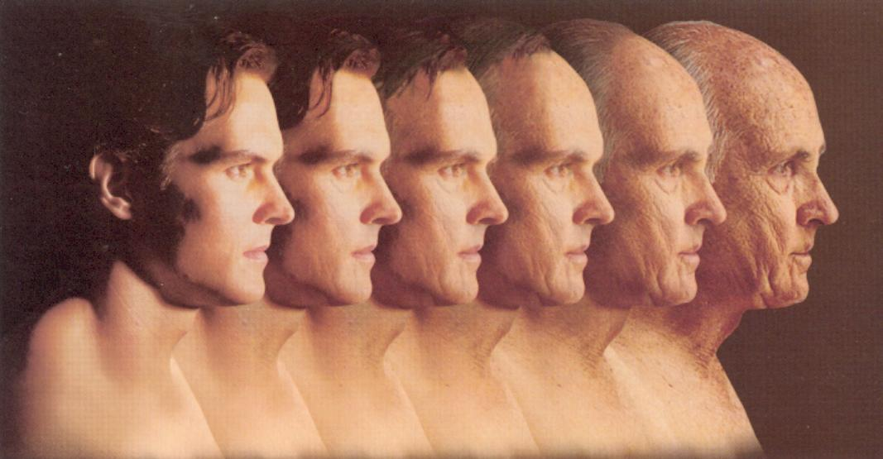
THE FIRST ASPECT OF THE FINITUDE OF LIFE:
AGING

Slide 5
EVIDENCE THAT AGING IS A STOCHASTIC PROCESS
There is no direct evidence that supports the common belief that aging is the result of a genetic program. No gene that codes for a generally accepted biomarker of aging has been found.
Animate and inanimate objects require no instructions to age.
Everything in the universe ages and for the same reason.
For example, your car is brilliant because it knows how to age without any instructions that exist either in the car itself or in the blueprints.
A huge body of knowledge exists indicating that age changes are characterized by the loss of molecular structure in the molecules of both animate and inanimate objects.

Slide 6
THE CAUSE OF ALL AGE CHANGES IS THE ACCUMULATION OF UNREPAIRED OR UNREPLACED MOLECULES
Aging is the random, systemic, loss of molecular fidelity (hence function) that occurs from
life’s beginning.
Redundancy, repair, maintenance and synthesis processes are capable of maintaining
the balance in favor of sustaining molecular fidelity until reproductive maturity.
If not, the species would vanish.
Age changes in molecular structures are caused by the loss of energy in chemical
bonds and other forces that maintain structure.
The loss of energy that breaks bonds is caused by the Second Law of
Thermodynamics which says:
Energy tends to disperse or spread out unless it is hindered regardless of whether
the system is open or closed.” *
* Lambert, F.L. 2012. http://secondlaw.oxy.edu/
Notes:
It can be viewed as an increase in entropy which follows the more recent interpretation of the Second Law of Thermodynamics where the belief that it only applies to closed systems has been overturned. (3). Entropy is the tendency for concentrated energy to disperse when unhindered regardless of whether the system is open or closed.
The hindrance is the relative strength of chemical bonds that are formed by what is called activation energy. The prevention of chemical bond breakage, among other structural changes is absolutely essential for the maintenance of the life of individuals and the
continuity of species, at least until reproductive maturation.
The tendency for molecules to lose energy is never entirely eliminated but it can be blocked for varying periods of time by repair or replacement processes. Although the dispersal of molecular energy may result in a biologically inactive or malfunctioning molecule, from the standpoint of a physicist this lowered energy state is not necessarily disorder because it simply results in a molecule with a lowered energy state. The fact that such a molecule might be biologically inactive does not concern
the physicist. It definitely does concern the biologist and especially, the biogerontologist.
It can be viewed as an increase in entropy which follows the more recent interpretation of the Second Law of Thermodynamics where the belief that it only applies to closed systems has been overturned. (3). Entropy is the tendency for concentrated energy to disperse when unhindered regardless of whether the system is open or closed.
The hindrance is the relative strength of chemical bonds that are formed by what is called activation energy. The prevention of chemical bond breakage, among other structural changes is absolutely essential for the maintenance of the life of individuals and the
continuity of species, at least until reproductive maturation.
The tendency for molecules to lose energy is never entirely eliminated but it can be blocked for varying periods of time by repair or replacement processes. Although the dispersal of molecular energy may result in a biologically inactive or malfunctioning molecule, from the standpoint of a physicist this lowered energy state is not necessarily disorder because it simply results in a molecule with a lowered energy state. The fact that such a molecule might be biologically inactive does not concern
the physicist. It definitely does concern the biologist and especially, the biogerontologist.
It can be viewed as an increase in entropy which follows the more recent interpretation of the Second Law of Thermodynamics where the belief that it only applies to closed systems has been overturned. (3). Entropy is the tendency for concentrated energy to disperse when unhindered regardless of whether the system is open or closed.
The hindrance is the relative strength of chemical bonds that are formed by what is called activation energy. The prevention of chemical bond breakage, among other structural changes is absolutely essential for the maintenance of the life of individuals and the
continuity of species, at least until reproductive maturation.
The tendency for molecules to lose energy is never entirely eliminated but it can be blocked for varying periods of time by repair or replacement processes. Although the dispersal of molecular energy may result in a biologically inactive or malfunctioning molecule, from the standpoint of a physicist this lowered energy state is not necessarily disorder because it simply results in a molecule with a lowered energy state. The fact that such a molecule might be biologically inactive does not concern
the physicist. It definitely does concern the biologist and especially, the biogerontologist.
It can be viewed as an increase in entropy which follows the more recent interpretation of the Second Law of Thermodynamics where the belief that it only applies to closed systems has been overturned. (3). Entropy is the tendency for concentrated energy to disperse when unhindered regardless of whether the system is open or closed.
The hindrance is the relative strength of chemical bonds that are formed by what is called activation energy. The prevention of chemical bond breakage, among other structural changes is absolutely essential for the maintenance of the life of individuals and the
continuity of species, at least until reproductive maturation.
The tendency for molecules to lose energy is never entirely eliminated but it can be blocked for varying periods of time by repair or replacement processes. Although the dispersal of molecular energy may result in a biologically inactive or malfunctioning molecule, from the standpoint of a physicist this lowered energy state is not necessarily disorder because it simply results in a molecule with a lowered energy state. The fact that such a molecule might be biologically inactive does not concern
the physicist. It definitely does concern the biologist and especially, the biogerontologist.

Slide 7
THE CAUSE OF ALL AGE CHANGES IS THE ACCUMULATION OF UNREPAIRED OR UNREPLACED MOLECULES
The processes of repair and synthesis after chemical bond breakage is the
sine qua non for the maintenance of life.
The length of time that favors repair and synthesis over the accumulation of
dysfunctional molecules is determined by evolution through natural selection.
After reproductive success the balance in favor of repair and synthesis slowly
shifts to favor accumulation of dysfunctional molecules. This accumulation is
expressed at higher levels of organization as age changes and indirectly determines
individual longevity.
Because the repair shops themselves are also composed of complex molecules
they too obey the 2nd Law and age.
The progressive loss of molecular fidelity increases vulnerability to age-associated
diseases.
Notes:
It can be viewed as an increase in entropy which follows the more recent interpretation of the Second Law of Thermodynamics where the belief that it only applies to closed systems has been overturned. (3). Entropy is the tendency for concentrated energy to disperse when unhindered regardless of whether the system is open or closed.
The hindrance is the relative strength of chemical bonds that are formed by what is called activation energy. The prevention of chemical bond breakage, among other structural changes is absolutely essential for the maintenance of the life of individuals and the
continuity of species, at least until reproductive maturation.
The tendency for molecules to lose energy is never entirely eliminated but it can be blocked for varying periods of time by repair or replacement processes. Although the dispersal of molecular energy may result in a biologically inactive or malfunctioning molecule, from the standpoint of a physicist this lowered energy state is not necessarily disorder because it simply results in a molecule with a lowered energy state. The fact that such a molecule might be biologically inactive does not concern
the physicist. It definitely does concern the biologist and especially, the biogerontologist.
It can be viewed as an increase in entropy which follows the more recent interpretation of the Second Law of Thermodynamics where the belief that it only applies to closed systems has been overturned. (3). Entropy is the tendency for concentrated energy to disperse when unhindered regardless of whether the system is open or closed.
The hindrance is the relative strength of chemical bonds that are formed by what is called activation energy. The prevention of chemical bond breakage, among other structural changes is absolutely essential for the maintenance of the life of individuals and the
continuity of species, at least until reproductive maturation.
The tendency for molecules to lose energy is never entirely eliminated but it can be blocked for varying periods of time by repair or replacement processes. Although the dispersal of molecular energy may result in a biologically inactive or malfunctioning molecule, from the standpoint of a physicist this lowered energy state is not necessarily disorder because it simply results in a molecule with a lowered energy state. The fact that such a molecule might be biologically inactive does not concern
the physicist. It definitely does concern the biologist and especially, the biogerontologist.
It can be viewed as an increase in entropy which follows the more recent interpretation of the Second Law of Thermodynamics where the belief that it only applies to closed systems has been overturned. (3). Entropy is the tendency for concentrated energy to disperse when unhindered regardless of whether the system is open or closed.
The hindrance is the relative strength of chemical bonds that are formed by what is called activation energy. The prevention of chemical bond breakage, among other structural changes is absolutely essential for the maintenance of the life of individuals and the
continuity of species, at least until reproductive maturation.
The tendency for molecules to lose energy is never entirely eliminated but it can be blocked for varying periods of time by repair or replacement processes. Although the dispersal of molecular energy may result in a biologically inactive or malfunctioning molecule, from the standpoint of a physicist this lowered energy state is not necessarily disorder because it simply results in a molecule with a lowered energy state. The fact that such a molecule might be biologically inactive does not concern
the physicist. It definitely does concern the biologist and especially, the biogerontologist.
It can be viewed as an increase in entropy which follows the more recent interpretation of the Second Law of Thermodynamics where the belief that it only applies to closed systems has been overturned. (3). Entropy is the tendency for concentrated energy to disperse when unhindered regardless of whether the system is open or closed.
The hindrance is the relative strength of chemical bonds that are formed by what is called activation energy. The prevention of chemical bond breakage, among other structural changes is absolutely essential for the maintenance of the life of individuals and the
continuity of species, at least until reproductive maturation.
The tendency for molecules to lose energy is never entirely eliminated but it can be blocked for varying periods of time by repair or replacement processes. Although the dispersal of molecular energy may result in a biologically inactive or malfunctioning molecule, from the standpoint of a physicist this lowered energy state is not necessarily disorder because it simply results in a molecule with a lowered energy state. The fact that such a molecule might be biologically inactive does not concern
the physicist. It definitely does concern the biologist and especially, the biogerontologist.

Slide 8
WHY IS THE 2ND LAW THE PROBABLE CAUSE OF AGING?
It:
governs the behavior of all molecules
can explain the ultimate cause of all other theories of aging
is testable using current technologies
is falsifiable
is universal and applies to both animate and inanimate objects

Slide 9
WHY IS AGING NOT DETERMINED BY GENES?
Genes are unnecessary to drive a spontaneous process.
Blueprints contain no information to instruct a car, - or any other inanimate object, - how to age. Age changes are universal phenomena.
Analogously, the genome also does not contain instructions that govern age changes.
Notes:
Genes do not directly cause age changes despite what has been claimed. Animals, like cars, do not need instructions telling them how to age. It happens spontaneously as the energetics of molecules changes.
Genes DO determine longevity although indirectly because genes must perform successfully until reproductive maturation in a majority of members or else the species will disappear. After reproductive maturation species survival does not depend on living significantly longer.
I have discussed why aging and disease cannot be manipulated.
NEXT : Now can longevity determinants be manipulated?

Slide 10
HUMAN AGING IS UNIQUE
The extreme manifestations of aging are unique to humans and the animals that we choose to protect.
Feral animals do not age because when the process starts they are culled by predation, disease or accidents.
By learning how to eliminate predators, prevent or delay diseases and accidents, we have revealed age changes in their extreme. We might argue teleologically that aging was never intended for us to experience.
Aging then is an artifact of human civilization.

Slide 11

THE SECOND ASPECT OF THE FINITUDE OF LIFE:
LONGEVITY DETERMINATION
Rembrandt van Rijn 1606-1669

Slide 12
AGE CHANGES MUST OCCUR IN MOLECULES THAT FIRST EXIST WITHOUT AGE CHANGES
Longevity is determined by the length of time that repair, synthesis and maintenance processes can retain the active state of biomolecules.
When molecules composing the repair, synthesis and maintenance processes themselves eventually succumb to the same irreparable reduced energy states as do their substrate molecules, the aging process becomes manifest at higher levels of organization.
The repair shops also age.

Slide 13
THE GENOME INDIRECTLY DETERMINES LONGEVITY
The genome governs events from life's beginning until reproductive maturation after which many of the events that it continues to govern are overtaken by the aging process.
From conception to adulthood, the efficiency of repair, synthesis and maintenance of molecules is favored over the continued loss of molecular structure in substrate molecules.
After reproductive success the balance slowly shifts as dysfunctional molecules accumulate because their numbers exceed repair and maintenance capacity.

Slide 14
THE GENOME INDIRECTLY DETERMINES LONGEVITY
Unlike the chance process that characterizes aging, longevity determination is not a chance process.
Longevity is governed by the enormous excess capacity, (or physiological reserve), reached at the time of reproductive maturity (For example: two kidneys, two lungs, huge heart capacity.)
This redundancy is achieved through natural selection to better guarantee survival to the age of reproductive success.
Thus, the determination of longevity is incidental to the main goal of the genome which is to reach reproductive maturity.

Slide 15
AGING DETERMINANTS vs. LONGEVITY DETERMINANTS
Longevity determination is an entirely different process from the aging process.
One might think of longevity determination as the energy state of molecules before they incur age changes. (“Why do we live as long as we do?”)
One might think of aging as the state of molecules as they continue to incur energy losses, become irreparable and dysfunctional. (“Why do things eventually go wrong?”)
Aging, then, is a catabolic process that is chance driven.
Longevity determination is an anabolic process that, indirectly, is genome driven.

Slide 16
THE THIRD ASPECT OF THE FINITUDE OF LIFE:
AGE-ASSOCIATED DISEASES
Six reasons why aging is not a disease:

Slide 17
UNLIKE ANY DISEASE:
1. Age changes occur in every animal that reaches a fixed size in adulthood.
2. Age changes occur in almost every species except those that continue to grow where aging does not occur or the rate is imperceptible.
3. Age changes occur in all species members only after the age of reproductive maturation.
4. Age changes occur in zoo animals protected by humans even after that species probably has not experienced aging for thousands or even millions of years in feral circumstances.
5. Age changes increase the vulnerability to pathology and death in all animals in which it occurs.
6. Age changes have the same universal molecular cause, (accumulation of dysfunctional molecules) in both animate and inanimate objects.
THERE IS NO DISEASE OR PATHOLOGY THAT SHARES THESE SIX CRITERIA THAT CHARACTERIZE THE AGING PROCESS.
Notes:
Some animals that continue to grow like deep sea cold water fish, sport fish, some amphibians like crocodiles, etc. age imperceptibly or not at all. Not known why.
They are not immortal but die from accidents, predation or disease.
Aging only occurs in humans or the animals we choose to protect like pets and zoo animals. Aging rarely occurs in feral (wild) animals unless their environment is seriously disturbed - usually by humans.
Next: Last 3 reasons why aging is not a disease.

Slide 18
WILL DISEASE RESOLUTION INCREASE OUR UNDERSTANDING OF THE FUNDAMENTAL BIOLOGY OF AGING?
Our success in resolving childhood diseases like poliomyelitis, iron deficiency anemia or Wilms’ tumors did not increase our understanding of childhood development.
Similarly, the resolution of the leading causes of death (age-associated cardiovascular disease, stroke respiratory diseases and cancer) will provide no new insights into the fundamental etiology of aging.

Slide 19
WHAT IF ALL LEADING CAUSES WRITTEN ON DEATH CERTIFICATES WERE TO BE RESOLVED?
In developed countries there could only be an increase in life expectancy of about 13 years.
79 years is the average life expectancy at birth in the U.S. today. Thus, about 92 years would be the maximum average life expectancy attainable if all causes of death were to be resolved.
The increase in years of life expectancy if leading causes of death were resolved:
At birth At age 65
Cardiovascular diseases and stroke 6.73 6.25
Cancer 3.4 2.19
Accidents 0.92 0.14
All other causes 4.29 1.71
(Anderson RN, U.S. Decennial Life Tables for 1989–91, Vol. 1, No. 4.US life tables eliminating certain causes of death. Hyattsville,MD: Nat. Ctr. for Health Statistics; 1999:7–8. ); Olshansky, Carnes and Cassel, Science, 1990)
Notes:
This information is acquired from statistical information in which it is assumed that each cause of death is eliminated and those who would have died from that cause are then redistributed proportionately to the remaining causes.
Next: Breakdown.

Slide 20
IF ALL CAUSES OF DEATH CURRENTLY WRITTEN ON DEATH CERTIFICATES WOULD BE RESOLVED THEN WHAT WOULD CAUSE DEATH?
Manifestations of the aging process would be the cause of most deaths. (Accidents, homicide, wars and suicide may never be eliminated.)
The aging process, which commonly begins well before most age-associated diseases appear, would continue.
A new vocabulary would be required to describe causes of death attributable to the loss of physiological capacity in some vital organ.
Notes:
Examples:
Loss of function or physiological capacity in some vital organ like the kidney, liver, lung or heart.
Some cause would still remain because they cannot be resolved theoretically:
Accidents
Homicide
Suicide
Violence from wars, rebellions, etc.

Slide 21
WHY ARE MOST DISEASES AGE-ASSOCIATED?
The milieu created by the appearance, and/or the accumulation, of 2nd Law induced dysfunctional biomolecules provides conditions that increase vulnerability for further modifications that lead to the appearance of age-associated diseases.
The dysfunctional molecules that also appear in repair, synthesis and disposal systems accelerate the aging process and further increase vulnerability to pathology.
Unlike what occurs in young cells, the increasing accumulation of unrepaired, or retained dysfunctional molecules explains the occurrence of age-associated trivial phenomena (gray hair, age spots, presbyopia, wrinkles) or serious pathology, (cardiovascular disease, cancer, stroke).
This reasoning suggests that all age associated diseases may have a common etiology that is favored by the milieu of old cells.

Slide 22
HOW OLD IS A LIVING FORM IF ALL OF ITS’ MOLECULES TURNOVER PERIODICALLY?
Most of our cells present today were formed no more than a few years ago. Some were formed a few minutes, or fractions of a second, ago.
We do not know of any cells or molecules proven to be present at birth and that survive to our present age.
After about 20 population doublings the smallest molecules are discarded or diluted to the vanishing point.
Thus, the essential quality of the “sameness” of the organism ultimately disappears.
If all of our cells, or the molecules that compose them, turnover in only a few years then what do you celebrate on your birthdays?
Notes:
No animal is immortal because, there is an annual likelihood (no matter how small) of death that is attributable to either starvation, disease, accident or predation.
NEXT: There is only one aspect of living forms that does not age.

Slide 23
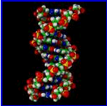
INFORMATION DOES NOT AGE
DNA, even in gametes and their precursors, is not immortal (despite Weismann’s claim that germ cells are immortal) but the information it contains comes close. DNA turns over.
Because of the essential role of mutations and recombination, information in DNA changes.
The only aspect of biology that approaches (but does not achieve) immortality is the flow of information.
Notes:
Immortality of the germ plasm is not so because of turnover, repair.recombination, mutations.
NEXT: How to intervene in the determinants of longevity.

Slide 24
THE MOST IMPORTANT QUESTIONS IN RESEARCH ON THE BIOLOGY OF AGING:
At the cell level:
Why are old cells in a lineage more vulnerable to disease and pathology than are young cells in that lineage?
At the molecular level:
What modifications occur in functional bio-molecules that result in age changes and increased vulnerability to age-associated pathology?
Notes:
Next: IF
Are their animals that do not age???

Slide 25
THE MOST IMPORTANT QUESTION IN RESEARCH ON LONGEVITY DETERMINANTS:
“HOW CAN THE ENERGETIC STATES OF FUNCTIONAL BIOMOLECULES BE MAINTAINED LONGER?"

Slide 26
WHAT IS RESEARCH ON AGING?
The rubric “Aging Research” embraces all aspects of the finitude of life.
Biogerontologists do research on the fundamental biology of aging which is only one small part of what is included in the general term “Aging Research.”
There is a common belief, held especially by policy makers and funding agencies, that to fund “Aging Research” means to fund research on age-associated diseases and that this will somehow provide insights into the fundamental biology of aging.
It will not and this has become a one-billion dollar misunderstanding.

Slide 27
THERE IS RELATIVELY LITTLE SUPPORT FOR RESEARCH ON THE BIOLOGY OF AGING
Contrary to popular belief, no research support is directed toward understanding the fundamental biology of human aging that is remotely comparable to the support for research on age-associated diseases.
For example, in recent years less than 5% of the National Institute on Aging budget was spent on research on the fundamental biology of aging. Half of the budget was spent on Alzheimer’s disease research, - the resolution of which will add 19 days onto life expectancy.
In the past five years the Alzheimer’s disease budget increased by 450 million dollars.
The research budget for aging remains the same or recently gained marginally.
Notes:
Next: What thought processes contribute to the neglect of research on the biology of human aging?

Slide 28
THE PHYSICIANS MANTRA:
“The greatest risk factor for the leading causes of death (cardiovascular disease, stroke and cancer) - is the aging process.’’
Then why is the funding for research on the fundamental biology of aging infinitesimal when compared to the funding for research on age-associated diseases?
The probable reason is the failure of decision makers and many biologists to distinguish aging from disease!
Notes:
There are dozens of medical center units, academic departments or centers and other private and public institutions throughout the United States (and in other countries) that profess to devote their resources to research on aging as implied by their titles. Few, if any do.
What they do devote the major proportion of their resources to is research directed toward the diagnosis, treatment or elimination of age-associated diseases. Although the study of age-associated diseases is certainly a laudable endeavor it is not the study of aging and to imply that it is by using “aging” in the name of an organization is not only misleading, it does a great disservice to the field of biogerontology. There is a perfectly good name for the study of age-associated diseases. It is called “Geriatric Medicine”.

Slide 29
THANK YOU!

Slide 30
PART THREE
DO LIFE FORMS EXIST THAT DO NOT AGE ?

Slide 31
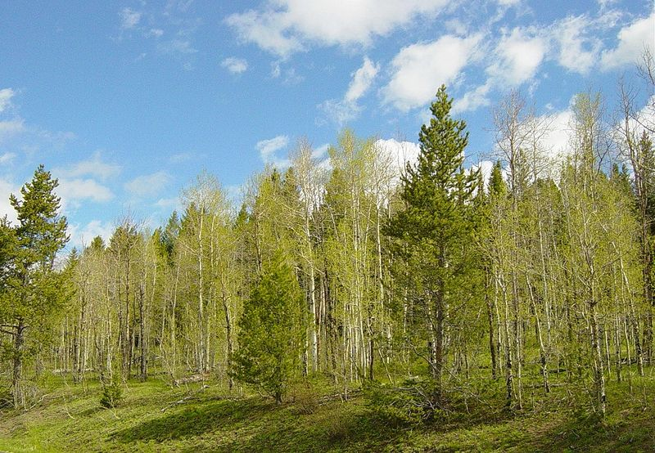
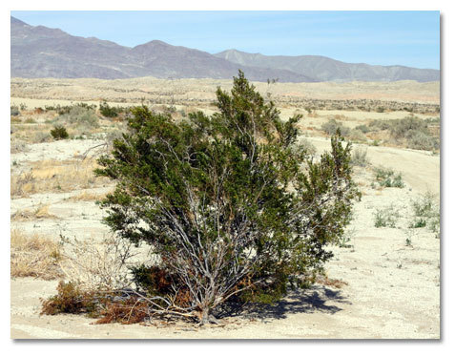

AGE DETERMINATION IS OFTEN DIFFICULT.
WHAT IS THE AGE OF A CLONED POPULATION?
Aspen Tree Grove
Creosote Bush
Orchid plants from a single leaf cutting.
Fairy Ring

Slide 32
DEFINING BIOLOGICAL AGE IS OFTEN FORMIDABLE
Examples: Clones that reproduce by root propagation:
PLANT ESTIMATED AGE (yrs) REFERENCE
Quaking aspen 10,000 Cook, 1985
Creosote bush 11,700 Vasek, 1980
(Larrea tridentate)
Bracken fern 1,400 Oinonen,1967
(Pteridium aquilinum)
Notes:
Aspens are examples of progeny trees arising from an underground root system producing a small forest. How old is any tree when all are connected by a root system?
Can also reproduce using seeds or spores.
Example of Fairy rings in molds spreading like aspen trees with underground mycelia.
Concentric growth rings as older plants in center die.
When old plant dies still connected to younger plants. So how old is a colony if original plants are no longer present?
What is the age of a human organ transplant relevant to it’s recipient?
NEXT: Can Redwood trees and Bristlecone Pines be thousands of years old?

Slide 33
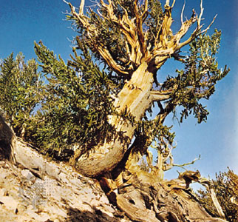
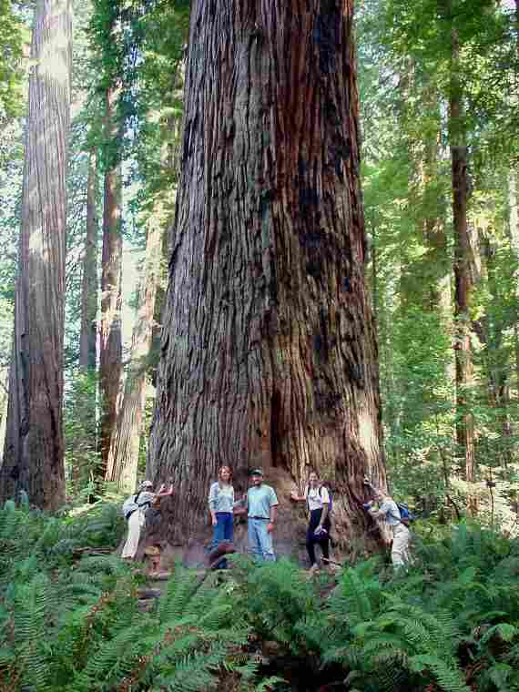
ARE REDWOOD TREES AND BRISTLECONE PINES THOUSANDS OF YEARS OLD?
These trees, allegedly several thousand years old, are not the oldest living things.
The oldest living cells in these trees are in the cambium layer, needles and roots. They are no older than about 30 years.
It is illogical to call a life form an “oldest living thing” if what is so old is so dead. (99% of the biomass is dead!)
If you are older than 30 your muscle cells and neurons may be older than these trees. (Your other cells have turned over.)
Bristlecone Pine
Redwood Tree

Slide 34
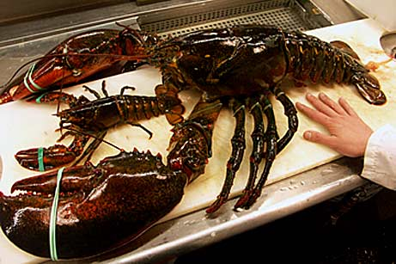

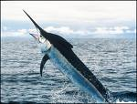
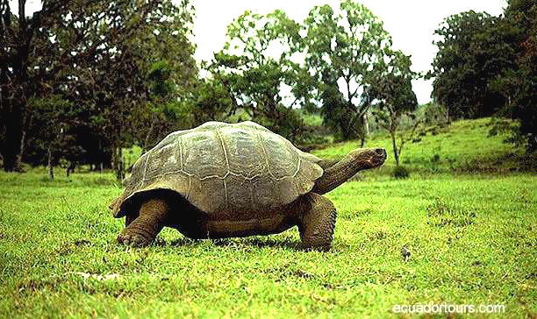

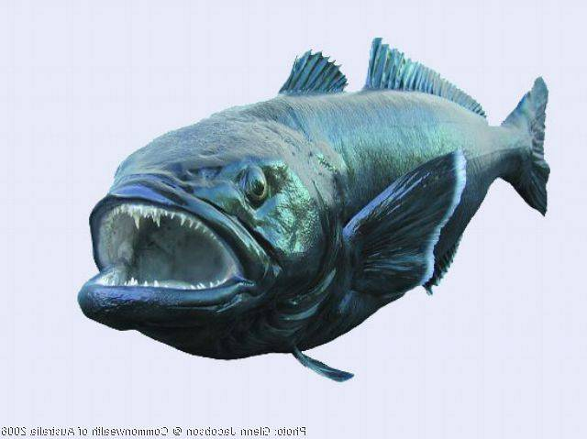
EXAMPLES OF ANIMALS THAT AGE IMPERCEPTIBLY OR NOT AT ALL
American Lobster
Australian crocodile
Billfish
Galapagos Tortoise
Deep Sea Cold Water Fish
Deep Sea Cold Water Fish

Slide 35
THERE ARE LIFE FORMS THAT AGE IMPERCEPTIBLY OR NOT AT ALL
Aging in some animals either does not occur at all or its’ rate is imperceptible.
This phenomenon occurs mostly in animals that do not reach a fixed size in adulthood.
Examples: Cold water, deep sea fish (Orange Roughy, red snapper, Chilean sea bass), lobsters, rainbow trout, sport fish (e.g. marlin, swordfish), amphibians, (crocodiles, alligators), turtles and tortoises, etc.
What are the criteria for demonstrating no or slow aging?
Notes:
My purpose here will be to point out some of the peculiarities and anomalies when considering the biology of longevity and aging.
NEXT: What are the biomarker criteria for determining that aging is slow or not occurring at all?

Slide 36
GENERALLY ACCEPTED CRITERIA FOR DETERMINING THAT AGING IS NOT OCCURRING (or, is not detectable)
1. No increase in age-specific mortality.
2. No decrease in rate of reproductive capacity after sexual maturation.
3. No decrease in peak physiological capacity including immunity to disease.
Notes:
Three generally accepted criteria.
Next: What is old in a living form?

Slide 37
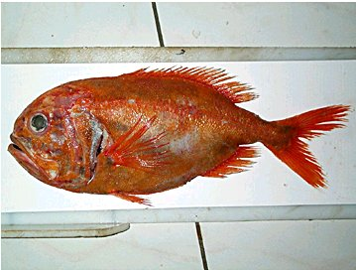
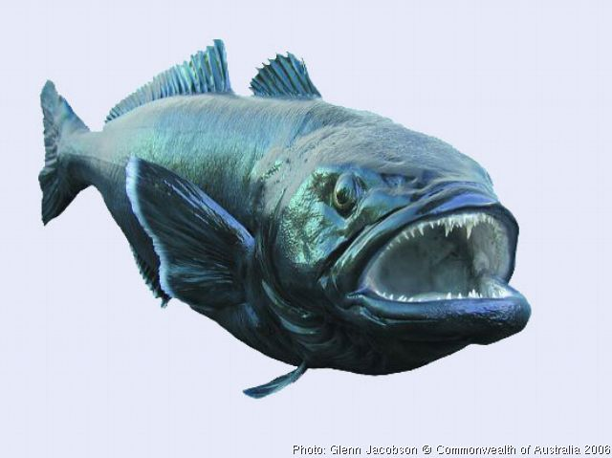
AGELESS FISH
The Patagonian Tooth fish (Dissostichus
eleginoides) was unacceptable as a food until
the name was changed to Chilean Sea Bass.
Usual portion is 35 – 90 years old.
An endangered species. Don’t eat them!
(See: www.agelessanimals.org)
Orange Roughy (Hoplostethus atlanticus) lives up to 140 years.
Extreme longevity is a mystery.
An endangered species. Don’t eat them!

Slide 38
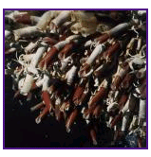
MARINE ANIMALS
The giant tube worm, Lamelli -brachia sp., is the longest-lived, non-colonial marine invertebrate known. It was discovered 14 years ago.*
Found around deep-sea hydrothermal vents (“black smokers”).
It requires 170 - 250 years to reach 2 meters. Many are longer.
*Bergquist et al., Nature, 403, 499, 2000
Notes:
Tube worm is now oldest animal!
Speed of growth determined by length measurements made over a span of a few years.
NEXT: Deep sea cold water fish.

Slide 39
WHY DO SOME ANIMALS AGE IMPERCEPTIBLY OR NOT AT ALL?
The probable reason for the absence of aging, or its extremely slowed rate, is the presence of more efficient repair, synthesis and maintenance systems (the longevity determinants).
Few studies have been done in an effort to understand why these animals age negligibly or not at all. No current studies are directed toward understanding the molecular basis for extreme longevity.
This has long been one of the most neglected areas of research on the biology of aging.
Notes:
Next: How old are cells?

Slide 40
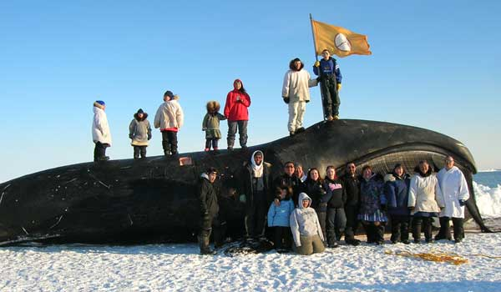
THE LONGEST LIVED MAMMAL
The belief that humans are the longest lived mammals has now been challenged.
Aspartic acid racemization tests on 48 bowhead whale eye globes reveal ages of 135, 159 and 211 years. No pathology found.
Traditional Inuit spear points found in bowheads seem to confirm the chemistry.
(George, et al., Can. J. Zool., 77, 571, 1999).
BOWHEAD WHALE

