Slide 1
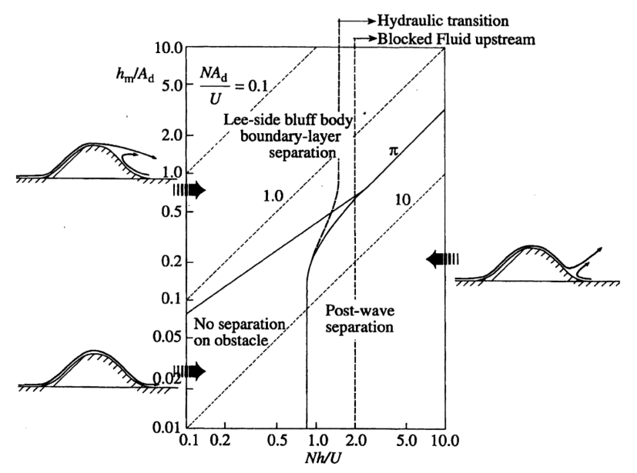
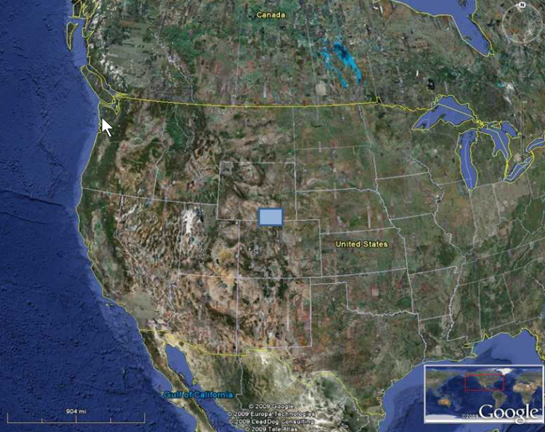
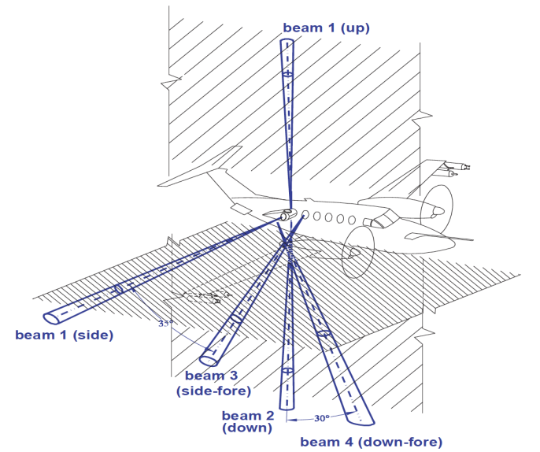
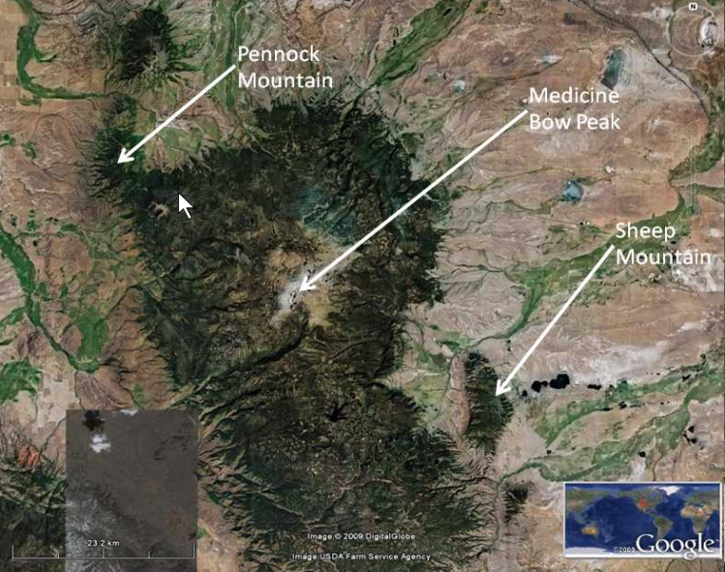
NASA06 Observations
Wyoming
Wyoming Cloud Radar
Dual-Doppler radar
Wavelength 3 mm (cloud ice)
2D wind fields
Resolution up to 30 x 30 m²
Haimov et al (2008)
NASA06 campaign, Jan-Feb 2006
Notes:
Summary of observations.
WCR scans were made using the configuration with beam 1 upward, and then 2 and 4 downward (“curtain” scan).
Red dot in phase diagram refers to observed upstream conditions on January 26th.
Leeside half-width, A = 15 km
Height, h = 1400 m
-> h/A = 0.09
Wind speed, U = 13 m/s
Brunt-Vaisala frequency, N = 0.012 1/s
-> Nh/U = 1.29

Slide 2
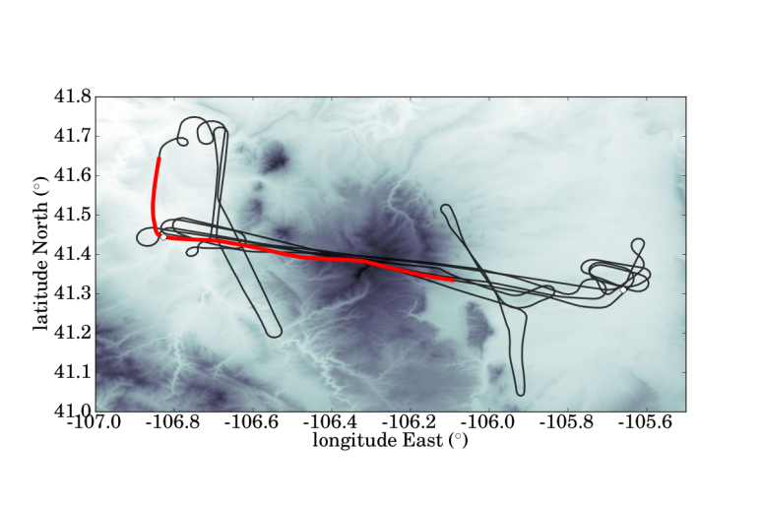
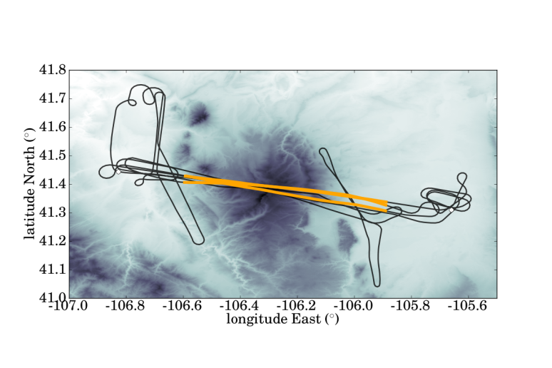
NASA06 Observations on Jan 26, 2006
1 ramp sounding
5 straight-and-level
flight legs
Notes:
Among other stretches, the flight track includes one ramp sounding (above) and three cross-mountain flight legs approx. parallel to the mean wind (below).
Observations presented refer to u (xsec-parallel) and w on leg 3.
Between 2025 and 2210 UTC, the UWKA made 5 passes over the MBM. The first two passes were flown at 4300 m MSL and the final three at 5200 m MSL (hereafter, all flight altitudes refer to height above MSL and all flight times are UTC).

Slide 3
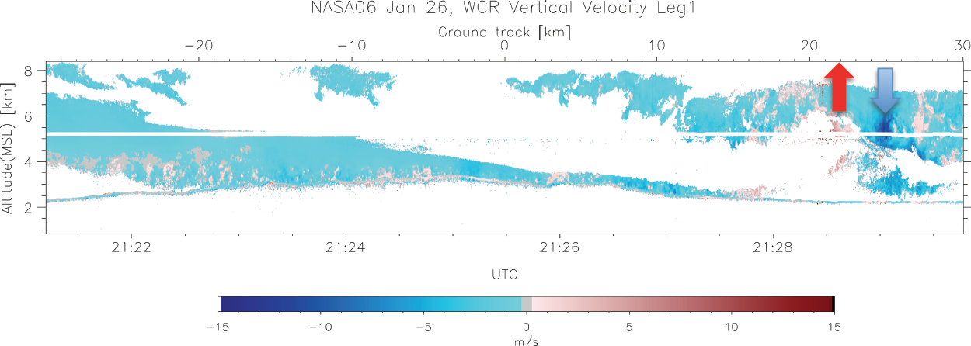
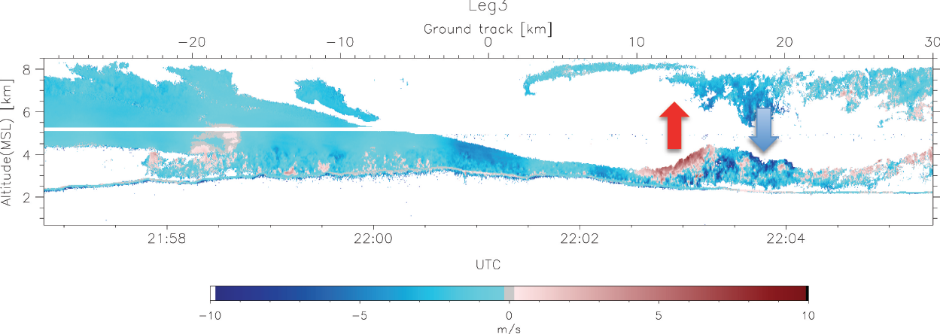
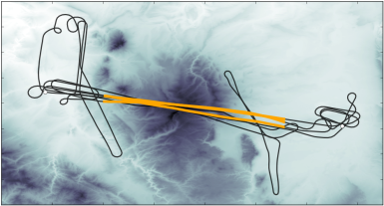
Jan 26, 2006 WCR Observations
LEG 1
~21:29 UTC
LEG 3
~22:05 UTC
w [m s⁻¹]
Haimov et al (2013)
Notes:
Non-stationarity of the rotor structure is highlighted by observing the difference between legs 1 and 3

Slide 4
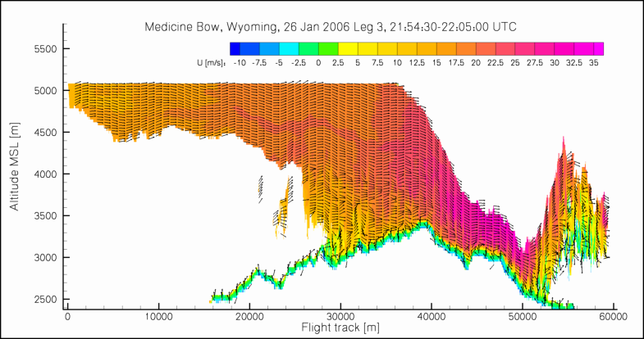
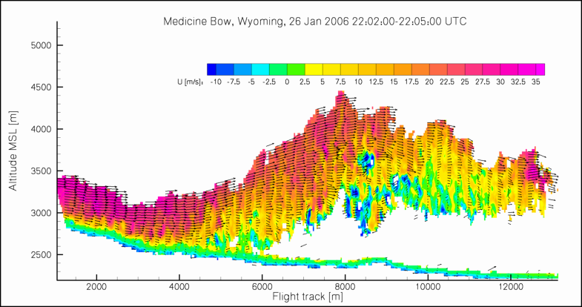
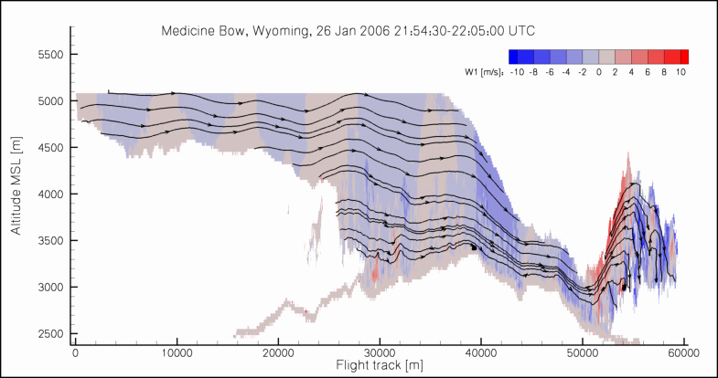
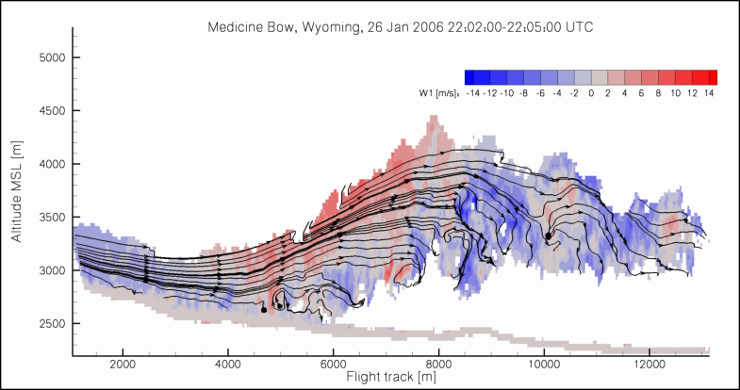
Jan 26, 20016 Leg 3 Dual Doppler Analysis
Resolution
33 m x 33 m
u
Resolution
33 m x 33 m
w
Notes:
Leg 3 zoom dual-Doppler 106.11 to 105.97

Slide 5
Mesoscale Modeling
WRF simulation
  Two two-way nested domains
  Outer domain with dx = dy = 2000 m, over the NW United States
  Inner domain with dx = dy = 400 m, over southern Wyoming
  dz stretching from ~20 to ~340 m
Notes:
Slide shows:
U component parallel to the cross-section. Green indicates reverse flow.
Vertical wind component (up-/downdrafts).
TKE (high turbulence within rotor).
Domain sizes:
240x195 - 2 km (d01)
341x241 - 400 m (d02)
101 vertical levels in both domains.
More details on model setup:
MYJ PBL and surface energy budget models.
Morrison microphysical scheme.
RRTM short-wave and Dudhia long-wave radiative scheme.

Slide 6
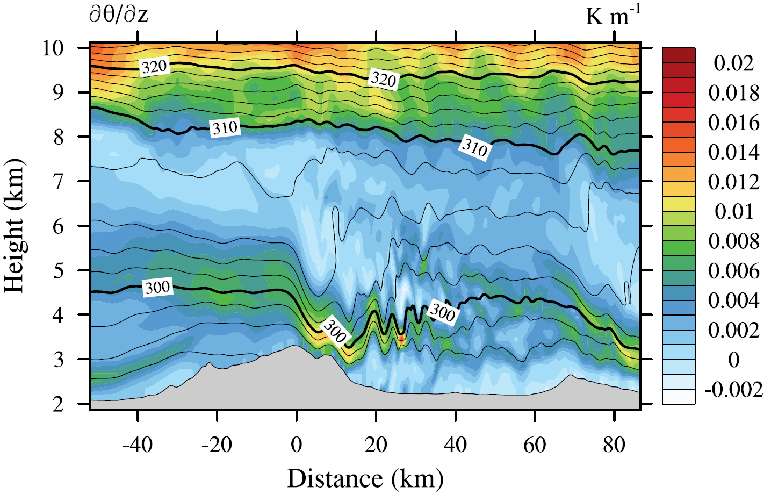
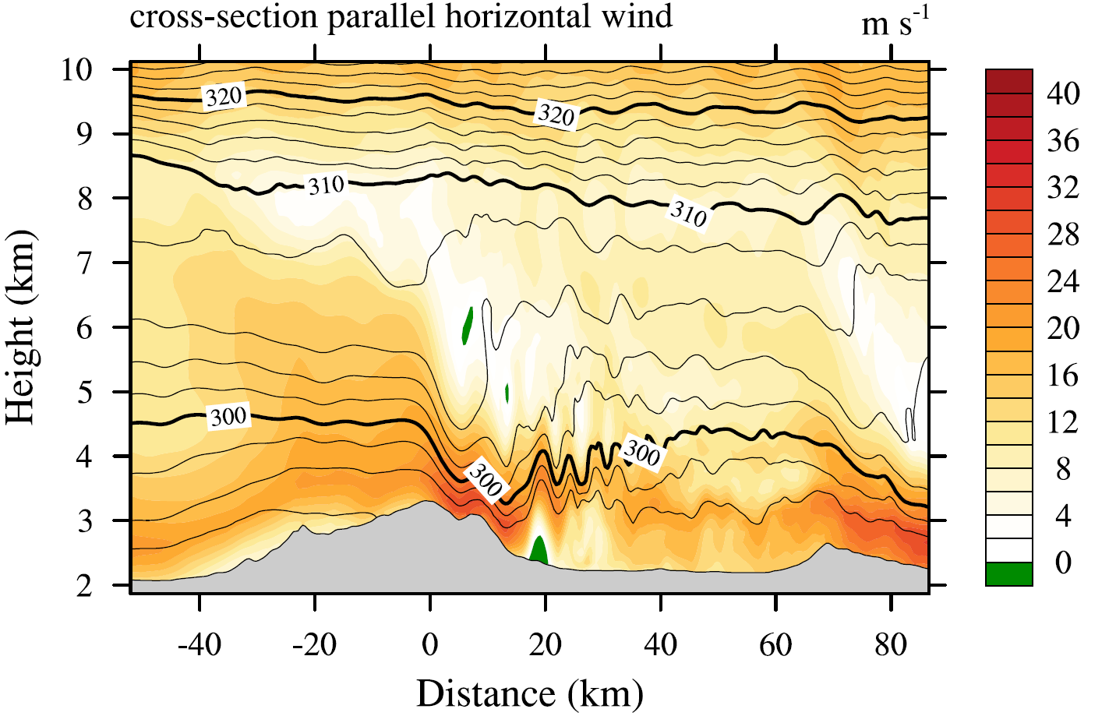
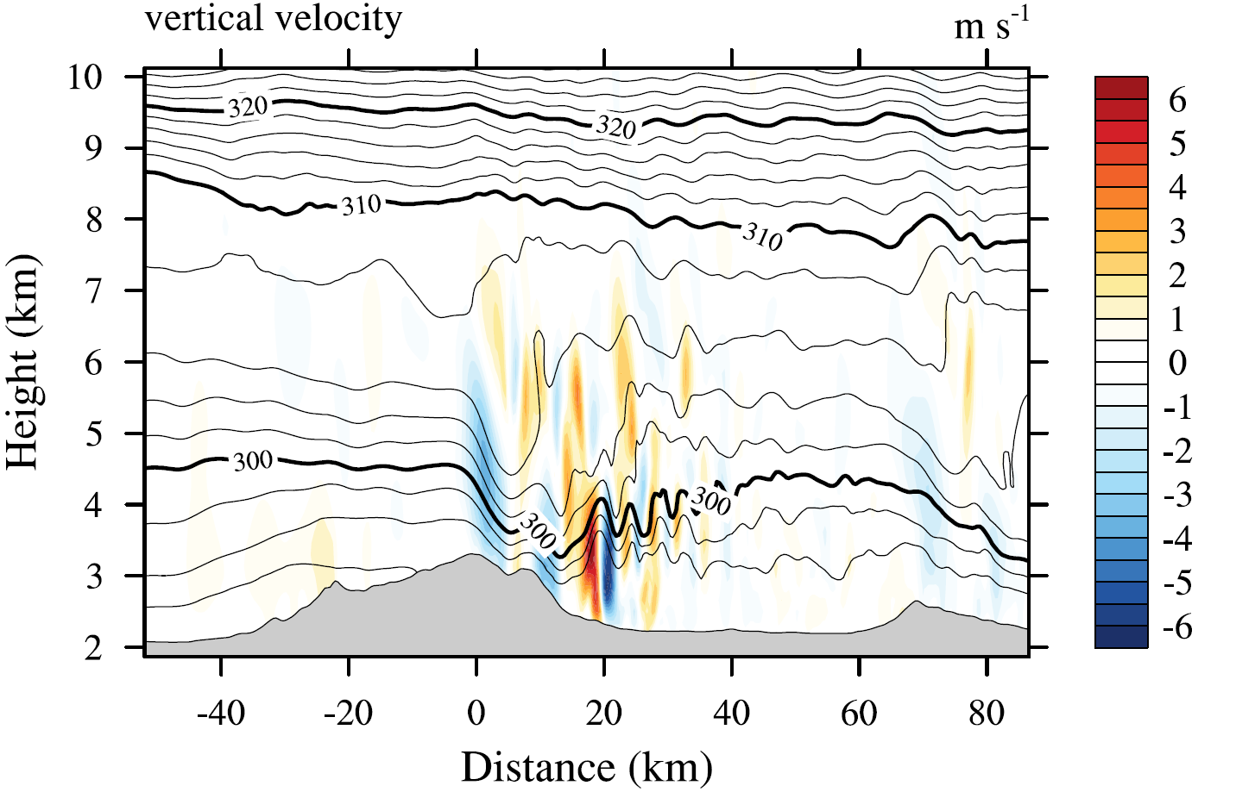
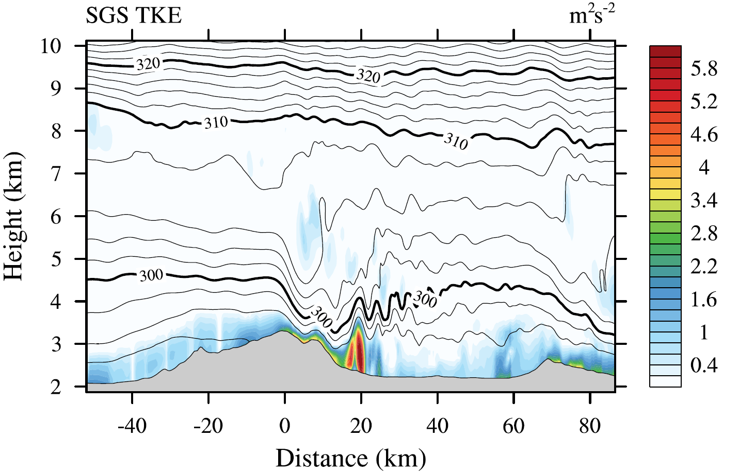
Flow Past MBM: Hydraulic Jump
Flight
Legs
21:45 UTC Jan 26, 2006
Notes:
@21:45 UTC the aircraft flight leg was @ 5200 m MSL

Slide 7
Flow Past MBM: Waves and Wake
w @ 3000 m MSL
TKE @ 3000 m MSL
21:45 UTC Jan 26, 2006

Slide 8
Trapped Lee Wave Resonance
04:00 UTC Jan 27, 2006
Notes:
@21:45 UTC the aircraft flight leg was @ 5200 m MSL

Slide 9
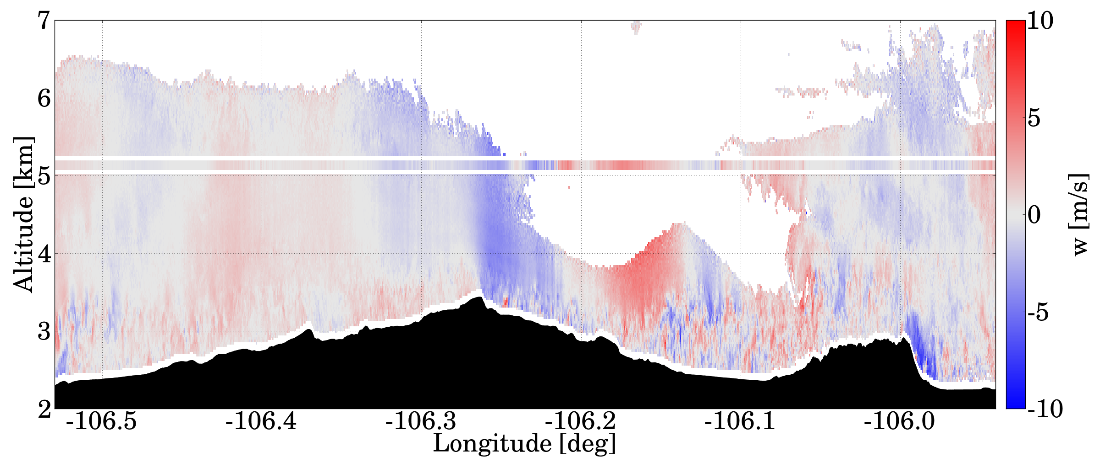

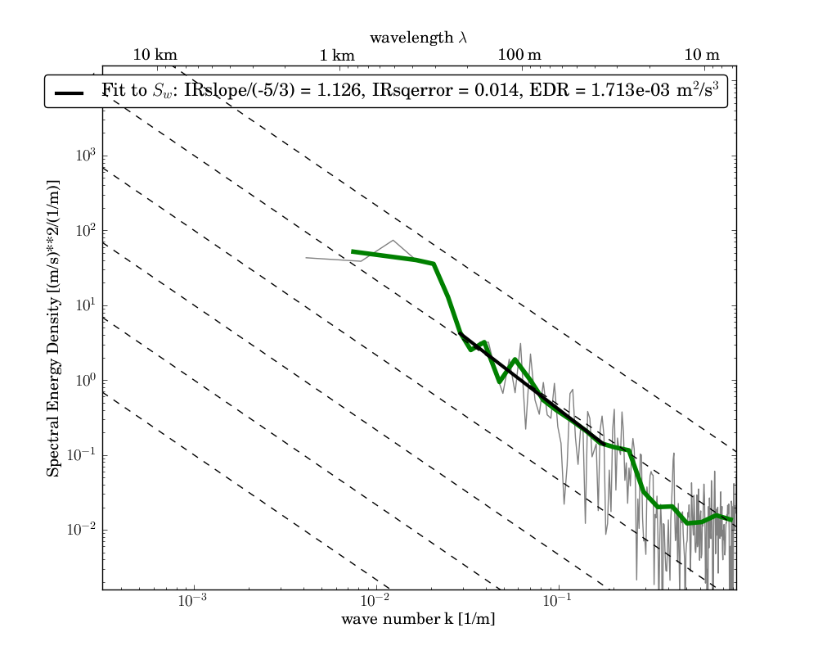
Turbulence Analysis
Approach to estimating turbulence from remotely-sensed data
w
Cut out
1.5 km long segments from time series
1.5 km segment
For each segment:
Power spectrum
of vertical velocity
σ_{w}² variance of
vertical velocity
S(k)
EDR eddy
dissipation rate
RADAR
log₁₀(k)

Slide 10
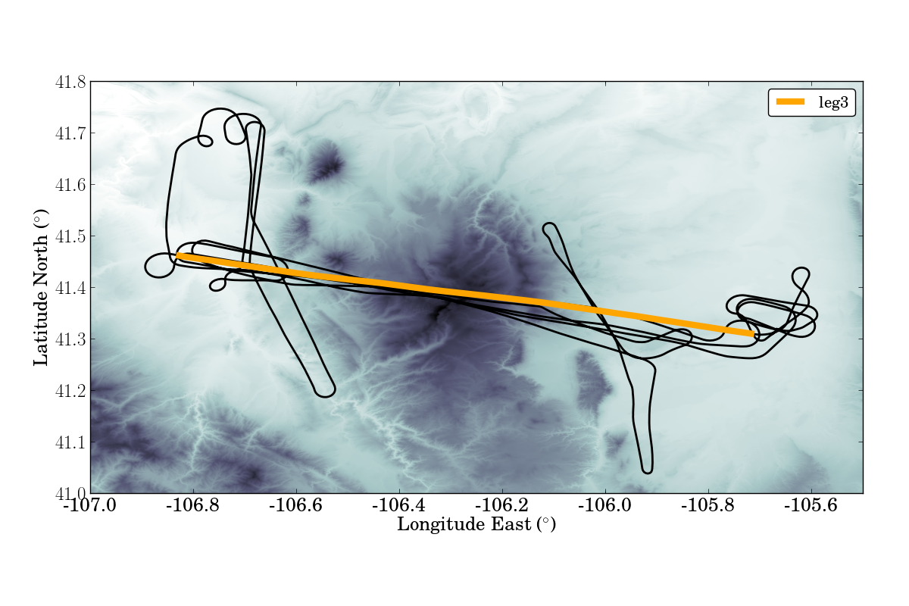
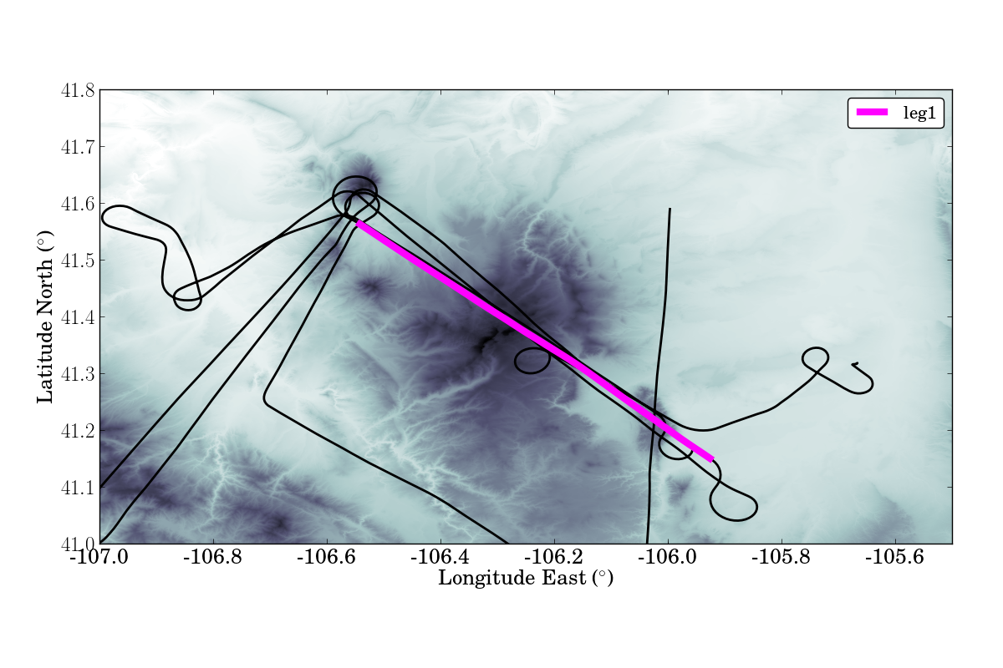
Turbulence Anaysis Results
NASA06 Orographic Clouds Experiment, Wyoming
26 Jan 2006
5 Feb 2006
Hydraulic jump, BL separation
Lee waves, BL separation
Interpretation of the events aided by mesoscale numerical modelling (WRF)
Lukas Strauss
Terrain-induced turbulence
10

Slide 11
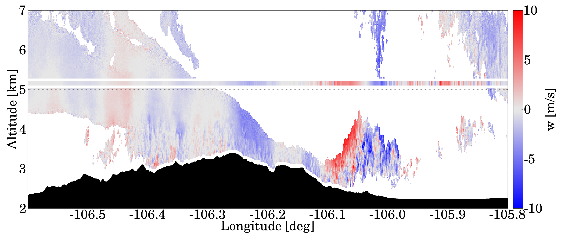
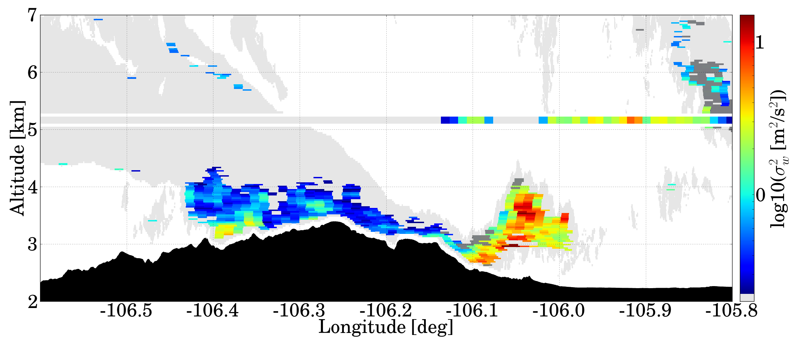
January 26 Event
Hydraulic jump, BL separation, a large rotor
w
26 Jan 2006
1
1
Moderate turbulence.
Wave breaking!?
2
2
Very strong updraft.
A large rotor.
σ_{w}²
1
3
Severe turbulence
in the interior of
the rotor.
3
Lukas Strauss
Terrain-induced turbulence
11

Slide 12
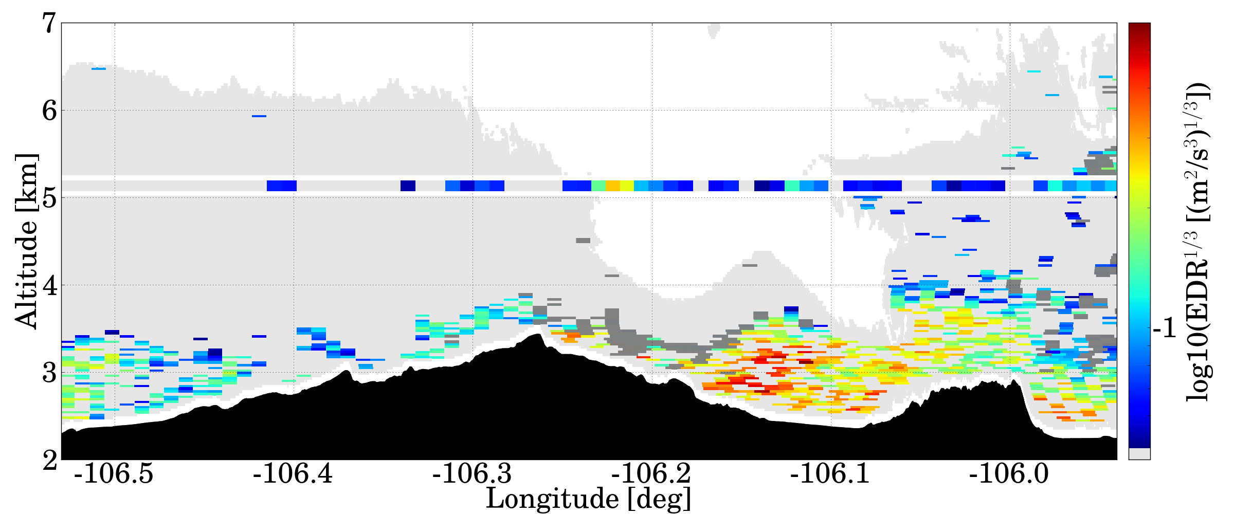
February 5 Event
Lee waves, wave-induced BL separation
w
5 Feb 2006
1
Smooth lee wave. No turbulence.
1
2
Severe turbulence.
Wave-induced BLS.
EDR
S
M
3
Patch of strong turbulence behind a steep peak.
3
1
2
L
Lukas Strauss
Terrain-induced turbulence
12

Slide 13
Summary and Conclusions
Observations
First observational documentation of wave-induced boundary-layer separation (BLS) by an airborne remote sensor,
Observed BLS on Jan 26 was non-stationary,
BLS associated with both a hydraulic jump and lee-waves.
Modeling
Observed BLS in the lee of MBM on Jan 26 was related to mountain wave breaking at mid-tropospheric levels inducing an undular hydraulic jump at low levels
Non-stationarity induced by a change in the upstream environment, causing a collapse of the large-amplitude mountain wave and establishment of trapped lee waves,
Double ridge terrain promoting constructive interference of resonant lee waves.

Slide 14
Summary and Conclusions
Turbulence Analysis
Turbulence analysis reveals a variation of turbulence intensity over several orders of magnitude along the flight legs,
Eddy-dissipation rate estimates from radar data provide insight into the levels of turbulence within gravity wave breaking, boundary layer separations and rotors,
The method is capable of detecting locations of strong turbulence in complex terrain.

Slide 15
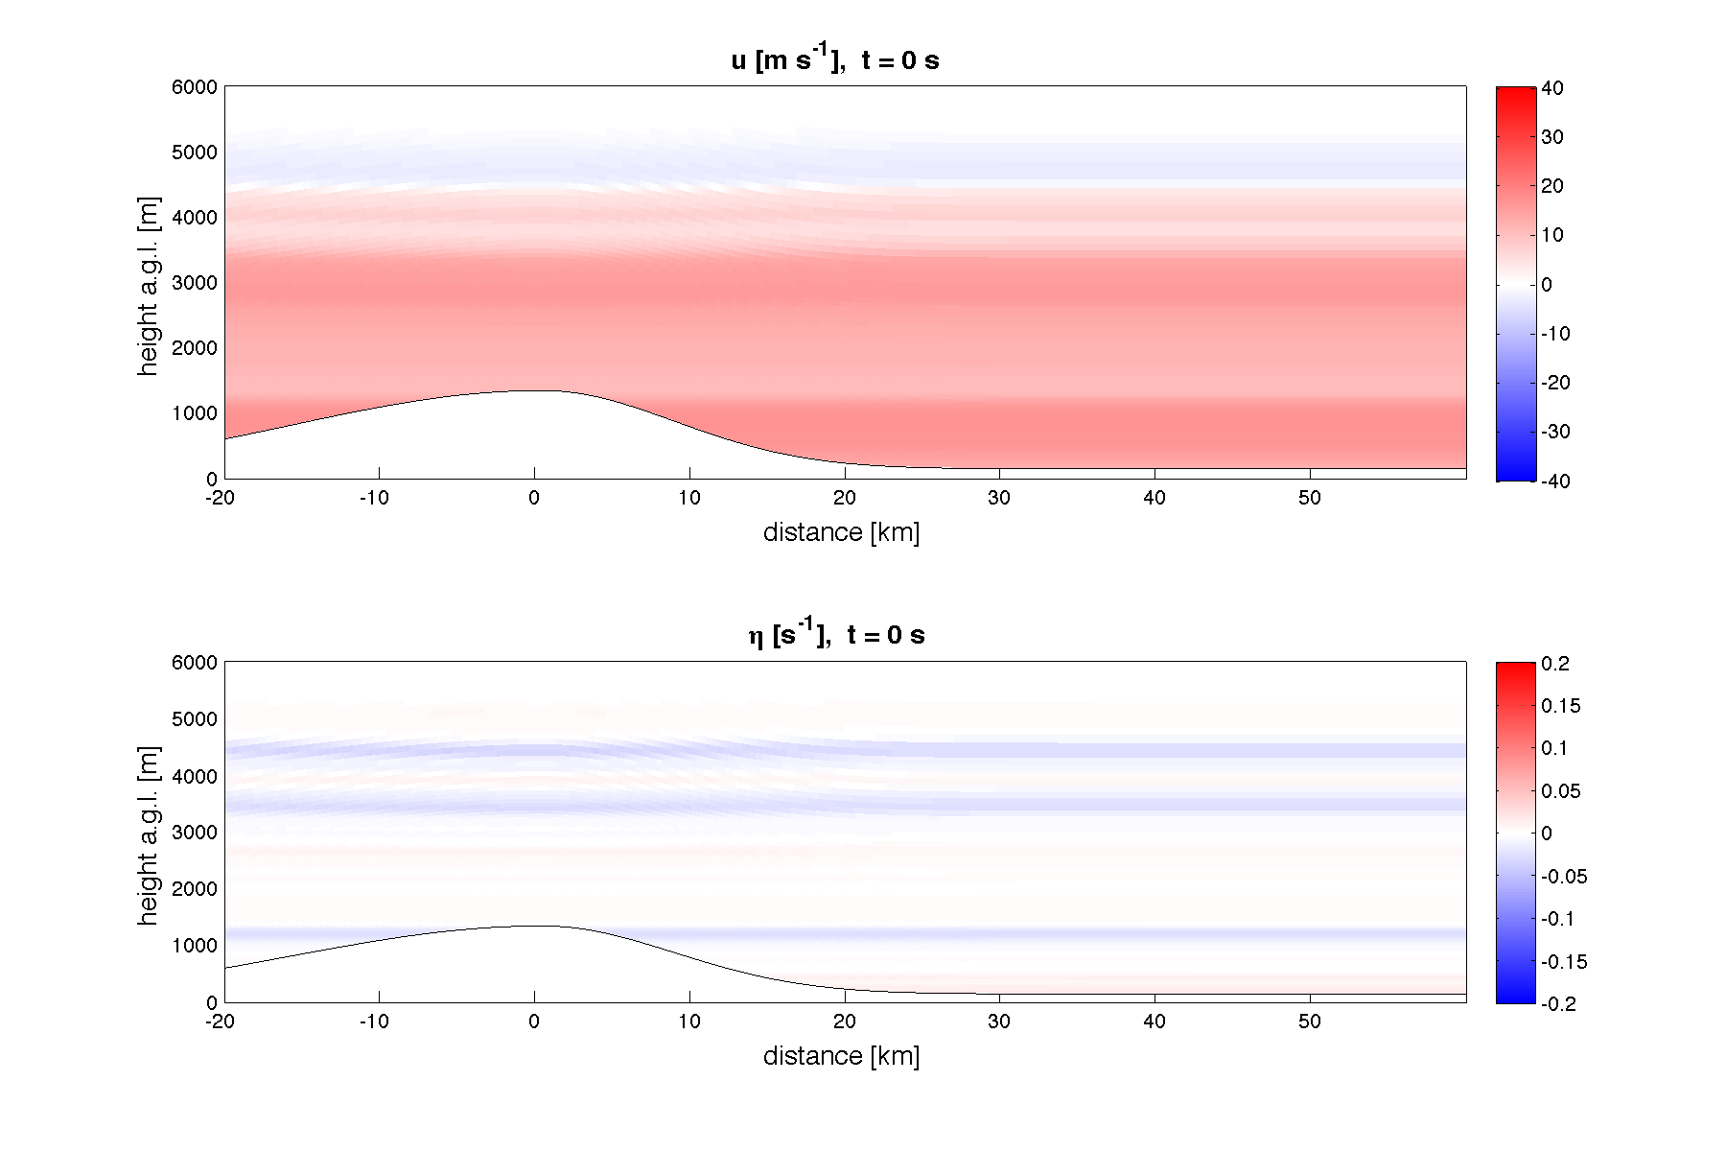
Outlook: LES
1
2
4
5
3
5
6
1
Wave breaking
2
Downslope winds
3
Shear vorticity
4
Wave-induced BLS
5
KH instability
6
Rotors and subrotors
Notes:
Animation refers to a cross-section in the middle of the domain (along y): no averaging performed.

Slide 16

Outlook: Laboratory Experiments
CNRS – Hydralab http://hydralab.cnrs.fr
Toulouse stratified flume , July & Sep 2014
Lee wave resonance, boundary-layer separation & rotors
Team: Stiperski, Grubišić, et al.
Notes:
Animation refers to a cross-section in the middle of the domain (along y): no averaging performed.

