Slide 1
Microscale Modeling Initiatives at the US Army Research Laboratory
UNCLASSIFIED / APPROVED FOR PUBLIC RELEASE
Co-PIs: Yansen Wang, Benjamin MacCall
Team members: Yansen Wang (TL), Benjamin MacCall, Giap Huynh, Christopher Hocut (post doc)
UNCLASSIFIED / APPROVED FOR PUBLIC RELEASE

Slide 2
Objective and Vision
Vision
Develop a microscale (Spatial:1-100m, Temporal: minutes) Atmospheric Boundary Layer Environment (ABLE) modeling system to predict mean wind, temperature, moisture and turbulence over urban and complex terrain in near real time.
Objectives
Improve microscale meteorological capabilities using new theoretical and observational results, apply new scientific advancements in computational fluid dynamics and in computer technology to accomplish near real-time simulation.
Demonstrate increases in microscale model accuracy by assimilating data from remote-sensing systems (Doppler wind lidar and Raman lidar) and other in-situ observations.
Provide the warfighter with improved microscale weather information for applications such as: atmospheric transport and dispersion, small UAV flights, and acoustic/optical/electromagnetic wave propagation.

Slide 3
Suite of computer models
1. 3DWF (three-dimensional Wind Field) Model
A diagnostic wind model developed for fast output over complex terrain and in urban areas, suitable for near neutral, strong wind conditions.
2. ABLE (Atmospheric Boundary Layer Environment) Model
Encapsulate new results and discoveries from recent theoretical and field studies about the turbulent flow in complex terrain, urban and forest canopies.
Apply recent advancements in computational fluid dynamics such as immersed boundary method, Lattice Boltzmann method.
Use modern program design and advanced computational technologies such as GPU computing and hybrid GPU/MPI technology.
Incorporate GIS based user interface

Slide 4
BED Modeling Framework (BMF)
Source Code Infrastructure
ABLE-CFD
ABLE-LBM
etc.
Enhance modularity with Object-Oriented Programming Principles.
Provide additional functionality with minimal overhead (e.g., MPI communication, HDF5 or NetCDF output).
Abstract away repetitive and error prone code.
Codify commonly used operations and data structures.
Aid in coupling different software packages (e.g., couple ABLE to WRE-N).
Facilitate transfer to other platforms (e.g., tablets, wearable computing).
BED Modeling Framework
Support Libraries
Platform Frameworks
Platform Supported Language

Slide 5
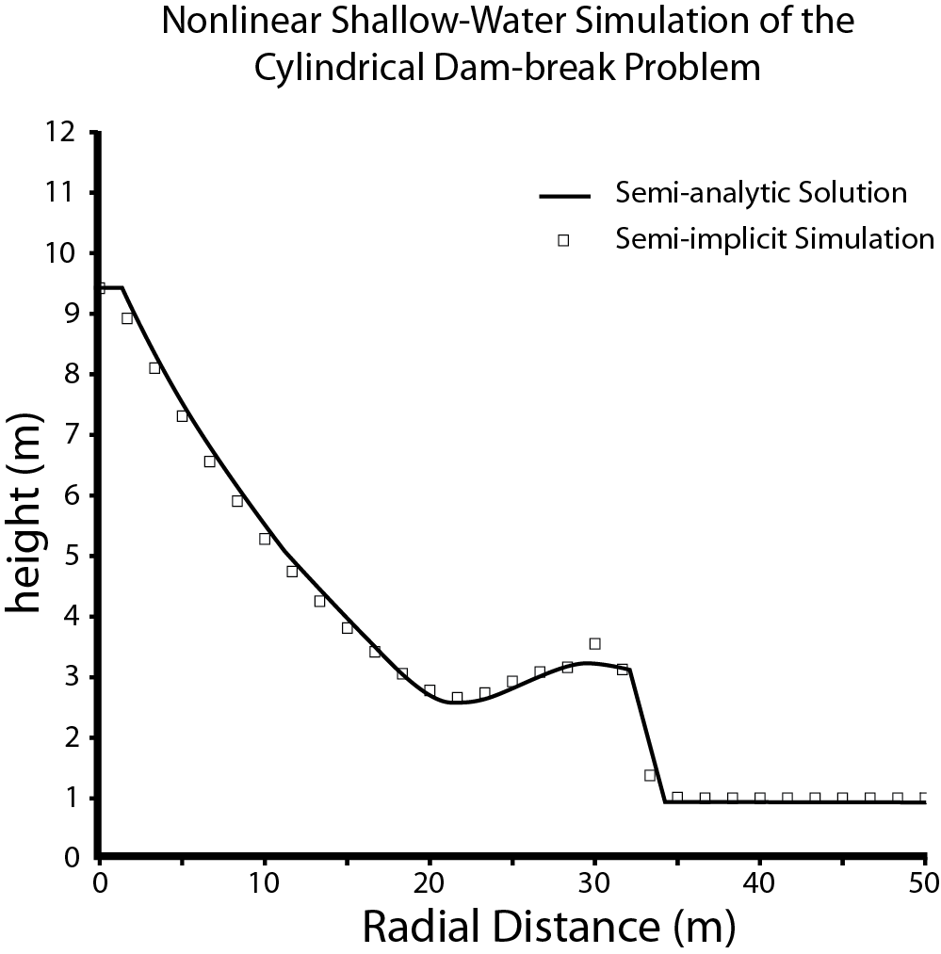
Traditional CFD Module
A New Dynamical Core
Numerical Design:
We extended to 3-D Navier-Stokes the semi-implicit time-integration scheme of Sun (2011).
Finite-volume convection-diffusion scheme
Non-uniform C-Grid.
Prognostic continuity equation and diagnostic pressure equation.
Performance Characteristics
Maintain sharp gradients in flow quantities without destabilizing oscillations.
Minimal required smoothing for stability.
Simple to efficiently parallelize for HPC.
(Sun, 2011)

Slide 6
Comparison with Laboratory Results of Driven Cavity Flow
Simulate fluid in a box driven by a moving lid.
Fluid is initially at rest with a random density perturbation of 10⁻⁵ρ₀.
No-slip boundary conditions.
Integrated for 125 non-dimensional time steps.
DNS simulations with Re=3200 (not shown) and Re=10,000.

Slide 7
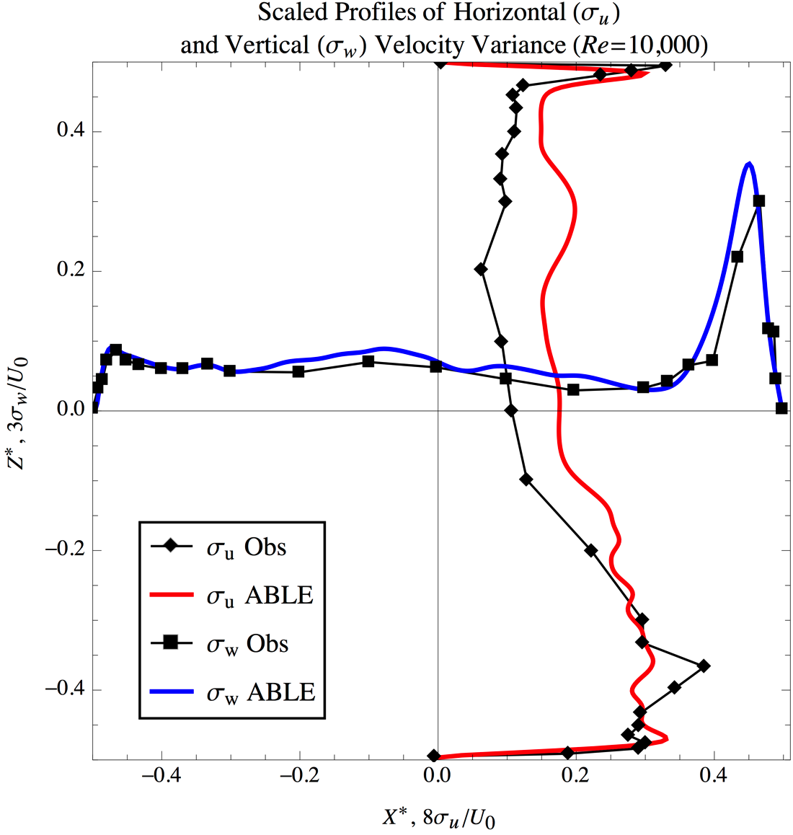
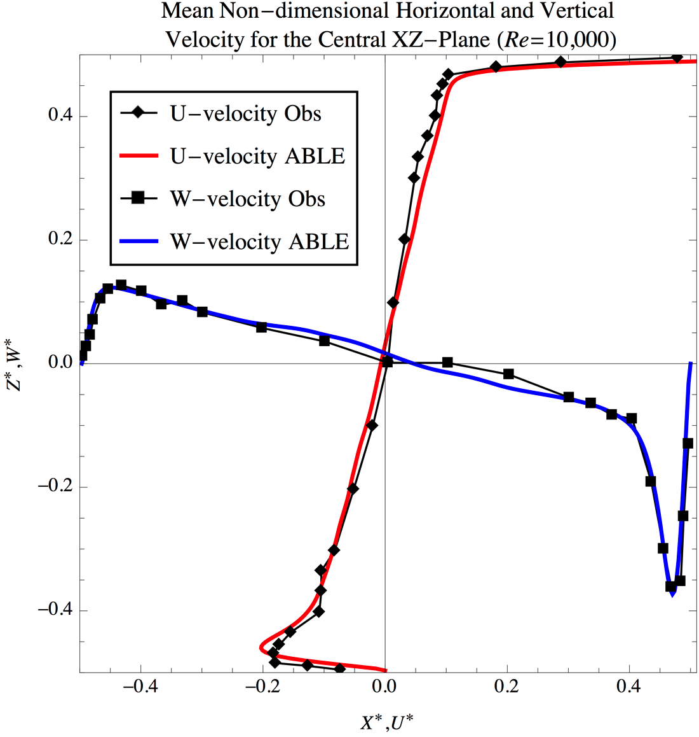
Comparison with Laboratory Results of Driven Cavity Flow
Simulated Re=3200 and Re=10,000
Good agreement in mean fields and in turbulent fluctuations with laboratory observations.
Observations from Prasad and Koseff (1989)

Slide 8
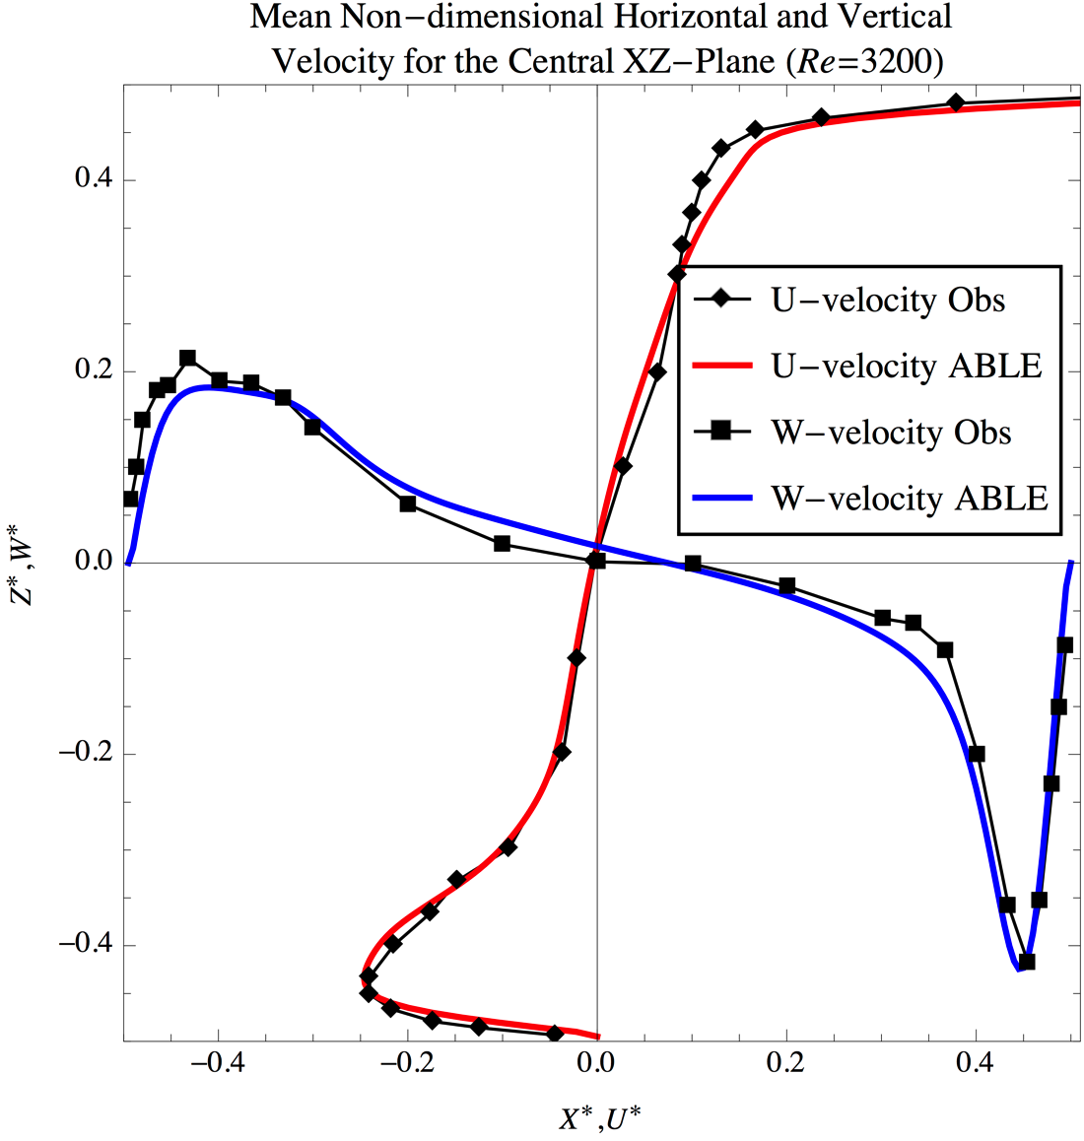
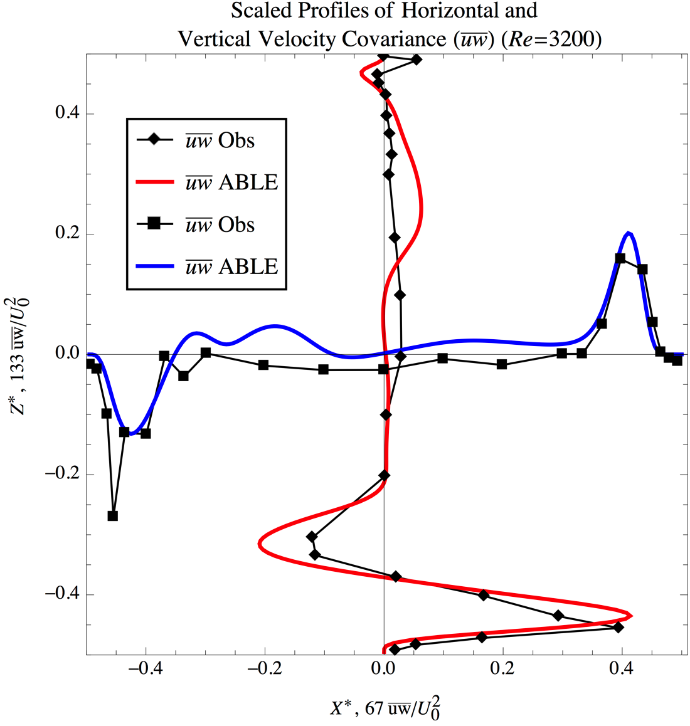
Comparison with Laboratory Results of Driven Cavity Flow
Observations from Prasad and Koseff (1989)

Slide 9
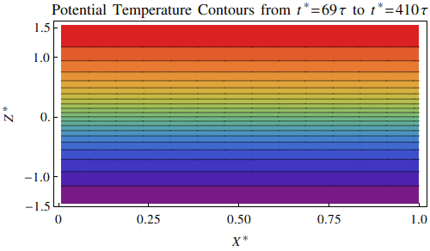
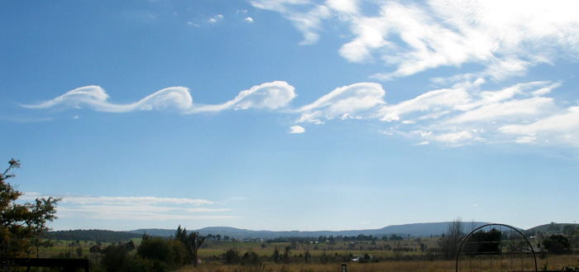
Kelvin-Helmholtz Instability
Re = 2000
Rimin = 0.1
Random perturbation 10⁻⁵ρ0
Early non-dimensional growth of most unstable mode compared with linearized solutions:
Simulation: 0.1056±0.014
Linear model: 0.120

Slide 10
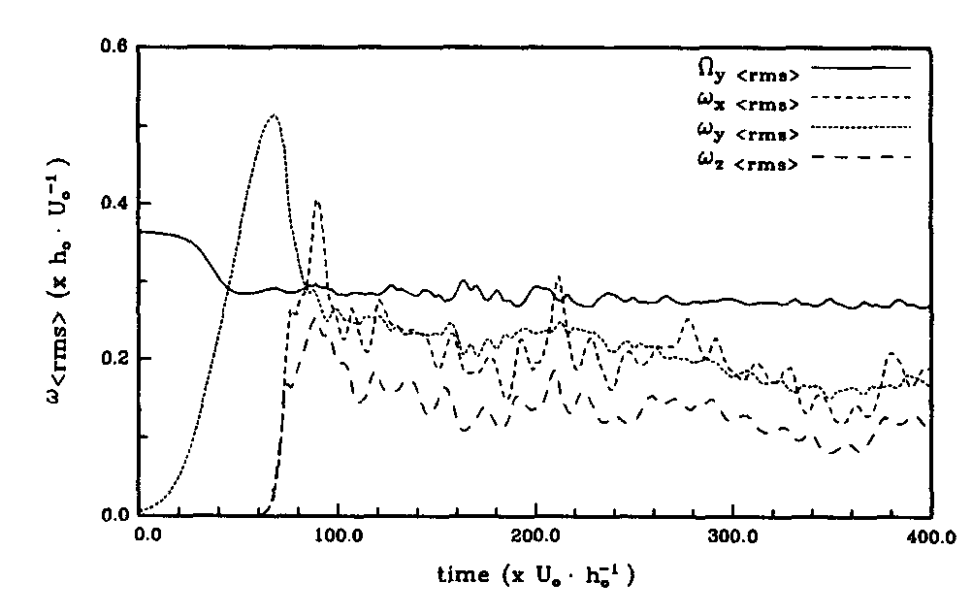
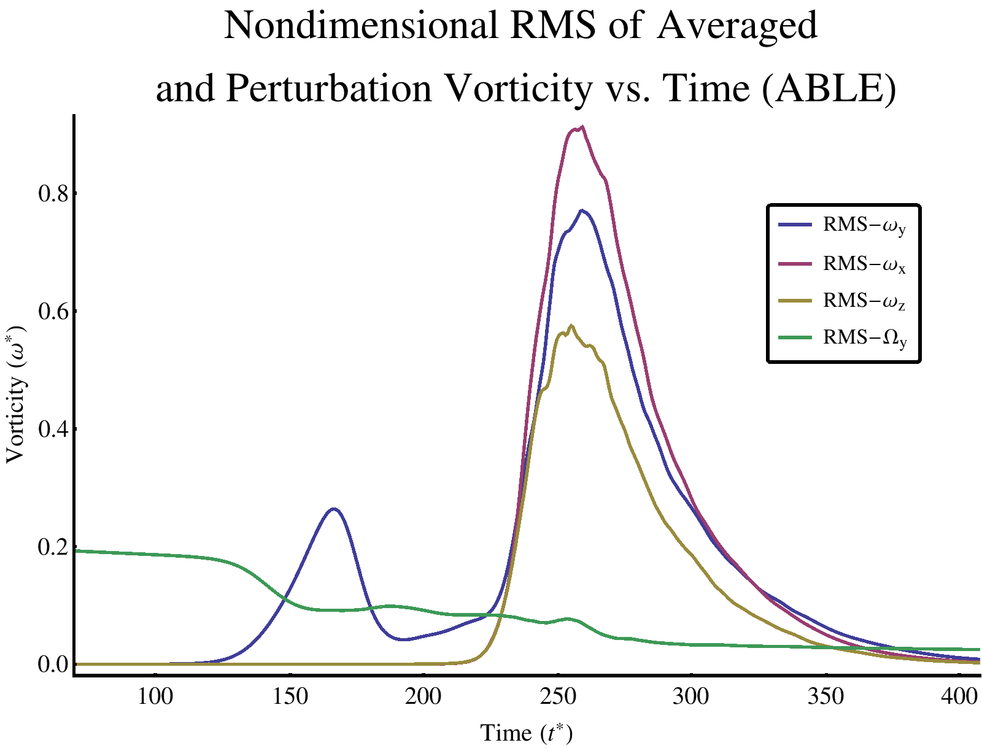
The Role of Secondary Instabilities
Mean and Perturbation RMS Vorticity
From DNS Results of Scinocca (1995)
Source of the second peak:
Rapid breakdown into 3-D turbulence initiated by spanwise convective modes in the core that were not generated in Scinocca (1995).

Slide 11
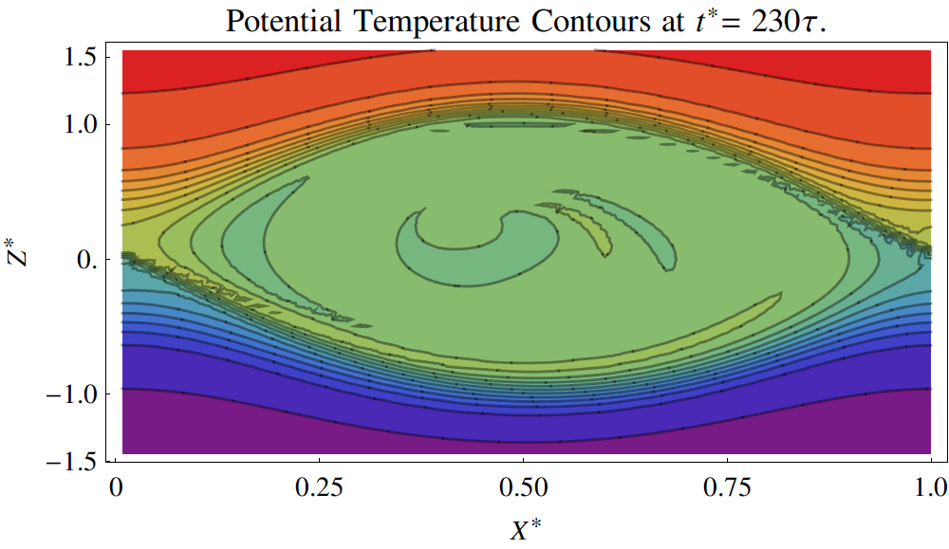
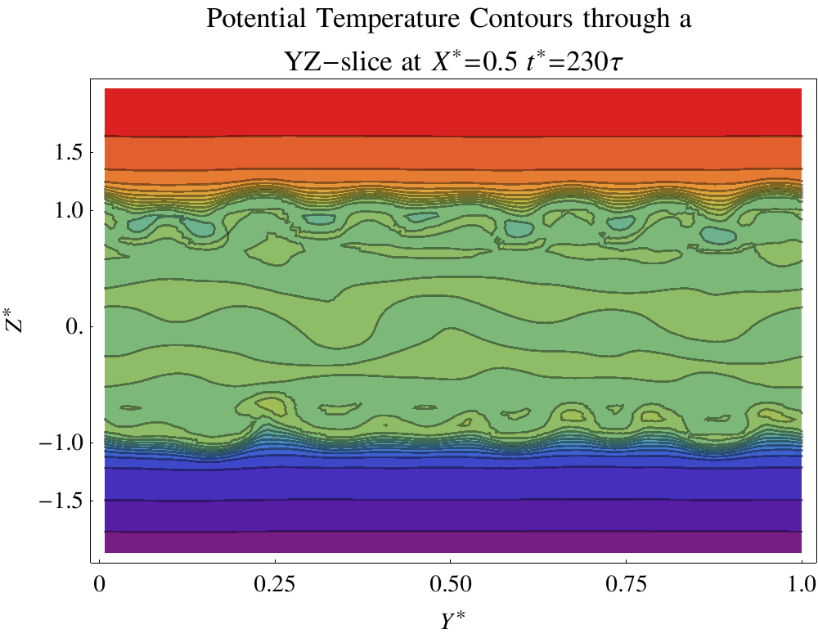
Spanwise Instability
Slice

Slide 12
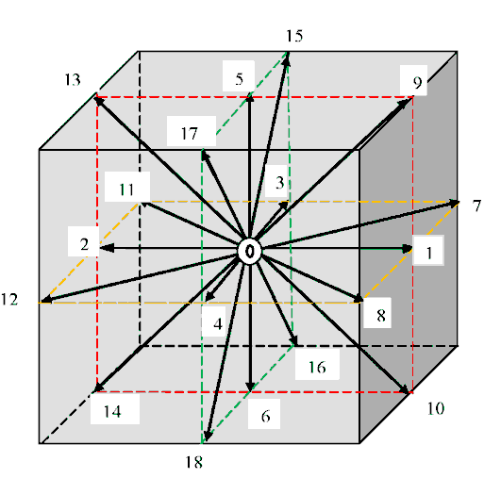
ABLE-LBM Model Using Lattice Boltzmann Method (LBM)
A Very short Introduction on LBM
LBM is a particle method based on kinetic theory of gases; it solves the discrete Boltzmann equation. Each of the fictitious particles of a fluid with a velocity, collides with the other particles with a probability distribution function and relaxes the distribution function to an equilibrium
The macroscopic fluid quantities are as follows
i: discrete directions collision (i=18 for 3D)
f i^{(eq)} : equilibrium prob. Distr. Function
ei : discrete particle velocity
ωi: weighting factor
τ: relaxation coefficient
u: macroscopic fluid velocity vector
ρ: macroscopic fluid density

Slide 13
Remarks on LBM
The Navier-Stokes equations can be recovered from LBM via Chapman-Enskog expansion.
No need to solve pressure equation explicitly.
Easily incorporate complex geometry, such as urban buildings and porous media.
Coupled turbulence models can be used.
The thermal equations can be easily incorporated.
Suitable for multiphase flow.
Well suited to massively parallel processing – such as GPU.
Not ideal for compressible flow.

Slide 14
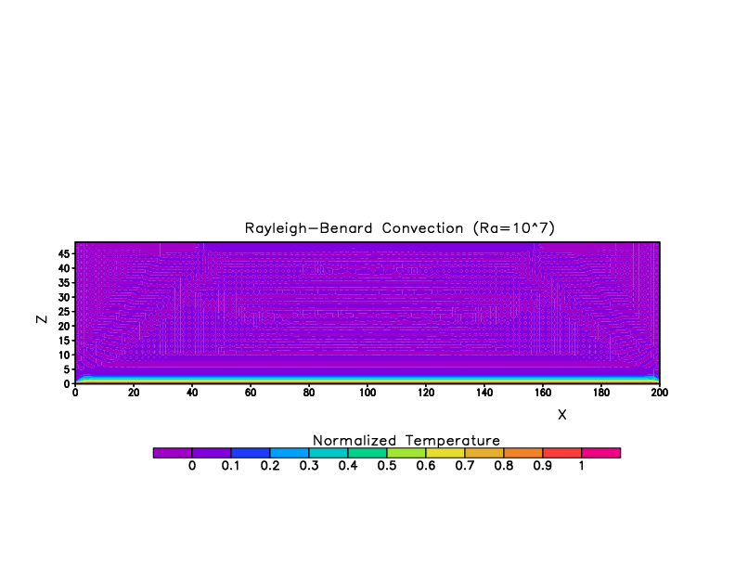
2D simulation using ABLE-LBM

Slide 15
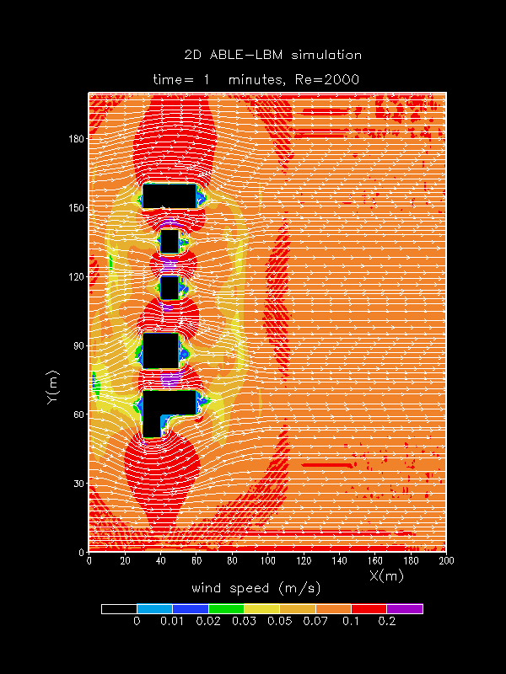
Preliminary 2D Results from ABLE-LBM

Slide 16
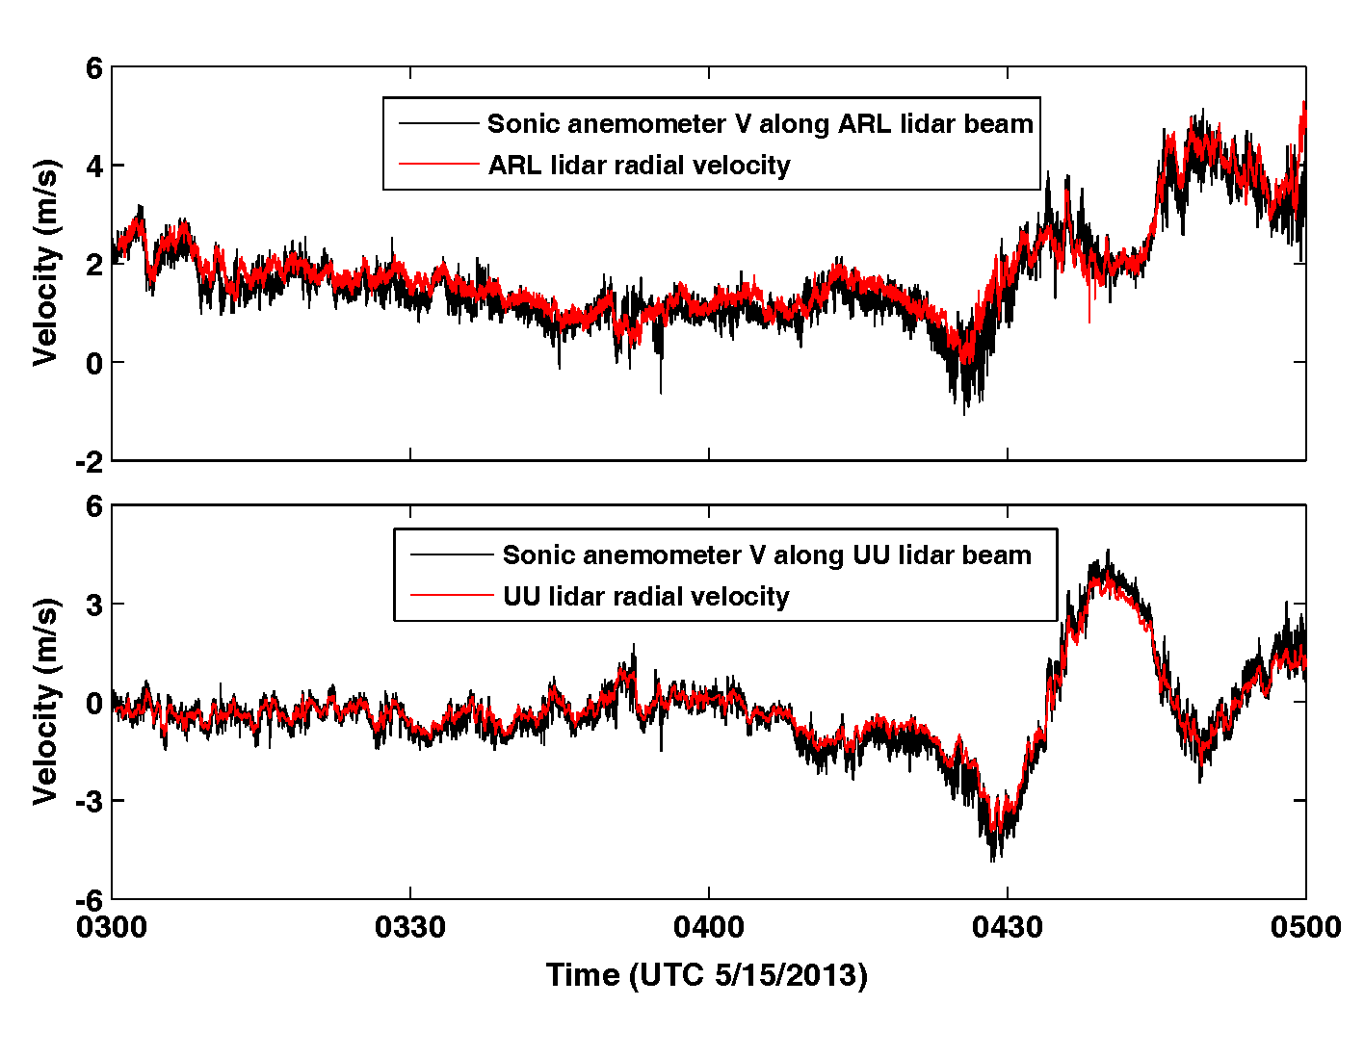
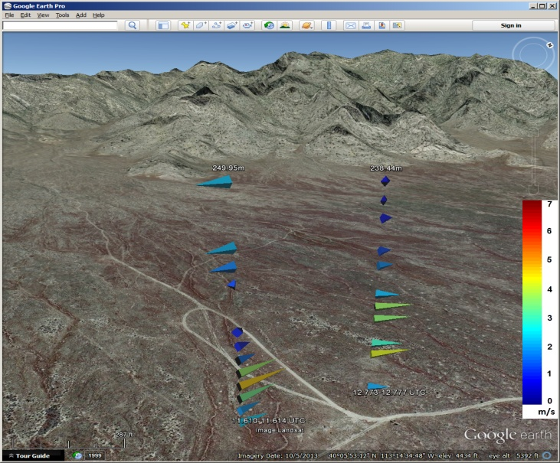
Doppler Wind Lidar Observations during MATERHORN MURI
Triple Lidar set-up
Leading development of triple lidar wind retrieval with Notre Dame and Univ. Utah.
Capture large eddies up heights of several hundred meters and in areas with complex terrain.
Comparison with Sonic Anemometer
Virtual towers for 3D wind profile

Slide 17
Summary and Future Efforts
Summary of Results
New efficient CFD dynamical core optimized for microscale environments.
CFD code performs well for two idealized flows (shear instability).
Preliminary 2D LBM simulation of flow around buildings.
Triple Doppler wind lidar observation of turbulent wind over a complex terrain
Future Efforts
Immersed Boundary implementation for steep terrain.
Turbulence closure scheme for LES simulation.
Extend 2D LBM to 3D for complex urban environment.
Doppler wind Lidar data assimilation into the 3DWF/ABLE models.

Slide 18
Related Publications
Wang, Y., G. Huyhn, C. Williamson, 2013. Integration of Google Maps/Earth with Microscale Meteorology Models and Data Visualization, Computer and Geosciences. 61: 23-31.
Wang, Y., E. Creegan, M. Felton, D. Ligon, and G. Huynh, 2013, An investigation of nocturnal low-level-jet generated gravity waves over Oklahoma City before the jet dissipation using Doppler wind lidar data. Submitted to J. Applied Remote Sensing. Vol 7: DOI:10.1117/1.JRS.7.073487.
Wang, Y., E. Creegan, M. Felton, G. Huynh, C. Hocut, H.J.S. Fernando, S. Hoch, and D. Whiteman, 2014, Triple Doppler wind lidar observations of turbulent winds over a mountain terrain during the MATERHORN field project. J. Appl. Meteorol. Clim. (submitted).
Wang, Y., C. Williamson, B. MacCall, 2012, A description of the framework of the atmospheric boundary layer environment (ABLE) model. ARL-TR6149.
MacCall, B., Y. Wang, G. Huynh, 2014, The battlefield environment division modeling framework (BFM) part I: optimization the atmospheric boundary layer environment model for cluster computing. ARL-TR-6813.
Huynh, G., Y. Wang, and C. Williamson, 2012, Visualization of wind data on Google Earth for the three-dimensional wine field (3DWF) model. ARL-TR6138.
Hanna,S., J.White, J.Trolier, R.Vernot, M. Brown, A. Gowardhan, H. Kaplan, Y. Alexander, J. Moussafir, Y.Wang, C.Williamson, J. Hannan, E. Hendrick , 2011, Comparisons of JU2003 observations with four diagnostic urban wind flow and Lagrangian particle dispersion models. Atmos. Environment, 45, 4073-4081.
Wang, Y., C. Klipp, D. Garvey, D. Ligon, C. Williamson, S. Chang, R. Newsom, R. Calhoun, 2007. Nocturnal Low-level-jet Dominated Atmospheric Boundary Layer Observed by Doppler Lidars over Oklahoma City during JU2003. J. Appl. Meteorol and Climatology. 46: 2098-2109.
Wang, Y., C. Williamson, D. Garvey, S. Chang, J. Cogan, 2005. Application of a multigrid method to a mass consistent diagnostic wind model. J. Appl. Meteorol., 44: 1078-1089.

Slide 19
Related Publications (Continued)
Huynh, G., Y. Wang, and C. Williamson, 2012, Visualization of wind data on Google Earth for the three-dimensional wind field (3DWF) model. ARL-TR6138.

