Slide 1
NCAR Perspective and EOL Resources
Vanda Grubišić
NCAR Associate Director for Earth Observing Laboratory

Slide 2
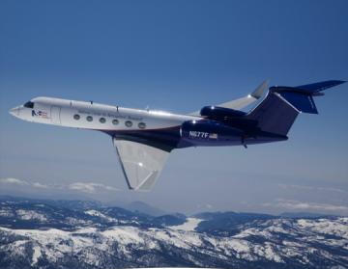
EOL Mission
NCAR Earth Observing Laboratory (EOL) Develops and Deploys observing facilities and provides Data Services needed to advance scientific understanding of the Earth System.
Notes:
Our Mission is to Develop and Deploy observing facilities and provide Data services needed to advance scientific understanding of the Earth System.

Slide 3
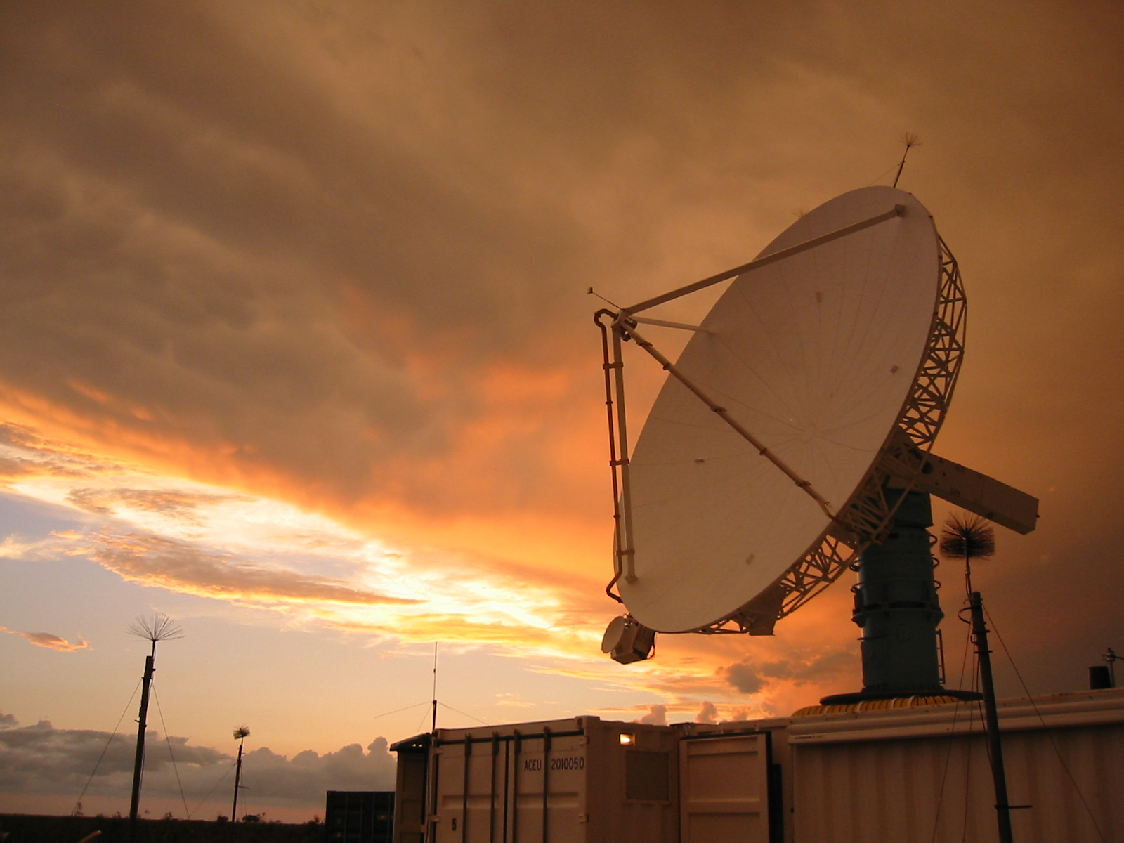
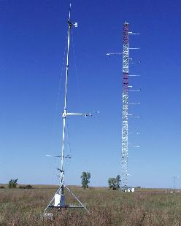
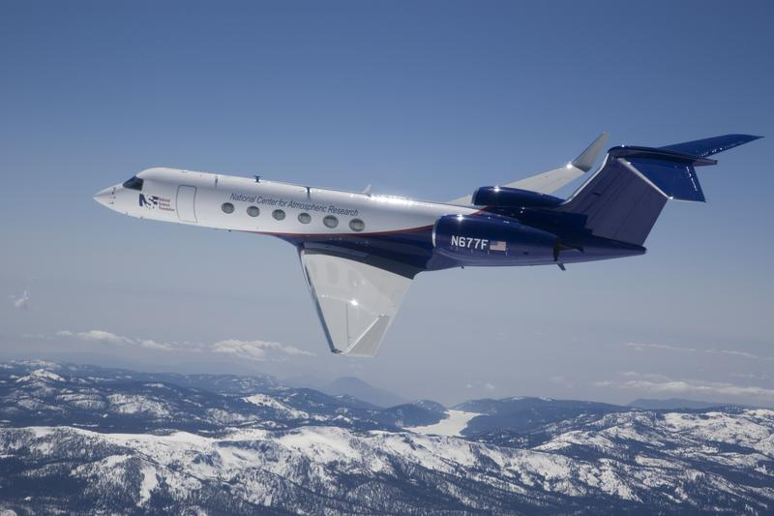
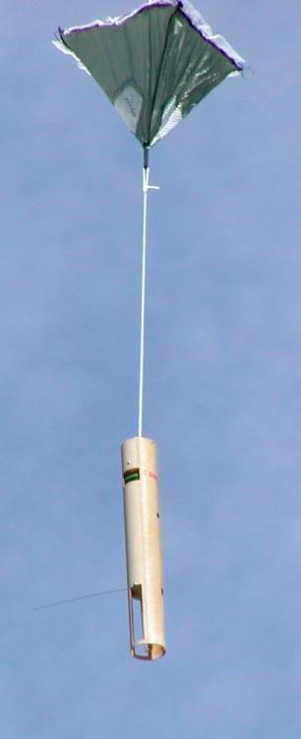
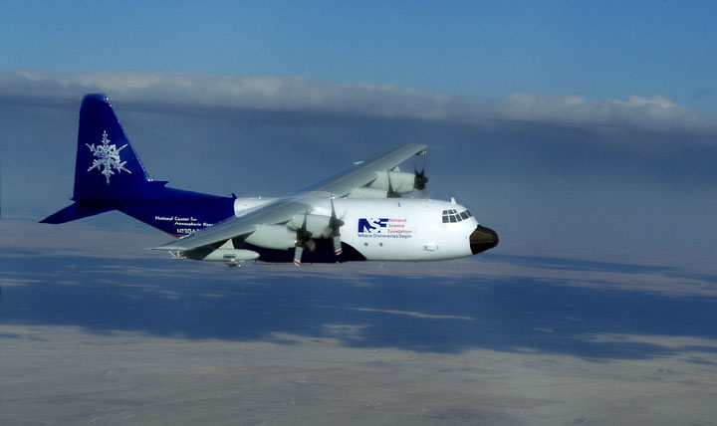
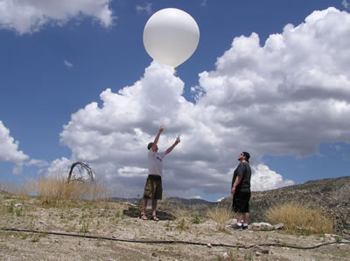
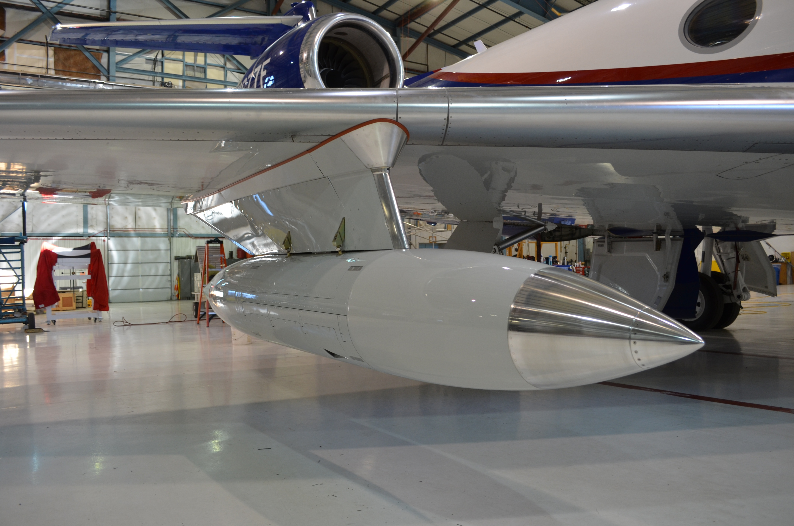
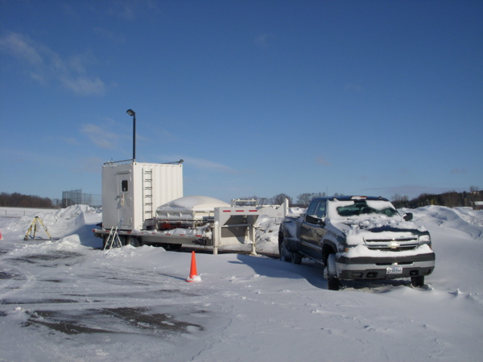
Imperatives: Manage and Operate LAOF
NCAR/EOL Managed NSF LAOF:
RAF:
GV
C-130
HAIS Instruments
RSF:
S-POL
High Spectral Resolution Lidar (HSRL)
HIAPER Cloud Radar (HCR)
ISF:
ISS/GAUS (Boundary
layer profiling)
ISFS (Flux towers)
AVAPS (Dropsonde)
Notes:
1st Imperative: Maintain LAOF so that they are ready for deployment
HAIS (HIAPER Aircraft Instrumentation Solicitation ) Instruments
14 equipment packages developed outside of EOL (NESL, Universities, private sector) for GV operation
all have completed the required FAA certification and test flights
Including HSRL and HCR
S-POL
ground-based dual-polarimetric S-band weather radar
measures cloud and precipitation microphysics and dynamics
- ELDORA
airborne dual-Doppler X-band weather radar
measures wind, clouds and precipitation
- HSRL (High Spectral Resolution Lidar) HAIS Instrument
airborne eye-safe lidar that measures cloud and aerosol particle characteristics
built by University of Wisconsin; maintained & deployed by EOL
- HCR (HIAPER Cloud Radar) - airborne scanning single-polarization W-band Doppler radar
In-Situ Facilities
- ISS (Integrated Sounding System)
self-contained meteorological observing system consisting of wind profiler radar, radiosonde sounding system, and a standard 10-m tower
measures the state-of-the-atmosphere
- ISFS (Integrated Surface Flux System)
tower-based sensors
measure exchange processes between the atmosphere & Earth’s surface
- AVAPS (Airborne Vertical Atmospheric Profiling System)
dropsondes ejected from aircraft
measure pressure, temperature, humidity and wind profiles
The NSF Lower Atmospheric Observing Facilities that EOL operates covers MEASUREMENTS FROM THE SURFACE TO THE STRATOSPHERE, from pole to pole, and FROM short to long timescales.
For the mid to upper atmosphere we have the aircraft, the NSF GV and C-130 and their associated instrumentation. We also have ELDORA, the airborne radar which deploys on the NRL P3 aircraft.
In the lower atmosphere we have S-Pol, our dual polarimetric S-band weather radar, we have ISS, the Integrated Sounding System which measures the physical characteristics of the lower atmosphere, we have ISFS, the Integrated Surface Flux System, which measure the surface energy budget, fluxes, and some soil parameters.
And we have the GAUS, which is our GPS Advanced Upper Air Sounding system and the dropsondes which are deployed from aircraft, both of which provide temperature, pressure, winds, and humidity throughout the troposphere.
All of these systems represent not only a range of spatial and temporal observational capabilities, but also a range of operational complexity from small autonomous instruments to resource intensive research aircraft.

Slide 4
EOL Field Campaigns in FY11/12
Campaign | Location | Period | PI
IDEAS 4 | Colorado | 11/1 -11/30/11 | Stith (NCAR)
DYNAMO | Indian Ocean | 10/1/11-1/31/12 | Zhang (U Miami)
ICEBRIDGE | Chile | 10/1/11-11/3/11 | Tagg (NASA)
TORERO | Chile, Costa Rica | 1/18/12-2/28/12 | Volkamer (CU)
ASCII | Wyoming | 1/15/12-3/15/12 | Geerts (U Wyoming)
DC3 | Kansas | 5/1/12-6/30/12 | Barth (NCAR)
Notes:
Lead Pis
DYNAMO: Zhang (UM), Rutledge (CSU), Richard Johnson (CSU), Bob Houze (UW)
ICEBRIDGE: Bruce Tagg only
IDEAS: Stith, Jeff French and Al Rodi, U. WY, Raymond Shaw, Michigan Technological Univ.
TORERO: Volkamer only
ASCII: Geerts, Roy Rasmussen (RAL), Dan Breed (RAL), Neal Laird (Univ. Illinois Urbana-Champaign)
DC3: Mary Barth, Bill Brune (Penn State Univ), Steve Rutledge

Slide 5
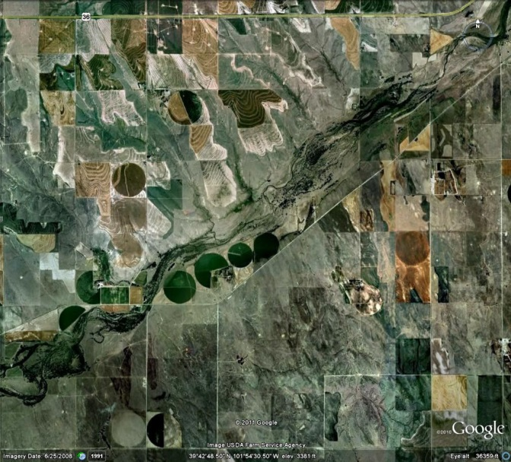
Imperatives: Development
Priority Developments: Airborne Phase Array Radar (APAR) and CentNet
20, 5-level Towers
-or-
100 Surface Flux Stations
APAR - New generation airborne Doppler radar, replacement for ELDORA
C-band (less attenuation), dual-Doppler (exceeding ELDORA performance), with dual-pol capability
Composite view of the storm environment in conjunction with the weather avoidance radar for maneuvering around storms
Partnerships (NOAA, universities, etc.)
CentNet - New generation integrated surface flux system
All-digital sensors, wireless data transfer, network-based control, quick deployment, solar powered
Observations of meteorological parameters, surface energy fluxes, atmospheric composition, surface characteristics
Partnerships (EU)
Notes:
3rd Imperative: Anticipate future needs resulting from changing priorities, aging equipment or emerging opportunities, and develop new technology (instrumentation, software, and infrastructure) to meet those needs. This is the area of new developments: design of new sensors, new instruments, new platforms and/or capabilities
The last two are also examples of the university-EOL partnerships in the area of new development.
These are development efforts that are unique to EOL that we are currently working on. Each of them requires a high level scientific and technical expertise in a variety of areas. We have the dropsonde, shown here, the driftsonde, shown here, which is a balloon borne dropsonde system,
the 449 MHz wind profiler shown here, the Ka Band radar which sits next to the S-Pol antenna,
the Laser air motion sensor shown here, the HIAPER cloud radar shown here,
the high spectral resolution lidar, with a schematic of the lidar curtain of aerosol distributions as the plane is in flight,
the HAIS instruments, HAIS is the HIAPER Aircraft Instrumentation Solicitation, and you’ll hear about these in the next talk,
and the Front Range Observational Network Testbed, or FRONT, which is collaboration between EOL and Colorado State University involving the S-Pol and CHILL radars.
You’ll hear more about all of these developments over the next couple of days.
There’s also another very recent collaborative effort between EOL and Dr. Kevin Repasky, Assistant Professor in the Electrical and Computer Engineering Department at Montana State University. Kevin has created a low cost, eye-safe, lidar water vapor and aerosol (and possibly temperature) profiler with 15 minute updates and 150 m vertical resolution. The prototype can measure to the top of the boundary layer during daytime and well above at night. Kevin combined significant technology improvements from telecom industry based components in developing the instrument -- similar in kind to what TDF utilizes to perform trace gas detection. The instrument is inherently low-cost, scales well to multiple units that could be used in a network, and would be a huge benefit to our NSF user community.
DIAL Differential Absorption Lidar
STORY: COMPLETELY CONCEIVED AT NCAR (AT LEAST THE DRIFTSONDE). LIFE CYCLE MANAGEMENT PROGRAM, HOW DO WE MAKE DECISIONS ABOUT DEVELOPMENT? WHAT STAYS, WHAT GOES AND WHAT GETS DEVELOPED NEXT?

Slide 6
Requestable NSF Lower Atmospheric Observing Facilities
for Science & Project-based Learning

Slide 7
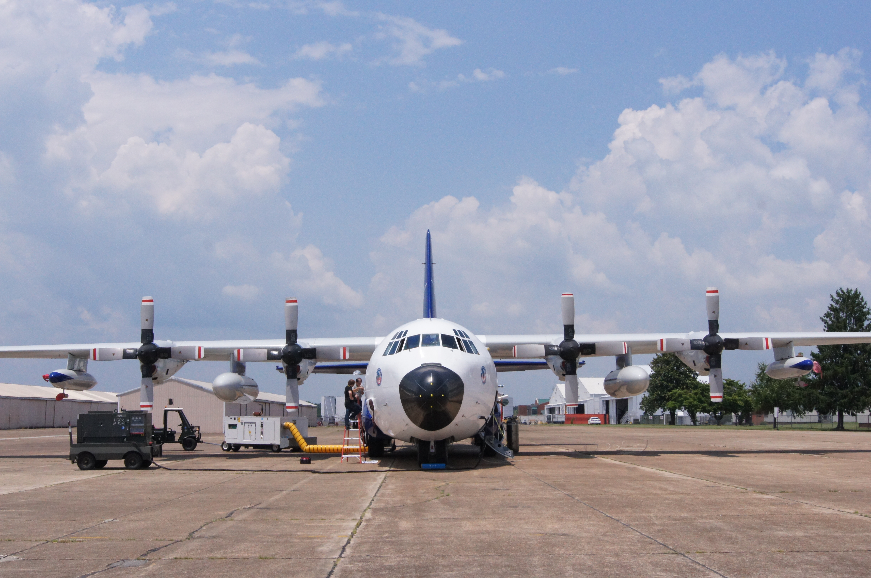
Requesting Lower Atmospheric Observing
Facilities (LAOF)

Slide 8
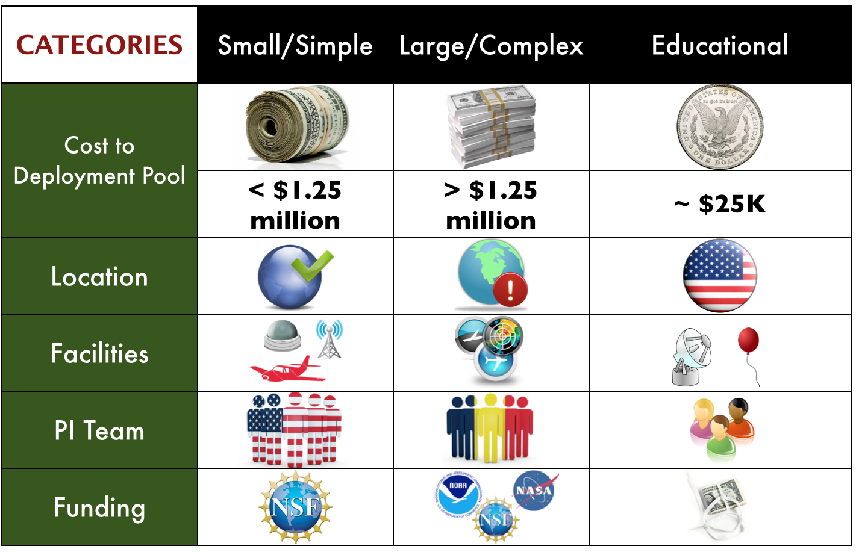

Slide 9
Documentation
Letter of Intent (LoI)
Scientific Project Overview (SPO)
overall scientific justification of program
proposal to NSF via FastLane
Experiment Design Overview (EDO)
overall concept of experiment including design, resource needs and management
EDO due to NSF and Facility Providers
Science Proposal
Facility Request

Slide 12
Responsibilities
Principal Investigators:
Write Scientific Project Overview (SPO), Experimental Design Overview (EDO) and Science Proposals
Submit Facility Request Forms
EOL and other Facility Providers:
Prepare EDO assessments, feasibilities, cost estimates, & risk assessments
Conduct OFAP Meeting
NSF Program Officers:
Conduct peer review of Science Proposals & SPOs

Slide 13
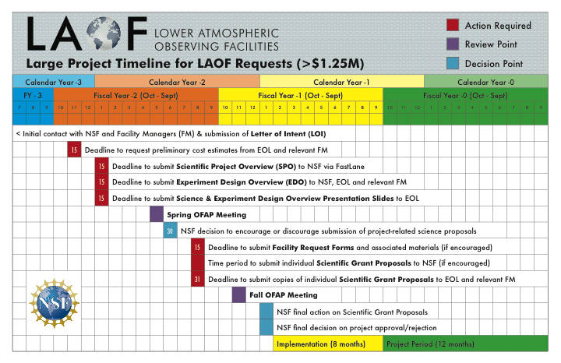

Slide 14
Observing Facilities Assessment Panel
(OFAP) Charge
Importance and uniqueness of program
Experiment design
Operations
Platforms and instrumentation
Project planning, management & implementation
Data management
Science team
Safety/security
Resource and cost
Optimization

Slide 15
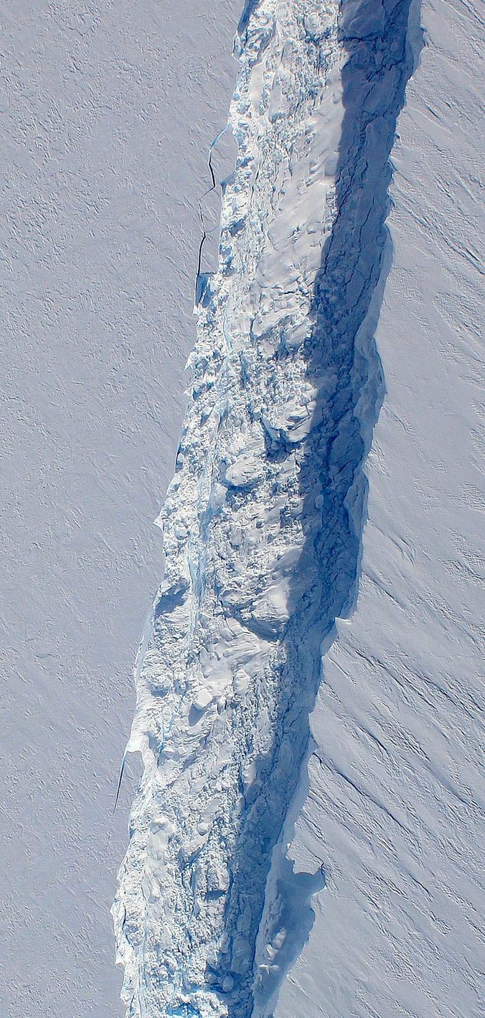
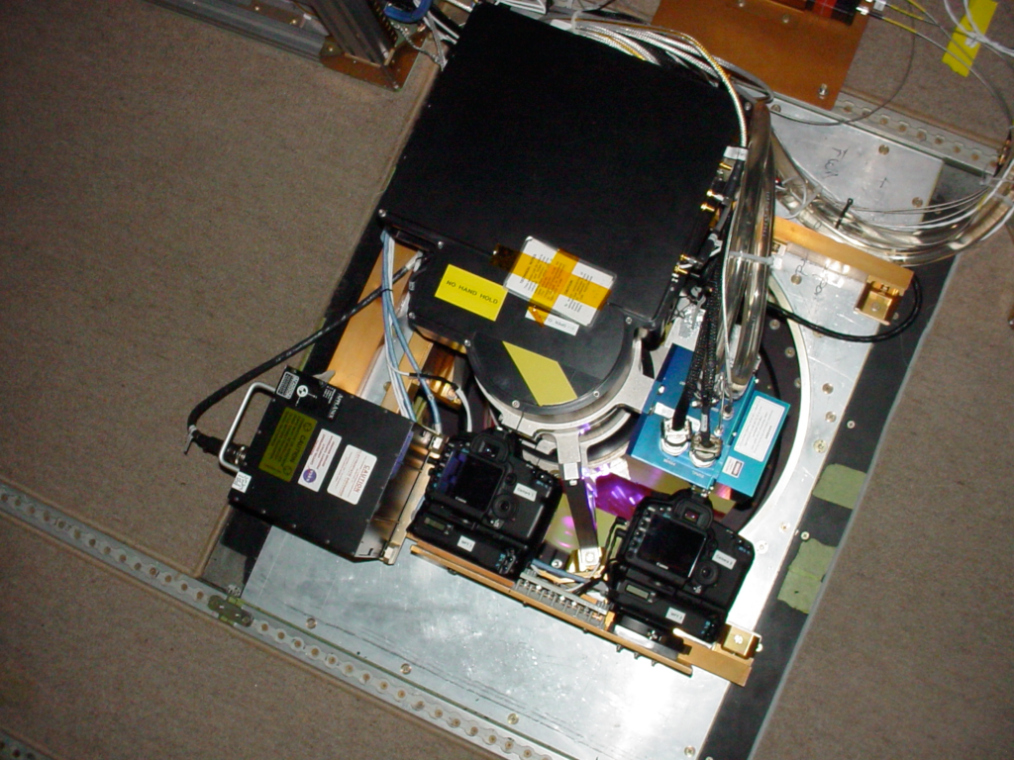
Cost Recovery
Similar Process, except:
Science review done by other funding agencies
“Appropriate Use of the requested Facility”
Non-interference basis with NSF projects
Deadlines less stringent
User Rate applies
NASA ICEBRIDGE - October 2011

Slide 16
In Summary
Available LAOF address and serve a wide range of science objectives and communities
Field campaigns vary in size and complexity and require time to plan and implement
Field campaign size matters with respect to documentation, timelines, deadlines and budgets
Communication is essential with NSF and LAOF partner organizations
EOL is here to help!

Slide 17
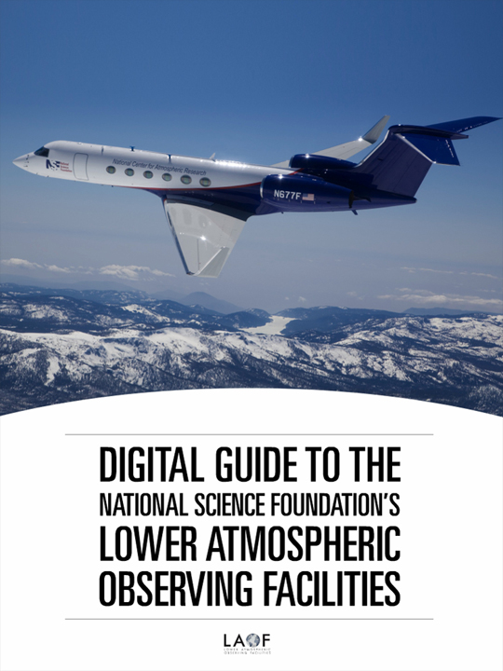
New User Outreach and Training
New series of activities in EOL for
Training and Entraining New Users
of the observational facilities
1) Digital Guide to NSF Lower Atmospheric Observing Facilities (LAOF):
Online Magazine and iOS and Android apps
2) Tutorials at AGU & AMS Annual Meetings
Dec 4, 2012 @ AGU Fall Meeting
Dec 9-13, 2013 @ AGU Fall Meeting
Feb 2-6, 2014 @ AMS Annual Meeting
Next Turorial at 2014 AGU Fall Meeting
http://www.eol.ucar.edu/laof

Slide 18
Request Facilities
Brigitte Baeuerle
EOL Assistant Director for Operations
baeuerle@ucar.edu
303.497.2061

Slide 19
Questions?

Slide 20
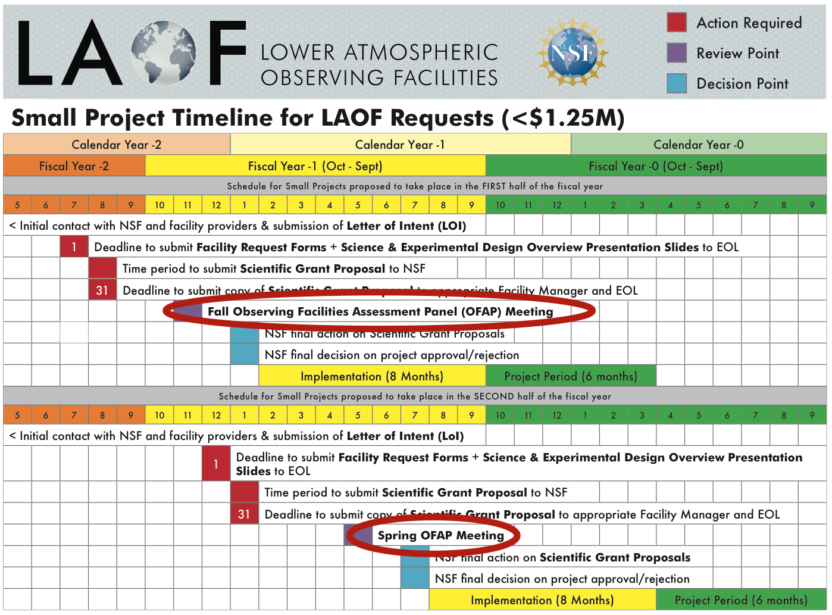

Slide 21
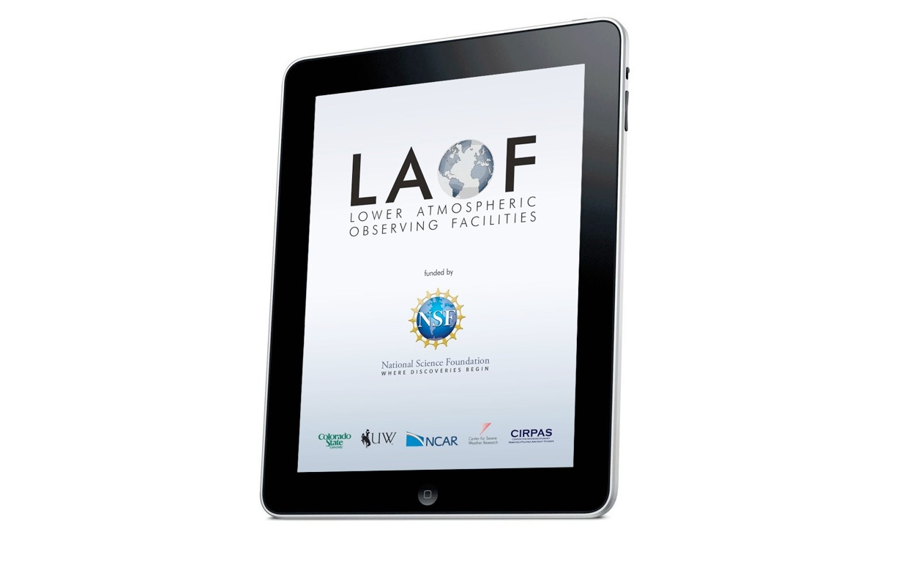
Digital Guide to the National Science Foundation’s Lower Atmospheric Observing Facilities
www.eol.ucar.edu/laof

