Slide 1
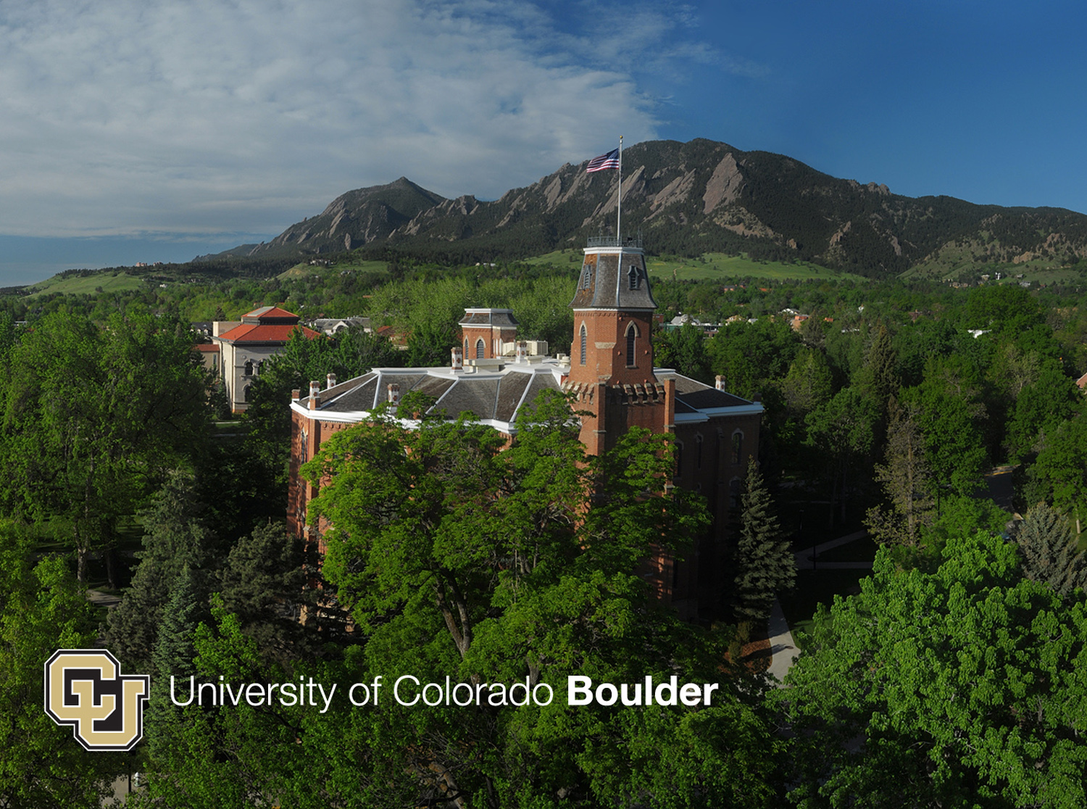

Perdigão (experimental) science goals
Headline
Julie K. Lundquist
Prof., University of Colorado at Boulder &
Scientist, National Wind Technology Center, NREL

Slide 2
1. Multiscale flow interactions
When/how are the flow structures in the valley impacted by local thermal circulation for a given incident flow? How do the slope and valley flows interact? Multiscale flow interactions.
  characterize mesoscale (including ocean/SST as site is 100km from the coast) required for mesoscale/microscale coupling
  characterize inflow
  pressure measurements for waves and characterizing unsteady flows
  differential heating

Slide 3
2. Influence of terrain heterogeneity
What is the impact of “The Gap” on the flow field?
  flow channeling
  variations with stability
The 3D nature of the ridges may also influence channeling and recirculation – how?

Slide 4
3. Transitions & Diurnal Cycle
What determines the location and character of features such as fronts during transitions?
What are the impacts of various forcing mechanisms on TKE and the TKE balance through the diurnal cycle?
  continuous high-rate measurements of winds, pressure
  profiles and transects to estimate advection and turbulence transport terms
  UAVs and tethered lifting systems could help
  mixed layer depth

Slide 5
4. Heterogeneity
What is the impact of microscale heterogeneity?
  roughness, moisture, soil moisture, sap flow, vegetative canopy, differential heating
  remember sonic footprint issues
  need lidar measurements, aerial photographs, right before campaign to characterize elevation and vegetative canopy
What data do we need to collect to reassess/surpass MOST?
Assess spatial coherence; need to cross-calibrate instruments

Slide 6
5. Turbine interactions
How does the turbine wake generate and interact with coherent structures induced by terrain flow?
  Wake meander in the horizontal and vertical
  TKE budgets in wake
  Does the wake affect flow in the valley?

Slide 7
6. Budgets
What is the complete hydrological balance of the valley?
Perhaps CO2 as well, but be careful and consult with a CO2 person

Slide 8
7. Instrumentation science questions (Broader Impacts!)
How to define optimal lidar scanning strategies?
  will build on results from Windscanner (3 Windcube 200S operated synchronously) deployment in 2015
How to use sonics, radiometers in complex and heterogeneous terrain?

Slide 10
Possible strategies for science proposals (to help ensure that everyone gets funded)
Map each important question from SPO to an investigator to ensure everyone gets funded?
Collaborative proposals between investigators can link complementary investigations
  many of us bring both modeling and obs expertise: be careful with areas of overlap to ensure they are complementary
Do we all submit to NSF AGS/PDM? Should we also look into NSF Fluid Dynamics? (Energy for Sustainability not currently funding wind-related work)
European focus is on improving wind resource assessment models (wind application). US participation can focus on advancing state of science to improve the model chain and process studies.
Interaction between SPO and MRI – be sure to define a plan with/out CentNet. Specify the science that can be done with/out CentNet.
Make the clear case that we are leveraging significant European resources to justify the additional expense of transporting US participants to Europe

Slide 14
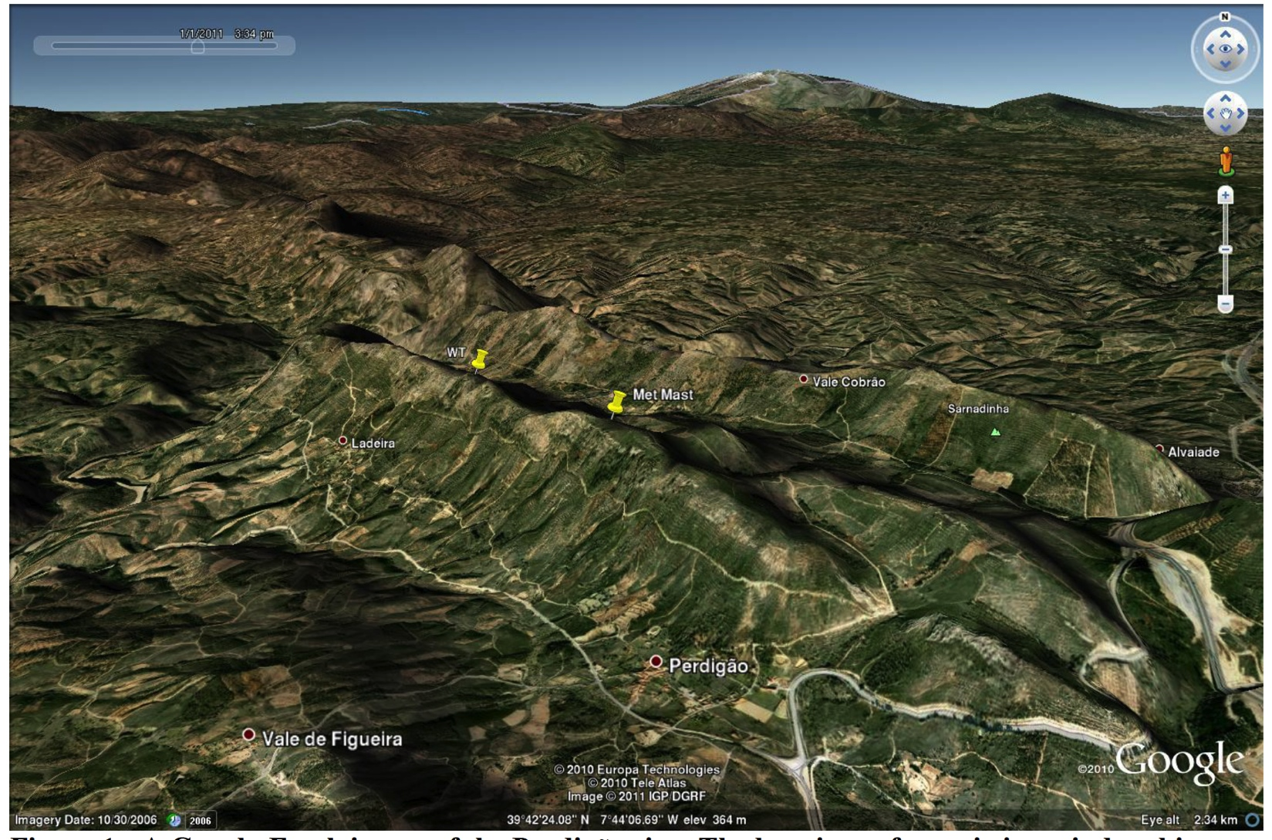
CU-Boulder goals for Perdigão: observations and simulations
documenting and understanding the diurnal cycles of wind, turbulence, turbulence dissipation rate, and atmospheric stability at the Perdigão double-hill site
assessing how this daily cycle affects the evolution of wind speed and turbulence at turbine altitudes and the resulting evolution of wind turbine loads and wind turbine wakes in complex terrain

Slide 15
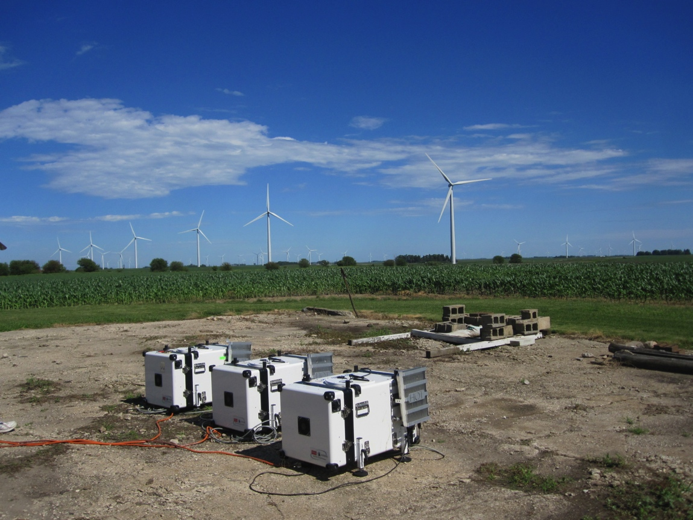
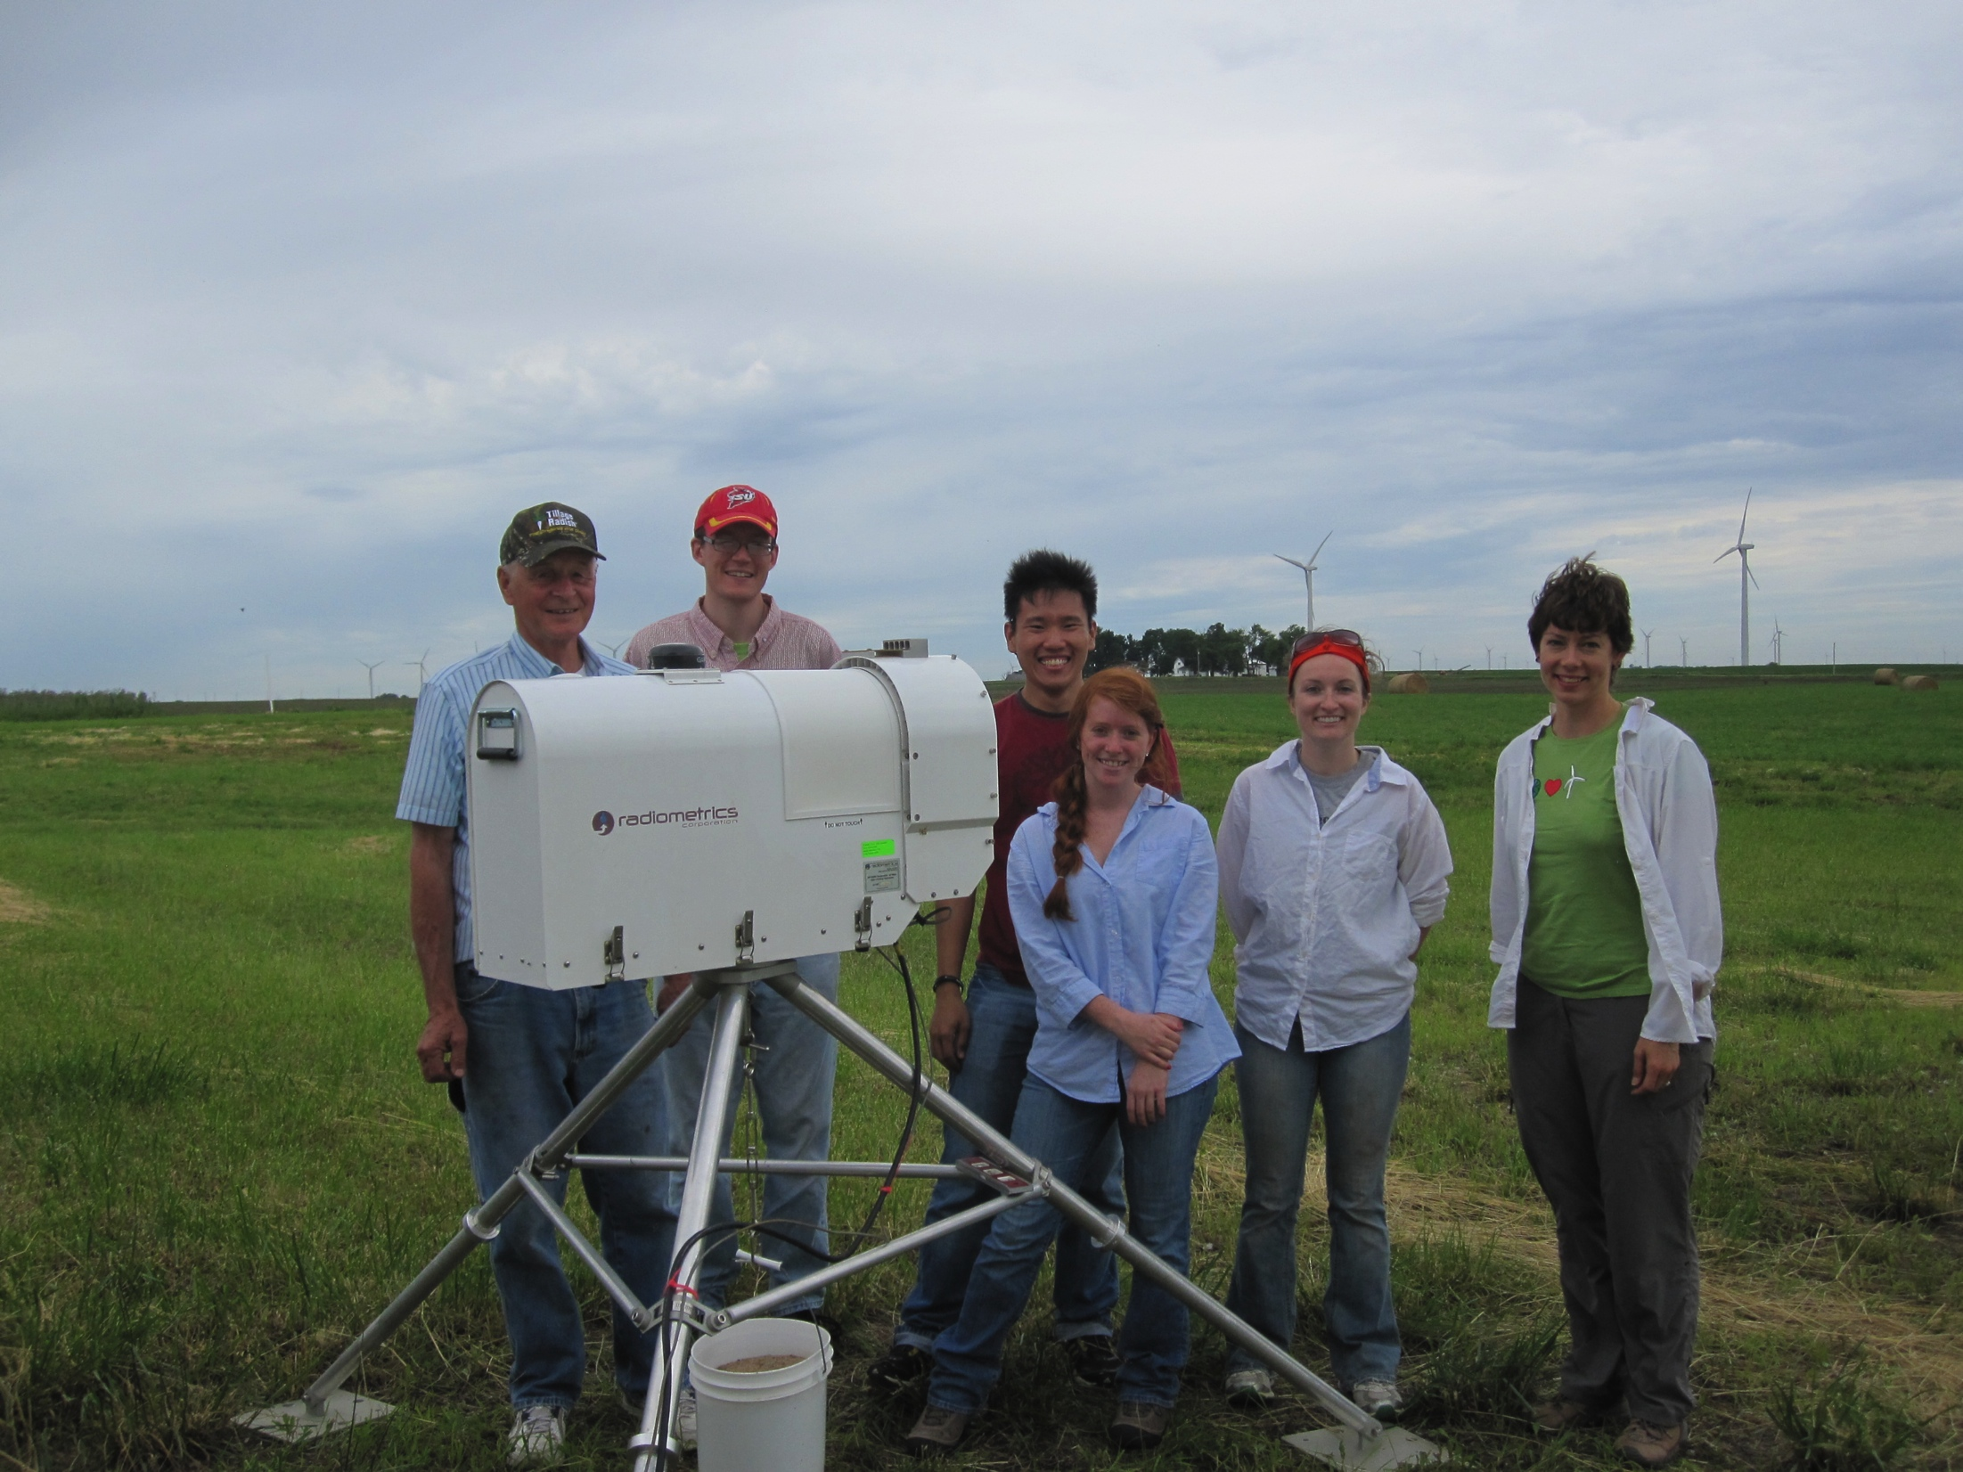
CU’s Remote sensing platforms
CU and NCAR lidar deployments at the
CWEX-13 experiment, Iowa
2-3 Windcube v1 profiling lidars (winds and lidar turbulence 40m-220mabove surface, dz=20m )
Microwave radiometer (T, RH, precip) 0-10km
CU and ISU staff with radiometer at
CWEX-13 experiment, Iowa

Slide 16
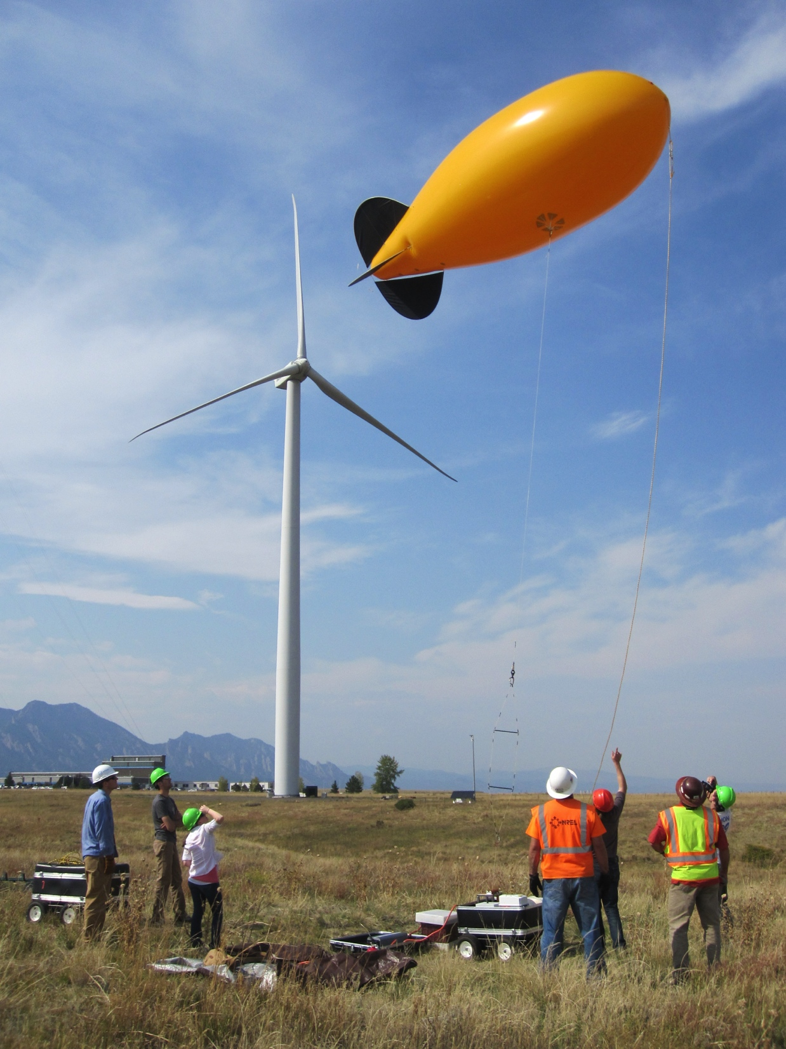
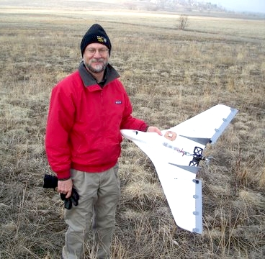
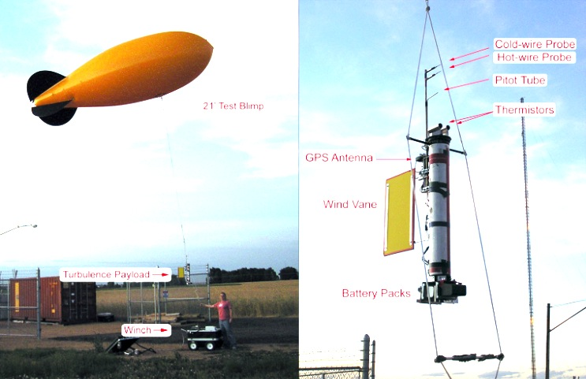
In situ observations (require coordination with Portugese Air Force)
Tethered lifting system
UAV (1-m wingspan Datahawk)
Turbulence
Payload
21’ Test Blimp
Wind→
Vane
Turbulence
Payload
Winch →
Used to quantify winds, temp, and
TKE dissipation rate in wind turbine wakes
(Lundquist & Bariteau 2014, BLM, to appear)
Lawrence and Balsley 2013, J Tech

Slide 17
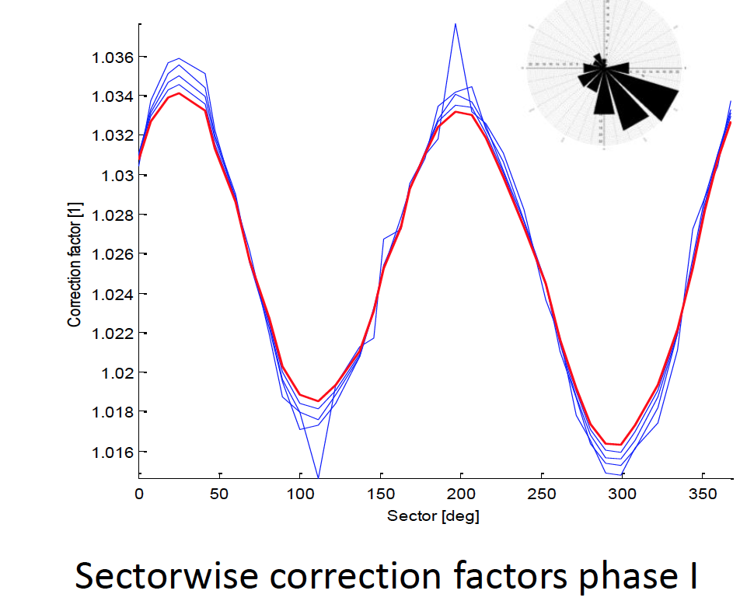
In flat terrain, lidars are suitable to provide “inflow” conditions, but “corrections” (based on CFD) are usually applied to complex terrain
Corrections are product-specific
Usually based on neutral BL flow
Vogstad et al. 2013

Slide 18
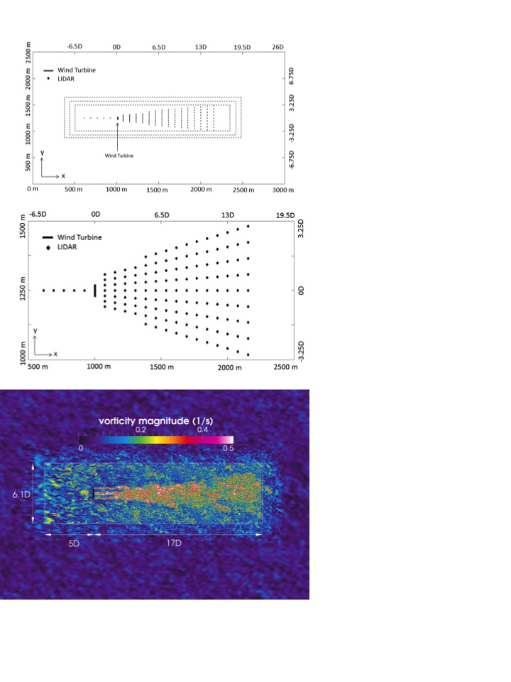
Inhomogeneous flow challenges the assumptions of the lidar, introducing error that can be quantified with stability-aware modeling (wake example)
Using CFD, we simulate stable BL flow past
a wind turbine (actuator line mode).
We introduce hypothetical lidars into the flow
and calculate the difference between what
the lidar actually saw and what it should have seen.
Lundquist, Churchfield, Lee, and Clifton, 2014, AMTD

Slide 19
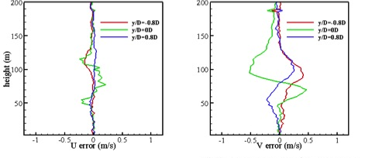
Largest errors are within 1D, but even at 3D downstream, cross-stream velocities are unreliable
3D Downstream – 10 minute average .
200
150
100
50
200
150
100
50
y/D=-0.8
y/D=0
y/D=+0.8
y/D=-0.8
y/D=0
y/D=+0.8
height (m)
-1 -0.5 0 0.5 1
U error (m/s)
-1 -0.5 0 0.5 1
V error (m/s)
Lundquist, Churchfield, Lee, and Clifton, 2014, AMTD

Slide 20
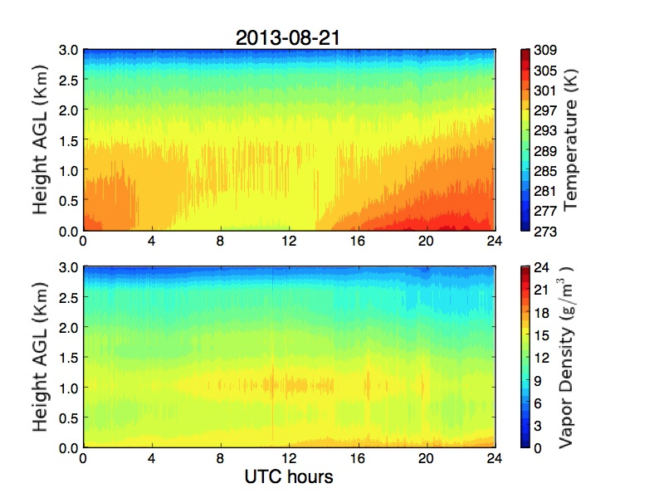
Assessing stability with radiometer (CWEX-13)

Slide 21
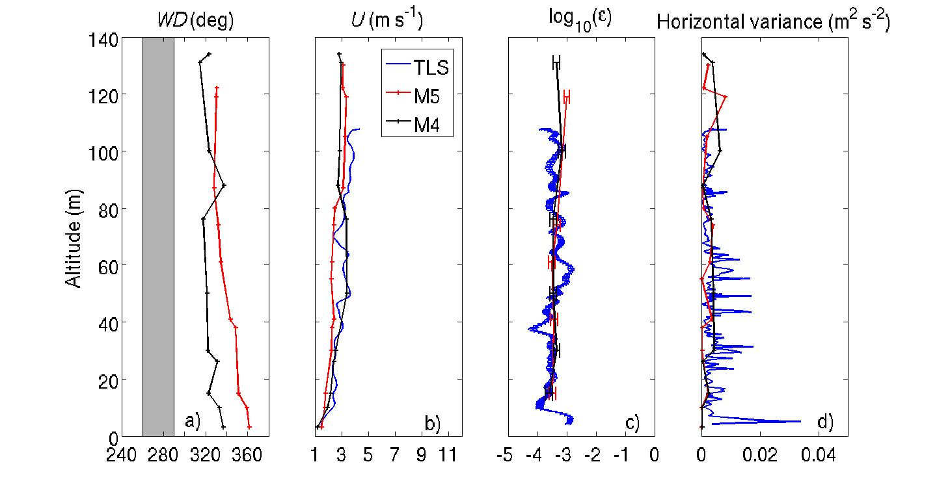
TKE dissipation from TLS compares well to towers outside turbine wake
Lundquist and Bariteau, 2014, BLM to appear

Slide 22
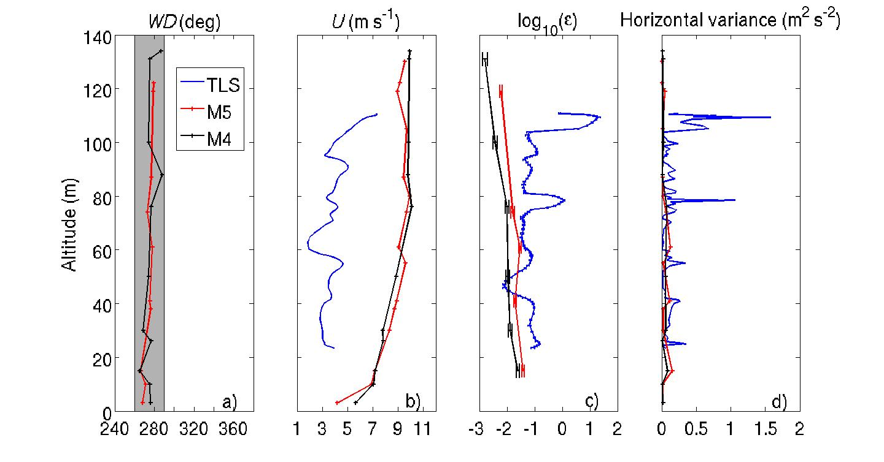
TLS shows enhanced dissipation in wake – in neutral conditions
Lundquist and Bariteau, 2014, BLM to appear

Slide 23
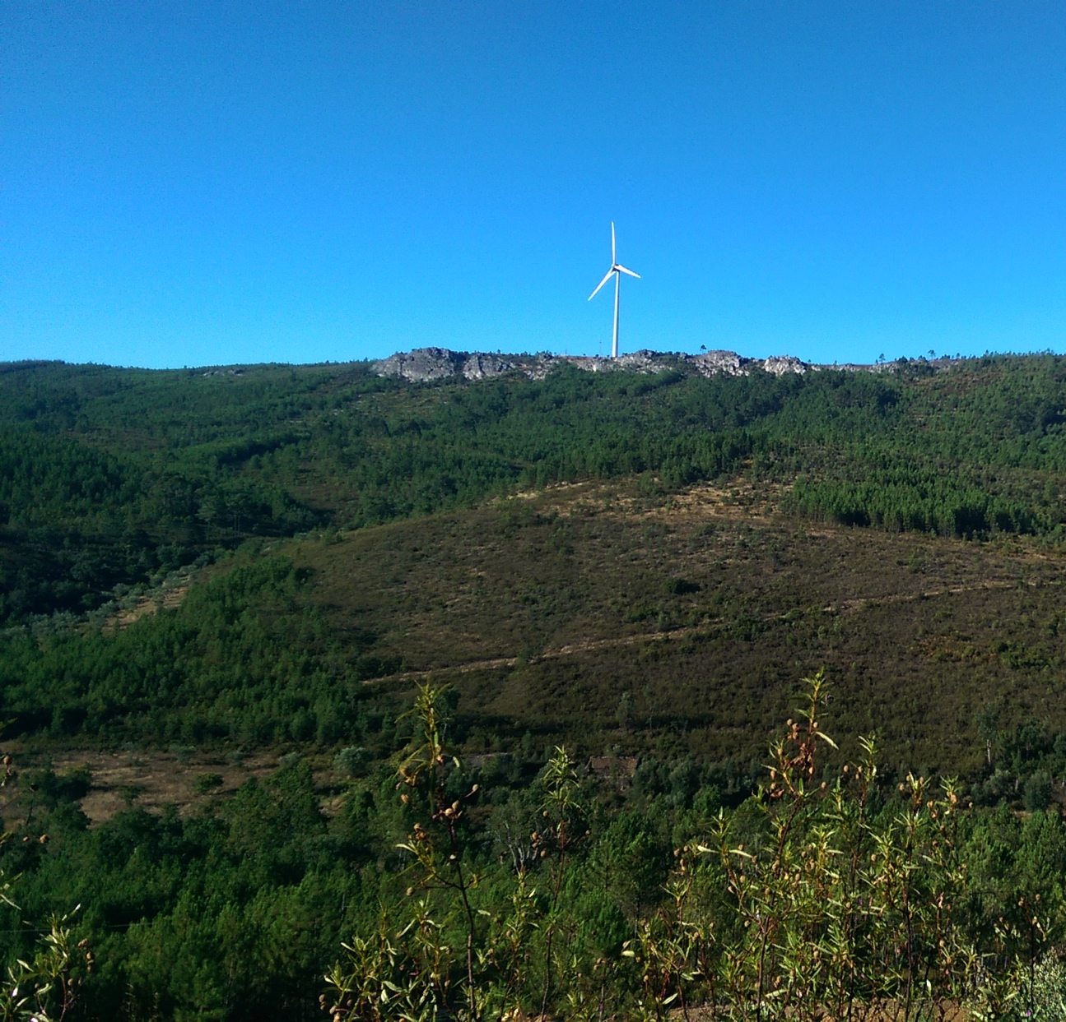
For Perdigão, we can test the hypothesis that stability drives variability in dissipation rate, even within the wake
Lidars quantify inflow
Radiometer helps quantify stability
TLS and UAV document dissipation rate
…And then challenge LES with these observations

Slide 24
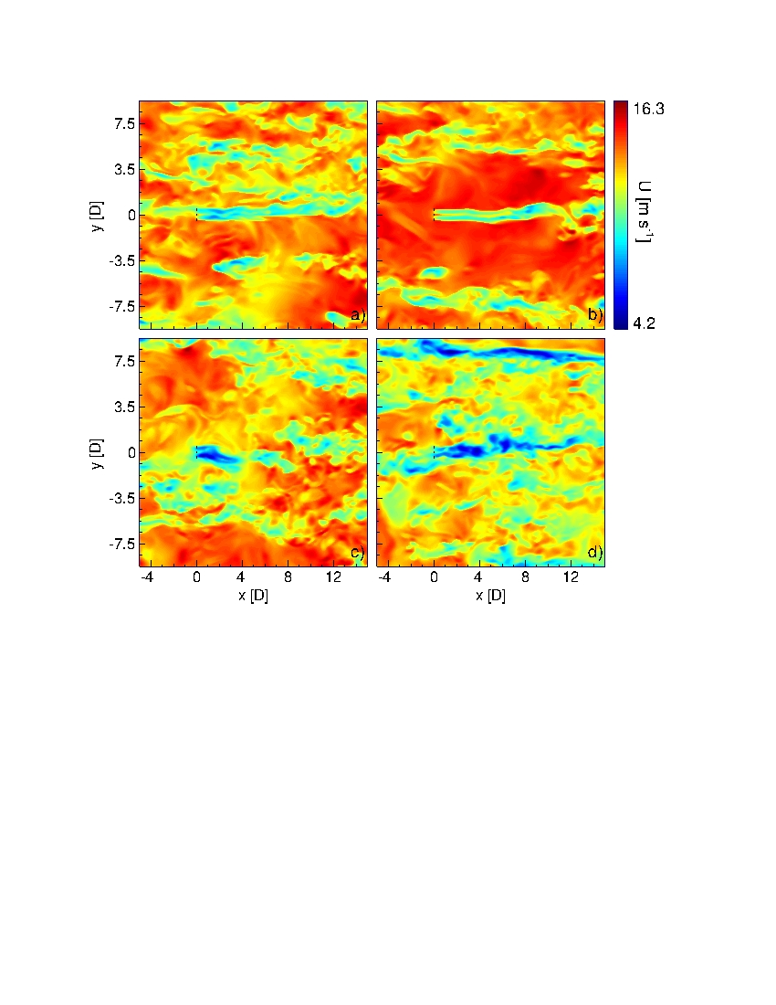
How skillful are models at capturing this cycle of stability and its interaction with wind turbine wakes?
WRF-LES for CBL
WRF-LES for SBL
Flow
Mirocha, Lundquist et al. 2014 JRSE
Aitken, Kosovic, Mirocha, and Lundquist
2014 JRSE

