Slide 1
NCAR/EOL Involvement in Perdigão Experiment
Steve Oncley
National Center for Atmospheric Research
Earth Observing Laboratory
Boulder, CO
I have 3 hats today:
Facility Scientist (supply EOL facilities)
Facility Developer (augment resources)
CentNet
TRAM
Researcher (H₂O/CO₂ budgets)

Slide 2
WVDIAL
ISS
NSF/
Deployment
(PI-Led)
OFAP
ISFS
Perdigão
(~10 SEB + 15 3DS)
(EOL-Led)
NSF/MRI
CentNet
(+10 SEB + 60 3DS)
NEWA

Slide 3
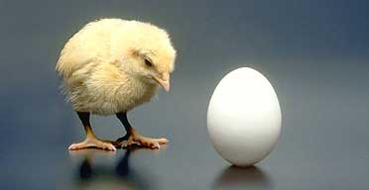
WVDIAL
ISS
NSF/
Deployment
(PI-Led)
OFAP
ISFS
Perdigão
(~10 SEB + 15 3DS)
(EOL-Led)
NSF/MRI
CentNet
(+10 SEB + 60 3DS)
NEWA

Slide 4
Science
WVDIAL
ISS
NSF/
Deployment
(PI-Led)
OFAP
ISFS
Perdigão
(~10 SEB + 15 3DS)
(EOL-Led)
NSF/MRI
CentNet
(+10 SEB + 60 3DS)
NEWA

Slide 5
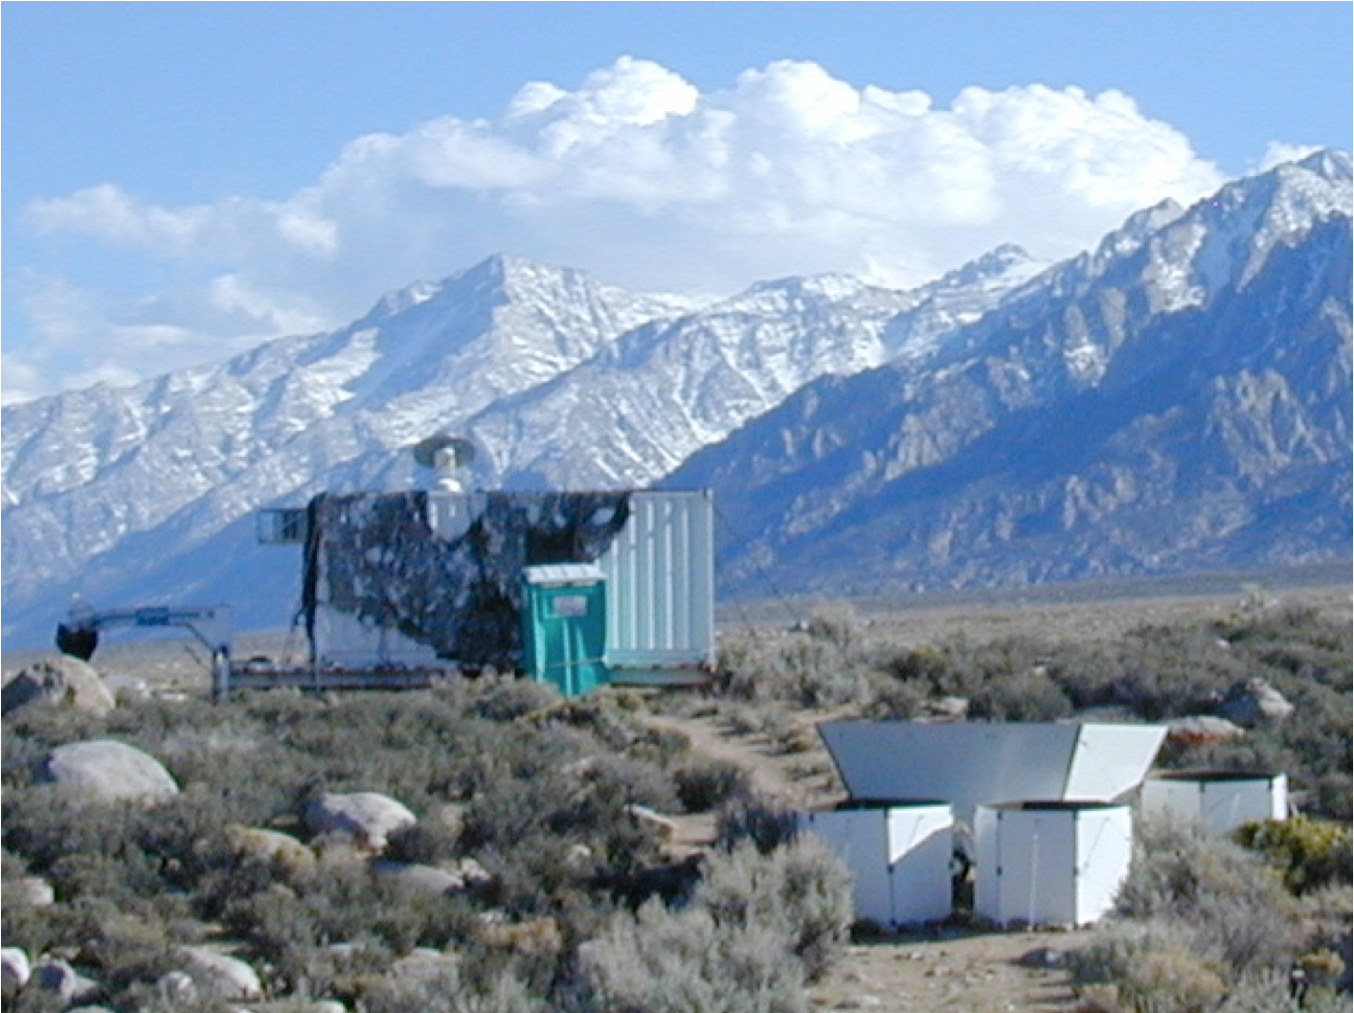
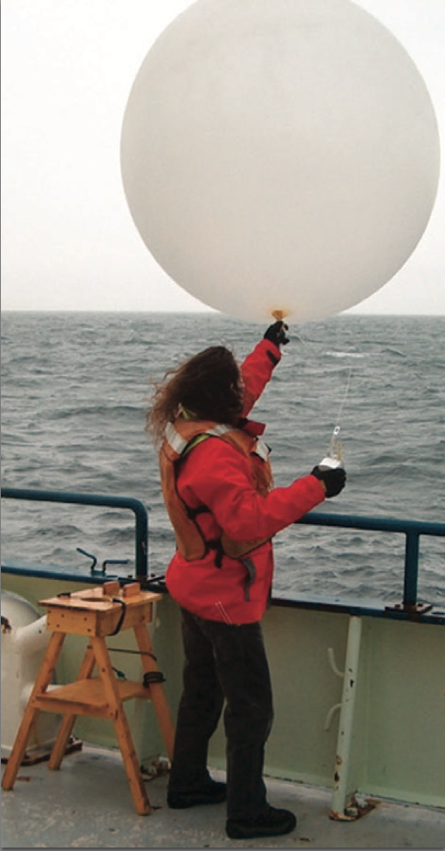
EOL Boundary-Layer Profiling
915 MHz Wind Profiler/RASS
Radiosonde launching
(fixed/mobile)
SODAR/RASS
Ceilometer
All-Sky Camera
Developmental 449 MHz Wind Profiler

Slide 6
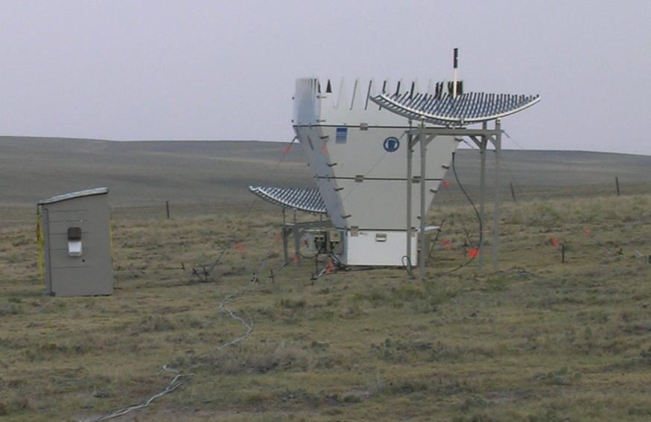
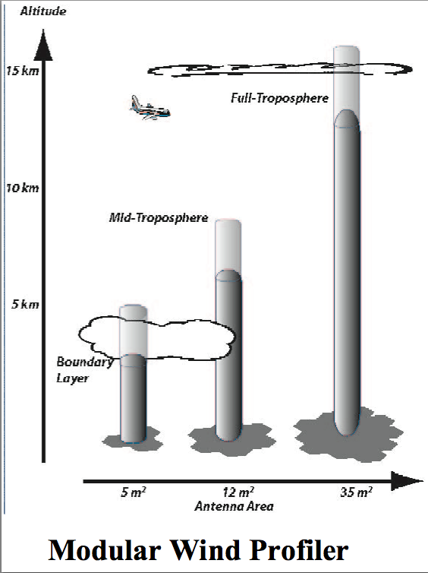
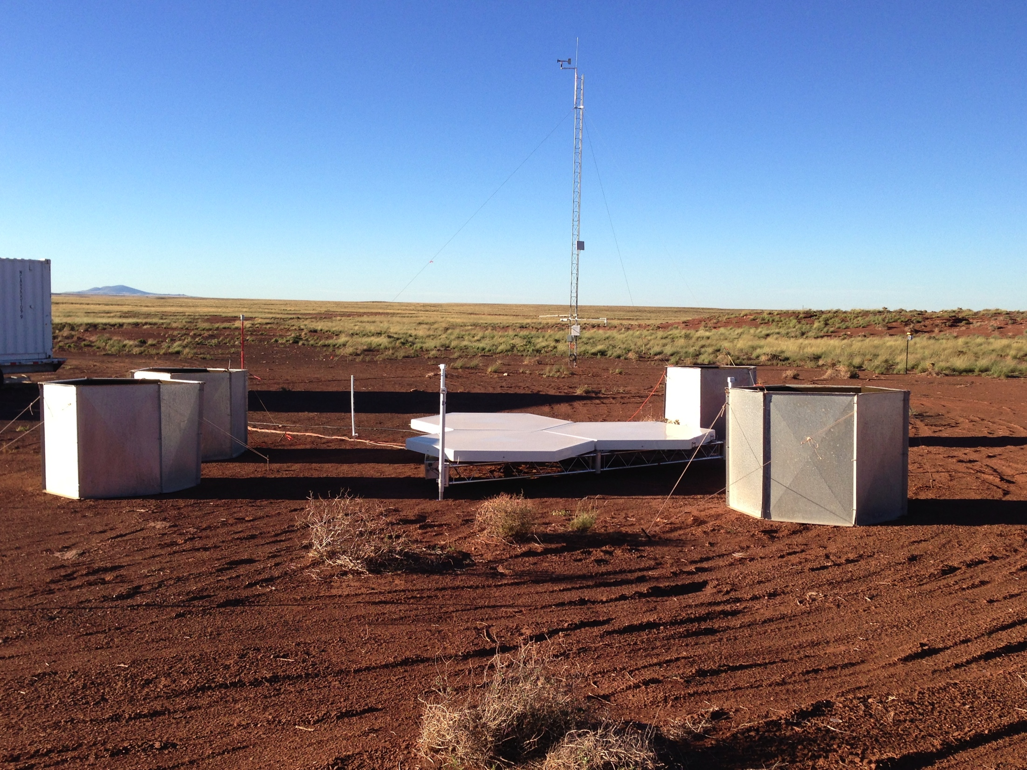
SODAR-RASS
(u,v,w,T; 40—200m @15m; 10 min)
RADAR Wind Profiler-RASS
(u,v,w,T; 200—3000+m (1500m T) @50/150m; 5 min)

Slide 7
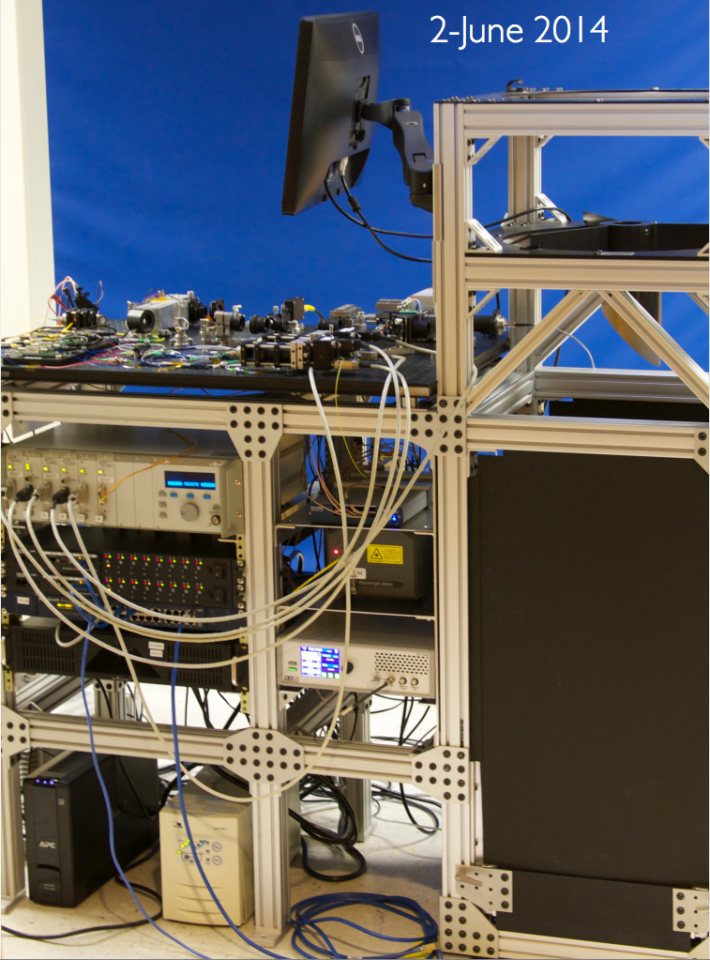
Water-Vapor DIAL
Expect humidity profiles equivalent to radiosondes
every minute
from 0.25—4+ km above ground
Even better performance likely by time of Perdigão
How much to run? (Best continuous)

Slide 8
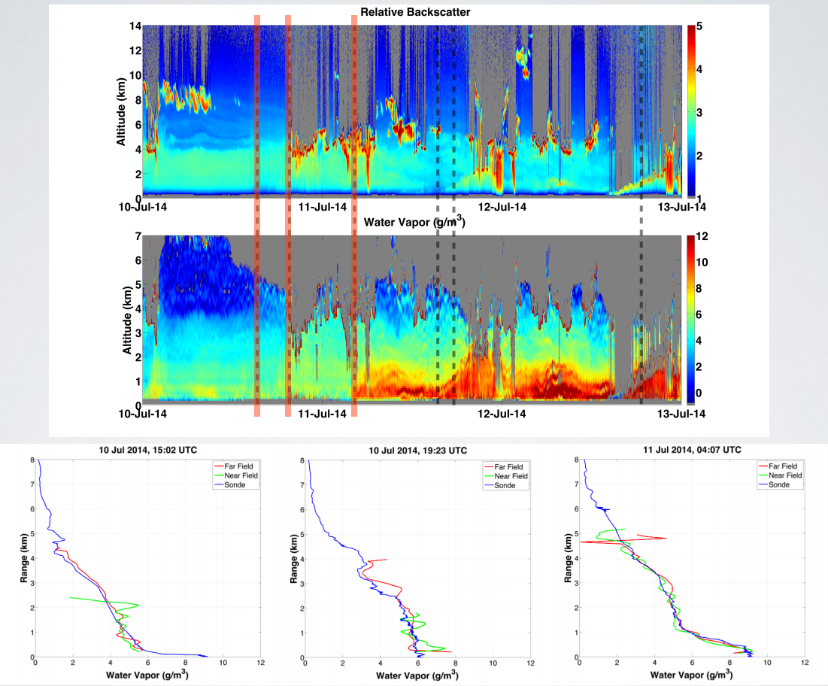

Slide 9
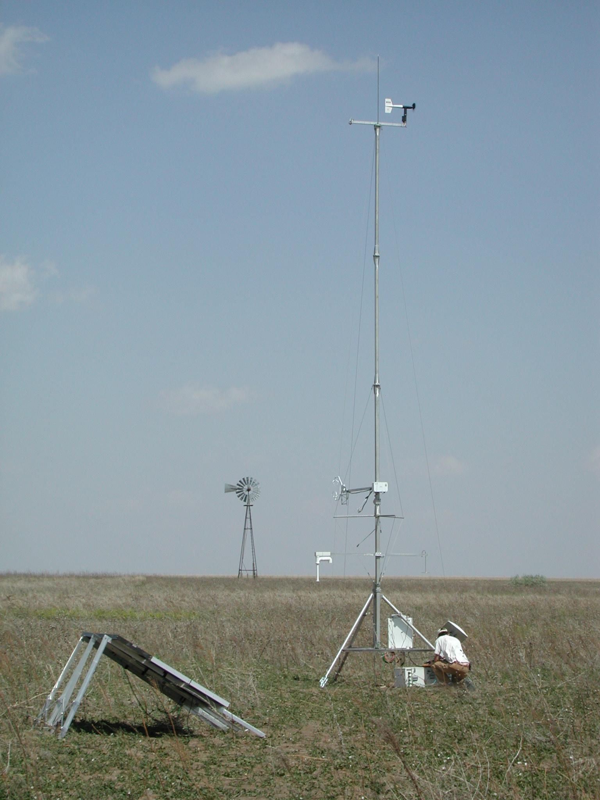
Integrated Surface Flux System
ISFS is a configurable suite of tower-based sensors, commonly used to study exchange processes between the atmosphere and the earth's surface.
ISFS can be deployed as either a
spatially disperse network of stations to measure the surface energy budget...

Slide 10
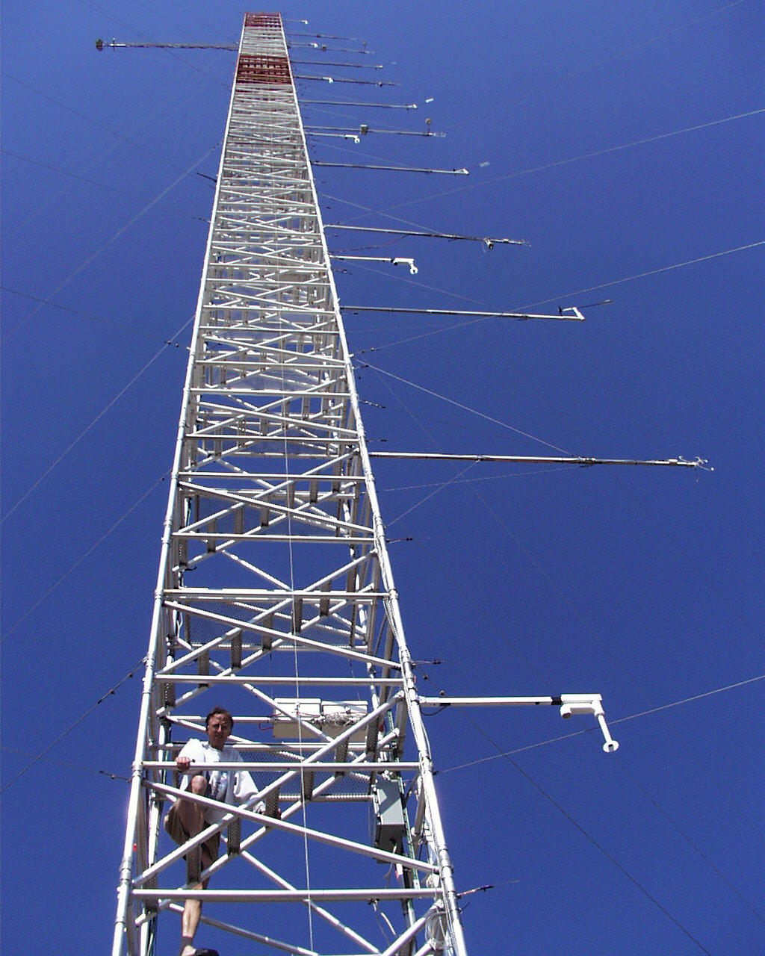
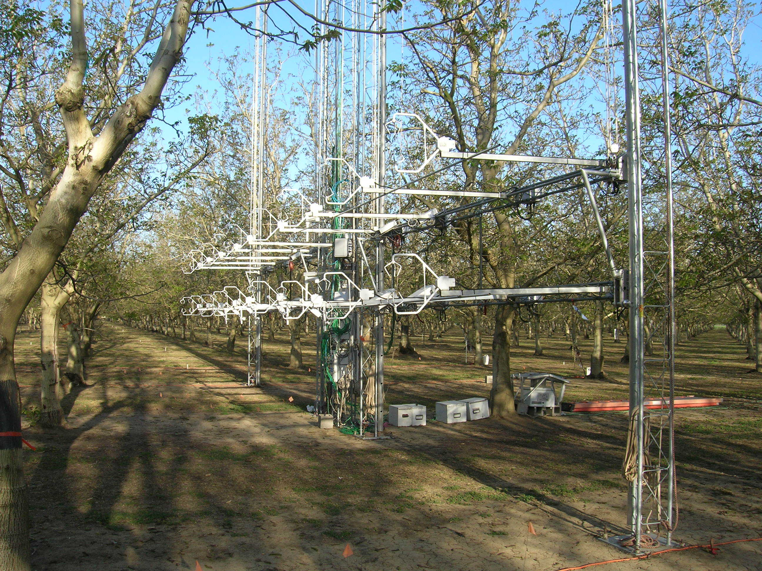
Integrated Surface Flux System
... and/or as a dense array of sensors in a single location for an intensive micrometeorological study

Slide 11
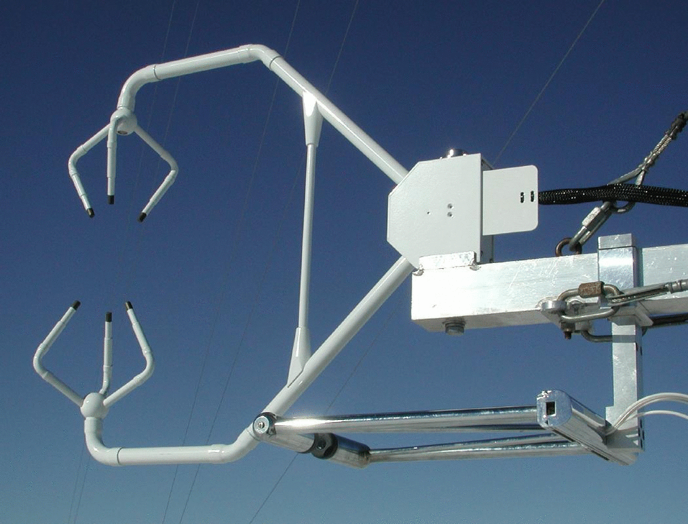
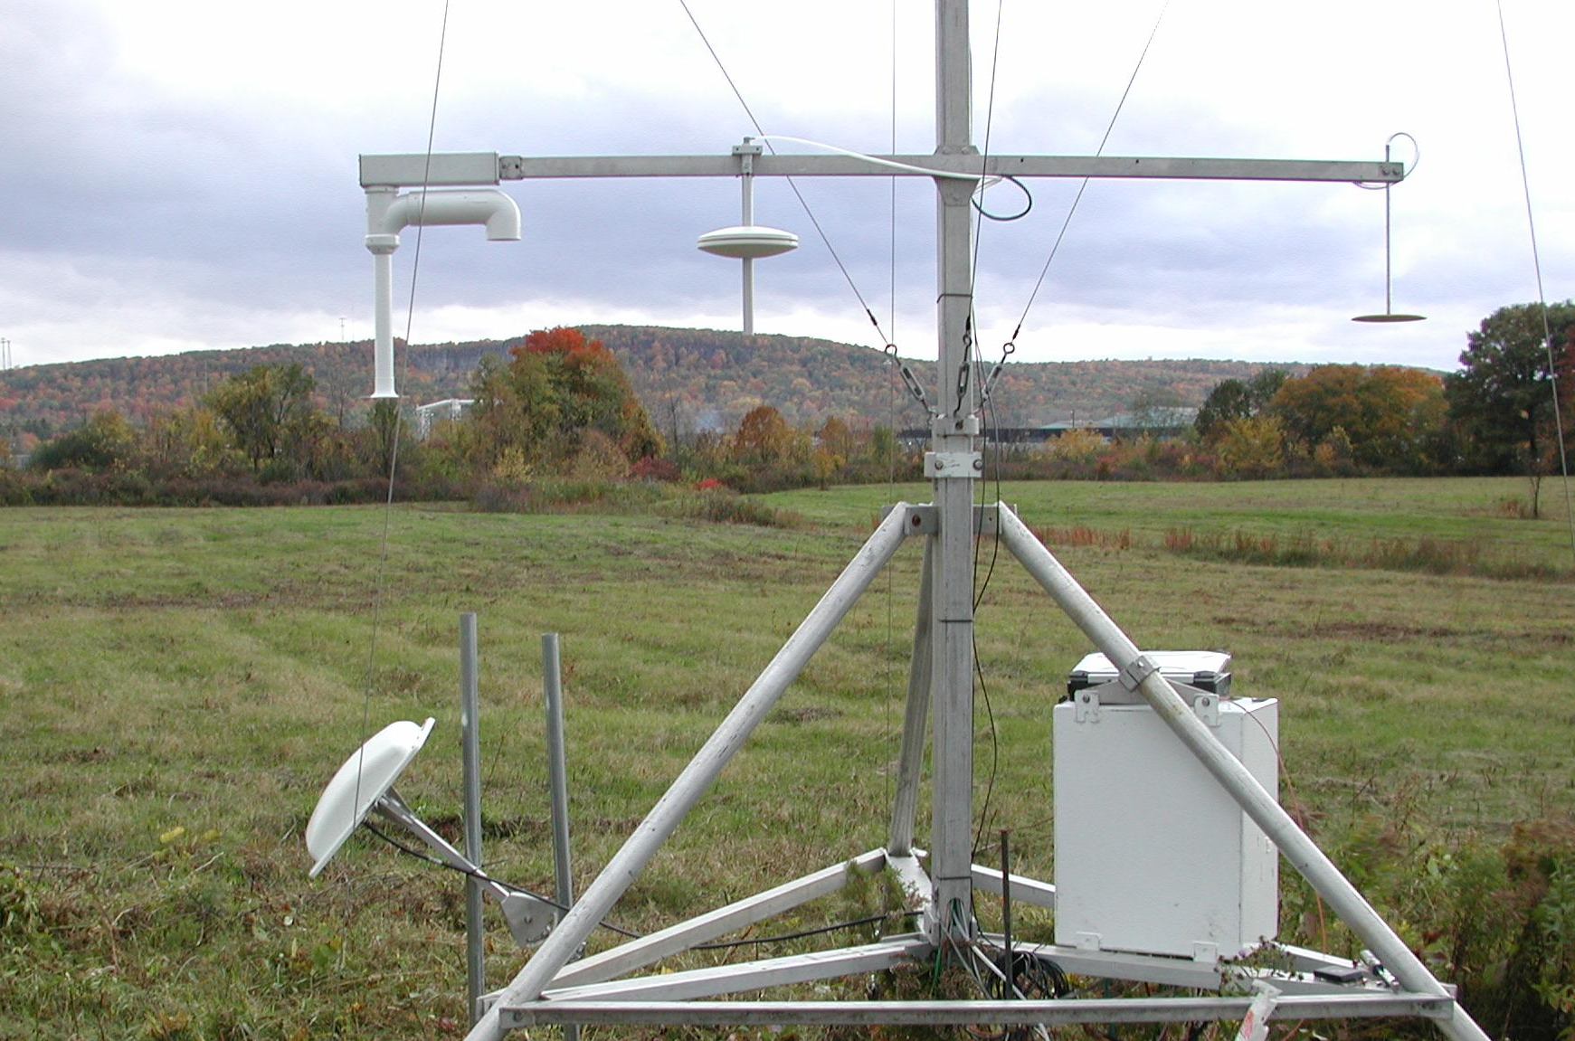
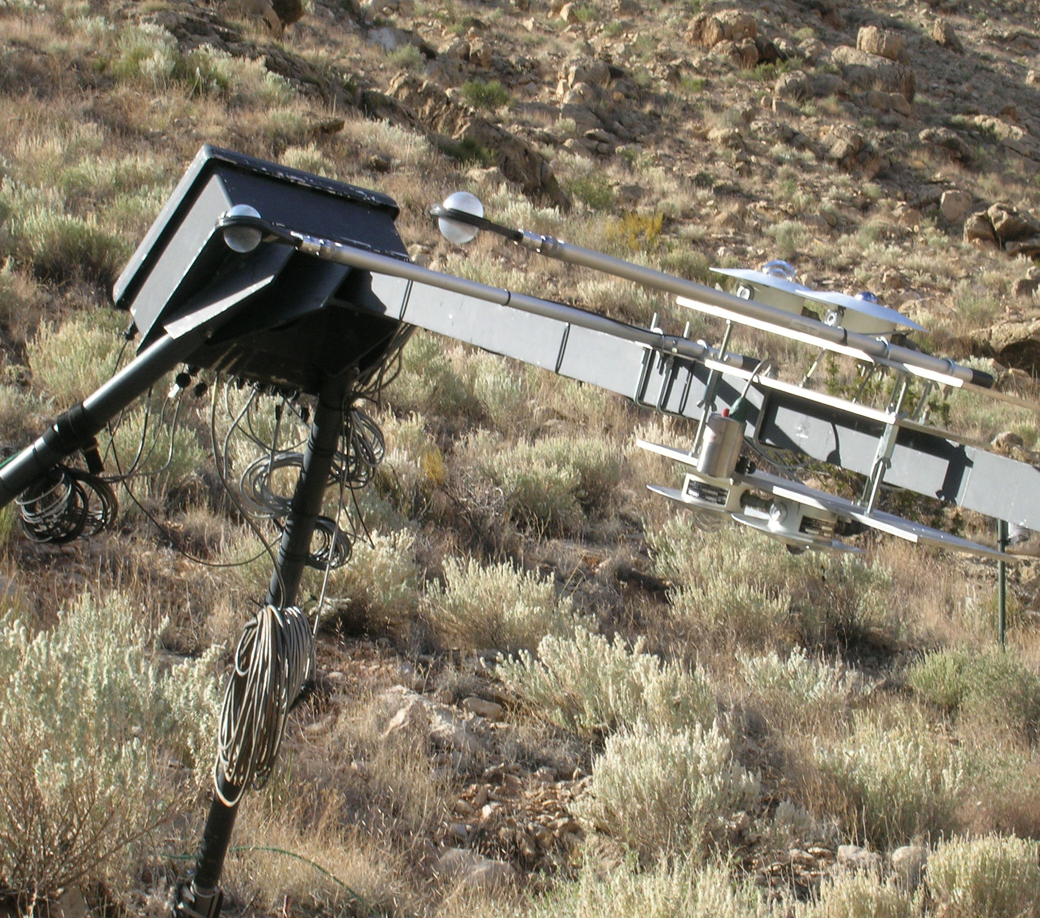
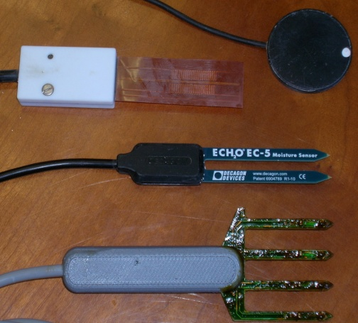
ISFS Measurement Capabilities

Slide 12
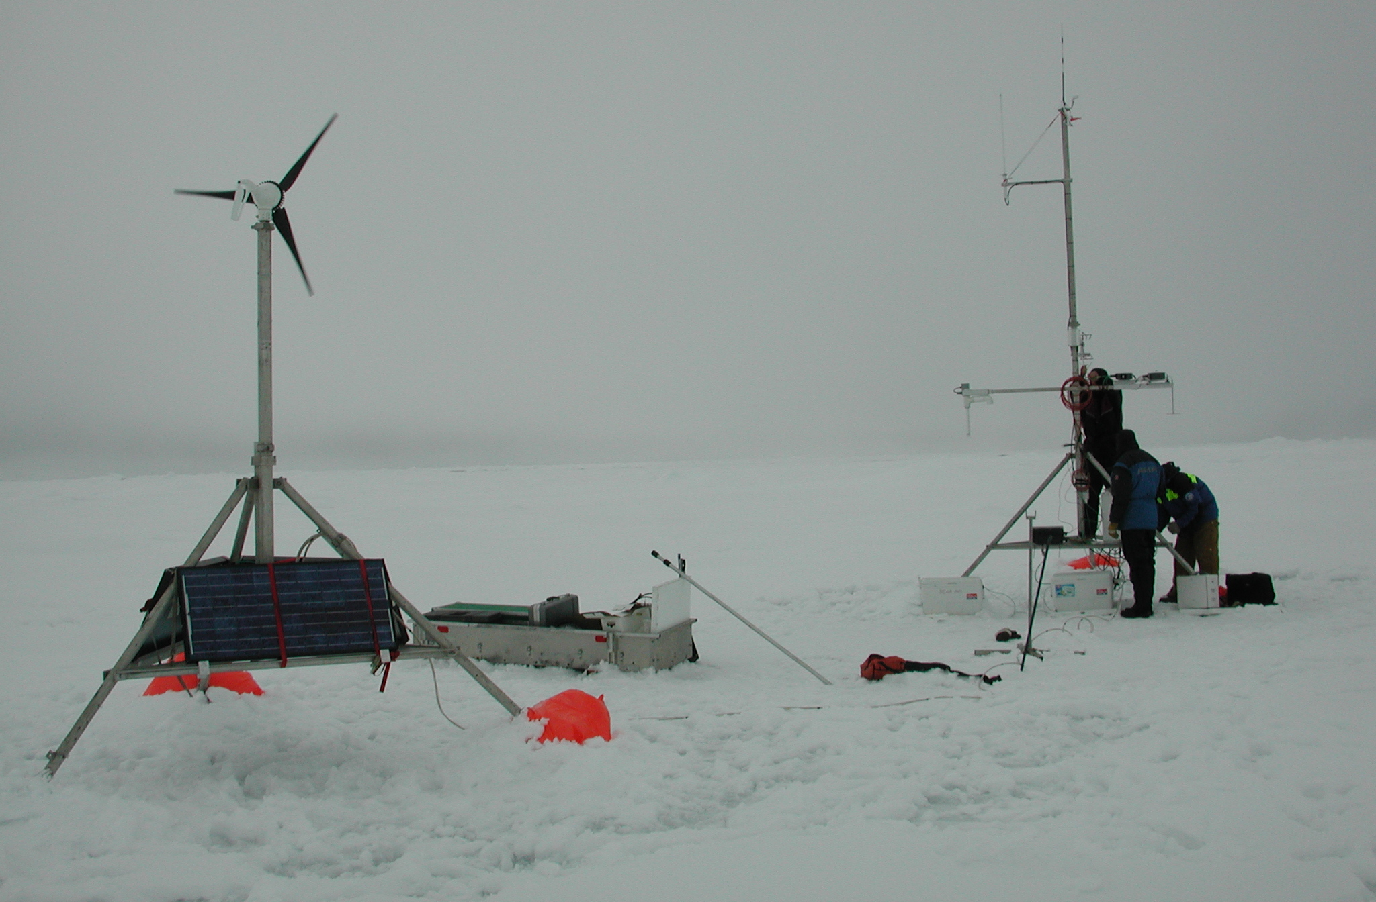
ISFS Logistics
AC line power distribution to 2 km
Off-grid: Solar, wind, (hydrogen fuel cell)
Tripod, triangular, scaffolding towers up to 45m (also have used user-supplied towers)
Field office/laboratory trailer

Slide 13
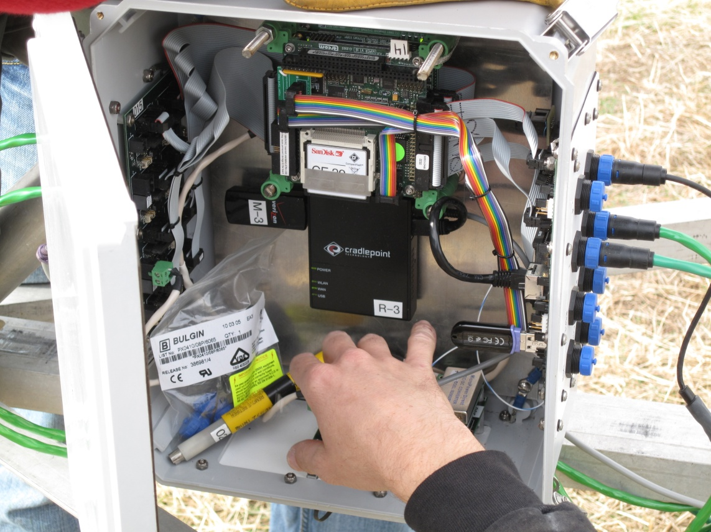
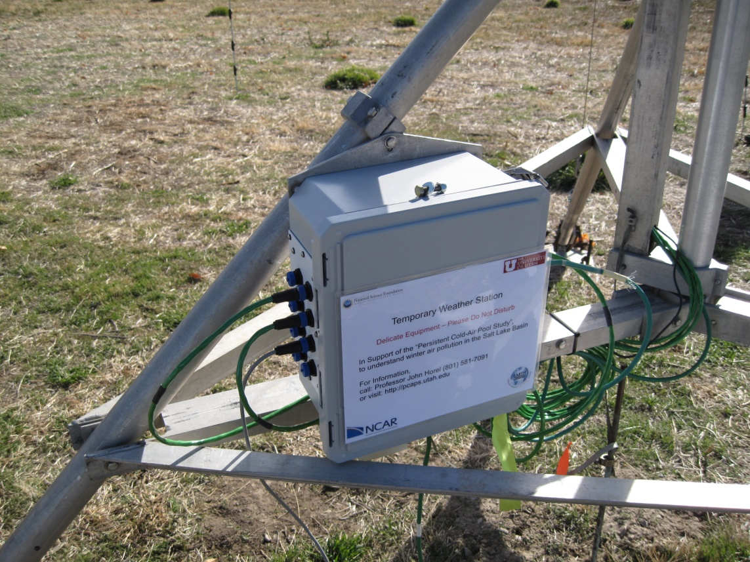
ISFS Data System – DSM
Linux
Low power (12 VDC, 5 watts) based on commercial-off-the-shelf electronics
Save every sample with μs timestamp (GPS/network-based)
Ethernet (wired/wireless/cell) for real-time monitoring/control world-wide
Serial ports/USB
Upgradable/Expandable
Extended temperature range (-40C to 50C)
Front panels with surge suppression/power control

Slide 14
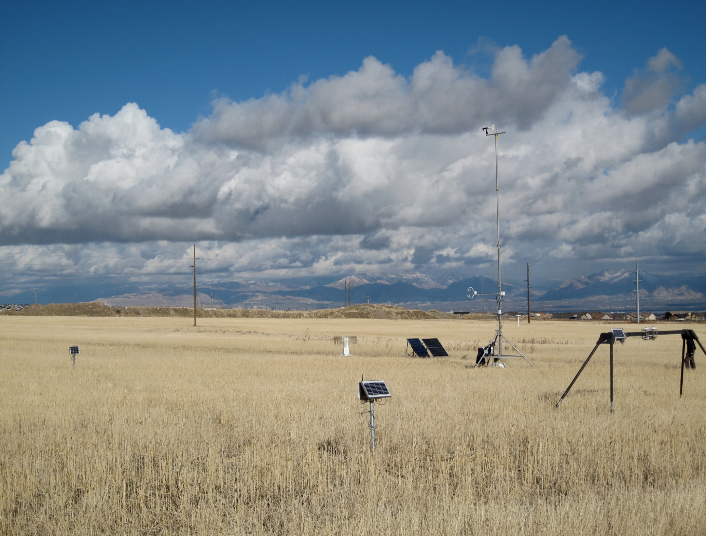
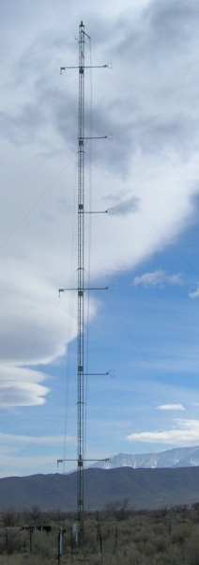
100 Measurement locations (CentNet)
Disciplines Supported:
Mesoscale Meteorology
Biogeosciences
(Climate Processes)
Hydrology
Urban Meteorology
Wind Energy
Polar Meteorology
20, 5-level Towers
-or-
100 Surface Flux Stations
Observations of:
Meteorology
Surface Energy Fluxes
Atmospheric Composition
Surface Characteristics
Notes:
New plan: users need greater spatial sampling
still intens/extens modes
disciplines supported

Slide 15
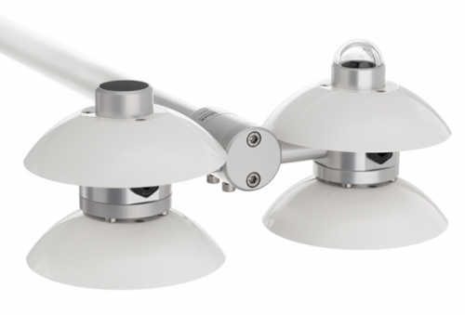
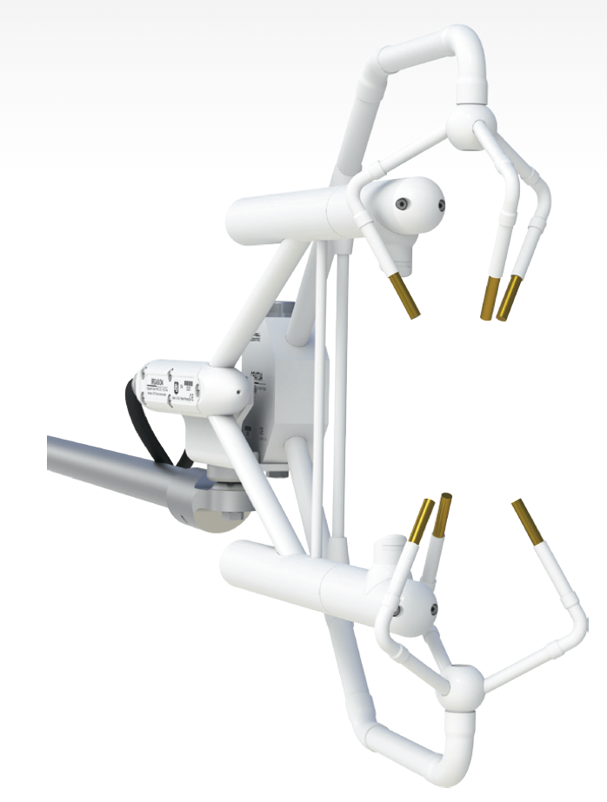
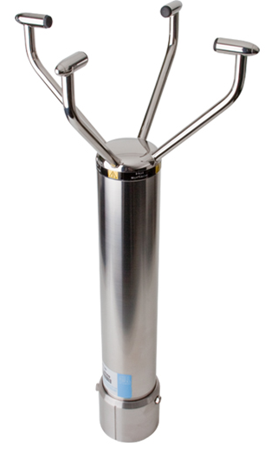
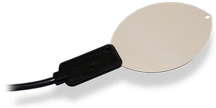
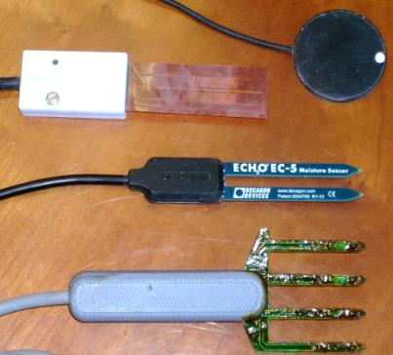
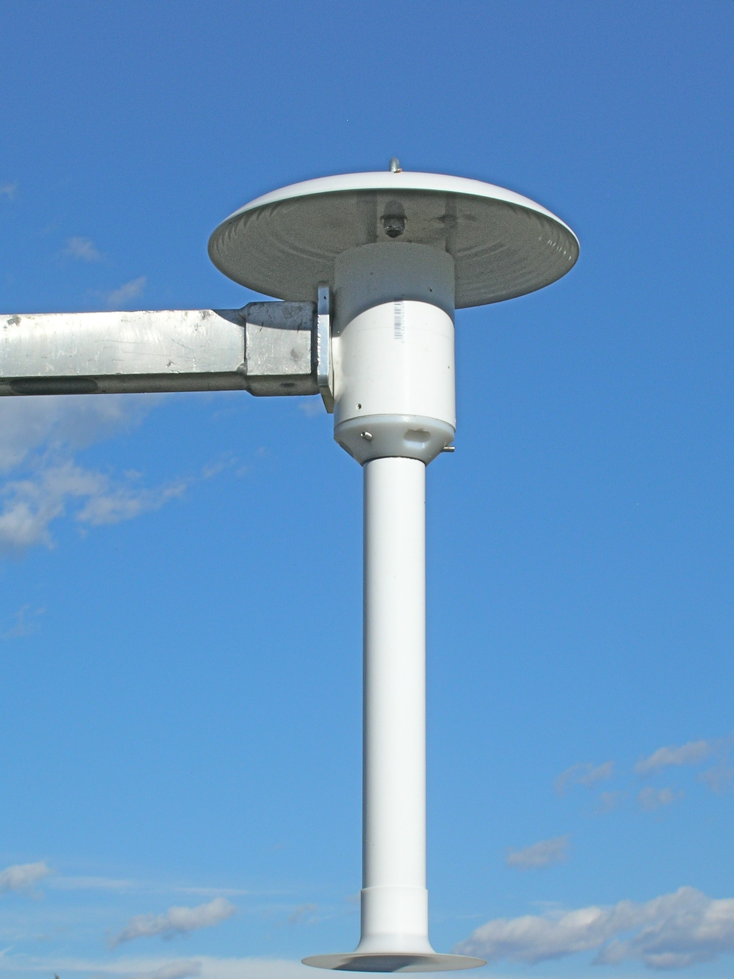
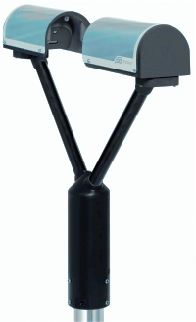
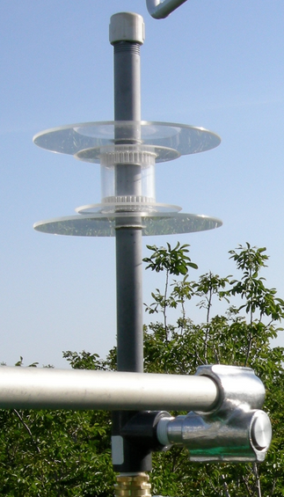
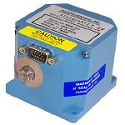
CentNet: Core Sensor Selection
Fluxes/Turbulence:
3-Component Sonic Anemometer with Infrared CO₂/H₂O Gas Analyzer
Meteorology:
2-Component Sonic Anemometer
(with heating)
Data Quality:
Wetness Sensor
Radiative Forcing:
4-Component
Integrated Radiometer
All-Season Precip.:
Optical Distrometer
Meteorology/Turbulence:
Absolute Nanobarometer
Fluxes/Hydrology:
Soil Thermal Properties
and Moisture
Meteorology:
Temperature/Humidity

Slide 16
CentNet Budget
Total need: $7M
$1.2M NSF MRI
+$0.5M NEWA
=$1.7M (25%)

Slide 17
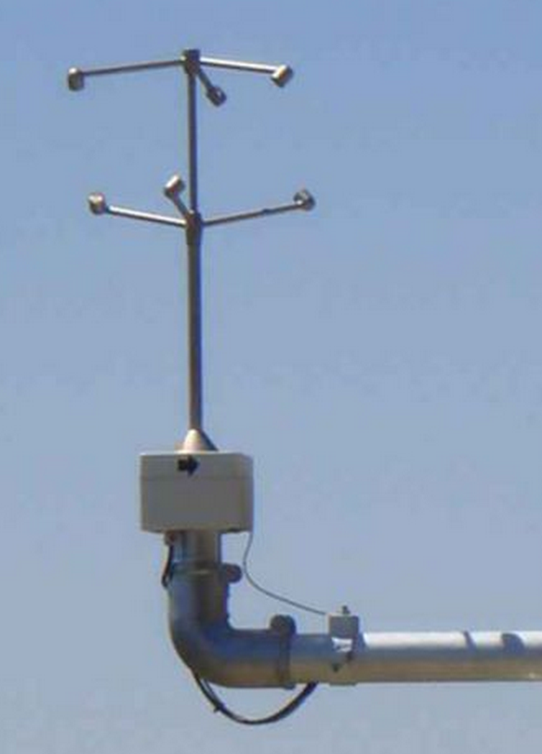
In Situ Resources:
ISFS: ~10 EBS + 15 3D Sonics
w/NEWA+MRI: + 10 EBS +60 Sonics
DTU: 50 3D Sonics
UND:?
Others:?

Slide 18
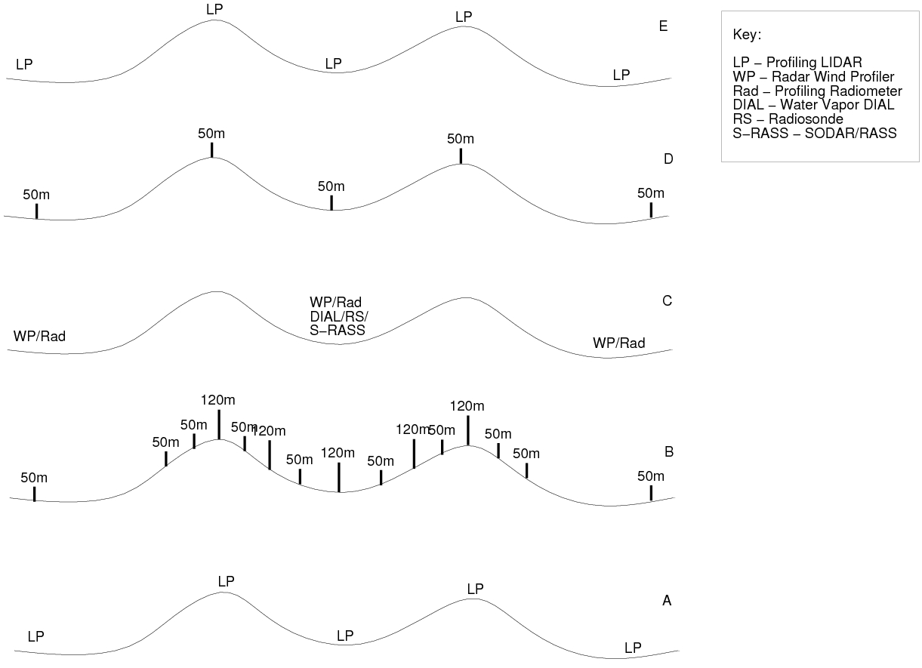

Slide 19
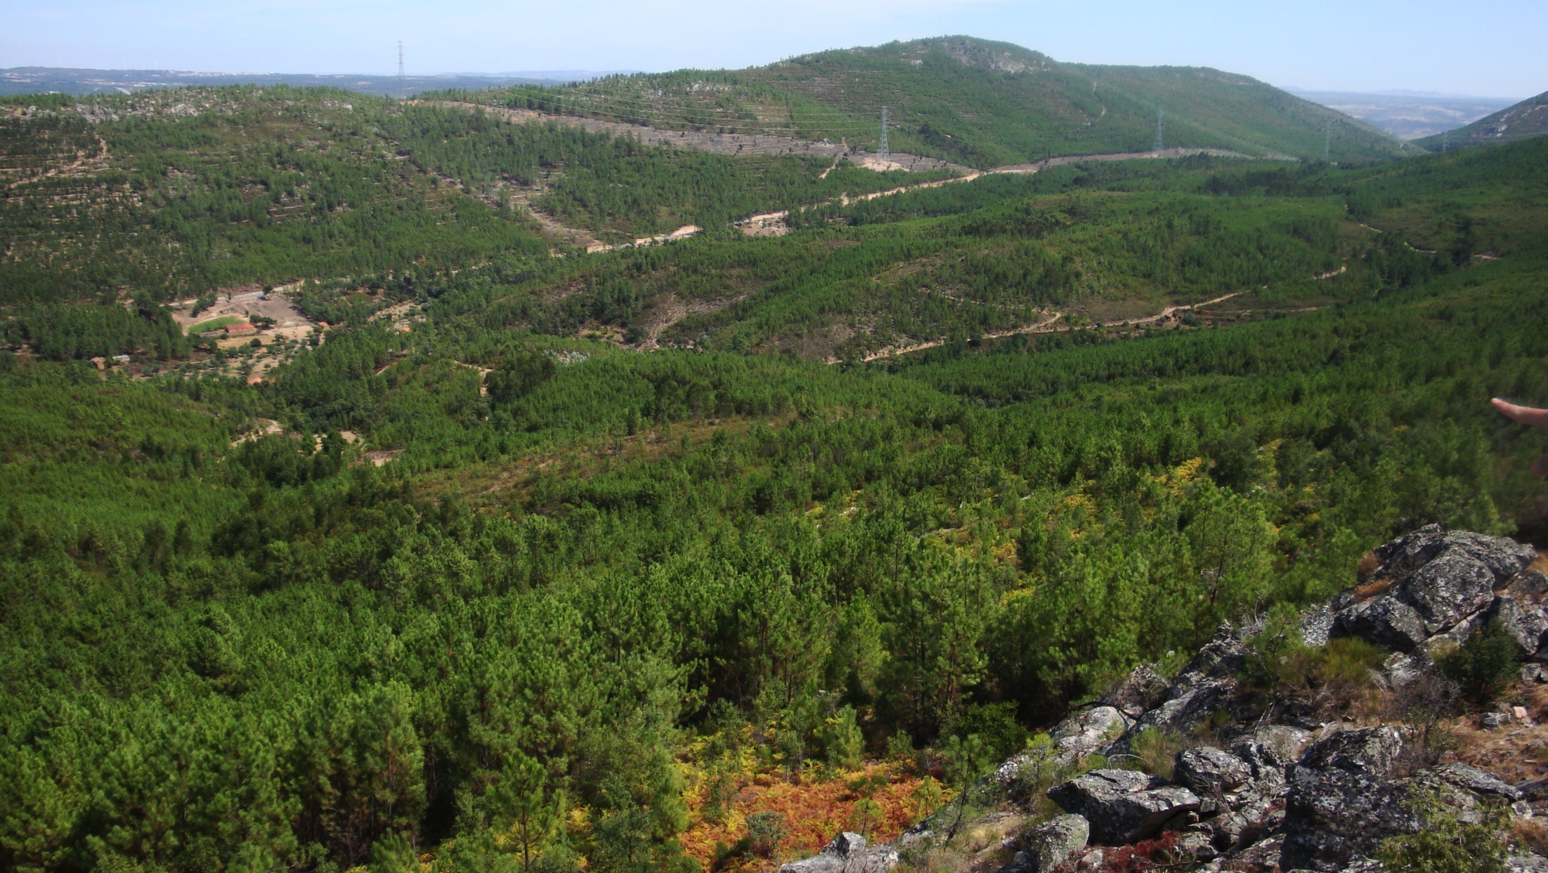

Slide 20
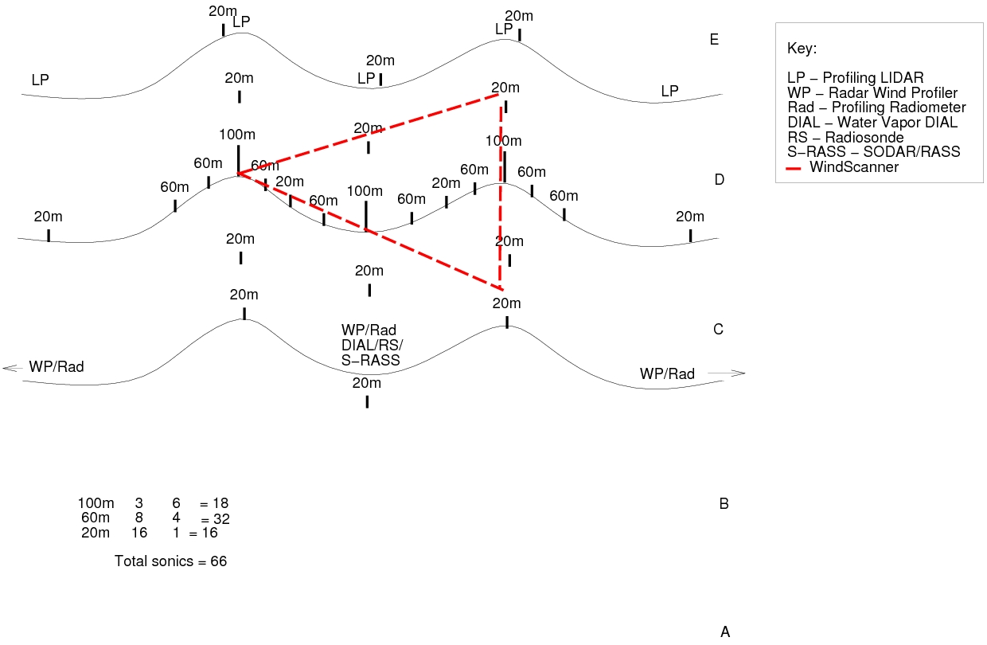

Slide 21
Key questions: (save for Friday discussion?)
What resources will be available (from NEWA partners and us)?
Where/how will these resources be deployed?
Are IOPs needed? If so, when, what duration, how many?
UAV operations
Soundings
Change of Windscanner locations (short-range?)
Mapping of resources to science questions.

Slide 22
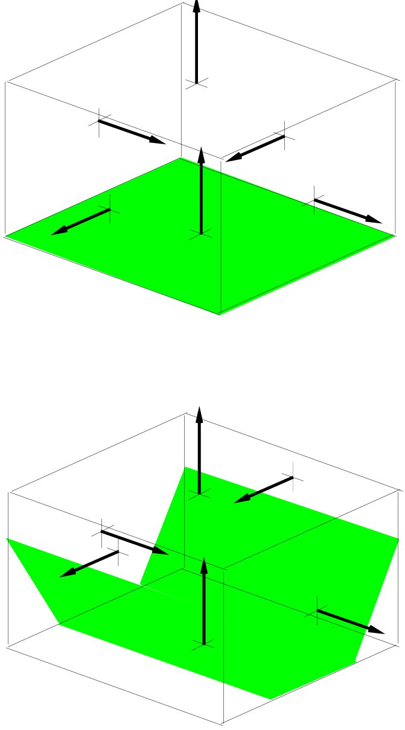
H₂O/CO₂ Budget Study
(won’t have sensors for mean CO₂, CO₂ in water)
bottom = top – sides – storage (air/canopy/surface)
bottom: surface flux, eddy-covariance towers near
ground, rain gauges, tree throughfall/stemflow
top: eddy-covariance fluxes; mean vertical advection;
tall towers, UAV H₂O/CO₂, lidar winds
sides: eddy-covariance?; horizontal advection; tall
towers, UAV, lidar, sodar/profiler
storage (air): tall towers, UAV
storage (canopy/surface): manual soil sampling, farm
productivity records, stream gauges.
Perdigão is great site, though have to deal with:
Dominate flow is cross-valley, with large gradients
at least at ridges
Seasonal stream drainage
Power transmission line data gaps
(Still) only representational surface coverage (enough?)
Collaboration with Tomas de Figueiredo (IPB) can
supply surface/subsurface water data

Slide 23
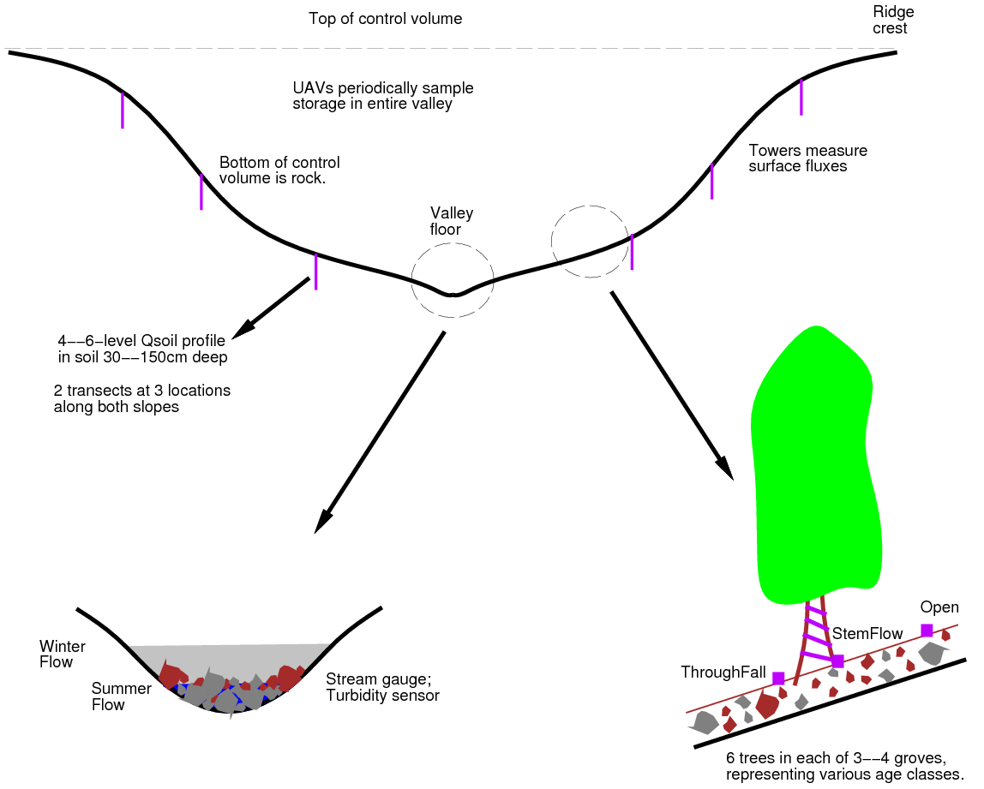

Slide 24
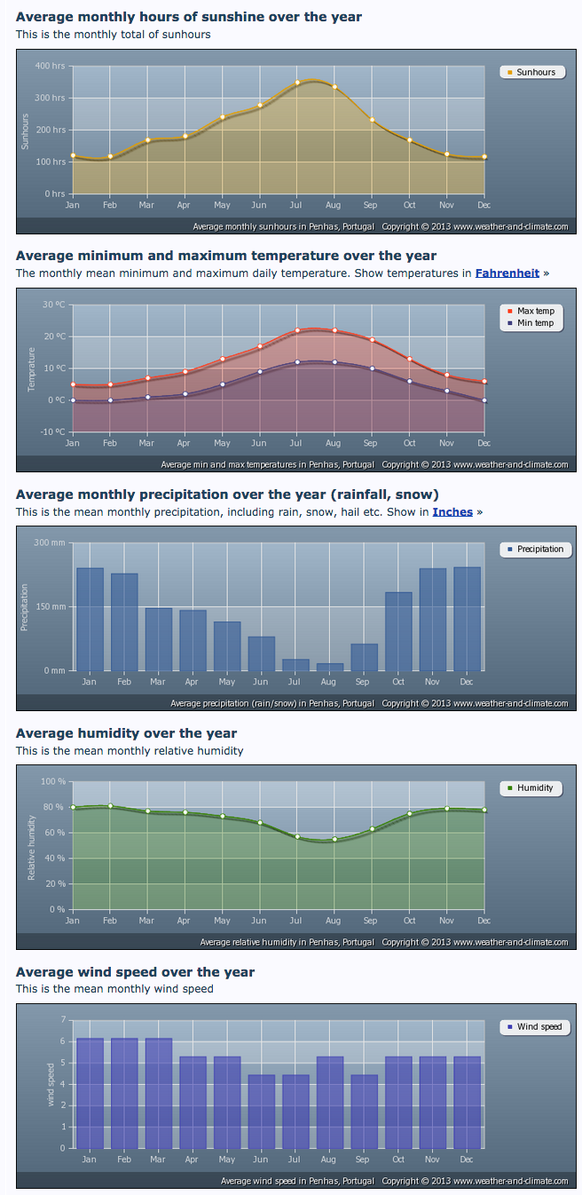
Penhas (60km N)

Slide 25
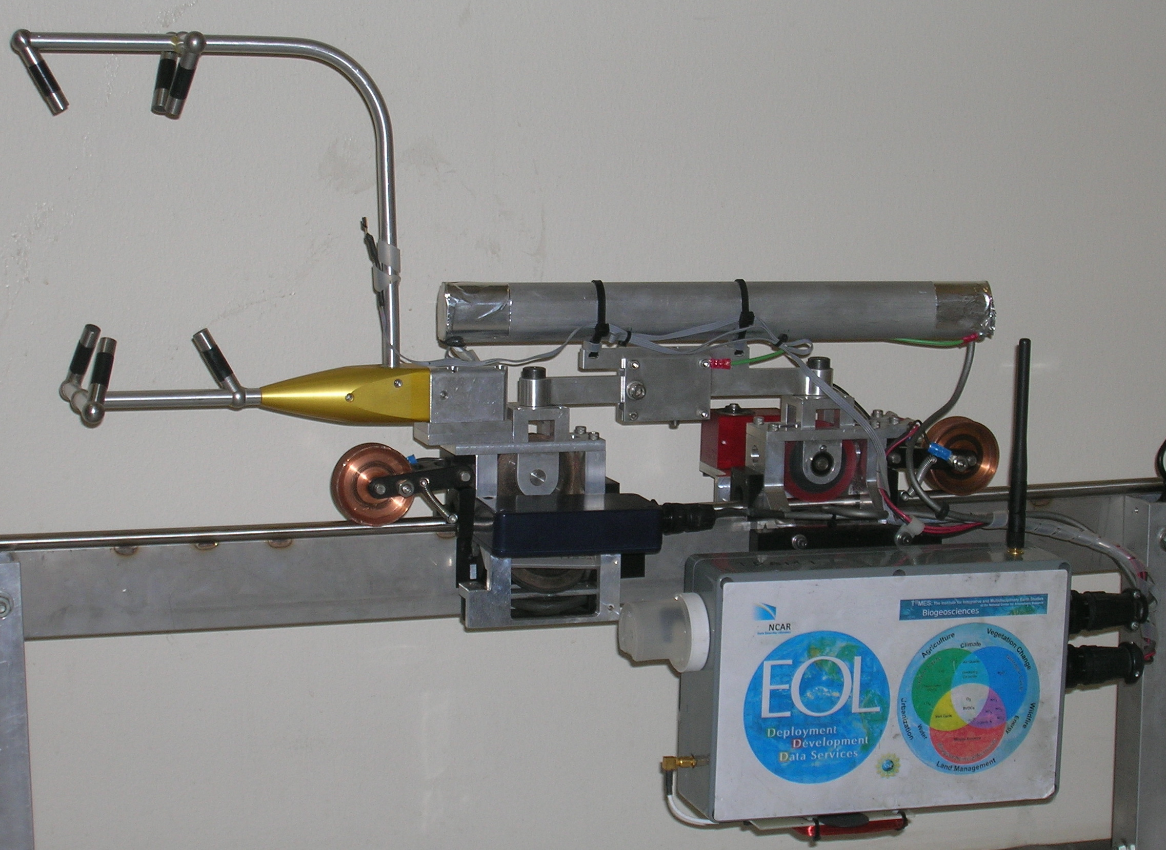
TRAnsect Measurement (TRAM) System
SPECIFICATIONS (most are flexible):
Track: up to several km loop
Trolley speed: 2-10 m/s
Number of sensor packages: several
Instrumentation payload: several kg
Payload power: <100W at 20-40VDC
RF Modem (2.4 GHz) to transmit data/receive commands
Multiple trolleys could increase sampling
SENSORS:
Sonic Anemometer/thermometer
Temperature/Humidity
CO₂ IRGA
Housekeeping: GPS; 3-axis
Flux-gate compass; RFID position
Downward PAR

Slide 26
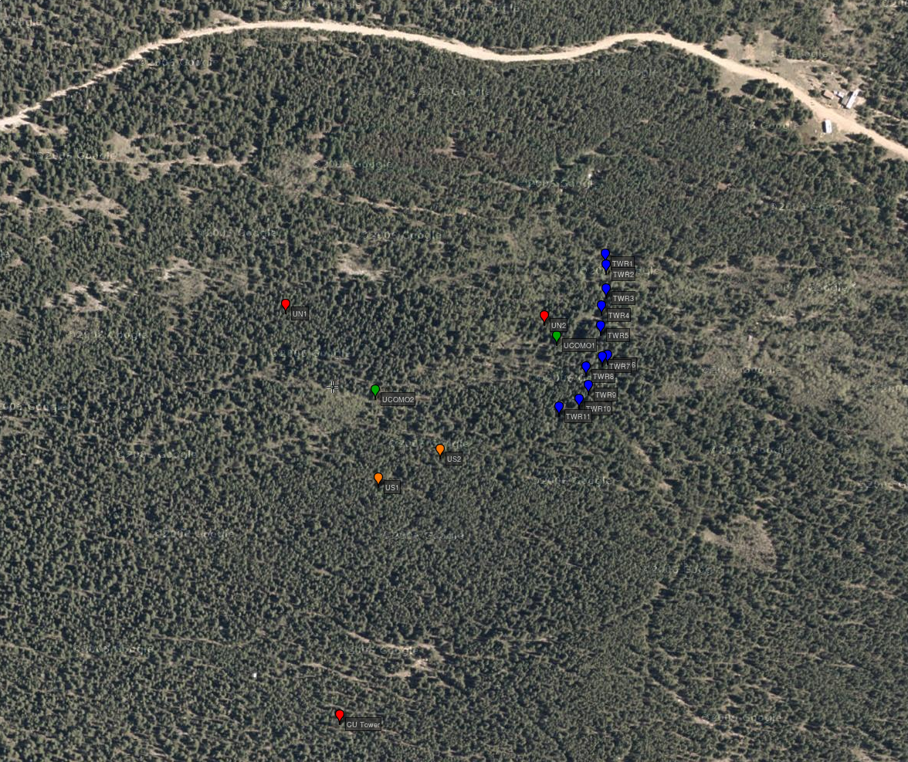
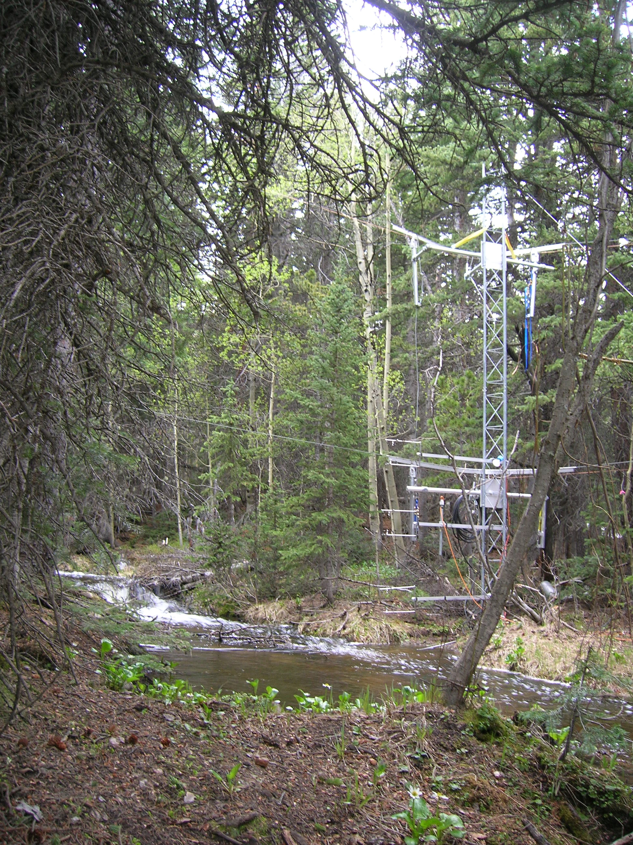
TRAM at NIWOT07
(Niwot Ridge FluxNet site, Colorado)
CUFF
Describe other meas...

Slide 27
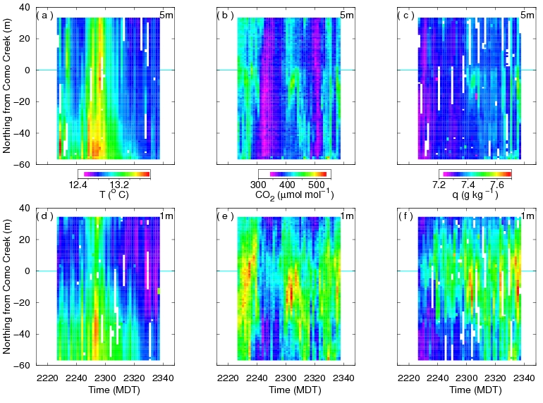

Slide 28
ISFS Measurement Capabilities
Turbulent Fluxes
Momentum
Sensible and Latent Heat
Carbon dioxide
Trace species (with user-provided scalar sensors)

Slide 29
ISFS Measurement Capabilities
Surface Meteorology
10m Wind speed and direction
2m Temperature and relative humidity
Pressure
Precipitation

Slide 30
ISFS Measurement Capabilities
Radiation
Broad-band shortwave
Broad-band longwave
Net
PAR
IR surface temperature

Slide 31
ISFS Measurement Capabilities
Soil
Temperature
Moisture
Heat flux
Heat capacity

Slide 32
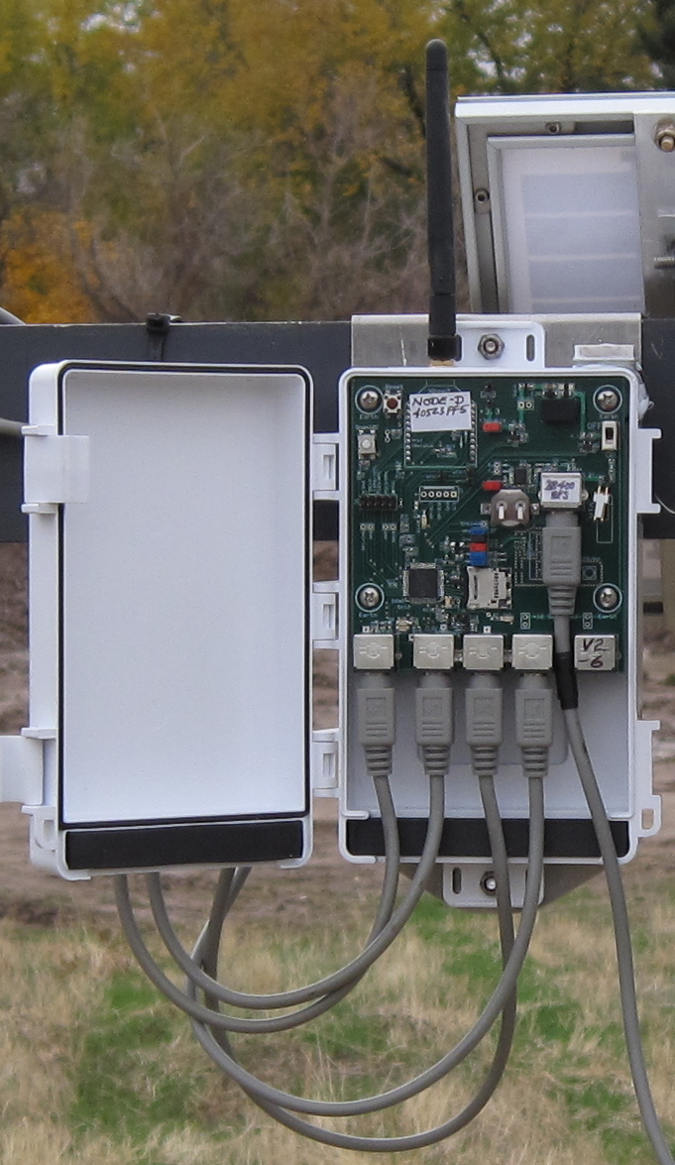
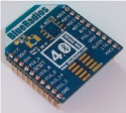
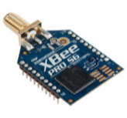
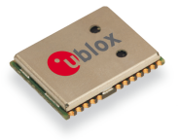
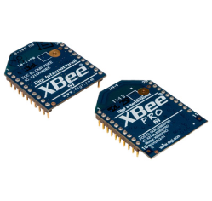
Mote
Microchip16-bit Processor
I2C / RS232
5 Intelligent Sensors
Status / Auto-Sleep
Local Storage
6-months
Communications
Bluetooth
Serial Port
Command Control
Long-Range Radio
DSM Interface
WiFi
GPS
Date-Time Stamp / Location
Deep Sleep
mesh
Zigbee
Power
4 -28 VDC
Solar / Battery: 3+ weeks
Notes:
RF options
GPS timetagging

Slide 33
Data Products
On EOL WWW site (permanently):
Project documentation (site survey through QC processing), photos, etc.
Data overview plots (real-time through QC processing)
QC-d derived statistics (NetCDF)
Field logbook (Source now on NCAR Wiki)
On HPSS (permanently):
- Raw sensor data (NIDAS binary); Duplicate data sets kept until saved on HPSS
On EOL servers, available on demand:
Real-time derived statistics (NetCDF); Can delete once QC is done
QC-d time series (NetCDF); Could move to HPSS
Issues:
QC processing version tracking: Via subversion and manual WWW site entries
Data management plan/data and metadata tracking: TBD
World distribution (EMDAC, Earthcube, CDP, etc.): TBD

Slide 34
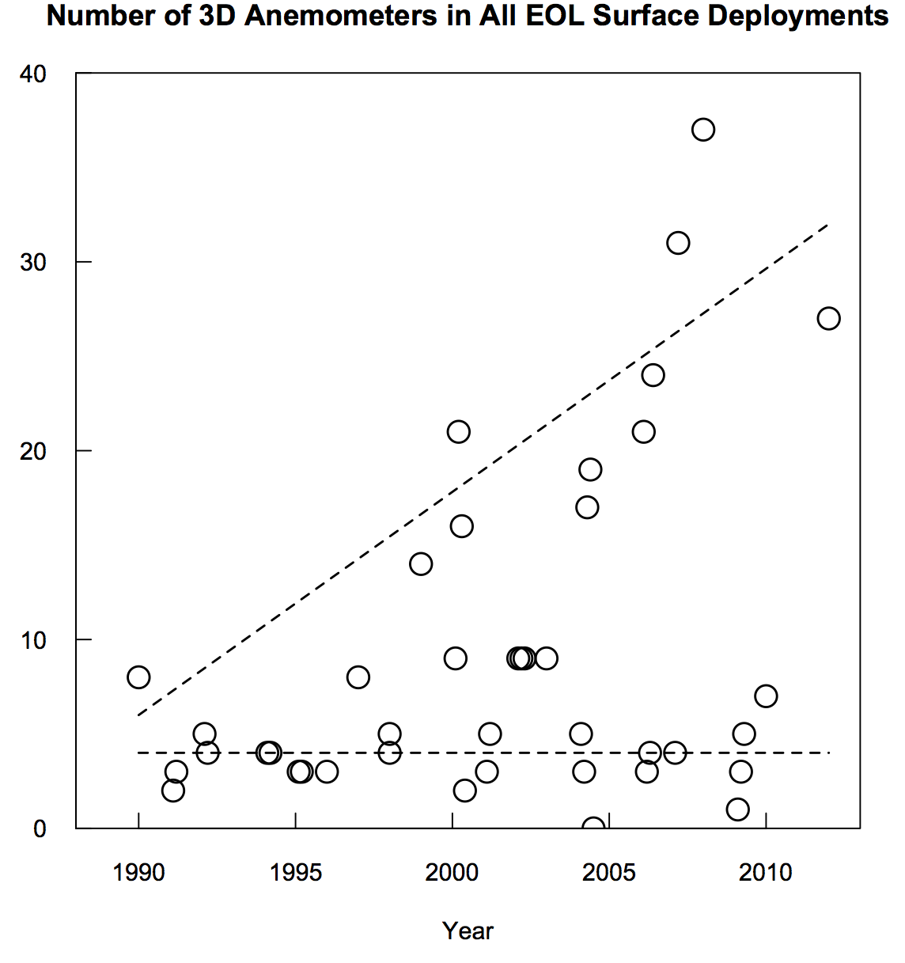
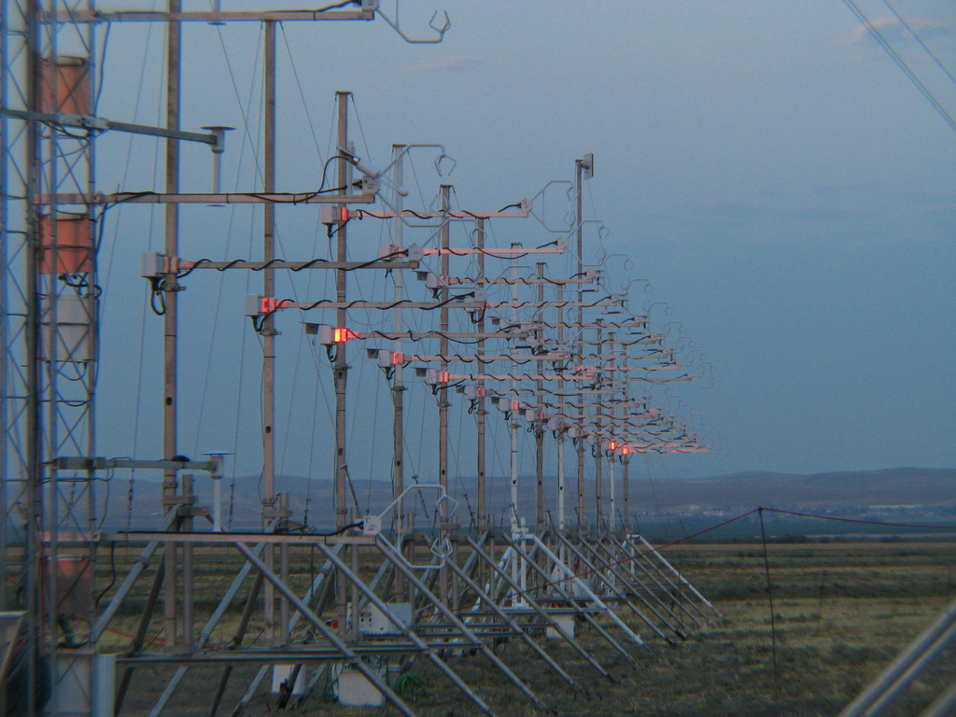
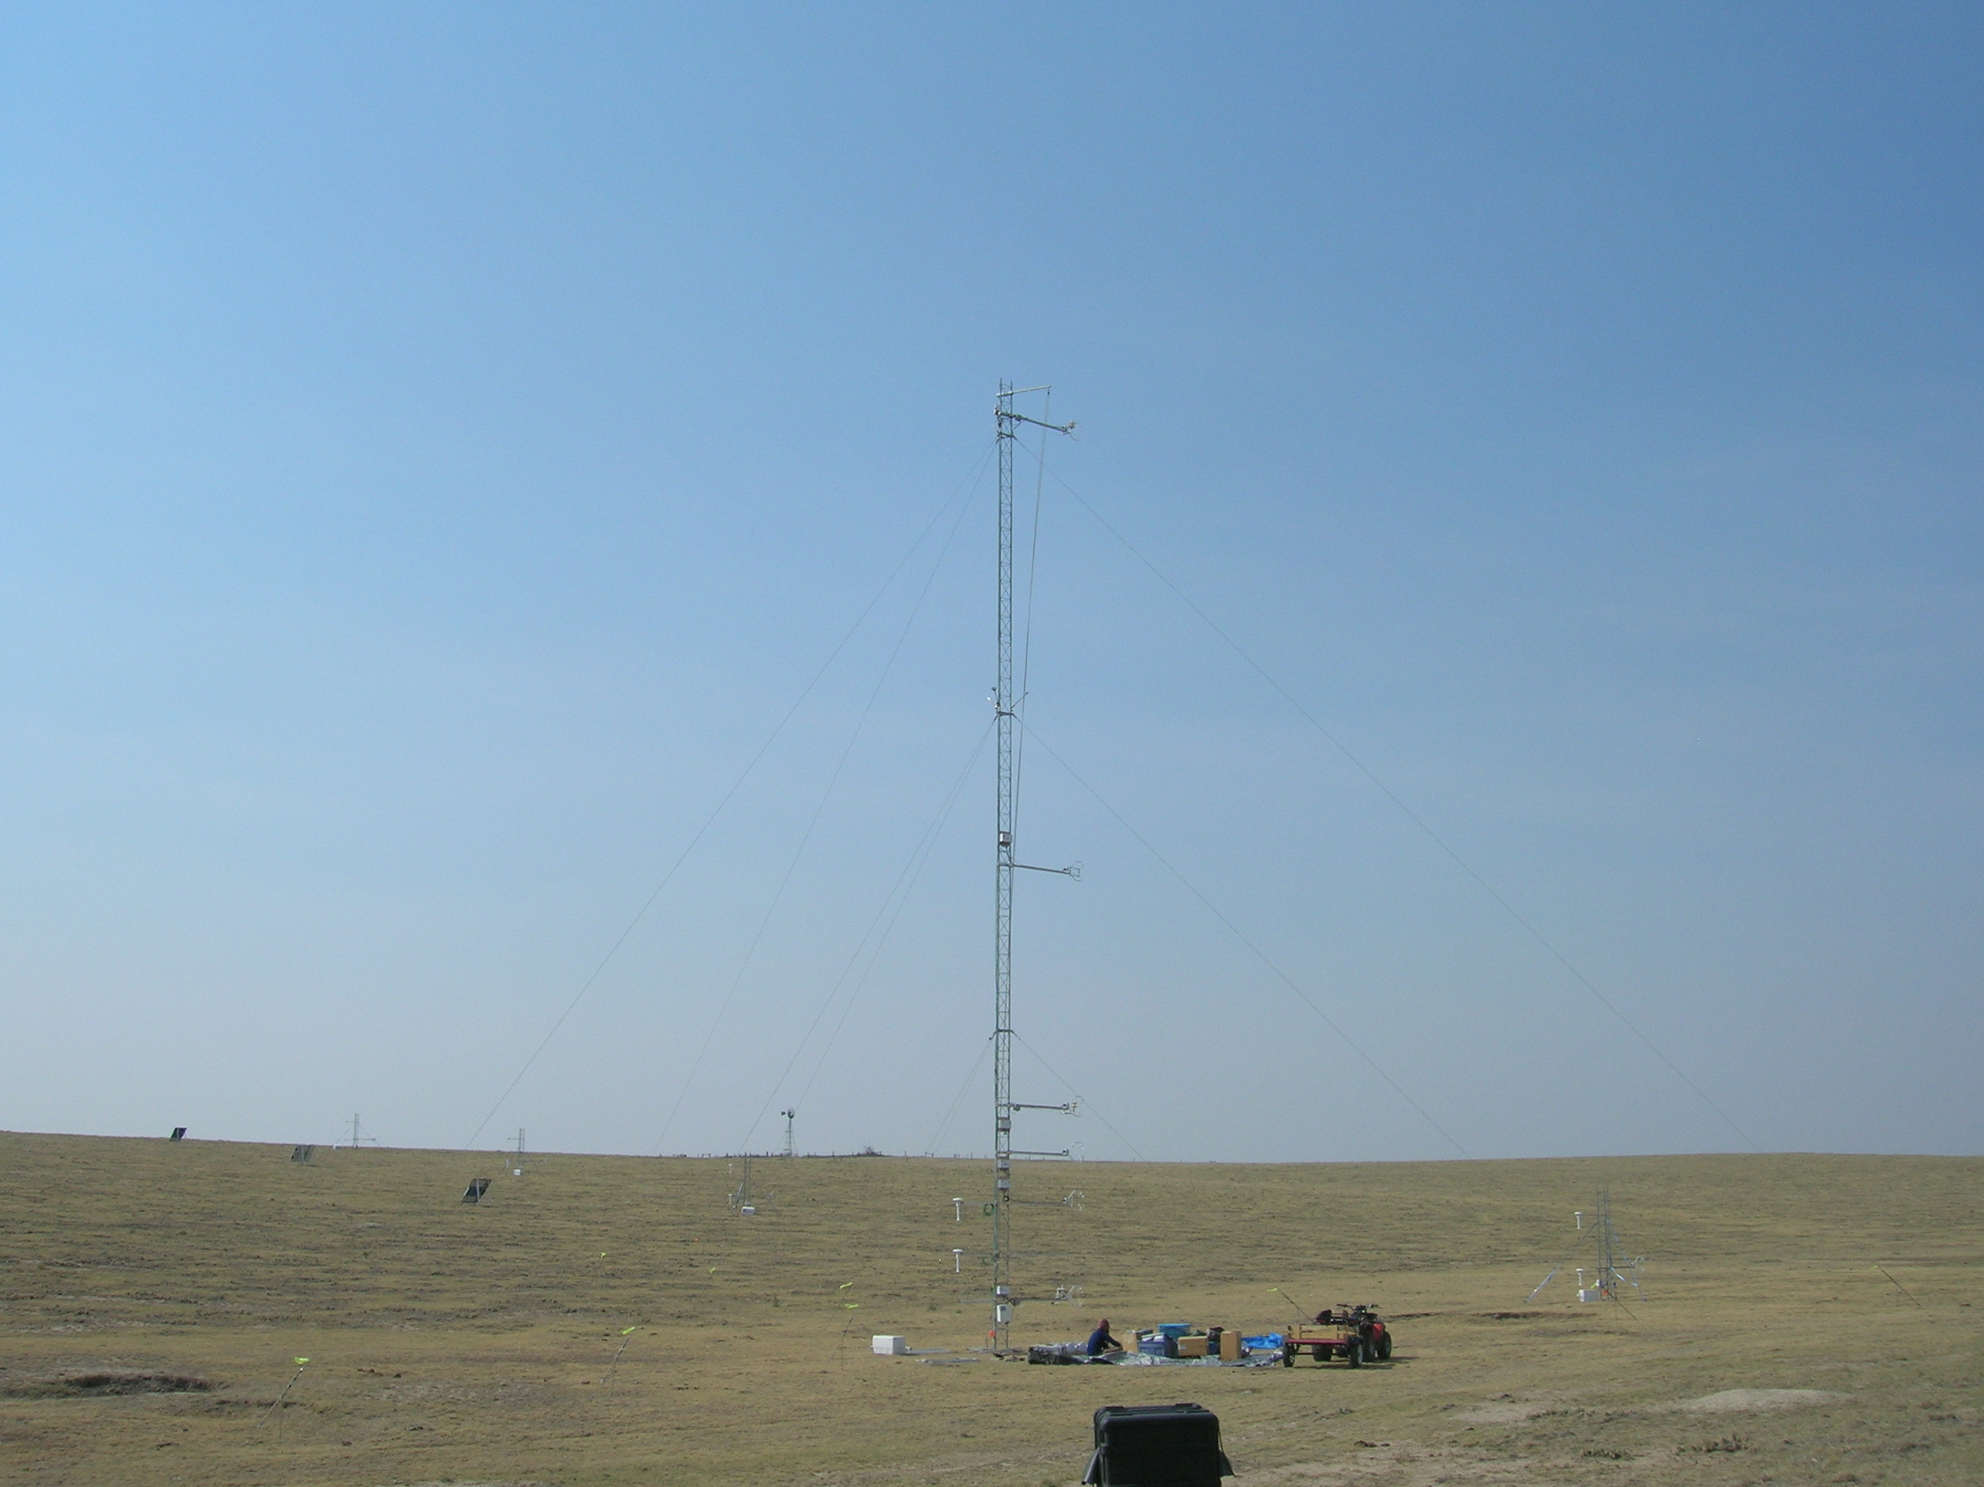
AHATS
SCP

Slide 35
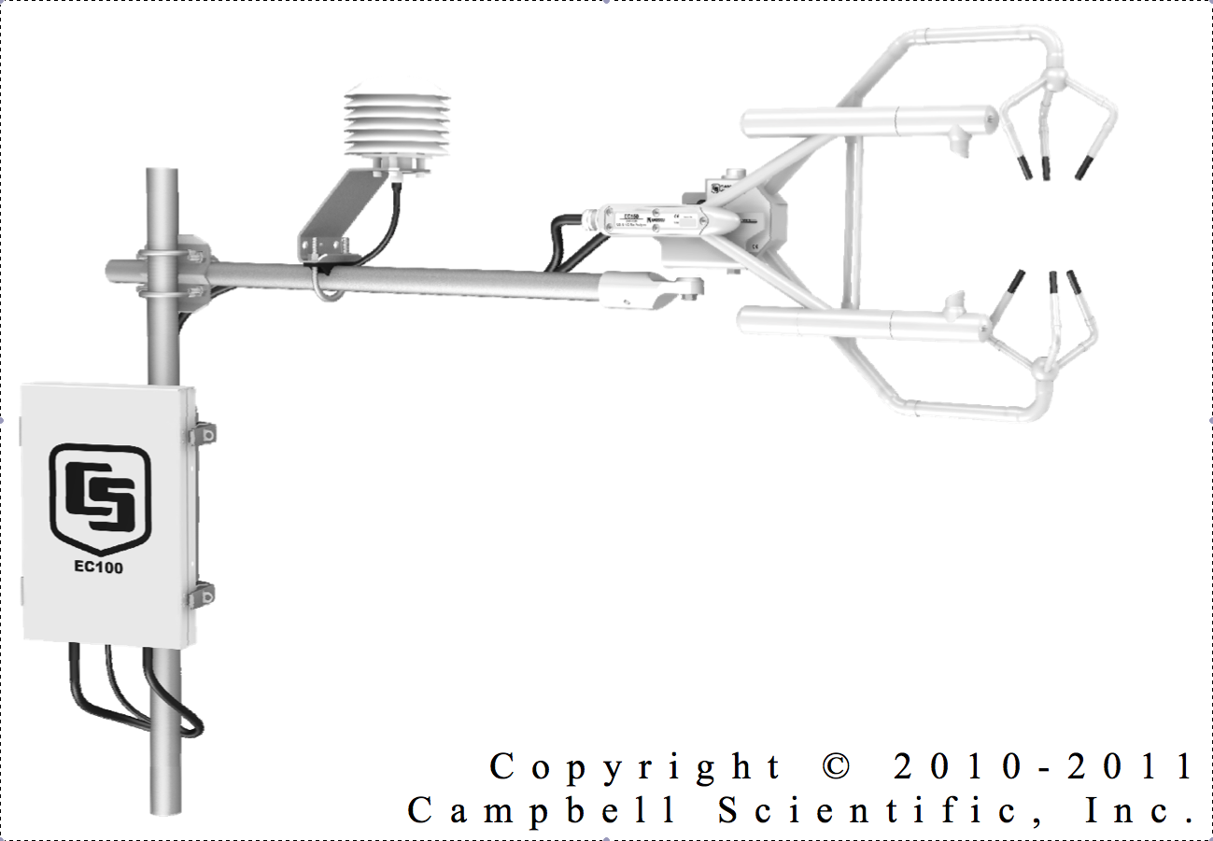
H₂O/CO₂ Fluctuations
Use with sonic anemometer to measure fluxes
Need to use open-path sensors to avoid gas handing
Power (with anemometer): 4W
100 samples/s

Slide 36
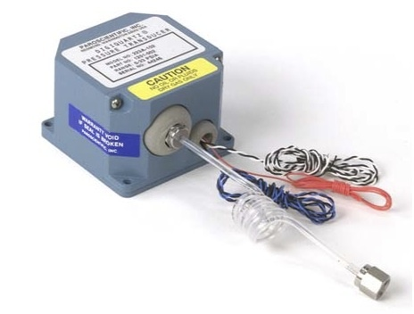
Nano-barometer
Phenomena:
Small gradients (with GPS height survey)
Gravity waves, especially nocturnal
Pressure transport terms in turbulence equations
Features:
Low power
Also absolute barometers ($5K vs. $1.5K)
Easily deployed
Use with quad-disk probe
to reduce dynamic errors
black – nanobarometer
cyan – PTB220
black – sonic anemometer

