Slide 1
Microscale modeling of winds over complex terrain using an immersed boundary method on GPU clusters
Inanc Senocak, Rey DeLeon, Clancy Umphrey, Micah Sandusky
High Performance Simulation Laboratory for Thermo-Fluids
Department of Mechanical & Biomedical Engineering
25 September 2014

Slide 2
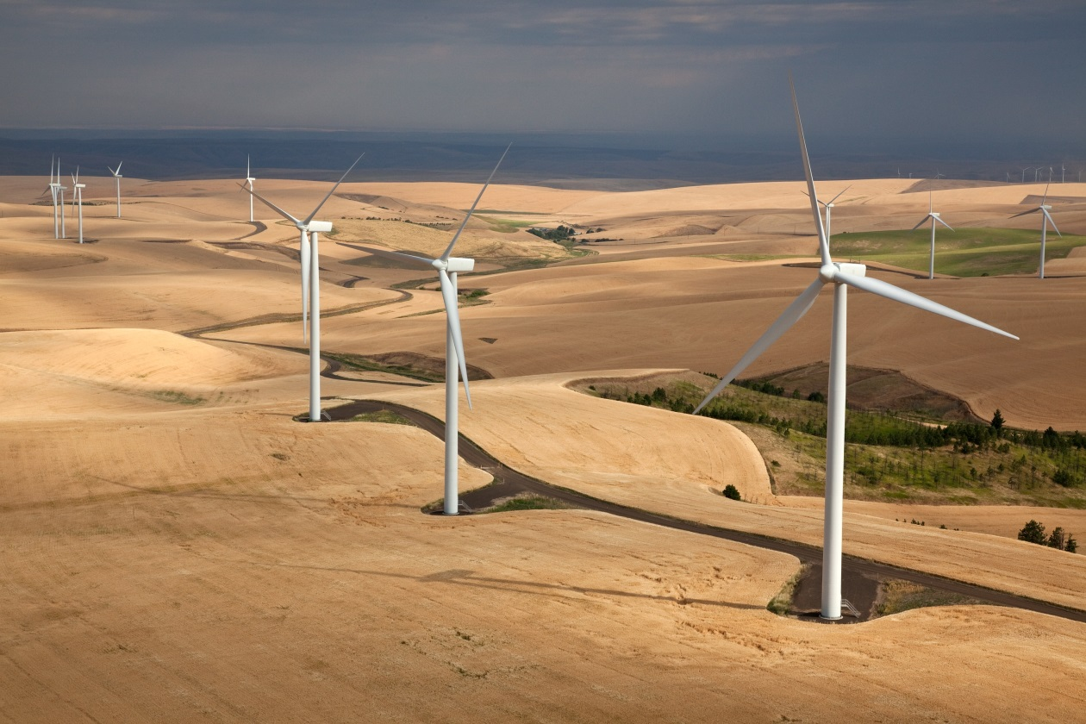
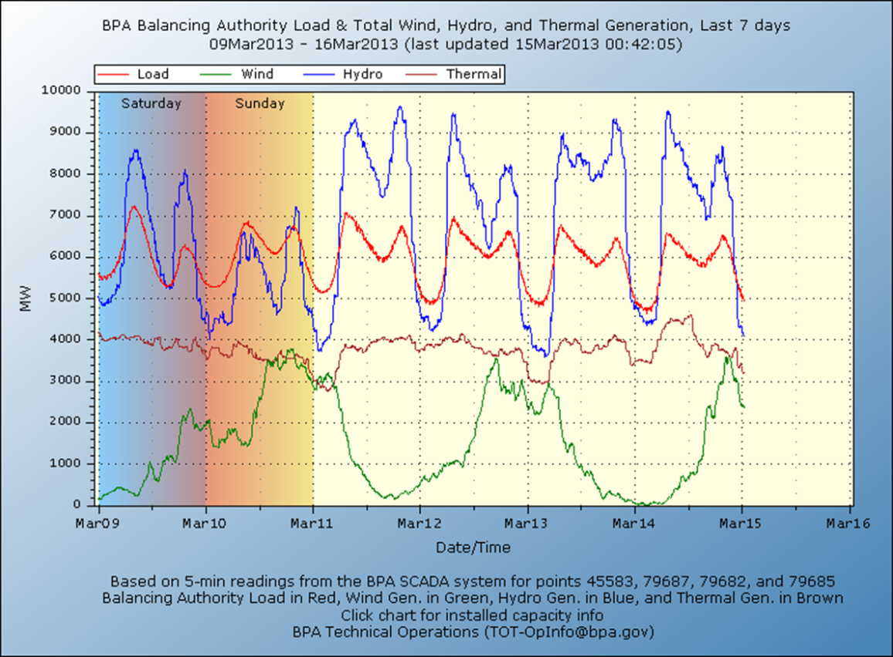
Applications
Forecasting to integrate/balance variable generation
Image Source: Jeffrey G. Katz, wikicommons
Source: Bonneville Power Administration
Notes:
So now I’ll present three applications where fast computations can make a real difference.
First one is forecasting to integrate and balance variable generation on the grid

Slide 3
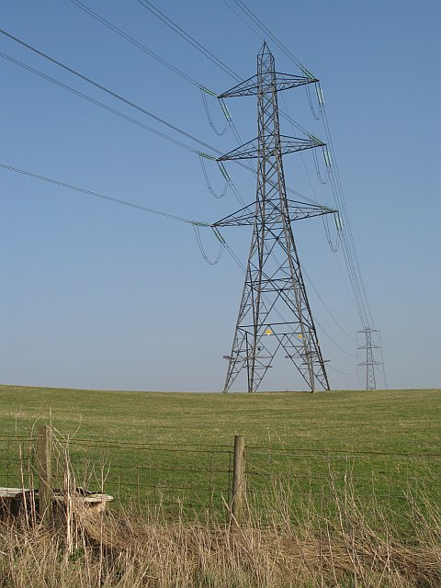


Potential Applications
Dynamic rating of transmission lines
Collaboration: Phil Anderson (IPCo), Kurt Myers & Jake Gentle (INL)
Image source: Richard Webb,
wikicommons

Slide 4
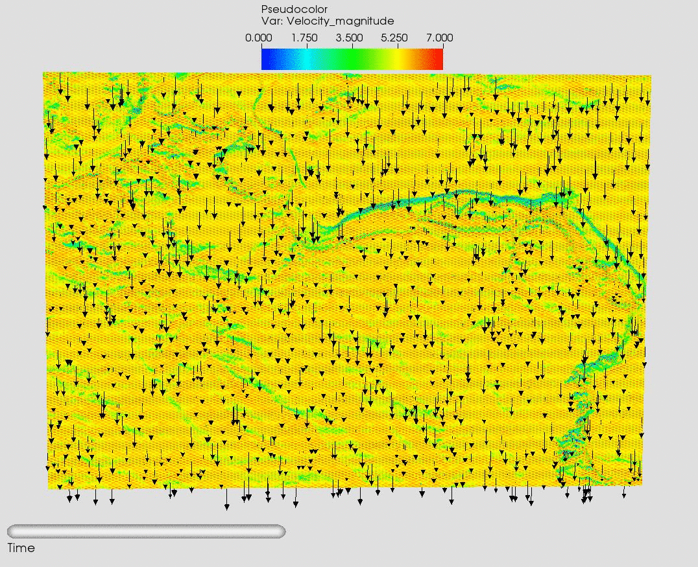

Microscale modeling with variable input
  4 K20 Tesla: RTF=0.49
  8 K20 Tesla: RTF=0.72
49km × 40km × 1.9km
  78m x 48 m x 10 m

Slide 5
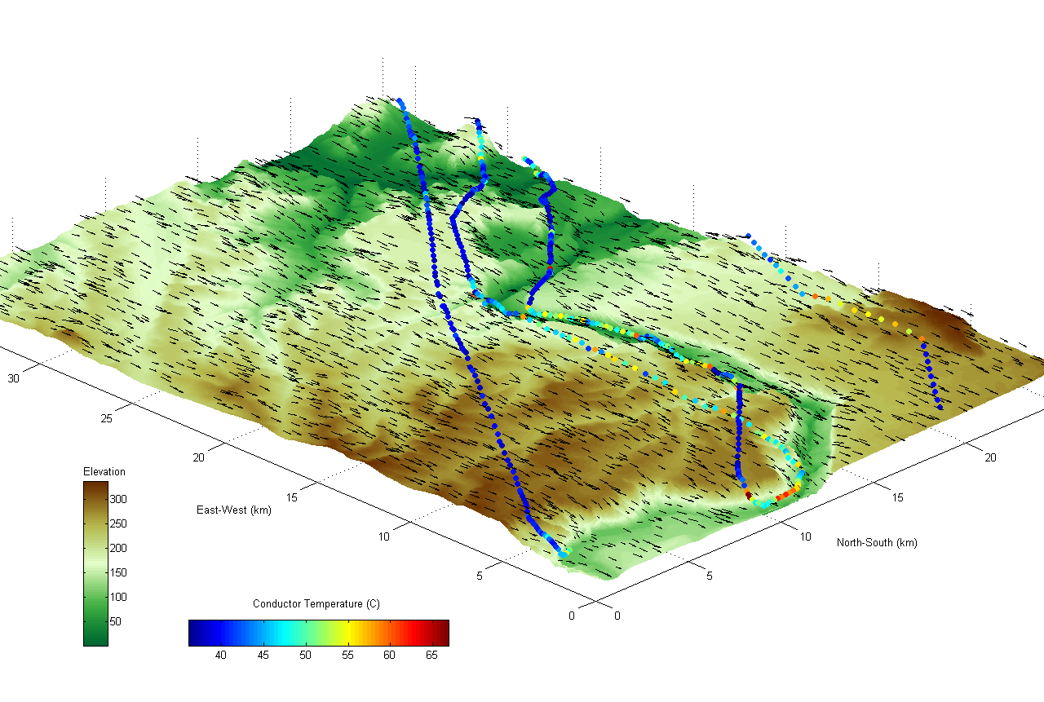
CFD based dynamic line rating
49km × 40km × 1.9km
  78m x 48 m x 10 m

Slide 6
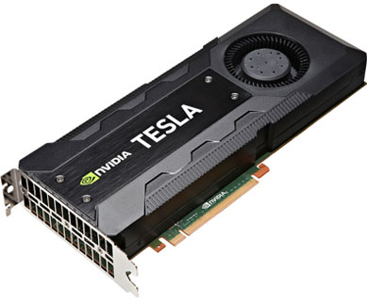
GIN3D: GPU-accelerated Incompressible Navier-Stokes 3D solver
Started in 2007
  Multi-GPU parallel
  MPI-CUDA (overlapped)
Buoyancy-driven incompressible flows
Numerical method
  Explicit finite difference
  Projection method, staggered mesh, skew-symmetric formulation
  2nd order Adams-Bashforth
  2nd order central difference, QUICK
Pressure Poisson Equation
  Amalgamated parallel geometric multigrid
Arbitrarily complex terrain
  Immersed boundary method
Turbulence modeling
  Lagrangian dynamic LES
  Wall-modeled LES
Notes:
The work that I am going to talk about for the rest of my talk is GIN3D. The unique feature of our code is that we design it for urban and complex terrain. We are not trying to develop a general-purpose CFD solver, like OpenFOAM for instance. We favor Cartesian methods because it maps well to the GPU architecture.

Slide 7
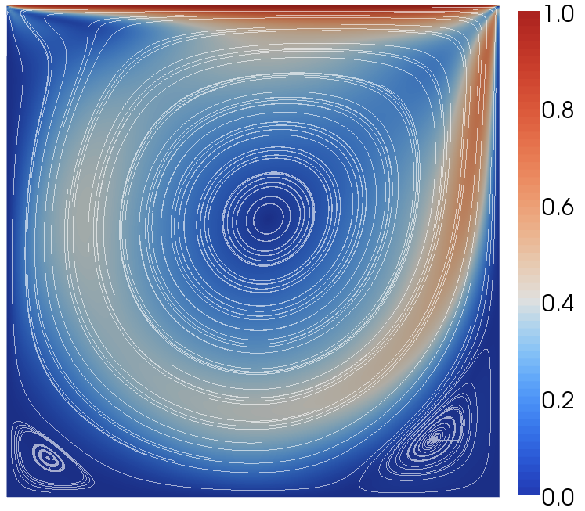
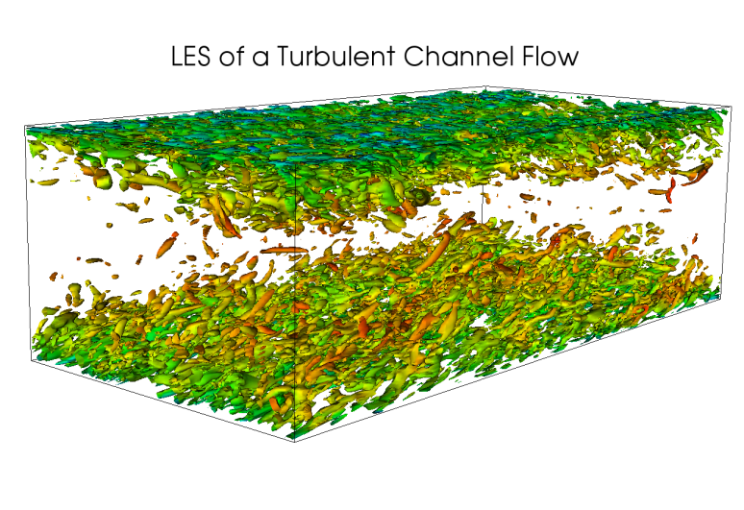
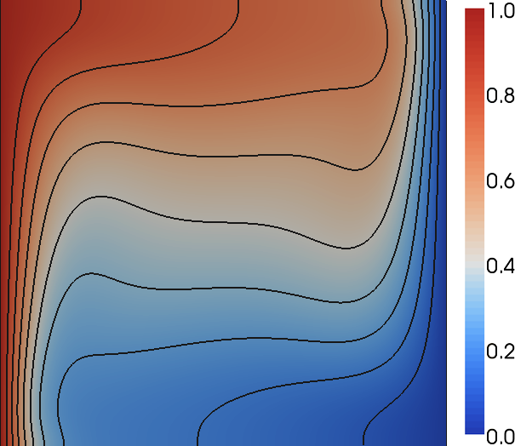
Validation & Performance Studies (2009-2013)
D. A. Jacobsen, and I. Senocak, “Multi-level parallelism for incompressible flow computations on GPU clusters,” Parallel Computing, 39: 1-20 (2013)
D. A. Jacobsen, and I. Senocak, “A full-depth amalgamated parallel 3D geometric multigrid solver for GPU clusters,” AIAA-2011-946, 49th AIAA Aerospace Sciences Meeting, Orlando, Florida, Jan. 4-7, (2011)
J. Thibault, I. Senocak, Accelerating incompressible flow computations with a Pthreads-CUDA implementation on small-footprint multi-GPU platforms, The Journal of Supercomputing, 59: 693-719 (2012)
R. Deleon, D. A. Jacobsen, and I. Senocak, “Large-eddy simulations of turbulent incompressible flows on GPU clusters,” Computing in Science and Engineering, 15 (1): 26–33 (2013)
Notes:
I’ll refer you to these publications for actual CPU/GPU performance comparisons and validation. Bottomline is GPU came on top and we decided to adopt GPU computing in our research.

Slide 8
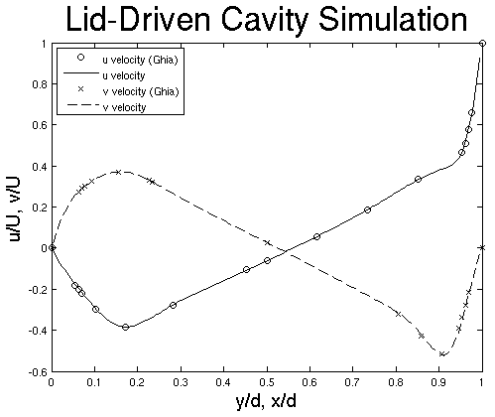
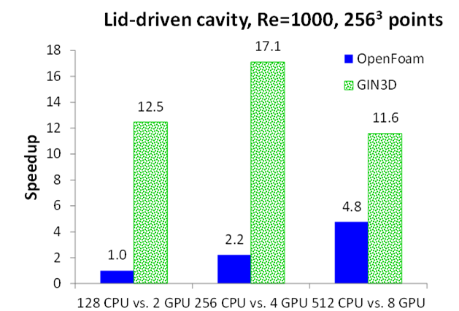
Practical Performance: GIN3D vs. OpenFOAM
Each code used its best settings for 256³ domain
Notes:
But once in a while we have to make sure that we are still ahead of the curve because it is very easy to lose performance. So for that we run OpenFOAM for the same problem and feel good about ourselves.

Slide 9
Arbitrarily Complex Terrain

Slide 10
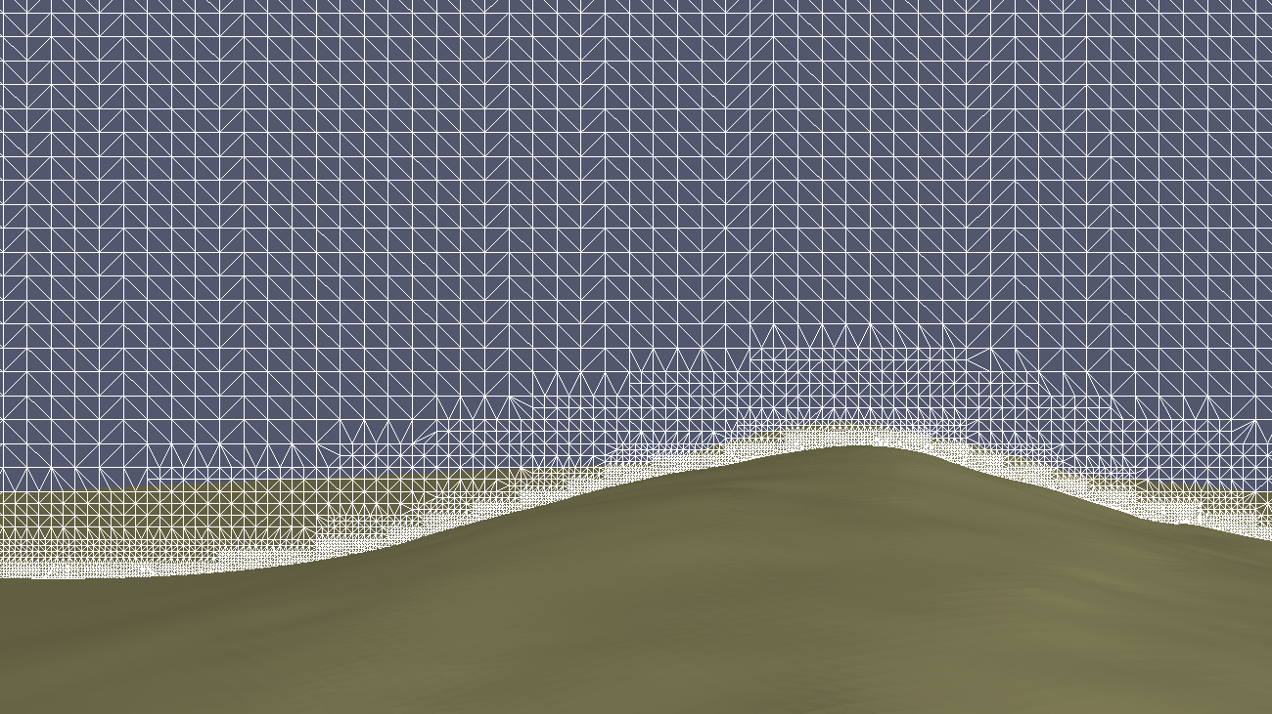
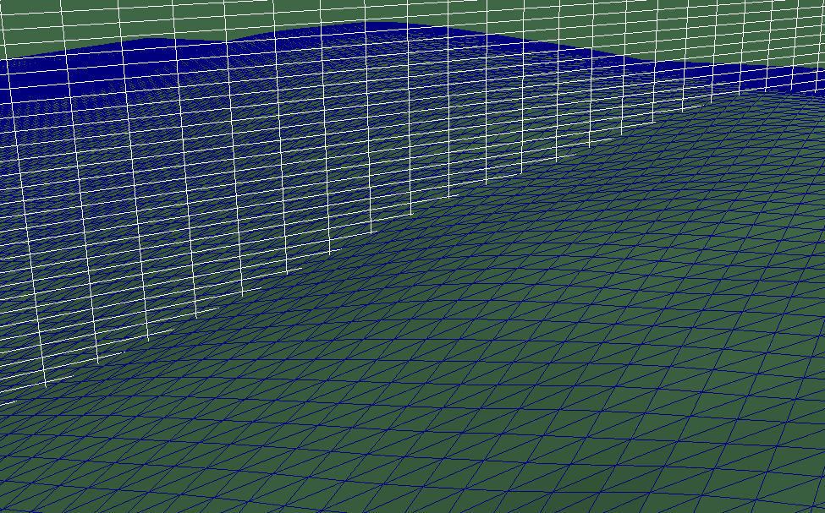
Two approaches
OpenFOAM Snappy Hex Mesh
GIN3D IB Mesh

Slide 11
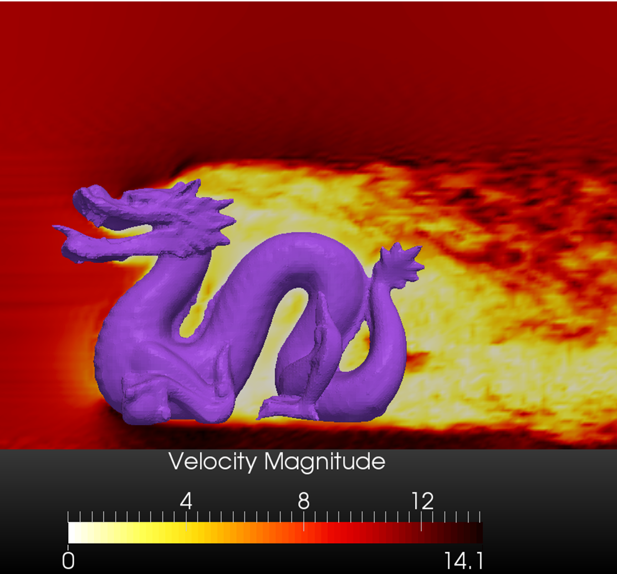
Why immersed boundary method?
Cartesian methods fits to the GPU better. Faster execution
  Forecasting at the microscale
Automated meshing with better numerics

Slide 12
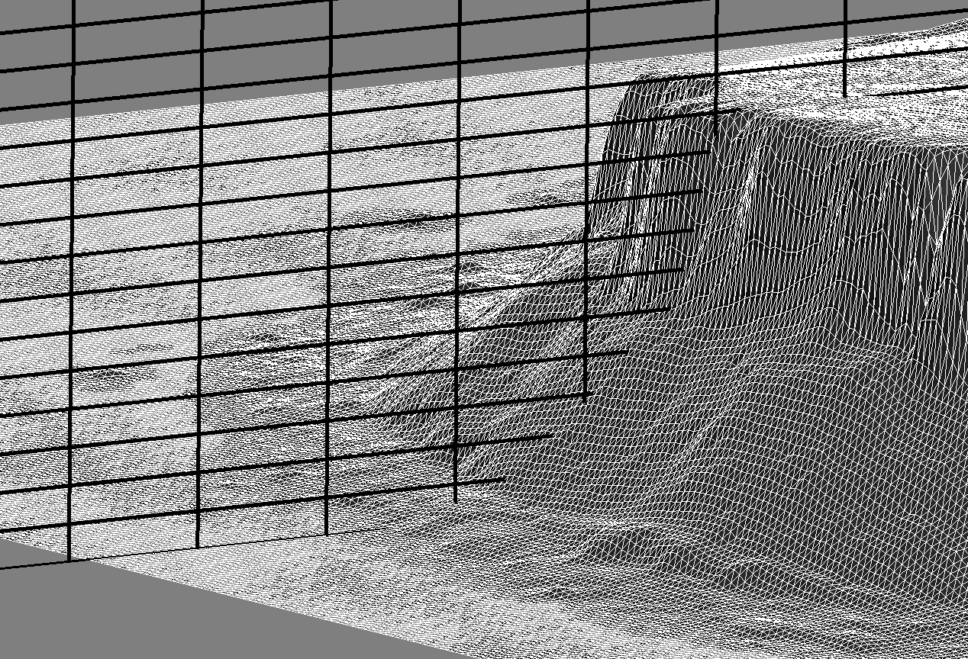
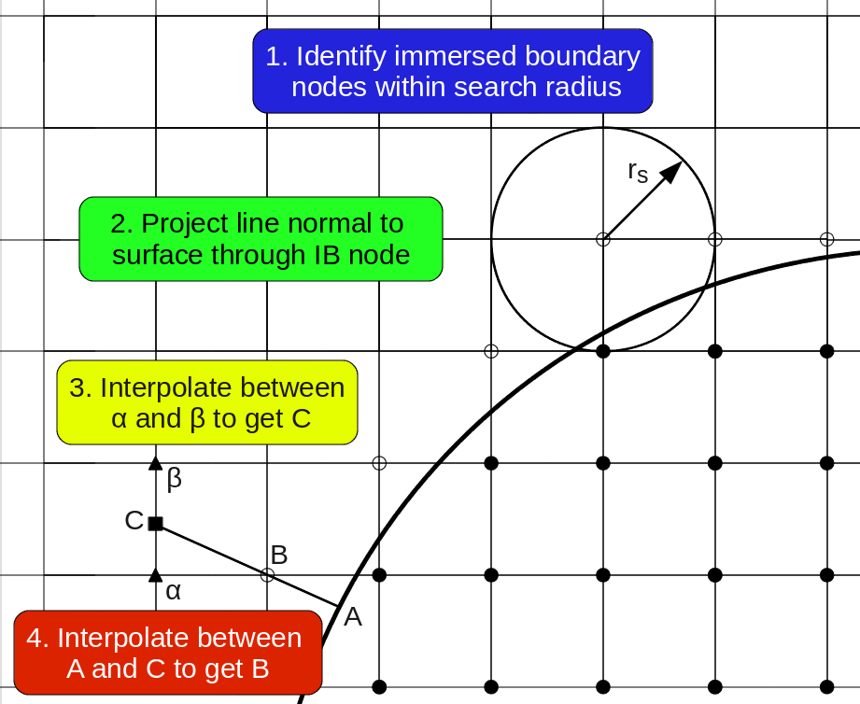
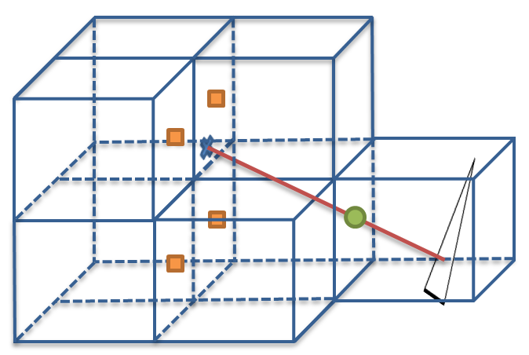
Immersed Boundary for Complex Terrain
Direct-Forcing Approach
Mohd-Yusof (1998)
Fadlun et al. (2000)
Gilmanov & Sotiropoulos (2005)
Mittal et al. (2008)

Slide 13
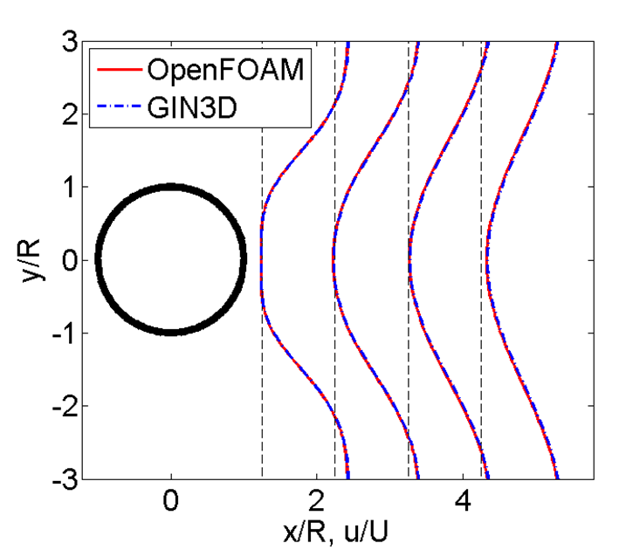
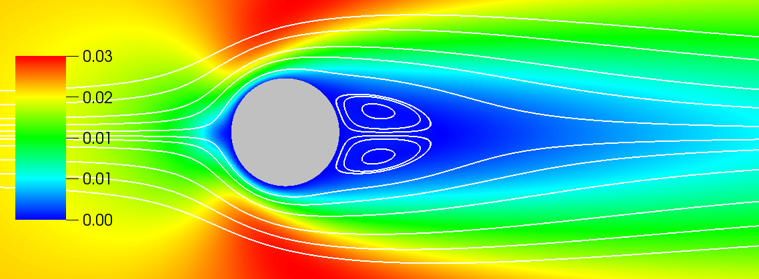
Laminar Flow over Circular Cylinder

Slide 14
Quantitative comparison

Slide 15
Issues with IB geometric preprocessing stage
Our revised algorithm fixes these issues

Slide 16
IB Preprocessor for Arbitrarily Complex Objects

Slide 17
IB Preprocessor for Arbitrarily Complex Objects

Slide 18
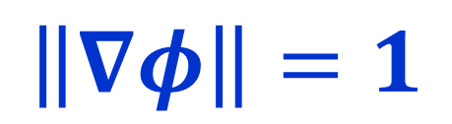
Distance Field Calculation: Eikonal Equation
$$\left\|∇φ\right\|=1$$
Fast Sweeping Method (Zhao, 2004)

Slide 20
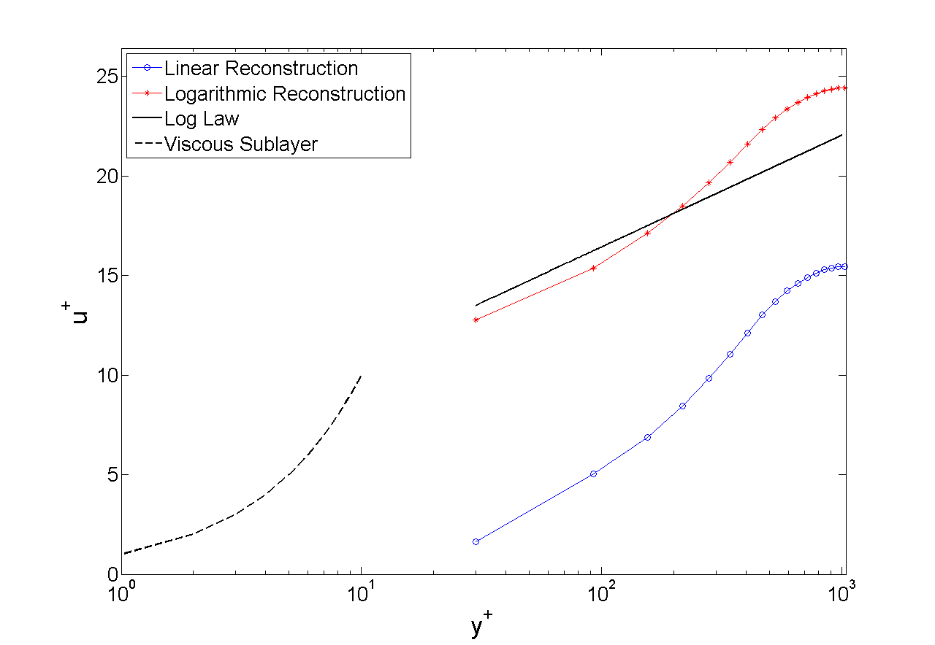
Immersed Boundary for High Re # and Coarse LES
Turbulent Channel Flow at Re_{τ}=1000
Log-law mismatch problem due to wall modeling
Wall modeling, SGS modeling, and IB reconstruction are tied to each other

Slide 21
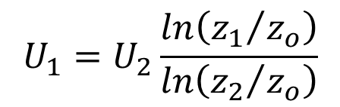
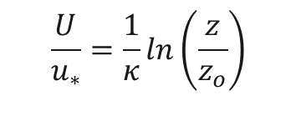
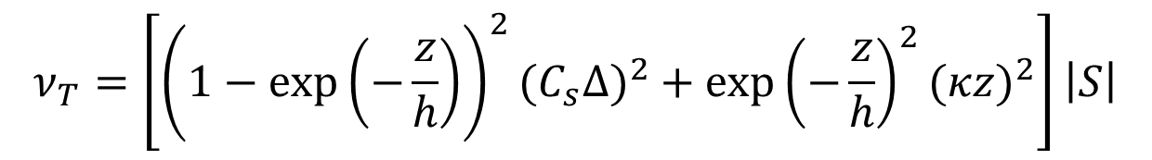
Baseline SGS & wall-model
Log-law reconstruction
Senocak et al., 2004, CTR Brief
$$\frac{U}{u_{∗}}=\frac{1}{κ}ln\left(\frac{z}{z_{o}}\right)$$
$$U_{1}=U_{2}\frac{ln\left({z_{1}}/{z_{o}}\right)}{ln\left({z_{2}}/{z_{o}}\right)}$$
Hybrid RANS/LES
Senocak et al., 2007, BLM
$$ν_{T}=\left[{\left(1−exp\left(−\frac{z}{h}\right)\right)}^{2}{{(C}_{s}Δ)}^{2}+{exp\left(−\frac{z}{h}\right)}^{2}{(κz)}^{2}\right]\left|S\right|$$
Lagrangian dynamic Smagorinsky & Prandtl mixing length

Slide 22
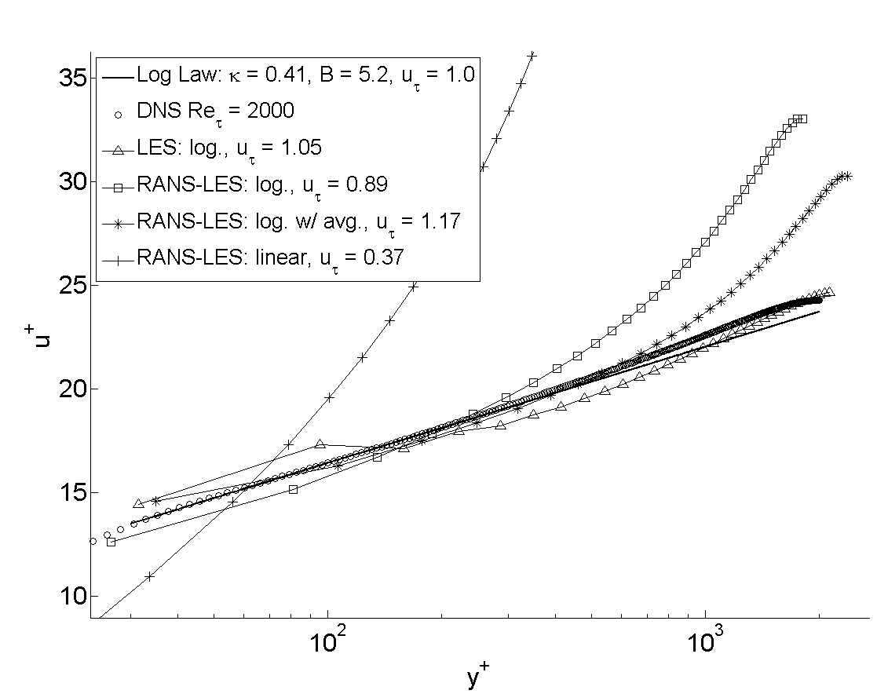
On-going work on wall-modeled LES
DNS of Jimenez and Hoyas (2008)

Slide 23
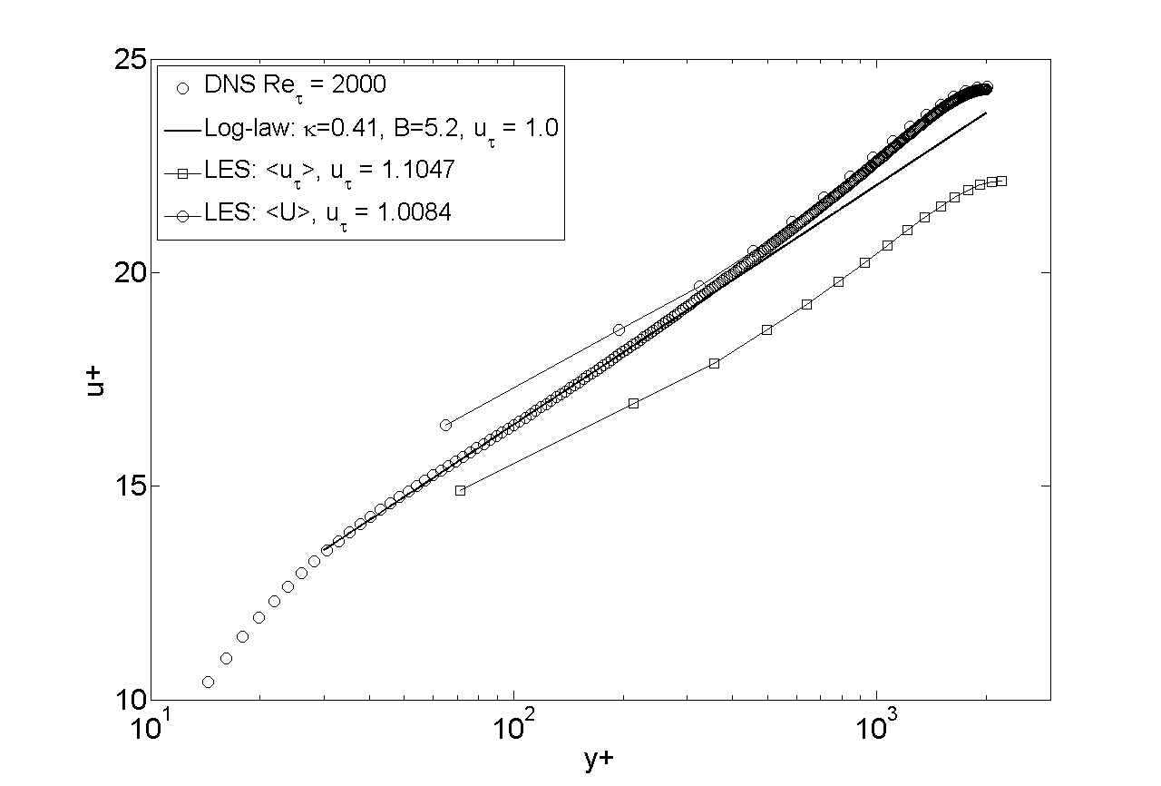
Further improvements to the coarse LES
Note that the mesh is really coarse!

Slide 24
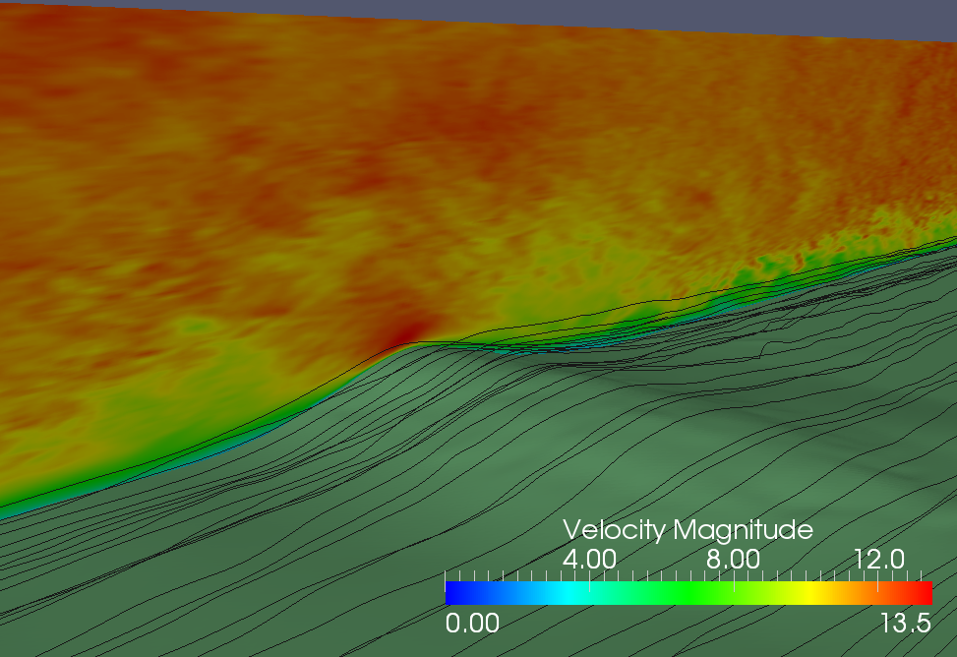
Askervein Hill Simulation
Periodic boundary (!) conditions in streamwise directions

Slide 25
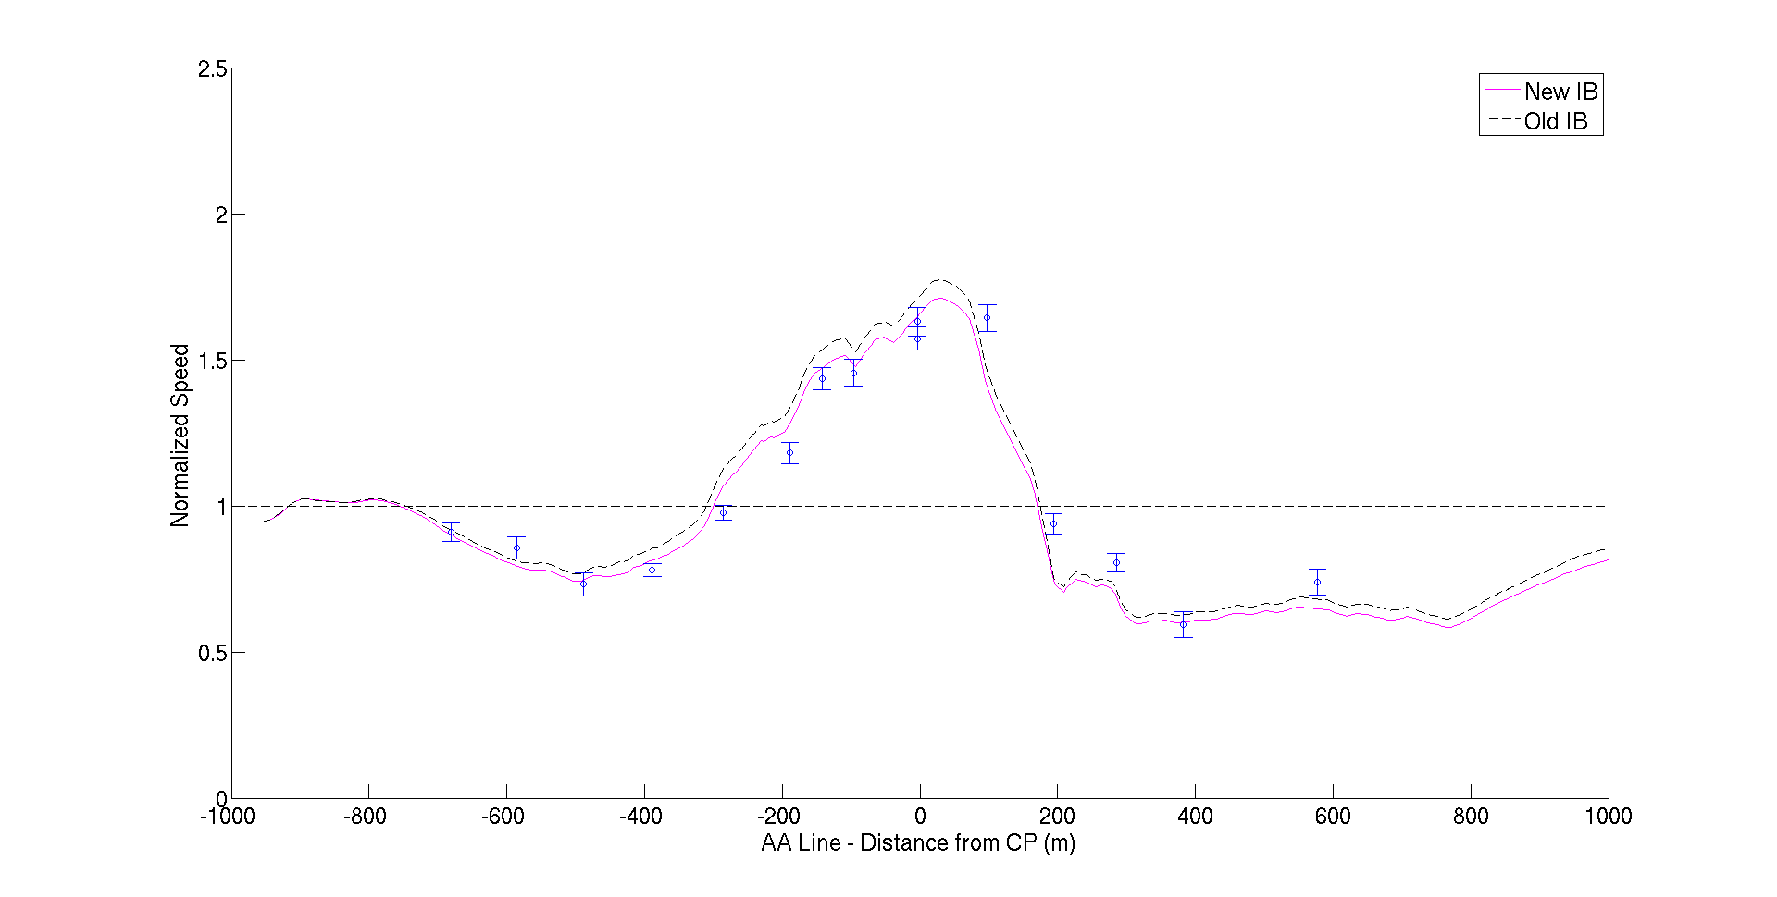
Askervein Hill Simulation

Slide 26
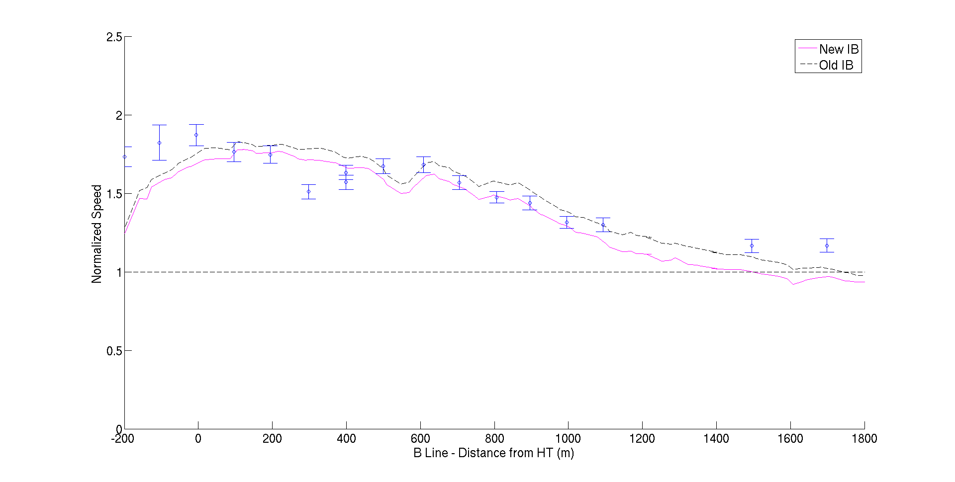
Askervein Hill Simulation

Slide 27

Forecasting potential
Define real-time factor: $RTF= \frac{δt^{sim}}{δt^{wall}}$
Forecasting mode: RTF>1.0
8 Tesla K20 on 4 nodes (Infiniband FDR)

Slide 28
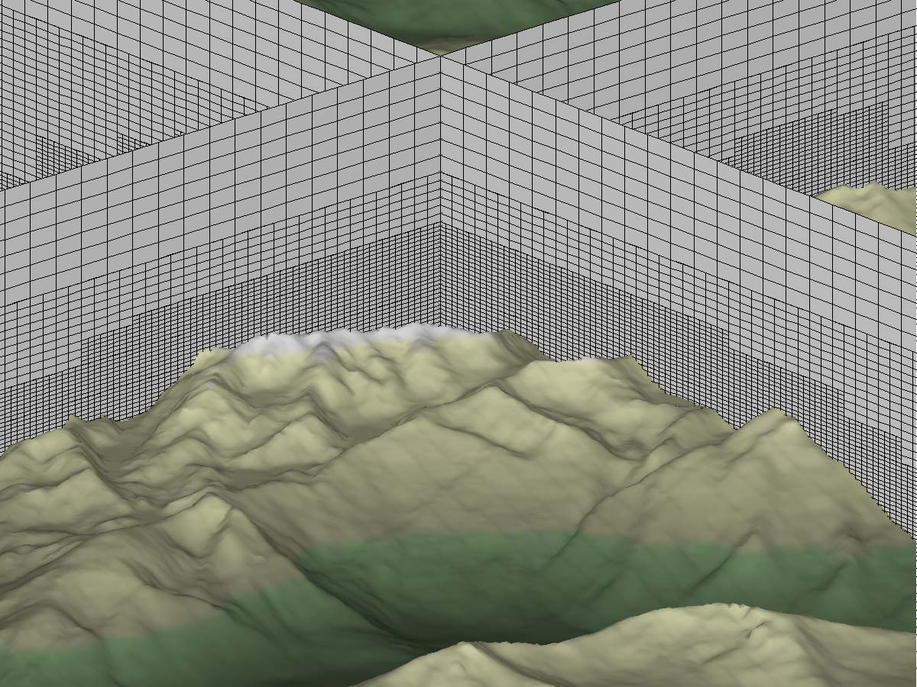
New NSF Grant (2014-2017)
Sustainable Software Infrastructure Program
Separate from GIN3D effort
GEM3D
Open-source
  NSF program requirement
Multi-GPU parallel
Adaptive Mesh Refinement
Software Engineering

Slide 29
Conclusions
Fast turnaround on multi-GPU platforms
  Forecasting at the microscale is feasible
  Broadens the application of CFD and LES at the microscale
Cartesian methods have attractive features for many-core computing
  Hardware-oriented numerics
Surface/wall modeling with LES & IB is critical
  Mesh is relatively coarse

Slide 30
On-going Work
Wall-modeled LES & Immersed Boundary
  LES on a coarse mesh over rough surfaces
  Heat & moisture fluxes
Turbulent Inflow Boundary Conditions
  Arbitrarily Complex Terrain
  Initialization of turbulent fields over complex terrain
Atmospheric Stability
  Unstable/Stable boundary layer
Multi-scale coupling
  GIN3D-WRF
  Concurrent execution on the same cluster (CPU-GPU)

Slide 31
Acknowledgments
National Science Foundation, CAREER: Multi-scale modeling of short-term forecasting and grid integration of wind energy over complex terrain, PI, Award # 1056110, 01/15/2011-12/31/2015, $400,011
National Science Foundation, MRI: Acquisition of a GPU-accelerated high performance computing and visualization cluster, PI, (co-PIs: Mullner, Marshall, Oxford, Andersen) Award # 1229709, 10/01/2012-09/30/2015, $555,384
National Science Foundation, ATD: Data-driven stochastic source inversion algorithms for event reconstruction of biothreat agent dispersion, Co-PI (PI: Jodi Mead), Award # 1043107, 10/01/2010-09/30/2014, $466,803

Slide 32
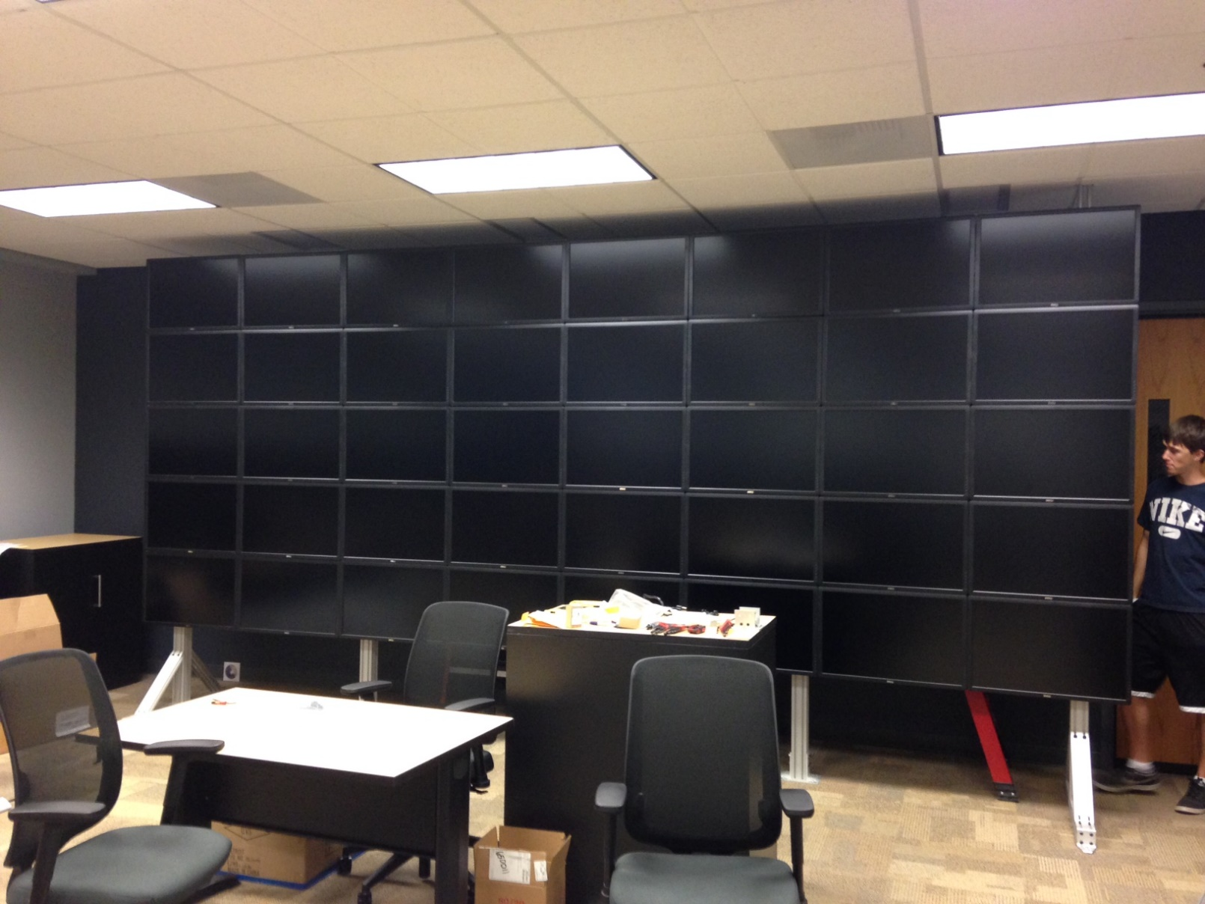
HiPerSimLab

Slide 33
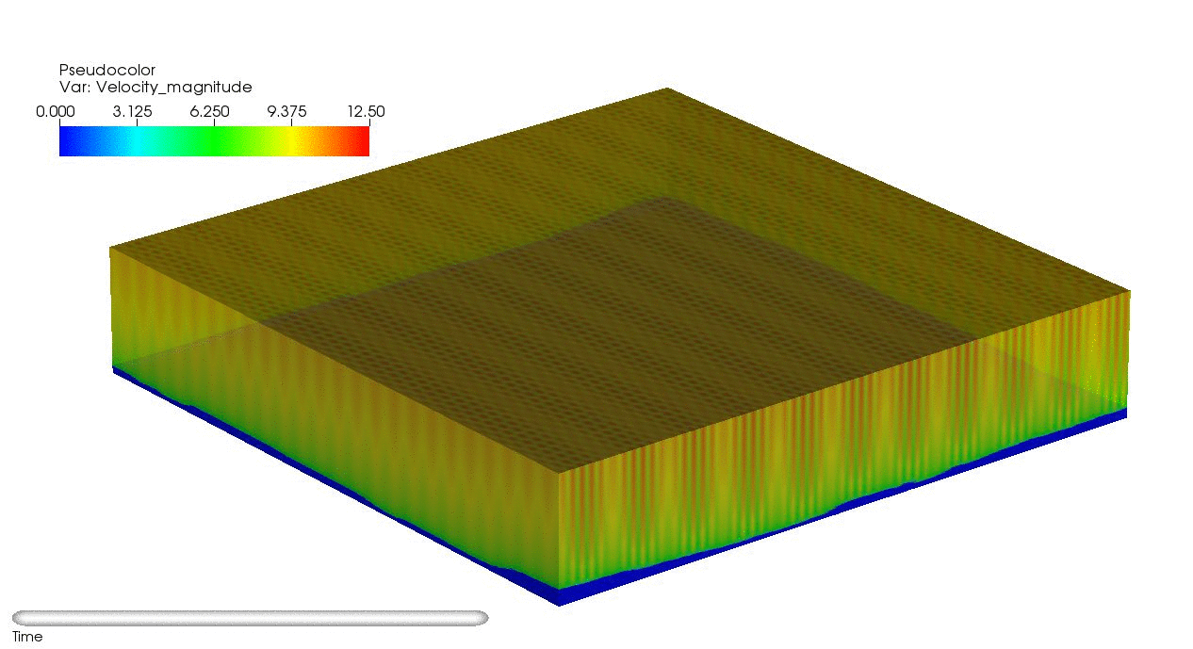


Slide 34
LES Validation: Re_{τ}=180
Re_{τ}=395

Slide 35
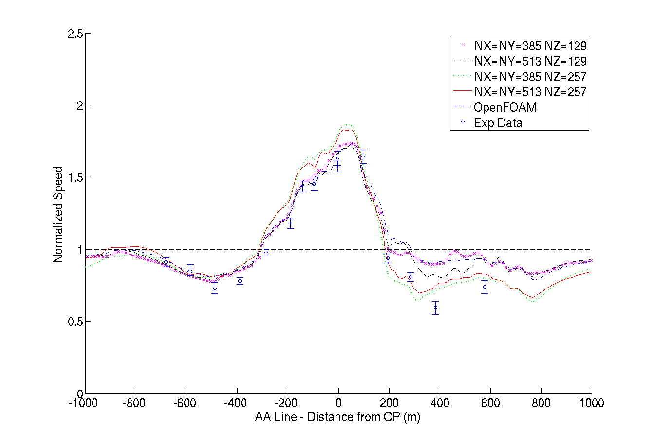
Askervein AA Line, old simulations

Slide 36
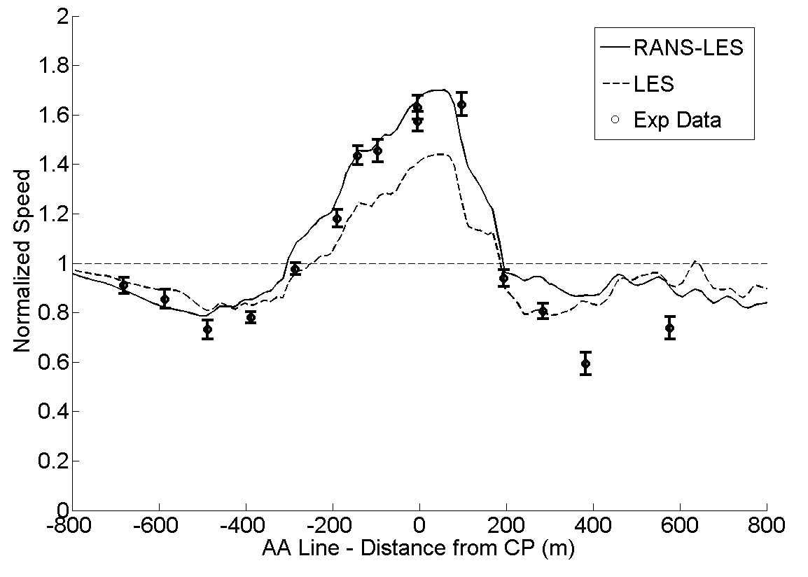
Askervein AA Line, old simulations

Slide 37
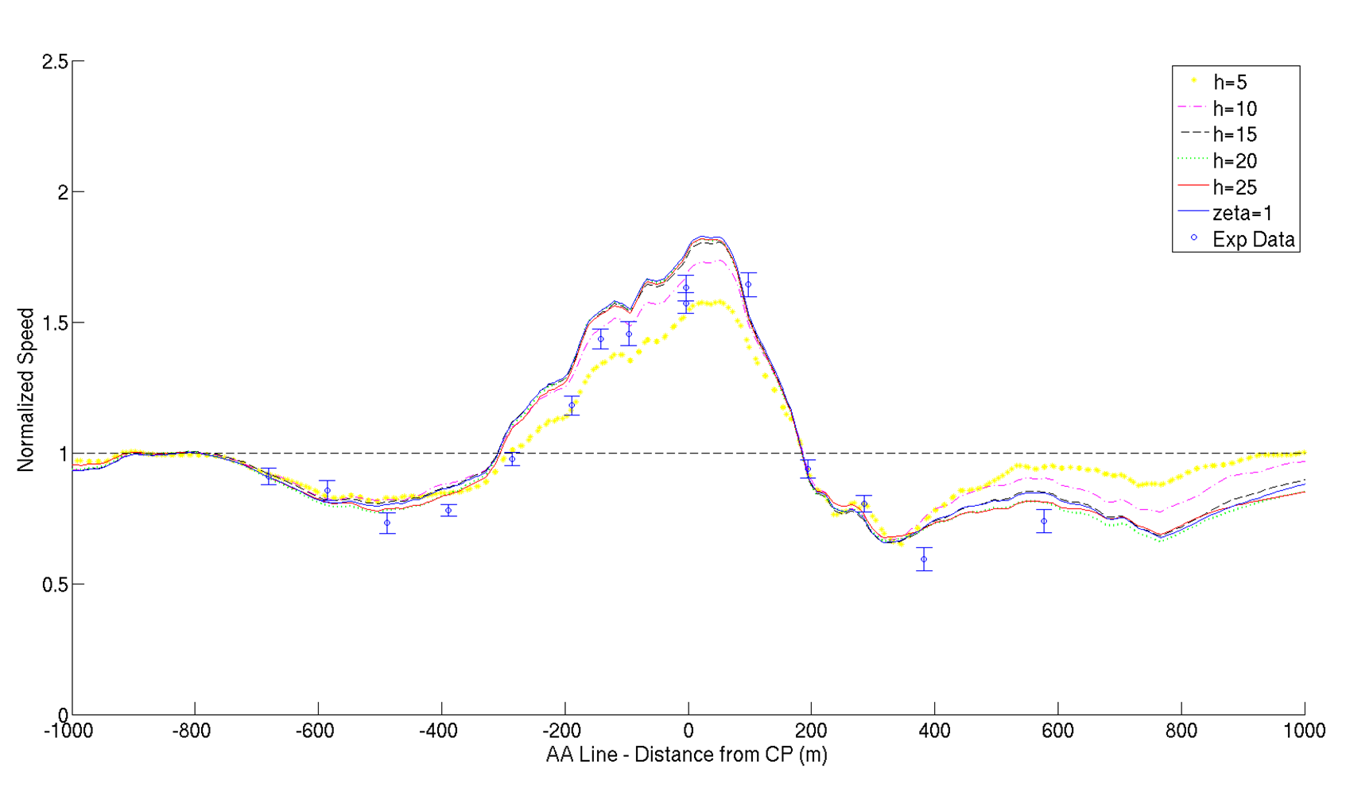
Sensitivity to RANS-LES Hybridization

Slide 38
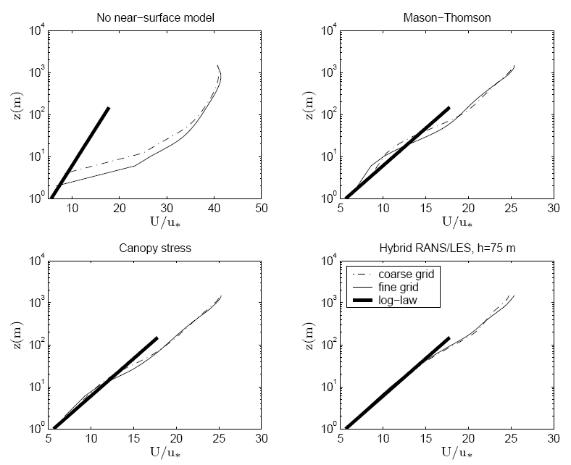
Neutral ABL results from Senocak et al. 2007

Slide 39
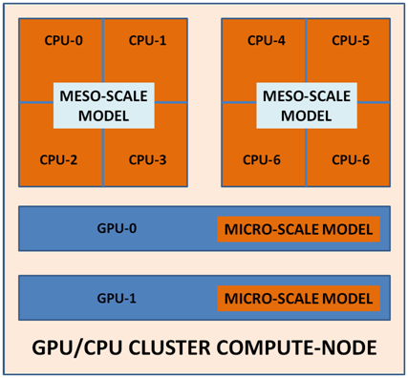
Multi-scale Wind Forecasting Engine
Meso-scale model: WRF
Micro-scale: GIN3D
Concurrent execution
32-node dual-GPU cluster
  With 5x8 tiled display
National Science Foundation, MRI: Acquisition of a GPU-accelerated high performance computing and visualization cluster, Award # 1229709, 10/01/2012-09/30/2014, $555,384

