Slide 1
shaders, part 2
alexandri zavodny

Slide 2
shaders, part 1: recap
shaders go here

Slide 3
shaders, part 1: recap
Shaders replace those stages from the pipeline
> Your vertex shader must transform vertices with the ModelViewProjection matrix
> Your fragment shader must assign a color!
Your vertex shader:
Has access to:
gl_Vertex, gl_Normal, gl_Color, texture coordinates, user-defined attributes, etc.
And is expected to produce gl_Position

Slide 4
shaders, part 1: recap
Your fragment shader:
Has access to whatever you pass to it from the vertex shader (varying inputs) and uniforms
Interpolated texture coordinates, color values, vertex positions, etc.
Is expected to set gl_FragColor

Slide 5
shaders, part 2: lighting
Recall: Phong lighting model
Diffuse term given by Lambertian reflectance:
I_{l} = max(dot(dir_{L}, n) × L_{i}, 0)
Image credit: en.wikipedia.org/wiki/Lambertian_reflectance

Slide 6
shaders, part 2: lighting
But OpenGL gives us
this:
Or this:

Slide 7
shaders, part 2: lighting
Recall: OpenGL does lighting per vertex…
GL_FLAT: compute the lighting once per face.
GL_SMOOTH: compute the lighting once per vertex, and blend across faces. (This is also known as Gourad shading.)

Slide 8
shaders, part 2: lighting
We really want lighting per pixel:
GL_FLAT
Flat Shading
Per Face
GL_SMOOTH
Gourad Shading
Per Vertex
Phong Shading
Per Pixel

Slide 9
shaders, part 2: lighting
OpenGL computes the lighting at each vertex and blends the color across the triangle
This is the rasterizer!
All of your varying shader variables get blended across each triangle…
…so blend the normals instead and do lighting in the fragment shader.

Slide 10
shaders, part 2: lighting
How do you get the direction to the light in the fragment shader?
gl_LightSouce[X].position gives the position of light X in eye coordinates.
So vertices must be transformed into eye space before calculations make sense:
vec4 vertexInEyeSpace = gl_ModelViewMatrix * gl_Vertex;
vec4 dirToLight = normalize(gl_LightSource[0].position –
vertexInEyeSpace);

Slide 11
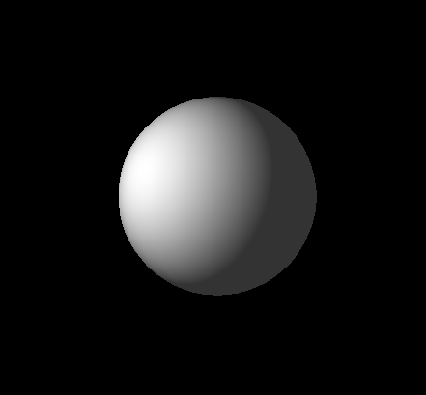
shaders, part 2: lighting
Demo

Slide 12
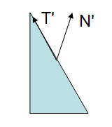
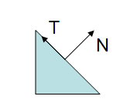
shaders, part 2: lighting
You may have noticed…
We normalized the normal / light direction in both the vertex shader AND the fragment shader.
gl_Normal was multiplied by gl_NormalMatrix, not gl_ModelViewMatrix
For gl_Normal, consider:
Image credit: http://www.lighthouse3d.com/opengl/glsl/index.php?normalmatrix

Slide 13
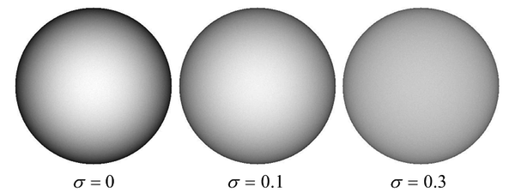
fun with lighting
Now that we can do lighting ourselves, we can implement more interesting models…
Oren-Nayar reflectance model:
Image credit: http://en.wikipedia.org/wiki/Oren-Nayar_reflectance_model
Notes:
The Oren-Nayar reflectance model accounts for microfacets in the surface that cause more the reflectance to be higher if the viewing direction is aligned with the light direction.

Slide 14
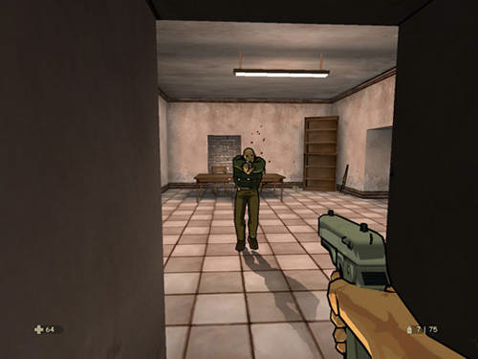
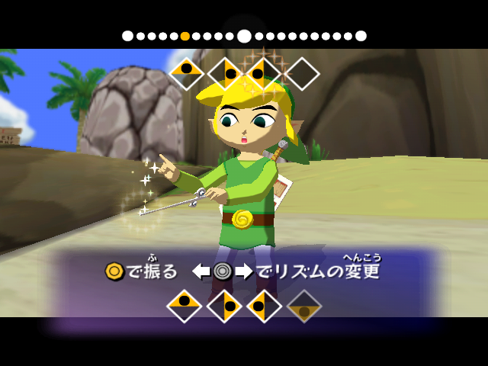
fun with lighting
Cel shading / toon shading:
Step the intensity instead of smoothly varying it
Image credits:
http://ui15.gamefaqs.com/462/gfs_51174_2_4.jpg
en.wikipedia.org/wiki/Wind_Waker/

Slide 15
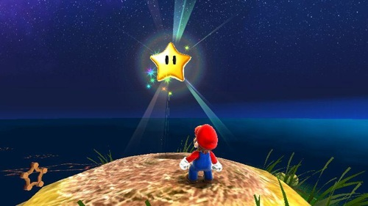
fun with lighting
Shade based on ‘angle of incidence’

Slide 16
fun with lighting
How do you get the view direction?
You don’t! Well… not really.
After the transformation into normalized device coordinates, the view direction is aligned with the –Z axis
i.e. the view direction is always (0,0,-1)
Demo

Slide 17
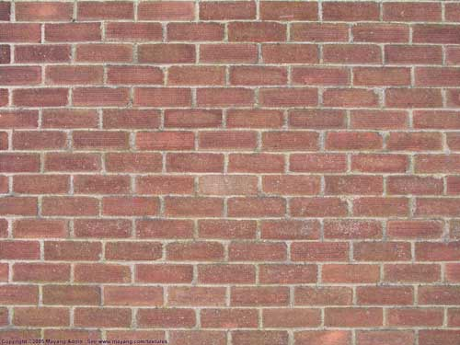
fun with lighting
Normal Mapping
What if we distort the normals of an object?
Pass in a texture of normals instead of colors
Use these new normals for lighting

Slide 18
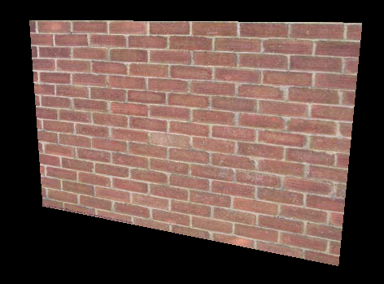
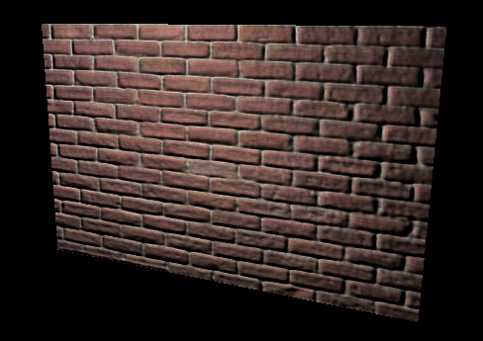
fun with lighting
Normal Mapping
demo!
old and busted
new hotness!

Slide 19
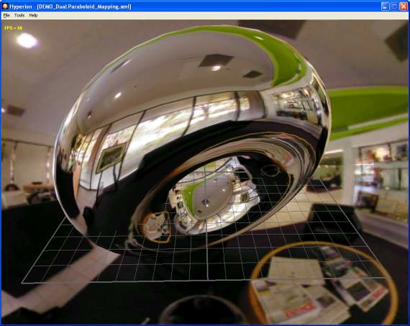
fun with lighting
Environment mapping
Compute reflection
ray at each pixel,
and index into an
environment map

Slide 20
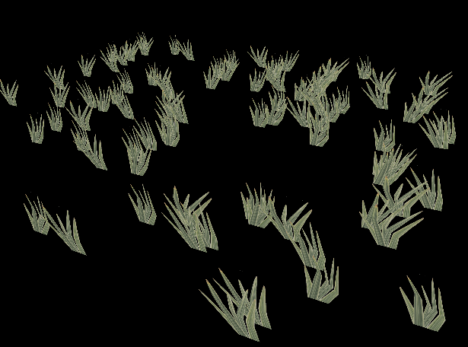
fun with vertex shaders
Vertex shaders: what happens if you vary the coordinates with time and position?
Foliage / grass!

Slide 21
fun with vertex shaders
Pose-based animation:

Slide 22
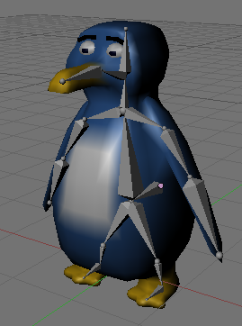
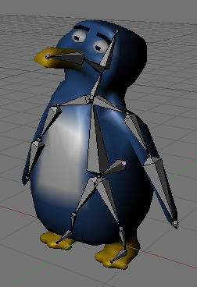
fun with vertex shaders
Or skeletal animation (skinning):

Slide 23
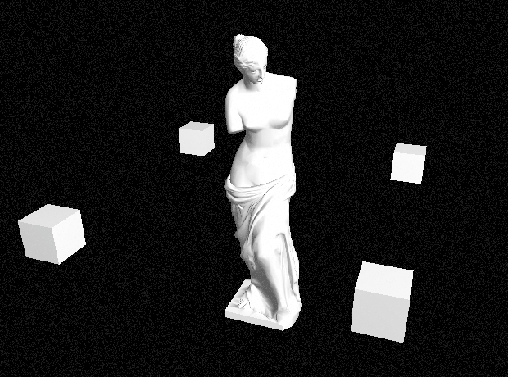
fun with fragment shaders
Render a quad over the screen, and randomly add to each pixel’s value:
Film grain!

Slide 24
fun with fragment shaders
Lots of techniques utilize multipass rendering
Render the scene normally
Read the pixels back, create a texture with them
Render a quad over the whole screen with the framebuffer texture
Perform special effects with the screen texture

Slide 25
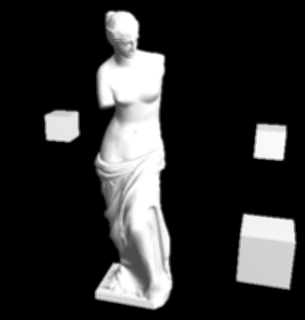
fun with fragment shaders
Gaussian blur
Read the rendered scene back onto a texture
Render a quad with that texture on it, pass it through a fragment shader
In the fragment shader, set the output value of a pixel to be a weighted sum of its neighbors

Slide 26
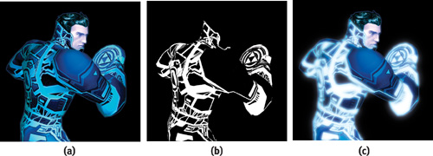
fun with fragment shaders
Glow / bloom effect
Render parts of the scene that glow / are bright
Blur that texture, and overlay it on the scene
Image credit: http://http.developer.nvidia.com/GPUGems/gpugems_ch21.html

Slide 27
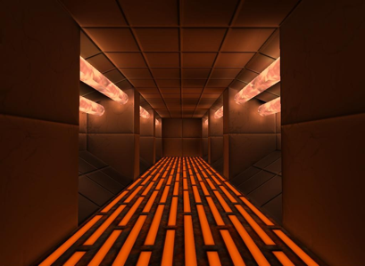
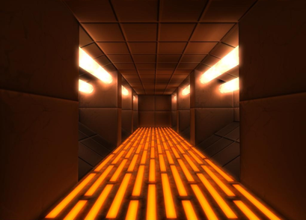
fun with fragment shaders
Without Bloom
With Bloom
Image credit: http://controlprotocol.files.wordpress.com/2010/06/dxl_hallway.jpg / hallwaybloom.jpg

Slide 28
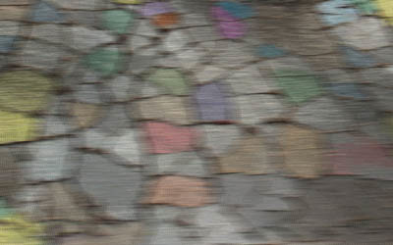
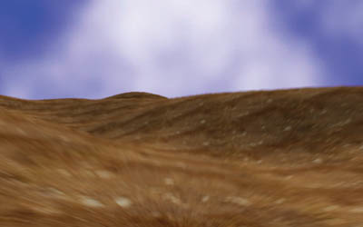
fun with fragment shaders
Keep track of the velocity at each vertex and blur in that direction: motion blur

Slide 29
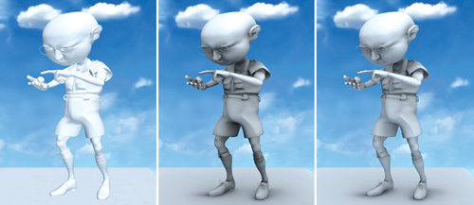
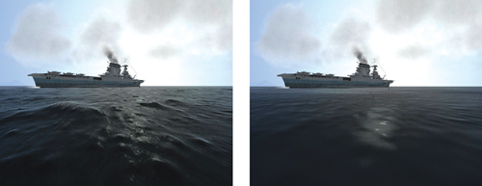
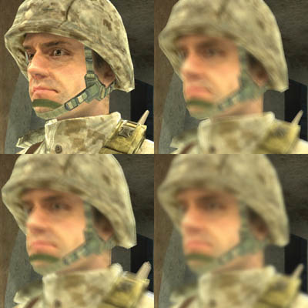
and much, much more…

