Slide 1
CETR: Content Extraction via Tag Ratios
Tim Weninger, William H. Hsu and Jiawei Han
Department of Computer Science
University of Illinois Urbana-Champaign, Urbana, IL
Department of Computing and Information Sciences
Kansas State University, Manhattan KS

Slide 2
Problem:
Too much junk in a web page
Goal:
Extract only the content of a page
Taken from The Hutchinson News on 8/14/2008

Slide 3
Example
Published online 8/13/2008 A home away from school
Day care has after-school duties as some clients start academic year
By Kristen Roderick - The Hutchinson News - kroderick@hutchnews.com
(Travis Morisse/The Hutchinson News) Mary Waln, 7, and Nija Morris, 6, read “The Magic Mat” together Wednesday at Hadley Day Care.
The doors at Hadley Day Care opened Wednesday afternoon, and children scurried in with tales of their first day of school. Nija Morris, a 6-year-old attending Faris Elementary, smiled as she hung her pink-and-blue flowered backpack on a hook and talked to her classmates about her first day. "I played and I did art and I played outside and I went to the gym, and I went inside and did centers," she said. "And then I went to meet the other classes and then we went home." The school-aged children were a little more wound up on Wednesday, program director Christie Gardner said. The excitement is always higher the first day of school, and not everyone is in a routine.
Rendered HTML Document
Text content of the document

Slide 4
Naïve Approach
Remove all HTML tags
RSS
CIRCULATION
YOUR ACCOUNT
CONTACT US
Home
News
Top Stories
Local/Regional News
Briefs
Education
Ask Hutch
Business
Public Record
Special sections
Videos
Photos
Slideshows
Forums
Weather
Obituaries
Sports
Latest Sports
NJCAA Tournament
Opinion
Editorials
Letters to the Editor
Columnists
Lifestyles
Food
Health
Religion
Outdoors
Life’s Little Moments
Weddings
Engagements
Anniversaries
Coming Events
Et cetera
Entertainment
Preview
TV listings
Jobs
Autos
Classifieds
Marketplace
Archive search
Thursday, August 14, 2008 10 : 35 AM
Search the Web using Hutch News
Weather Forecast
today’s top stories
Published online 8/13/2008 A home away from school
Day care has after-school duties as some clients start academic year
By Kristen Roderick - The Hutchinson News - kroderick@hutchnews.com
(Travis Morisse/The Hutchinson News) Mary Waln, 7, and Nija Morris, 6, read “The Magic Mat” together Wednesday at Hadley Day Care.
The doors at Hadley Day Care opened Wednesday afternoon, and children scurried in with tales of their first day of school. Nija Morris, a 6-year-old attending Faris Elementary, smiled as she hung her pink-and-blue flowered backpack on a hook and talked to her classmates about her first day. "I played and I did art and I played outside and I went to the gym, and I went inside and did centers," she said. "And then I went to meet the other classes and then we went home."
Original, Rendered HTML Document
All Text of the Document

Slide 5
Tag-based Approach
Use HTML tags as clues for content
Problem: Style-sheets
<div>
<div>
</div>
<div>
<div>
Eat at Joes
</div>
</div>
<div>
<div>
<div>
The doors at Hadley Day Care opened Wednesday afternoon, and children scurried in with tales of their first day of school. </div>
<div> Nija Morris, a 6-year-old attending Faris Elementary, smiled as she hung her pink-and-blue flowered backpack on a hook and talked to her classmates about her first day.
</div>
</div>
</div>
</div>
Original, Rendered HTML Document

Slide 6
Wrapper Generation
Learn rules via machine learning from webpage
Problem: pages vary, web changes

Slide 7
Text-to-Tag Ratio
Algorithm 1: Text-To-Tag Ratio pseudocode
input h ← HTML source code begin Remove all script, remark tags and empty lines for each line k to numLines( h ) do x ← number of non-tag ASCII characters in h[k] y ← number of tags in h[k] if y = 0 then TTRArray[i] ← x else TTRArray[i] ← x / y end if end for return TTRArray end

Slide 8
Example
Text: 21 - Tags: 8 -> TTR: 2.63
Text: 22 - Tags: 8 -> TTR: 2.75
Text: 298 - Tags: 6 -> TTR: 49.67
Text: 0 - Tags: 0 -> TTR: 0
Text: 0 - Tags: 1 -> TTR: 0
http://www2010.org/www/2010/04/program-guide/

Slide 10
Preprocessing – Blur the tag ratios

Slide 11
Apply a Threshold
Threshold based on the standard deviation
Std. Dev. Is 20.3TTR for
Hutchinson News document

Slide 12
What’s wrong with this?

Slide 13
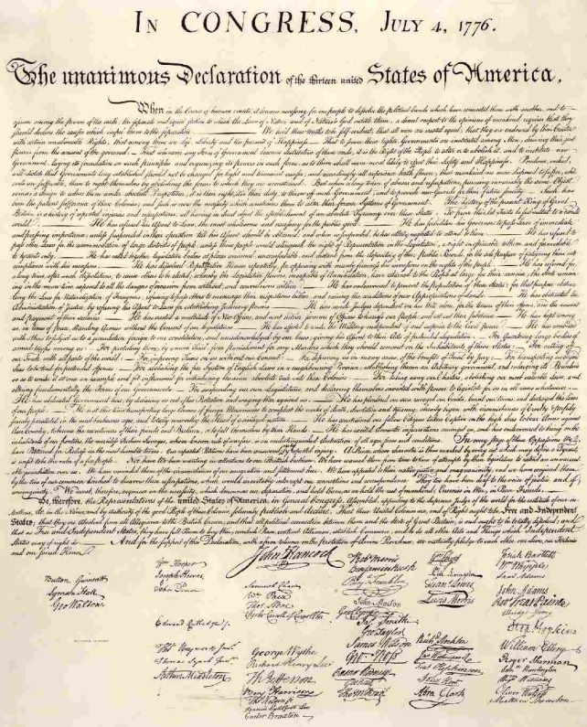
Worst Case
American Declaration of Independence Web page
American Declaration of Independence
TTR computed from digital copy at
http://www.ushistory.org/declaration/document/index.htm

Slide 14
Histogram Clustering in 2-Dimensions
Looks for jumps in the moving average of TTR

Slide 15
Histogram Clustering in 2-Dimensions
Absolute value gives insight

Slide 16
Histogram Clustering in 2-Dimensions
Make a scatterplot

Slide 17
How should we cluster this?

Slide 18
Modified k-Means

Slide 19
Can also use a Max-Margin Approach
But we don’t

Slide 20
Evaluation method
CleanEval Dataset (Standard Evaluation dataset)
741 English documents
713 Chinese documents
Myriad 40 Dataset
40 News Websites – 206 documents at random
Big 5 Dataset
NY Post, Freep, Suntimes, Techweb, Tribune – 50 each
BBC and NYTimes
50 documents each
Evaluation Metrics
Precision, Recall, F1-Measure

Slide 21
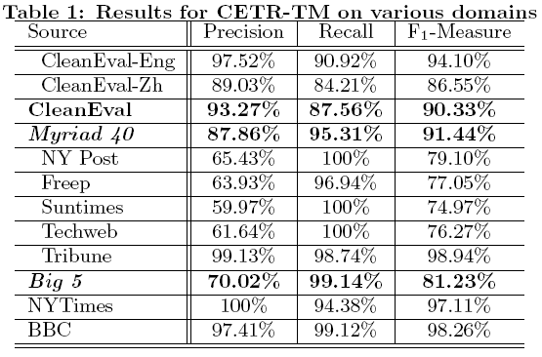
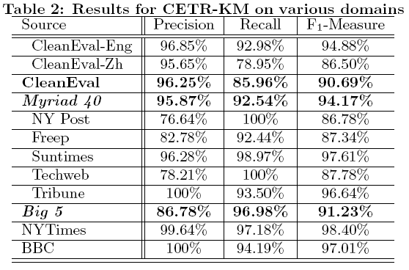
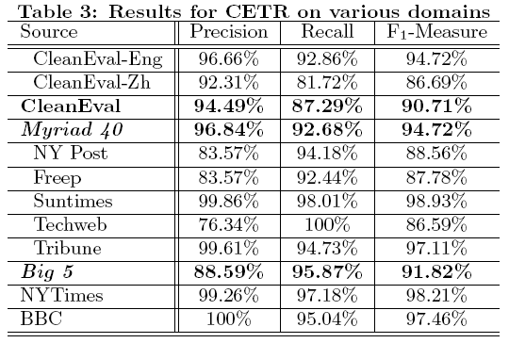
CETR Results

Slide 22
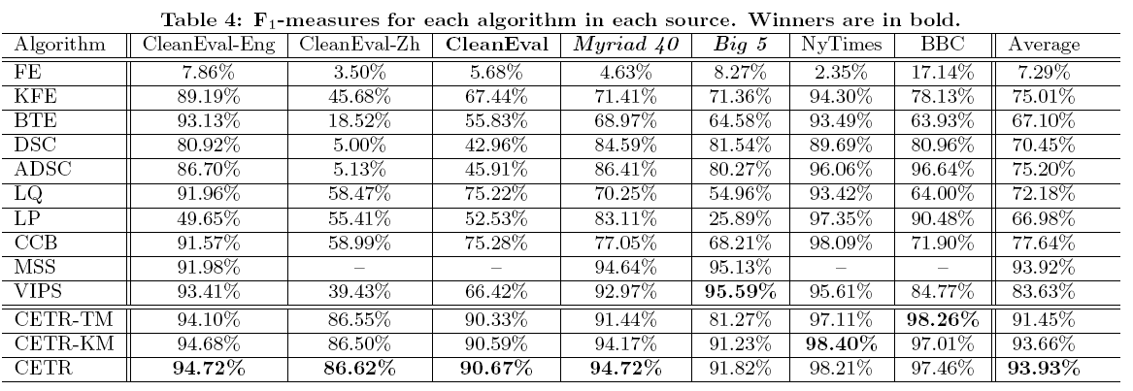
Case study

Slide 23
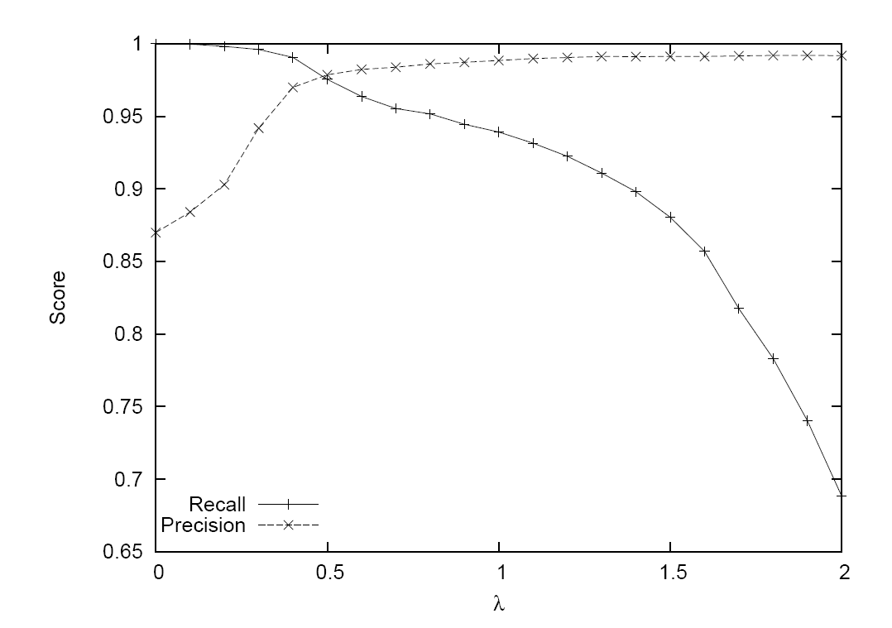
CETR-TM as the σ coefficient (λ) (i.e. threshold) varies

Slide 24
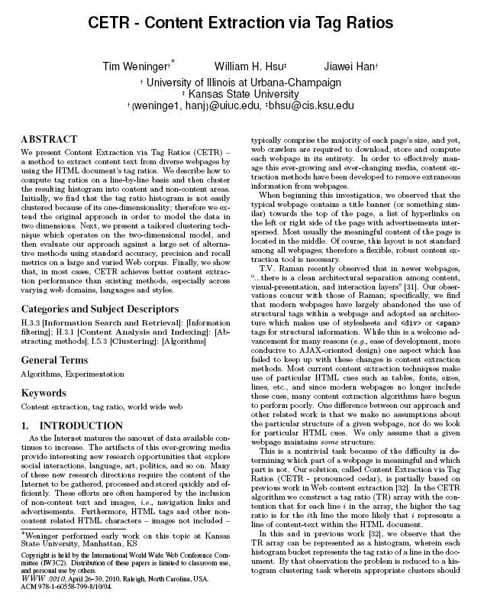
Worst Case Revisited
Non-HTML or all content pages
approximation
WWW’10 Paper

Slide 25
Conclusions and Future Work
Tag Ratio Approach
Content extraction technique – outperforms existing methods
Simple… easy to implement and use
Static method
no training required
Just give a document and get content
Future Work
Use for page segmentation
Use in Search/Retrieval

Slide 26
Questions?

