Slide 1
Developing genetic technology and the military
Isabel Canfield
Notes:
Slide template adapted from Slidesgo and Freepik

Slide 2
“the whole supersoldier business”
Notes:
Picture and quote from: https://futurehuman.medium.com/the-military-is-funding-ethicists-to-keep-its-brain-enhancement-experiments-in-check-b3b45371364

Slide 3
Where is Genetic /Genomic technology: A Case Study
Gene Therapy to protect against chemical weapons
PREPARE Program from DARPA
Notes:
Slide template adapted from Slidesgo and Freepik

Slide 4
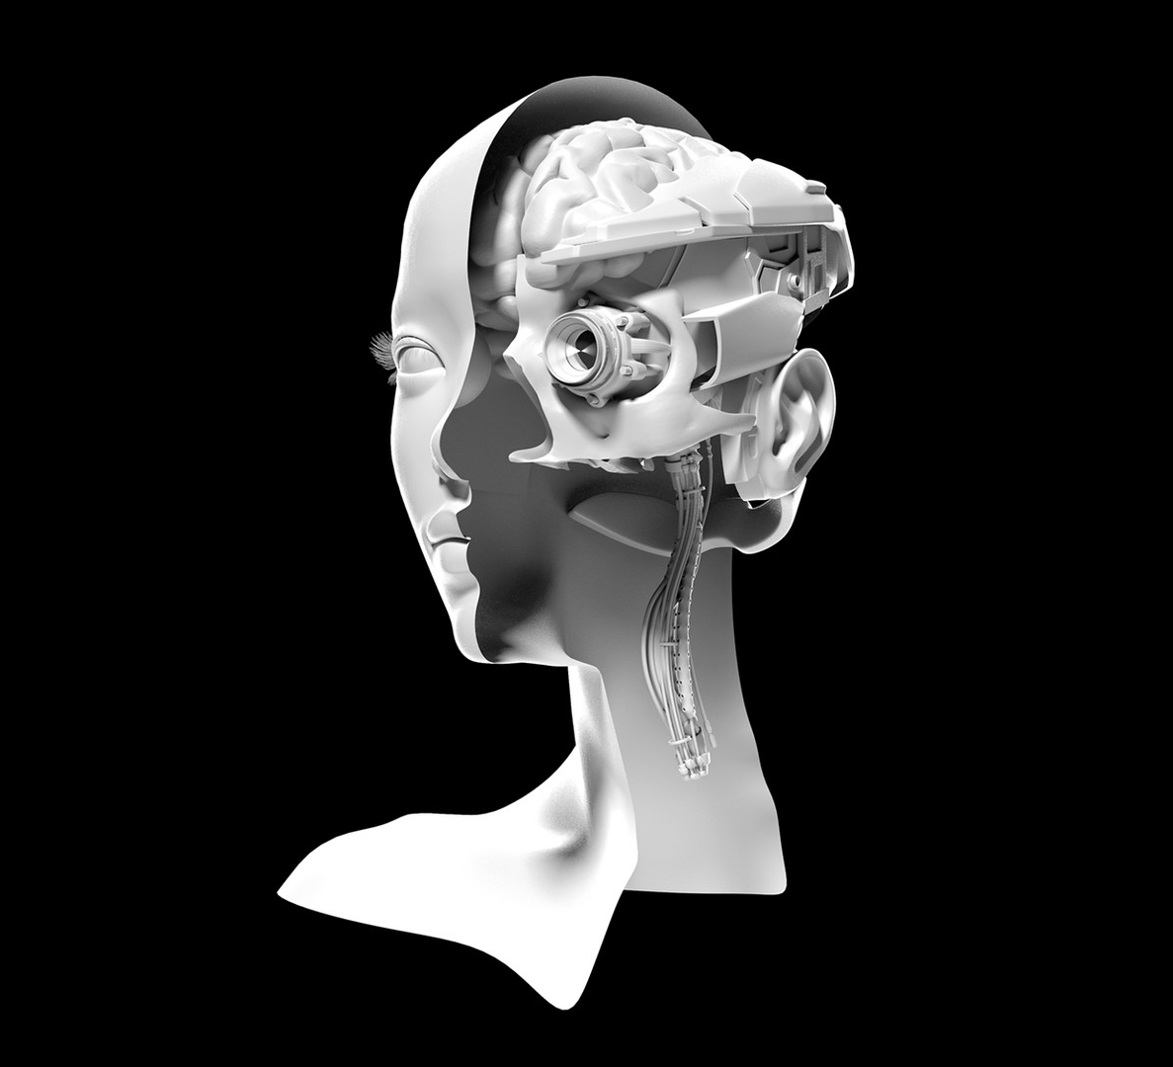
Some Ethical Concerns:
1) Offensive vs. Defensive Weapons
2) Altering Human Identity – particularly to Become better at warfare
3)selection of Research subjects and associated risk
Notes:
Picture from: https://www.theatlantic.com/magazine/archive/2018/11/the-pentagon-wants-to-weaponize-the-brain-what-could-go-wrong/570841/

Slide 5
Bioethics principles and requirements for research ethics
Requirements for Research Ethics
- Informed Consent:
  1. Voluntariness
  2. Information/disclosure
  3. Understanding
  4. Choice
- Risk/ Benefit Analysis
- Justice (subject selection)

Slide 6
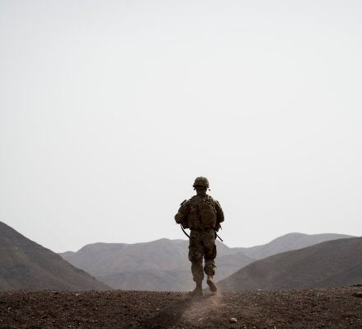
Military Context And Informed consent
Concerns about voluntariness and ethos in military
Strategies to mitigate?
  Special volunteer groups to test medical treatments
  Educational campaigns
Notes:
Picture: https://taskandpurpose.com/news/11-best-military-photos/

Slide 7
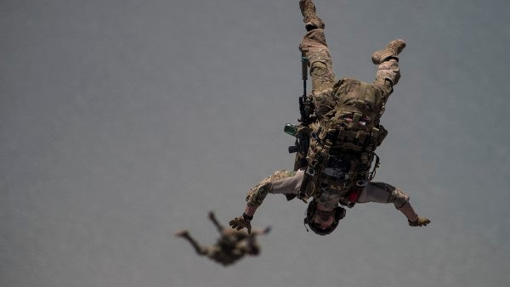
Military context, Risk/Benefit, & Justice
The military is comprised of a subsection of the US population – this subsection is not representative of the country more broadly. Are we adequately distributing the risks?
Are we asking members of the military to test something too dangerous? What does it do to our calculation when the members of the military are in life threatening situations and these technologies could potentially save their lives?
Notes:
Picture: https://taskandpurpose.com/news/11-best-military-photos/

Slide 8
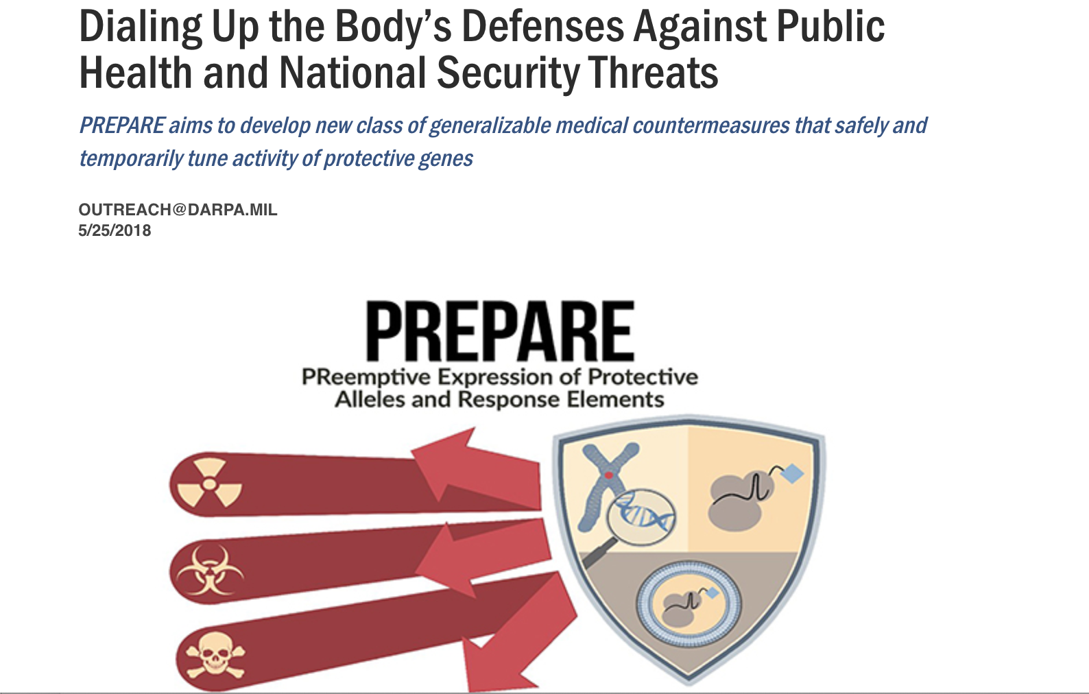
Reversibility
Right now, DARPA has focused publicly disclosed research on reversible technology.
What about non-reversible biotech?
Notes:
Source: https://www.darpa.mil/news-events/2018-05-25

Slide 9
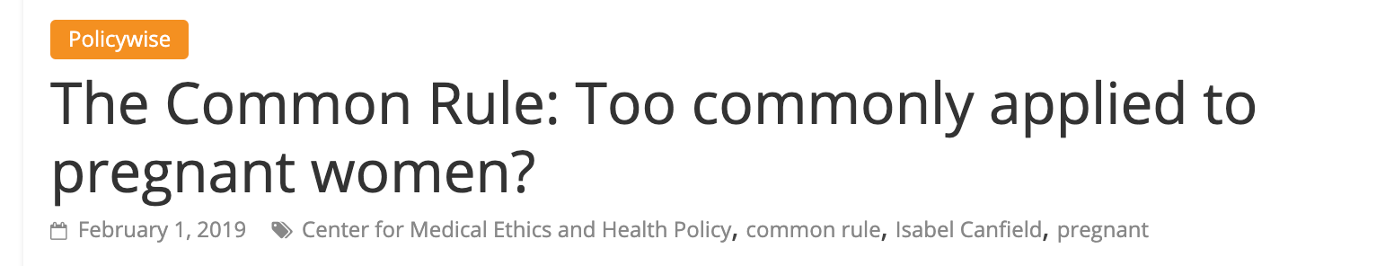

Dual Use Technology and Problems with Subject Selection in medical research
Demographic note: The US military is only 16% women.
What does that mean if the technology is developed in the military but is eventually used in the general public?

Slide 10
Future Research:
Looking at similar ethical challenges in Neuroethics and related technology
Expanding scope to consider international military use of biotechnology

Slide 11

Questions and Discussion
Notes:
https://www.cbc.ca/radio/quirks/arctic-salt-lake-eyebrow-communication-and-creating-captain-america-1.4612575/how-close-are-we-to-creating-a-real-life-super-soldier-1.4612579

