Slide 1
Social Media, Algorithms, and Virtue
Elias Chahoud
May 11th, 2021

Slide 2
Overview
Background and Timeline
Understanding Social Media Algorithms
Social Media and Human Psychology
Algorithms and Society
Finding Solutions
The Advertising Model
Considering Alternative Business Models
Cultural Barriers
Emphasizing Virtues

Slide 3
Timeline
1973 - The birth of chatrooms
1994 - Cookies
1996 - Communications Decency Act
1996 - Pop-up ads
2004 - Facebook founded
2006 - Algorithmic sorting
2006 - Twitter founded
2009 - The like button
2009 - Pull to refresh
2010 - Instagram founded
2011 - Snapchat founded

Slide 4
Background
Where did the internet go wrong?
1. Good intentions and free services
2. Wall Street and the price of keeping things free
3. Achieving user engagement through addictive design
4. Lack of accountability
5. Increasing polarization
Where do we go from here?

Slide 5
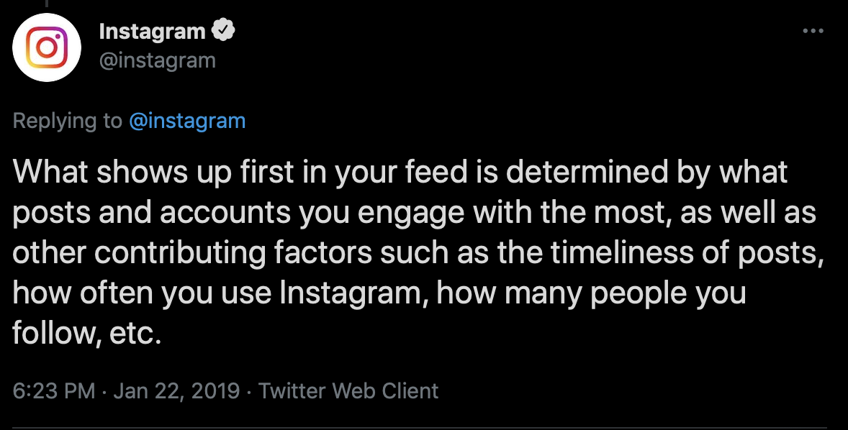
Social Media Algorithms
Algorithm feeds content specifically curated to a user’s interest
Facebook News Feed
Assortment of associated posts, even if not explicitly followed by the user
Goal: maximizing engagement
The more controversial the content, the more engaging
Promotion of misinformation, attacks, conspiracy theories, etc
Hyper-polarized filter bubbles

Slide 6
Social Media and Human Psychology
Design tactics
Endless scrolling and autoplay
The Endowment and Mere Exposure Effect
Maximizing engagement
Social Pressure and Comparison
Zeigarnik/Ovsiankina Effect

Slide 7
Social Media and Human Psychology
Heuristics - social media algorithms alter our perception of reality and create unrealistic expectations
Availability bias: things that come readily to mind are more representative than is actually the case
Extremity bias: the tendency of respondents to respond to the extremes
Confirmation bias: the tendency to interpret new evidence as confirmation of one’s existing beliefs or theories
Ideological homophily: the tendency to associate with others similar to oneself in political ideology; decreasing political diversity among social groups
Group polarization: the tendency for members of a deliberating group to move toward a more extreme point in the direction indicated by the members’ pre-deliberation tendency

Slide 8
Algorithms and Society
How have the algorithms used to tailer our social media experiences impacted society as a whole?
Good:
Organizing protests
Revolutions against oppressive regimes
Bad:
Viral fake news and hate speech —> escalation of conflict and genocide
Promotion of extremist groups; “groups you should join” and “discover” features
Long term use of social media —> measurable increase in polarization
Affective vs ideological polarization

Slide 9
Solutions?
Increasing exposure to different viewpoints?
“repulsion” away from opposing viewpoints
Sentiment analysis: use of machine learning to interpret opinions in bits of text
identification of extreme points of view
De-prioritization of the destructive —> reducing engagement?
Platform vs publisher —> liability and regulation as incentives

Slide 10
The Advertising Model
The main financial driver of social media —> advertising
default business model on the web
audience growth —> increased revenue
Investor storytime —> surveillance and selling ad slots
Expectation of surveillance and lack of privacy
Benefits of the advertising business model:
ease of access, supports free riders and those in developing worlds
preserves privacy by avoiding subscription with a card that can link online and real-world identity; ads deal with demographic/psychographic identity
Downsides
Invites surveillance and incentivizes clickbait
Centralization of the web
Intentionally inflammatory advertisements attract more impressions

Slide 11
Alternative media model
Premium subscription model: no algorithms, no ads
MeWe; “anti-Facebook” —> uses purely chronological feed with no manipulation or ads
A few dollars/month subscription = revenue Facebook gets from advertising
Advertisements —> ~$0.01 per hour per user
Increased competition, less centralization, more competitive innovation

Slide 12
Culture of Growth
The longstanding culture of growth among companies like Facebook resists change
Responsible AI team
Facebook leadership hesitant to undermine growth, even to deal with misinformation on the platform
“antigrowth” fixes unsuccessful; reducing engagement essentially considered a nonstarter
Pay incentives are still tied to engagement and growth metrics
“When you’re in the business of maximizing engagement, you’re not interested in truth. You’re not interested in harm, divisiveness, conspiracy. In fact, those are your friends. They always do just enough to be able to put the press release out. But with a few exceptions, I don’t think its actually translated into better policies. They’re never really dealing with the fundamental problems.”

Slide 13
Emphasizing Virtues
Changes in culture and practicing of virtues needed to solve the problems posed by social media
Relevant technomoral virtues:
Humility - “knowing what we do not know”
Civility - “a sincere disposition to live well with one’s fellow citizens of a globally networked information society”
Honesty - “an exemplary respect for truth”

