Slide 1
Genetics: a taboo science?
Genetics: A Taboo Science?
Thought experiment to show why the field of genetics is perceived as more taboo than other methods of human enhancement
-Also to show that the field of human enhancements isn’t quite as foreign as people might think: in fact, it’s already pretty widely employed through other means.
-Glasses, pacemakers, laser eye surgery, performance enhancing drugs, to name a few.
Notes:
Talk about aversion to genetics as a means of human manipulation, while other kinds are commonplace.

Slide 2
Genetics: a taboo science?
Genetics: A Taboo Science?
Thought experiment to show why the field of genetics is perceived as more taboo than other methods of human enhancement
-Also to show that the field of human enhancements isn’t quite as foreign as people might think: in fact, it’s already pretty widely employed through other means.
-Glasses, pacemakers, laser eye surgery, performance enhancing drugs, to name a few.
-We’re all fine with the idea of improving our vision with glasses, contacts, or laser eye surgery, but genetic engineering???
Medical Devices
-Pacemakers
-Prosthetic devices
Pharmaceuticals:
-Steroids
-Focus enhancing drugs (adderall)
-Cosmetic pharmaceuticals (Rogaine - causes hair to grow thicker and fuller)
Can seem almost obligatory in some cases
-School mandated eye exams
-Orthodontia
Notes:
Talk about aversion to genetics as a means of human manipulation, while other kinds are commonplace.

Slide 3
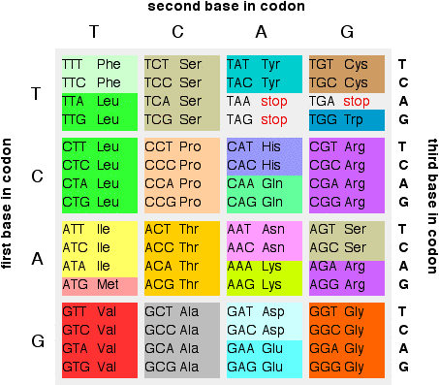
A Theoretical Gene
ATGAGGTCGGATACATTGAACTAG
- healthy gene, encodes a functional protein
ATGAGGTAGGATACATTGAACTAG
- mutant gene, protein lacks normal function because it terminates early
Suppose this is the CFTR gene, and causes Cystic Fibrosis when mutant. If we use gene editing technology (such as CRISPR/CAS9) to restore the mutant gene to normal, our patient will no longer suffer from Cystic Fibrosis.
Now Suppose this is the AR gene, which causes baldness in men when mutant. If we use the same gene editing technology to do the same thing, our patient will grow a full head of hair.
ATG - A start codon
TAG - A stop codon

Slide 4
If we allow these technologies to be used for therapeutic purposes, bad actors WILL be able to use them for the purposes of human enhancement. The only difference in the technology is what gene we target.
Notes:
The applications of this technology for therapeutic purposes are indistinguishable from its applications concerning human enhancement

Slide 5
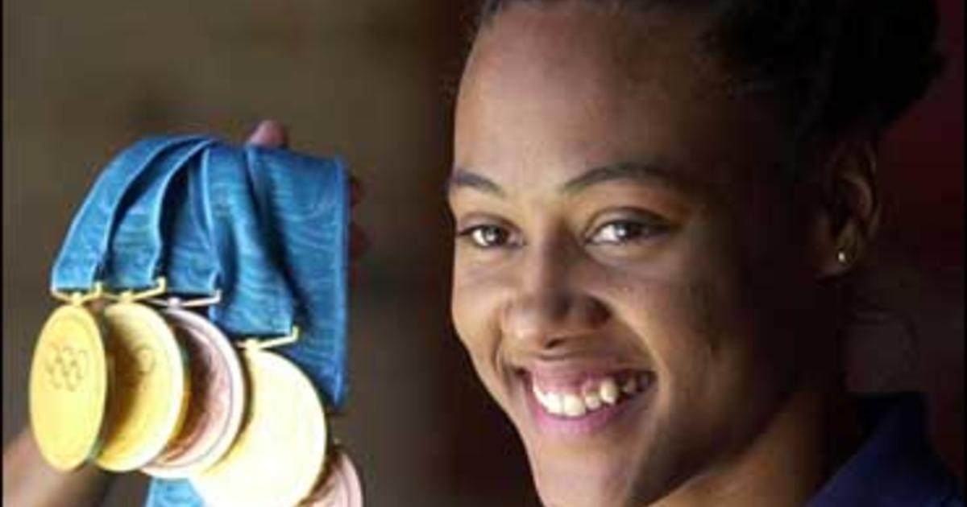
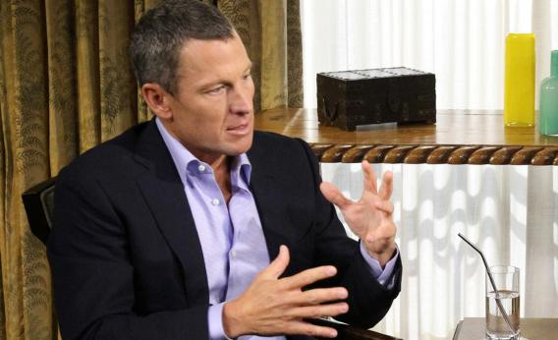
Why do Athletes use Steroids?
Oprah Winfrey: Did you ever take banned substances to enhance your cycling performance?
Lance Armstrong: "Yes."
Was one of those banned substances EPO?
"Yes."
Did you ever blood dope or use blood transfusions to enhance your cycling performance?
"Yes."
Did you ever use any other banned substances such as testosterone, cortisone or Human Growth Hormone?
"Yes."
In all seven of your Tour de France victories, did you ever take banned substances or blood dope?
"Yes."
In your opinion, was it humanly possible to win the Tour de France without doping, seven times in a row?
"Not in my opinion....”

Slide 6
A Fundamental Issue with Human Enhancing Technologies
You said to me earlier you don't think it was possible to win without doping?
"Not in that generation, and I'm not here to talk about others in that generation. It's been well-documented. I didn't invent the culture, but I didn't try to stop the culture, and that's my mistake, and that's what I have to be sorry for, and that's what something and the sport is now paying the price because of that. So I am sorry for that. I didn't have access to anything else that nobody else did."
Notes:
These kinds of technologies are unique in the sense that once they do exist, they cannot be taken back: people will use them for malicious purposes.

Slide 7
Common Concerns With Human Enhancing Technologies
Playing God - Frankenstein
The Gatica Problem
How can we be sure that tampering with our genes will be safe? What if there are adverse effects elsewhere?
There is an ongoing moral discussion about what it actually means to be human. If we can’t agree on what that is, how can we be sure that we don’t lose it in the pursuit of enhancements?

Slide 8
What is “safe?”
What do we classify as “therapeutic interventions?”
Are these two examples really “in contrast?”
“Drugs and medical interventions which are allowed by authorities such as the Olympic Committee are justified on the grounds that they are therapeutic interventions that treat conditions or illnesses. This also includes treatments such as laser eye surgery to improve eyesight (particularly common in shooting events and archery).
In contrast some performance enhancing drugs are banned because they place the health of the athlete at risk and because they contravene the spirit of fair play and do not promote integrity and unity in sport.”
- Bioethics Education Project (BEEP), 2008
Notes:
https://sportsanddrugs.procon.org/questions/why-are-some-performance-enhancing-drugs-legal-while-others-are-banned/

Slide 9
Beauchamp and Childress proposed the four principle approach in 1979, but we still see things like:
-A 1994 United States drug trial for the drug AZT on HIV-positive African subjects with the goal of developing treatments to reduce the transmission of HIV/AIDs during childbirth. According to Peter Lamptey, the head of the AIDS Control and Prevention Program, "if you interviewed the people in the study, most wouldn't understand to what they had actually consented." An estimated 1000 newborns of women in the study contracted HIV/AIDS, even though this could have been avoided by treating the women with known drugs.
-A 1996 clinical trial in Kano, Nigeria involving the Pfizer drug Trovan to treat meningitis resulted in 200 children being disabled and the deaths of 11.
And gives rise to the following questions…
-Why is it that, since the late 20th century (coincidentally when these principles were explicitly detailed), have African nations been the primary sites of clinical testing by large international pharmaceutical companies?
-Why is there documented cases of rural communities in these areas developing iatrophobia (fear of doctors) after undergoing or learning of highly controversial medical experimentation?
-Unfortunately, there are people who refuse to follow even the most fundamental rules.
Requirements for
Research Ethics
- Informed Consent:
1. Voluntariness
2. Information/disclosure
3. Understanding
4. Choice
- Risk/ Benefit Analysis
- Justice (subject selection)

Slide 10
November 25, 2018- He Jiankui announces to the world that he created the first CRISPR babies: twins born without the CCR5 gene.
This mutation, found naturally in 10% of Europeans, is known to confer resistance to HIV.
We do suspect that the CCR5 gene confers resistance to other viruses, specifically the West Nile virus, to which the twins would now be vulnerable.
The international community condemned He, who was disgraced as a scientist.
Called for a moratorium on human germline editing, something which requires a degree of international cooperation the likes of which we almost never see.
Additionally, lead to a vast expansion of restrictions placed on genetic research by governments and biotech companies alike.

Slide 11
“Incentives for a stunt like [He’s] are probably diminished in a country where there are clearer and easier paths to scientific status,” says Jonathan Kimmelman, who thinks that the next Mavericks will likely pop up in less well developed countries.
Indeed, more restrictions->more people doing research unethically
International community had concerns about how they might stop bad actors from ignoring the moratorium - after all, just about anyone can do CRISPR in their basement with a frog!

Slide 12
Vallor: Technomoral Wisdom
Vallor argues in her book that human enhancing technologies need to be pursued with specific goals in mind, otherwise we run the risk of allowing the pursuit of enhancements to drive its own course.
Yet, He’s scandal has been the primary thing driving the course of genetic research in the years since it happened - as technomoral agents, it would behoove us to make sure that this doesn’t remain the case.

Slide 13
A Starting Point for Discussion
Are research restrictions really the correct way to ensure that these dangerous technologies are developed ethically, or do they actually ensure that bad actors get their hands on these technologies first?
An overwhelming majority of medical literature published in the past 5 years has fallen into the domain of genetics, and its therapeutic applications are being pursued, for better or worse. However, if the applications of this science in medicine are truly inseparable from the applications for human enhancement, is it really a good idea to focus our policy making efforts on restricting research? Are there other stages in the process that might be a better use of our time?

