Slide 1
Decentralizing Finance: Solutions for Fintech and the Public
Luke Uhlman

Slide 2
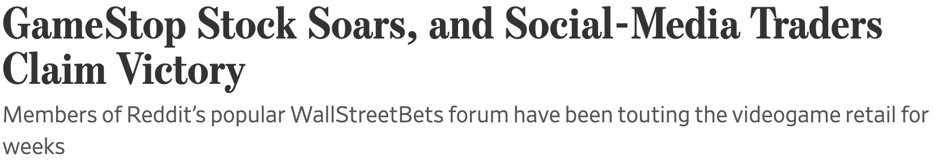
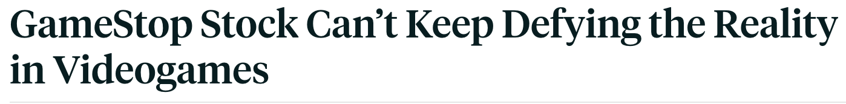
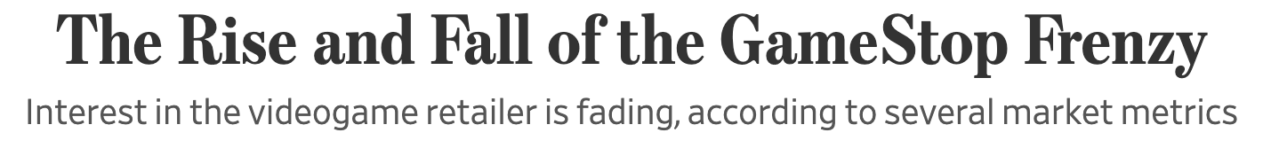
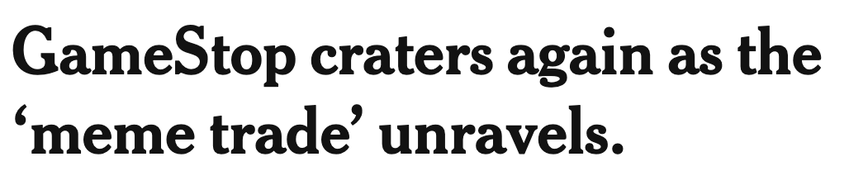
First, a Case Study…

Slide 3
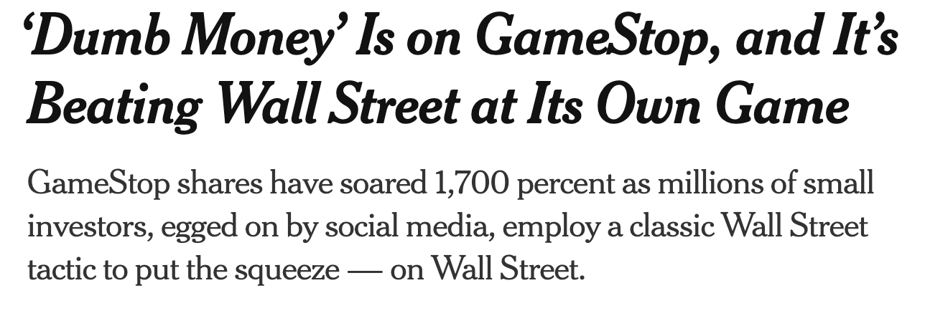
This frenzy placed Wall Street back under intense scrutiny…

Slide 4
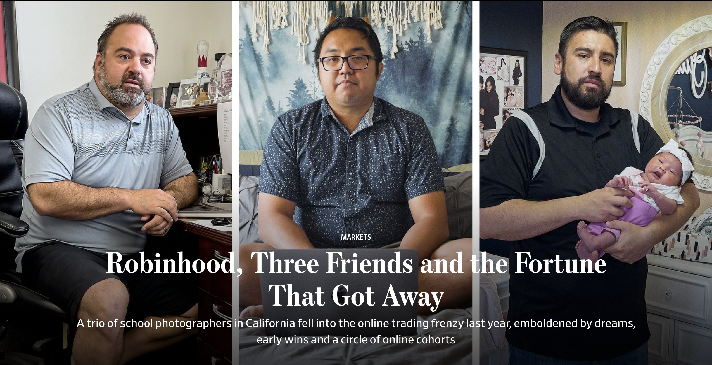
But the consequences of the short squeeze also created headlines like these…

Slide 5
Two Central Questions:
What regulations/warning systems should be in place so that those unacquainted with finance won’t lose more than they bargained for?
How might financial services be reimagined using the technology that is now available to us?
Notes:
Two Central Questions:
How can the financial services industry make the world a more fair/equitable place?
What regulations/warning systems should be in place so that those who don’t know any better do not lose more than they bargained for?

Slide 6
Part I:
How do we help those less acquainted with finance from being taken advantage of?
Notes:
While people can be taken advantage of through traditional methods (e.g., financial advisors), fintech resources are far more accessible (which is part of their value proposition) with less regulation. This means this threat is far more prevalent in fintech apps and in emerging currencies that have come to fruition due to technology.

Slide 7
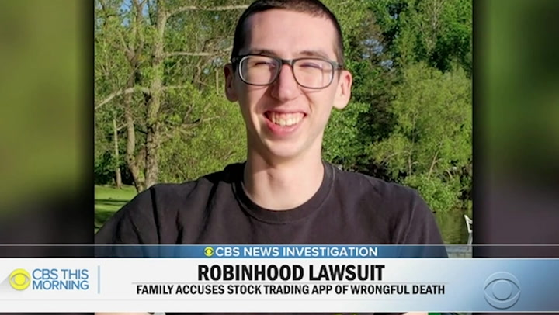
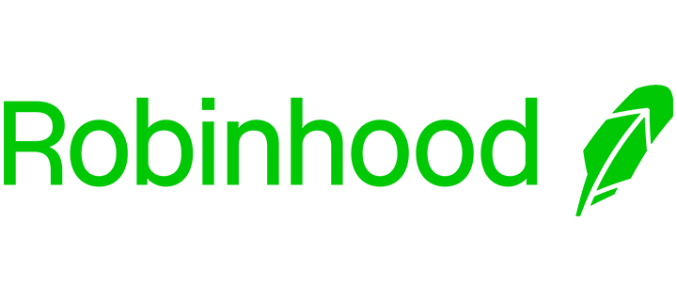
Example 1: Robinhood
Alexander Kearns, 20-year-old student at University of Nebraska
Took his own life due to accumulating over $700k in losses by trading in options
  Showed temporary balance- not how much he was in debt
He was new to options trading, had “no idea” what he was doing

Slide 8


Any Thoughts??

Slide 9
Discussion Questions
If self-control is the most pertinent virtue to allow customers to practice technomoral virtue…
Should people be allowed to make potentially life-altering trades (for the better or for the worse) without any sort of guidance?
Should the app have an algorithm in place where it can alert the user if they are about to make an unadvisable/strange trading decision?
What else might encourage customers to practice self-control when it comes to online trading?
If we want to include cryptos and NFTs into this conversation, should there be any sort of regulation or oversight when it comes to traders purchasing these products? Or is part of their value proposition that its future value is so unknown (unlike, say, a government bond)? How can we help people become more informed with making these decisions?

Slide 10
Part II:
How can technology help financial activity be safer, less costly, and more widely available to the public?

Slide 11





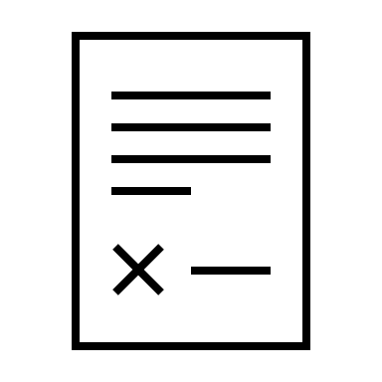
Decentralized Finance
is a new financial system
that is open to everyone
and doesn’t require trust
which makes use of
Cryptography
Blockchain
“Smart” contracts
Notes:
Financial products are available on a public network
Buyers/sellers and lenders/borrowers interact peer-to-peer
kh
Replaces ”middlemen” like banks or brokerages
Proposed systems would use software written on blockchain

Slide 12
Context: Why is “DeFi” being touted?
Modern financial infrastructure built on “hub and spoke” model
  Key economic centers (e.g., New York) are operational hubs
  Influence economic activity at spokes (e.g., Mumbai)
Financial services can be provided to anyone, anywhere
Current financial system is ripe for reimagining
Intermediaries like financial advisors no longer necessary
  Surveys to fit customers into 1 of 6 models aren’t worth it
Participation in financial markets will be maximized

Slide 13
Discussion Questions
Since DeFi is still in a nascent stage of development, there isn’t a lot of information about how this model would be regulated. From a policy perspective, what concerns would you want to explicitly address if this model were to be implemented?
The “code is law” theory is worrying to some. How do you feel about this concept, and does it undermine the viability or attractiveness of a DeFi model?
A more general question concerning the financial services industry: why is financial literacy not taught in secondary school (i.e., before college)??

