Slide 1
Technology and the Virtues, Chapters 9 & 10
By: Luke Uhlman

Slide 2
(9.1) robot ethics as virtue ethics
Roboethics is the study of robot ethics, but how do robots affect the cultivation of virtue?
Deontology and Consequentialism are the dominant ethical frameworks used
Vallor believes these ethical traditions are, by themselves, inadequate for roboethics
  Too rigid and stagnant for the ever-changing nature of technology
  Not to say deontology and consequentialism have no role to play at all in roboethics
First, we will look at autonomous military robots…

Slide 3
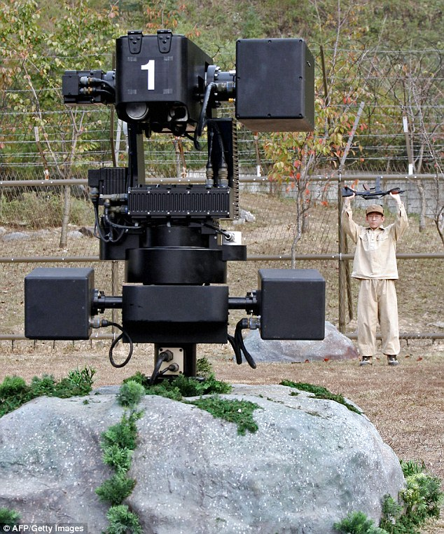
(9.2) Autonomous Military Robots: Courage and Hope for the Human Future
Semi/fully autonomous military robots:
  Sense, and act upon information gathered from the physical environment
  Calculate and select courses of action independent of human judgement
Development of robot soldiers with moral AI underway
Debate centers around robots with lethality capacities
Courage is the most relevant virtue for this issue
How can policymakers reward technomoral courage to realize the potential of emerging military technologies?
Discussion Questions:
Is courage the most pertinent technomoral virtue at play in the discussion of emerging military technologies? If not, is there any other technomoral virtue which you think is more relevant?
Samsung Techwin SGR-1 Robot

Slide 4
(9.3) ‘Killer robots’ and technomoral courage: the ‘troubles we do not avoid’
Physical injury/death vs. moral injury
  Virtue ethics tradition tells us to fear moral injury more
  Do killer robots spare us from experiencing moral injury?
Asymmetrical warfare: drone warfare vs. low-tech methods
Cultivating moral virtue embedded within military profession
  Selfless service: what distinguishes soldiers from criminals
Hope in military combat: victory, honor in defeat, or more?
Are we at an inflection point with automated lethal robots?
  Hope of preventing endless warfare could be gone if we don’t act
Discussion Questions:
Do we find ourselves at a Wallachian inflection point that we ought to be gravely concerned about? Do autonomous military weapons actually afford the global community a chance to engage in inevitable warfare in a far more humanistic way? More generally, does the use of autonomous military robots aid or hinder our ability to pursue (technomoral) virtue?

Slide 5
(9.4) Carebots and the ethical self
‘Carebots’: social robots designed to assist vulnerable people (elderly, sick, etc.)
Functions that Carebots perform (other than basic caregiving tasks):
  Monitoring the status of those receiving care
  Providing companionship to those under care
Naïve technophilia and reactionary technophobia are equally unwise
Categories and questions of ”roboethics” (as laid out by Mark Coeckelbergh):
  Can artificially intelligent robots be considered moral agents, and deserve “robot rights”?
  Can traditional ethical theories be applied to human-robot interactions?
  How does our interactions with robots affect us as social and emotional beings?

Slide 6
(9.5) Technomoral care in relations of human dependence
‘Care’: an activity, an art, and a virtue
Should we aim to ‘reduce the care burden’ on caregivers?
Vallor believes there is a moral good internal to caregiving
  Moral meaning of reciprocity, putting empathy into practice
Nel Noddings’ two criteria for a caring commitment:
  Engrossment: understanding/processing the reality of the other
  Motivational displacement: actively addressing the other’s reality
We must meet the fear of caregiving with courage
Carebots could sustain rather than liberate human caregivers
Important to consult with recipients of care about which levels of human and robot interaction they prefer
Discussion Questions:
Do you think that humans will ultimately cede the responsibility and burden of caregiving to robots? Is there a way you see for us as a society to strike the medium between bearing all caregiving responsibility ourselves and just letting robots do this emotionally straining work? What can we do today to ensure that our vulnerable are adequately cared for?

Slide 7
(10.1) Competing visions of human (or posthuman) flourishing
Human enhancement technologies:
  Genetic, biomechanical, nanomedical, pharmacological (alone or combination)
What technomoral virtues do humans need to enhance themselves?
Vallor disagrees with bioconservatives’ view on human enhancement
  Arguments are unclear, particularly about how they define human dignity
A contingent argument from virtue is far more persuasive…

Slide 8
(10.2) technomoral humility, wisdom, and the argument from hubris
Objection: transhumanists are guilty of technomoral hubris
  Vallor calls for technomoral humility: an honest assessment of our ability to wield technological power responsibly
Technomoral courage as a mean between cowardice and rashness
Technomoral humility, courage (et. al) make up technomoral wisdom
We must know what it is that we ought to wish for, rather than blindly allowing enhancements to chart their own course
Recommit to moral self-cultivation for the safety of our descendants
  Biomedical or pharmacological means of accelerating this process?
  Invest resources in the wider cultivation of technomoral virtue/leadership
  “Science-sophy”: wisdom about appropriate uses of scientific/technical power
  Sacrifice enhancements that impede our cultivation of technomoral virtue
Discussion Questions:
What are your thoughts on Vallor’s proposed solution to ensuring that human enhancement technology doesn’t get out of hand? Should she have gone into more specifics as to how we should allocate resources for the cultivation of technomoral virtue? Is her solution actually feasible?

Slide 9
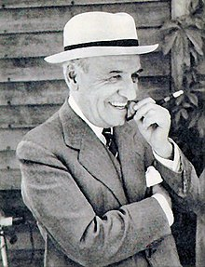
(10.3) technomoral virtue and contemporary life: a crisis of moral wishing
”Autofabrication” as a project of self-realization
  Actions will become increasingly lacking in purpose
Must have clear intentions for leveraging technology
  Will extending life provide us more time to live well?
Directionless seeking due to multitude of choices
“Crisis of wishing” paralyzes our practical wisdom
Vallor wrote this book to expose the gap between technosocial power & technomoral wisdom
Discussion Questions:
Any general comments on Ortega y Gasset’s writings as described by Vallor? Is our mass consumer culture to blame for society’s lack of technomoral wisdom? Is Ortega y Gasset’s prediction of the future (without substantive action) too pessimistic or is it valid?
José Ortega y Gasset (1883-1955)

