Slide 1
VALLOR CHAP 1 & 2 PRESENTATION
CLASS PRESENTATION: ETHICS IN TECHN POLICY
MARCH 16

Slide 2
1.1 “Virtue” the term
Historical association
“Virtue”’s true meaning in the context of Philosophical ethics
Greek: arete - excellence, “moral sense entailing excellence of character”
Chinese: De “ethical power of the exemplary person”
Buddhist Ethics: Sila, “character that coordinates and upholds right conduct”
Questions
Methodologically speaking, do you think there are advantages in Vallor using global examples of “virtue” to define the meaning of the word?
What do you think about similar concept of “virtue” appearing in different and disconnected ancient cultures? Does it mean such concept could be innate?
Is Vallor’s definition of “virtue” satisfying? Why use a word with historical baggage instead of choosing a new word?

Slide 3
1.2 Aristotelian Ethics
1. “Moral virtues are… states of a person’s character; stable dispositions such as honesty,...” (P18)
2. “They are states that the person must cultivate in herself… The virtuous states emerges gradually from habitual and committed practice and study of right actions.” (P18)
3. “virtue implies an alignment of the agent’s feelings, beliefs, desires and perceptions” (P18)
4. Practical wisdom: the agent is never blindly courageous or loyal. The agent knows how to judge the appropriate situation (P19).
5. Virtuous people are moving towards the good life, This entails the incompatibility with moral relativism.
6. Aristotelian notion of happiness: even when starving or suffering, the agent can still be happy, as long as the she is virtuous. Virtue is necessary, if not sufficient for living well and happily.
Questions:
In our contemporary world, do we still have a single notion of what is the good life? What’s our different definition of happiness? Does technology push us further away from the Aristotelian definitions of the good life and happiness or the contrary?

Slide 4
1.3 Contemporary Renewal of Virtue Ethics
Disfavor of virtue ethics in the 19th and 20th
Turning point: 1958, Anscombe, “Modern Moral Philosophy”.
Internal disagreement
External resistance
Challenge to applying virtue ethics to real world problem: globalization & cultural differences

Slide 5
1.4 Virtue Ethics and Tech Ethics
Acute techno-socio opacity and virtue ethics
Technical convergence
The three waves of philosophy of technology: pessimistic -> sufficient hope to find robust tech ethics -> “the empirical turn”
Problem with the field: philosophy of technology
Questions:
Do you agree with Vallor that virtue ethics is the best in facing techno-socio opacity and technical convergence?
Do you agree with the problem with ethics of technology studies that Vallor points out after we’ve studied Wallach?

Slide 6
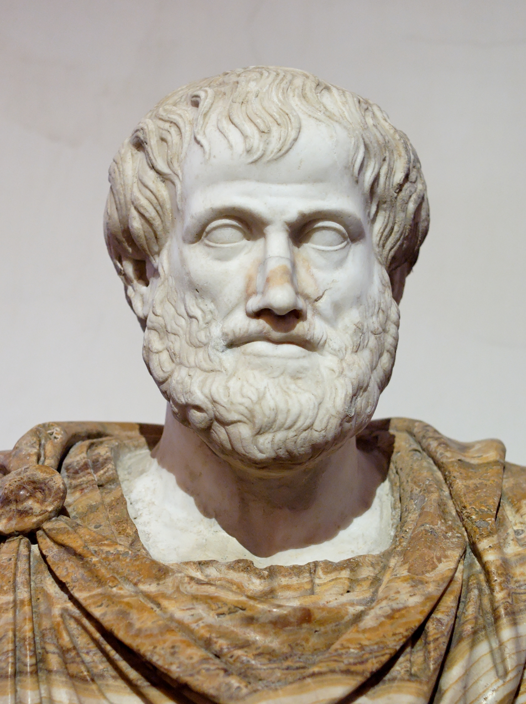
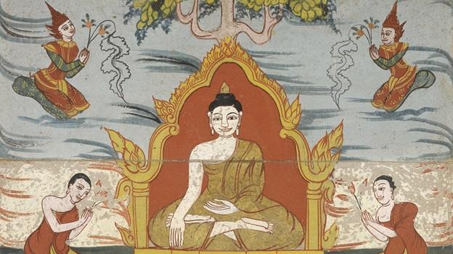
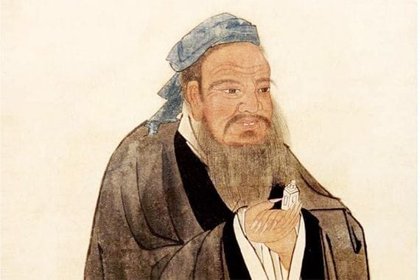
2.1 Varied Traditions
Similarities and differences among virtue traditions
Blindspots and weaknesses of ancient traditions
A comparison

Slide 7
2.2 Challenges and Solutions
Are confucianism and buddhism virtue traditions?
MacIntyre: Thick vs. Thin concepts
Shared Thin concepts among mentioned traditions:
1) conception of “higher human good”
2) moral virtue as a cultivated state
3)practical path of moral self-cultivation
4) a conception of what human beings are generally like.
4. Internal goods in techno society
1) global community;
2)intercultural understanding and global justice
3)human security,
4)collective human wisdom

Slide 8
2.3 Steps to Progress
Step 1: “start from guiding concept of a virtue as a character trait that enables us to cooperatively achieve internal goods”
Step 2: “recognize in the current human environment the emergence of new coordinated technosocial practice with its own distinctive moral goods. “
Step 3: “grasp the chances of humans flourishing: coordinate decision and activities to secure these moral goods.”
Step 4: “begin to cultivate the set of moral virtues identified.”
In the meantime: Don’t be afraid to adapt, extend or qualify traditional virtue concepts.
Question:
Vallor provides a step-by-step solution based on virtue ethics. Are you satisfied? Is it a clearer solution between what we’ve encountered so far?
Does vallor make assumptions in her identification of internal goods in the techno society? Do you agree?

Slide 9
2.4 Cultural Challenges
Objection 1: No common agreement on the human goods defined
Solution: 1) complete agreement and support not necessary; 2) the goods identified are relatively fundamental
Objection 2: Different goods entail different actions in varied cultures
Solution: 1) ethical pluralism 2) similarities in cultures already 3) special requests during special event 4) develop new set of global virtue ethics
Question:
Do you think Vallor answers the two concerns successfully? Do you have other, different objections?

