Slide 1
Chapter 6: Engineering Of organisms Chapter 7: Mastery of the human genome

Slide 2
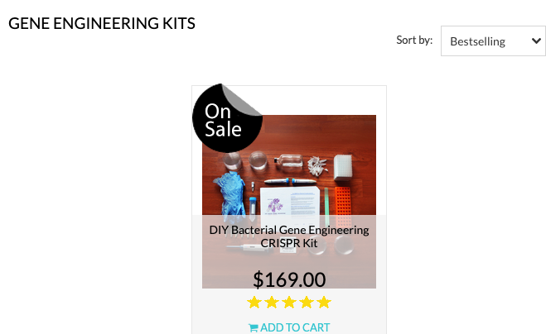
The Odin and The biohackers
A Case Study

Slide 3
TIMELINE Genetics/Genomics
2018: CRISPR-baby
He Jiankui used the CRISPR gene-editing system to edit DNA in human embryos to make them less susceptible to HIV.
1866: Mendel
Medel’s pea plant experiments led to the discovery of dominant and recessive traits.
1977: Sanger
Develops rapid DNA sequencing techniques
1953: Watson & Crick AND Rosalind Franklin
1859: Darwin
1990: The Humane Genome Project
Darwin writes On the Origin of Species and in doing so popularized the idea of evolution. Built around: heredity, variation, and natural selection
Note: The first use of the term “eugenics” was around 1183
Described the structure of DNA (the ”source code” for life) - changes in individual base pairs serve as a simple vehicle for genetic mutations.
The project's goals included mapping the human genome – which succeeded in 2003

Slide 4
Research Ethics Fundamentals
The horrific history of human subjects research eventually led to the development of formal regulations
Things to consider in research ethics:
Respect for Persons (consent)
Paternalism vs. Beneficence
Justice (fairness)

Slide 5
Top-Down and Bottom-Up Engineering
Key Regulation
Three Crucial Questions

Slide 7
GMOs – Golden Rice
Are GMOs too harmful to be produced? Have we passed the inflection point? Reflections on the Golden Rice case study?

Slide 8
Chimeras: or Human/animal hybrids
Is this sort of research rightly prohibited? Or are there good enough benefits to pursue this research?

Slide 9
Rapid Increase of sequencing
Personalized Medicine Goals
Concerns:
Privacy (GINA)
Harms to small groups and harms of research

Slide 10
Reproduction, Stem Cells, and Designer/ test-tube babies
Frist “test-tube” baby was born in 1978
Debates on personhood status of embryos
Debate over stem cell research
Debate over PGD and eugenics
Dolly and cloning

Slide 11
CRiSPr/cas9 Babies
Other variations that would be more acceptable? Or is the moratorium on this research warranted?

Slide 12
The inflection Point
Is the next inflection point going to be in cloning a human as Wallach suggests?
Have we reached any inflection points in widespread use of genomic/ genetic technology? If so, what are they?
Has your initial opinion of The ODIN and at home biohacking changed at all?

