Slide 1
Ethical Hacking: A Possible concept?
Term paper work in progress presentation
April 15th

Slide 2
Main argument(s)
There’s no definite line separating ethical and unethical hacking.
The virtue ethics framework might be the be best framework to judge if certain hacking activities are ethical.
Hacktivism presents ethical problems for the global technosocial community that might be harder to solve even within a global virtue ethics framework as Vallor suggests. Therefore needs more attention.
Notes:
As the problem is complicated and case-by-case and evolving fast with the rest of tech world

Slide 3

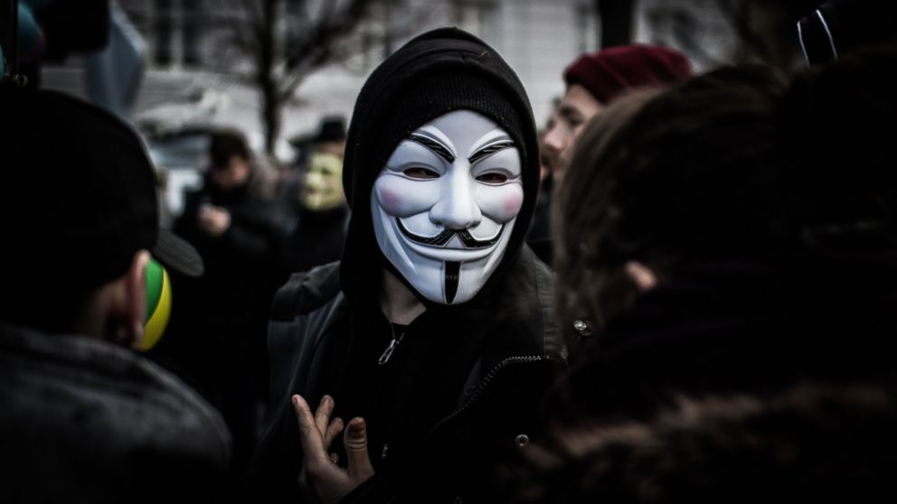


Categories
Black, grey and white hat hackers. I’m focusing on white hat hackers.
Hacktivist(Main focus)
Hacking for Business
Hacking in Education

Slide 4
What’s considered ethical now?
Simple definition of “white hat”: authorized hacking.
Popular Distinction: hacking for one’s ethical purpose vs. ethical hacking.
COG conference 2011, Hacker Self Regulations (黑客自律公约): Any hacking activities for pure personal gain shall be unethical; social impact should always be considered...
Notes:
A literature review.

Slide 5
How else to consider what’s ethical hacking?
Deontological evaluation: do we agree with universal hacktivism? Even when we become the victims?
Vallor: Honesty and justice (are hackers with whistle blowers’ spirit manifesting the virtue of honesty and justice when exposing truth? ) Self-control (say no to illegal profits)
Virtue Ethics in general: is hacktivism aiding human flourishing?

Slide 6

Case 1: Anonymous
Complexity of activities: Jessi Slaughter and help during the Arab Spring contributed to the same group.
Fluid agenda: No fixed political agenda; no fixed members
Different from traditional protests: bigger impact on bystanders’ lives (DoS attack diabeling services etc.); secrecy about true identity...

Slide 7
Case 1: Anonymous, So What?
Hard to have an overall evaluation of the ethics of the group’s activities
Hard to evaluate future ethical standing of the group
Illegal means for good purpose? How can the purpose be judged to be ethical?
Whether the purpose for hacking is ethical--- whether it’s for human flourishing?
With the great flexibility, the only way to have the group ethical is to depend on virtues(honesty, self-control) of its members.

Slide 8
Case 2: the HUC
Different conceptions: national hero vs. cyber crime
When hackers build their clear ethics system based on other traditions: HUC with Daoism, “Xiake”, and “Jianghu”.
What’s certain hacktivism against? Who’s benefiting from hacktivism?
Hard to evaluate if certain hacktivism is ethical from different standpoints
How to incorporate hacktivists’ self-defined ethics into our ethical framework when it’s possible? Virtue ethics seem to be the best option, again.
Hard to separate hacktivists from political entities sometimes, which makes ethical evaluation harder.

Slide 9
Other Cases
Hacking in Education:
handing the weapon to more people. How to make sure the gun is used for defense, not attack?
Thus the importance of virtues in hacking education.
Hacking in Business:
Is it ethical to hack back?
Cases where ethical hackers were being exploited for illegal activities unknowingly. Thus the importance of maintaining individual judgement.

Slide 10
Questions
What do you think are some virtues that Vallor lays out and can be used for the case of hacktivism?
Other cases that I might not have heard?
Weak points in my argument? Where do I fail to convince?
What do you think makes the most sense?

