Slide 1
The Entrepreneurial Ecosystem: shifting away from exuberant technological colonialism toward a more humane and virtuous landscape.
By Kekoa Wong

Slide 2
Scattered Inspirations
“Move Fast and Break Things”
Harmful impact of technological innovations
Technologies are “extensions of the human value contexts in which they operate”
Behavioral Economics
Assumption of limited rationality in traditional economic models
Prospect Theory
Human moral and virtuous development
Notes:
“Move Fast and Break Things”
Facebook’s slogan before 2010
Young entrepreneurs inspired by models such as Facebook, in which they are encouraged to hustle and gain quick traction. Work with Idea Center, constantly about hustling.
Entrepreneurs who are in this hustle and rushed state are not very concerned with ethics, they are simply trying to finish a job for a goal
Relate to hustling with homework and schoolwork. Under the time and pressure crunch, you learn/retain a lot less
From my own experience, also cheat a lot more. There are the professors who assign an absurd amount of work for a week and then you split the work amongst your friends because you are simply trying to get it all done for a good grade.
This is the state of the hustled and rushed entrepreneur in the current ecosystem.
Harmful impact of technological innovations
Talk about addictive behavior and value capture
Tiktok variable reward
Robinhood gamification of stock trading due to gaining profit from order flows.
Vallor quote “technologies are “extensions of the human value contexts in which they operate”
Behavioral Economics
Assumption of Rationality
Talk about the multidimensionality of human wants and needs
We are not fully selfish creatures, and the way we fulfill our needs is tied to much more than our own wealth maximization
Prospect Theory
Human Moral and Virtuous Development
Rawls, psychologist Lawrence Kohlberg and Vallor

Slide 3
Overview of Presentation
Prospect Theory
Stakeholder Capitalism
Finance and the Good Society (book by Robert Shiller)
Proposal (largely based on these sources)

Slide 4
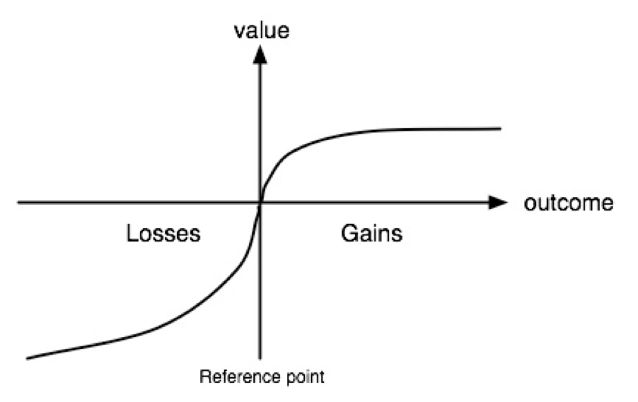
Prospect Theory
Diminishing Sensitivity
Reference Point
Loss Aversion
What are your thoughts on this theory and its
challenge to traditional rationality?
Notes:
Diminishing Sensitivity
Point out the axis
Give an example of gaining a 1 million vs 2 million vs 89 million vs 90 million
Give an example of playing poker and going all in.
Reference Point
Framing in marketing, how you phrase a question
Such as saying you have a 98% chance to live, vs. 2 out of every 100 people will die
Loss Aversion
We generally behave in a way that will avoid losses than seek gains of the same utility.
Example of a coin flip, losing $100, or gaining $110.

Slide 5
Stakeholder Capitalism
Literature by Prof. R. Edward Freeman (University of Virginia) and Prof. Kirsten Martin (University of Notre Dame) to build stronger ethics and deeper understanding of the human into theories of capitalism.
Complexity
Value-Creation instead of Value-Capture
Notes:
Complexity: Meaning humans are much more complex than simple profit maximization
We act for the interest for others
We are social creatures, enjoy cooperation
There are a lot of psychological factors that go into our decision-making
Value Creation instead of Value-Capture
Economic theories focus on the competitive capture of the market share, rather than complex value creation
We may look at a market and say that we can capture a certain proportion of the market, assessing along the single dimension of monetary value
Example of stakeholder value creation: the idea of philanthropy, or donations are not able to be assessed with this idea of value capture. However, philanthropist are still getting value by furthering a cause in their donation, or improving their public image. Only issue is that this is not easily capturable by an easy metric, such as stock price.

Slide 6
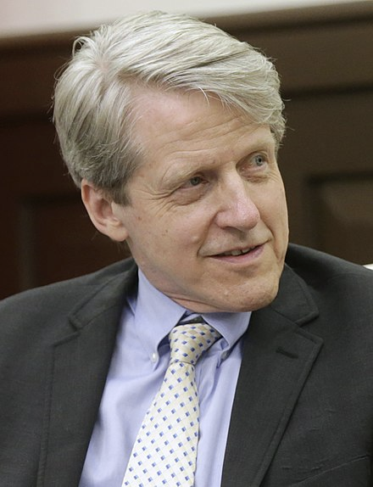
Finance and the Good Society
By Robert Shiller
Useful Topics Covered:
“Irrationality” present in markets
Issues with CEO incentive structure
Non-profit investment
Philanthropy
Notes:
By Robert Shiller
Nobel Laureate in 2013 for Economics
Professor at Yale
Referenced in Pasquale’s book for Irrational Excuberance
Useful Topics Covered:
“Irrationality” present in markets
Challenged the efficient market hypothesis
Argues that much of trading is made based off of emotion and human narratives
Quant trading cannot replicate this, and is not necessarily a better form of trading. Business is innately a human business.
Issues with CEO incentive structure
Enslaved to short-term gains in the stock price
Non-profit investment
Non-profits that rely on donations do not have psychological investment of donors. Proposed a type of non-profit that has share price, to keep investors engaged in the organizations. Ownership is a valuable tool, and donors do not feel like owners necessarily.
Philanthropy
Argues for better ways and incentives for philanthropy,
Rich people want to find redeeming ways to give their money away.

Slide 7
Main Question
How might we place the entrepreneur in a system that pushes them to cultivate more virtuous, or socially beneficial, behavior?

Slide 8
Proposal: Entrepreneurial Pledge
Pledge: Any shareholder who holds voting shares in a young venture will pledge to use only a certain amount (say $20 million) of their shares for personal use.
Anything over this amount must be invested into other “pledge” organizations or non-profits, or donated in some way.
Shares can still count toward one’s net worth..
Notes:
Give example of Zuckerbergs pledging to give away shares. Still count toward net worth but must be donated
Initial Expectations and Pledge:
Multidimensional motivations
Talk about motivation
The low reference point original position
The original position pledge
Low reference point and ignorant of future holdings
Relate to prospect theory, not a large difference for personal wealth between 20 million and 80 million.
At that point in time, do not know how successful of a coroporation they will be
Inspired by Rawl’s original position and veil of ignorance about their standing in society.
Obviously an entrepreneur thinks they are the most talented person in the world and will def succeed.
Cap shares that can be used for personal wealth at some limit
Rest can count towards their net worth.
Be used to invest in future pledge organizations or non-profits.
Limit to profit for climate change
Push their moral development beyond wealth maximization.
Looking at the moral development in Rawls, Kohlberg, and virtuous development in Vallor
Place entrepreneur in a position to give right to shares to certain NGOs
Shareholders would have stake in value of company.
Give an example of oil companies and who has share in them. We all have to lose money together.

Slide 9
Support
Original Position Pledge
Prospect Theory
Rawls original position and veil of ignorance
Multi-dimensional motivation
Natural Tendency for Philanthropy
Finance and the Good Society
Stakeholder Capitalism: Complexity and Value Creation
Ecosystem for Moral Cultivation
Notes:
Original Position Pledge
Prospect Theory
Logorithmic Value
Psychological Value between $1-20 million is great, whereas the difference between 20-50 million would be much less.
Rawls original position and veil of ignorance
Idealized version of justice, in which individuals who were all in the same position have to determine rules of justice. Additionally, in this OP individuals have a veil of ignorance, meaning that they do not their talents or standing in society when they enter society out of this OP. Rawls argues that this collection of individuals would form rules of justice. This situation is not that close to the same, as most entrepreneurs are privileged individuals who can afford to to go on a venture. However, it is definitely inspired from it as these individuals do not know if they will be extremely successful ventures in their future. As most individuals who lack have a reference point of a few thousand dollars agree that exorbitant wealth and greed are , I would argue that many would agree to these conditions, because at their point largely because they still view 20 million as a huge success from their reference point. The decision to pursue more money becomes harder as one increase their wealth and greed kicks in, but at that point they had already agreed to the terms.
Multi-dimensional motivation
Motivated by social power, authority, public image, and publicity beyond personal wealth. While some of these traits can be tied to money, they are distinctly different from personal wealth alone. An individual who is still pursuing to increase their public image due to wealth can still achieve this through pledge organizations, since it can be counted toward their personal value. Just that it has to be used to give to others instead of a yacht.
Natural Tendency for Philanthropy
Finance and the Good Society: argument that we cannot achieve the spoils of all our wealth.
Stakeholder Capitalism: Humans are more complex than a value maximization and philanthropist still get value out of giving
Life paradox that one can gain more by giving
Philanthropy is not necessarily virtuous, one can still gain be solely pursuing their public image and rationally realize that they can gain more in their public image by donating than by solely pursuing more money.
Ecosystem for Moral Cultivation
Kohlberg’s Moral development, Rawls moral development, and Vallor Virtues development
Arguing that while taking this step does not necessarily make a person virtuous, is does put them in an ecosystem that is not solely enslaved to one dimension.
For example, an entrepreneur who has moved to improving their public image, would not be a virtuous person necessarily by Vallor, but they would have a higher stage of moral development than a person solely pursing wealth maximazation according to Kohlberg. One can see this person who is pursuing public image to be faced with a choice to potentially increase their company’s value by doing something corrupt, which would decrease their public image, and thus not doing it
There is this realization among the elite that giving one’s money away brings more joy than trying to hoard it, even in such controversial books such as Carnegie’s gospel of wealth

Slide 10
Open Discussion
General questions about proposal?
Feedback (especially from business students)?
Anyone with previous research/experience in area?

Slide 11
Further Research:
Investor Relations
Will investors be willing to invest in these companies with the limited payoff for personal wealth?
Would corporations still be more motivated by some data collection and would this proposal be ineffective at making individuals motivated beyond profit?
The exit strategy: public company or company acquisition.
Tax incentives.
Notes:
Investor Relations
Will investors be willing to invest in these companies with the limited payoff for personal wealth?
Argument: will act like an investment non-profit
Would corporations still be more motivated by some data collection and would this proposal be ineffective at making individuals motivated beyond profit?
The exit strategy: public company or company acquisition.
Tax incentives.

