Slide 1
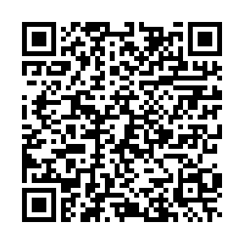
Insurance Career Night Tuesday February 21st at 7:00pm Room 512 Duncan Student Center Companies Include: Northwestern Mutual, Elevance Health, Allstate, Allianz, Prudential, Oneamerica, and Aon

