Slide 1
Chapter 2 - Hydrostatics
CE30460 - Fluid Mechanics
Diogo Bolster

Slide 2
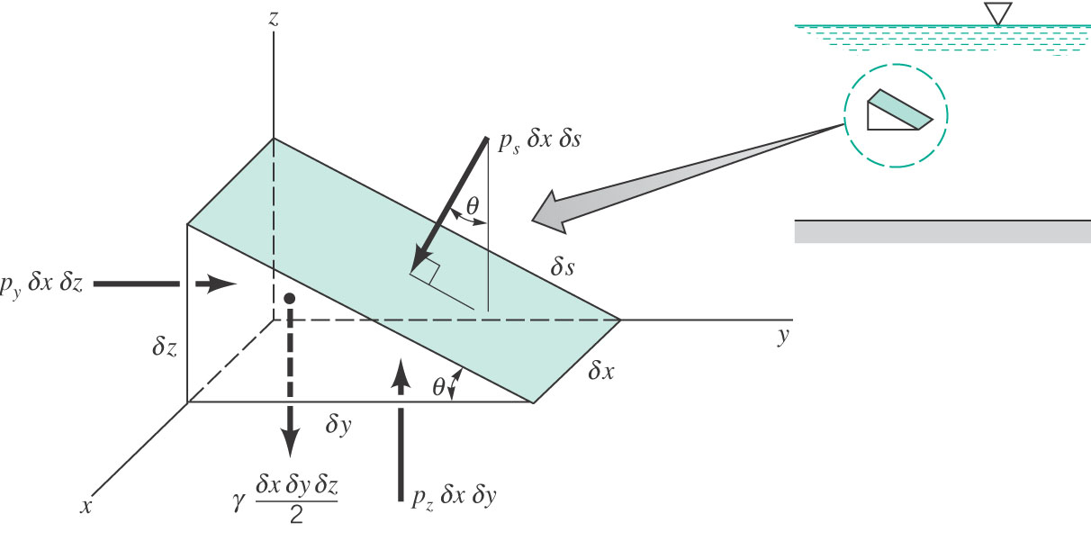
Pressure at a Point Consider the following setup
The sum of forces on immobile infinitesimal element is zero.
Horizontal
Vertical

Slide 3
Pressure at a Point Consider the following setup
Conclusion: The pressure at a point in a fluid at rest does not depend on direction
As long as no shearing stresses are present (Pascal’s Law)

Slide 4
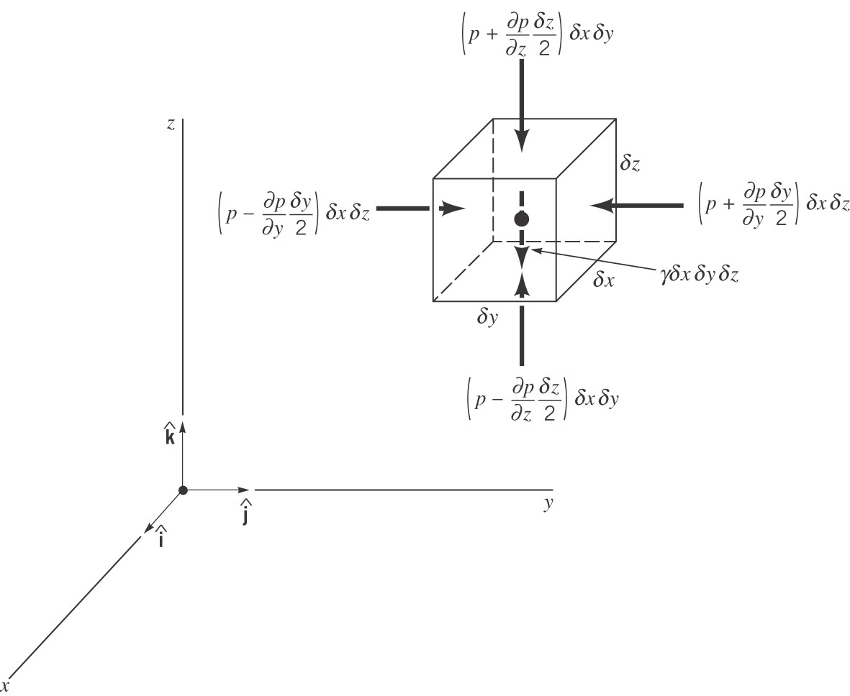
Basic Equation for Pressure Field
Hydrostatic
Recall γ=ρg

Slide 5
Pressure Variation in a Fluid at Rest

Slide 6
Who cares?
It is often said that it is easier for us to explore space than the depths of the oceans
https://xkcd.com/1040/large/
Assuming constant density pressure increases approximately by 1 atm every 10 meters
1 atm $≈105 Pa$
$ρgh≈10$⁴$h$
Atmospheric Pressure – can you think of a demonstration to show it exists?

Slide 7
Hydrostatic for different Fluids
Incompressible => Constant Density
Compressible
Isothermal Ideal Gas – p=ρRT
Isentropic p/ρ^{κ}=constant

Slide 8
Hydrostatic for different Fluids
Incompressible => Constant Density
Compressible
Isothermal Ideal Gas
Isentropic p/ρ^{κ}=constant
Exercise…

Slide 9
Sample Problem 1
Determine the change in hydrostatic pressure in a giraffe’s head as it lowers its head from eating leaves 6m above the ground to getting a drink of water at ground level. Assume that blood has the same density as water
Compare this with the pressure of a human heart at 120 mm Hg
As it drops its head down to drink, specialized valves in the neck counter the potentially explosive effects of gravity, blocking blood flowing back into the skull. Meanwhile, a built-in pressure suit in its extraordinarily long legs prevents fluid and blood from pooling in its feet.
https://www.novartis.com/stories/from-our-labs/giraffes-have-high-blood-pressure-why-dont-they-drop-dead

Slide 10
Sample Problem 2
In a density stratified lake we measure that the density of the lake varies with depth in a manner that can be approximated by the function
ρ(z)=1000+1.1 z 0<z<100 m
where z=0 is the lake free surface and increases with depth
Determine the pressure field

Slide 11
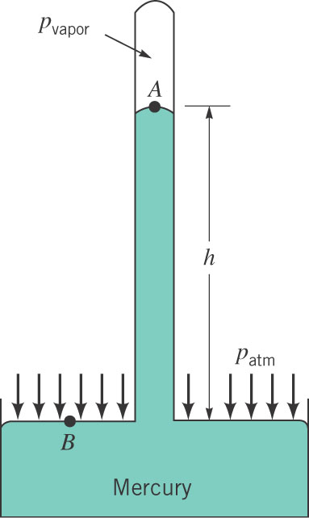
How to measure pressure (Mercury Barometer)
Find a relationship between pressure at
A and at B
Often assume p_{vapor}=0

Slide 12
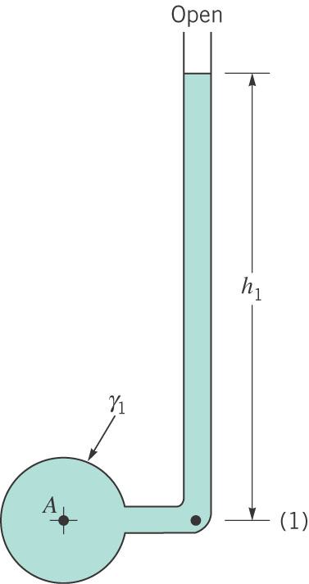
How to measure pressure (Piezometer Tube)

Slide 13
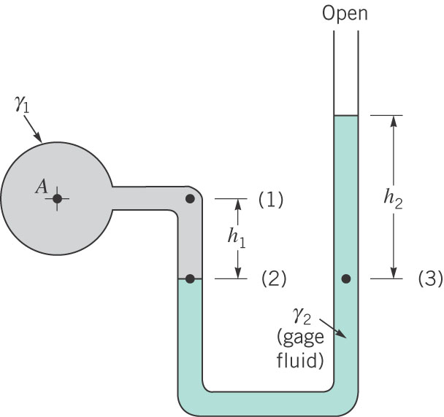
How to measure pressure (U-Tube) Manometer

Slide 14
General Manometer Equation
To connect the pressure between two points 1 and 2 that can pass through multiple fluids (i=1..N) of different density
If Δz is down => positive jump
If Δz is up => negative jump

Slide 15
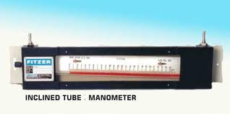
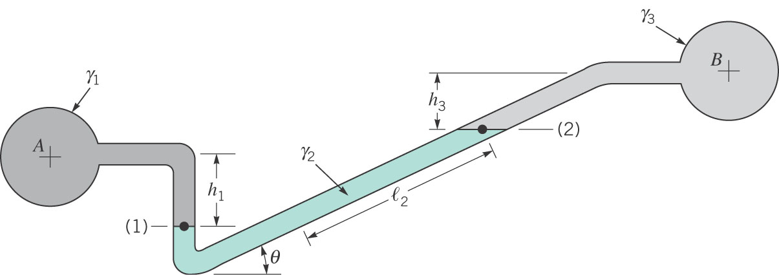
Inclined Manometer
Sensitive to small pressure changes

Slide 16
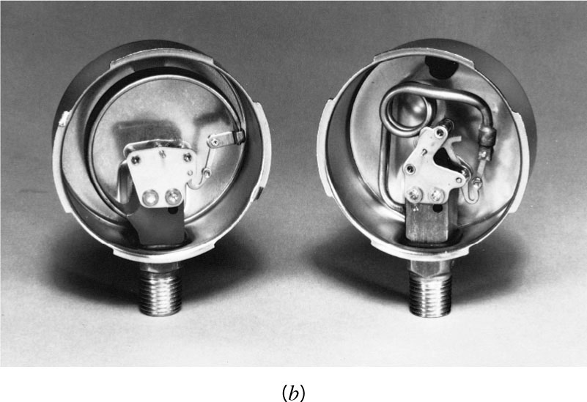
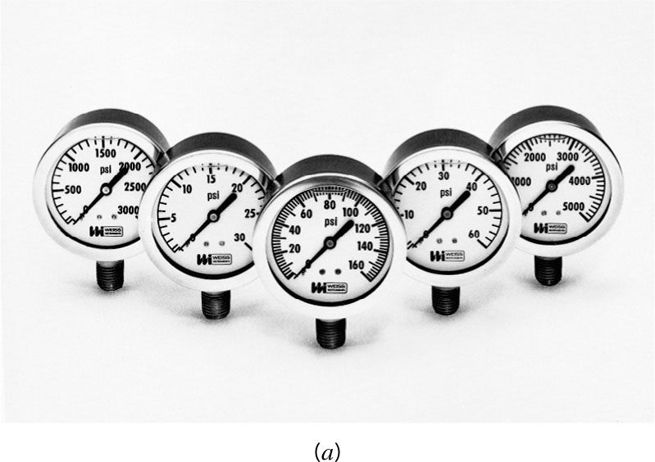
Other Devices

Slide 17
Sample Problem
Pipe A and B are connected. A contains gasoline (SG=0.65) and B water.
Determine differential reading h if A has pressure of 20kPA and B has a vacuum of 150mm Hg.

Slide 18
Sample Problem 2
U-shaped tube initially contains only water. A second liquid of specific weight γ (less than water) is placed on top with no mixing. Can the height h be adjusted so that the left and right levels are the same? Proove it.

Slide 19
Hydrostatic Force on a Plane Surface
p=0
p=0
h
What’s the difference in effective force on the bottom vertical surface
and horizontal ones?

Slide 20
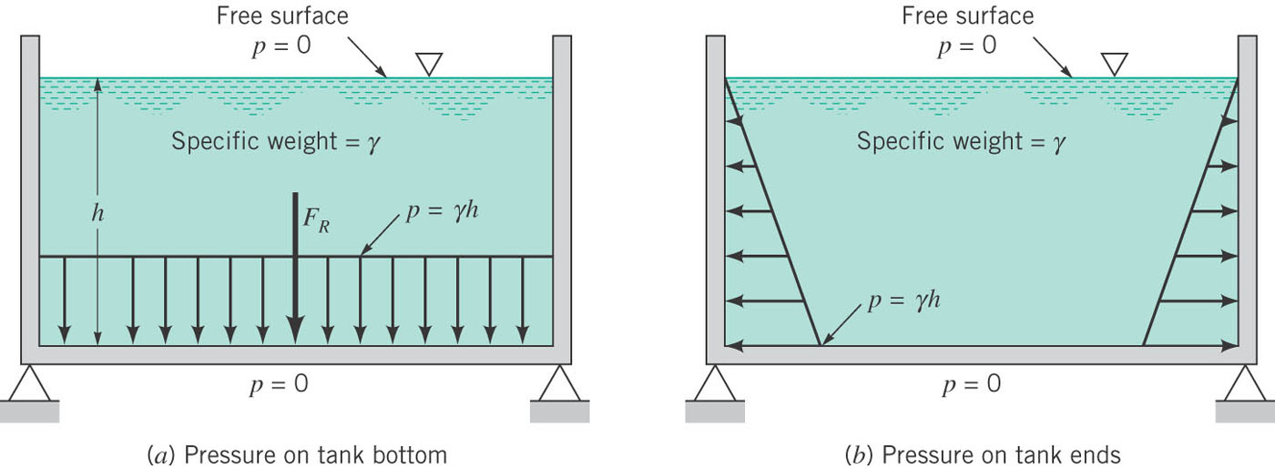
Here it is….
Uniform vs. varying with depth

Slide 21
Consequences

Slide 22
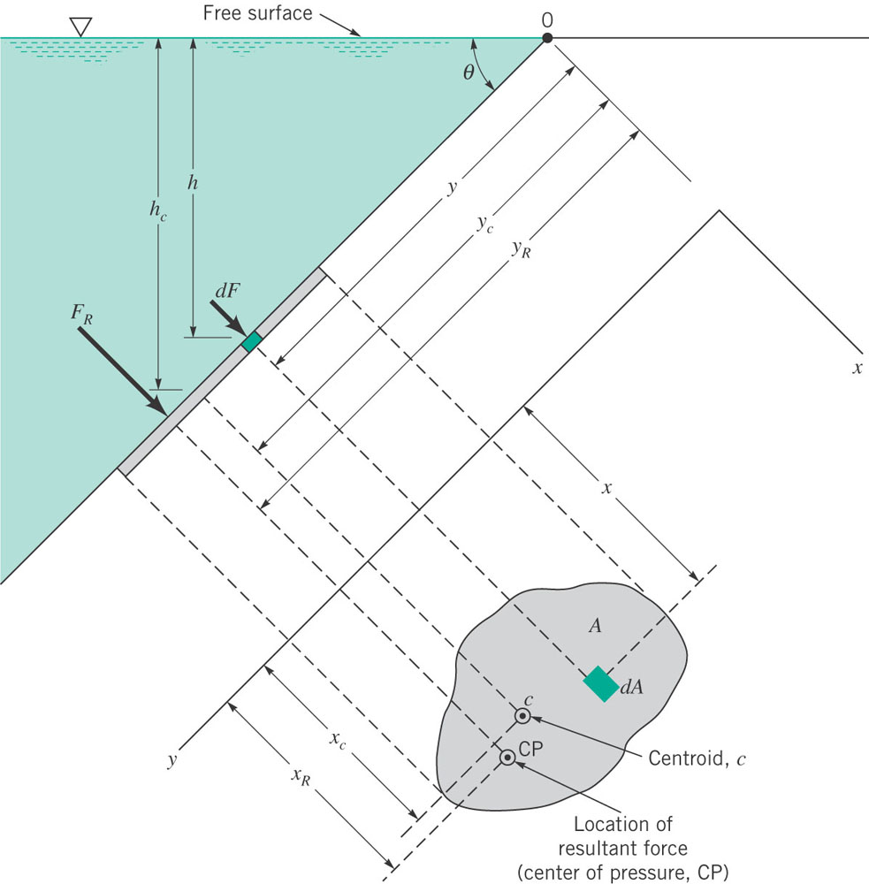
Pressure on an Inclined Plane

Slide 23
Pressure on an Inclined Plane
The effective force is
This is true for any shape gate, where h_{c} is the depth of centroid. The location of the effective force is
Second Moment of area divided by the first (recall statics – you can use any of the tools you learned there to calculate these by the way)

Slide 24
Pressure on an Inclined Plane
For a rectangular plate with shallow point y_{l} and deep point y_{u}:
And if plate starts at the free surface (y_{l}=0)

Slide 25
Sample Problem
A homogeneous, 4 ft wide, 8-ft long rectangular gate weighing 800lb is held in place by a horizontal flexible cable (see figure). Water acts on the gate, hinged at point A. Friction in the hinge is negligible. Determine the tension in the cable.

Slide 26
Concept of Hydraulic Lift
Apply a small force
Get big force
How?
A
B

Slide 27
Sample Problem 2
When water depth h=5m it is desired that both gates open simultaneously. Determine the weight of the horizontal gate and the horizontal force on the vertical gate needed to keep them closed until this happens. The vertical gate has negligible weight. Friction effects are negligible too.

Slide 28
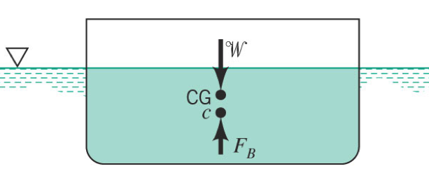
Archimides Principle

Slide 29
Sample Problem
A cylinder of 1ft diameter and 2 ft length floats in a tank that contains a liquid of specific weight γ. A U-tube manometer is connected as shown. In figure the pressure in A is 0.1 psi below atmospheric. What is the weight of the cylinder, whose upper surface is flush with the fluid surface.

Slide 30
Stability
When in balance the centroid where total weight acts and buoyancy act are aligned
If not – rotational couple occurs
Can be stabilizing or destabilizing

Slide 31
Important Equations
(pressure gradient in a stationary fluid)
(hydrostatic force on a plane surface)
(Location of hydrostatic force on a plane)
F_{b}=γV_{disp} (buoyant force)

Slide 32
Famous Fluid Mechanicians Marie-Louise Dubreil-Jacotin (1905-1972)
French mathematician who worked in fluid mechanics and abstract algebra
Topics in fluids: infinite wave shapes, turbulence
Brilliant at math since high school
An exception was made for her to attend some previously “male-only” math courses at the Collège de Chaptal
2nd woman in France to get a PhD in applied math
1st woman in France to become full professor of math (Univ. of Poitiers)
Dubreil-Jacotin–Long equation,"the standard model for internal gravity waves" in fluid mechanics.
https://www.zmescience.com/ecology/climate/internal-waves/

Slide 33
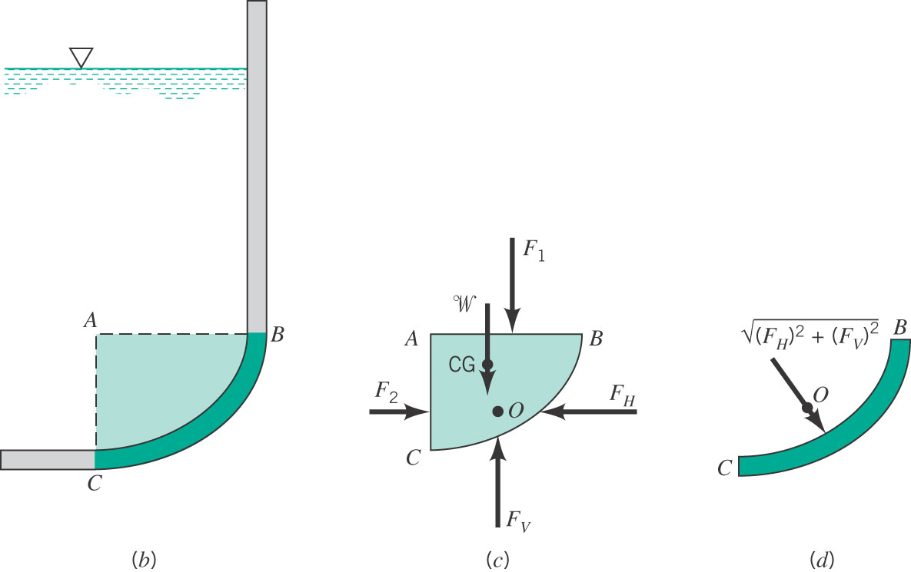
Curved Surfaces

