Slide 1
Chapter 5 Finite Control Volume Analysis
CE30460 - Fluid Mechanics
Diogo Bolster

Slide 2
Objectives of this Chapter
Learn how to select an appropriate control volume
Understand and Apply the Continuity Equation
Calculate forces and torques associated with fluid flows using momentum equations
Apply energy equations to pipe and pump systems
Apply Kinetic Energy Coefficient

Slide 3
Recall System and Control Volume
Recall: A system is defined as a collection of unchanging contents
What does this mean for the rate of change of system mass?

Slide 4
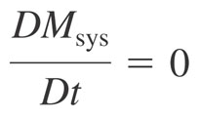
Recall Control Volume (CV)
Recall Reynolds Transport Theorem (end of last chapter)

Slide 5
Conservation of Mass
Combining what we know about the system and the Reynolds Transport Theorem we can write down a equation for conservation of mass, often called ‘The Continuity Equation’
All it is saying is that the total amount of mass in the CV and how that changes depends on how much flows in and how much flows out …

Slide 6
What if the velocity is not uniform
Imagine V_in looks like the flow on the left
You have to use an average velocity, but which one?

Slide 7
Fixed Non Deforming CV
Examples

Slide 8
Sample Problem 1

Slide 9
Sample Problem 2

Slide 10
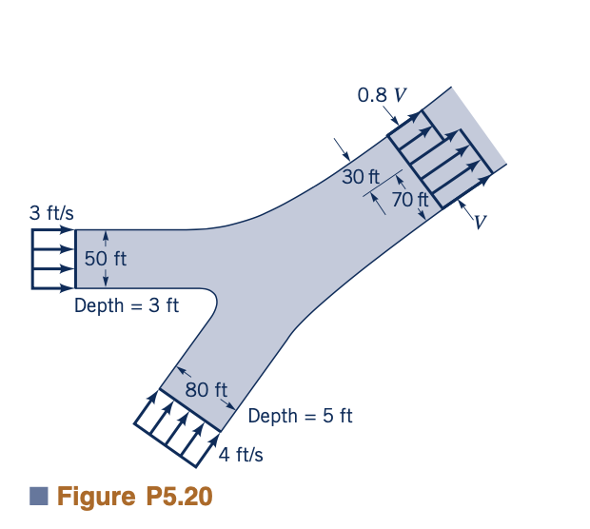
Sample Problem 3

Slide 11
Sample Problem 4
Consider a rectangular tank (2mx2m) of height 2m with a hole in the bottom of the tank of size (5cmx5cm) initially filled with water. Water flows through the hole
Calculate the height of the water level in the tank as it evolves in time
Assume the coefficient of contraction for the hole is equal to 0.6

Slide 12
Conservation of Momentum
Newton’s Second Law
ΣF=ma
Or better said :
Time rate of change of momentum of the system=sum of external forces acting on the system
Again, we will apply the Reynolds Transport Theorem (write it out yourselves)

Slide 13
Conservation of Momentum
General Case
Steady Flow
Linear Momentum Equation

Slide 14
Relevant Examples
Fire Hose
http://www.youtube.com/watch?v=R8PQTR0vFaY&feature=related
https://www.youtube.com/watch?v=zP53h5yrE48

Slide 15
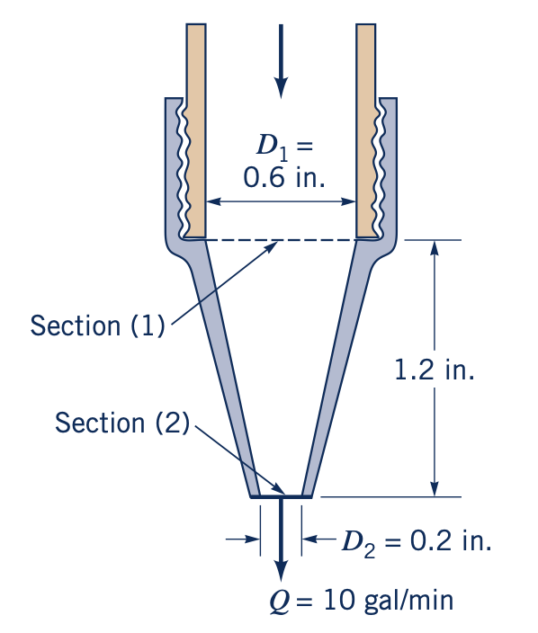
Sample Problem 1

Slide 16
Sample Problem 2

Slide 17
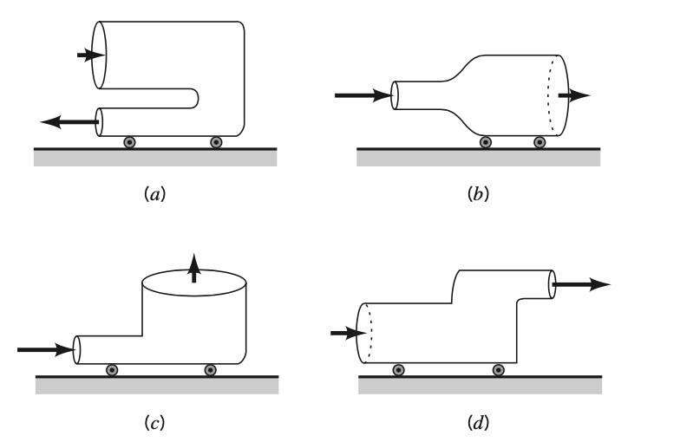
Sample Problem 3

Slide 18
A few comments on linear momentum applications
Linear Momentum is directional (3 components)
If a control surface is selected perpendicular to flow entering or leaving surface force is due to pressure
May need to account for atmospheric pressure
Sign of forces (direction) is very important
On external forces (internal forces cancel out – equal and opposite reactions)

Slide 19
Sample Problem 4

Slide 20
Sample Problem 5

Slide 21
Moment of Momentum
In many application torque (moment of a force with respect to an axis) is important
Take a the moment of the linear momentum equation for a system
Apply Reynolds
Transport Theorem

Slide 22
Let’s focus on steady problems
Moment of Momentum Equation for steady flows through a fixed, nondeforming control volume with uniform properties across inlets and outlets with velocity normal of inlets and outlets (more general form available in book Appendix D)
Rotating Machinery

Slide 23
Two important things to remember
Right hand rule for cross product – for r x V terms
Sign of a Torque –right hand rule

Slide 24
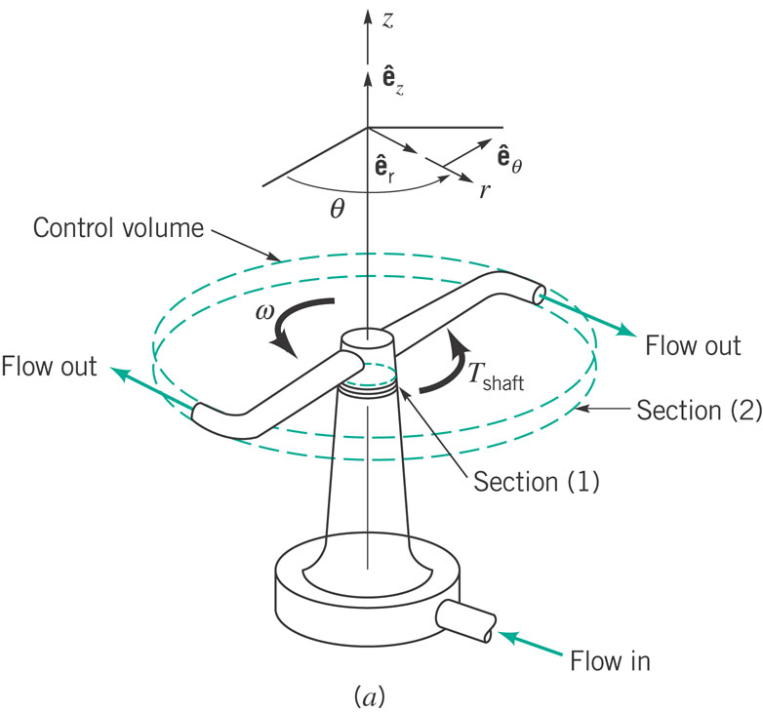
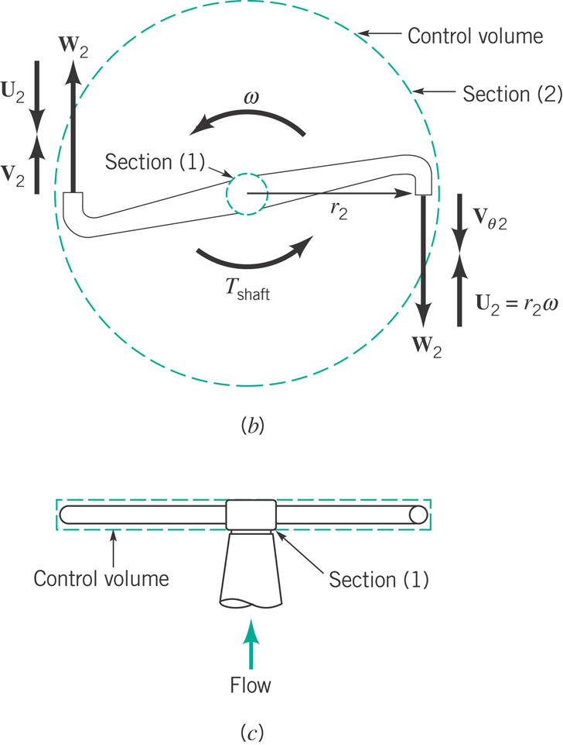
Application (from textbook)

Slide 25
Moment of Momentum Formulas
Torque
Power
Work per Unit Mass

Slide 26
Sample Problem 1

Slide 27
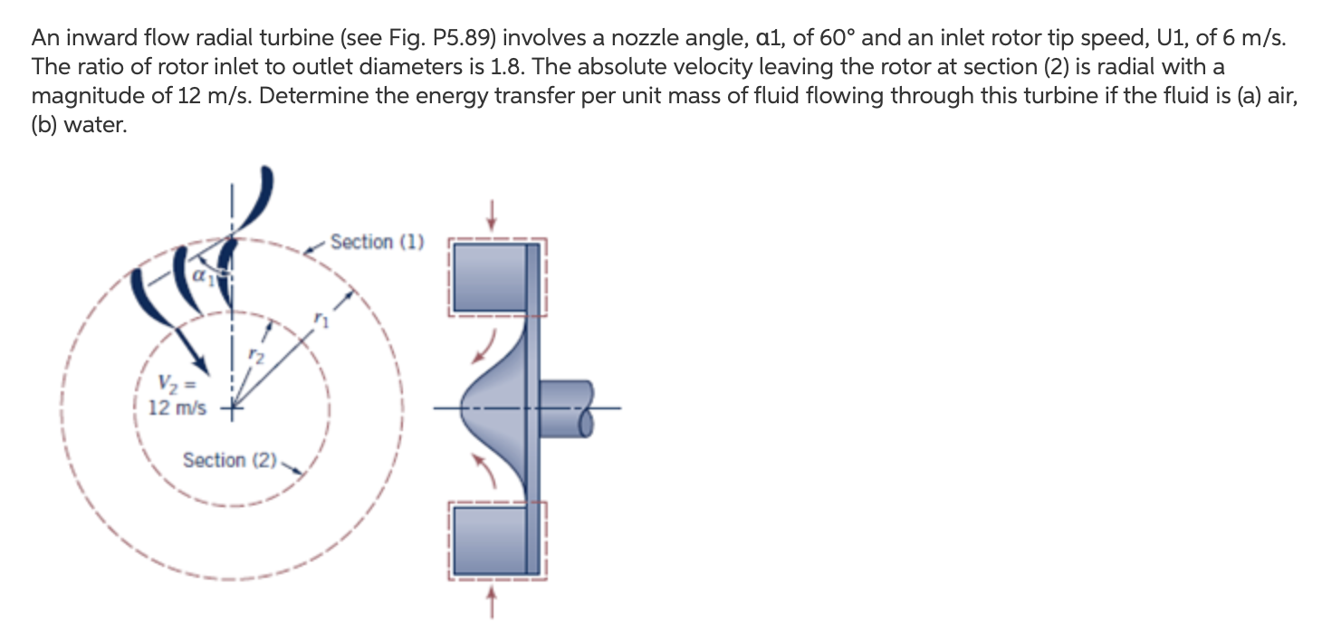
Sample Problem 2
2
https://www.youtube.com/watch?v=IZdiWBEzISM
Example radial turbine

Slide 28
Conservation of Energy First Law of Thermodynamics
Same principles as for all conservation laws
Time rate of change of total energy stored
=
Net time rate of energy addition by heat transfer
+
Net time rate of energy addition by work transfer
We go through the same process transferring system to control volume by Reynolds Transport Theorem

Slide 29
Mathematically Speaking
First Law of Theromodynamics
A few definitions
Adiabatic – heat transfer rate is zero
Power – rate of work transfer W
.

Slide 30
Power – comes in various forms
For a rotating shaft
For a normal stress (Force x Velocity)

Slide 31
For application purposes
OR for steady flow….
Internal energy, enthalpy, kinetic energy, potential energy

Slide 32
Comparison to Bernoulli’s Eqn
For steady, incompressible flow with zero shaft power
Include a source of energy (turbine, pump)
If this is zero – identical
Often treated as a correction
Factor called ‘loss’

Slide 33
Or in terms of head

Slide 34
Sample Problem 1

Slide 35
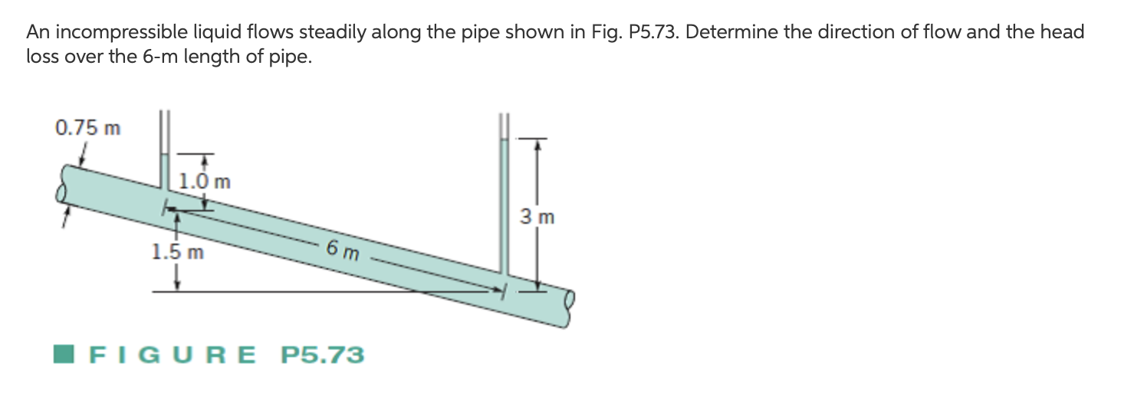
Sample Problem 2

Slide 36
Application of Energy Equation to Nonuniform Flows
Modified energy Equation
α – kinetic energy coefficient
α = 1 for uniform flows,
α > 1 for nonuniform (tabulated, many practical cases
α ~1) – in this course will be given

Slide 37
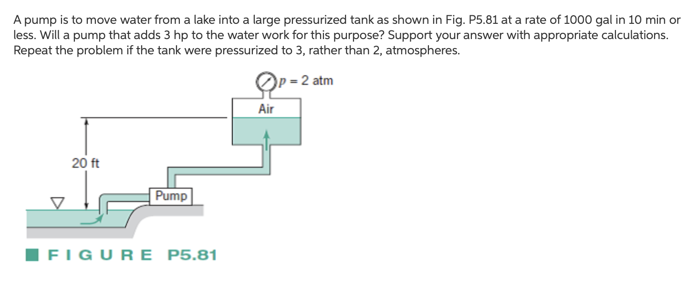
Sample Problem 1

Slide 38
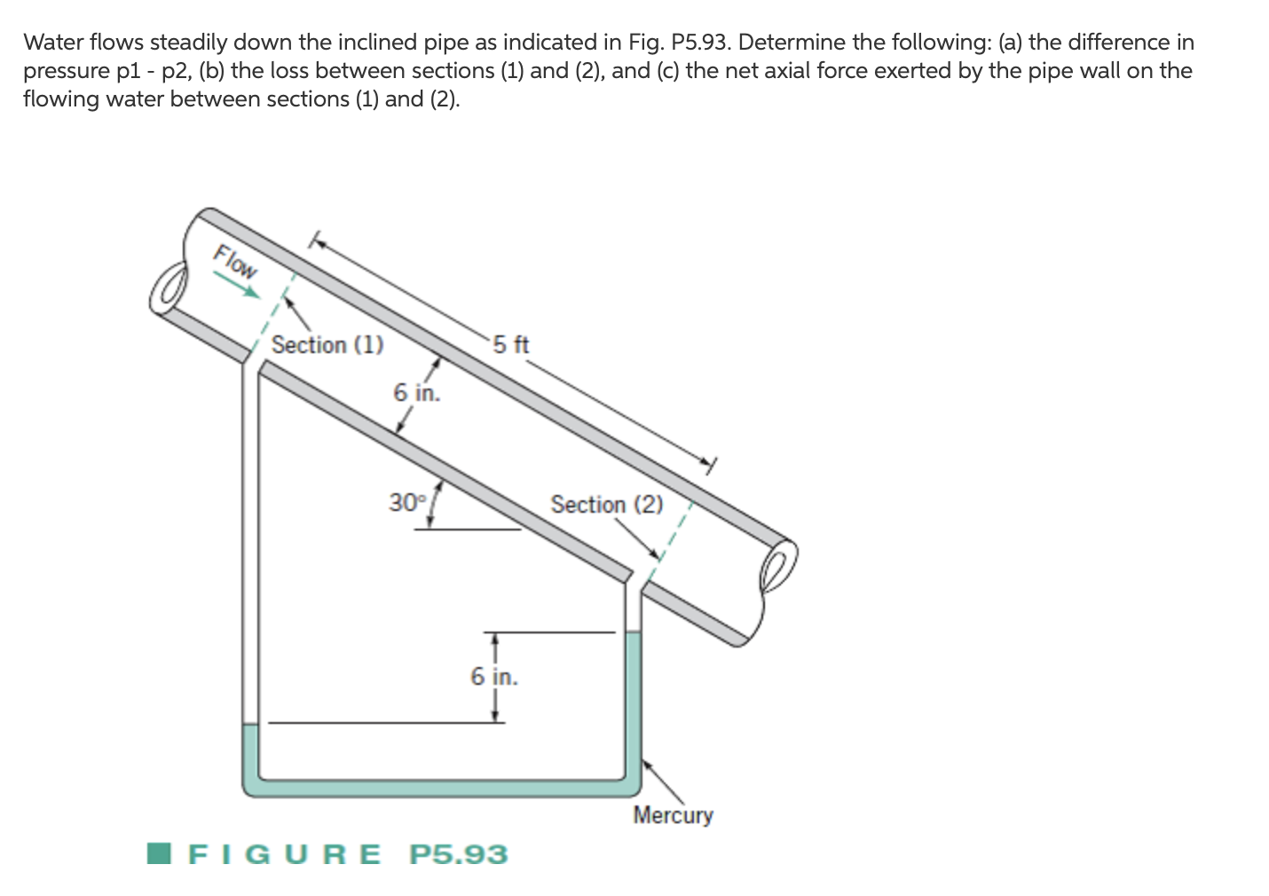
Sample Problem 2

