Slide 1
Chapter 8 – Pipe Flow
CE30460 - Fluid Mechanics
Diogo Bolster

Slide 2
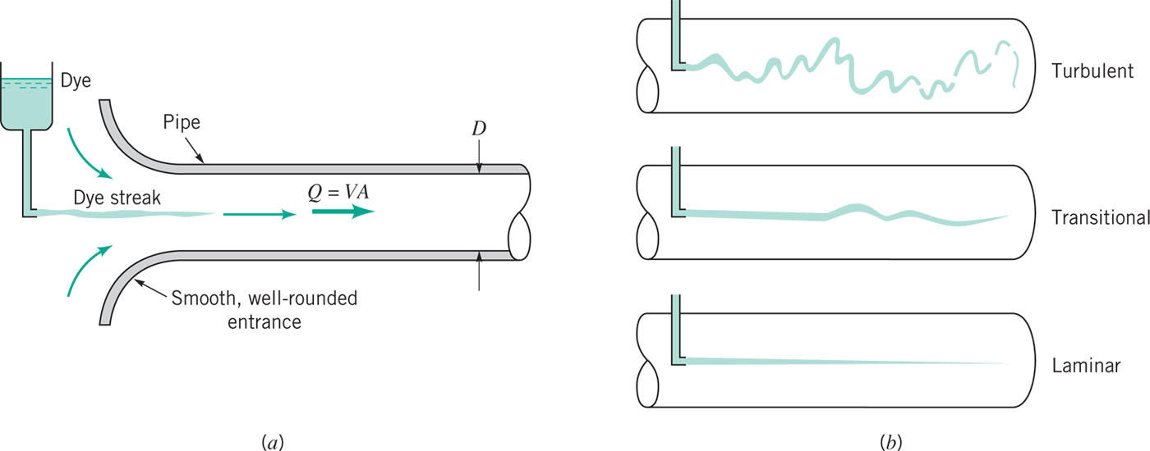
Laminar or Turbulent Flow
Re>4000
Re<2000
Re=UDρ/μ
Laminar Flow http://www.youtube.com/watch?v=KqqtOb30jWs&NR=1
Turbulent Flow http://www.youtube.com/watch?v=NplrDarMDF8

Slide 3
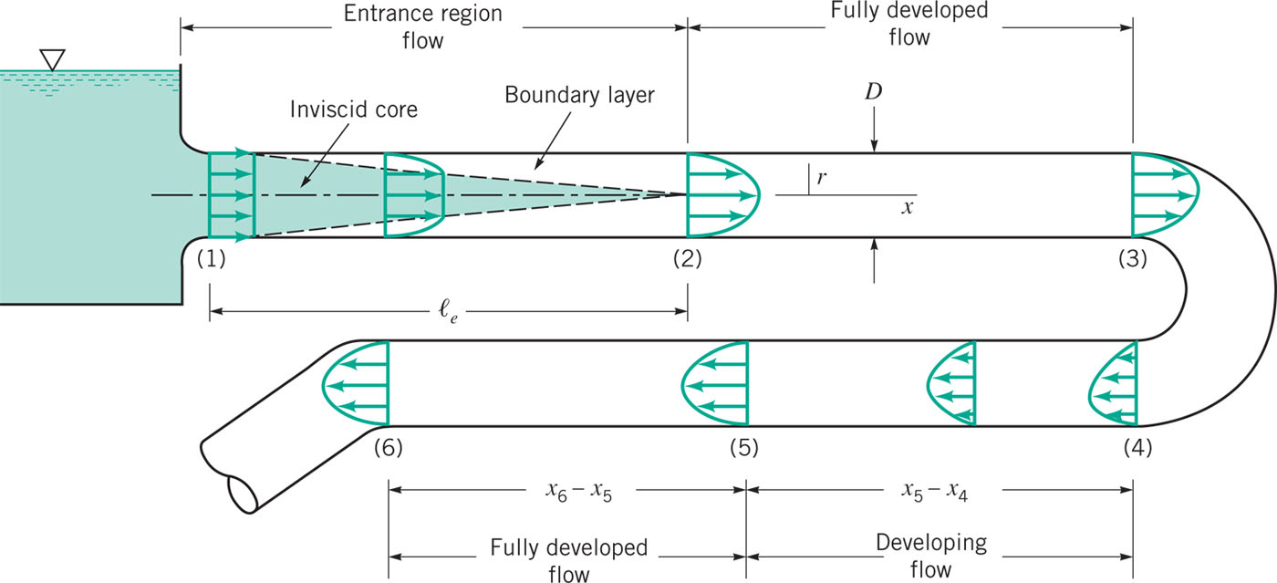
Fully Developed Flow
Entrance length:

Slide 4
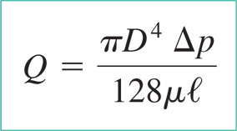
Fully Developed Laminar Flow
We’ve done this one already in chapter 6

Slide 5
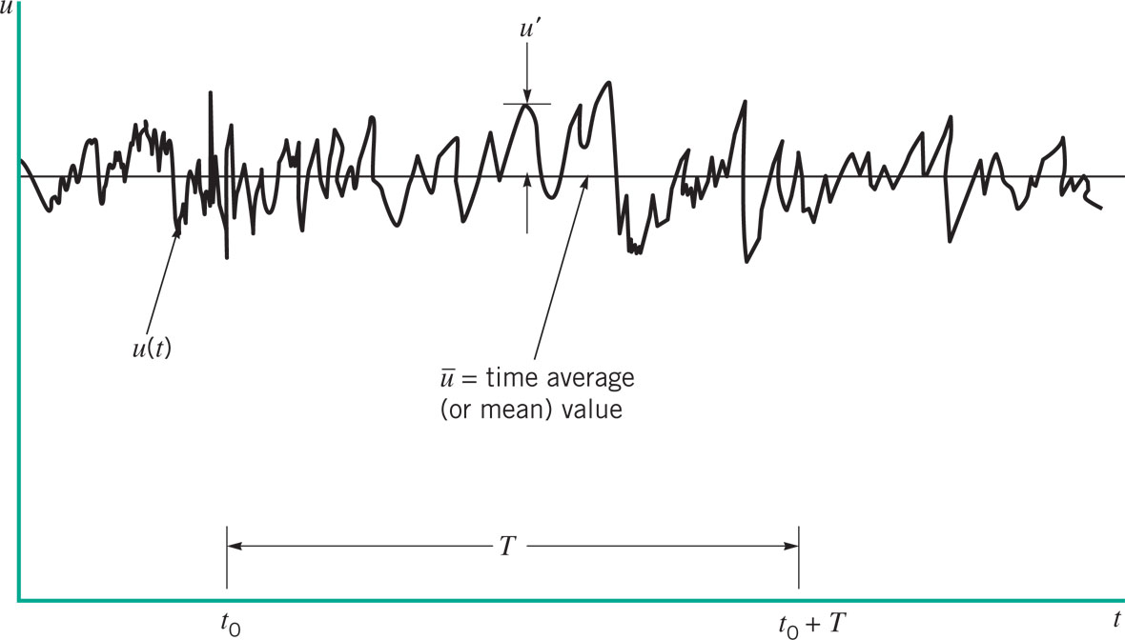
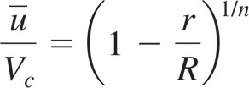
What about Turbulent Flow
Typically:
n is between 6 and 10

Slide 6
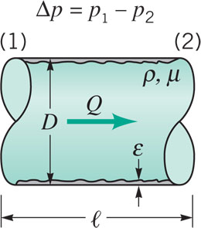
Dimensional Analysis
Pressure Drop depends on
Mean velocity V
Diameter D
Pipe length l
Wall Roughness ε
Viscosity μ
Density ρ
By dimensional Analysis

Slide 7
Pressure drop must increase linearly with length of tube
Recall from chapter 5
Therefore we can say that (part of) the loss in a pipe is
Friction factor – look up in table

Slide 8
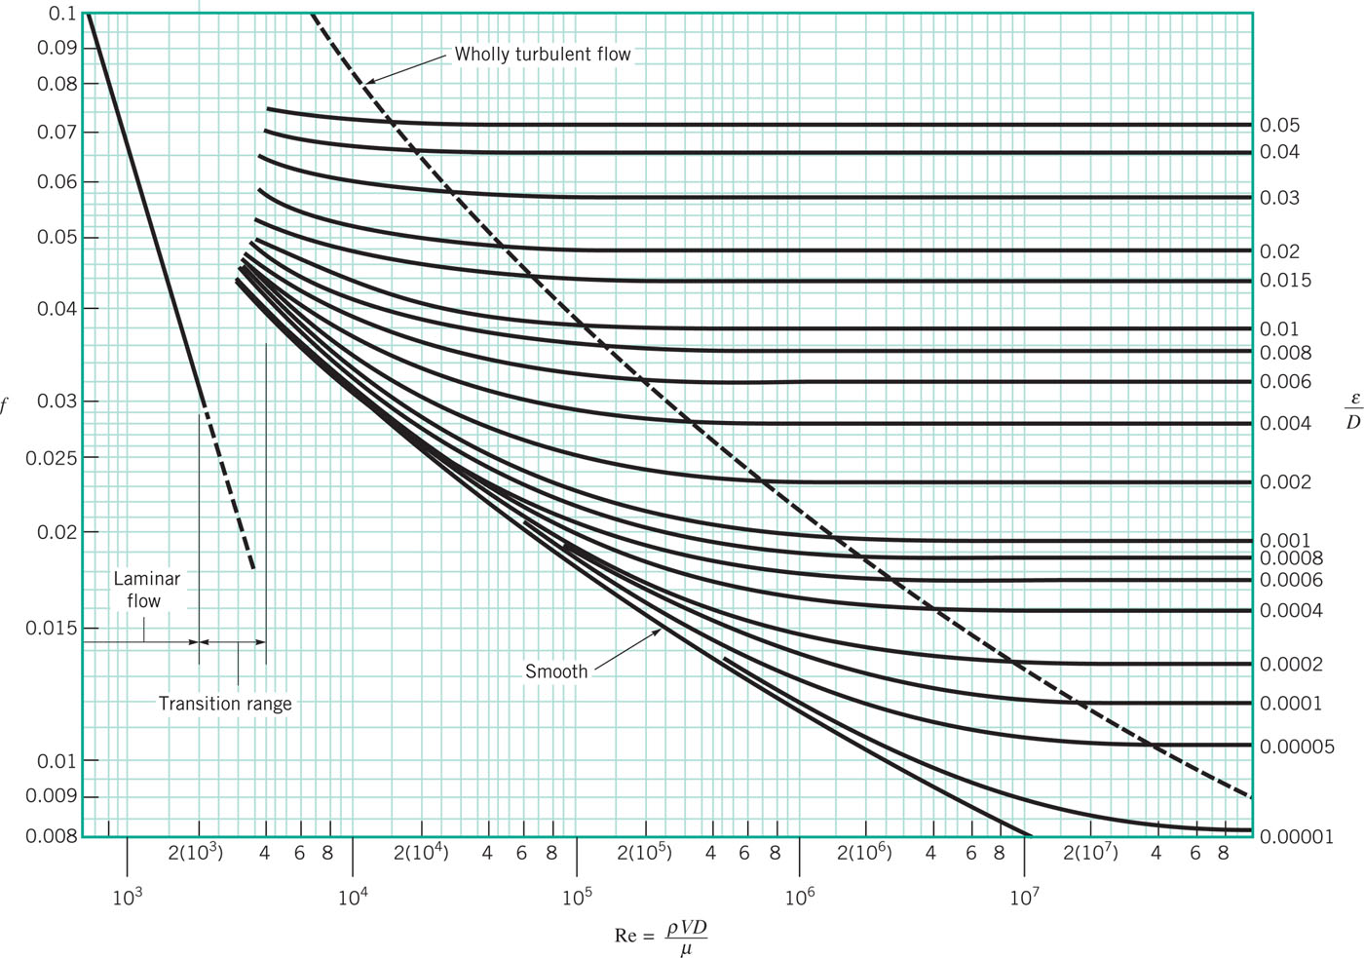
Moody Diagram (Friction Factor)
For laminar
For non-laminar flow approximately true that

Slide 9
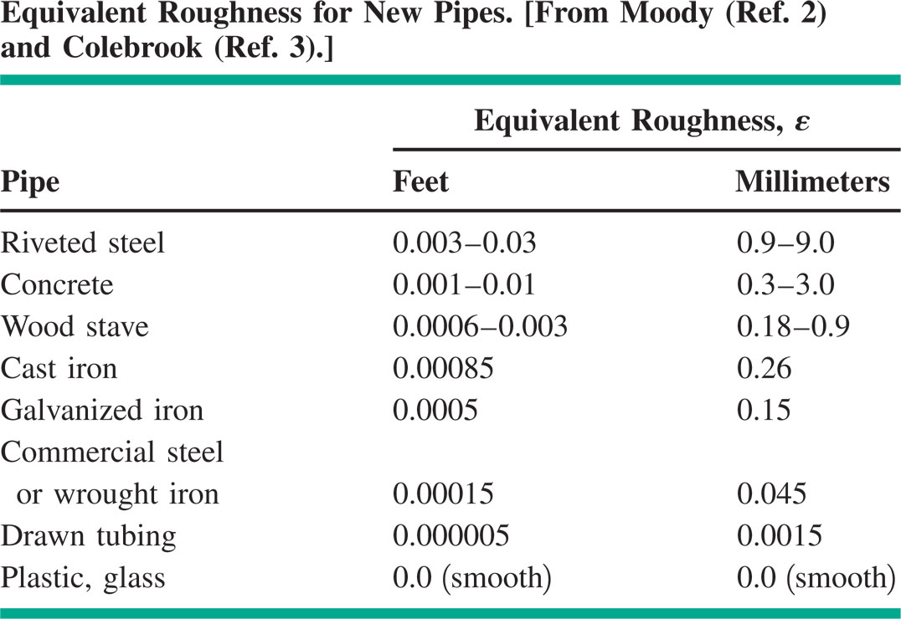
Roughness (Typical)

Slide 10
Minor Losses
K_{L} depends on the flow (expansion, contraction, bend, etc)

Slide 11
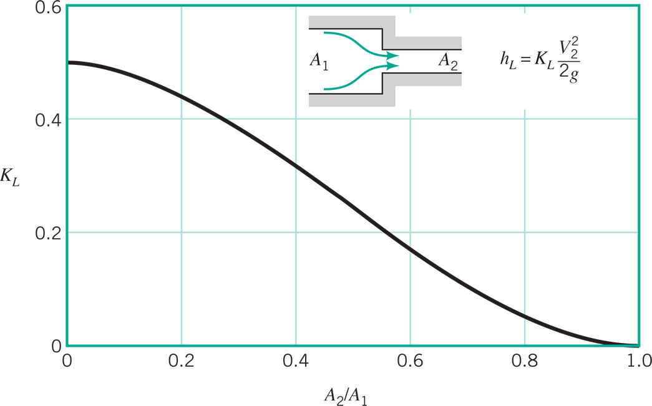
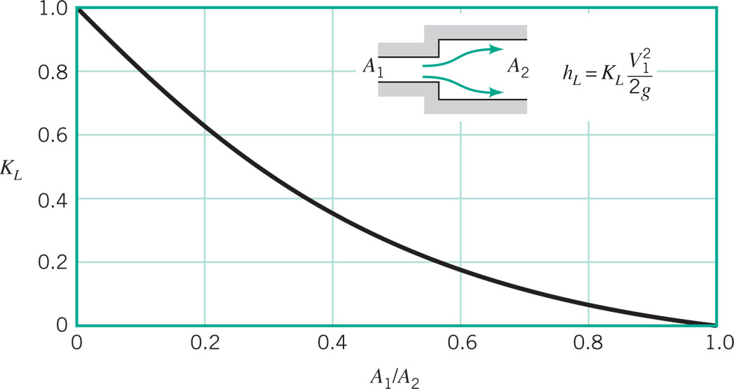
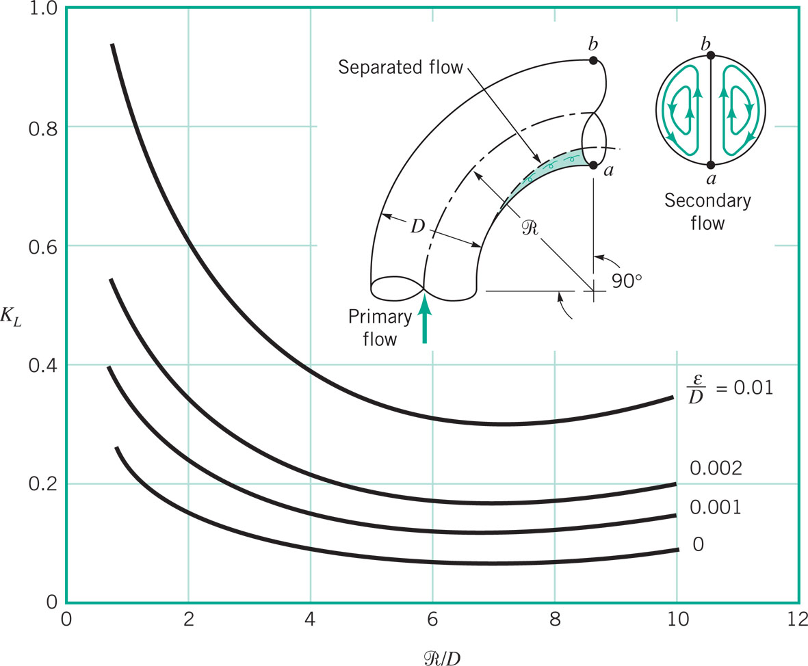
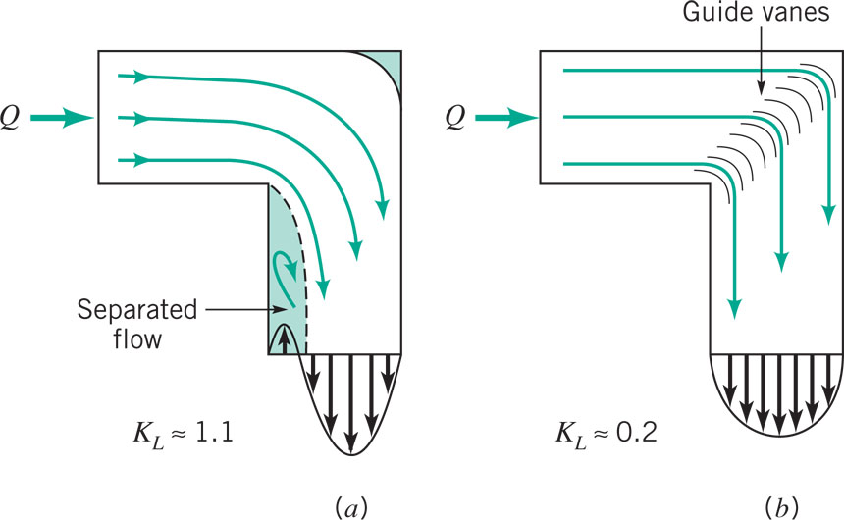
Minor Losses

Slide 12
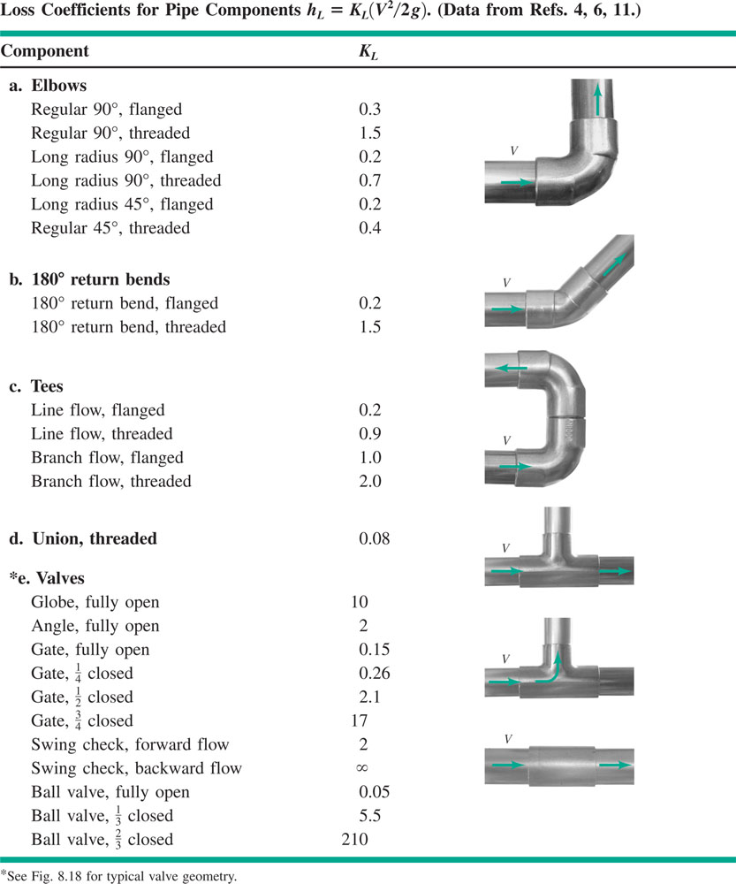
Minor Losses

Slide 13
Sample Problem

Slide 14
Sample Problem

Slide 15
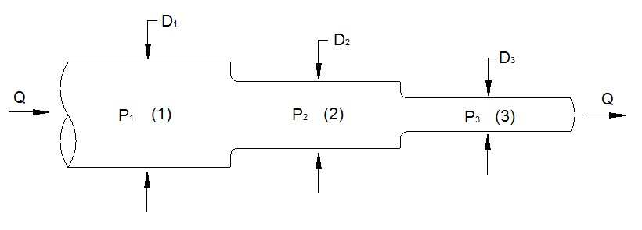
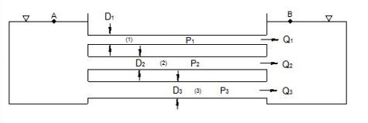
Multiple Pipe Systems
Series/ Parallel

Slide 16
Series/ Parallel
h_{L(total)}=h_{L1}+h_{L2}+h_{L3}
h_{L1}=h_{L2}=h_{L3}

Slide 17
Sample Problem

Slide 18
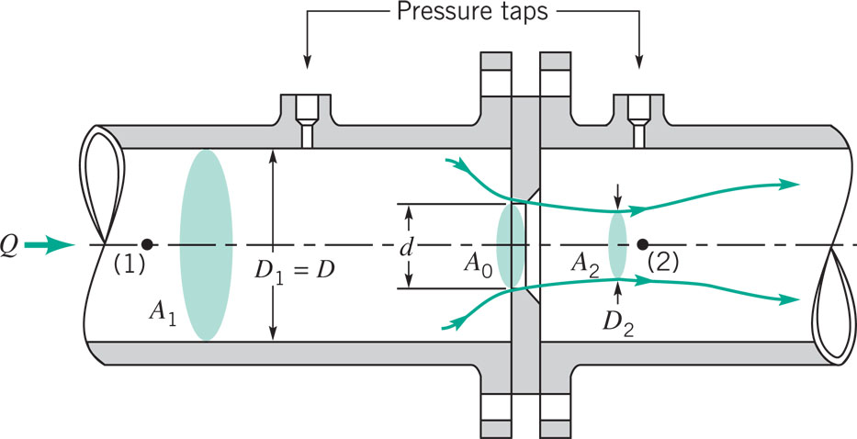
Pipe Flow Measurement
C is a constant that depends on geometry

Slide 19
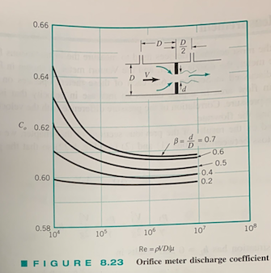

Slide 20
Sample Problem

Slide 21
More Problems

Slide 22
Single Pipe – Determine Pressure Drop

Slide 23
Single Pipe – Determine Flowrate

Slide 24
Single Pipe – Determine Diameter

Slide 25
Multiple Pipe Systems

