Slide 1
Potential Flow

Slide 2
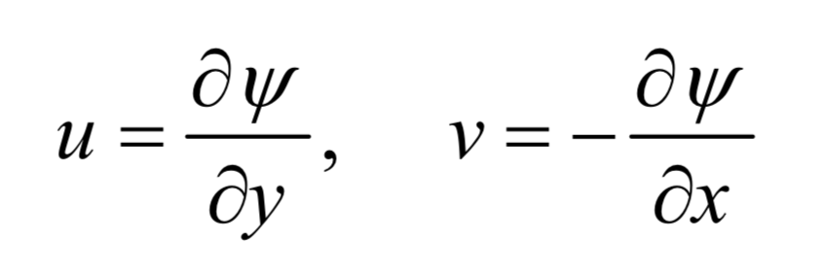
Potential Flow
Assumptions
Flow is inviscid
Flow is irrotational
Consequently – Beroulli’s equation is valid everywhere (i.e. not just between two points on a streamline)
We can define a flow potential and a stream function φ and ψ

Slide 3
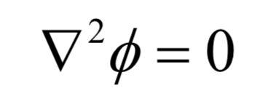
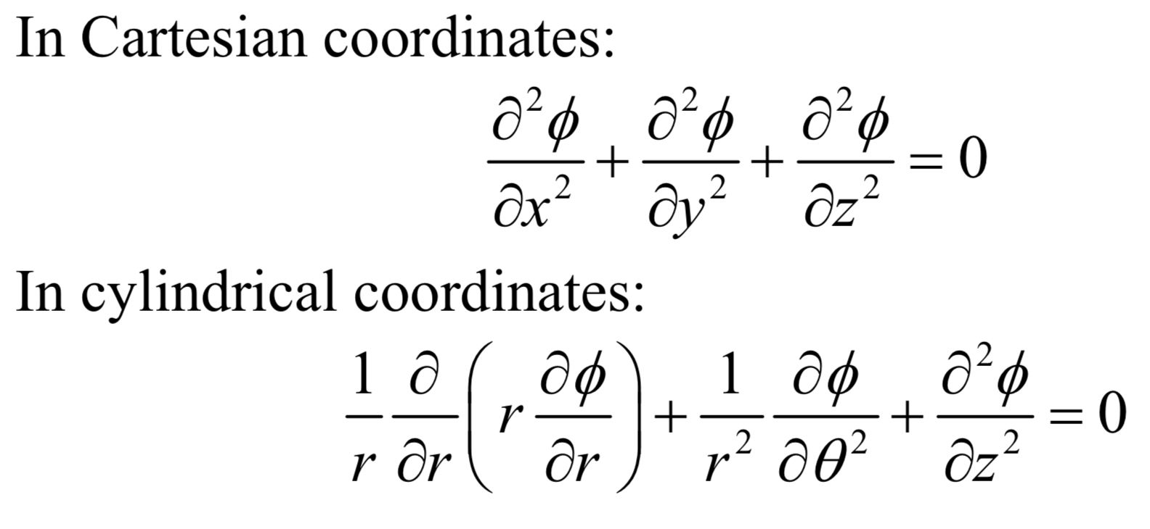
Governing Equations
Flow potential and a stream function φ and ψ.
Same for streamfunction
-
But on different grounds and
only in 2d.
See lectures for Chapter 6.

Slide 4
Who cares?
These equations are linear
So What?
It means that we can use superposition to understand several simple flows, add them together and describe more complex flows.
We can for example begin to understand why a a wing can generate lift and airplanes can fly… even though in reality these also depend on viscous flows. But this is faster and simpler.
But we need to understand some fundamental flows first.

Slide 5
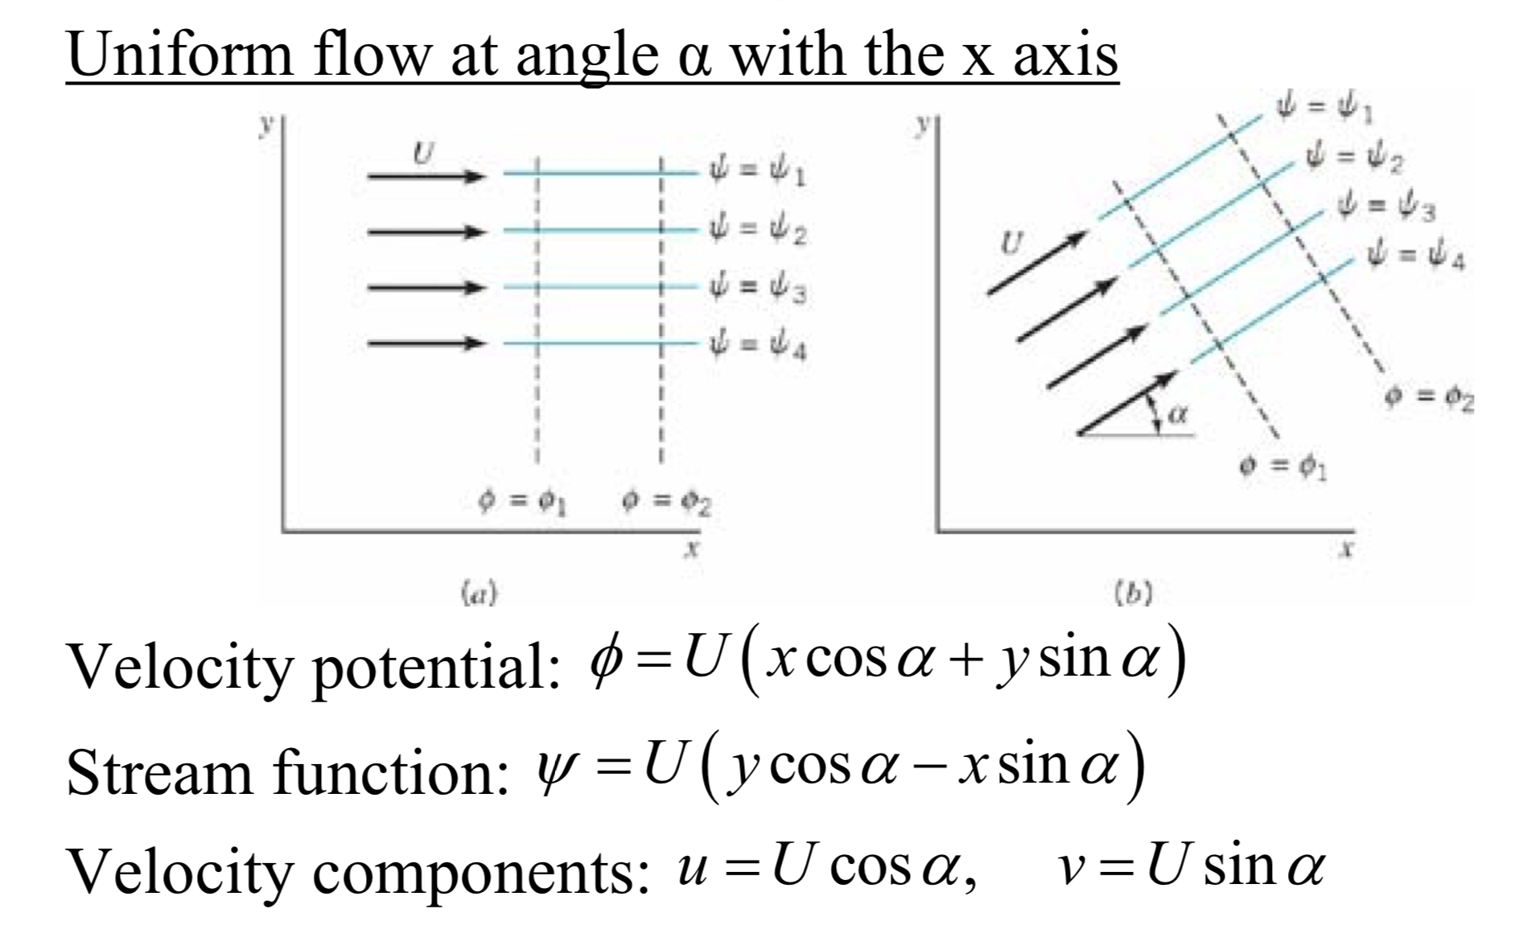
Uniform Flow

Slide 6
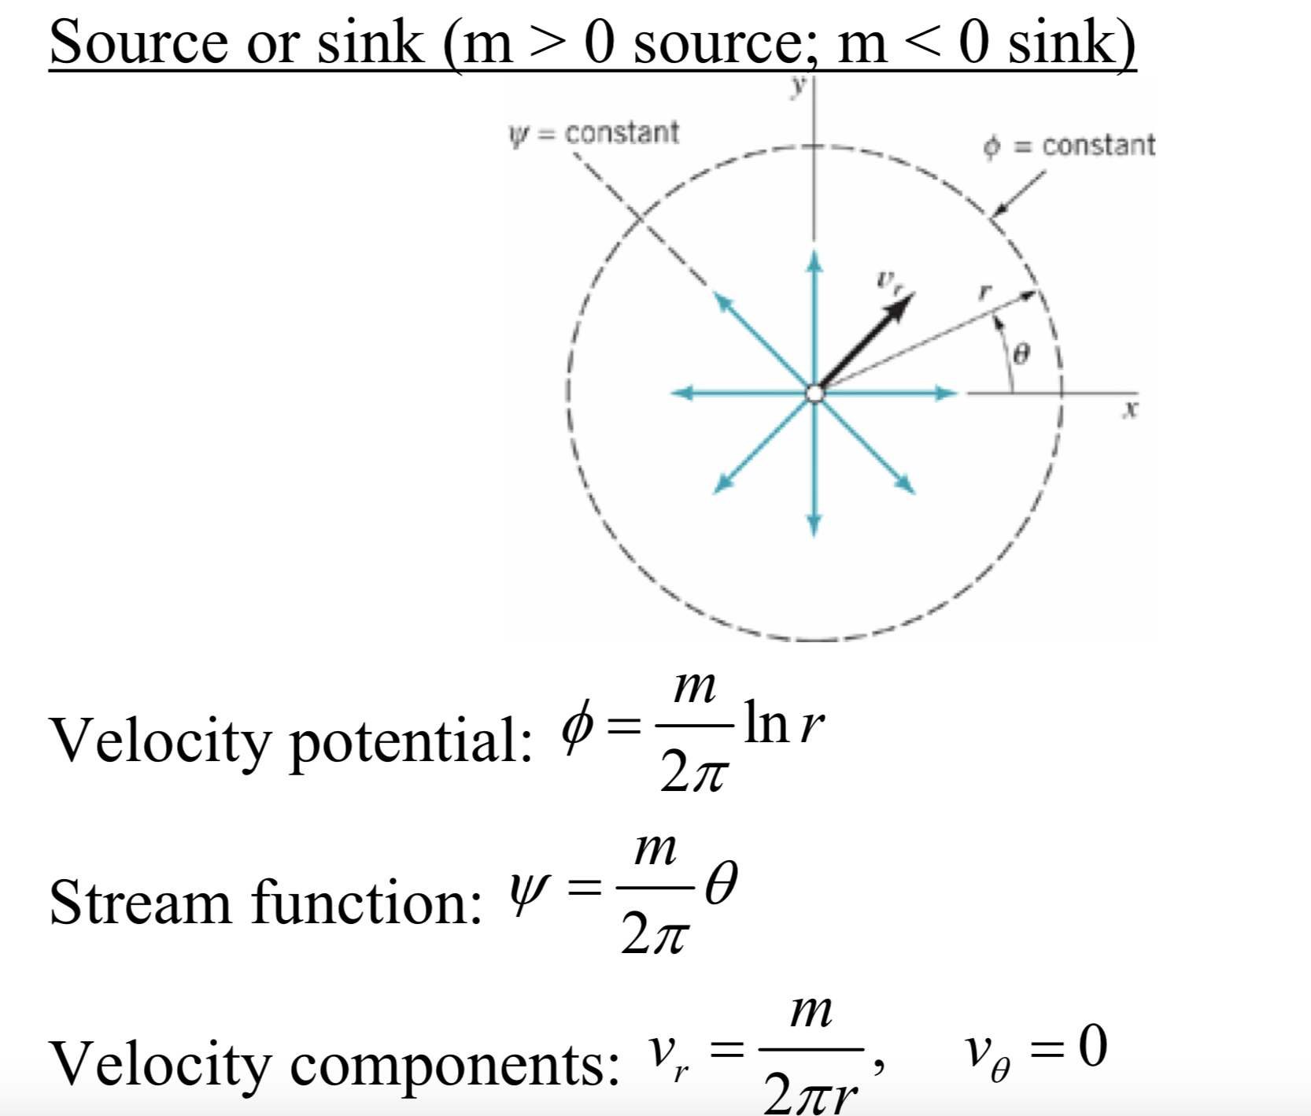
Source or Sink

Slide 7
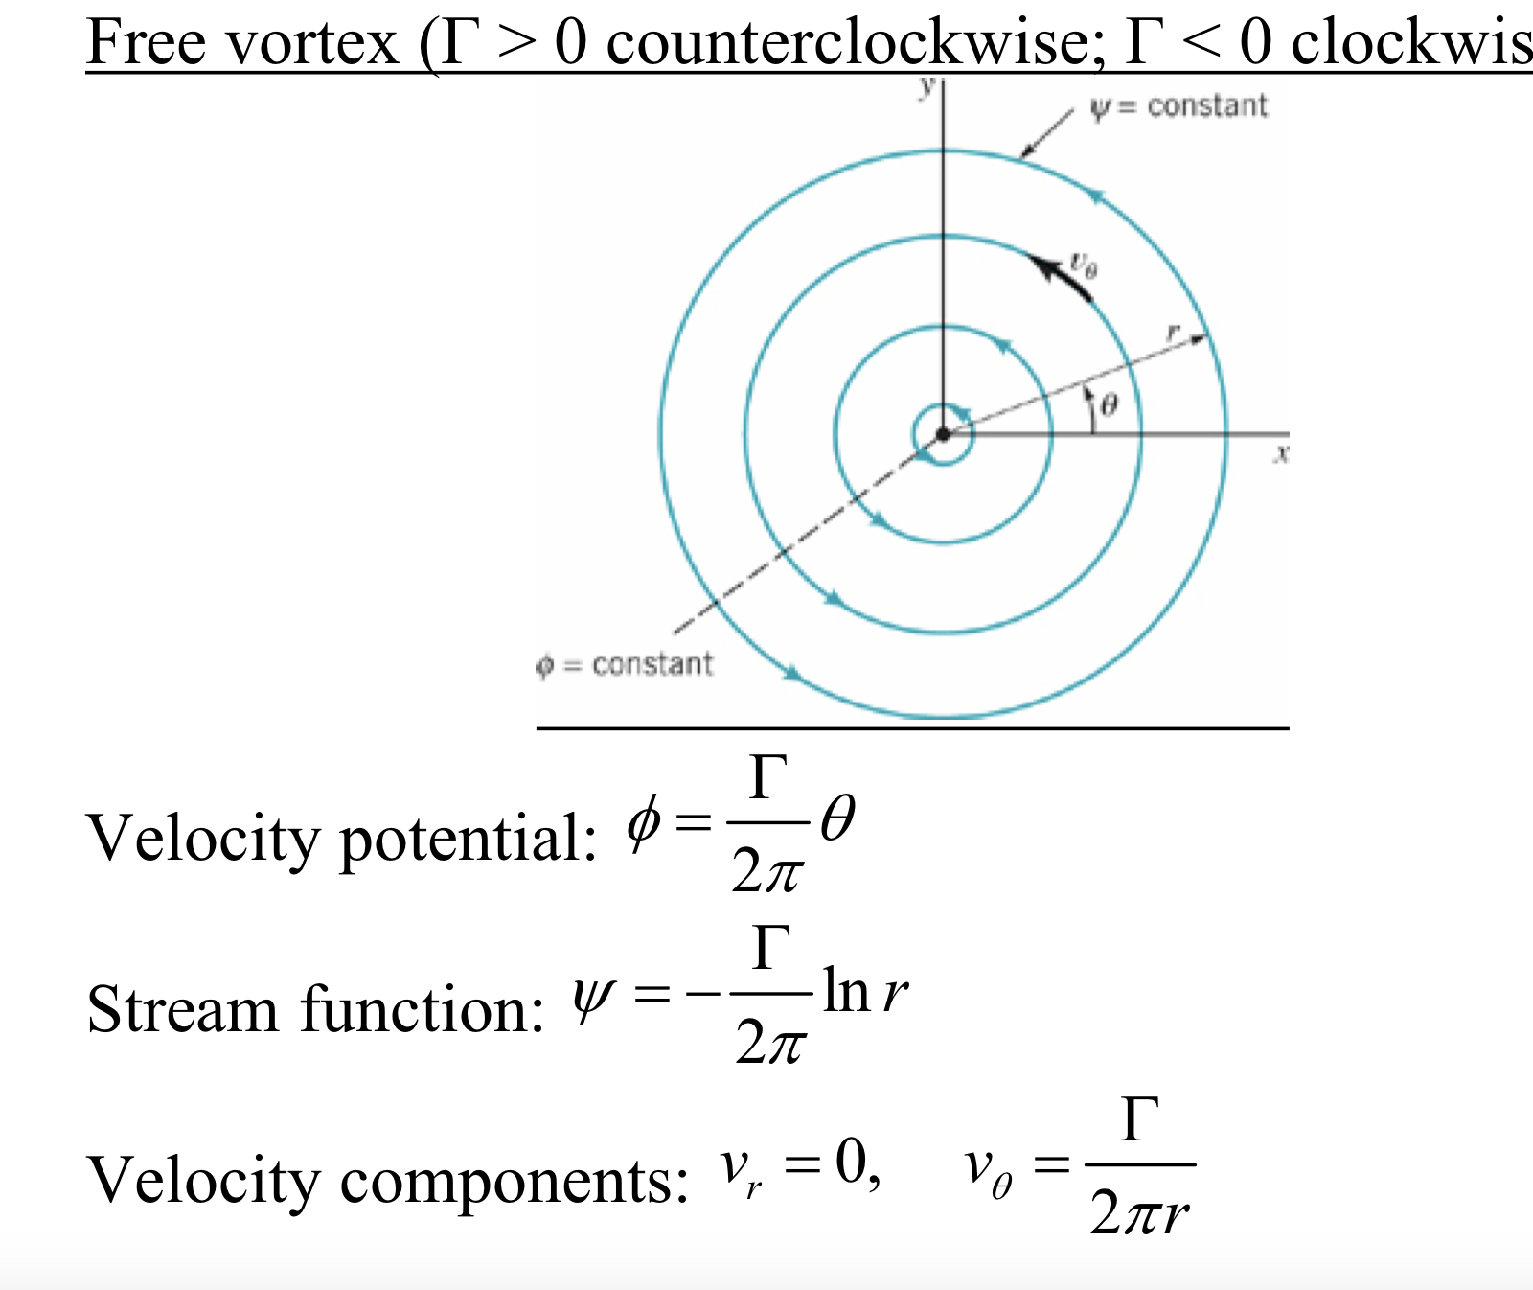
Free vortex

Slide 8
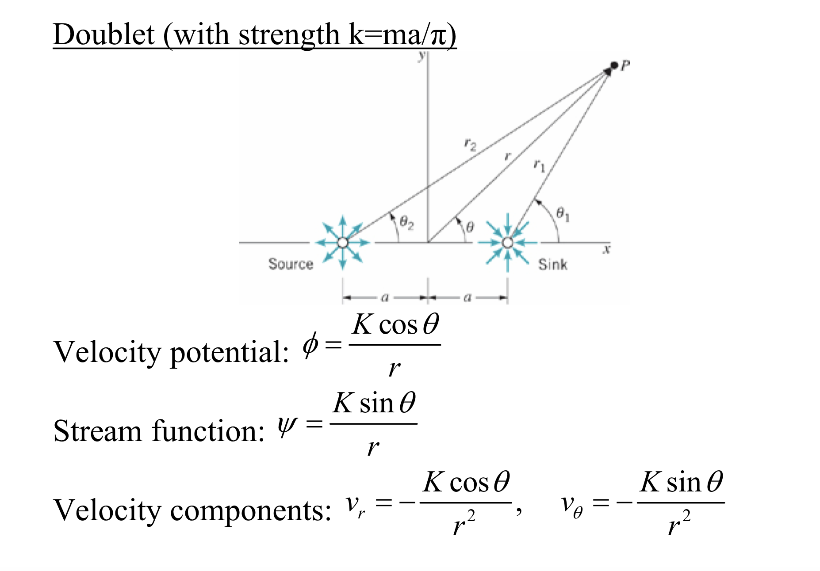
Doublet

Slide 9
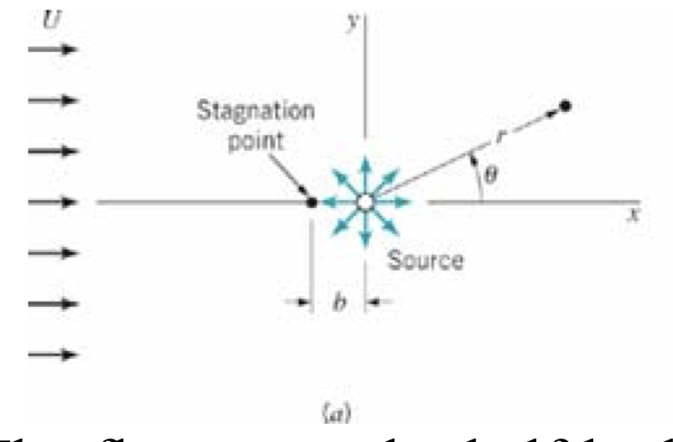
Let’s Add a Source and a Uniform flow together – what happens?

Slide 11
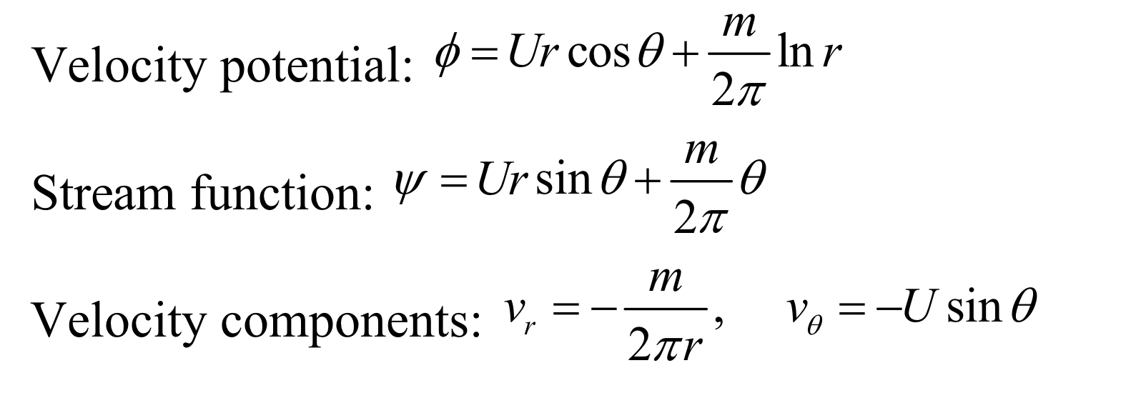
Flow Around a Half Body

Slide 12
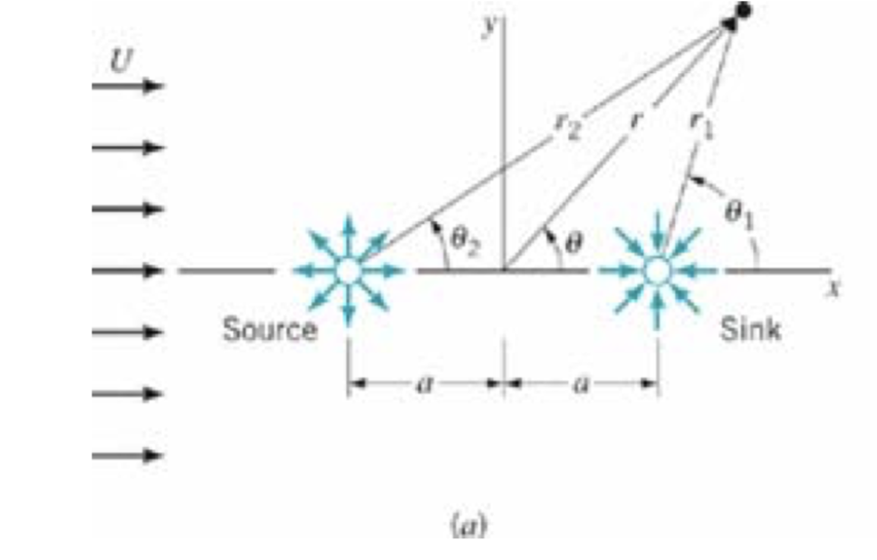
What if I add a Sink to the Mix?

Slide 13
Rankine Oval

Slide 14
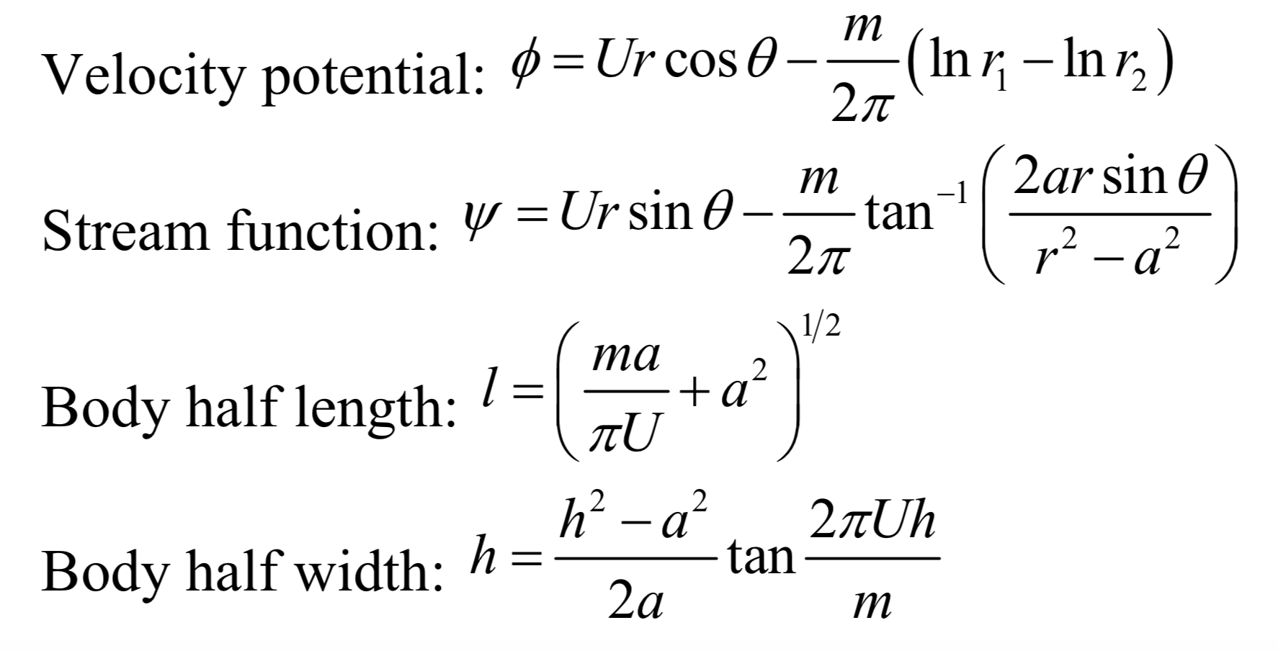
Rankine Oval

Slide 15
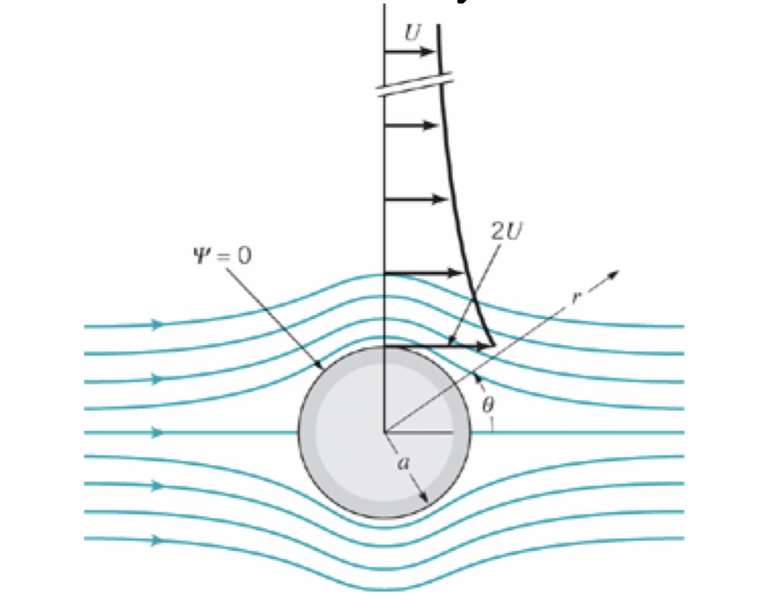
Flow Around a Circular Cylinder – How?

Slide 16
Flow around a Circular Cylinder
A doublet combined with a uniform flow can be used to represent flow around a circular cylinder.

Slide 17
Question: What is the lift on the Sphere?

Slide 18
What if it is Rotating?

Slide 19
We can look at more complex Shapes
And something called the Kutta-condition allows us to calculate the circulation…

Slide 20
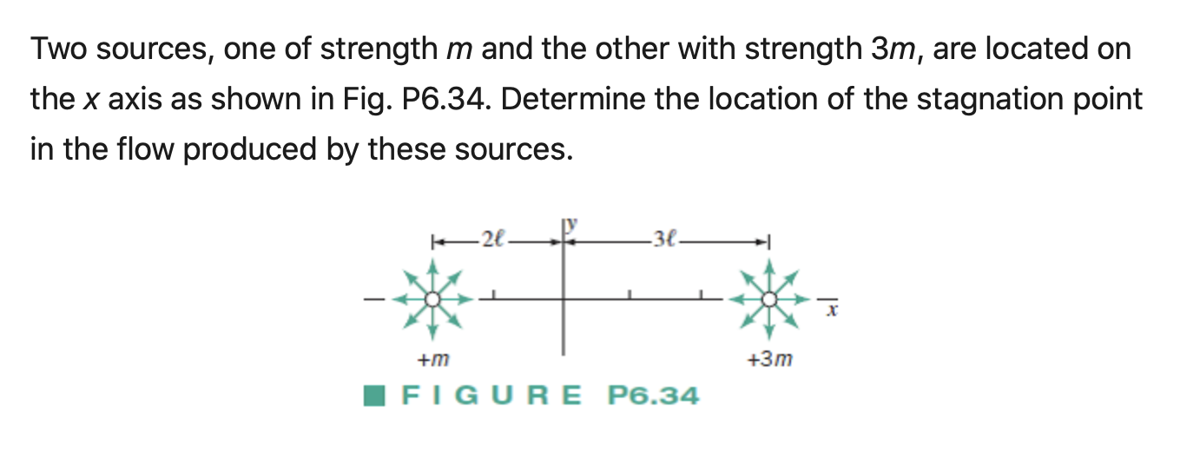
Sample Problems

