Slide 1
CE 30460 – Fluid Mechanics
Diogo Bolster
120 c Cushing Hall
dbolster@nd.edu

Slide 2
Course Objectives
Learn the fundamental physics behind fluid flows
Apply these principles to solve engineering problems
Acquire basic knowledge for other courses such as
Hydraulics
Hydrology (Groundwater)

Slide 3
What is Fluid Mechanics

Slide 4
A couple of questions
Why do engineers care about fluid mechanics?
Why do civil/mechanical engineers care?
Why should you specifically care?
Breakout session (1 minute)
Assignment 1: Take a photo of something you think is fluid mechanics as you walk around your daily life.

Slide 5
Let’s take a look at my department ceees.nd.edu

Slide 6
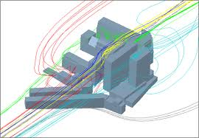
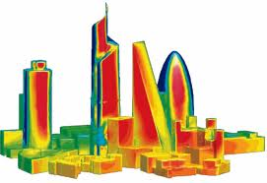
Structural Engineering
Flow around buildings – Forces that must be understood
Take a look at:
http://www.nd.edu/~nathaz/
http://www.nd.edu/~cpssl/

Slide 7
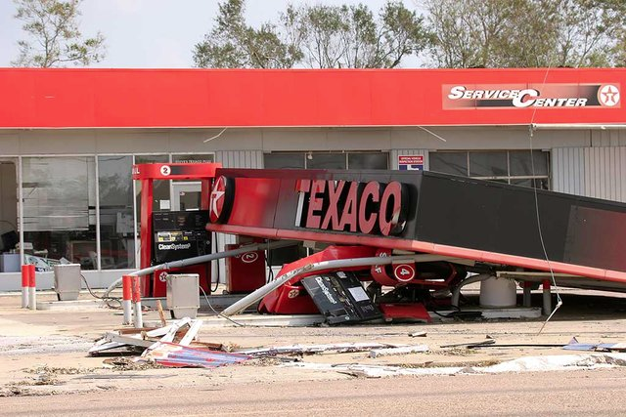
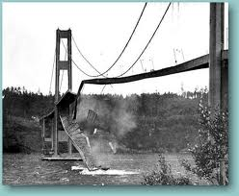
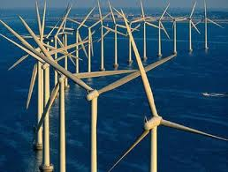
Other Structural Problems

Slide 8
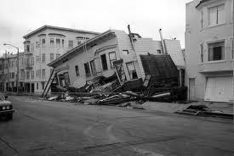
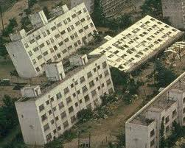
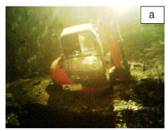
Geotech

Slide 9
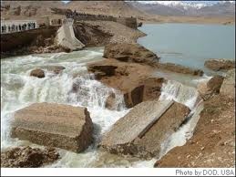
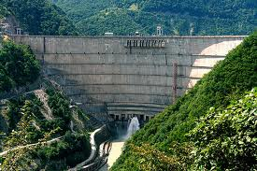
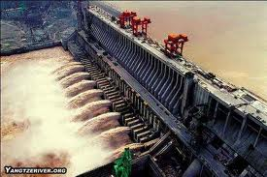
Dams, Hydroelectric Plants, Flood Control

Slide 10
Water Cycle
Environmental Fluid Dynamics

Slide 11
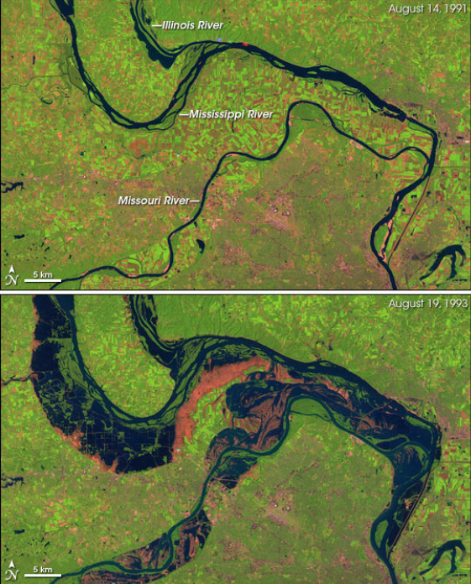
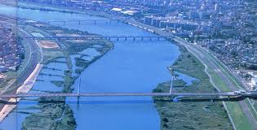
River/Canal Dynamics

Slide 12
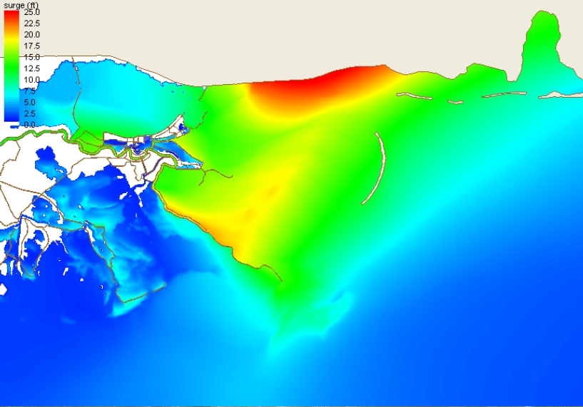
Predicting Hurricanes
http://nd.edu/~coast

Slide 13
Hurricane Damage

Slide 14
Hurricane Damage

Slide 15
Coastal Erosion (Slower, but Severe)

Slide 16
Atmospheric and Ocean Science

Slide 17
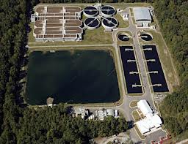
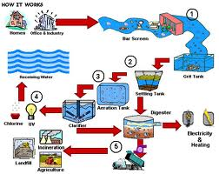
Environmental Engineering
Wastewater Treatment

Slide 18
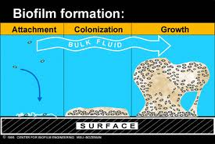
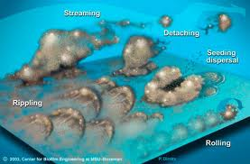
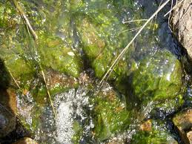
Biofilms

Slide 19
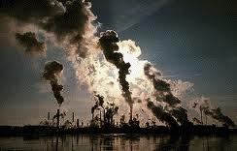
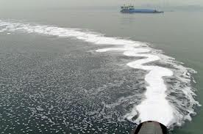
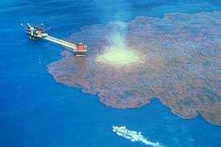
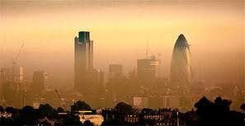
Pollutant Transport

Slide 20
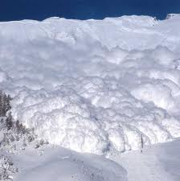
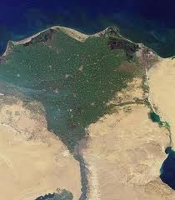
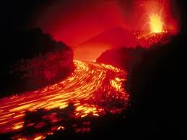
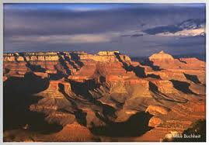
Earth Sciences (most of you are Engineers I know)

Slide 21
General Engineering Applications

Slide 22
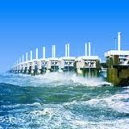
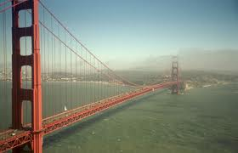
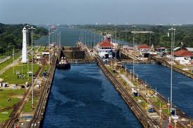
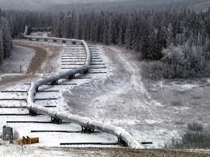
Infrastruture

Slide 26
Fluid Dynamics in the News
Kelvin Helmholtz Waves in Alabama:
http://www.alabamawx.com/?p=55225
http://www.youtube.com/watch?v=dcwOn4VeJOE
News stories relating to fluids research
http://www.physorg.com/tags/fluid+mechanics/
Stories about professors in our department over the years:
http://newsinfo.nd.edu/news/22057/
http://newsinfo.nd.edu/news/22131-engineering-professors-receive-muri-grants/
https://news.nd.edu/news/joannes-westerink-to-receive-inaugural-magoon-sustainable-coasts-award/
https://news.nd.edu/news/researchers-receive-funding-to-advance-accuracy-of-hurricane-storm-surge-forecasts/
https://news.nd.edu/news/notre-dame-engineers-part-of-consortium-proposing-us-mexico-energy-water-corridor-in-lieu-of-border-wall/
https://www.newyorker.com/news/dispatch/the-changing-climate-inside-the-worlds-largest-bat-colony?utm_medium=social&mbid=social_twitter&utm_social-type=owned&utm_source=twitter&utm_brand=tny

Slide 27
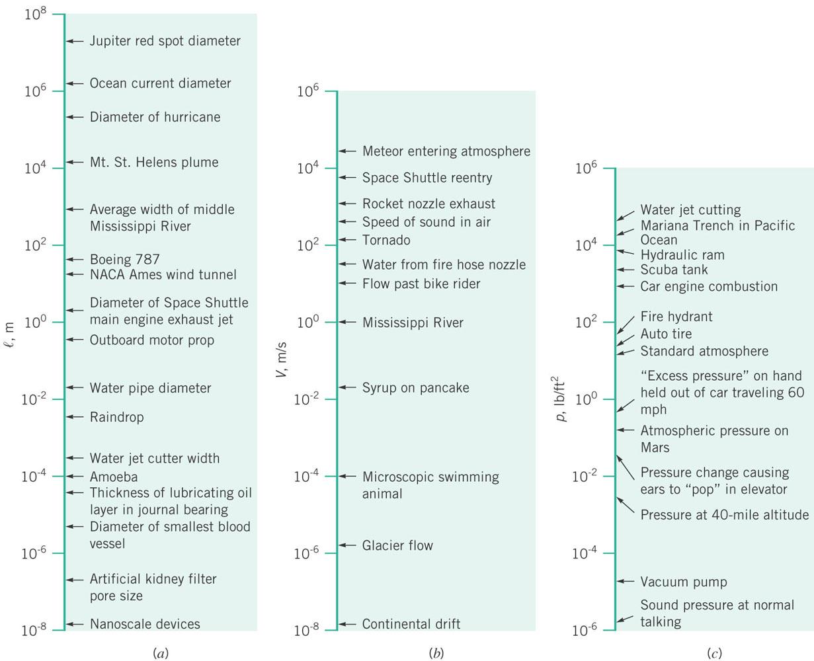
Scales of Interest – HUGE VARIATION very few other subject you study will be this wide

Slide 28
Course Outline
Ch 1: Fluid Properties
Ch 2: Hydrostatics
Ch 3: Bernoulli’s Equation
Ch 4: Kinematics
Ch 5: Control Volumes
Ch 6: Differential Analysis
Ch 7: Similitude and Dimensional Analysis
Ch 8: Pipe Flows

Slide 29
Notes
This is a mechanics (fundamentals) class and one of the last you may have
Be patient – fundamentals are necessary to understand and solve more complicated and interesting problems

Slide 30
Assignment (Due with HW 1)
Take a photo of something you think is fluid mechanics as you walk around your daily life. Include it with HW1.

Slide 31
ENGINEERING SUMMER EXPERIENCE SURVEY
Please take 3 minutes to complete this brief survey to share your internship, research, or other summer experience.
or
CareerDevelopment.nd.edu/summer2022
Login with netID / PW required
If the response rate >95%, candy will be brought in for the entire class the week of 9/13
Any problems with the survey? Email CareerDevelopment@nd.edu

