Slide 1
Conservation of Mass
Often called ‘The Continuity Equation’
What is velocity not uniform

Slide 2
Conservation of Linear Momentum
General Case (F=ma)
Steady State

Slide 3
Moment of Momentum
Torque
Power
Work per Unit Mass

Slide 4
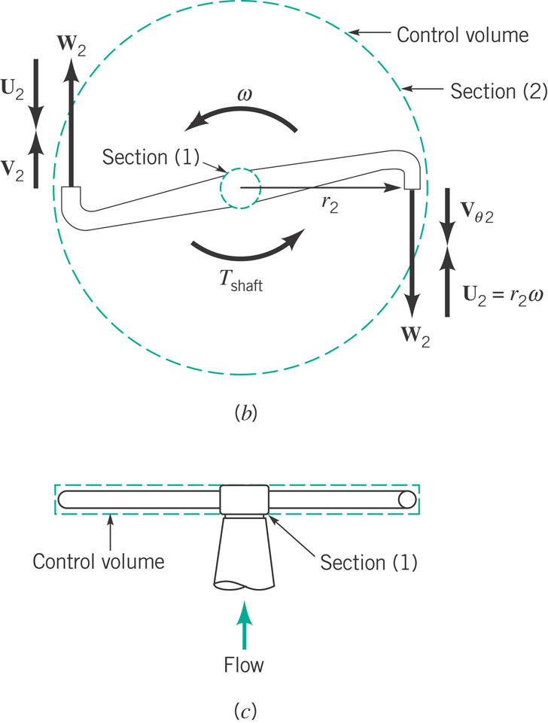
Application (from textbook)
U – velocity of head due to angular rotation (velocity of nozzle as measured relative to a fixed surface) - ωR
W – velocity of nozzle exit flow as viewed from the nozzle – Q/A
V – fluid velocity as measured relative to a fixed control surface (typically what you need for formulas on previous slide)

Slide 5
Conservation of Energy
For steady, incompressible flow with shaft work

Slide 6
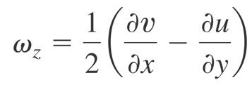
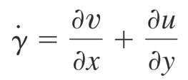
Vorticity (Rotation)
Counterclockwise rotation is positive (z component is component out of the page). Others, in x-y also exist
vorticity (zero => irrotational)
Related, rate of shearing strain

Slide 7
Forms of Continuity Equation
General Form
Steady
Incompressible

Slide 8
Cylindrical Polar Coordinates
General Form
Steady
Incompressible

Slide 9
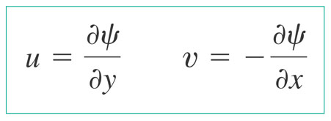
Streamfunction
For incompressible, plane two dimensional flow we can define a streamfunction psi, such that
Quantifies the flow rate between two streamlines (lines of constant psi)
Cylindrical:

Slide 10
The Navier Stokes Equations

Slide 11
In Cylindrical Coordinates

Slide 12
Our assumptions
2d (x-y or r-z or r-θ)
Incompressible
Steady State (d/dt=0)
Fully Developed (d/dx=0 or d/dz=0 – except pressure)
With these we are typically left with a 2nd order ordinary differential equation that we can readily solve.
We then must apply boundary conditions for unknown constants
No flow (velocity normal to a boundary is zero)
No slip (fluivelocity tangential to a boundary is the same as the velocity of the boundary)

Slide 13
Momentum - Recipe Approach
Draw Control Volume
Identify all inlets and outlets
Identify all forces acting and their specific direction of action (break into x and y components)
For each inlet and outlet calculate mass flow rate (ρAv)
For each inlet outlet identify velocity vector (v)
Break velocity vector v into x and y components
Combine last three steps to identify x and y components of momentum flux, i.e. v|_{x}ρAv and v|_{y}ρAv
Substitute into x and y momentum equations

Slide 14
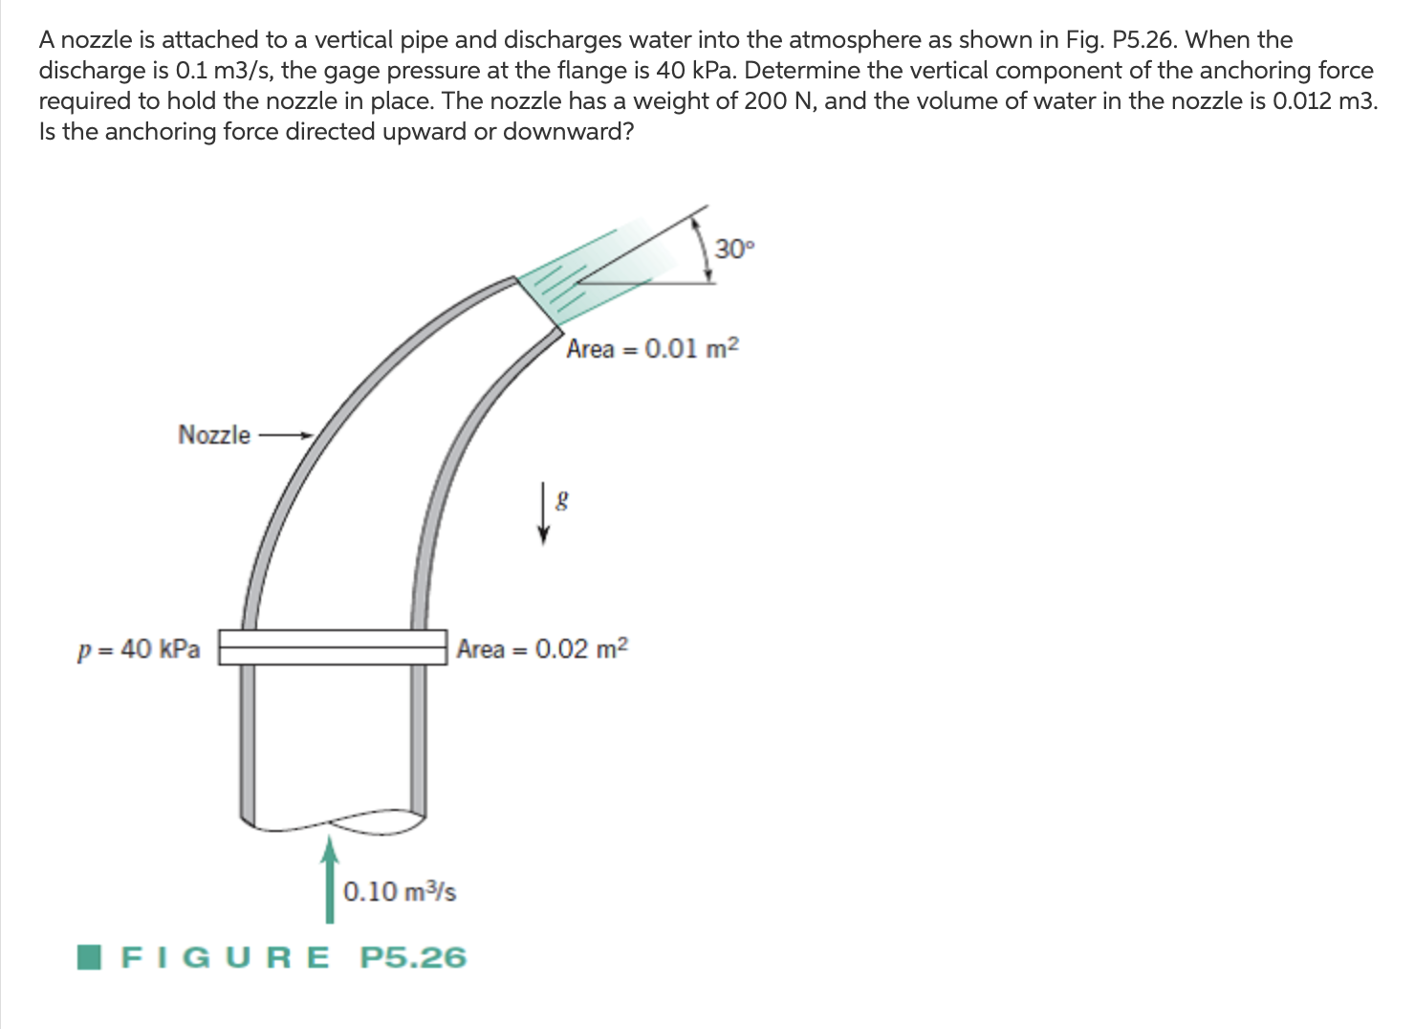
Sample Problems

Slide 15
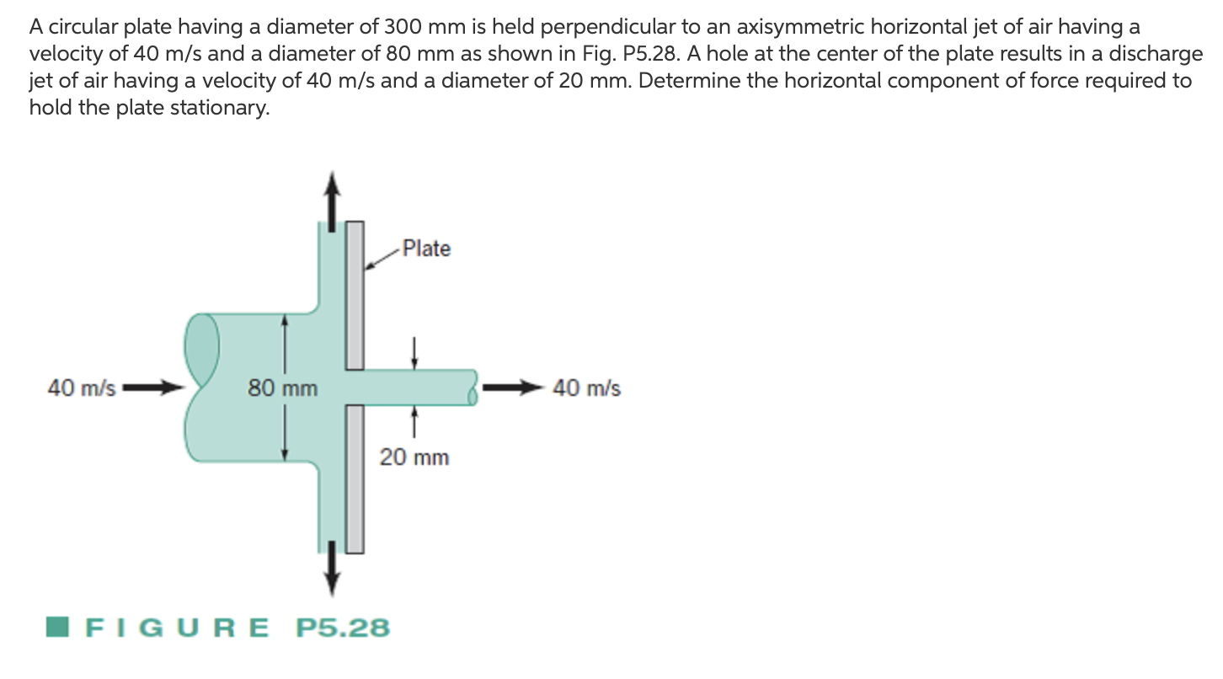

Slide 18
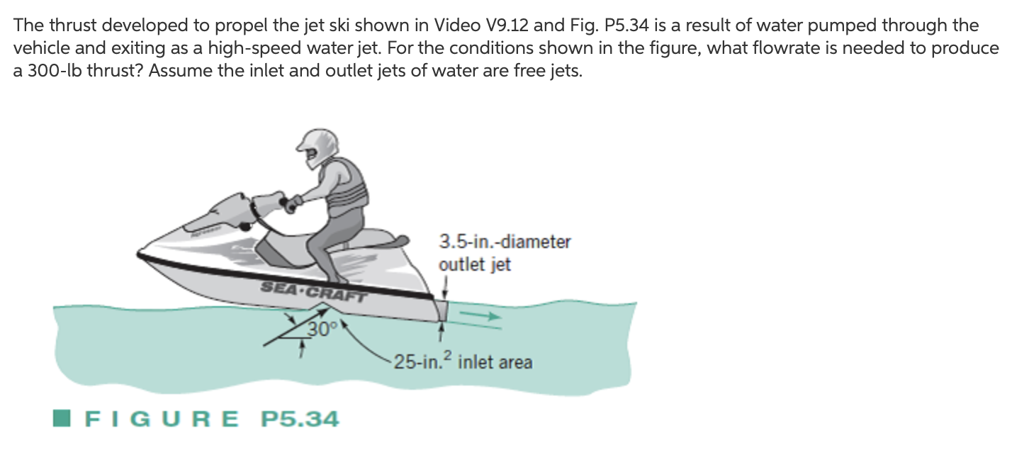

Slide 19
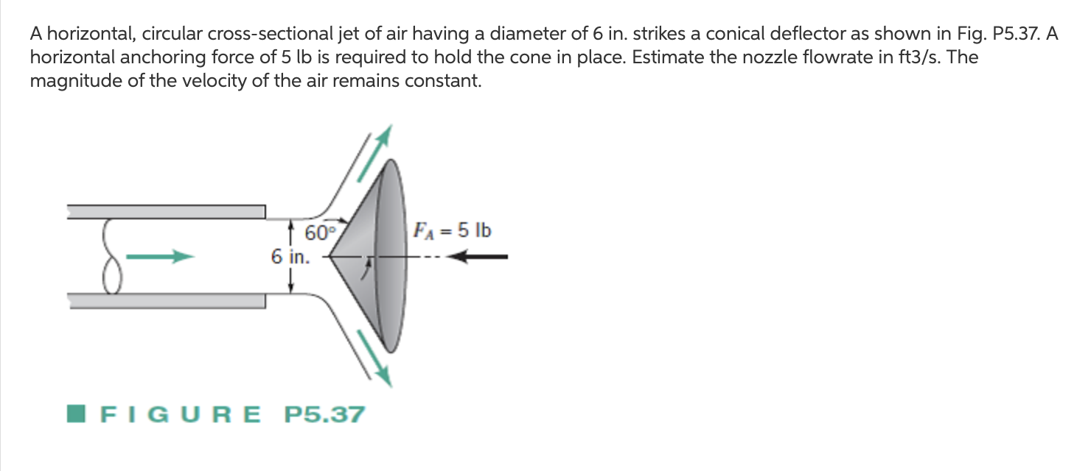

Slide 20
Energy Equations

Slide 21
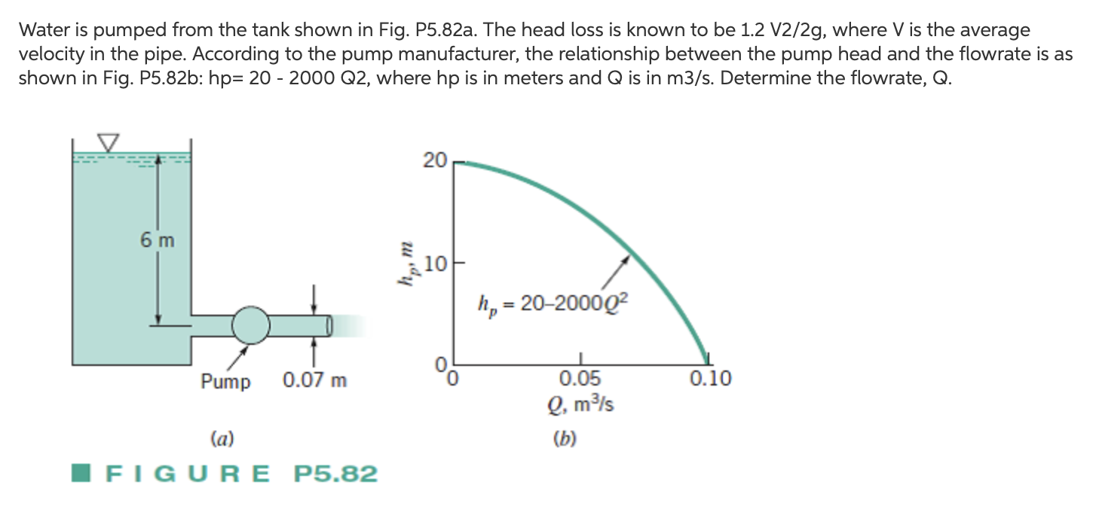

Slide 22
