Slide 1
Review Final – Fluid Properties
CE30460 - Fluid Mechanics
Diogo Bolster

Slide 2
Important Equations Chapter 1
Specific Weight γ=ρg
Ideal Gas Law p=ρRT
Newtonian Fluid Shear Stress τ=μ du/dy
Bulk Modulus
Speed of Sound
Capillary Rise in a Tube

Slide 3
Important Equations Chapter 2
(pressure gradient in a stationary fluid)
(hydrostatic force on a plane surface)
(Location of hydrostatic force on a plane)
F_{b}=γV_{disp} (buoyant force)
Manometer Equation

Slide 4
Useful Equations – Chapter 3
Streamwise Acceleration
Bernoulli Equation
Free Jet
Flow Meter
Sluice Gate

Slide 5
CH5 - Conservation of Mass
Often called ‘The Continuity Equation’
What is velocity not uniform

Slide 6
CH5 - Conservation of Linear Momentum
F=ma
Steady State

Slide 7
Momentum - Recipe Approach
Draw Control Volume
Identify all inlets and outlets
Identify all forces acting and their specific direction of action (break into x and y components)
For each inlet and outlet calculate mass flow rate (ρAv)
For each inlet outlet identify velocity vector (v)
Break velocity vector v into x and y components
Combine last three steps to identify x and y components of momentum flux, i.e. v|_{x}ρAv and v|_{y}ρAv
Substitute into x and y momentum equations

Slide 8
CH5 - Moment of Momentum
Torque
Power
Work per Unit Mass

Slide 9
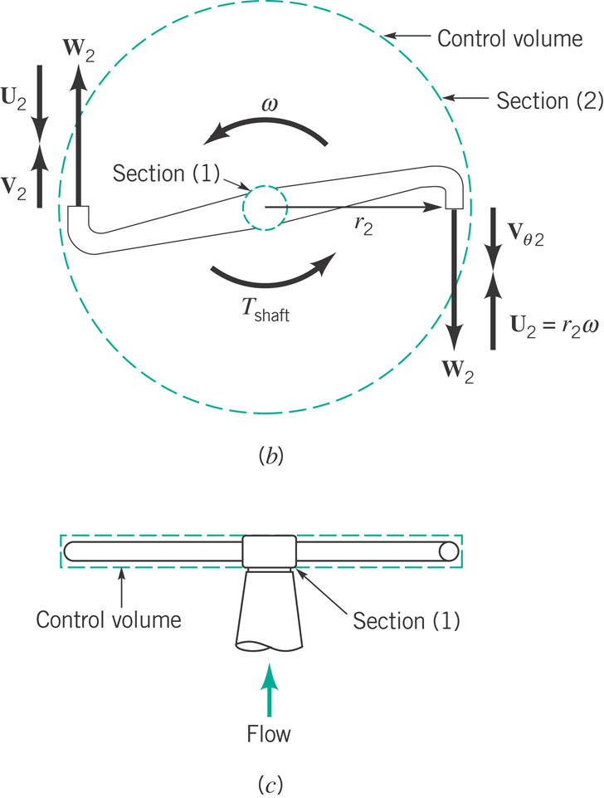
CH5 - Application (from textbook)
U – velocity of head due to angular rotation (velocity of nozzle as measured relative to a fixed surface) - ωR
W – velocity of nozzle exit flow as viewed from the nozzle – Q/A
V – fluid velocity as measured relative to a fixed control surface (typically what you need for formulas on previous slide)

Slide 10
CH5 - Conservation of Energy
For steady, incompressible flow with shaft work

Slide 11
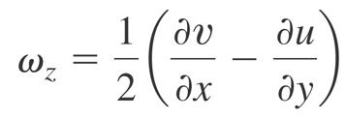
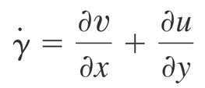
CH6 - Vorticity (Rotation)
Counterclockwise rotation is positive (z component is component out of the page). Others, in x-y also exist
vorticity (zero => irrotational)
Related, rate of shearing strain

Slide 12
CH6 - Forms of Continuity Equation
General Form
Steady
Incompressible

Slide 13
CH6 - Cylindrical Polar Coordinates
General Form
Steady
Incompressible

Slide 14
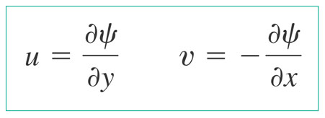
CH6 - Streamfunction
For incompressible, plane two dimensional flow we can define a streamfunction psi, such that
Quantifies the flow rate between two streamlines (lines of constant psi)
Cylindrical:

Slide 15
The Navier Stokes Equations

Slide 16
In Cylindrical Coordinates

Slide 17
Our assumptions
2d (x-y or r-z or r-θ)
Incompressible
Steady State (d/dt=0)
Fully Developed (d/dx=0 or d/dz=0 – except pressure)
With these we are typically left with a 2nd order ordinary differential equation that we can readily solve.
We then must apply boundary conditions for unknown constants
No flow (velocity normal to a boundary is zero)
No slip (fluid velocity tangential to a boundary is the same as the velocity of the boundary)

Slide 18
CH7 – Dimensional Analysis
Buckingham Pi Theorem
I an equation involving k variables is dimensionally homogeneous, it can be reduced to a relationship among k-r independent dimensionless products where r is the minimum number of reference dimensions required to describe the variables
Mathematically can be reduced to

Slide 19
Determination of Pi terms
List all variables that are involved in the problem
Express each on in terms of primary dimensions (MLTθ)
Determine required number of Pi terms (each independent) – i.e. k-r
Select a number of repeating variables (equal to number of dimensions)
Form pi terms by multiplying one of the nonrepeating variables by the product of repeating variables
Repeat last step for all nonrepeating variables
Check that all resulting Pi terms are dimensionless
Express in final form

Slide 20
Data
Problems with One Pi Term :If only one term exists then according to the Pi Theorem we can say:
Π₁=C
For two terms Π₁=f(Π₂)
Π₁=f(Π₂)
Means when you have data you should plot Π1 against Π2 to deduce relationships or at least make best fits that can be used predicatively.

Slide 21
Types of Similarity
Geometric (ratio of length scales the same)
Kinematic (velocity structures are the same)
Dynamic (ratio forces the same)
The best situation is: Get all dimensionless variables (Pi groups) the same between model and prototype. Then all similarities are preserved…..
If N-1 dimensionless groups between model and prototype are the same then the last one must be also.

Slide 22
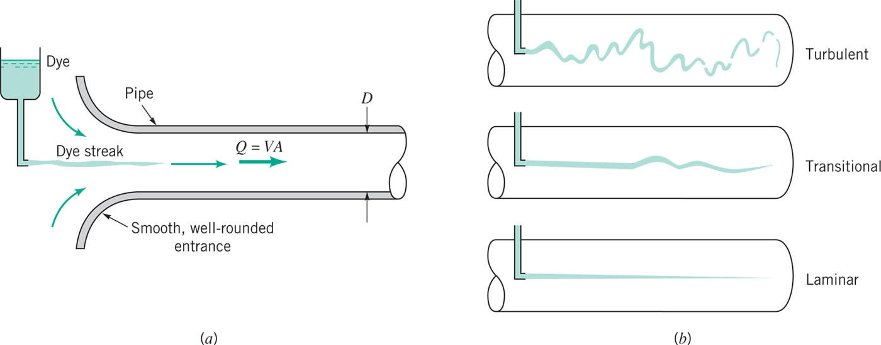
CH8 - Pipeflow
Re>4000
Re<2000
Re=UDρ/μ

Slide 23
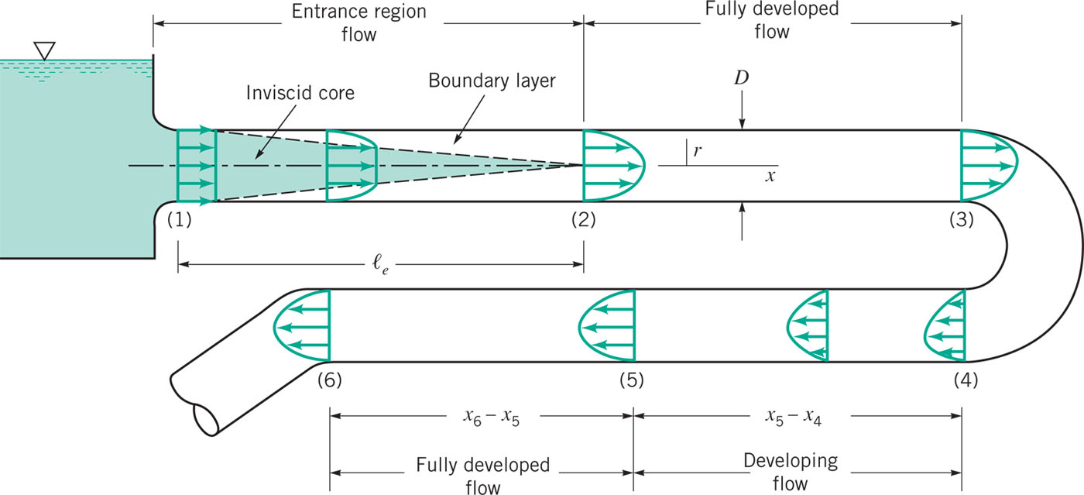
Fully Developed Flow
Entrance length:

Slide 24
Energy Equation
Recall Energy Equation
Therefore we can say that (part of) the loss in a pipe is

Slide 25
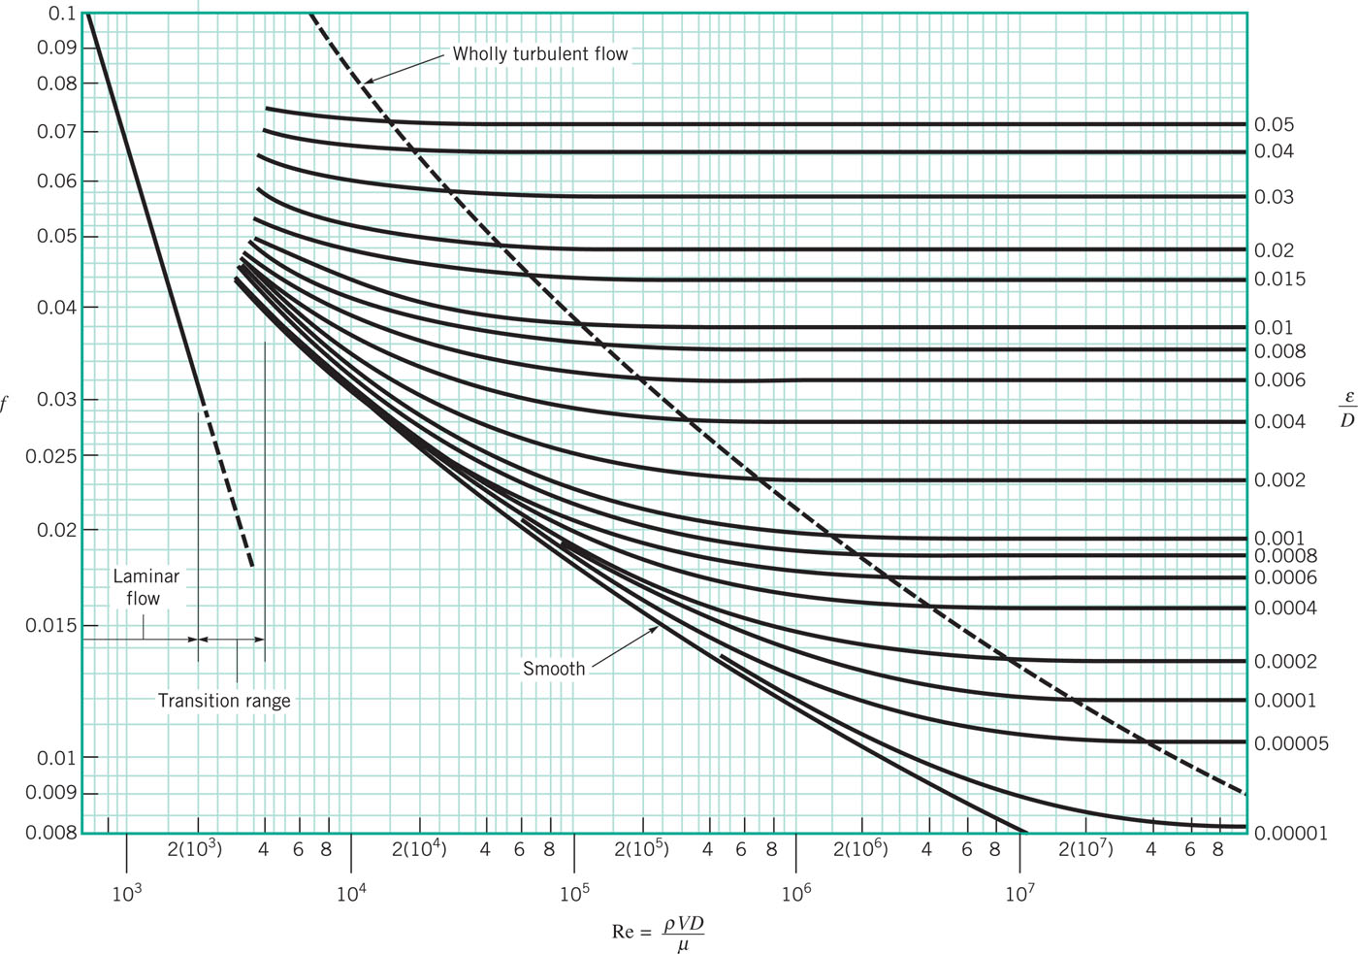
Moody Diagram (Friction Factor)
For laminar
For non-laminar flow approximately true that

Slide 26
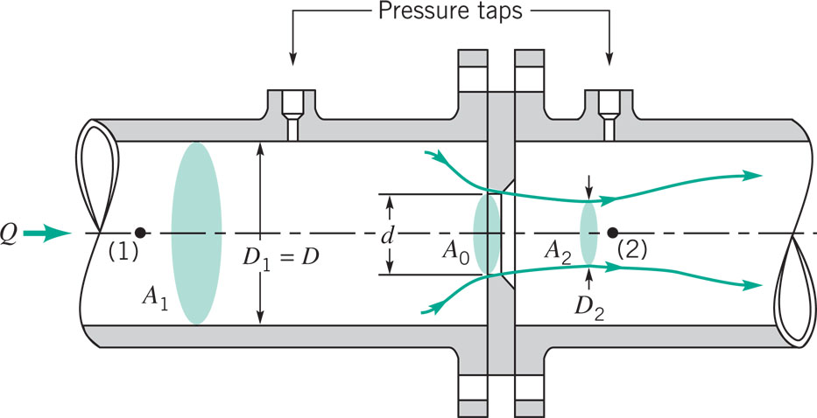
Pipe Flow Measurement
C is a constant that depends on geometry

