Slide 1
Review Midterm 1 – Fluid Properties
CE30460 - Fluid Mechanics
Diogo Bolster

Slide 2
Important Equations Chapter 1
Specific Weight γ=ρg
Ideal Gas Law p=ρRT
Newtonian Fluid Shear Stress τ=μ du/dy
Bulk Modulus
Speed of Sound
Capillary Rise in a Tube

Slide 3
Important Equations Chapter 2
(pressure gradient in a stationary fluid)
(hydrostatic force on a plane surface)
(Location of hydrostatic force on a plane)
F_{b}=γV_{disp} (buoyant force)
Manometer Equation

Slide 4
Useful Equations – Chapter 3
Streamwise Acceleration
Bernoulli Equation
Free Jet
Flow Meter
Sluice Gate

Slide 5
Ch 1

Slide 6
Ch1
Utop
Fluid 1
Umid
Fluid 2

Slide 7
CH1

Slide 8
CH1

Slide 9
Ch2

Slide 10
CH2

Slide 11
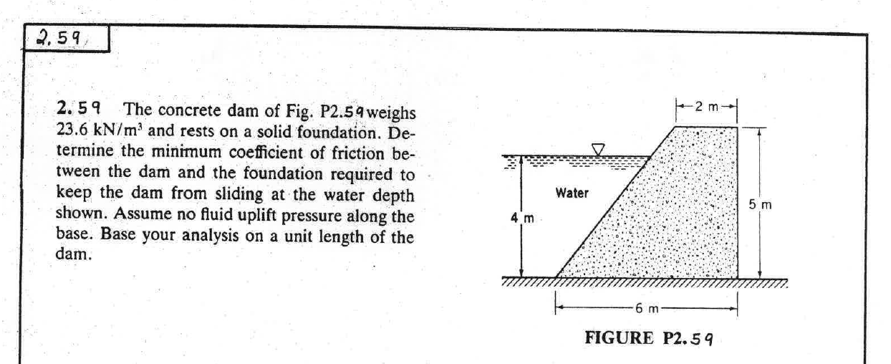
Ch2

Slide 12
Ch2

Slide 13
Ch3

Slide 14
CH3

Slide 15
CH3

Slide 16
CH3

Slide 17
CH3

