Slide 1
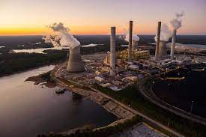
ETS & Blockchain A Digitally Native Carbon Pricing Mechanism

Slide 2
Roadmap for Our Discussion
1
Energy Trading Systems
2
Blockchain Technology
3
Energy Trading Systems + Blockchain Technology
4
Quantifiable Outcomes
5
Virtue Ethics Perspective
6
Future Considerations

Slide 3
Executive Summary
A worldwide Energy Trading System should be created through blockchain, leveraging its encryption, automated market maker, and stablecoin technological capabilities, creating a more equitable, liquid, and stable carbon market. To prevent unscrupulous speculators from profiting in carbon markets while sitting idle in the battle against climate change, derivative and secondary financial markets should be made illegal in the trading of carbon instruments. Further, regulations for fossil fuel emissions must be created to ensure this behavior does not continue in the wake of worldwide carbon market participation.
Thesis
ETS Regional Exclusivity and Differing Prices
Additionality & Lofty Expectations
Carbon Derivative Trading
Due to ETS’ regional exclusivity and difficult to navigate bureaucracy, they are often only used by large corporations, they house accounting fraud, and allow for arbitrage opportunities in regional carbon credit markets
Carbon credit projects are either funded prior to them starting with only an expectation (often incorrect) for their carbon reduction, or they are funded after they’ve started and would not have been in need of funding—additionality
Carbon has been treated as a commodity on financial markets, used in a variety of financial instruments with derivative markets created as well, corroding the purpose and morality of carbon pricing
Core Issues
Inefficient and Immoral Energy Trading Systems
Automated Market Maker
Blockchain Technology
Stablecoin
Solutions
An Automated Market Maker is a cryptocurrency-specific market mechanism that cuts out intermediaries for transactions, supported by liquidity pools curated by traders in the network
An Automated Market Maker (AMM), Stablecoins, and the security of blockchain could create a more equitable carbon market,
Stablecoins peg a cryptocurrency to a fiat currency or store of value (i.e. USD, gold) by holding in perpetuity either that fiat currency or similar cryptocurrency-–providing liquidity and stability, while preserving the benefits of blockchain
Short Term
Long Term
Impact
1
Stabilize commodity prices, reducing food insecurity and commodity market manipulation
1
Lower emissions to be in line with 2 degree celsius increase targets
2
Monitoring carbon credits ensures trust and validity of a worldwide marketplace, sparking widespread involvement
2
Distribute proceeds to impoverished adversely impacted by climate change
Additionality & Lofty Expectations
Delayed Carbon Offsetting & A New White Man’s Burden
A Variety of GHG Mitigation Efforts
Failures
Blockchain does not resolve the issues innate to a carbon market, the worldwide market would further exacerbate these issues to a worldwide scale
ETSs have allowed emitters to buy credits and continue to emit without remorse, while putting the carbon plight on developing countries
Other GHG mitigation efforts must be implemented in earnest, such as worldwide emissions regulations, territory-specific emissions reduction goals, and government financing & tax breaks

Slide 4
There are three groups of ways to deal with the effects of firms that emit large amounts of GHGs.
1
Government
Market-based Mechanisms
Subsidies and Tax Breaks
Regulation
Energy Trading Systems
Cap-and-Trade
Auction Style
Subsidies
Research
Government stipulated projects
Fuel Standards
Usually levied on automobiles and airplanes which must comply with certain mandates
Carbon Tax
Levied on corporation
Levied on consumers
Patents
To researchers ensuring that innovation is rewarded & protected
Emissions Standards
Similarly, levied on transportation, electric, and power companies
Conservation Taxes
Levied on those destroying important ecosystems (The Amazon, Great Barrier Reef)
Tax Breaks
To corporations implementing climate-sensitive technology
Technology Standards
Mandatory updates to self-monitoring emissions technology

Slide 5
Energy Trading Systems form a core component of reducing worldwide GHGs, using four key actors and two possible systems.
1
How does an Energy Trading System Work?
Main Components of an ETS
Auction House System
Lower bid
Carbon Credits
Businesses
Governments
Businesses Buying Credits
Carbon credits are a permit that allow companies to emit a certain level of greenhouse gases. If they exceed the cap, they are either fined or they can buy carbon credits on an exchange to cover their excess emissions
Under Cap-and-Trade: Businesses are issued carbon credits allowing them to emit a certain pre-determined level of emissions
Under Auction: Businesses buy credits from an exchange to emit a certain level of GHGs
Under Cap-and-Trade: A government body issues a level of carbon emissions for each firm that they are allowed to emit
Under Auction: A government body facilitates the sale of carbon mitigating projects, via credits, to carbon emitting firms
Businesses Creating Carbon Mitigation Projects
Carbon credit to highest bidding firm
Auction House
Payment to carbon mitigating firm
Auction House
Cap-and-Trade System
State Designated Amount of Carbon Credits
The auction house is integral to the seamless functioning of the system, by allowing lower emitters to sell credits and higher emitters to buy credits. This is used in both possible ETS systems. The auction house is often a centralized government actor.*
Businesses
Auction House
Government
Most widely used ETS around the world
Buy and sell credits based on need for emissions coverage

Slide 6
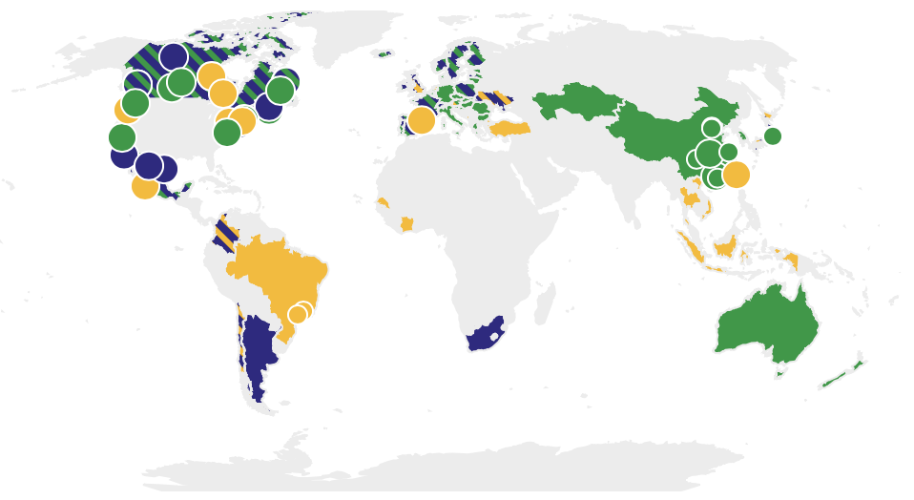
1
Energy Trading Systems are a recent phenomenon to combat climate change, with only a few governmental entities across the world deploying them facilitated in part by international agreements.
Global ETS Usage and Implementation
Global ETS Usage and Implementation
China National ETS Started operating nationally
Paris Climate Agreement Set emissions standards and allows for emissions trading
2021
2015
Doha Amendment Makes emissions reductions for participating countries legally binding
2012
Kyoto Protocol
UN proposal to reduce worldwide carbon emissions
35 countries and 20 subnational jurisdictions have adopted an ETS
10.74% of emissions are covered by ETSs (not including China)
EU ETS covers 40% of GHGs, with an estimated 8.7% reduction in emissions in 2019 comp. to 2018
1997
U.S. Clean Air Act
Marks world’s first cap-and-trade program
Binding Emissions Targets for signees
ERPA cap-and-trade program
Compliance Mechanisms
Created…
1990
Implement Emissions Monitoring Systems
To comply with emissions standards and government mandates…

Slide 7
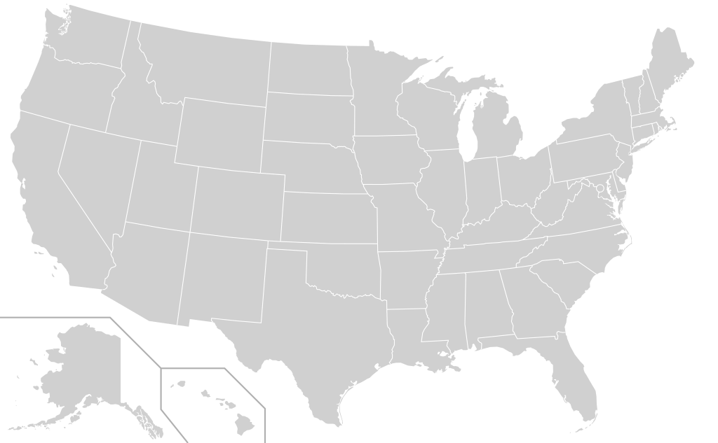
1
The shortcomings of the current ETS model are that they are prone to fraudulent counting errors, allow for only large entities to take part, and are not internationally coordinated.
Double Counting Problem
Example: BP finances an offshore wind project from Orsted
Example: BP & Duke Energy finance the same offshore wind project from Orsted
&
Same credit given out for one carbon credit project, should only count as one
+1
US ETS
+1
Carbon Credit
EU ETS
Only for Large Businesses
Not Internationally Coordinated
EU ETS
US ETS
Few Marketplaces
China ETS
Frothy
Illiquid
Different Carbon Prices
Lack of Systematized Coordination

Slide 8
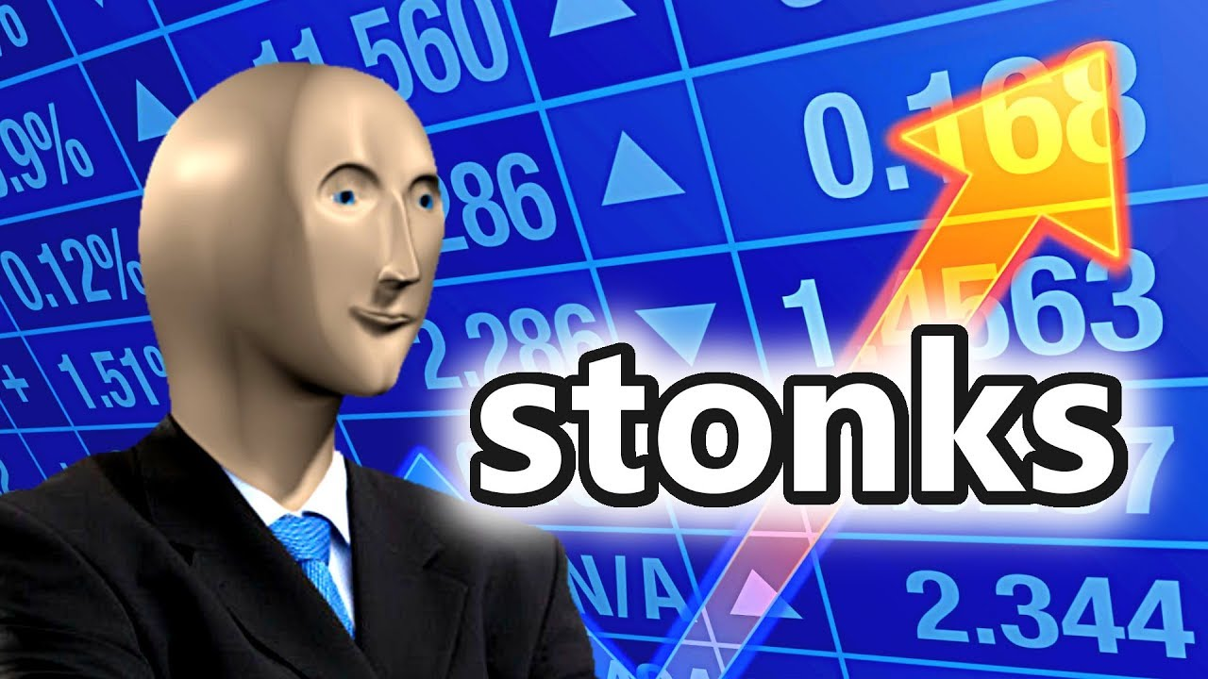
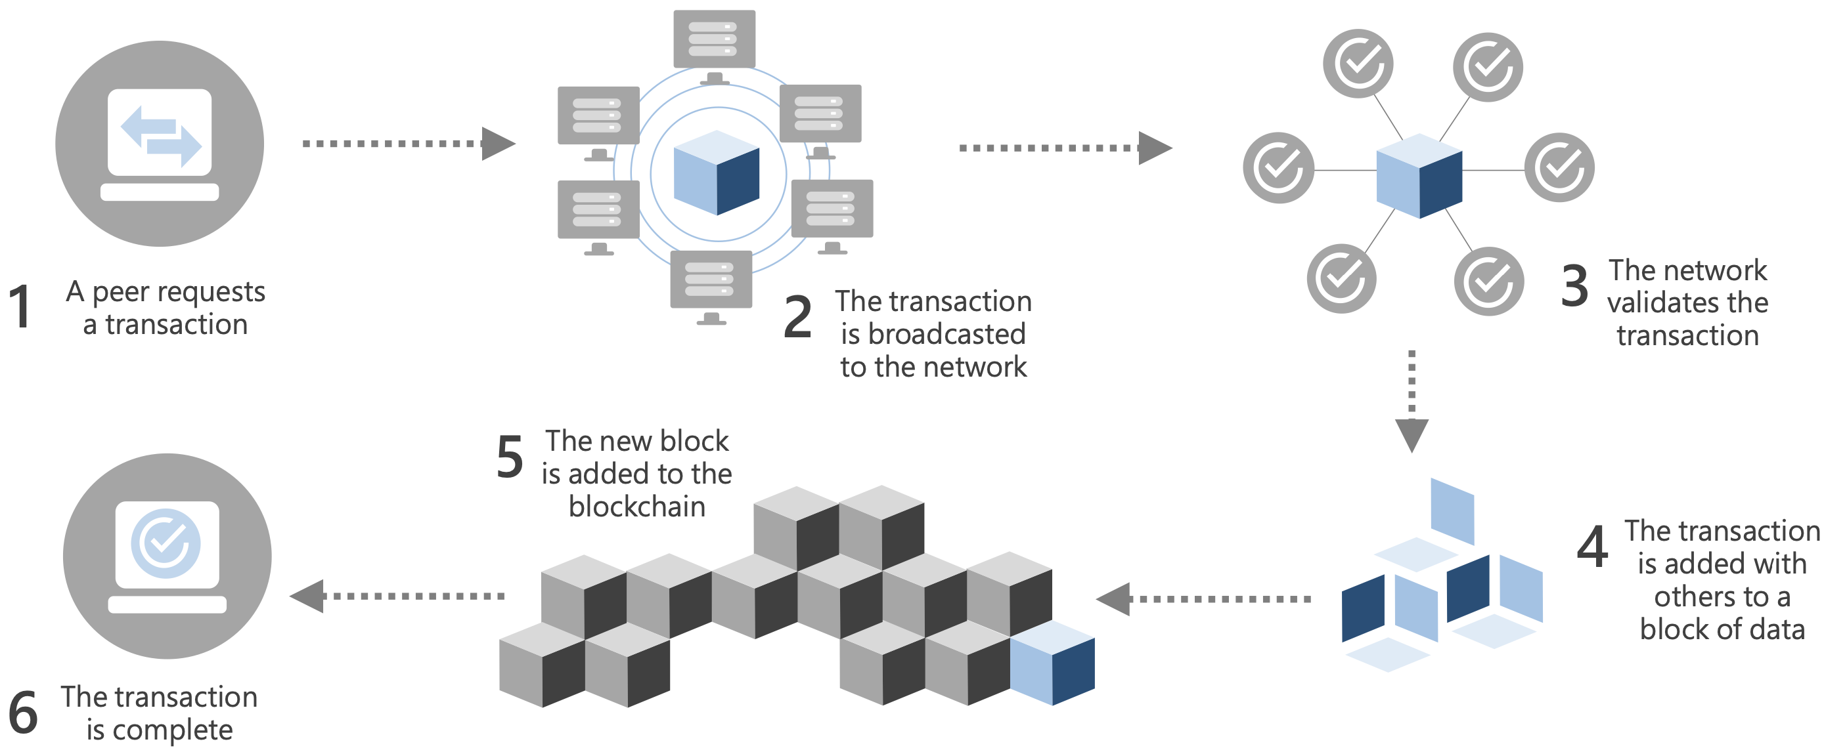
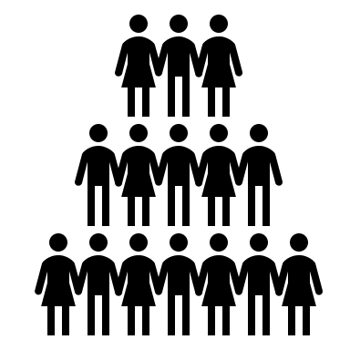
2
Blockchain technology leverages the security of cryptographic technology to create a digital marketplace between buyers and sellers on a distributed ledger, with two possible types of consensus mechanisms.
What do you picture when you hear blockchain?
What blockchain actually is…
Price tag: $69 million
Price tag: $580,000
Two different consensus mechanisms
This is where most of the carbon output comes from
Proof of Stake
Proof of Work
Core components of blockchain
Cryptography
Distributed Ledger
Decentralized
Can have fixed or unlimited supply of currency
Cryptography is a subset of cybersecurity that is on each block of the chain
All transactions are made fully public to all actors in the marketplace, with public keys shown
There is no central authority which validates and ensures the validity of the blockchain, it is among the actors in the network that all is verified
Businesses put up owned currency for a chance to verify previous transaction and receive newly issued

Slide 9
How much energy does a blockchain backed-currency use (like bitcoin)? …It’s complicated
2
Consensus Mechanisms
Proof of Stake
Proof of Work
Only one calculation performed, so carbon footprint far lower than the proof of work model
These calculations with all different computers are what lead to the huge energy footprint
%
%
%
%
%
%
92.89% of
energy consumption
energy consumption

Slide 10
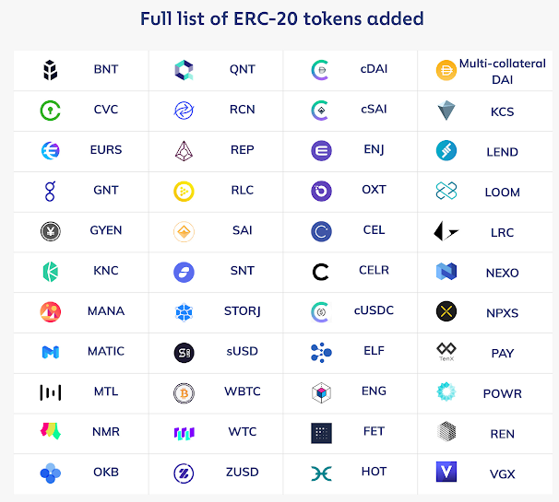
A major breakthrough has been an automated market maker coming out of the burgeoning field of decentralized finance, powered by blockchain enabled smart contracts.
2
Automated Market Maker
Primary Financial Markets
For Retail Investors*
Liquidity Pool
Liquidity Providers
% fee for providing tokens to the pool
Buyers
Sellers
Supply pool with tokens
Brokerage Firms
Benefits of this model
Traders
Spread = Arbitrage = Profit
Transparency
Price of each token is determined by a specified mathematical formula
Disintermediation
Security
Buy tokens from the pool
Market Makers
Example: Purchase EOS, then price per EOS on the exchange increases and all other currencies’ price per token decreases
Commodification*

Slide 11
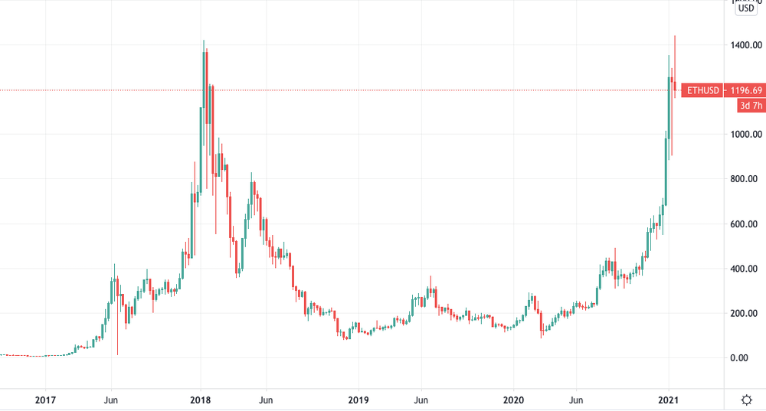
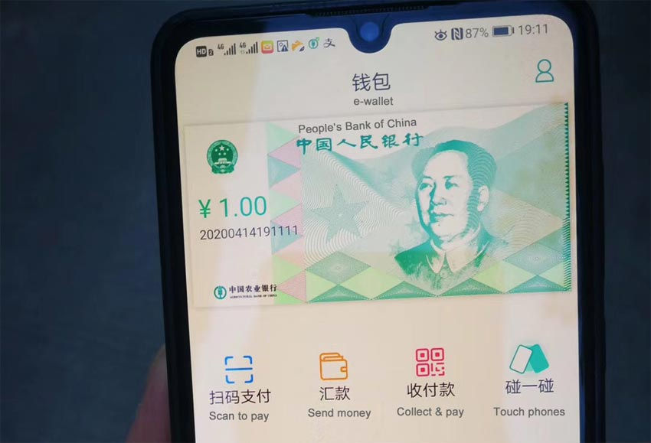
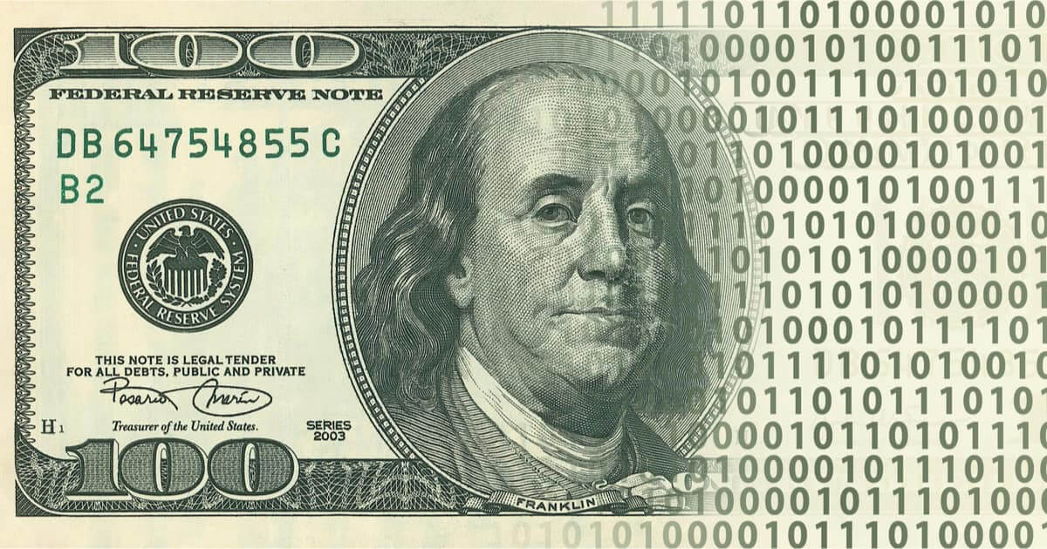
2
For a worldwide ETS facilitated on blockchain technology to be viable, a stablecoin is needed to ensure that the value of carbon credits is not susceptible to volatile swings that are a byproduct of many cryptocurrencies.
Stablecoins
Volatility of Cryptocurrencies
Some crypto assets, especially those used for lending are already pegged to the US dollar, strictly using blockchain tech as a means of business rather than store of value
Low volatility
Benefits of Blockchain
How does Dai Remain Pegged to the USD?
Through collateralized debt positions, Maker (creator of Dai) turns one’s Ethereum into Dai and holds the Ethereum on the blockchain as collateral
Speculation on margin in decentralized markets
Fiat Digital Currencies
2x
…
If major reduction in Ethereum’s price occur, Maker sells off Ethereum in order to cover its position and keep the peg to the USD
&

Slide 12
3
A blockchain-enabled ETS would leverage blockchain’s security, disintermediation, and liquidity to create a more equitable carbon market
New Auction-based ETS
Old Auction-based ETS
IMF or World Bank’s Role
Peg stablecoins to fiats
Vet carbon offerings
Lower bid
Ensure one trade per credit
Carbon credit
Validate blockchain transactions using proof of stake
Stablecoin
Businesses Buying Credits
Carbon credit to highest bidding firm
Fiat currency
Businesses Creating Carbon Mitigation Projects
Auction House
IMF or World Bank
Buyers
Liquidity Pool
Only carbon credits and stablecoins
Buyers
Payment to carbon mitigating firm
Credit Suppliers

Slide 13
4
A worldwide ETS could possibly curb our greenhouse gas emissions to a level that complies with the two degree celsius threshold, often heralded as the point of no return.
Bull Case
International community prioritizes climate change over economic imperatives, renewables become mainstream, less red meat consumed
(Modeled after EU ETS reductions)
2-Degree Threshold Matches Up with Best Case
Base Case
Developed countries spearhead the charge to reduce emissions, effectively stabilizing them, developing countries continue to use cost-effective fossil fuels
(Modeled after weighted average)
Bear Case
Developing countries become fully globalized using fossil fuels at an ever-increasing rate, while developed countries do little to mitigate GHG emissions
(Modeled after India’s emissions)

Slide 14
4
The worldwide ETS has a small carbon footprint, regardless of what energy source is used on a yearly basis, with excess capital available to deploy for international development projects.
ETS itself has a SMALL Carbon Footprint
About $20 billion dollars could be afforded to the IMF/World Bank annually through auction proceeds, financing operations and subsidies for impoverished populations reeling from increases in energy prices

Slide 15
5
Technomoral virtues in Energy Trading Systems will largely be centered around courage, self-control, and flexibility
Courage
Technomoral Virtues
No current universal price on carbon
Honesty
Courage
Flexibility
Only 10.74% of carbon used in ETSs
Self-Control
Empathy
Perspective
Climate change disproportionately hurts marginalized communities
Self-Control
Humility
Care
Magnanimity
Focusing on economics sacrifices stewardship for profit
Small changes now have outsized compounding effects long term
Justice
Civility
Technomoral Wisdom
Reaching a tipping point for climate change at an ever-increasing pace

Slide 16
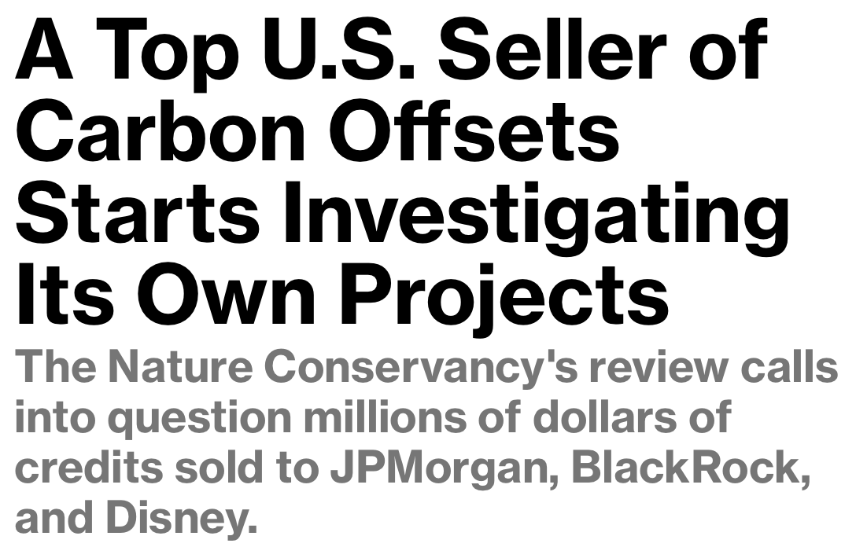
6
The worldwide ETS is not a one-size fits all solution for climate change, rather many problems will still exist even if blockchain is used in this process inherent to the ETS design.
Additionality
Delayed Carbon Offsetting
Carbon Credit Issuance
Pollute more than they would if carbon weren’t priced
Existing project
Lofty Expectations
Minority Man’s Burden
Outdated Credits
Non-existing project
10 years later…
Still exists later and could be purchased

Slide 17
Should we even consider evaluating climate change in economic terms?

